Slide 1
CHAPTER 8.9 · PHASE 8: AI AGENTS — FOUNDATIONS
Conversational and Agent
UX Design

Slide 2
TL;DR / INTUITION
A great agent can still fail at the interface layer
• Two evidence-based foundations: Nielsen's 'visibility of system status' heuristic, and Amershi et al.'s 18 guidelines for human-AI interaction.
• Four organizing moments: Initially, During, When Wrong, Over Time - the guidelines' own categories.
• What's new for an acting agent: one question a text-only chatbot never faced - should this action auto-proceed, or pause for a human?
• Anthropic's own finding: requiring approval for every action creates friction without reliably improving safety.

Slide 3
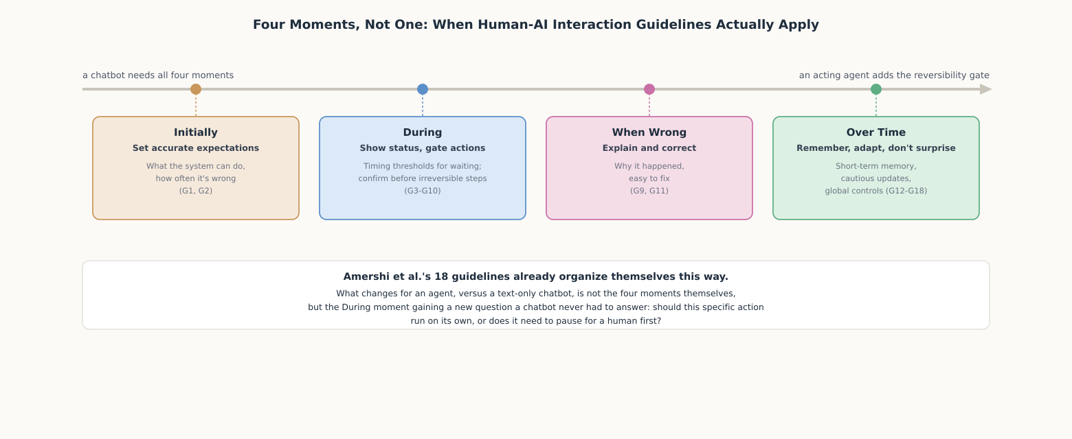
HIGH-LEVEL EXPLANATION
Four moments, one new question for agents

Slide 4
DEEP-DIVE · 1 OF 5
Before the First Message: Setting Accurate Expectations
• G1 and G2 (Amershi et al.): "Make clear what the system can do" and "how often the AI system may make mistakes" - validated against 49 practitioners, 20 products.
• Ch. 8.8 connection: the label itself sets expectations - calling a system 'agent' primes autonomy; calling it 'assistant' primes narrower help.
• NN/g on chatbots: tailor the opening message to context - "users won't assume a chatbot knows what they're looking at" otherwise.
• The harder guideline: communicating error rate isn't a number bolted on - it's whether the interface's confidence tracks actual task difficulty.

Slide 5
DEEP-DIVE · 2 OF 5
During the Interaction: Status, Timing, and the New Question
• Nielsen's heuristic: "systems should always keep users informed... through appropriate feedback within reasonable time."
• Concrete thresholds (NN/g): feedback past 1.0s; indeterminate spinner for 2-10s; determinate progress for 10s+.
• Mapped to the agent loop: each Plan-Act-Observe step (Ch. 8.3) is its own status unit, not one generic spinner for the whole task.
• The new question: Anthropic's own data - only 0.8% of actions are irreversible - argues for gating the tail, not every step.

Slide 6
DEEP-DIVE · 3 OF 5
When the Agent Is Wrong: Explanation, Correction, Degradation
• G11: "Make clear why the system did what it did" - NN/g's Qwen Agent case study shows what happens when this is skipped: a price changed with no explanation.
• Silent re-planning is the same failure: Ch. 8.7's re-planning is a feature architecturally, but invisible re-planning is a UX failure.
• G9 and G10: efficient correction, and graceful degradation - both beat confidently guessing wrong and forcing the user to detect it.
• The fix costs nothing architecturally: surface the re-plan event with the same status treatment as any other step.

Slide 7
DEEP-DIVE · 4 OF 5
Over Time: Memory, Adaptation, and Not Surprising the User
• G12: "Maintain short term memory" - the UX-facing requirement Ch. 8.5's entire memory-systems chapter is built underneath.
• Ch. 8.6 connection: a bad compaction pass is invisible infrastructure until it produces a visible symptom - the system forgetting a constraint.
• G14, G16, G18: update cautiously, convey consequences of user actions, notify of capability changes - all protect one thing: the user's mental model.
• Why it's sharper for agents: a silently changed confirmation gate isn't a minor annoyance - it's a change to what the system does without asking.

Slide 8
DEEP-DIVE · 5 OF 5
Designing the Whole System, Not Isolated Screens
• One session, four moments: a returning user (Over Time) triggers a multi-step task (During), hits a re-plan (When Wrong) - all in one sitting.
• Guidelines aren't separable features: a status update should already reflect onboarding's capability claims; an explanation should draw on accumulated memory.
• The gate belongs inside the loop: middleware bolted on after the fact either over-fires on safe actions or misses context-dependent risk.
• Worked example: a spreadsheet-reconciliation task shows a re-plan surfaced, a confirmation gate fired, and a denial routed back into re-planning - not a special escape hatch.

Slide 9
COMPARISON & RELATED CONCEPTS
Same 18 guidelines, different stakes across the spectrum
Aspect | Assistant | Copilot | Agent
Default confirmation posture | Confirms after every single action, by definition | Confirms before a chained sequence finalizes, by design | Confirms only for the reversibility-gated minority
What a status update must convey | Which one action is happening now | Which step of a short chain, and what remains | Which step of a longer plan, and whether a re-plan occurred
Cost of a silent behavior change | Low: the next action just looks different | Moderate: a reviewed sequence may finalize differently | High: the reversibility gate itself may have shifted
All 18 guidelines apply across all three; what changes is how much is at stake when any one of them is skipped.

Slide 10
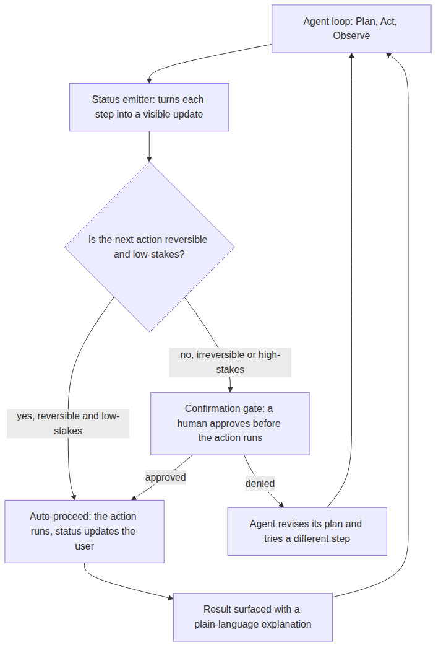
REFERENCE ARCHITECTURE
A confirmation gate wired into the agent's own loop
Agent loop: Ch. 8.3's Plan, Act, Observe cycle - the source of every step this architecture makes visible or gates.
Status emitter: converts each step into a status update sized to its own estimated duration.
Reversibility check: the one question a chatbot never had to ask: does this action need approval first?
Auto-proceed: runs a reversible, low-stakes action immediately, with only a status update.
Confirmation gate: pauses an irreversible or high-stakes action for explicit human approval.
Result explanation: surfaces the outcome in plain language, including a visible note when a re-plan occurred.
Revise: a denial feeds back into Ch. 8.7's own re-planning mechanism, not a separate escape hatch.

Slide 11
HANDS-ON
A status and confirmation policy from two properties
• The function: ux_policy() maps est_seconds to a status tier and reversible/high_stakes to a gate decision.
• Six straightforward cases: instant lookups and private edits auto-proceed with no indicator; a 25s report draft gets step-by-step progress and still auto-proceeds.
• Duration doesn't decide the gate: a 2-second email send still requires confirmation, because gating depends on reversibility, not speed.
• The case that matters most: a technically reversible public post still gates, because high_stakes overrides reversibility - the same policy choice that separates a copilot from an agent in Ch. 8.8.

