Slide 1
CHAPTER 3.5 · PHASE 3
Tokenizers Deep Dive: BPE, WordPiece, SentencePiece
How three subword algorithms actually build the vocabulary that chapter 3.1 took as a given.
NLP & Language Model Foundations

Slide 2
AGENDA
What this chapter covers
BPE: bottom-up merges ranked by raw frequency, and byte-level BPE's no-OOV guarantee
WordPiece: bottom-up merges ranked by likelihood gain, BERT's tokenizer
SentencePiece: whitespace-as-symbol, language-independent framework
The Unigram algorithm: top-down pruning instead of bottom-up merging
Subword regularization and why it needs a probabilistic tokenizer
Industry use cases across Finance, Healthcare, and Telecom

Slide 3
TL;DR
The short version
BPE: merges the most frequent adjacent pair, repeat (GPT-2, GPT-3, GPT-4)
WordPiece: merges the pair that most improves data likelihood (BERT)
SentencePiece: whitespace is an ordinary symbol, language-independent
Unigram (used inside SentencePiece): prunes a large vocabulary down, not up
The algorithm choice shapes vocabulary size, OOV robustness, and multilingual behavior

Slide 4
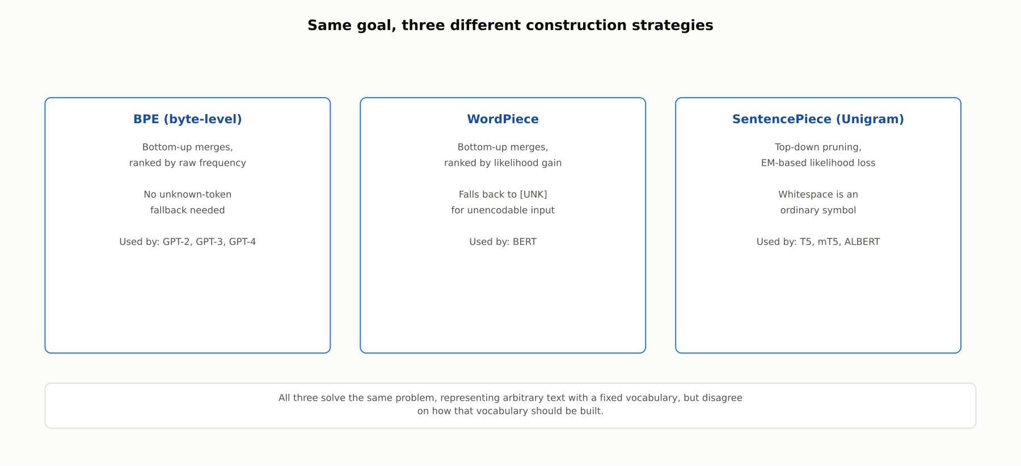
HIGH-LEVEL
Two build up, one prunes down
BPE and WordPiece both merge characters upward. SentencePiece's Unigram algorithm prunes a large candidate set downward.

Slide 5
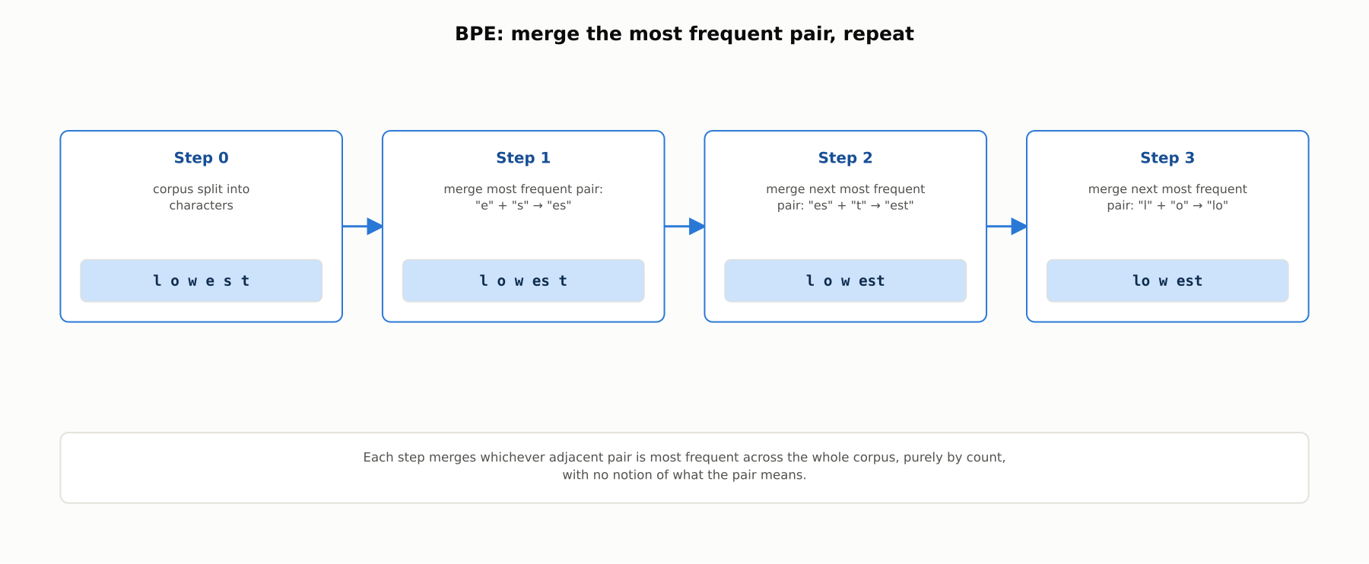
DEEP-DIVE
BPE: merge the most frequent pair, repeat
Each merge is chosen purely by frequency, with no notion of what the pair means linguistically.

Slide 6
DEEP-DIVE
Byte-level BPE removes the out-of-vocabulary problem
GPT-2 introduced running BPE over raw UTF-8 bytes, not Unicode characters
Only 256 possible starting bytes: a complete, fixed starting alphabet
Every possible input string can always be encoded, with no unknown-token fallback
Used by GPT-2, GPT-3, and GPT-4

Slide 7
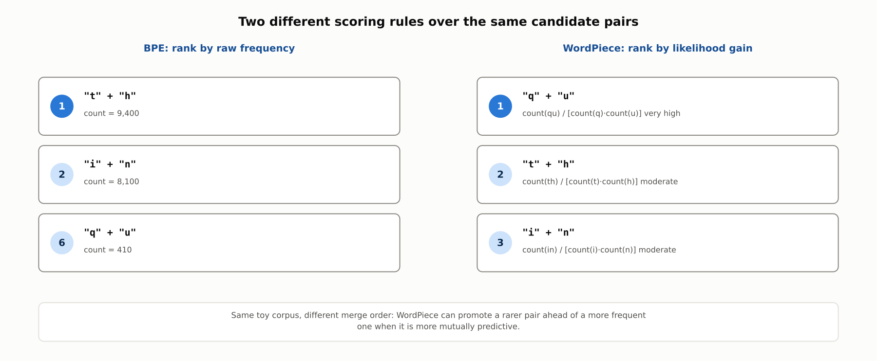
DEEP-DIVE
WordPiece ranks candidate merges differently than BPE
WordPiece scores a merge by likelihood gain, closer to pointwise mutual information than to raw frequency, so it can promote a rarer but more mutually predictive pair.

Slide 8
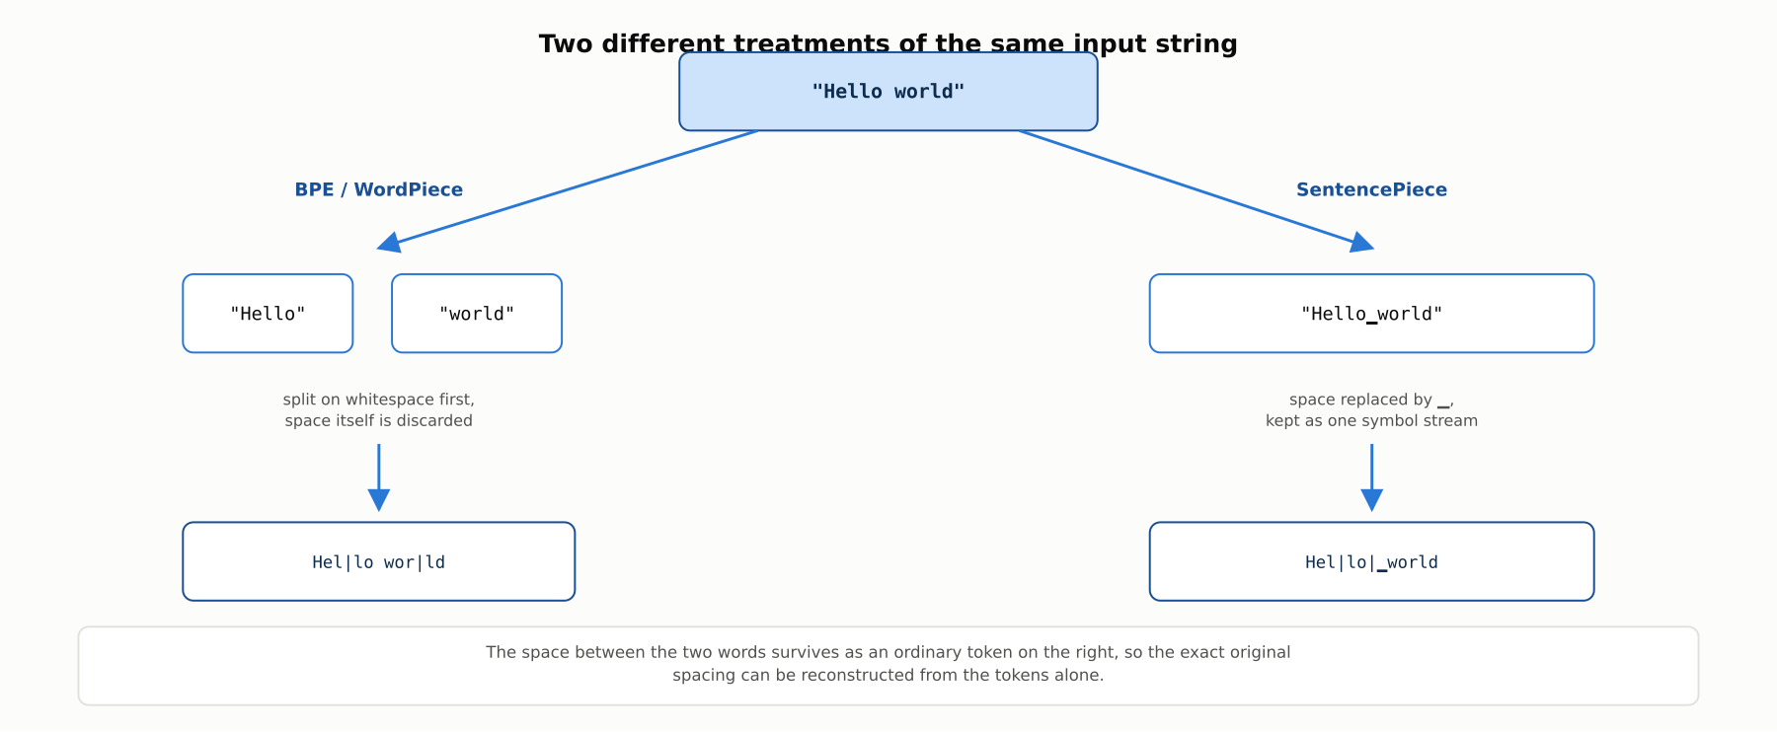
DEEP-DIVE
SentencePiece treats whitespace as an ordinary symbol
This keeps tokenization fully reversible and makes the same tokenizer usable on languages without whitespace-delimited words.

Slide 9
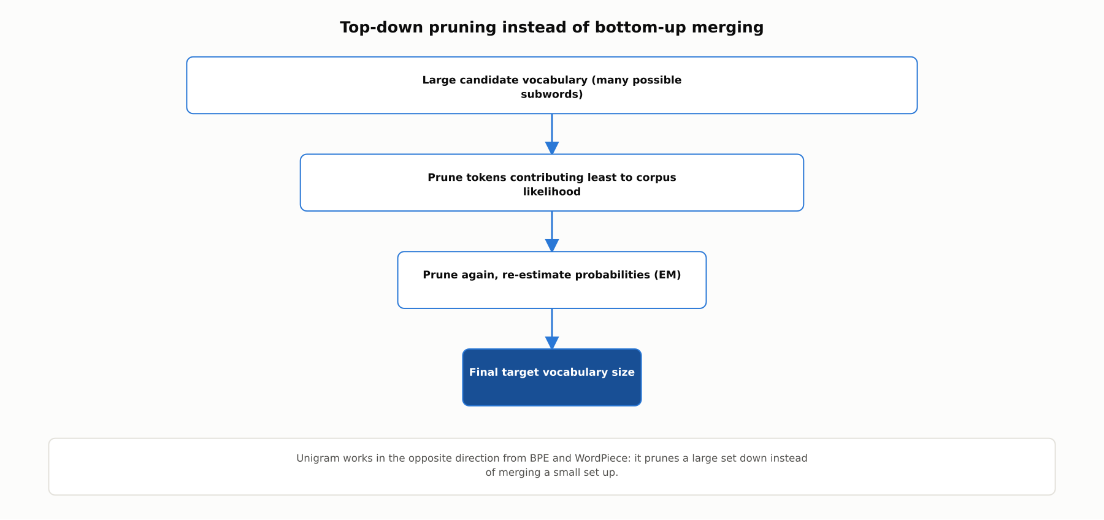
DEEP-DIVE
Unigram: pruning a large vocabulary down to size
An expectation-maximization procedure repeatedly removes whichever tokens contribute least to the corpus likelihood.

Slide 10
REFERENCE ARCHITECTURE
From raw text to token IDs
Normalization: consistent unicode and casing rules applied first
Optional whitespace pre-tokenization: BPE and WordPiece typically do this, SentencePiece typically does not
Subword segmentation: BPE merges, WordPiece merges, or SentencePiece Unigram pruning
Vocabulary lookup: the same fixed-integer-ID step covered in 3.1

Slide 11
COMPARISON & RELATED CONCEPTS
BPE vs. WordPiece vs. SentencePiece (Unigram)
Aspect | BPE (byte-level) | WordPiece | SentencePiece (Unigram)
Vocabulary construction direction | Bottom-up: merge into larger units | Bottom-up: merge into larger units | Top-down: prune a large candidate set
Merge/prune criterion | Raw pair frequency | Likelihood gain (PMI-like) | EM-based likelihood loss
Whitespace handling | Typically pre-split first | Typically pre-split first | Ordinary symbol, no pre-split
Out-of-vocabulary behavior | None (byte-level) | Falls back to [UNK] | None
Representative models | GPT-2, GPT-3, GPT-4 | BERT, DistilBERT | T5, mT5, ALBERT, XLNet
All three are subword strategies; they differ in how the vocabulary is built and how a string gets split.

Slide 12
INDUSTRY USE CASES
Finance
FINANCIAL SERVICES
Fragmentation of ticker symbols in a general-purpose vocabulary
Revalidating AML keyword rules after a base model upgrade
Problem: Proprietary fund codes and less common ticker symbols fragment into pieces with no coherent meaning.
Problem: A new base model usually changes the tokenizer, which can change how regulatory keyword phrases segment.
Solution: Evaluate tokenizer fragmentation on the firm's actual ticker vocabulary before deployment, extending it where warranted.
Solution: Treat a base model upgrade as a trigger to revalidate keyword-based monitoring rules against the new tokenizer.
Watch for: A ticker that tokenizes differently across a model upgrade can silently break exact-match logic in sanctions-list screening or trade surveillance.
Watch for: An AML rule tuned to a specific token boundary can silently stop matching, an undetected transaction-monitoring gap until the next audit.

Slide 13
INDUSTRY USE CASES
Healthcare & Telecom
HEALTHCARE + TELECOM
(Healthcare) Byte-level BPE's missing unknown-token safety net
(Telecom) WordPiece underweighting rare high-severity alarm codes
Problem: Byte-level BPE encodes every string, including a pasted patient identifier that should have been redacted.
Problem: WordPiece's likelihood-based criterion favors common patterns, so a rare high-severity alarm code may never earn its own token.
Solution: Enforce de-identification upstream of tokenization rather than relying on tokenizer behavior to surface leftovers.
Solution: Specifically verify stable tokenization of rare, high-severity codes, not just aggregate tokenizer quality metrics.
Watch for: A team that treats an unknown-token signal as an implicit safety net gets none from byte-level BPE, a distinct PHI-exposure mechanism from a WordPiece pipeline that would at least emit [UNK].
Watch for: A rare critical code that never gets a dedicated token is systematically underweighted by a downstream severity classifier at exactly the moment during an outage when correct triage matters most.

Slide 14
CHECK YOUR UNDERSTANDING
Discuss before moving on
1. What criterion does BPE use to choose merges, and how does WordPiece's criterion differ?
2. Why does byte-level BPE eliminate the out-of-vocabulary problem entirely?
3. How does the Unigram algorithm differ structurally from BPE and WordPiece?
4. What is subword regularization, and which algorithm enables it?

Slide 15
CHAPTER 3.5 · PHASE 3
Key Takeaways
BPE: bottom-up merges by raw frequency; byte-level BPE has no OOV problem
WordPiece: bottom-up merges by likelihood gain, BERT's tokenizer
SentencePiece: whitespace as an ordinary symbol, language-independent
Unigram: prunes a large vocabulary down, enabling subword regularization
Next: 3.6 Scaling Laws & Emergent Abilities

