Slide 1
CHAPTER 3.6 · PHASE 3
Scaling Laws & Emergent Abilities
How to spend a fixed training compute budget, and whether scale ever changes a model in kind, not just in degree.
NLP & Language Model Foundations

Slide 2
AGENDA
What this chapter covers
Kaplan et al. (2020): test loss falls as a smooth power law in model size, data, and compute
Chinchilla (2022): the compute-optimal correction to that early heuristic
Emergent abilities: capabilities that appear only above a scale threshold
The "mirage" critique: how evaluation metric choice can manufacture apparent emergence
Industry use cases across Finance, Healthcare, and Telecom

Slide 3
TL;DR
The short version
Test loss falls as a smooth power law in model size, data size, and compute (Kaplan et al., 2020)
Chinchilla (2022) corrected the compute allocation: scale model size and data roughly together
Gopher (280B params) was undertrained; Chinchilla (70B params, more data) beat it at equal compute
Emergent abilities appear only above a scale threshold, unlike smooth loss curves
The "mirage" critique: metric choice can make emergence look sharper than it is

Slide 4
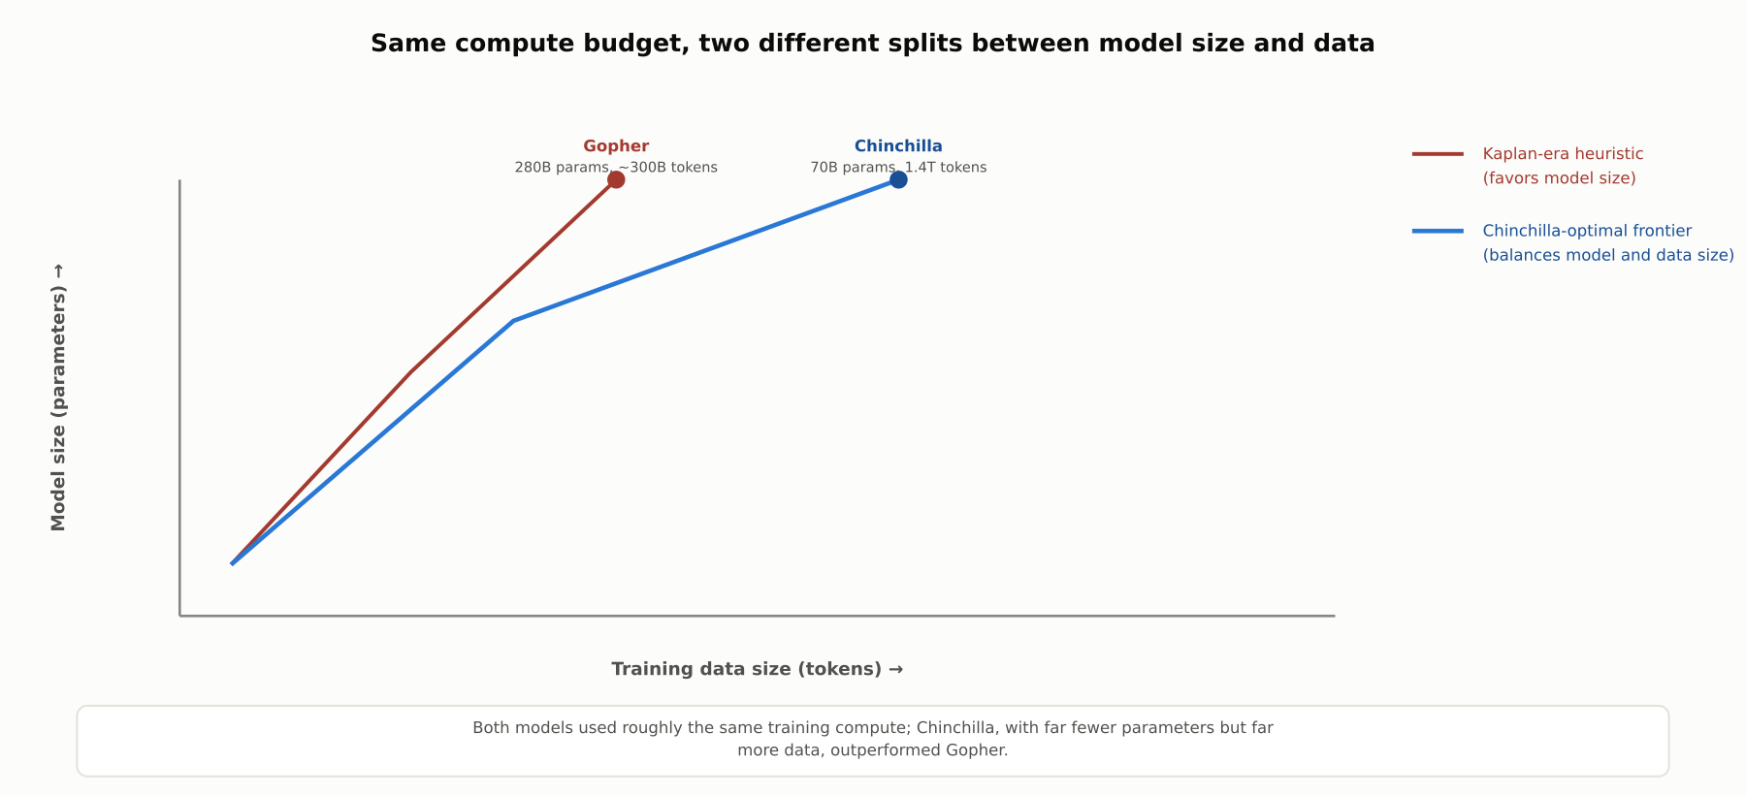
HIGH-LEVEL
Same compute budget, two different splits
Kaplan-era scaling favored growing model size faster than data; Chinchilla's compute-optimal frontier corrects this toward balance.

Slide 5
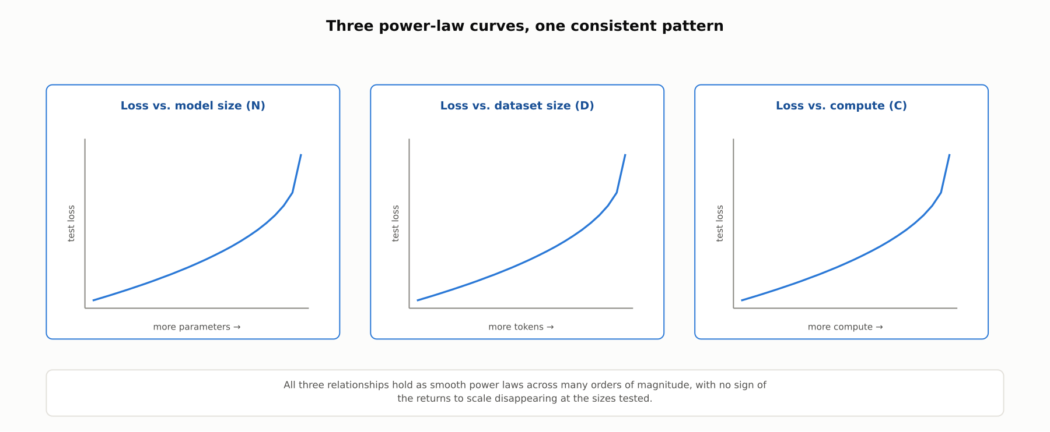
DEEP-DIVE
Kaplan et al.: three smooth power-law curves
Test loss falls smoothly and predictably as model size, dataset size, or compute independently increase, holding across many orders of magnitude.

Slide 6
DEEP-DIVE
Chinchilla's correction, demonstrated directly
Hoffmann et al. (2022) systematically varied model size and data size together
Chinchilla: 70B parameters, trained on 1.4 trillion tokens
Gopher: 280B parameters, trained on roughly 300 billion tokens, same total compute
Chinchilla outperformed Gopher across a wide range of benchmarks
Evidence that many contemporary large models were undertrained relative to their size

Slide 7
DEEP-DIVE
Emergent abilities: not present, then present
Wei et al. (2022): a capability not present in smaller models, present in larger ones
Cannot be predicted by extrapolating smaller models' performance trend
Examples: certain multi-step arithmetic and instruction-following tasks on BIG-Bench
Accuracy stays near chance, then rises sharply above a scale threshold

Slide 8
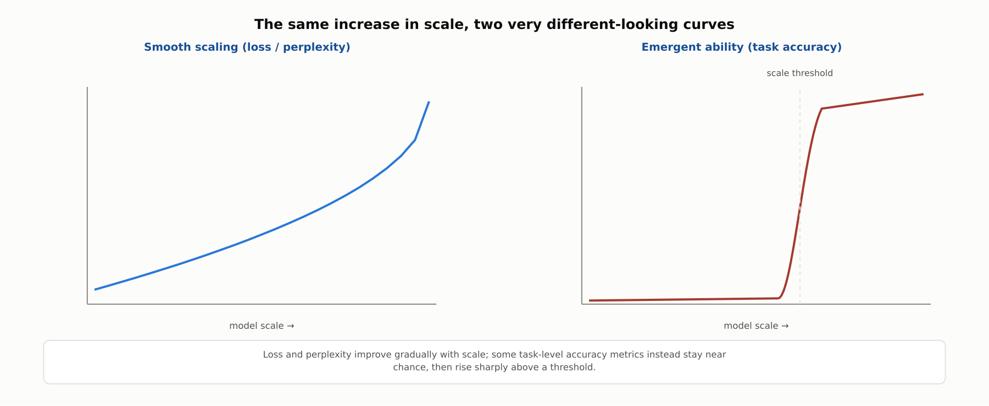
DEEP-DIVE
Smooth loss versus a sharp emergent-ability jump
The same increase in scale can look completely different depending on whether the metric is a smooth loss curve or a task-level accuracy threshold.

Slide 9
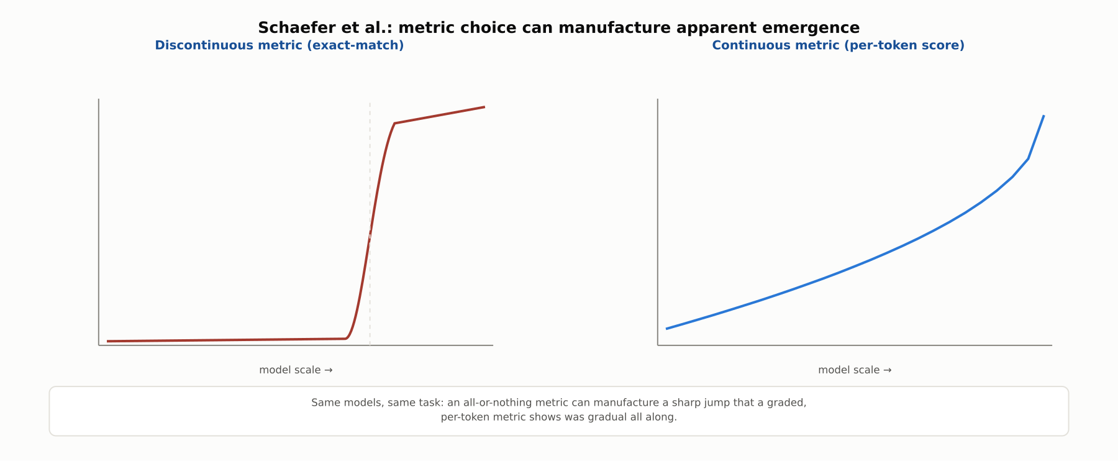
DEEP-DIVE
The mirage: metric choice can manufacture apparent emergence
Schaefer et al. (2023): a discontinuous exact-match metric can turn a smoothly improving per-token error rate into a sharp jump. The debate is not fully settled for every case.

Slide 10
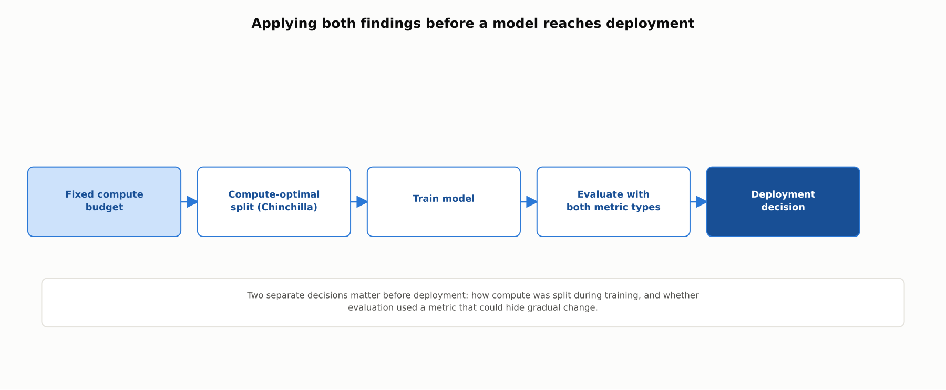
REFERENCE ARCHITECTURE
From compute budget to deployment decision
Two separate decisions matter: how compute was split during training, and whether evaluation used a metric that could hide gradual change.

Slide 11
COMPARISON & RELATED CONCEPTS
Three related but distinct findings
Aspect | Kaplan-era scaling (2020) | Chinchilla compute-optimal (2022) | Emergent abilities
What it describes | How test loss falls as scale grows | How to split a fixed compute budget | Capabilities appearing above a scale threshold
Compute allocation implication | Favor a larger model over more data | Scale model size and data together | Not a compute-allocation finding
Nature of the curve | Smooth power law | Smooth power law, corrected split | Apparently discontinuous; contested
Key evidence | Loss curves across many scales | Chinchilla beating Gopher at equal compute | Sharp accuracy jumps on BIG-Bench tasks
These answer different questions: how loss scales, how to allocate a compute budget, and whether capabilities appear discontinuously.

Slide 12
INDUSTRY USE CASES
Finance
FINANCIAL SERVICES
Choosing between a larger base model and more task-specific data
Revalidating a numerical-reasoning capability after a model downgrade
Problem: A team must decide whether budget is better spent on a larger base model or more fine-tuning data for classification at scale.
Problem: A multi-step reasoning capability used for a regulatory ratio calculation may be specific to the previous model's scale.
Solution: Apply Chinchilla-style compute-optimal reasoning rather than defaulting to the older size-favoring assumption.
Solution: Explicitly revalidate the specific capability whenever the model is downgraded, not just recheck aggregate scores.
Watch for: An oversized, undertrained model can silently underperform on unusual transaction types underrepresented in training data, a gap model-risk-management would need to specifically test for.
Watch for: A cost-driven downgrade can silently lose a numerical-reasoning capability relied on for a regulatory calculation, since emergent capabilities do not necessarily degrade gracefully.

Slide 13
INDUSTRY USE CASES
Healthcare & Telecom
HEALTHCARE + TELECOM
(Healthcare) Underestimating training-data needs for a clinical model
(Telecom) Compute-optimal selection for real-time network-log analysis
Problem: Assuming a bigger clinical model needs comparatively less data reflects the outdated Kaplan-era heuristic.
Problem: Model choice affects both accuracy and inference latency for time-sensitive network monitoring.
Solution: Apply Chinchilla-style compute-optimal reasoning when planning a clinical-domain-adapted model's training budget.
Solution: Check whether a smaller, more thoroughly trained model can match a larger, undertrained one before selecting.
Watch for: An undertrained, oversized clinical model can silently underperform on rarer scenarios underrepresented in training data, a patient-safety-relevant gap a generic benchmark would not reveal.
Watch for: An oversized model chosen on parameter-count marketing alone can add unnecessary latency to outage detection without buying accuracy, threatening detection-time SLA commitments.

Slide 14
CHECK YOUR UNDERSTANDING
Discuss before moving on
1. What did Kaplan et al. find about test loss, and how was it initially read as a compute-allocation recommendation?
2. What did Chinchilla correct, and what evidence supported the correction?
3. What is an emergent ability, and how does its pattern differ from a smooth scaling curve?
4. What does the "emergent abilities mirage" critique argue about evaluation metric choice?

Slide 15
CHAPTER 3.6 · PHASE 3
Key Takeaways
Test loss falls as a smooth power law in model size, data size, and compute
Chinchilla corrected the compute-optimal split: scale size and data together
Emergent abilities appear only above a scale threshold, not gradually
Metric choice can materially affect whether emergence looks sudden or gradual
Next: 3.7 The 2026 Model Landscape: Open vs. Closed, Size Classes, Choosing a Base Model

