Slide 1
CHAPTER 3.7 · PHASE 3
The 2026 Model Landscape: Open vs. Closed, Size Classes, Choosing a Base Model
How to actually choose a model to deploy, across openness, size class, and licensing together.
NLP & Language Model Foundations

Slide 2
AGENDA
What this chapter covers
Open-weight versus closed API-only models
Why "open-weight" is not the same as "open-source"
How real license terms vary, from permissive to conditional
Size classes: frontier, mid-size, and small/edge
Weighing capability, residency, cost, and vendor risk together
Industry use cases across Finance, Healthcare, and Telecom

Slide 3
TL;DR
The short version
Closed models: API only, vendor controls hosting and versioning (OpenAI, Anthropic, Google)
Open-weight models: downloadable, self-hostable (Llama, DeepSeek, Qwen, Mistral)
"Open-weight" is not "unrestricted": license terms vary considerably
Llama 4's license requires a separate agreement if MAU exceeded 700 million as of its release date
Size class (frontier, mid-size, small/edge) is a second, independent choice

Slide 4
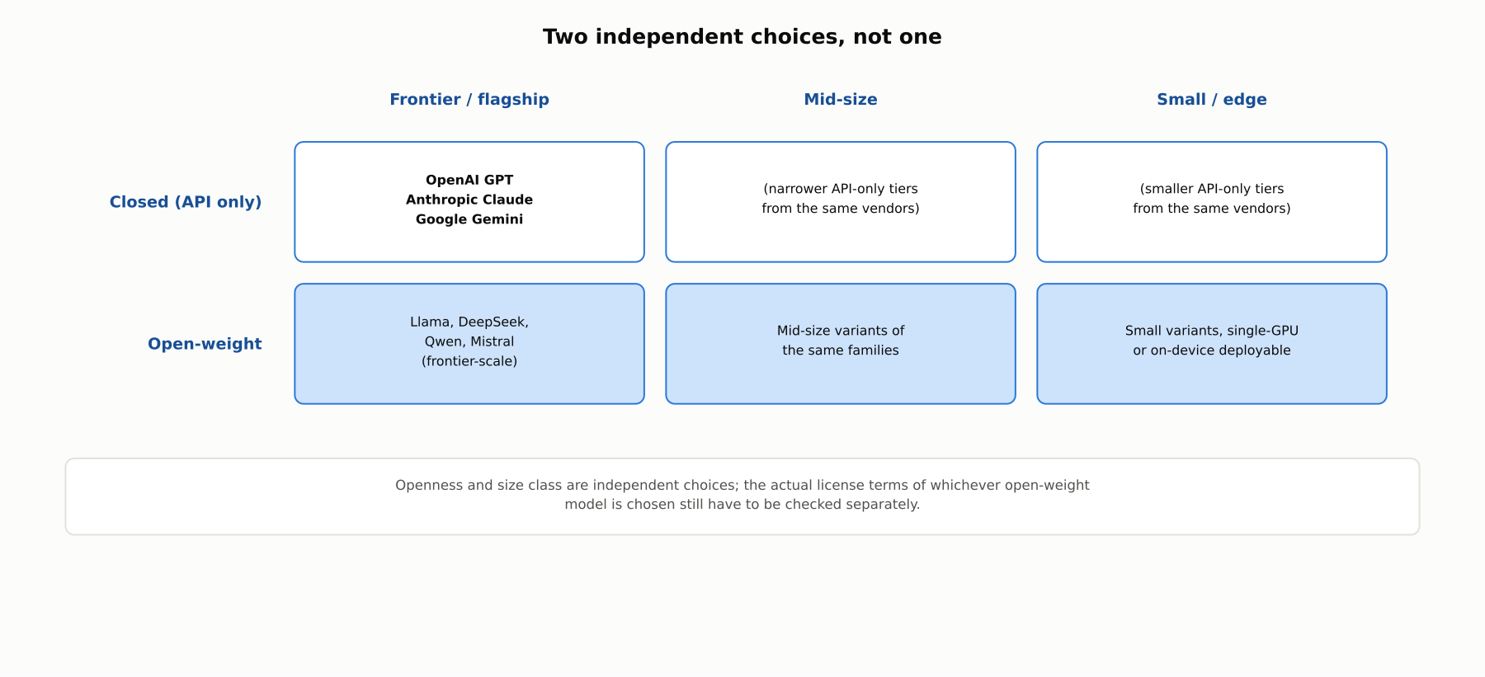
HIGH-LEVEL
Two independent dimensions: openness and size class
A real deployment decision has to weigh both, plus the specific license terms attached to whichever open-weight option is chosen.

Slide 5
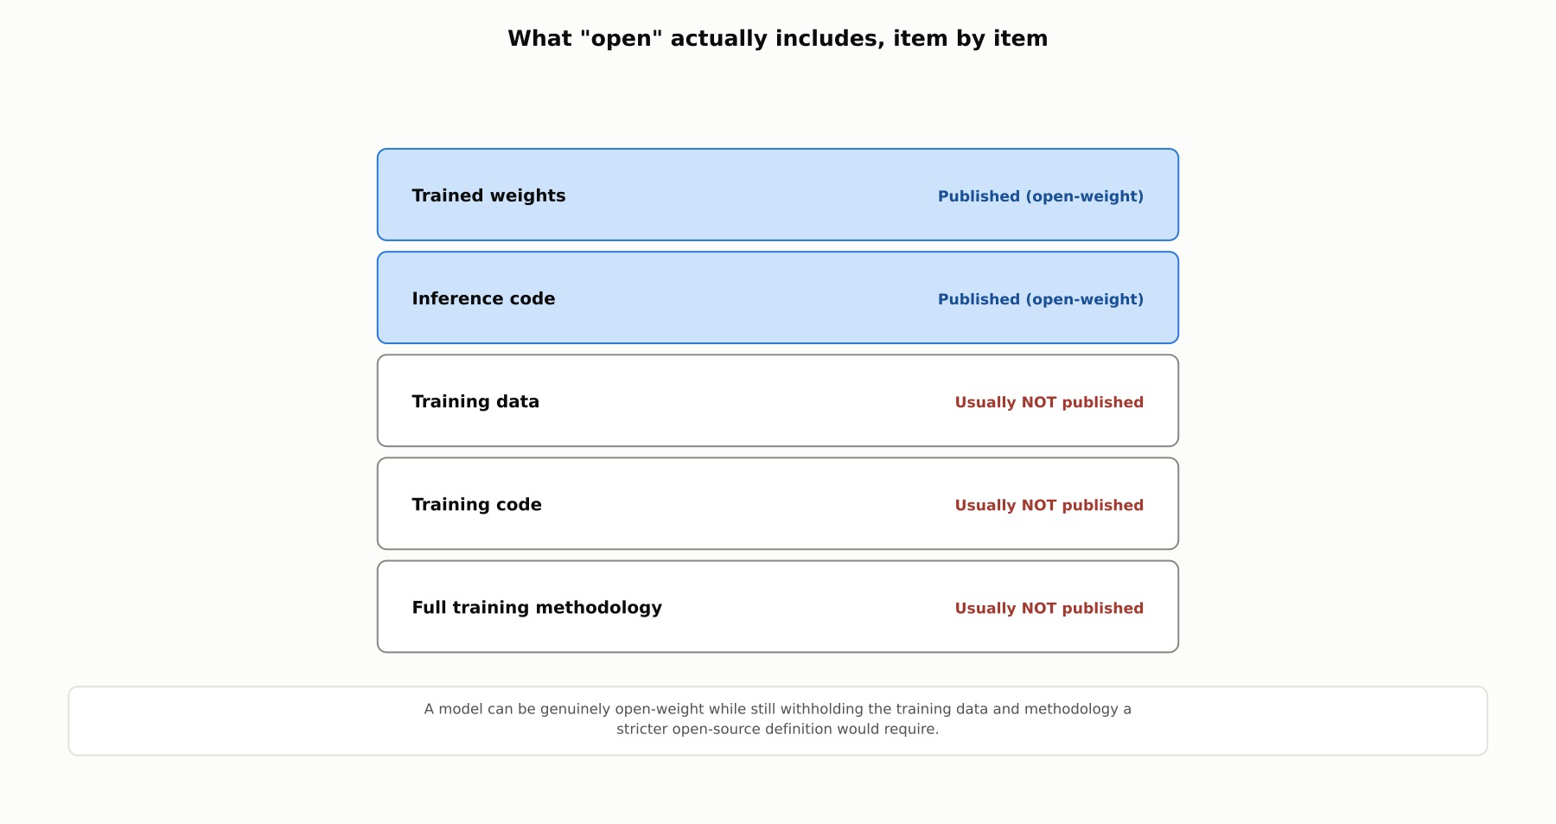
DEEP-DIVE
What "open" actually includes, item by item
Open-weight publishes the trained result. Open-source would additionally require publishing the training data, training code, and methodology.

Slide 6
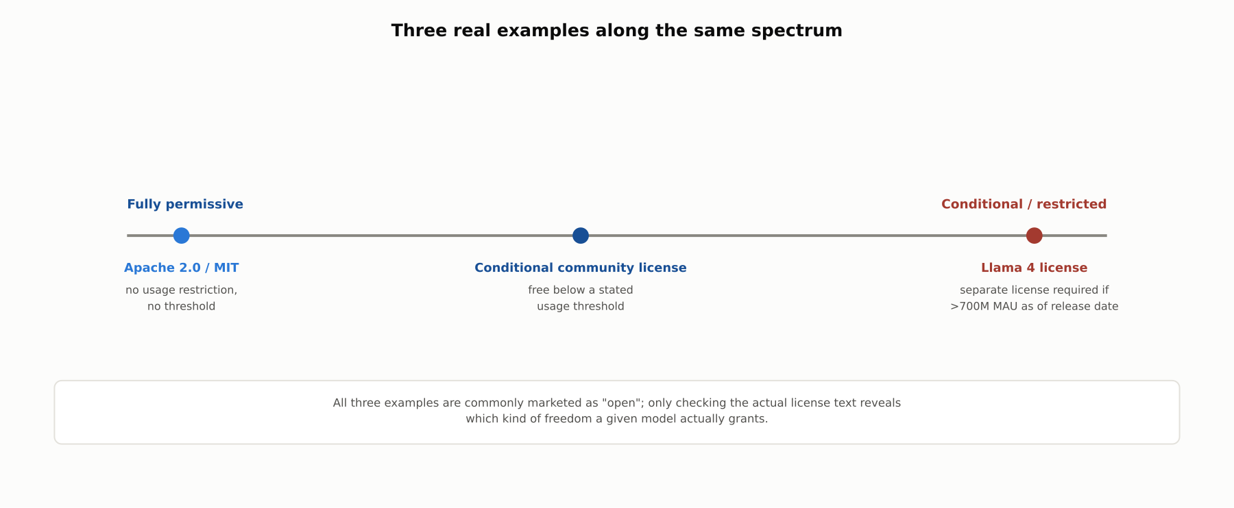
DEEP-DIVE
"Open-weight" spans a spectrum of actual legal freedom
From fully permissive Apache 2.0/MIT licenses to Meta's Llama 4 license, which requires a separate agreement if the licensee exceeded 700 million monthly active users as of the release date.

Slide 7
DEEP-DIVE
The label "open" does not tell you which kind you are getting
A genuinely permissive license (Apache 2.0, MIT) has no usage restriction, ever
A conditional community license is free below a stated threshold
Llama 4: separate license required if MAU exceeded 700M as of release date, at Meta's discretion
The specific license text must be checked per model, not inferred from marketing

Slide 8
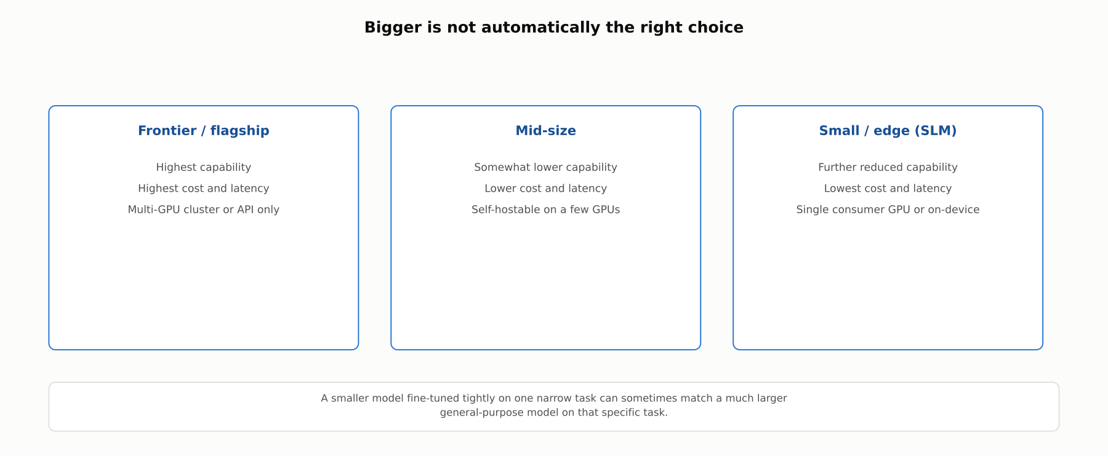
DEEP-DIVE
Three size classes, three deployability trade-offs
A smaller model fine-tuned tightly on one narrow task can sometimes match a much larger general-purpose model on that task.

Slide 9
DEEP-DIVE
Choosing a base model means weighing several axes together
The task's actual capability requirement, not just the highest benchmark score available
Whether data residency or privacy rules permit sending data to a third-party API at all
Total cost of ownership: API per-token pricing versus self-hosting infrastructure and engineering cost
Latency requirements, and whether the license actually permits the intended use at the intended scale
Vendor-concentration risk: depending on one API vendor versus owning a downloadable checkpoint

Slide 10
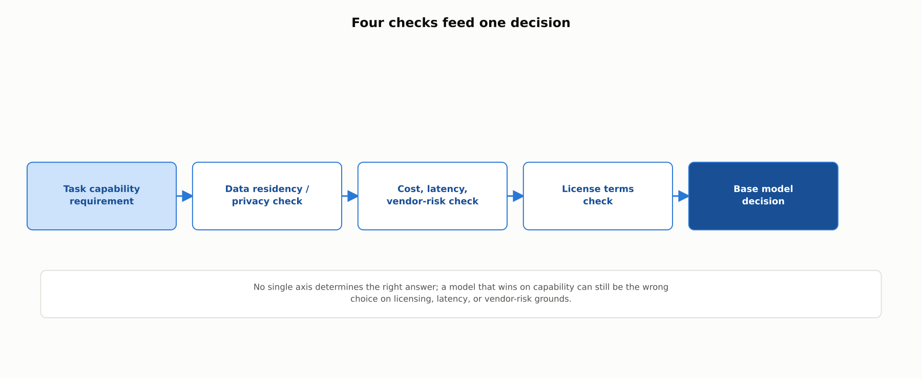
REFERENCE ARCHITECTURE
Four checks feed one base model decision
Capability, data residency, cost/latency/vendor-risk, and license terms all have to be checked, not just capability alone.

Slide 11
COMPARISON & RELATED CONCEPTS
Closed vs. open-weight, frontier vs. smaller
Aspect | Closed frontier models | Open-weight frontier-scale | Open-weight mid-size / small
Access method | API only; weights never released | Downloadable, self-hostable | Downloadable, self-hostable
Typical hosting | Vendor-hosted only | Self-hosted (multi-GPU) or vendor-hosted | Self-hosted on a few GPUs, or on-device
Licensing model | Set by the vendor's API terms | Permissive to conditional; varies by model | Same range; must be checked per model
Representative families | OpenAI GPT, Anthropic Claude, Google Gemini | Llama, DeepSeek, Qwen, Mistral | Smaller variants of the same families
Openness, size class, and licensing are three separate dimensions that all have to be checked for the specific model in question.

Slide 12
INDUSTRY USE CASES
Finance
FINANCIAL SERVICES
Choosing a closed API model for proprietary trading-strategy analysis
Verifying an open-weight model's license against deployment scale
Problem: Sending proprietary trading-strategy text to a third-party API risks exposing alpha-generating information.
Problem: Assuming "open-weight" means unrestricted use without checking the license's scale threshold.
Solution: Evaluate whether a self-hosted open-weight model is required because the workload should never leave the firm's infrastructure.
Solution: Have legal review the exact license text against the firm's actual deployment scale before committing.
Watch for: Sending proprietary strategy content to a closed API creates a competitive-exposure risk distinct from ordinary data handling; any signal reaching a competitor or the vendor is a direct business risk.
Watch for: Deploying past a license's usage threshold without the required agreement creates a licensing-compliance exposure and a possible forced shutdown if discovered later.

Slide 13
INDUSTRY USE CASES
Healthcare & Telecom
HEALTHCARE + TELECOM
(Healthcare) Data residency rules out a closed API for PHI processing
(Telecom) Security exposure from processing network telemetry via a closed API
Problem: Processing PHI through a third-party API may conflict with data-residency or business-associate-agreement requirements.
Problem: Network telemetry can reveal infrastructure topology that should not leave the operator's infrastructure.
Solution: Evaluate self-hosting an open-weight model within the institution's own controlled environment.
Solution: Evaluate self-hosting an open-weight model for telemetry-processing workloads specifically.
Watch for: Sending PHI to a closed API without a proper agreement or residency guarantee is a direct HIPAA exposure, distinct from general best practice.
Watch for: Sending live telemetry to a closed API introduces a network-security exposure a general privacy review would not fully capture.

Slide 14
CHECK YOUR UNDERSTANDING
Discuss before moving on
1. What is the difference between "open-weight" and "open-source," and why does it matter?
2. What commercial-use condition does Meta's Llama 4 license impose, and at what threshold?
3. What are the three size classes, and what trade-off does each represent?
4. Why might data residency rule out a closed API model even at the highest capability?

Slide 15
CHAPTER 3.7 · PHASE 3
Key Takeaways
Closed models: API only; open-weight models: downloadable and self-hostable
"Open-weight" is not "open-source," and not automatically unrestricted
Real licenses range from permissive to conditional; always check the actual text
Choosing a base model means weighing capability, residency, cost, and licensing together
Next: Phase 3 complete: NLP & Language Model Foundations

