Slide 1
CHAPTER 4.1 · PHASE 4
What Is Generative AI? Generative vs. Discriminative Models
The mechanical distinction underneath every "is this generative AI" question, and why it splits further into explicit- and implicit-density models.
Generative AI Foundations

Slide 2
AGENDA
What this chapter covers
Discriminative vs. generative models: what each actually learns
Explicit-density vs. implicit-density generative models
The generative learning trilemma: quality, diversity, speed
Mode collapse as a specific implicit-density failure mode
Comparison across all three model types
Industry use cases across Finance, Healthcare, and Telecom

Slide 3
TL;DR
The short version
Discriminative models learn P(label given input) directly; they never model the data itself
Generative models learn something about the data's own distribution, enabling new samples
Explicit-density models compute a real probability per output (e.g., an autoregressive LLM)
Implicit-density models only learn to sample convincingly, with no probability computed (e.g., a GAN)
No generative family gets high quality, full diversity, and fast sampling all at once

Slide 4
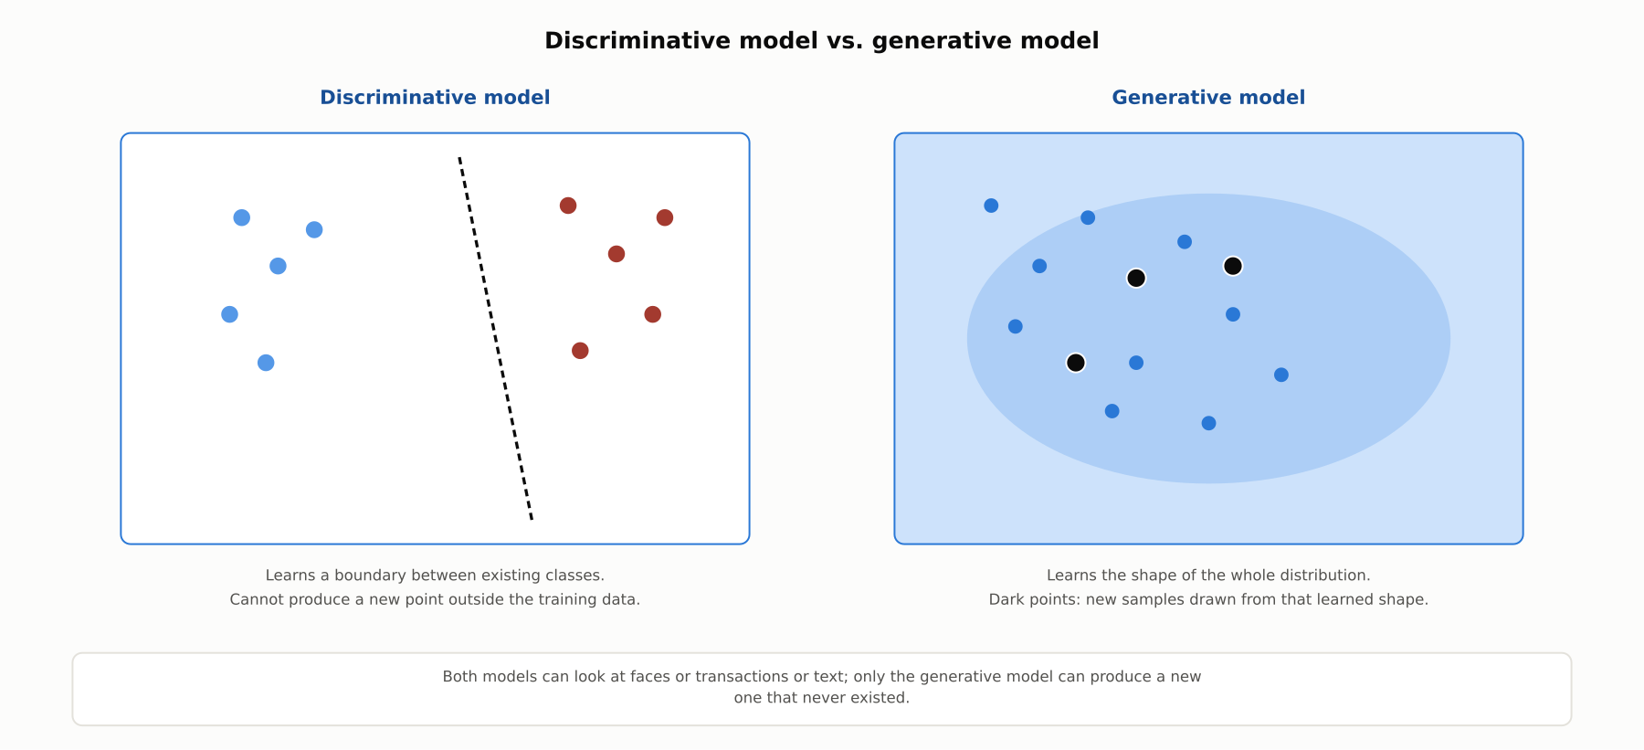
HIGH-LEVEL
The security guard and the sketch artist
A discriminative model draws a boundary between existing classes. A generative model learns the shape of the data well enough to produce new examples from it.

Slide 5
DEEP-DIVE
The mathematical distinction, stated precisely
Discriminative: directly parameterizes P(label given input), with no representation of P(input) anywhere
Generative (classical): parameterizes the joint distribution P(x, y), from which P(label given input) can be derived via Bayes' theorem (1.8)
Generative (modern): treats P(output given input) as a full distribution to sample from, not a single predicted label
Naive Bayes (1.5) is the standard textbook generative classifier: it models P(x given y) and P(y) separately
Logistic regression, purely discriminative, cannot generate a synthetic x for a class even though it solves the same classification task

Slide 6
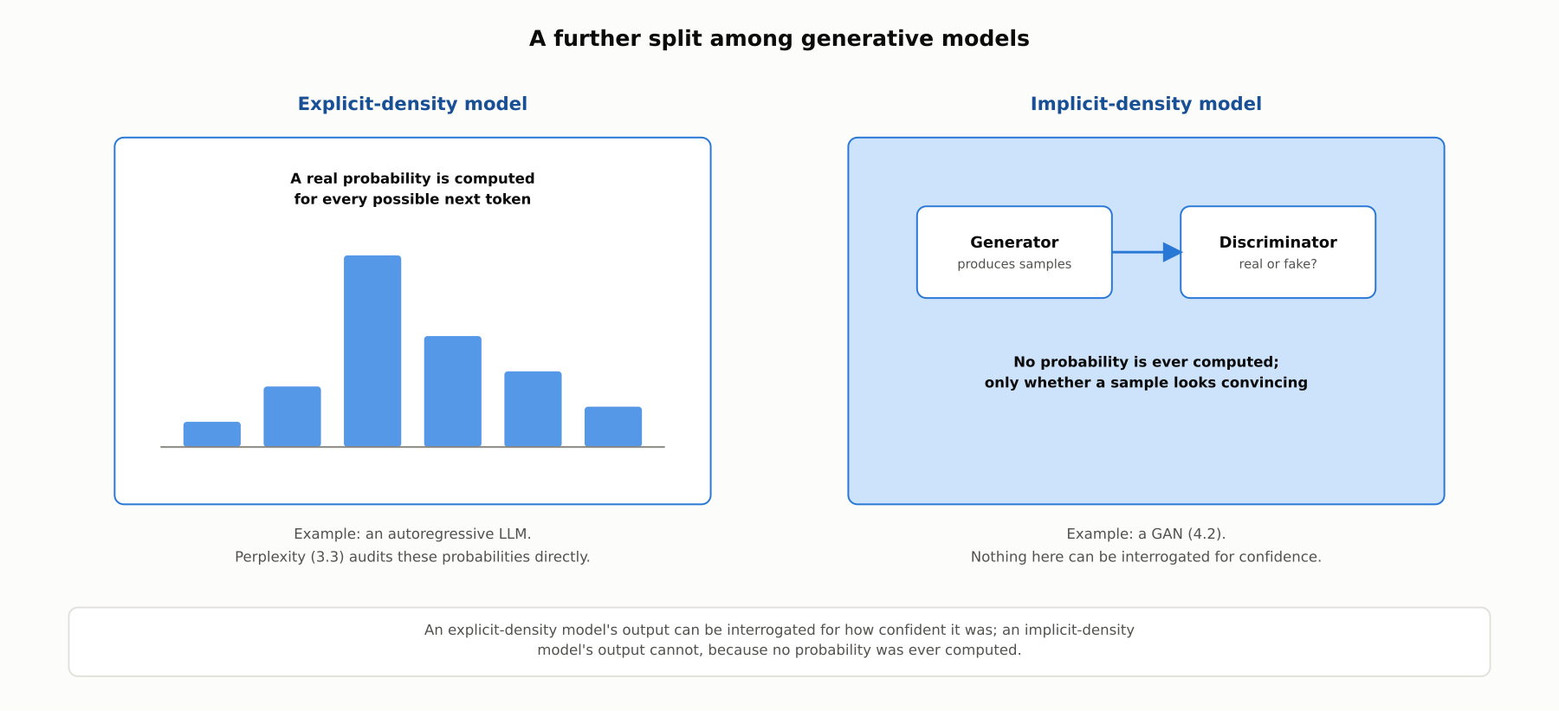
DEEP-DIVE
A further split: explicit-density vs. implicit-density
An explicit-density model computes a real probability for every output. An implicit-density model only learns to fool a discriminator, with no probability computed anywhere.

Slide 7
DEEP-DIVE
Why this split matters operationally
An autoregressive LLM (3.3) is explicit-density: perplexity (3.3) is a direct, auditable summary of its computed probabilities
A Generative Adversarial Network (covered fully in 4.2) is the standard implicit-density example
An explicit-density model's output can, in principle, be interrogated for how confident the model was
An implicit-density model's output cannot be interrogated this way, because no probability was ever computed

Slide 8
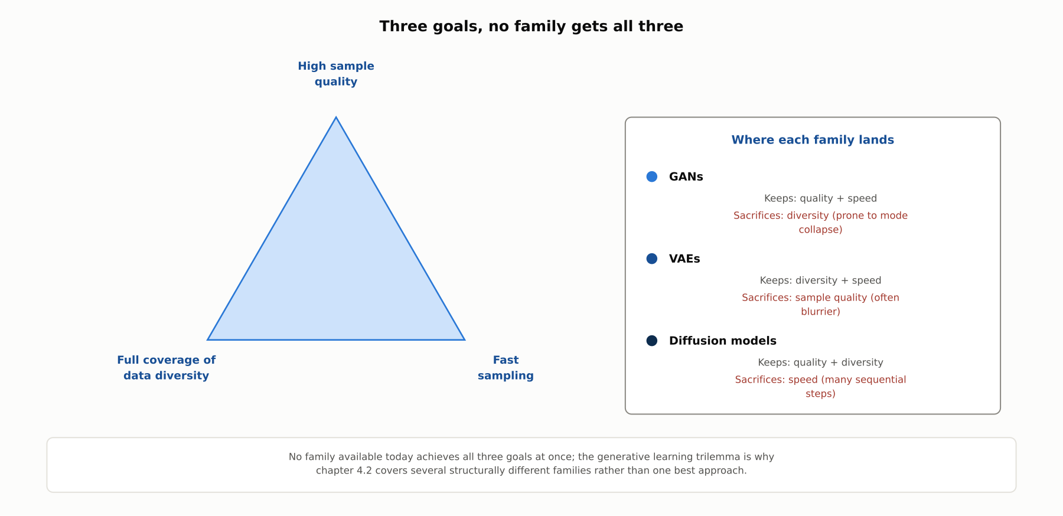
DEEP-DIVE
The generative learning trilemma
Xiao, Kreis, and Vahdat (arXiv:2112.07804, 2022): high sample quality, full data diversity, and fast sampling are not achieved simultaneously by a single family.

Slide 9
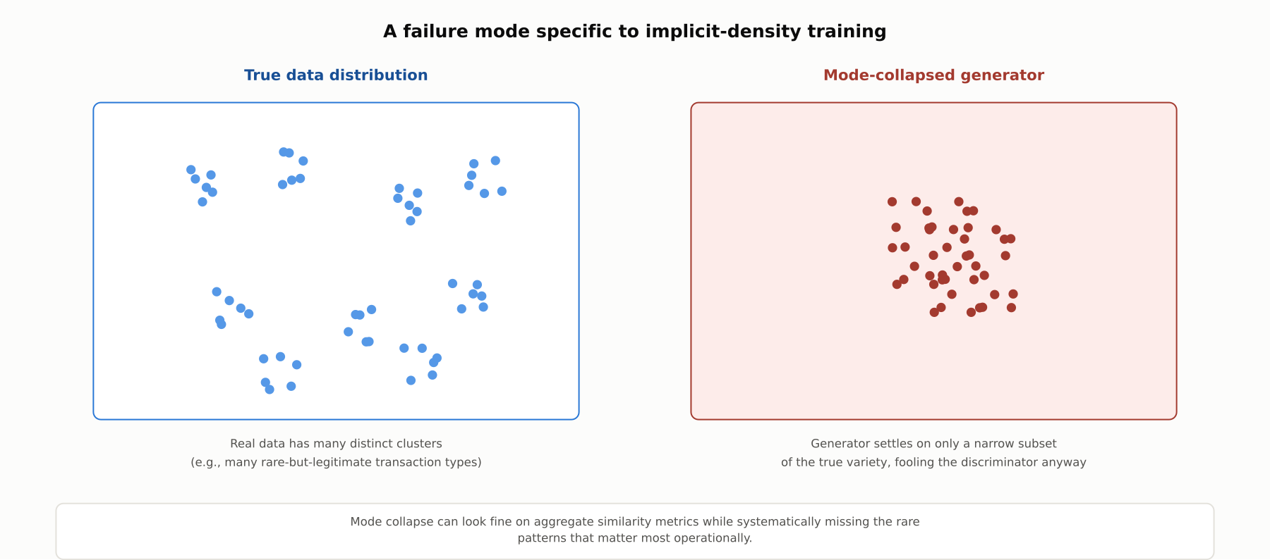
DEEP-DIVE
Mode collapse: a failure mode specific to implicit-density training
A mode-collapsed generator reproduces only a narrow slice of the true data's variety while still looking locally convincing.

Slide 10
COMPARISON & RELATED CONCEPTS
Discriminative vs. explicit-density vs. implicit-density
Aspect | Discriminative model | Explicit-density generative | Implicit-density generative
What is learned | P(label given input), directly | A real, computable probability over outputs | Only how to sample; no probability computed
Can generate new samples | No | Yes, by sampling the computed distribution | Yes, by sampling the trained generator
Per-output confidence available | Yes (a calibrated label probability) | Yes, in principle (e.g., perplexity, 3.3) | No; nothing to interrogate
Representative example | Logistic regression, a fine-tuned classifier | Autoregressive LLM (3.3) | GAN (4.2)
Both kinds of generative model can produce new samples; only one of them can also tell you how confident it was in a specific output.

Slide 11
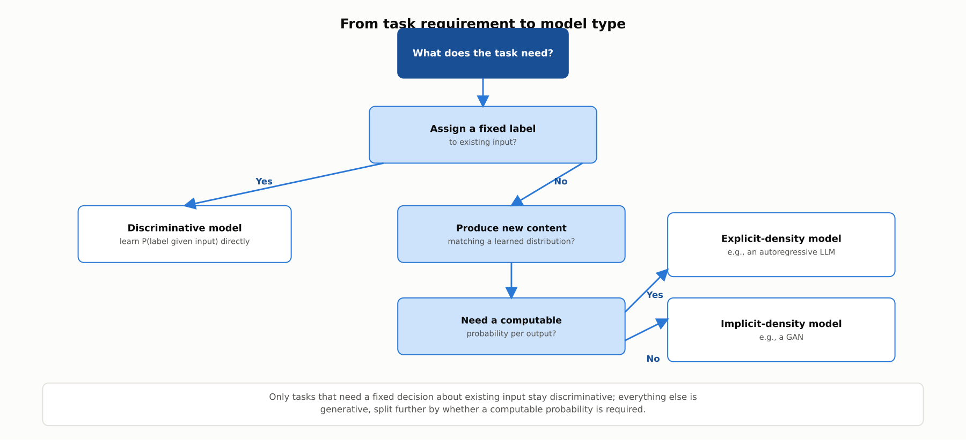
REFERENCE ARCHITECTURE
Choosing between a discriminative and a generative model
What the task needs to do about existing input versus new content drives the choice, before a computable-probability requirement splits generative models further.

Slide 12
INDUSTRY USE CASES
Finance
FINANCIAL SERVICES
Using a discriminative model, not a generative one, for the actual fraud decision
Validating synthetic transaction data for mode collapse before using it in testing
Problem: A team building a fraud-detection pipeline is tempted to have a generative LLM directly issue the fraud/no-fraud decision.
Problem: Synthetic transaction data can suffer mode collapse, underrepresenting rare-but-legitimate patterns like unusual large wire transfers.
Solution: Keep the actual scoring decision on a discriminative classifier that produces a calibrated P(fraud given transaction).
Solution: Specifically test synthetic data for coverage of rare transaction types, not just aggregate statistical similarity.
Watch for: A generative model's plausible-sounding fraud judgment is not a calibrated probability, and model-risk-management cannot validate it the same way.
Watch for: A fraud model validated against mode-collapsed synthetic data can look accurate in testing while remaining blind to the rare pattern that mattered in production.

Slide 13
INDUSTRY USE CASES
Healthcare & Telecom
HEALTHCARE + TELECOM
(Healthcare) Keeping a diagnostic classifier discriminative, separate from a generative imaging tool
(Telecom) Checking synthetic network-traffic generators for mode collapse before capacity planning
Problem: A diagnostic tool must output a calibrated probability; a separate generative tool might create synthetic training images.
Problem: A generative model producing synthetic traffic for capacity planning can suffer mode collapse, underrepresenting rare surge patterns.
Solution: Validate the diagnostic classifier on calibration and accuracy, and validate the generative image tool separately on feature preservation.
Solution: Validate synthetic traffic data specifically for coverage of rare surge patterns before using it for capacity-planning decisions.
Watch for: Treating a generative tool's fabricated finding as equivalent to a calibrated probability can lead a clinician to over-trust an unvalidated signal.
Watch for: Capacity plans built on mode-collapsed synthetic data can leave the network under-provisioned for exactly the rare event that matters most.

Slide 14
CHECK YOUR UNDERSTANDING
Discuss before moving on
1. What is the core mathematical difference between a discriminative model and a generative model?
2. What distinguishes an explicit-density from an implicit-density generative model?
3. What is the generative learning trilemma, and which goal does each of GANs, VAEs, and diffusion models sacrifice?
4. What is mode collapse, and why is it a particular risk for GAN-style models?

Slide 15
CHAPTER 4.1 · PHASE 4
Key Takeaways
Discriminative models learn P(label given input); generative models learn the data's own distribution
Generative models split into explicit-density (a computed probability) and implicit-density (no probability)
No generative family gets high quality, full diversity, and fast sampling all at once
Mode collapse is a specific, checkable risk for implicit-density models like GANs
Next: 4.2 Generative Model Families Compared: LLMs, Diffusion Models, GANs, VAEs

