Slide 1
CHAPTER 4.2 · PHASE 4
Generative Model Families Compared: LLMs, Diffusion Models, GANs, VAEs
Four structurally different mechanisms for reaching a distribution to sample from, each trading away a different corner of the generative learning trilemma.
Generative AI Foundations

Slide 2
AGENDA
What this chapter covers
Autoregressive LLMs as explicit-density generation, extended beyond text
VAEs: explicit density, but only approximately, via the ELBO
GANs: the generator/discriminator minimax game, revisited
Diffusion models: reversing a known noising process
Latent diffusion and distillation: how the trilemma is actively being pushed on
Industry use cases across Finance, Healthcare, and Telecom

Slide 3
TL;DR
The short version
Autoregressive LLMs: exact, tractable density, one token at a time (3.3)
GANs: implicit-density, generator vs. discriminator, fast but mode-collapse-prone
VAEs: explicit-density but approximate (ELBO), with a structured, interpolatable latent space
Diffusion models: explicit-density but approximate, dominant for image/video/audio as of 2026
Latent diffusion and distillation (e.g., consistency models) push directly on the trilemma's speed cost

Slide 4
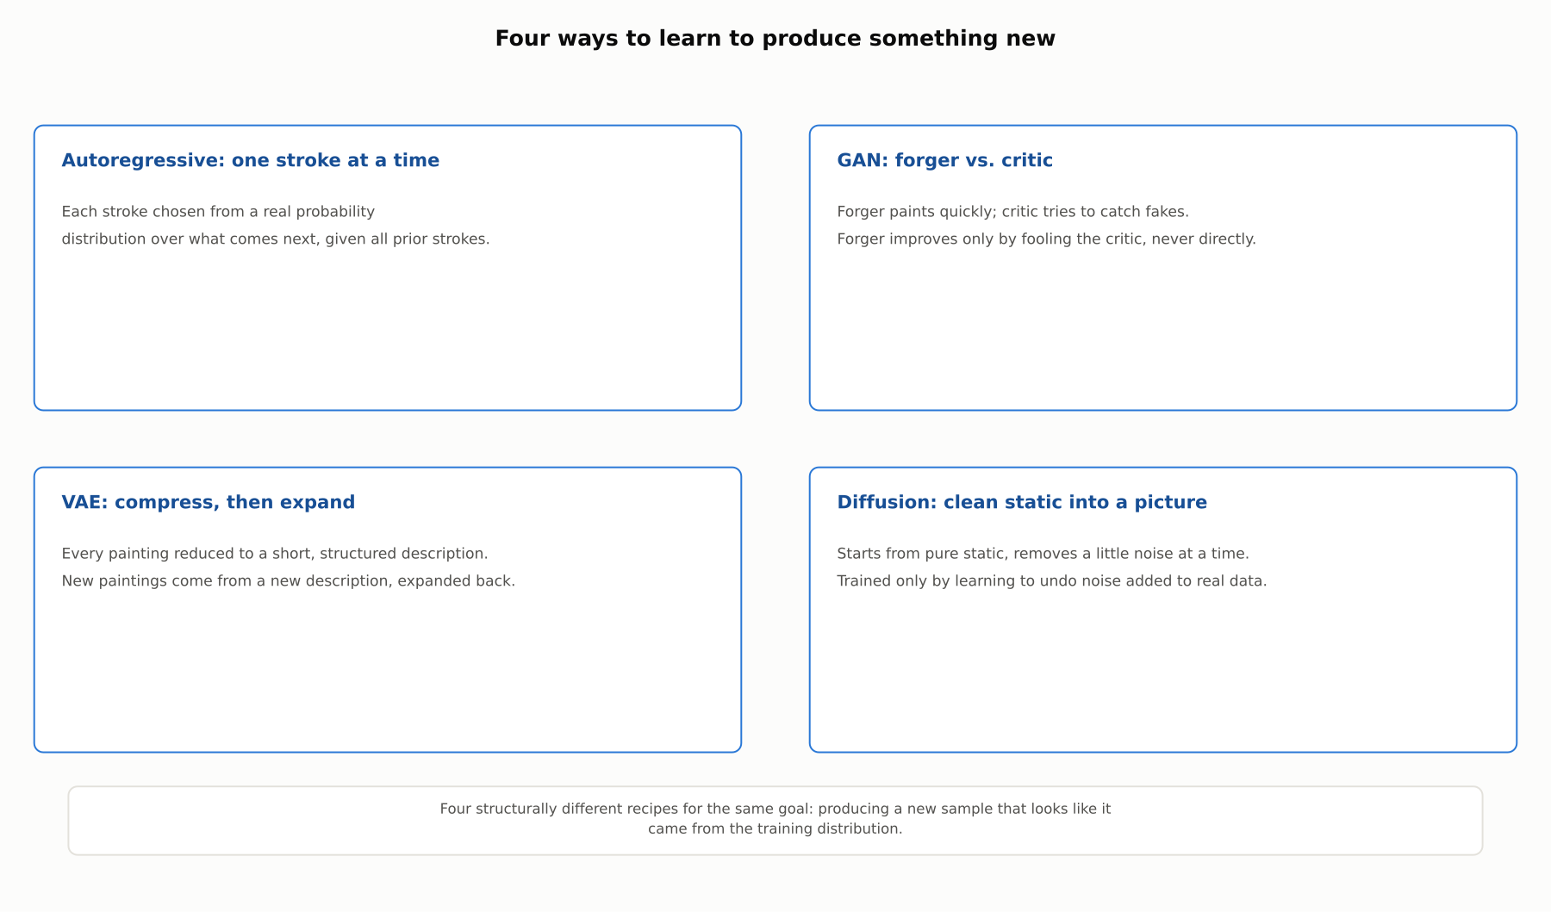
HIGH-LEVEL
Four ways to learn to produce something new
Four structurally different recipes for the same goal: producing a new sample that looks like it came from the training distribution.

Slide 5
DEEP-DIVE
Autoregressive models, extended beyond text
The causal, one-token-at-a-time mechanism (3.3) is not inherently text-specific
PixelRNN and PixelCNN (van den Oord et al., 2016) applied it to individual pixels, in a fixed scan order
An image has vastly more elements than a sentence has tokens
This is why autoregressive generation remains the default for text but not for images

Slide 6
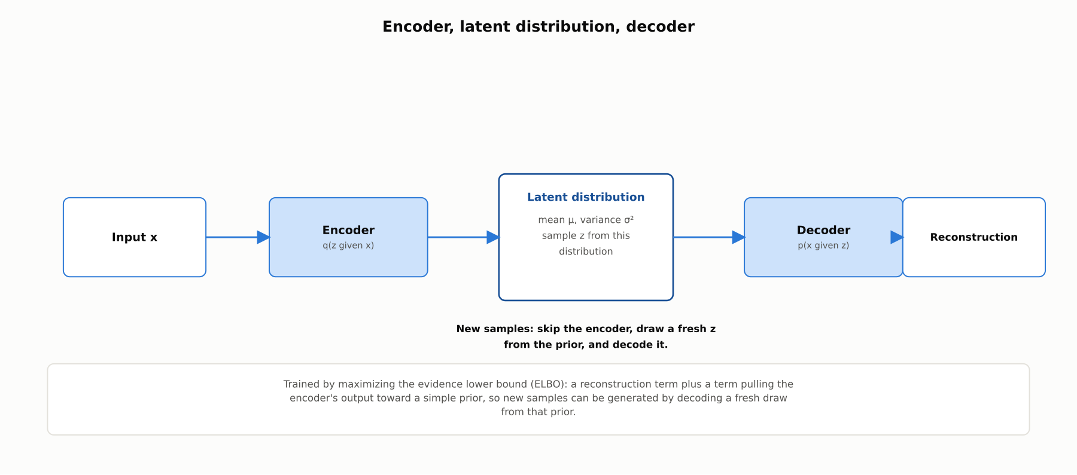
DEEP-DIVE
A VAE encodes to a latent distribution, then decodes back
Trained via the evidence lower bound (ELBO), Kingma and Welling, 2013: a lower bound on the true likelihood, not the exact likelihood itself.

Slide 7
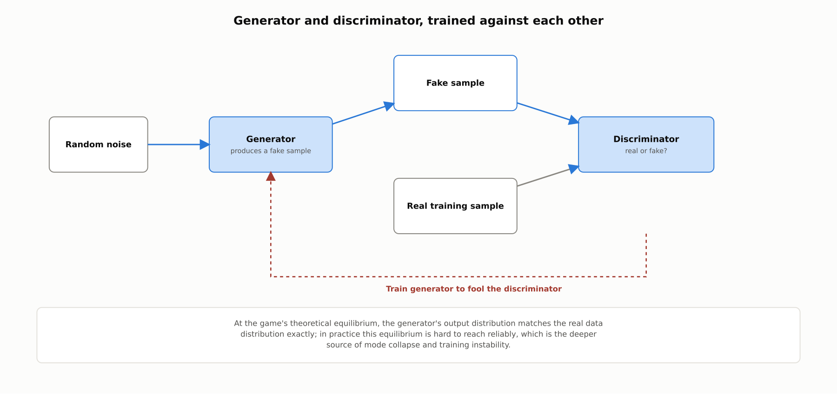
DEEP-DIVE
A GAN trains a generator and discriminator against each other
Goodfellow et al., 2014: at the theoretical equilibrium the generator matches the real distribution exactly; in practice this is hard to reach reliably.

Slide 8
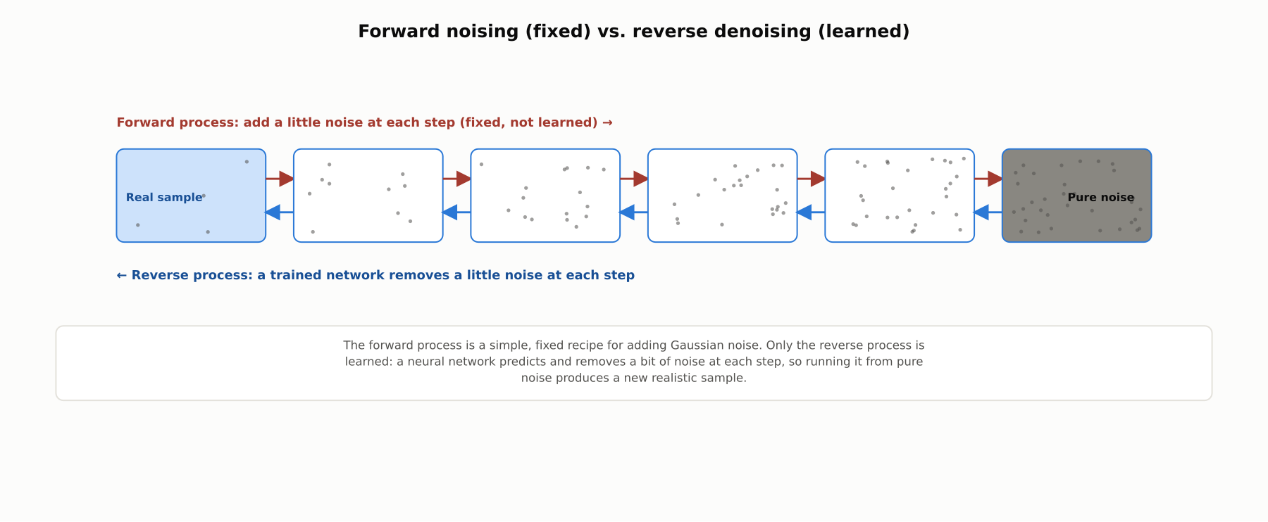
DEEP-DIVE
Diffusion models learn to reverse a gradual, fixed noising process
Ho, Jain, and Abbeel, 2020 (DDPM): a neural network predicts and removes a bit of noise at each step, so running it from pure noise produces a new realistic sample.

Slide 9
DEEP-DIVE
Latent diffusion and distillation: pushing on the trilemma directly
Latent Diffusion Models (Rombach et al., 2022, behind Stable Diffusion) run diffusion inside a VAE-compressed latent space, not raw pixels
This combines a VAE's compression with a diffusion model's denoising for practical high-resolution generation
Consistency Models (Song et al., 2023) train a model to map noise to a clean sample in a handful of steps, or one
This trades a small amount of quality for a large reduction in sampling cost, narrowing diffusion's speed disadvantage

Slide 10
COMPARISON & RELATED CONCEPTS
Four families, one shared density lens
Aspect | Autoregressive LLM | VAE | GAN | Diffusion model
Density type | Explicit, exact/tractable | Explicit, approximate (ELBO) | Implicit (none computed) | Explicit, approximate (variational bound)
Core mechanism | Predict next token from all previous | Encode to latent distribution, decode | Generator vs. discriminator game | Learn to reverse gradual noising
Sampling speed | Slow for long outputs | Fast: one pass | Fast: one pass | Slow by default; faster distilled
Dominant use today | Text generation | Structured latent spaces | Narrower niches | Image, video, audio
All four families can be read through the explicit/implicit density lens from 4.1; each trades away a different side of the generative learning trilemma.

Slide 11
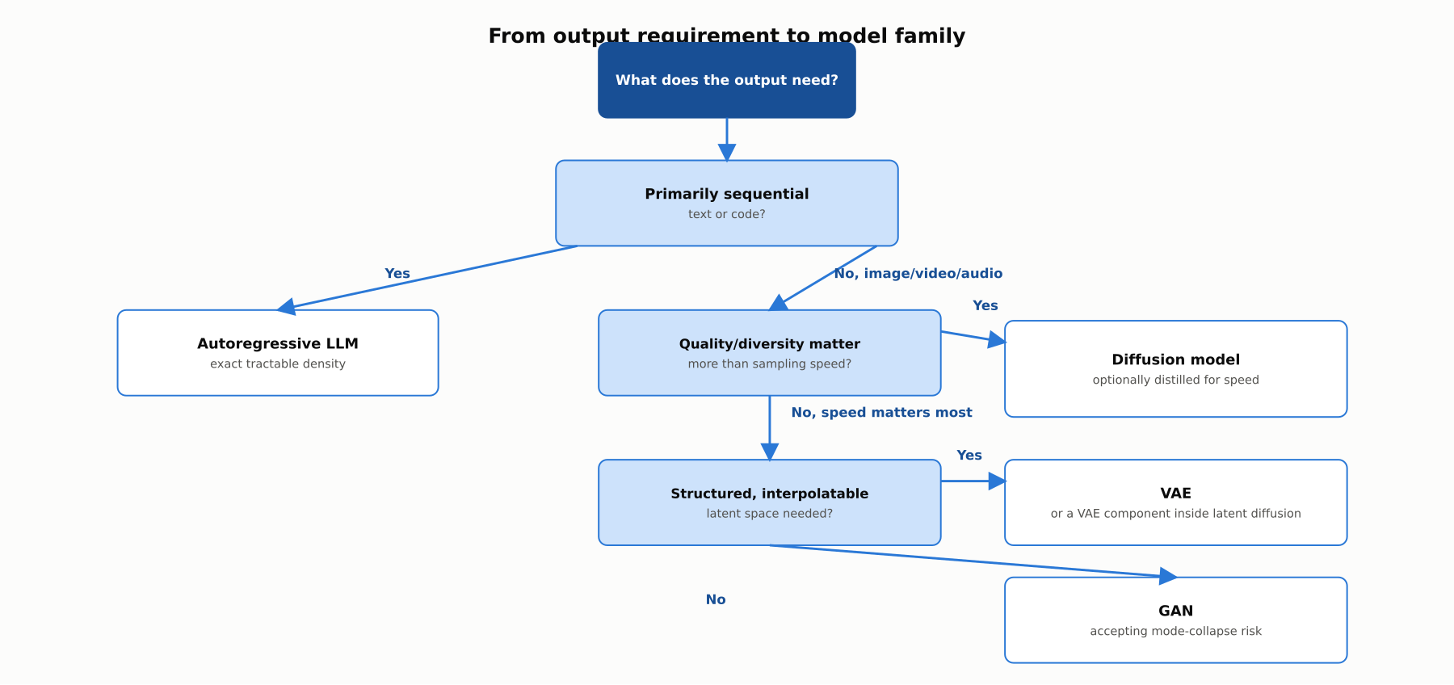
REFERENCE ARCHITECTURE
Choosing a generative model family for a task
Modality, then the quality-versus-speed trade-off, then whether a structured latent space matters, determine which family fits.

Slide 12
INDUSTRY USE CASES
Finance
FINANCIAL SERVICES
Choosing a VAE for anomaly-detection latent spaces in transaction monitoring
Auditing diffusion-generated synthetic market data for realistic tail events
Problem: A fraud-detection team wants a latent space where distance between transactions is meaningful, to flag transactions far from any learned cluster.
Problem: A risk-modeling team uses a diffusion model for synthetic market scenarios, valuing its higher diversity over a GAN's.
Solution: Use a VAE specifically for its structured, smooth latent space, rather than a GAN or diffusion model.
Solution: Specifically validate that synthetic scenarios include realistic tail events, not just realistic typical-day data.
Watch for: Building an anomaly-distance metric on a GAN's latent space, which has no such structure guarantee, can produce distance scores that do not correspond to how anomalous a transaction really is.
Watch for: A diffusion model tuned mainly for typical-data realism can still underweight rare tail scenarios, giving stress tests false confidence if tail coverage is not separately checked.

Slide 13
INDUSTRY USE CASES
Healthcare & Telecom
HEALTHCARE + TELECOM
(Healthcare) Choosing diffusion models for synthetic medical imaging, not GANs, when diversity matters most
(Telecom) Auditing diffusion-generated synthetic network traffic for rare surge coverage
Problem: A team generating synthetic medical images for training-data augmentation needs broad coverage of rare pathology presentations.
Problem: A network-testing team generates synthetic traffic with a diffusion model, valuing its diversity advantage for rare surge patterns.
Solution: Prefer a diffusion model given its typically stronger diversity coverage, validated against actual rare-presentation coverage.
Solution: Specifically validate rare-surge coverage, not just aggregate similarity to typical traffic, before load-testing.
Watch for: Choosing a GAN without accounting for mode collapse can leave a training pipeline blind to exactly the rare pathology presentations that matter most.
Watch for: A diffusion model realistic in aggregate can still underweight rare surges if not specifically validated, leaving load tests blind to the conditions that most threaten network stability.

Slide 14
CHECK YOUR UNDERSTANDING
Discuss before moving on
1. Why are VAEs "explicit-density, but only approximately," unlike autoregressive LLMs?
2. What is the core mechanical difference between how a GAN and a diffusion model each learn to generate?
3. Why do latent diffusion models combine a VAE with a diffusion process rather than running diffusion on raw pixels?
4. What do techniques like consistency models trade away to address diffusion's slow sampling?

Slide 15
CHAPTER 4.2 · PHASE 4
Key Takeaways
Autoregressive, VAE, GAN, and diffusion models are four distinct mechanisms for reaching a sampleable distribution
Each trades away a different corner of the generative learning trilemma
Diffusion models dominate image/video/audio generation as of 2026, aided by latent diffusion and distillation
Matching a family to a task means matching its density type and its specific trade-off to what the task actually needs
Next: 4.3 How LLMs Generate Text: Decoding Strategies

