Slide 1
CHAPTER 4.3 · PHASE 4
How LLMs Generate Text: Decoding Strategies
The algorithm that turns a model's per-token probabilities into an actual sequence, and why maximizing likelihood is not always the right goal.
Generative AI Foundations

Slide 2
AGENDA
What this chapter covers
Greedy decoding and beam search: maximizing sequence likelihood
Why maximizing likelihood produces repetitive, degenerate text
Temperature: reshaping the distribution's sharpness
Top-k sampling vs. nucleus (top-p) sampling
Speculative decoding: the same output, produced faster
Industry use cases across Finance, Healthcare, and Telecom

Slide 3
TL;DR
The short version
A decoding strategy turns an LLM's per-token probabilities into an actual chosen sequence
Greedy decoding and beam search maximize likelihood, but tend toward repetitive, generic text
Temperature, top-k, and nucleus (top-p) sampling introduce controlled randomness instead
Nucleus sampling adapts its candidate pool to the distribution's actual shape; top-k does not
Speculative decoding is a separate axis: same output, produced faster with a small draft model

Slide 4
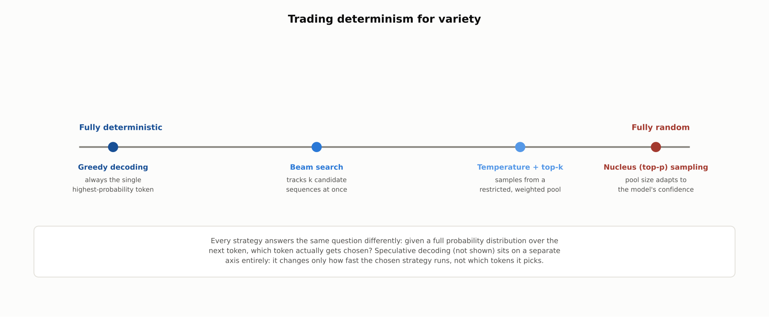
HIGH-LEVEL
Trading determinism for variety
Every strategy answers the same question differently: given a full probability distribution over the next token, which token actually gets chosen?

Slide 5
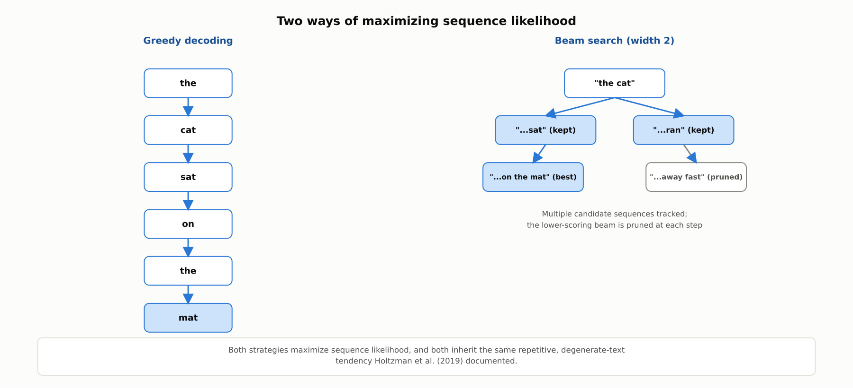
DEEP-DIVE
Two ways of maximizing sequence likelihood
Greedy decoding follows one path; beam search tracks several candidate sequences at once, pruning back to the top k at every step.

Slide 6
DEEP-DIVE
Why maximizing likelihood backfires
Holtzman et al. (2019): real human text is not the maximum-probability continuation at each point
Human writing carries substantial local unpredictability that likelihood-maximizing search strips out
Both greedy decoding and beam search keep finding that repeating themselves is the locally "safest" choice
Result: noticeably repetitive, generic text, often looping on the same phrase

Slide 7
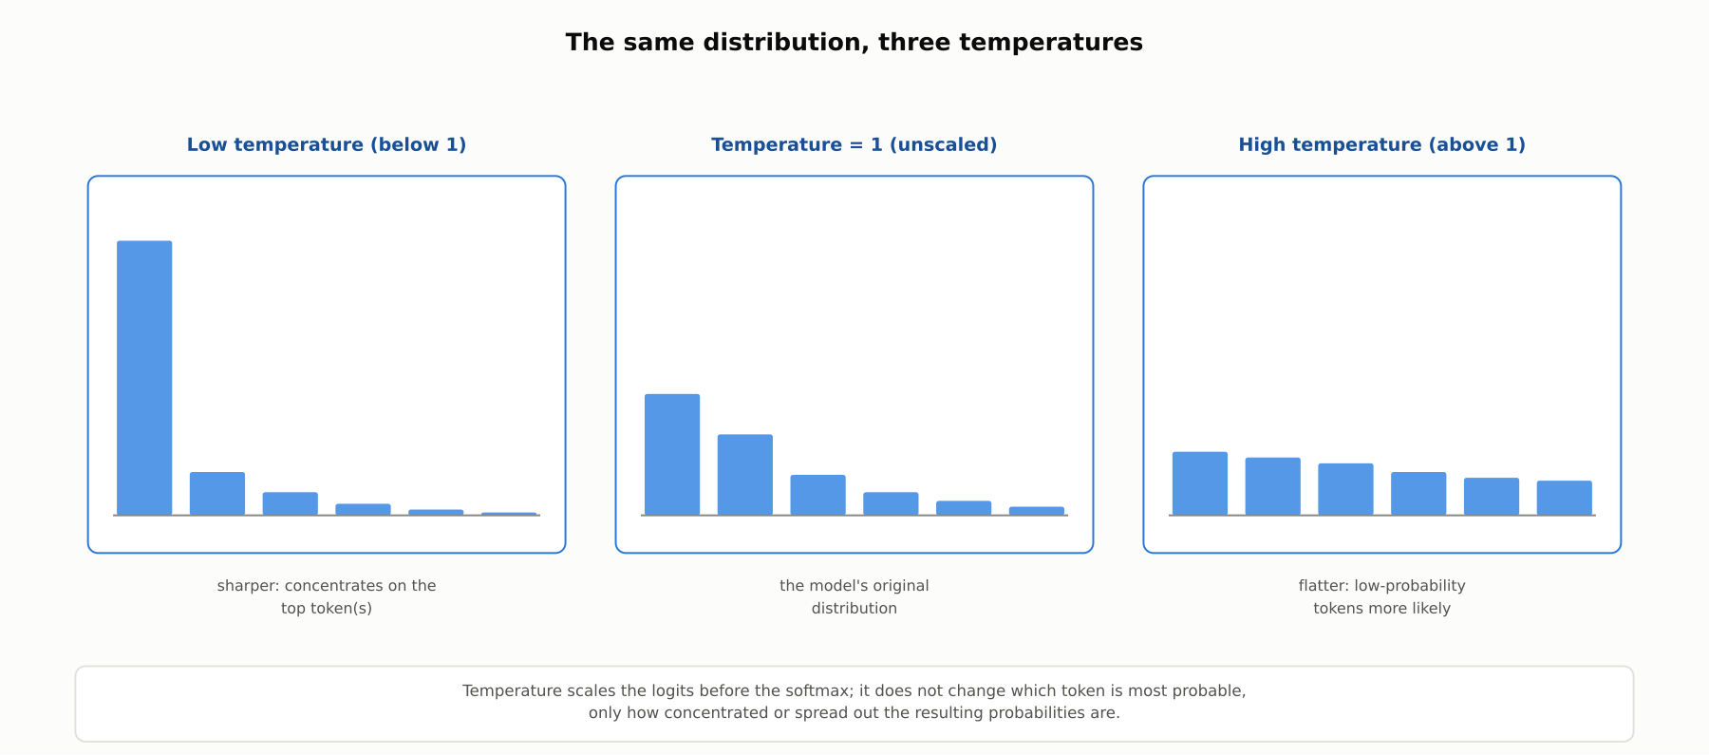
DEEP-DIVE
The same distribution, three temperatures
Temperature scales the logits before the softmax; it does not change which token is most probable, only how concentrated or spread out the probabilities are.

Slide 8
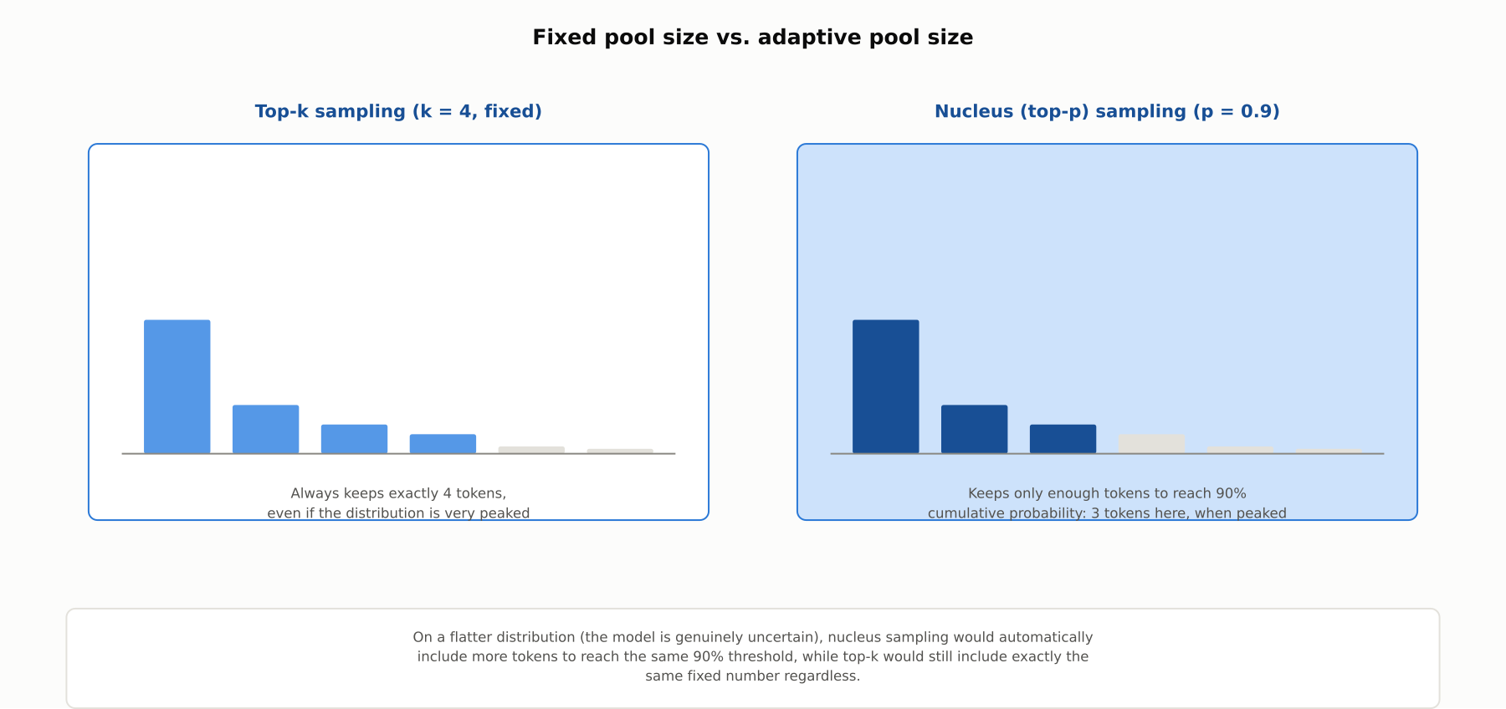
DEEP-DIVE
Fixed pool size vs. adaptive pool size
Top-k (Fan et al., 2018) always keeps a fixed number of tokens. Nucleus sampling (Holtzman et al., 2019) adapts the pool to the distribution's actual shape.

Slide 9
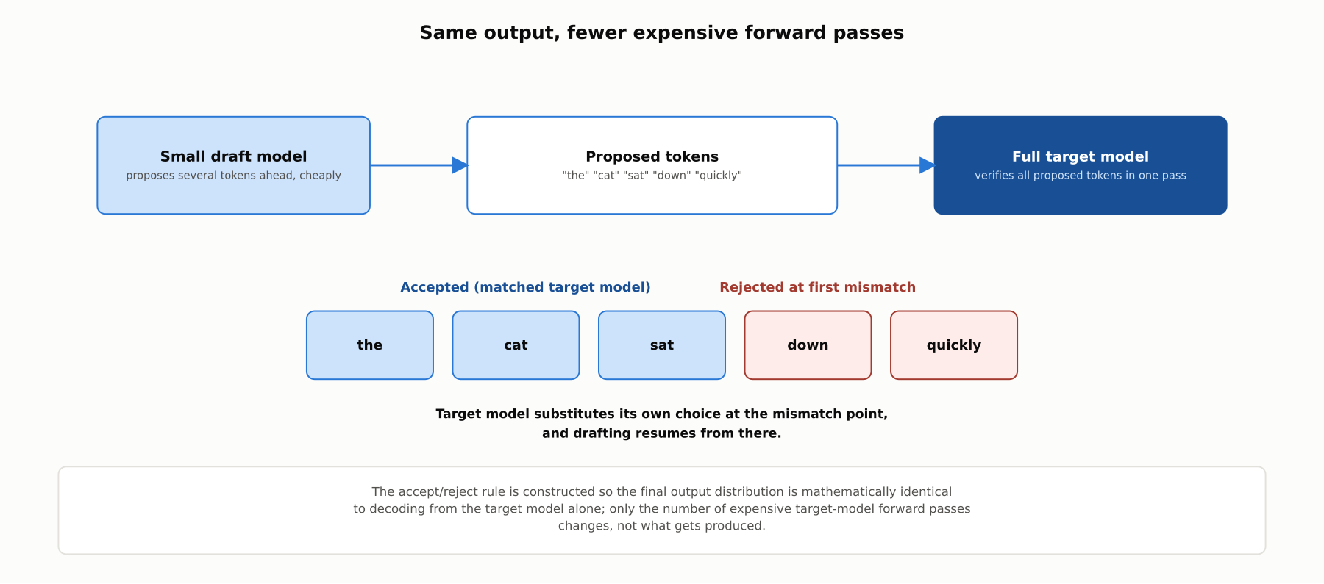
DEEP-DIVE
Speculative decoding: same output, fewer expensive forward passes
Leviathan et al., 2023: a small draft model proposes tokens; the full target model verifies them in one pass, provably preserving the exact same output distribution.

Slide 10
COMPARISON & RELATED CONCEPTS
Four ways to decode, one orthogonal speed layer
Aspect | Greedy decoding | Beam search | Temperature / top-k / nucleus | Speculative decoding
What it controls | Which single token: always highest-probability | Which full sequence, tracking k candidates | How much randomness is introduced | How fast tokens are produced, not which ones
Deterministic? | Yes, always | Yes, always | No, by design | Yes, matches target model exactly
Typical use case | Structured extraction, code | Translation, one clear best sequence | Creative writing, chat | Any strategy, purely to cut latency/cost
Main risk | Repetitive, degenerate text | Expensive; same bland tendency | Too high a temperature risks incoherence | Needs a well-matched draft model
Greedy decoding and beam search both maximize likelihood and share its degeneration risk; sampling trades determinism for variety; speculative decoding is orthogonal to all three.

Slide 11
REFERENCE ARCHITECTURE
Choosing a decoding strategy for a task
Reproducibility need, then variety need, then a separate latency check, determine both the decoding strategy and whether to layer speculative decoding on top.

Slide 12
INDUSTRY USE CASES
Finance
FINANCIAL SERVICES
Using greedy decoding for structured financial-figure extraction
Verifying speculative decoding does not require re-validating a model's output distribution
Problem: A pipeline extracting numeric fields from filings needs the exact same input to produce the exact same extracted values every time.
Problem: An engineering team wants speculative decoding to cut latency in a trading-support assistant, but compliance is unsure if prior validation still applies.
Solution: Use greedy decoding (or temperature near zero) for this extraction task specifically.
Solution: Confirm mathematically that speculative decoding preserves the target model's exact output distribution, so only the draft model's latency benefit needs checking.
Watch for: A pipeline run with nonzero-temperature sampling can extract a different value from the identical document on a re-run, an inconsistency an auditor reconciling two runs would have no reason to expect from what looks like deterministic processing.
Watch for: A compliance team that treats speculative decoding as an output change can waste effort re-validating outputs that provably did not change, or miss it if an implementation actually deviated from the equivalence guarantee.

Slide 13
INDUSTRY USE CASES
Healthcare & Telecom
HEALTHCARE + TELECOM
(Healthcare) Recognizing higher sampling temperature can raise hallucination risk in clinical documentation
(Telecom) Using greedy decoding for structured alarm-to-ticket field generation
Problem: A clinical documentation assistant tuned toward higher temperature for natural phrasing occasionally introduces a plausible but incorrect clinical term.
Problem: An automated pipeline turning network alarms into ticket fields needs the same alarm data to reliably produce the same fields for downstream routing.
Solution: Keep temperature low for clinical-content-bearing generation, reserving higher temperature only for non-clinical stylistic choices.
Solution: Use greedy decoding for this field-generation step, reserving sampling for natural-language ticket narratives elsewhere.
Watch for: A wider pool of plausible-but-lower-probability tokens at higher temperature meaningfully raises the chance an incorrect medical term enters a patient record where it could be mistaken for a verified finding.
Watch for: A field-generation step run with sampling-based decoding could route the identical alarm to a different team on different runs, undermining the deterministic routing logic the rest of the pipeline depends on.

Slide 14
CHECK YOUR UNDERSTANDING
Discuss before moving on
1. Why does maximizing sequence likelihood tend to produce repetitive, degenerate text?
2. What does temperature control, and what happens as it approaches 0 versus grows large?
3. What is the key structural difference between top-k and nucleus (top-p) sampling?
4. What does speculative decoding change about a model's output, and what does it not change?

Slide 15
CHAPTER 4.3 · PHASE 4
Key Takeaways
Decoding strategy is a separate choice from the model itself: how probabilities become a sequence
Maximizing likelihood (greedy, beam search) is not the same as matching real human text statistics
Nucleus sampling adapts its candidate pool to the distribution's shape; top-k does not
Speculative decoding changes speed only, provably preserving the target model's output distribution
Next: 4.4 Multimodal Generative AI: Text-to-Image, Text-to-Video, Speech

