Slide 1
CHAPTER 4.4 · PHASE 4
Multimodal Generative AI: Text-to-Image, Text-to-Video, Speech
Following the model families and decoding mechanisms from 4.2 and 4.3 into images, video, and speech.
Generative AI Foundations

Slide 2
AGENDA
What this chapter covers
Conditioning diffusion on text via cross-attention and a text encoder
Classifier-free guidance: sharpening prompt adherence without a classifier
Extending diffusion to video: the added complication of time
Text-to-speech: borrowing the autoregressive mechanism instead of diffusion
Why mechanism choice follows the trilemma, not the modality
Industry use cases across Finance, Healthcare, and Telecom

Slide 3
TL;DR
The short version
Text-to-image: diffusion (4.2) conditioned on text via cross-attention to a text encoder embedding
Classifier-free guidance sharpens prompt adherence without a separate classifier
Text-to-video: the same diffusion mechanism extended across a temporal dimension
Text-to-speech: often autoregressive audio-token generation instead of diffusion (3.3, 4.1)
Mechanism choice per modality still follows the generative learning trilemma (4.1)

Slide 4
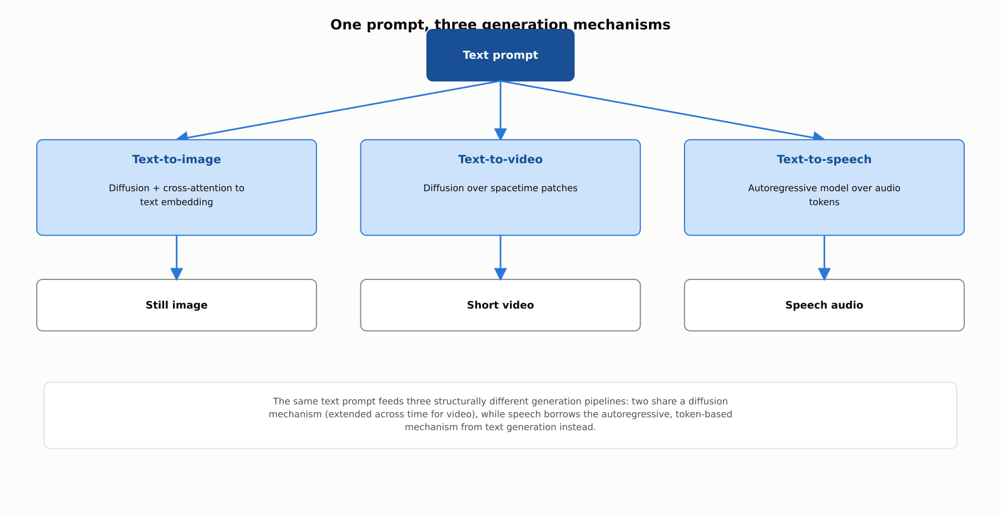
HIGH-LEVEL
One prompt, three generation mechanisms
The same text prompt feeds three structurally different pipelines: two share a diffusion mechanism, while speech borrows the autoregressive mechanism from text generation.

Slide 5
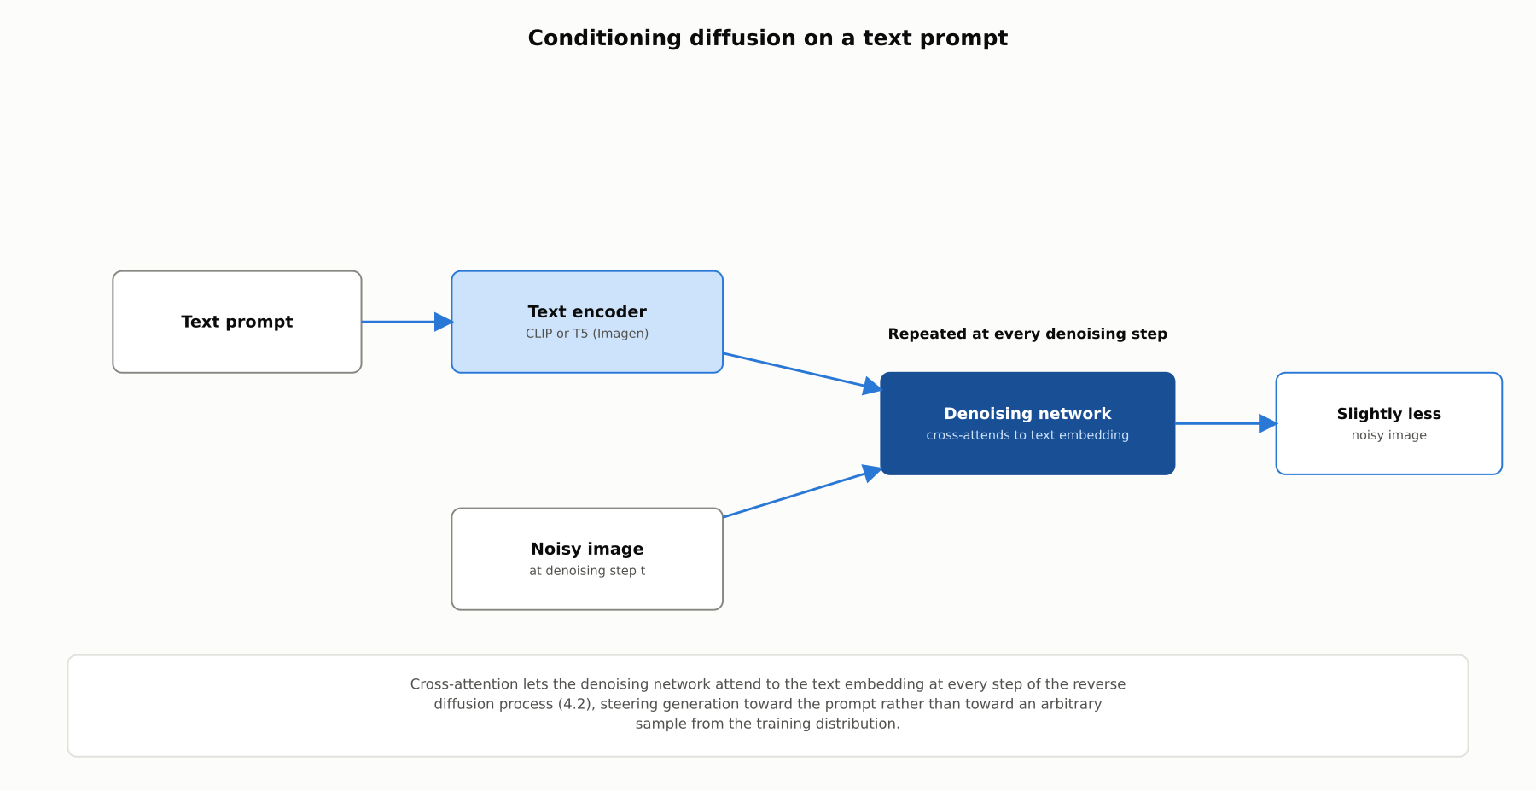
DEEP-DIVE
Conditioning diffusion on a text prompt
Cross-attention lets the denoising network attend to a text encoder embedding (CLIP or T5) at every step of the reverse diffusion process.

Slide 6
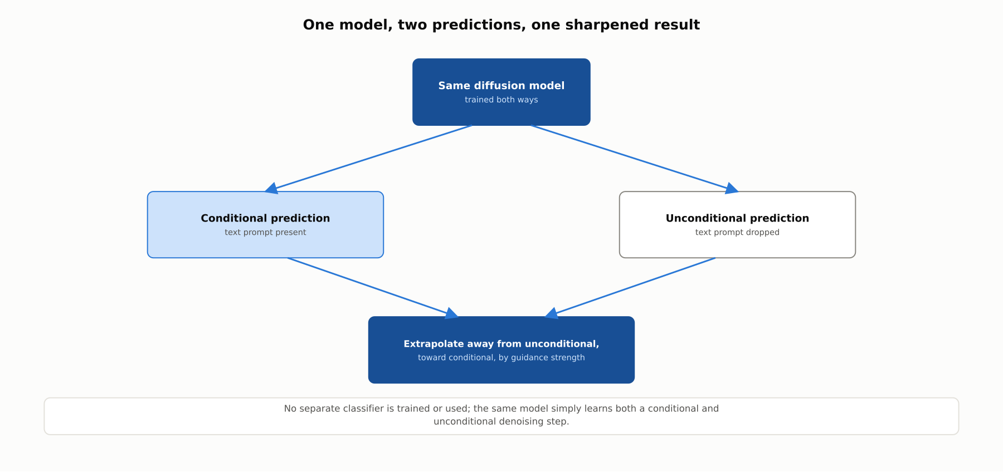
DEEP-DIVE
One model, two predictions, one sharpened result
Ho and Salimans, 2022: extrapolating away from an unconditional prediction and toward a conditional one sharpens prompt adherence without a separate classifier.

Slide 7
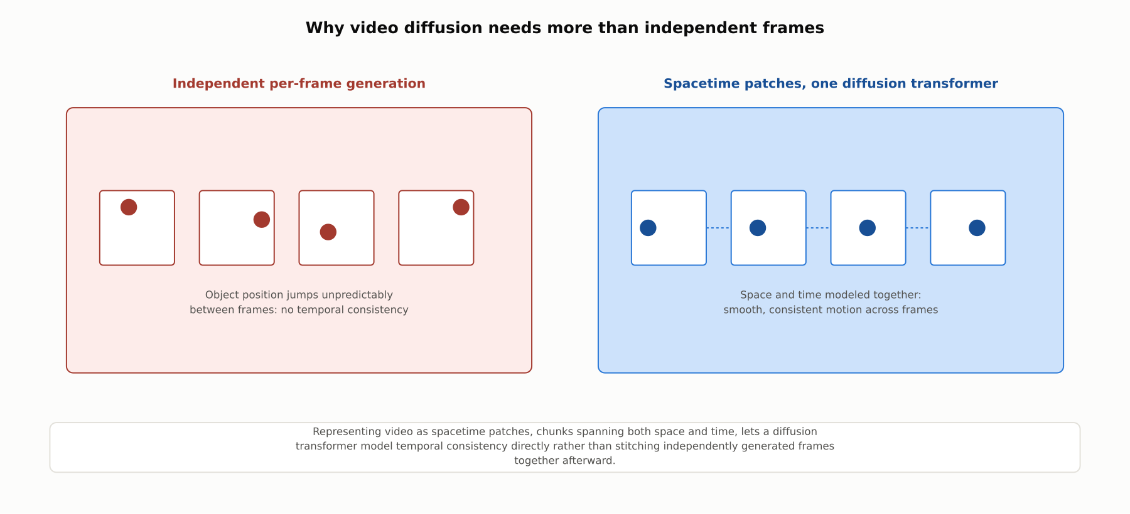
DEEP-DIVE
Why video diffusion needs more than independent frames
Representing video as spacetime patches lets a diffusion transformer model temporal consistency directly, rather than stitching independent frames together afterward.

Slide 8
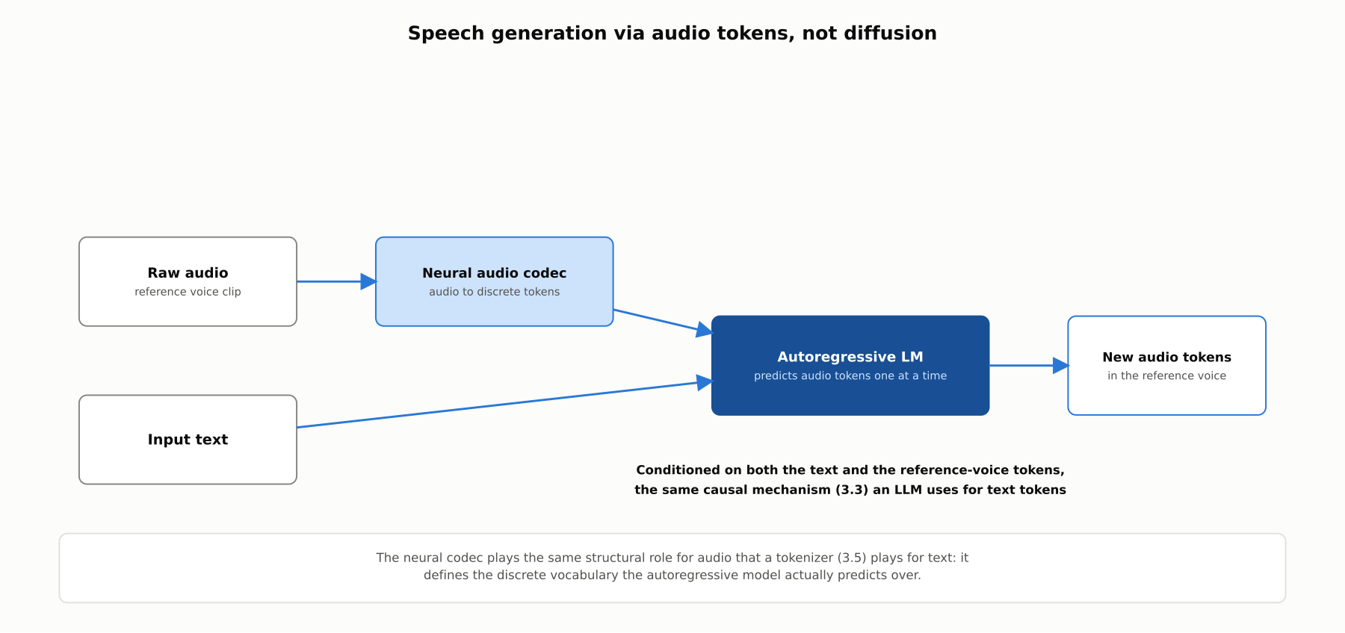
DEEP-DIVE
Speech generation via audio tokens, not diffusion
A neural audio codec compresses audio into discrete tokens; an autoregressive language model predicts new tokens one at a time, the same mechanism used for text (VALL-E, 2023).

Slide 9
DEEP-DIVE
Mechanism choice follows the trilemma, not the modality
Image and video generation lean toward diffusion: quality and diversity outweigh sampling-speed cost
Speech generation often leans toward autoregression: it is inherently sequential, like text
A well-trained audio-token LM captures prosody and voice identity without diffusion's speed cost
The lesson: the trade-offs from 4.1 and 4.2 determine the right mechanism, not the modality itself

Slide 10
COMPARISON & RELATED CONCEPTS
Text-to-image, text-to-video, text-to-speech, compared
Aspect | Text-to-image | Text-to-video | Text-to-speech
Typical dominant mechanism | Diffusion, text-conditioned via cross-attention | Diffusion, extended across a temporal dimension | Autoregressive audio-token language model
How text conditioning enters | Cross-attention to a text encoder embedding | Same cross-attention, per spacetime patch | Text tokens plus a reference-voice clip
Key added complexity | Baseline case | Frame-to-frame temporal consistency | Prosody, pronunciation, voice-identity consistency
Representative system | Imagen (2022) | Sora (OpenAI technical report, 2024) | VALL-E (2023)
Classifier-free guidance applies across the diffusion-based columns; the autoregressive speech pipeline conditions directly through input tokens instead.

Slide 11
REFERENCE ARCHITECTURE
From a text prompt to image, video, or speech
The modality determines which mechanism and conditioning path is used, but the underlying trade-offs are the same ones established in 4.1 and 4.2.

Slide 12
INDUSTRY USE CASES
Finance
FINANCIAL SERVICES
Governing voice-cloning-capable text-to-speech before deploying it in call-center voice bots
Updating voice-based authentication controls in light of realistic voice-cloning TTS
Problem: A team wants a natural-sounding voice bot and is evaluating a VALL-E-style system capable of cloning a voice from a short reference clip.
Problem: A bank's voice-based phone authentication was validated before few-shot voice-cloning TTS became broadly available.
Solution: Restrict which reference voices the system may clone to a consented, licensed set.
Solution: Re-assess voice authentication's spoofing resistance specifically against realistic few-shot voice cloning.
Watch for: A voice-cloning-capable TTS system deployed without consent controls could reproduce a real customer's or employee's voice, undermining voice-based authentication used elsewhere in the institution.
Watch for: A system validated only against older recorded-playback attacks can remain vulnerable to a short reference clip cloning a customer's voice well enough to defeat authentication.

Slide 13
INDUSTRY USE CASES
Healthcare & Telecom
HEALTHCARE + TELECOM
(Healthcare) Checking text-to-speech pronunciation accuracy for medication names
(Telecom) Detecting AI-generated voice traffic used in vishing scams
Problem: A TTS accessibility tool reading medical instructions aloud can mispronounce a drug name in a way that sounds like a different medication.
Problem: Realistic voice-cloning TTS increasingly powers voice-phishing scam calls carried over an operator's own voice network.
Solution: Specifically validate TTS pronunciation of medication names against a clinical pronunciation reference.
Solution: Invest in AI-generated-voice detection specifically for the fraud and abuse pipeline.
Watch for: A mispronounced medication name could lead a patient to believe they were prescribed a different drug, a distinct patient-safety risk general audio-quality testing would not catch.
Watch for: A vishing scam using cloned-voice audio can defeat detection built only for traditional recorded-robocall patterns, since a cloned voice can be generated dynamically per call.

Slide 14
CHECK YOUR UNDERSTANDING
Discuss before moving on
1. What role do cross-attention and a text encoder play in conditioning diffusion on a text prompt?
2. What problem does classifier-free guidance solve, and how does it work without a separate classifier?
3. What is the key added complexity in extending diffusion from images to video?
4. Why does text-to-speech generation often use autoregression instead of diffusion?

Slide 15
CHAPTER 4.4 · PHASE 4
Key Takeaways
Text-to-image and text-to-video both extend diffusion (4.2), conditioned via cross-attention
Classifier-free guidance is now standard for sharpening prompt adherence
Video diffusion must model time directly, e.g. via spacetime patches, not stitch frames after the fact
Text-to-speech often reuses the autoregressive mechanism (3.3, 4.1) applied to audio tokens instead
Next: 4.5 Context Windows, Memory Limits & Cost/Latency Trade-offs

