Slide 1
CHAPTER 4.5 · PHASE 4
Context Windows, Memory Limits & Cost/Latency Trade-offs
Why prefill and decode have different bottlenecks, and the four techniques used to manage long-context cost and latency.
Generative AI Foundations

Slide 2
AGENDA
What this chapter covers
Why prefill is compute-bound and decode is memory-bandwidth-bound
FlashAttention: an exact optimization, not an approximation (parallel to 4.3's speculative decoding)
The KV cache and why decode cost grows linearly with context length
RoPE and ALiBi for extrapolating beyond trained sequence length
"Lost in the middle": a distinct recall problem, independent of total length
Grouped-query attention and retrieval as complementary cost-reduction levers

Slide 3
TL;DR
The short version
Prefill processes the whole prompt at once: cost grows with the square of prompt length
Decode generates one token at a time: cost is dominated by re-reading the growing KV cache
FlashAttention reduces prefill's memory traffic without changing the output at all
RoPE and ALiBi extend how far position information generalizes beyond training length
"Lost in the middle" is about where in the context recall fails, not how long the context is
Grouped-query attention shrinks the KV cache directly; retrieval avoids needing the full context at all

Slide 4
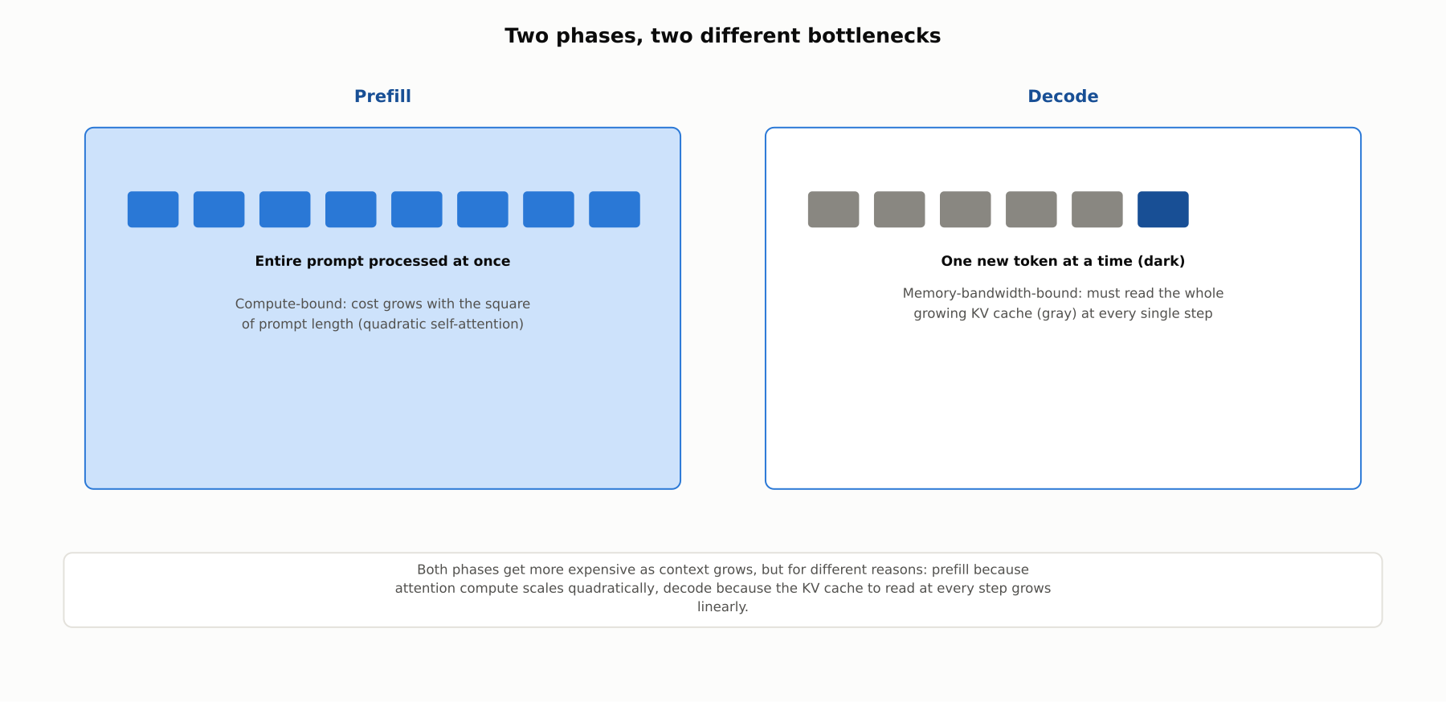
HIGH-LEVEL
Two phases, two different bottlenecks
Prefill processes every prompt token at once and is compute-bound; decode generates one token at a time and is bound by how fast the growing KV cache can be read.

Slide 5
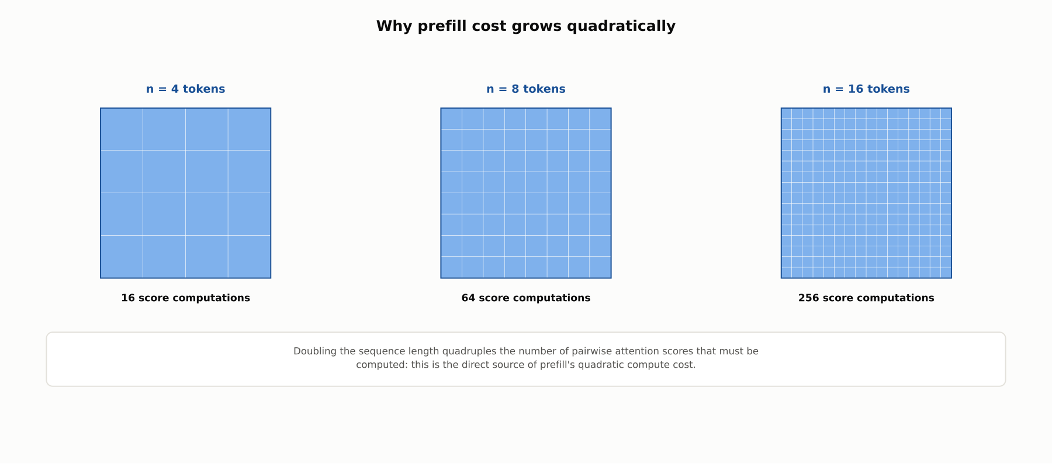
DEEP-DIVE
Why prefill cost grows quadratically
Every token must compute an attention score against every other token, so doubling the sequence length quadruples the pairwise attention computations.

Slide 6
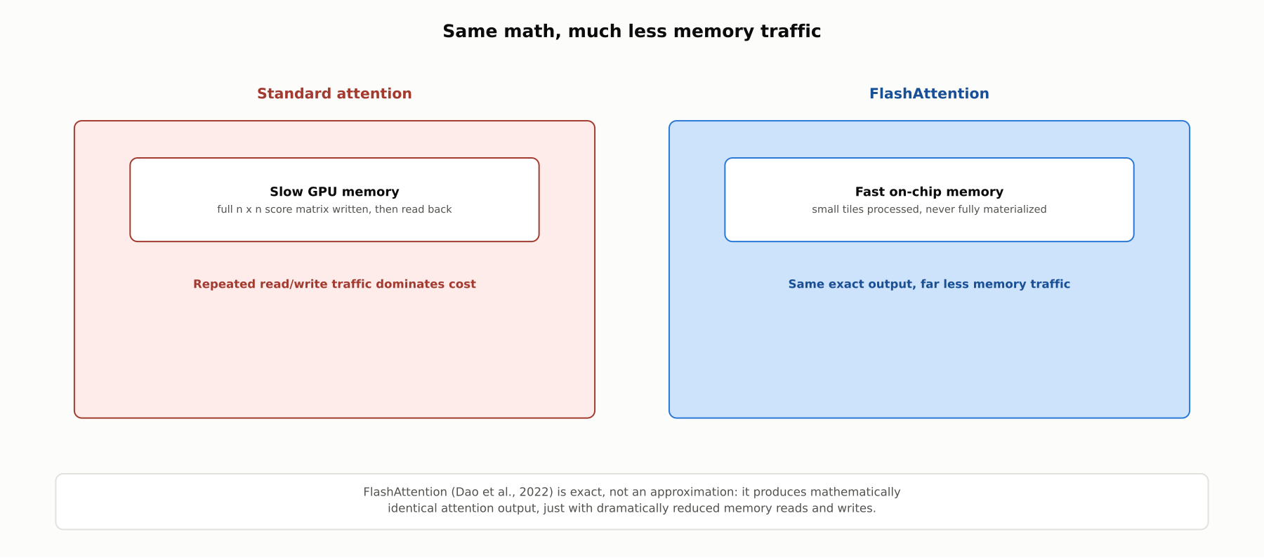
DEEP-DIVE
FlashAttention: same math, much less memory traffic
Dao et al., 2022: tiling attention computation to stay in fast on-chip memory produces mathematically identical output, echoing the "same output, faster" idea behind speculative decoding from 4.3.

Slide 7
DEEP-DIVE
The KV cache: why decode is memory-bandwidth-bound
Each generated token's keys and values are cached, avoiding recomputation of the entire prefix
But every new token still requires reading the entire cached history to attend over it
That cache grows by one entry per generated token: read volume grows linearly with output length
Decode throughput is limited by memory bandwidth, not by raw compute, unlike prefill

Slide 8
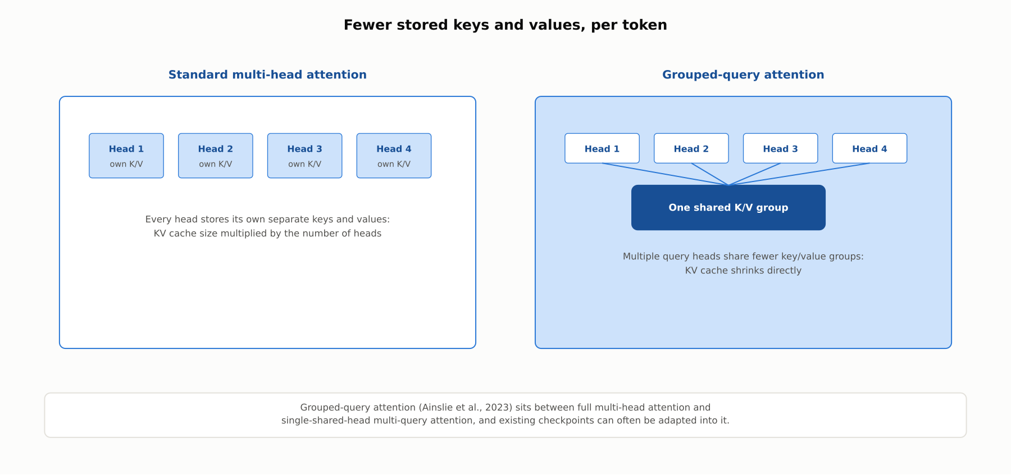
DEEP-DIVE
Grouped-query attention: fewer stored keys and values
Ainslie et al., 2023: multiple query heads share a smaller number of key/value groups, shrinking the KV cache directly rather than compensating for its growth after the fact.

Slide 9
DEEP-DIVE
Extrapolating position, and a distinct recall problem
RoPE (Su et al., 2021) encodes position as a rotation, generalizing better beyond trained lengths than learned position embeddings
ALiBi (Press et al., 2021) instead biases attention scores directly by distance, extrapolating further with no positional embedding at all
"Lost in the middle" (Liu et al., 2023) is a separate finding: recall accuracy varies by position within the context, dipping in the middle even when the model's length limit is not exceeded
The distinction matters: RoPE/ALiBi address how far a model can process; "lost in the middle" is about where within that range recall is reliable

Slide 10
COMPARISON & RELATED CONCEPTS
Four techniques, four different targets
Aspect | FlashAttention | RoPE / ALiBi | Grouped-query attention | Retrieval
What it targets | Memory traffic during attention computation | Position generalization beyond trained length | KV cache size | The need to process the full context at all
Changes model output? | No, exact | Yes, changes position behavior | Yes, approximates full multi-head attention | Yes, changes what content the model sees
Cost reduced | Memory reads/writes | None directly; enables longer context | KV cache memory and decode bandwidth | Prefill and decode, by shrinking context
Main limitation | Does not reduce compute, only memory traffic | Does not fix mid-context recall | Some quality trade-off vs. full multi-head attention | Retrieval quality becomes the new bottleneck
These four techniques are complementary, not competing: a production system often combines several of them at once.

Slide 11
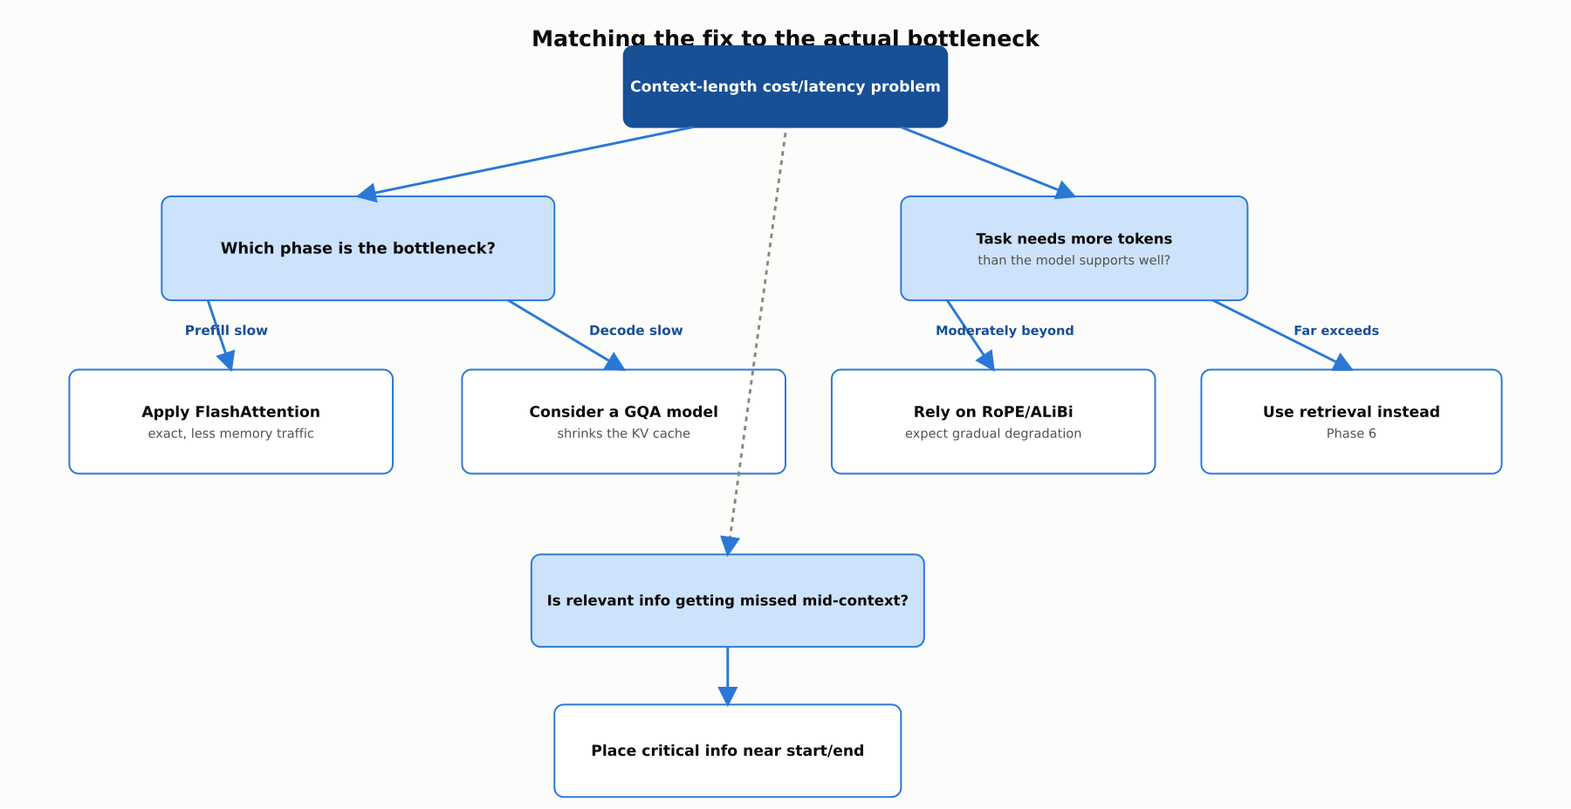
REFERENCE ARCHITECTURE
Matching the fix to the actual bottleneck
Diagnosing whether the bottleneck is prefill, decode, context length, or mid-context recall determines which technique actually helps.

Slide 12
INDUSTRY USE CASES
Finance
FINANCIAL SERVICES
Choosing retrieval vs. full-context for contract analysis cost control
Evaluating a GQA-based model for trading-support chat latency
Problem: A contract-analysis tool feeds entire lengthy agreements into an LLM for every query, even when only a few clauses are relevant.
Problem: A trading-desk support chatbot needs low per-token decode latency during active market hours.
Solution: Benchmark retrieval-augmented clause lookup against full-context processing on cost and recall.
Solution: Benchmark grouped-query-attention model variants against full multi-head attention for decode latency under load.
Watch for: Feeding full multi-hundred-page agreements into every query multiplies compute-bound prefill cost across a high-volume contract pipeline, inflating spend without improving answer quality on narrowly scoped questions.
Watch for: A model with an oversized KV cache from full multi-head attention can slow decode throughput exactly when trading-desk staff need sub-second responses during volatile market conditions.

Slide 13
INDUSTRY USE CASES
Healthcare & Telecom
HEALTHCARE + TELECOM
(Healthcare) Checking for "lost in the middle" risk in long clinical notes
(Telecom) Checking "lost in the middle" risk for early root-cause alarms in incident timelines
Problem: A clinical documentation assistant summarizes lengthy encounter notes where an allergy or contraindication notice appears mid-document.
Problem: A network-operations assistant summarizing a long incident timeline may fail to surface an early root-cause alarm buried in the middle of the log.
Solution: Specifically test recall of mid-document safety-critical notices, not just beginning- and end-of-document content.
Solution: Specifically test recall of early-timeline alarms against end-of-timeline status updates, not overall summary quality.
Watch for: A allergy notice buried mid-note that the model fails to surface in a summary could lead a clinician to prescribe a contraindicated medication, a distinct risk from the note simply being too long to process.
Watch for: An early root-cause alarm lost in the middle of a long incident timeline can lead an on-call engineer toward a later symptom instead of the actual cause, extending outage duration during a live incident.

Slide 14
CHECK YOUR UNDERSTANDING
Discuss before moving on
1. Why is prefill compute-bound while decode is memory-bandwidth-bound?
2. In what sense is FlashAttention "exact," and how does that parallel speculative decoding from 4.3?
3. How do RoPE and ALiBi differ from the "lost in the middle" problem, even though both concern context length?
4. How does grouped-query attention reduce cost, mechanically?
5. Why does retrieval address the context-length problem differently than the other three techniques?

Slide 15
CHAPTER 4.5 · PHASE 4
Key Takeaways
Prefill (compute-bound, quadratic) and decode (memory-bandwidth-bound, linear) have different bottlenecks
FlashAttention is an exact memory-traffic optimization; RoPE/ALiBi and GQA change model behavior or output
"Lost in the middle" is a distinct recall problem, independent of whether the length limit itself is exceeded
Retrieval sidesteps the trade-off entirely by reducing how much context is needed in the first place
Next: 4.6 Hallucination: Causes, Types, and Mitigation Strategies (Primer)

