Slide 1
CHAPTER 4.6 · PHASE 4
Hallucination: Causes, Types, and Mitigation Strategies (Primer)
Why LLMs state false content with the same confidence as true content, and what detection and mitigation can and cannot fix.
Generative AI Foundations

Slide 2
AGENDA
What this chapter covers
Defining hallucination and its intrinsic/extrinsic split
Why hallucination has a statistical floor, not just a training-quality problem
Why hallucination persists: an evaluation-incentive problem, not only a training one
Compounding factors: exposure bias, sampling randomness, and the long tail
Detecting likely hallucination: SelfCheckGPT and semantic entropy
Mitigating hallucination: Chain-of-Verification and retrieval, previewed for Phase 6

Slide 3
TL;DR
The short version
Hallucination: false or unsupported output, stated as confidently as accurate output
Intrinsic hallucination contradicts a given source; extrinsic hallucination is unverifiable from it
Kalai and Vempala: even a well-calibrated model must hallucinate on rare, singleton facts
A 2025 paper: standard scoring rewards confident guessing over honest "I don't know"
SelfCheckGPT and semantic entropy detect likely hallucination by sampling multiple outputs
Chain-of-Verification and retrieval (Phase 6) intervene earlier, but neither eliminates it outright

Slide 4
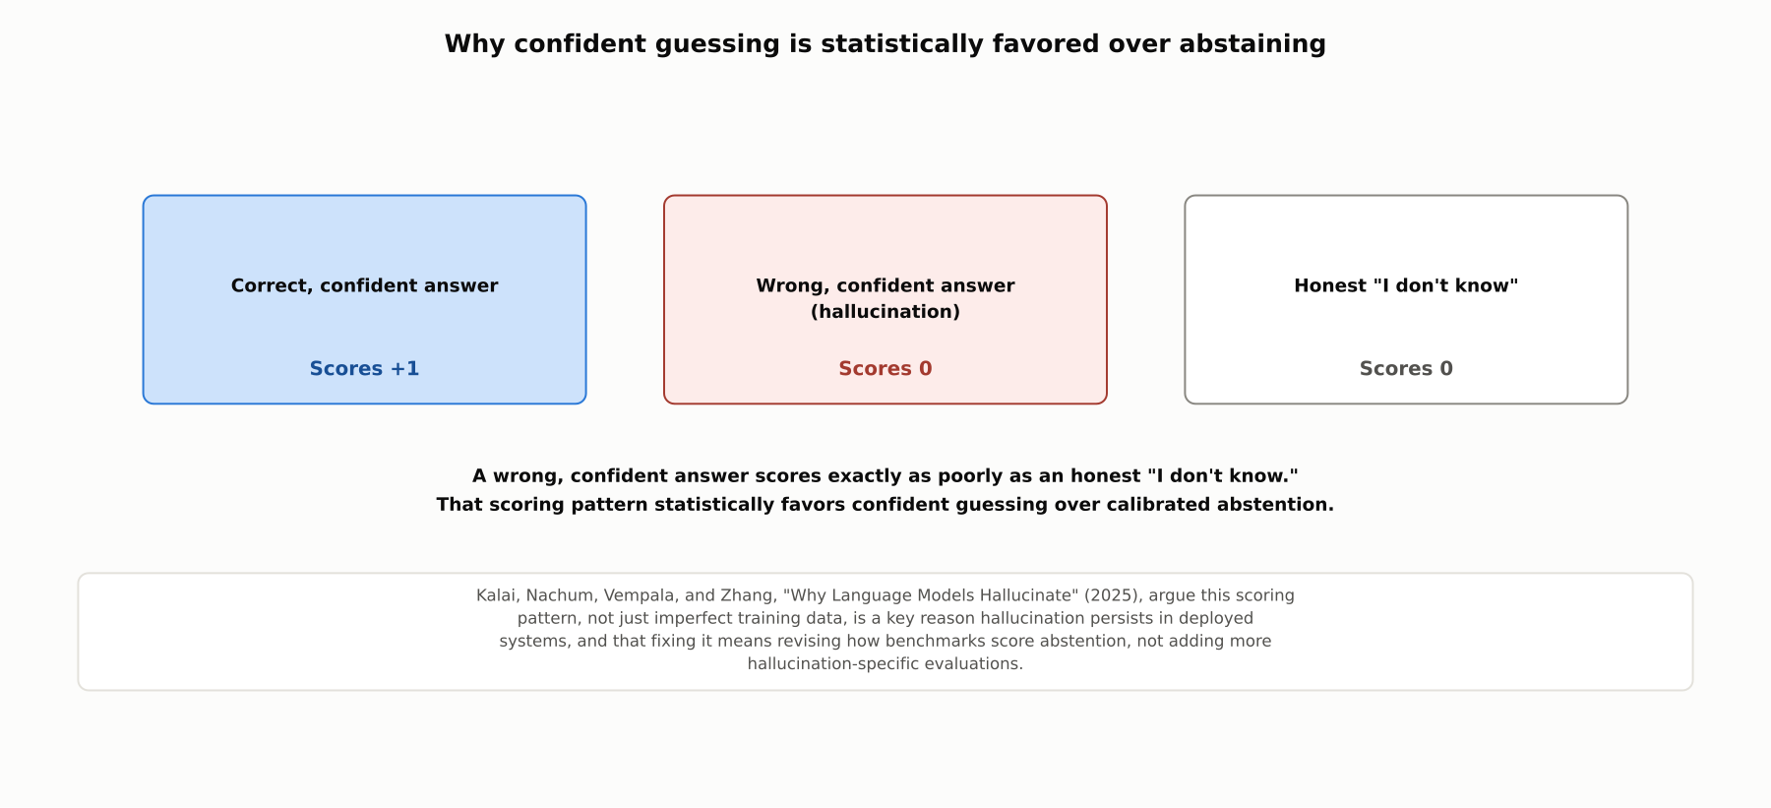
HIGH-LEVEL
Why confident guessing is statistically favored
When a wrong, confident answer scores no worse than an honest "I don't know," confident guessing is the statistically favored strategy, for a model as much as for a test-taker.

Slide 5
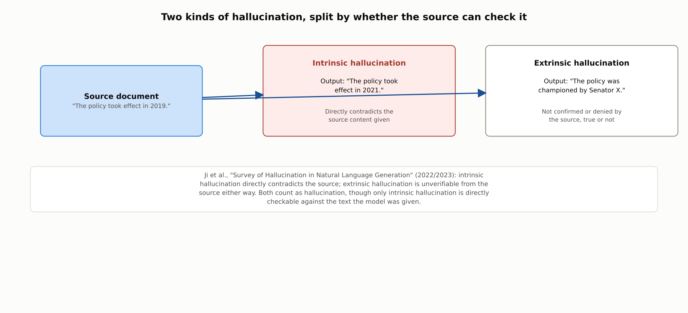
DEEP-DIVE
Two kinds of hallucination
Ji et al., 2022/2023: intrinsic hallucination directly contradicts the source; extrinsic hallucination is unverifiable from it either way. Both count as hallucination.

Slide 6
DEEP-DIVE
A statistical floor, and why it persists in practice
Kalai and Vempala (2023, STOC 2024): even a perfectly calibrated model trained on accurate data must hallucinate at some baseline rate on rare, singleton facts
Applies most strongly to arbitrary, rare facts; far less to systematic knowledge like arithmetic
"Why Language Models Hallucinate" (Kalai, Nachum, Vempala, Zhang, 2025): standard scoring is binary, and a wrong confident answer scores identically to an honest "I don't know"
That incentive statistically pushes a model toward guessing rather than abstaining, beyond the statistical floor alone
Proposed fix: revise how benchmarks score abstention, not add more hallucination-specific evals

Slide 7
DEEP-DIVE
Compounding factors on top of the baseline
Exposure bias (3.3): teacher forcing means the model never practices recovering from its own mistakes
Sampling-based decoding (4.3): temperature and nucleus sampling can occasionally drift toward less-supported output
Kandpal et al. (2023): factual accuracy correlates strongly with how often a fact appeared in training
Hallucination risk concentrates on rare entities and niche facts, not evenly across all content

Slide 8
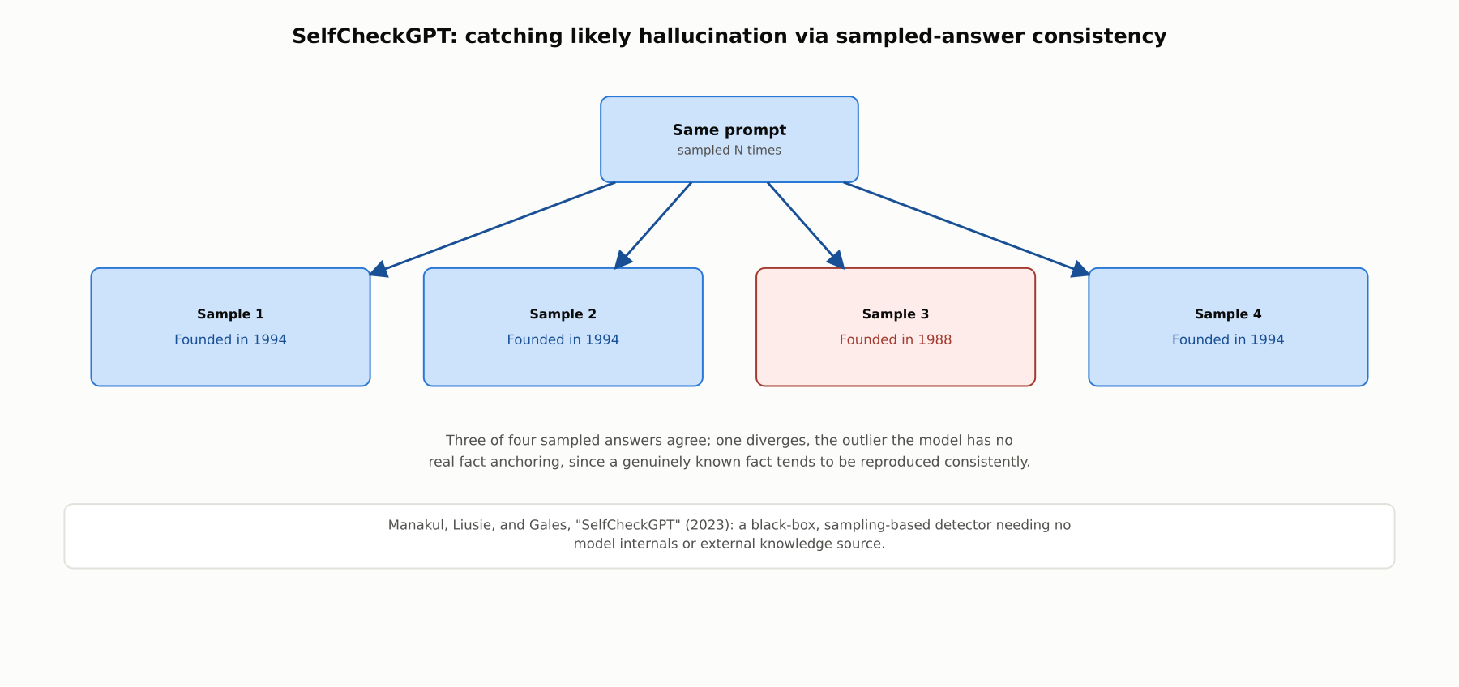
DEEP-DIVE
SelfCheckGPT: consistency across sampled answers
Manakul, Liusie, and Gales, 2023: sampling the same prompt multiple times and checking mutual consistency flags likely hallucination without needing model internals or an external source.

Slide 9
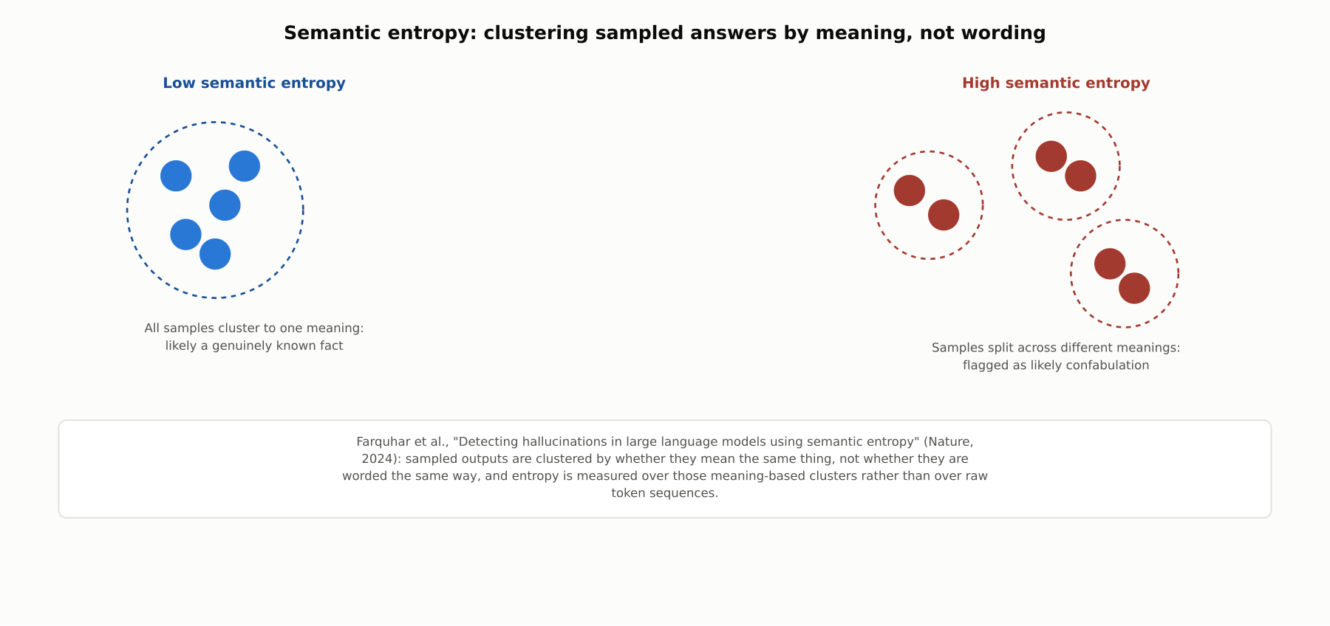
DEEP-DIVE
Semantic entropy: clustering by meaning, not wording
Farquhar et al., Nature, 2024: clustering sampled outputs by semantic equivalence and measuring entropy over those clusters catches confabulation that surface-level comparison misses.

Slide 10
COMPARISON & RELATED CONCEPTS
Four techniques, different points of intervention
Aspect | SelfCheckGPT | Semantic entropy | Chain-of-Verification | Retrieval-augmented generation
What it does | Samples multiple responses and checks mutual consistency | Clusters sampled responses by meaning and measures entropy | Drafts, independently verifies, then revises its own claims | Grounds generation in retrieved external documents
When it intervenes | After generation | After generation | During generation, before the final answer | Before and during generation
Needs external knowledge base? | No | No | No | Yes, a retrieval index
Main limitation | Flags but does not fix | Flags but does not fix | Only catches self-identifiable errors | Only helps where retrieval succeeds
Detection methods flag likely hallucination after the fact; verification and retrieval intervene earlier, and are commonly combined rather than used alone.

Slide 11
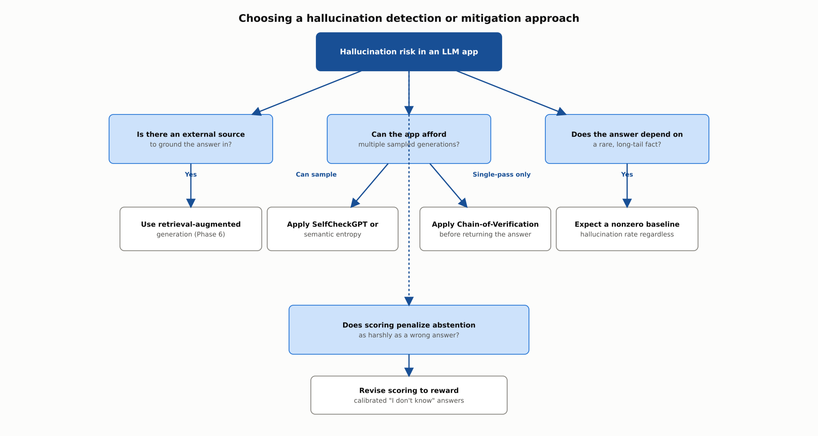
REFERENCE ARCHITECTURE
Choosing a detection or mitigation approach
The right approach depends on whether an external source exists, whether sampling is affordable, whether the fact is long-tail, and whether scoring itself rewards guessing.

Slide 12
INDUSTRY USE CASES
Finance
FINANCIAL SERVICES
Detecting fabricated regulatory citations in compliance-summary drafts
Flagging hallucinated transaction details in customer-facing statement explanations
Problem: An LLM drafting a compliance summary cites a regulation section number that sounds plausible but does not exist.
Problem: An LLM explaining account activity occasionally states a transaction detail not present in the real transaction log.
Solution: Apply Chain-of-Verification to independently check each cited section number against the actual regulation text.
Solution: Ground the explanation in retrieval from the actual transaction record rather than unaided model recall.
Watch for: A fabricated regulation citation that reads as plausible and specific can pass a reviewer's quick visual check, indistinguishable in tone from a correct one.
Watch for: A customer reading a plausible but fabricated transaction detail in an official-sounding explanation could reasonably believe it reflects their real activity.

Slide 13
INDUSTRY USE CASES
Healthcare & Telecom
HEALTHCARE + TELECOM
(Healthcare) Checking for fabricated citations in clinical-literature summarization
(Telecom) Detecting fabricated network-topology details in diagnostic summaries
Problem: A tool summarizing clinical literature occasionally cites a study finding that does not actually exist.
Problem: A diagnostics assistant occasionally states a topology detail that does not match the actual documented network configuration.
Solution: Apply a verification step checking each cited claim against the actual source article before clinical use.
Solution: Ground topology statements in retrieval from the actual current configuration database.
Watch for: A fabricated but plausible citation could shape a care team's discussion around a study finding that was never published.
Watch for: A fabricated topology detail stated with full confidence could send an on-call engineer to the wrong device, extending outage duration during an active incident.

Slide 14
CHECK YOUR UNDERSTANDING
Discuss before moving on
1. What is the difference between intrinsic and extrinsic hallucination?
2. In what sense does hallucination have a statistical floor, and for what kind of facts?
3. Why does hallucination persist in deployed systems beyond that statistical floor?
4. How do SelfCheckGPT and semantic entropy detect likely hallucination without a ground-truth source?
5. How does retrieval-augmented generation address hallucination differently than Chain-of-Verification?

Slide 15
CHAPTER 4.6 · PHASE 4
Key Takeaways
Hallucination splits into intrinsic (contradicts the source) and extrinsic (unverifiable from it)
Some hallucination rate is a statistical floor on rare facts, not just a fixable training defect
It persists partly because evaluation rewards confident guessing over honest abstention
Detection (SelfCheckGPT, semantic entropy) and mitigation (Chain-of-Verification, retrieval) each help, but none eliminates it alone
Next: 4.7 Responsible GenAI: Content Safety, Watermarking, Provenance

