Slide 1
CHAPTER 4.7 · PHASE 4
Responsible GenAI: Content Safety, Watermarking, Provenance
Three complementary layers for deploying generative AI responsibly, and why none of them substitutes for the others.
Generative AI Foundations

Slide 2
AGENDA
What this chapter covers
Content safety: red-teaming before deployment, moderation classifiers at runtime
Text watermarking: the green/red-list scheme and its limitations
SynthID: a tournament-based watermark that better preserves output quality
Provenance: C2PA Content Credentials and how they differ from watermarking
Why regulation increasingly expects more than one layer combined
Industry use cases across Finance, Healthcare, and Telecom

Slide 3
TL;DR
The short version
Content safety, watermarking, and provenance are complementary, none is sufficient alone
Content safety: red-teaming pre-deployment, moderation classifiers (e.g. Llama Guard) at runtime
Watermarking embeds a statistical signal in generated content itself, text or pixels
SynthID's tournament sampling preserves output distribution better than green/red-list biasing
C2PA provenance is signed metadata: tamper-evident, but strippable if removed entirely
Regulation (EU AI Act Article 50) increasingly expects watermarking and provenance together

Slide 4
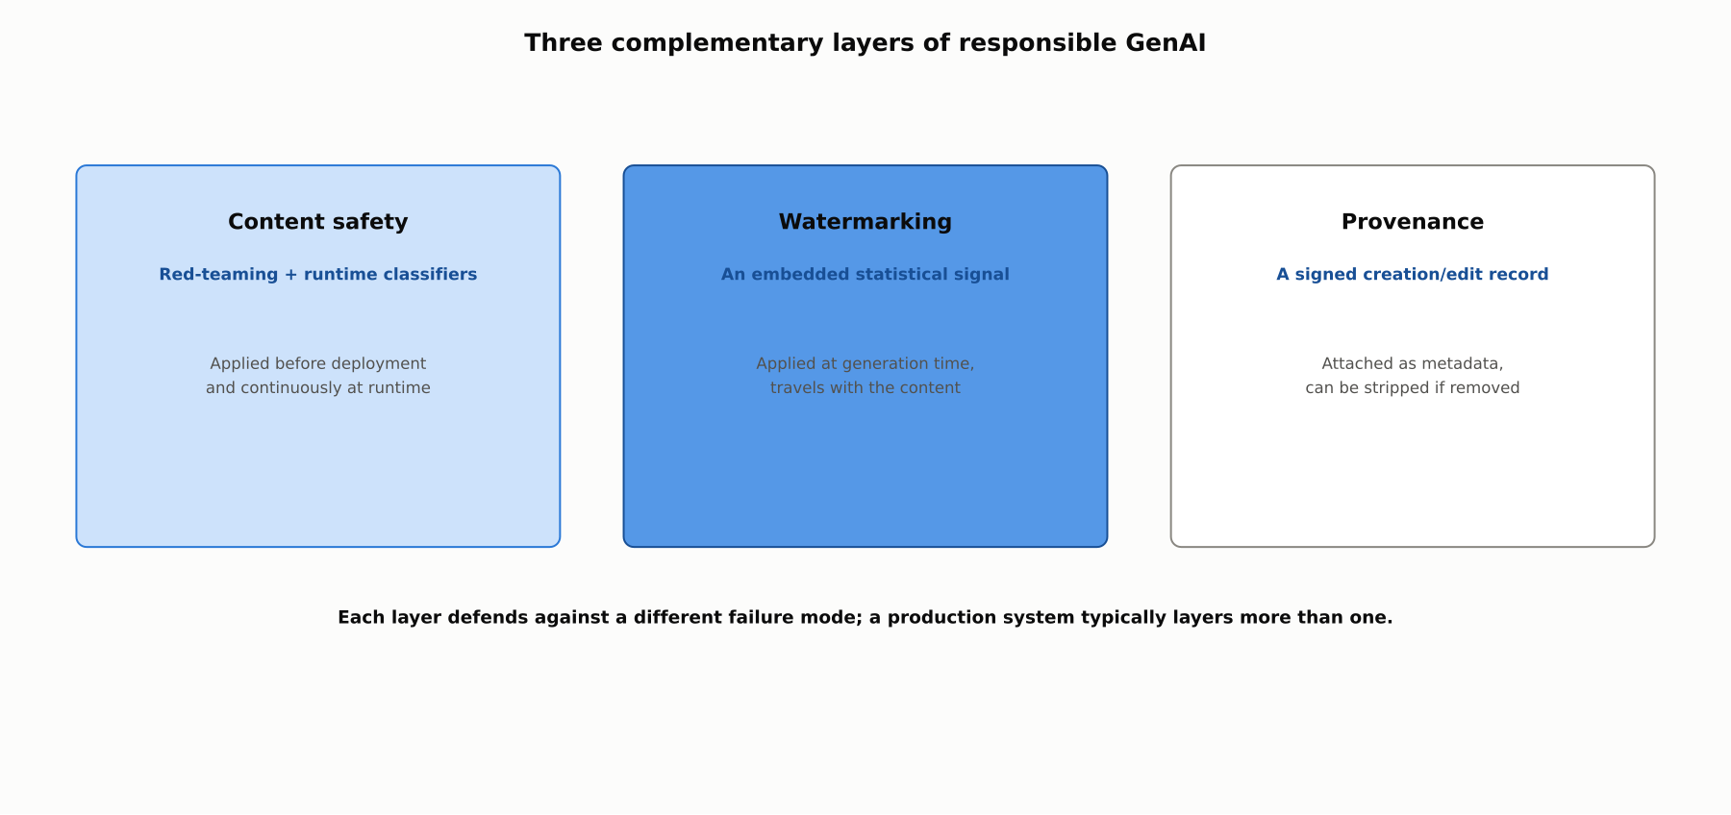
HIGH-LEVEL
Three complementary layers of responsible GenAI
Content safety, watermarking, and provenance each defend against a different failure mode; a production system typically layers more than one.

Slide 5
DEEP-DIVE
Content safety: before and during deployment
Red-teaming (Ganguli et al., Anthropic 2022): human red-teamers adversarially probe for harmful outputs pre-deployment
Automated red-teaming (Perez et al., DeepMind 2022): one LM generates adversarial test cases against a target model
Runtime classifiers (Llama Guard, Inan et al. 2023; building on OpenAI Moderation, Markov et al. 2022): score prompts and outputs against a harm taxonomy
Red-teaming finds and fixes systemic failure modes pre-launch; classifiers catch what slips through afterward

Slide 6
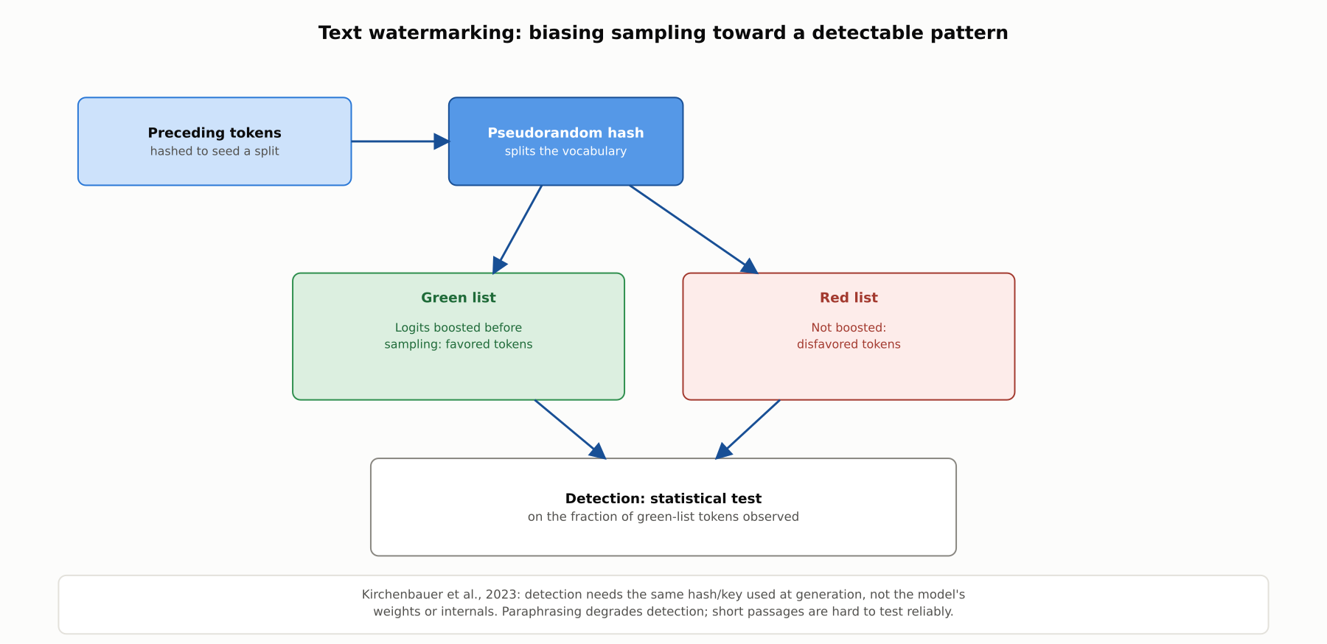
DEEP-DIVE
Text watermarking: biasing sampling toward a detectable pattern
Kirchenbauer et al., 2023: a pseudorandom hash of preceding tokens splits the vocabulary into a green and red list, biasing sampling toward green tokens; detection is a statistical test, degraded by paraphrasing.

Slide 7
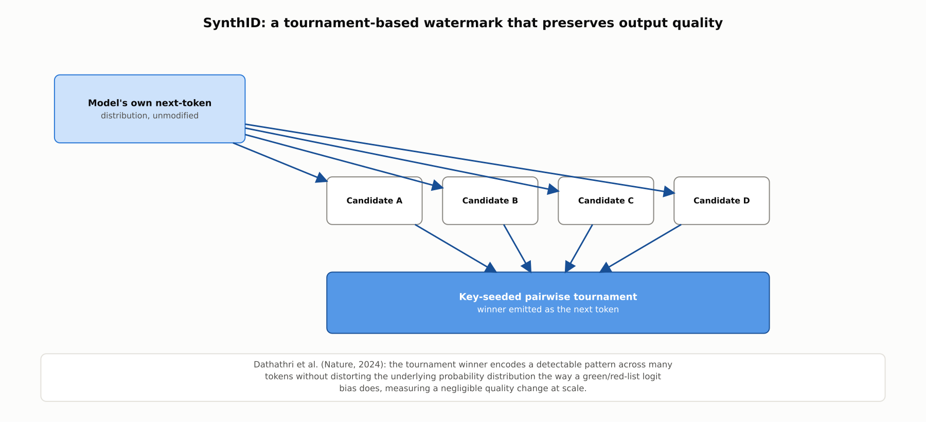
DEEP-DIVE
SynthID: a tournament-based alternative
Dathathri et al., Nature 2024: a key-seeded pairwise tournament over candidate tokens encodes a detectable signal without distorting the model's original output distribution.

Slide 8
DEEP-DIVE
Provenance: a signed record instead of an embedded signal
C2PA (founded 2021 by Adobe, Microsoft, Truepic, Arm, Intel, and the BBC): Content Credentials attach a cryptographically signed manifest to a piece of media
The manifest records how and when content was created or edited, including which tools, generative AI included, were involved
Signing makes tampering with either the content or the manifest cryptographically detectable
Key trade-off: metadata, not an embedded signal, so it can be stripped by a screenshot, re-export, or re-encoding pipeline

Slide 9
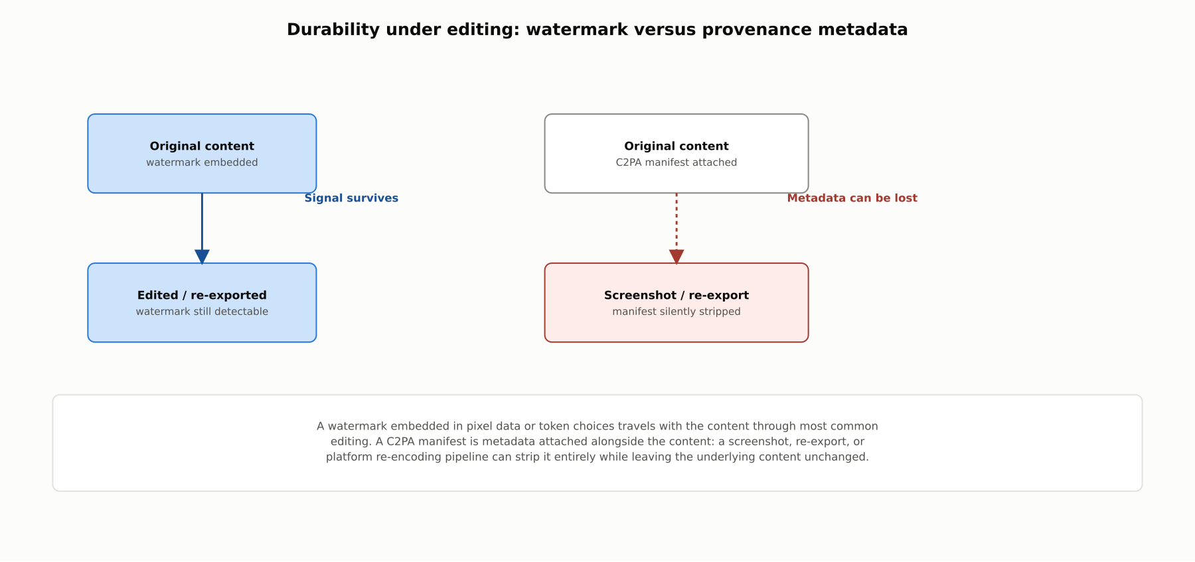
DEEP-DIVE
Watermark versus provenance: durability under editing
A watermark travels with the content through most editing; a C2PA manifest is metadata that a screenshot or re-export can strip entirely while leaving the content unchanged.

Slide 10
COMPARISON & RELATED CONCEPTS
Four approaches, four different failure modes
Aspect | Content safety classifiers | Text watermarking | Image/video watermarking | C2PA provenance
What it protects against | Harmful content reaching a user | AI text passed off as human-written | AI images/video passed off as authentic | Unverifiable creation/edit history
When applied | Pre-deployment and runtime | At generation time | At generation time | At creation and each edit
Survives editing? | N/A | Degrades under paraphrasing | Degrades under aggressive edits | No, metadata can be stripped
Main limitation | Taxonomy-bound | Statistical, not certain | Confidence-based detection | Not embedded in content itself
Regulatory obligations increasingly expect more than one of these applied together, since each addresses a different point in the content lifecycle.

Slide 11
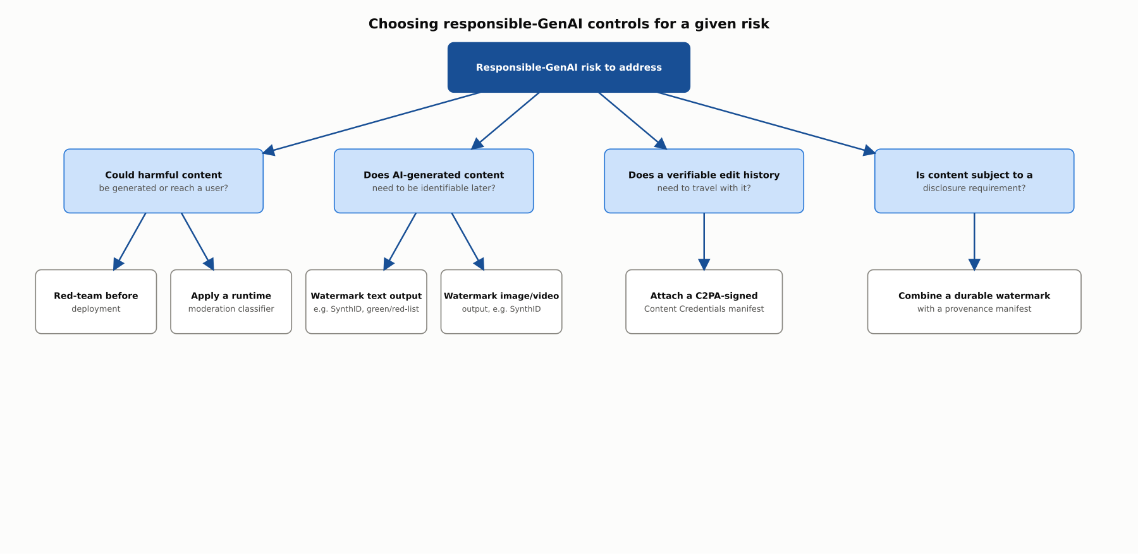
REFERENCE ARCHITECTURE
Choosing responsible-GenAI controls for a given risk
The right control depends on whether the risk is harmful generation, later identifiability, verifiable edit history, or a regulatory disclosure requirement.

Slide 12
INDUSTRY USE CASES
Finance
FINANCIAL SERVICES
Red-teaming an advisor-support LLM for compliance failure modes
Verifying C2PA provenance on submitted KYC documents
Problem: An internal LLM tool drafting client communications has not been systematically tested for noncompliant advice under adversarial prompting.
Problem: A know-your-customer process accepts scanned documents with no way to verify whether an image was synthetically generated.
Solution: Conduct structured red-teaming targeting compliance-relevant failure modes before client-facing use.
Solution: Check submitted documents for C2PA Content Credentials, flagging documents lacking any verifiable provenance for manual review.
Watch for: A tool deployed without compliance-focused red-teaming could produce advice violating suitability rules, creating regulatory exposure discovered only after it reaches a client.
Watch for: Accepting documents with no provenance verification leaves KYC reliant on visual inspection alone, missing a synthetic document that would pass a purely visual check.

Slide 13
INDUSTRY USE CASES
Healthcare & Telecom
HEALTHCARE + TELECOM
(Healthcare) Red-teaming a symptom-checker chatbot for dangerous misinformation
(Telecom) Red-teaming a customer-service chatbot against account-disclosure jailbreaks
Problem: A patient-facing symptom-checker has not been tested for producing dangerous medical misinformation under adversarial phrasing.
Problem: A telecom chatbot has not been tested against adversarial prompting designed to extract SIM-swap-relevant account details.
Solution: Conduct structured red-teaming targeting medically dangerous failure modes before patient-facing deployment.
Solution: Red-team specifically against account-disclosure social-engineering patterns, backed by a runtime moderation classifier.
Watch for: A symptom-checker deployed without medically focused red-teaming could produce a dangerous self-treatment suggestion that ordinary testing never surfaced.
Watch for: A chatbot not red-teamed against account-disclosure jailbreaks could be manipulated into enabling a SIM-swap fraud attempt, a telecom-specific pattern generic safety evaluation would not catch.

Slide 14
CHECK YOUR UNDERSTANDING
Discuss before moving on
1. What distinct failure mode does each of content safety, watermarking, and provenance address?
2. How does the green/red-list watermarking scheme work, and what are its two main limitations?
3. How does SynthID differ mechanically from green/red-list watermarking, and what advantage does that give it?
4. Why is C2PA provenance structurally different from watermarking?
5. Why might regulation call for combining a watermark with a provenance manifest rather than using just one?

Slide 15
CHAPTER 4.7 · PHASE 4
Key Takeaways
Content safety, watermarking, and provenance defend against different failure modes
Watermarking embeds a signal in content; provenance attaches a signed, strippable record alongside it
SynthID's tournament sampling preserves output quality better than logit-biasing approaches
Regulation increasingly expects layered controls, not any single technique alone
Next: Phase 4 wrap-up, then Phase 5: Prompt Engineering & LLM Application Development

