Slide 1
CHAPTER 5.1 · PHASE 5
Prompting Fundamentals: Zero-Shot, Few-Shot, Instruction Following
How zero-shot, few-shot, and instruction tuning shape what a prompt can reliably get a model to do.
Prompt Engineering & LLM Application Development

Slide 2
AGENDA
What this chapter covers
Precise definitions of zero-shot, one-shot, and few-shot (in-context learning)
Instruction tuning (FLAN) and RLHF (InstructGPT), previewed for Phase 7
Why base models and instruction-tuned models respond differently to the same prompt
Few-shot prompt sensitivity: example order and systematic biases
Selecting good few-shot examples via semantic similarity
Industry use cases across Finance, Healthcare, and Telecom

Slide 3
TL;DR
The short version
Zero-shot: task description only; few-shot: description plus worked examples, no weight updates either way
FLAN: instruction-tuning on many tasks improves zero-shot generalization to unseen instructions
InstructGPT: SFT + reward model + RLHF aligns a model with actual user intent, not just task format
A base model may continue text rather than obey an instruction; an instruction-tuned model usually will
Few-shot example order (Lu et al.) and bias (Zhao et al.) can swing accuracy independently of the task
Semantically similar example selection (Liu et al.) beats random selection

Slide 4
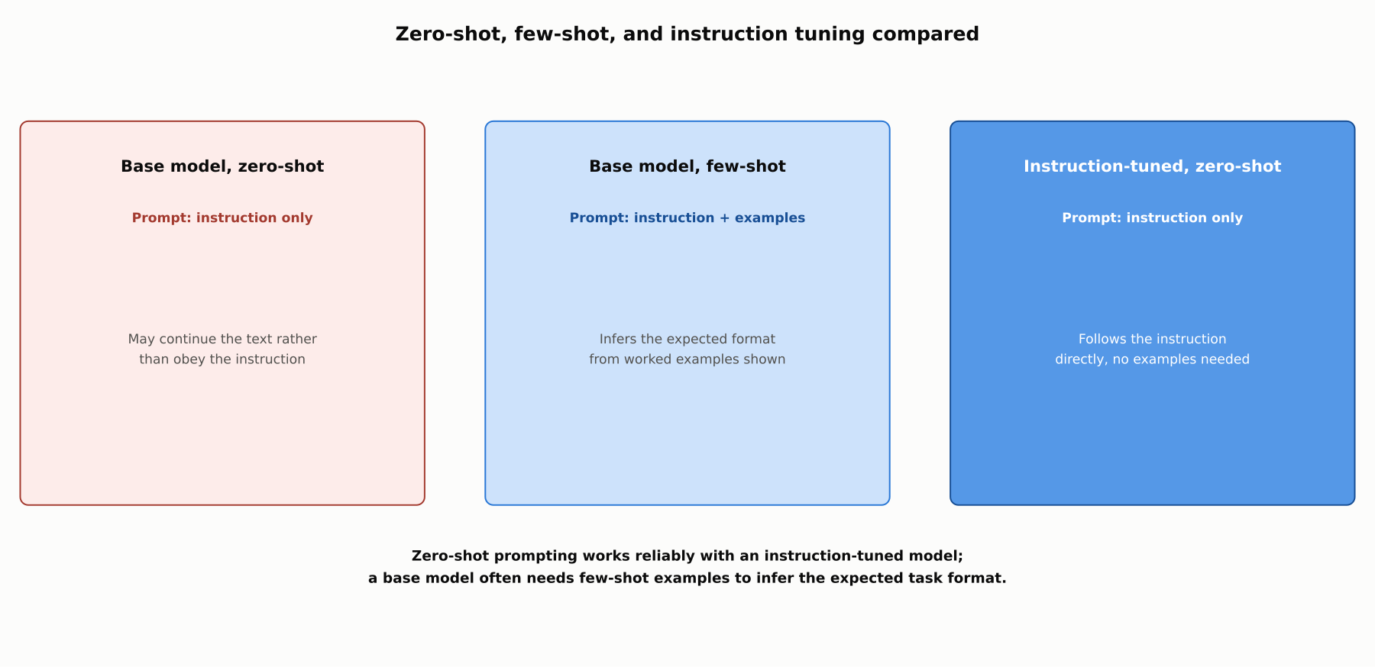
HIGH-LEVEL
Zero-shot, few-shot, and instruction tuning compared
Zero-shot prompting works reliably with an instruction-tuned model; a base model often needs few-shot examples to infer the expected task format.

Slide 5
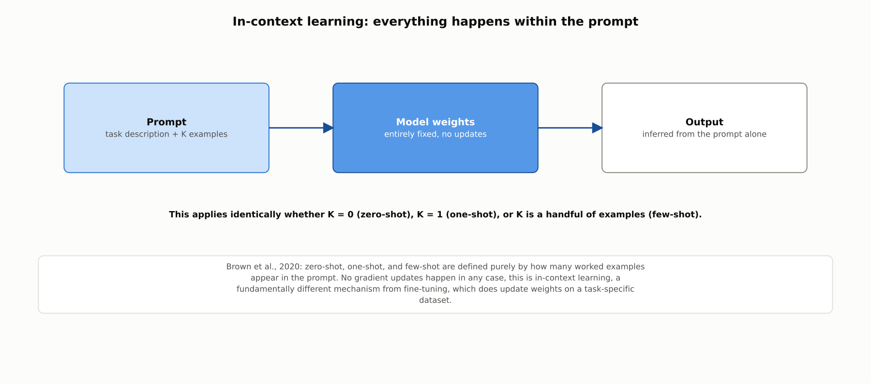
DEEP-DIVE
In-context learning: everything happens within the prompt
Brown et al., 2020: zero-shot, one-shot, and few-shot are defined purely by how many examples appear in the prompt, with no gradient updates in any case.

Slide 6
DEEP-DIVE
Instruction tuning and RLHF
FLAN (Wei et al., 2021): fine-tuning on many instruction-phrased tasks improves zero-shot generalization to unseen instructions
InstructGPT (Ouyang et al., 2022, previewed here, full treatment in Phase 7): SFT on human demonstrations, then a reward model trained on human preference rankings, then RLHF
Human evaluators preferred a 1.3B InstructGPT model's outputs over the 175B base GPT-3 model
FLAN uses only supervised multitask instruction data; InstructGPT adds human preference data and reinforcement learning

Slide 7
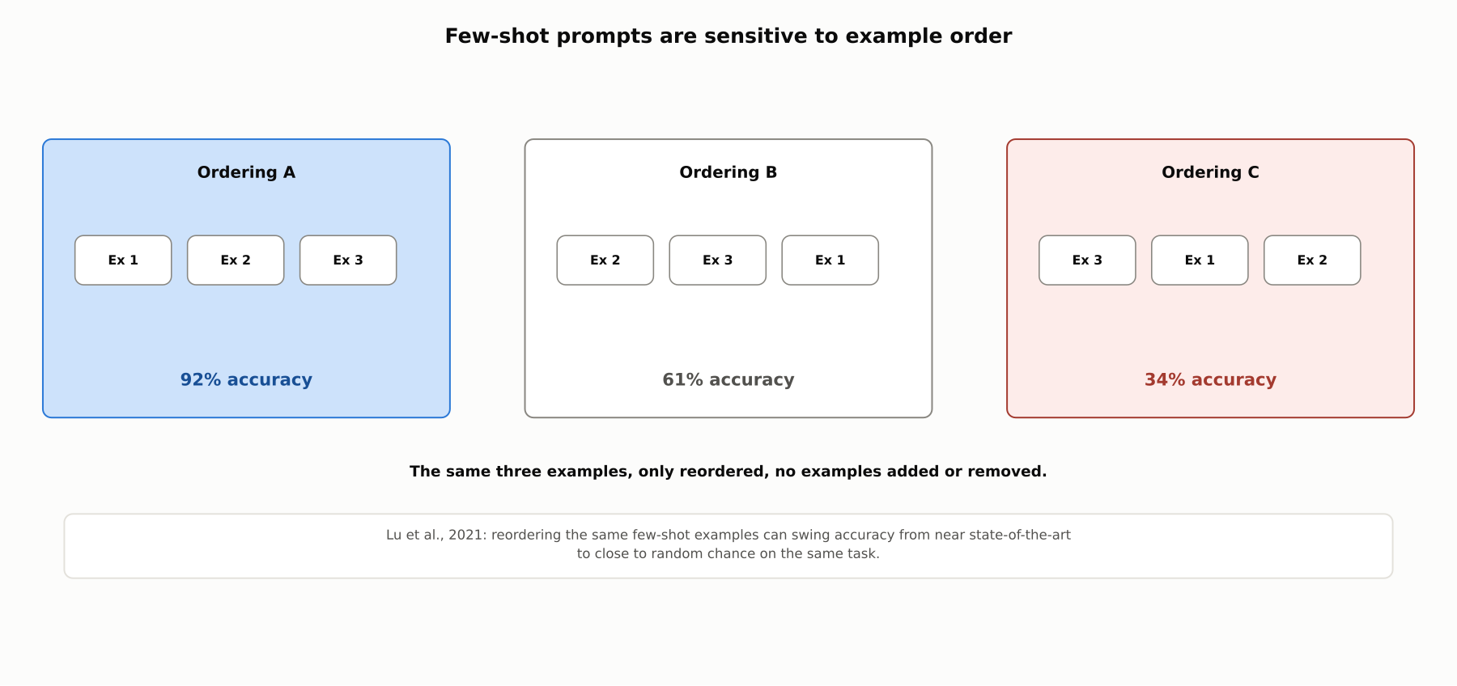
DEEP-DIVE
Few-shot prompts are sensitive to example order
Lu et al., 2021: reordering the same few-shot examples, with none added or removed, can swing accuracy from near state-of-the-art to close to random chance.

Slide 8
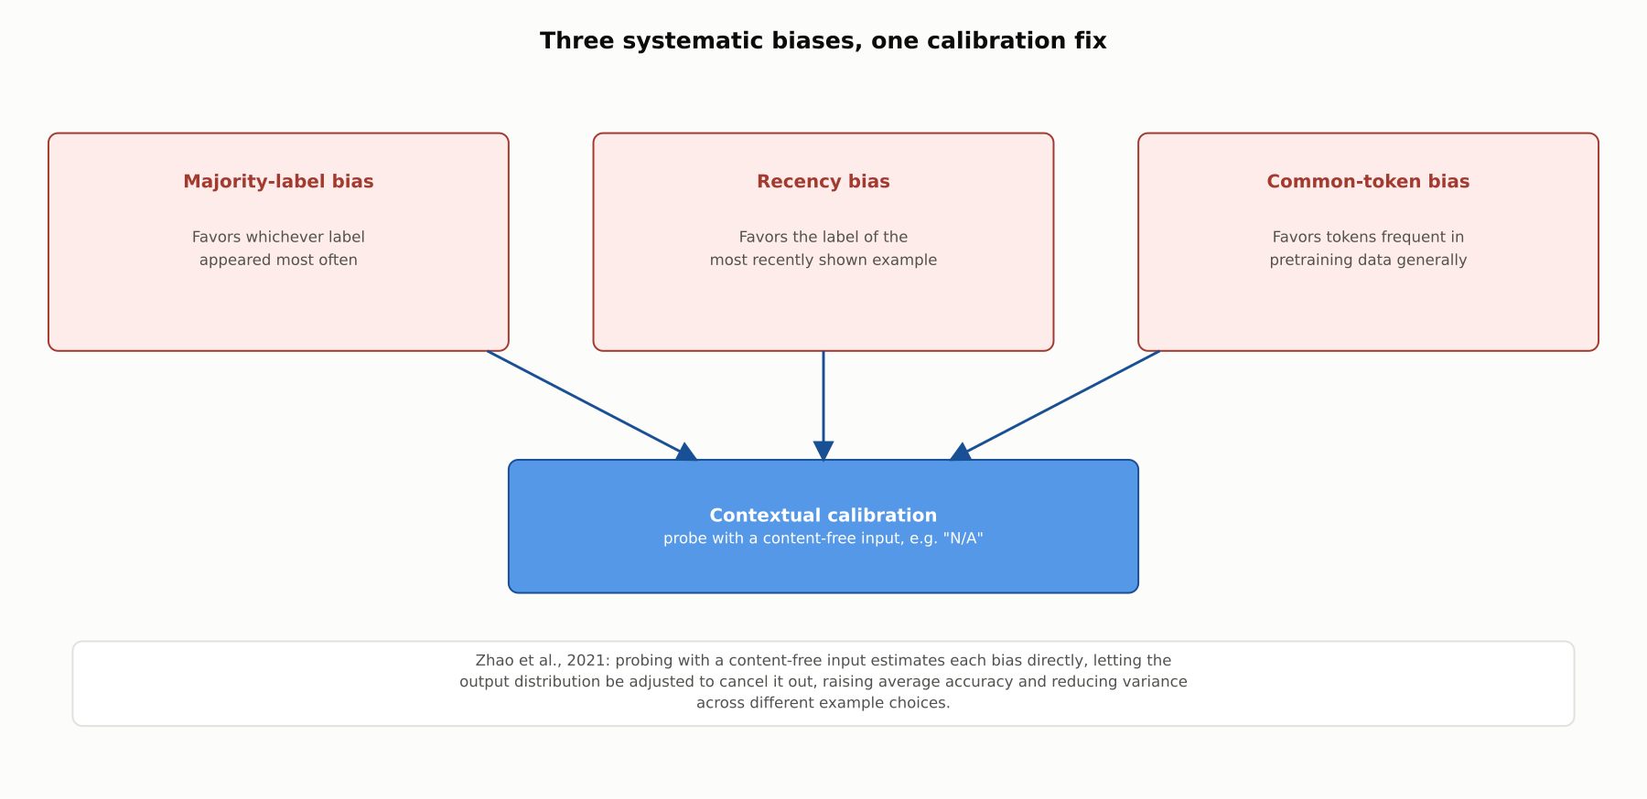
DEEP-DIVE
Three systematic biases, one calibration fix
Zhao et al., 2021: majority-label, recency, and common-token bias can all be estimated and corrected via contextual calibration using a content-free probe input.

Slide 9
DEEP-DIVE
Choosing which examples to show matters as much as how many
Liu et al., 2021: selecting few-shot examples semantically similar to the test input outperforms random selection
Similarity is typically measured via nearest-neighbor retrieval in an embedding space
The same fixed pool of candidate examples can yield meaningfully different results depending purely on selection
This holds across classification, table-to-text, and QA-style tasks, independent of prompt wording

Slide 10
COMPARISON & RELATED CONCEPTS
Four points on a prompting spectrum
Aspect | Zero-shot (base model) | Few-shot (base model) | Zero-shot (instruction-tuned) | Calibrated few-shot
What it requires | Only a task description | Task description plus examples | Only a task description | Examples plus a calibration step
Typical reliability | Often unreliable | More reliable than zero-shot | Reliable | More stable across example sets
Sensitive to order/selection? | N/A | Yes, substantially | N/A | Reduced, not eliminated
Main limitation | May not treat prompt as an instruction | Order/selection swing accuracy | Needs an instruction-tuned checkpoint | Extra calibration pass required
These are points on a spectrum, not a strict ranking; the right combination depends on the model available and the task's tolerance for variance.

Slide 11
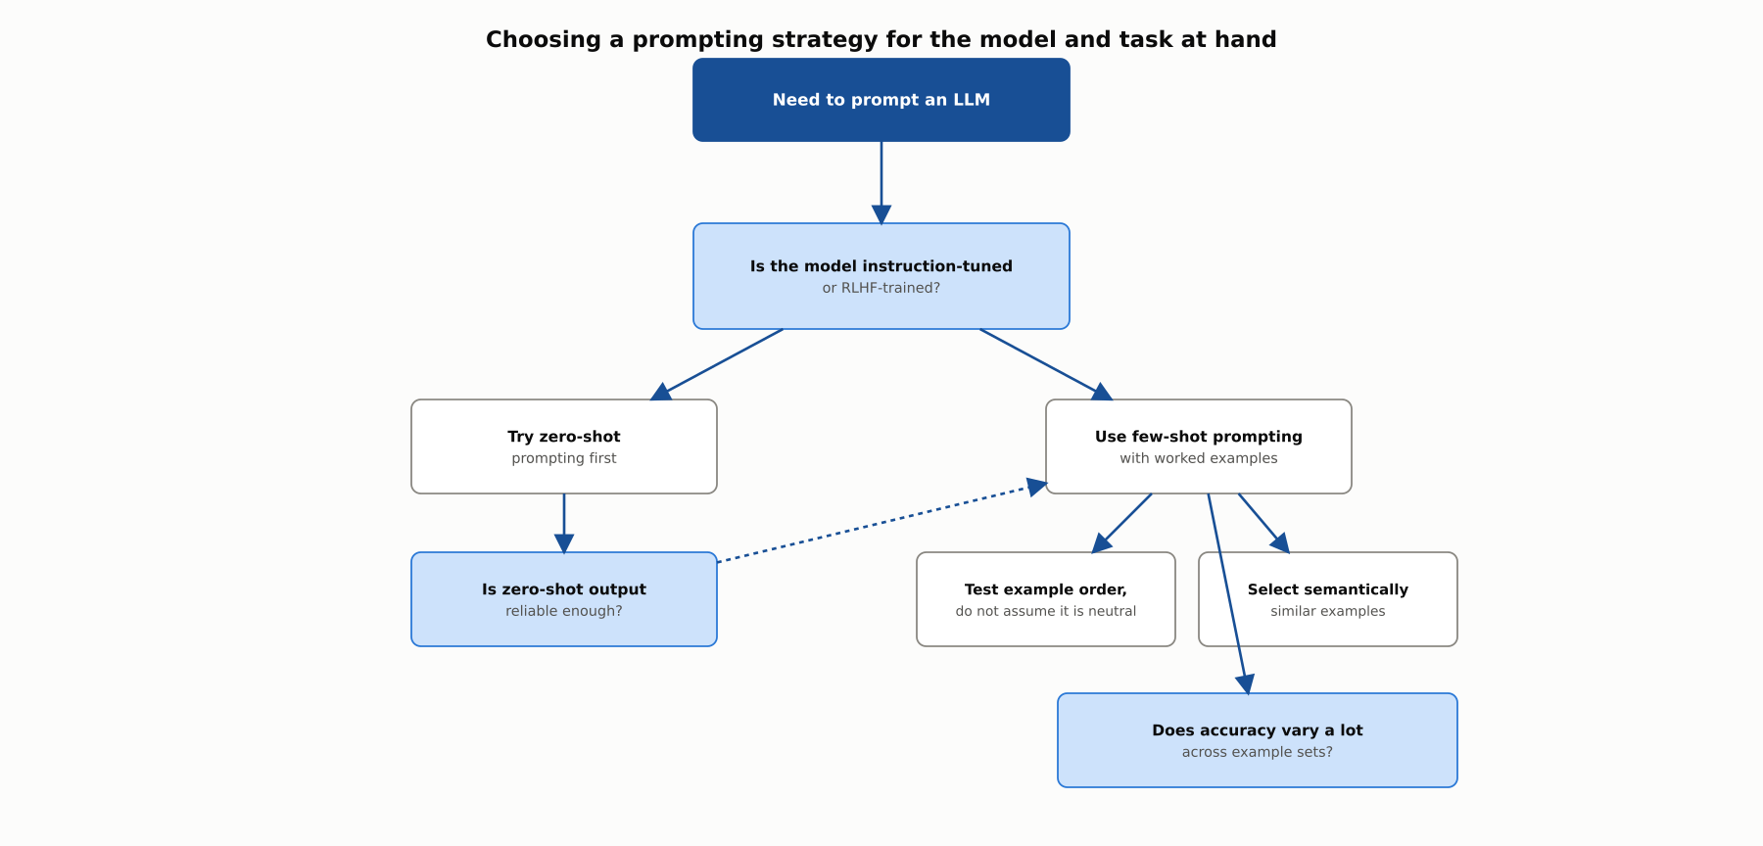
REFERENCE ARCHITECTURE
Choosing a prompting strategy for the model and task
Whether zero-shot suffices depends on instruction-tuning status; few-shot prompts then need attention to example order, selection, and bias.

Slide 12
INDUSTRY USE CASES
Finance
FINANCIAL SERVICES
Choosing zero-shot versus few-shot for a document-classification pipeline
Correcting majority-label bias in a fraud-flag few-shot prompt
Problem: A team assumes zero-shot prompting will work reliably without confirming whether the underlying model is instruction-tuned.
Problem: A fraud-flagging prompt's few-shot examples include more non-fraud than fraud examples, unchecked for majority-label bias.
Solution: Confirm instruction-tuning status before committing to a zero-shot design, falling back to few-shot if needed.
Solution: Apply contextual calibration or deliberately balance the example set.
Watch for: A zero-shot prompt against an unconfirmed base model can produce inconsistent classification in production, since the model may continue text rather than assign a category.
Watch for: Uncorrected majority-label bias can systematically under-flag genuine fraud cases, a skew invisible in an evaluation set built with the same imbalance.

Slide 13
INDUSTRY USE CASES
Healthcare & Telecom
HEALTHCARE + TELECOM
(Healthcare) Testing few-shot order sensitivity in a triage-priority prompt
(Telecom) Choosing zero-shot versus few-shot for incident categorization
Problem: A triage-priority prompt's few-shot examples have never been tested against reordering, despite influencing urgency flags.
Problem: A network-incident categorization tool assumes zero-shot prompting will work without confirming instruction-tuning status.
Solution: Specifically test the prompt's output across multiple example orderings before relying on it for prioritization.
Solution: Confirm instruction-tuning status before committing to zero-shot, falling back to few-shot if needed.
Watch for: An order-sensitive triage prompt could assign different urgency to the same case purely due to example order, a direct patient-safety risk.
Watch for: Inconsistent categorization during an active outage, precisely when consistent triage matters most.

Slide 14
CHECK YOUR UNDERSTANDING
Discuss before moving on
1. How do Brown et al. define zero-shot, one-shot, and few-shot, and what do all three share?
2. What is the key difference between FLAN's instruction tuning and InstructGPT's RLHF pipeline?
3. Why does a base model often need few-shot examples while an instruction-tuned model works well zero-shot?
4. What did Lu et al. find about few-shot example order?
5. What three biases did Zhao et al. identify, and how does contextual calibration address them?

Slide 15
CHAPTER 5.1 · PHASE 5
Key Takeaways
Zero-shot and few-shot are defined by example count in the prompt, with no weight updates either way
Instruction tuning and RLHF are why modern models follow zero-shot instructions reliably
Few-shot prompts remain sensitive to example order, selection, and systematic bias
Prompt construction is a deliberate design decision, not an afterthought
Next: 5.2 Advanced Prompting Patterns: Chain-of-Thought, Self-Consistency, Tree-of-Thought

