Slide 1
CHAPTER 5.2 · PHASE 5
Advanced Prompting Patterns: Chain-of-Thought, Self-Consistency, Tree-of-Thought
Four ways to elicit and stabilize multi-step reasoning, from a single answer to a searched, backtracking tree.
Prompt Engineering & LLM Application Development

Slide 2
AGENDA
What this chapter covers
Chain-of-thought (CoT) prompting and why its benefit is scale-dependent
Zero-shot CoT: eliciting reasoning with no worked examples at all
Self-consistency: sampling multiple reasoning paths and voting
Tree-of-thought: searching and backtracking across partial solutions
Least-to-most prompting and the limits of trusting a reasoning trace
Industry use cases across Finance, Healthcare, and Telecom

Slide 3
TL;DR
The short version
CoT (Wei et al.): writing out reasoning steps helps mainly at roughly 100B+ parameters, and can hurt smaller models
Zero-shot CoT (Kojima et al.): "Let's think step by step" elicits similar reasoning with no worked examples
Self-consistency (Wang et al.): sample several reasoning paths, take the majority-vote answer
Tree-of-thought (Yao et al.): search and backtrack across a tree of partial reasoning steps
Each technique trades more inference cost for more reliability
None of them guarantees a fluent reasoning trace faithfully reflects the model's actual process (Turpin et al.)

Slide 4
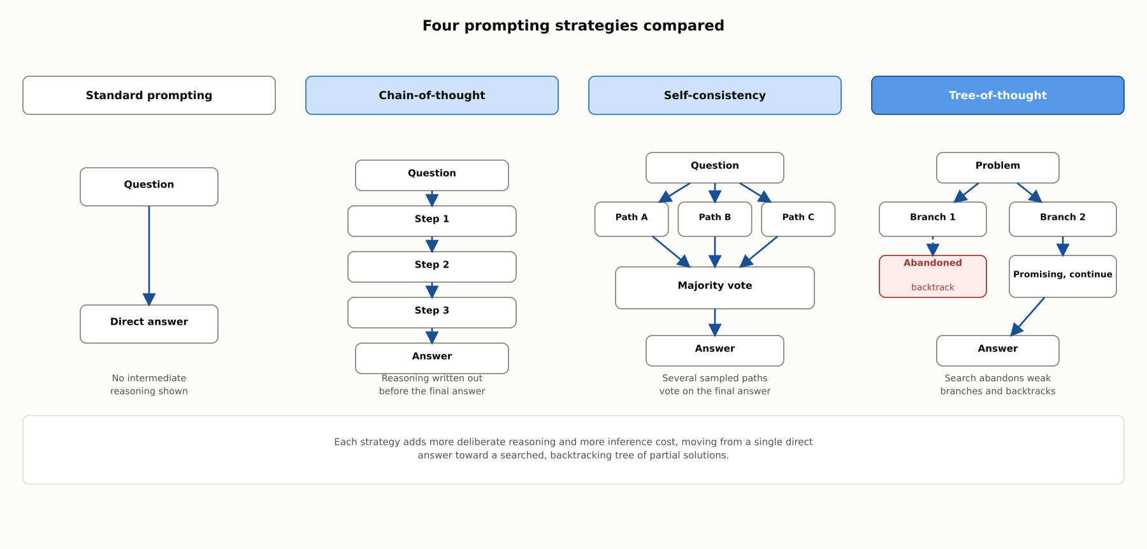
HIGH-LEVEL
Four prompting strategies compared
Each strategy adds more deliberate reasoning and more inference cost, from a single direct answer to a searched, backtracking tree of partial solutions.

Slide 5
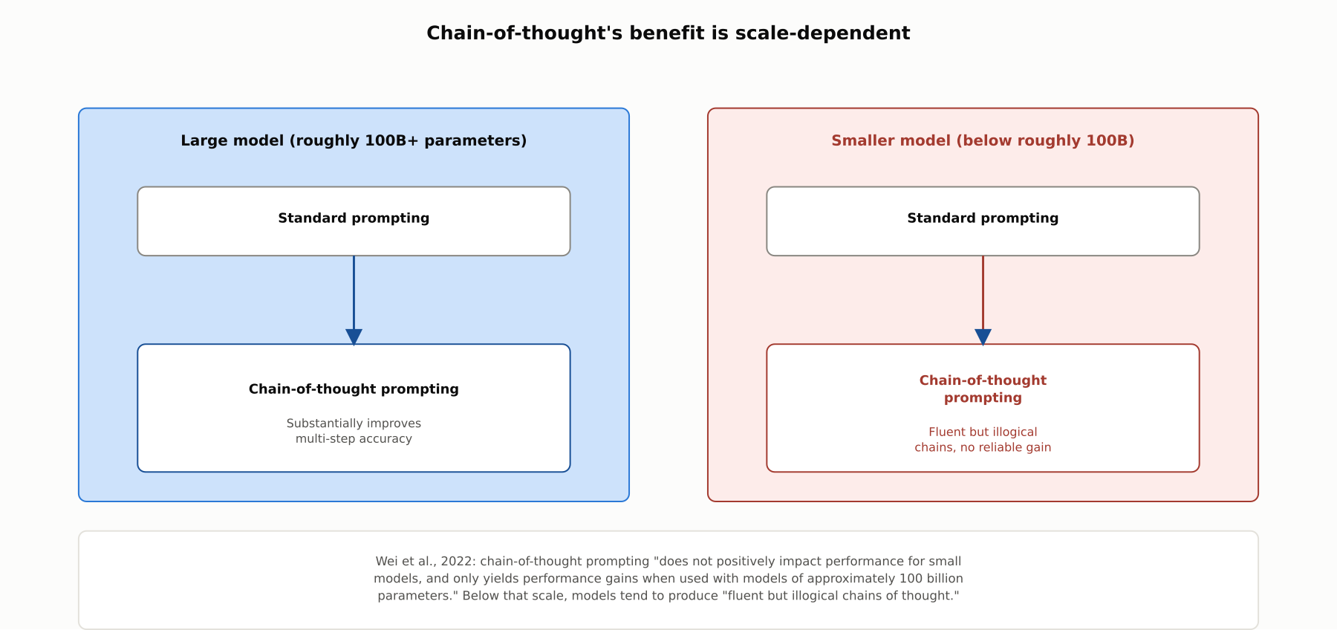
DEEP-DIVE
Chain-of-thought's benefit is scale-dependent
Wei et al., 2022: CoT prompting "does not positively impact performance for small models," and only helps around 100B+ parameters; below that, models produce "fluent but illogical chains of thought."

Slide 6
DEEP-DIVE
Zero-shot chain-of-thought: no worked examples required
Kojima et al., 2022: appending "Let's think step by step" before the answer, with zero CoT demonstrations
Reliably elicits similar step-by-step reasoning to few-shot CoT
Produces large accuracy gains over a plain zero-shot prompt, e.g. roughly 18% to roughly 79% on one benchmark
Shows the reasoning benefit does not strictly require worked examples in the prompt

Slide 7
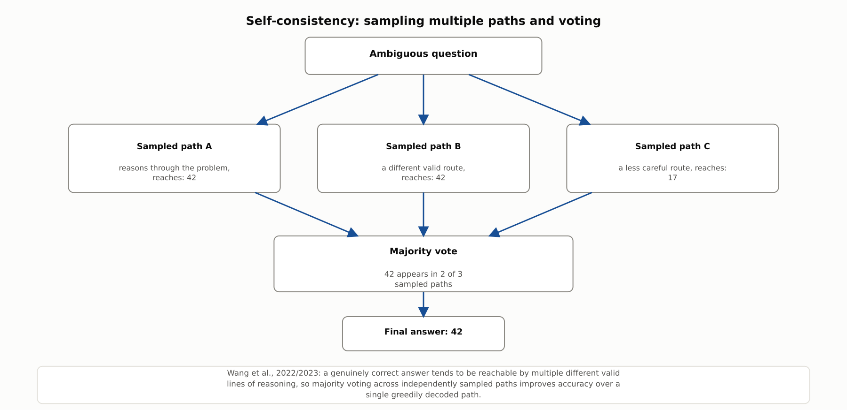
DEEP-DIVE
Self-consistency: sampling multiple paths and voting
Wang et al., 2022/2023: a genuinely correct answer tends to be reachable by multiple valid lines of reasoning, so majority voting across sampled paths improves accuracy over one greedily decoded path.

Slide 8
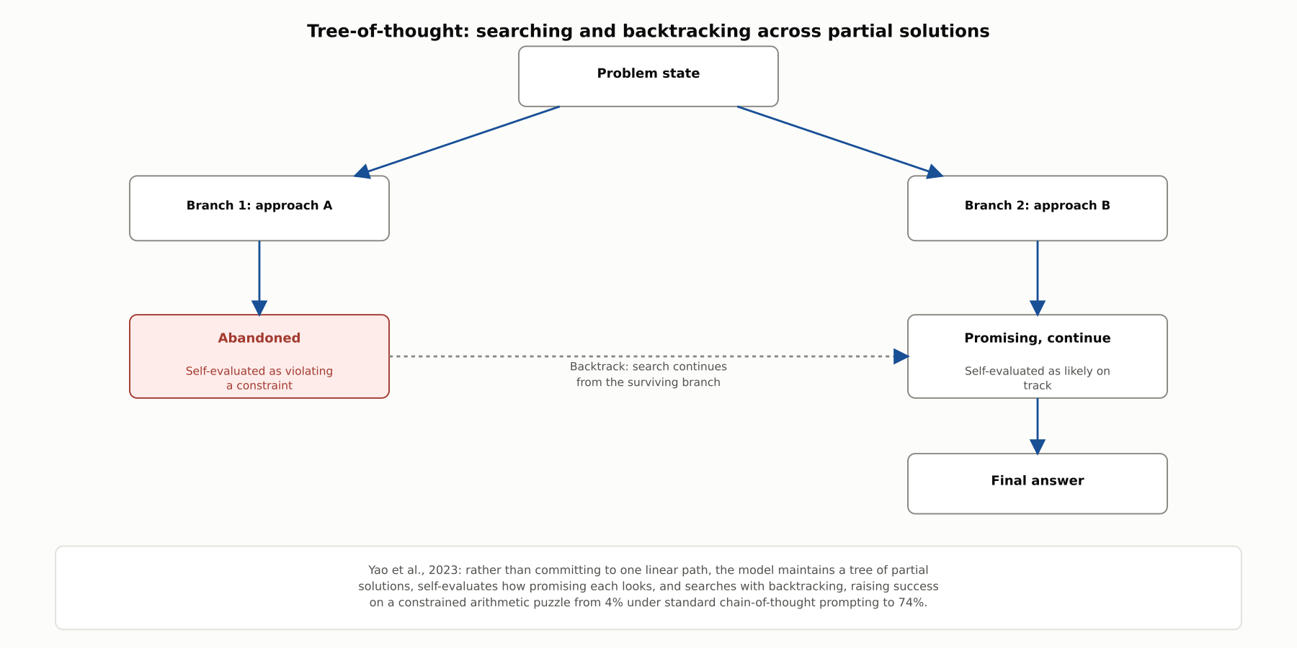
DEEP-DIVE
Tree-of-thought: searching and backtracking
Yao et al., 2023: maintaining a tree of partial solutions and backtracking away from unpromising branches raised success on a constrained arithmetic puzzle from 4% to 74%.

Slide 9
DEEP-DIVE
Decomposition, and the limits of a reasoning trace
Least-to-most prompting (Zhou et al.): decompose a problem into subproblems, solve in order, feed each solution forward
Reached over 99% on one compositional generalization benchmark versus roughly 16% for standard CoT
Turpin et al.: CoT explanations can be systematically unfaithful, biased inputs shift the answer without the stated reasoning ever mentioning the bias
A CoT trace can be a useful tool for better answers while still being an unreliable explanation of why an answer was reached

Slide 10
COMPARISON & RELATED CONCEPTS
Four points on a cost-versus-reliability spectrum
Aspect | Chain-of-thought (few-shot) | Zero-shot CoT | Self-consistency | Tree-of-thought
Core mechanism | Worked reasoning examples in the prompt | "Let's think step by step," no examples | Multiple sampled paths, majority vote | A searched, self-evaluated tree of partial paths
Backtracks on a bad path? | No | No | No, paths run independently | Yes, this is its defining feature
Relative inference cost | One generation, longer prompt | One generation, minimal extra cost | Multiplies cost by number of sampled paths | Highest: many partial-path evaluations
Best suited for | Multi-step reasoning with large models | Quick reasoning boost with minimal setup | Tasks where a majority-correct answer is likely | Hard problems needing exploration and recovery
Each pattern trades additional inference cost for additional reasoning reliability; none of them guarantees the reasoning trace itself is a faithful account of how the answer was reached.

Slide 11
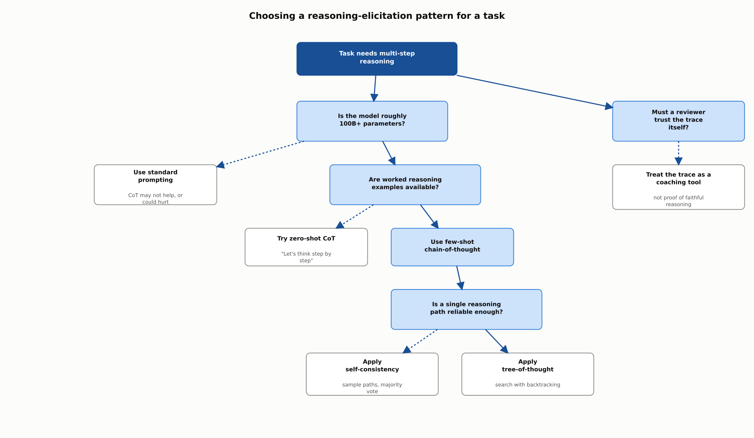
REFERENCE ARCHITECTURE
Choosing a reasoning-elicitation pattern for a task
Model scale governs whether CoT helps at all; example availability and reliability needs then decide among zero-shot CoT, few-shot CoT, self-consistency, and tree-of-thought.

Slide 12
INDUSTRY USE CASES
Finance
FINANCIAL SERVICES
Applying chain-of-thought prompting to multi-step loan-covenant calculations
Using self-consistency for a high-stakes fraud-amount estimation task
Problem: A standard answer-only prompt has produced silently wrong final figures on complex covenant-compliance calculations.
Problem: A single chain-of-thought pass estimating disputed transaction amounts occasionally reaches a different figure on a rerun.
Solution: Switch to chain-of-thought prompting so each intermediate ratio and threshold comparison is written out and checkable.
Solution: Apply self-consistency, sampling several independent paths and taking the majority-reached figure.
Watch for: A wrong compliance figure with no visible steps can pass review simply because there is nothing to check it against.
Watch for: An inconsistent disputed-amount figure finalized from one run undermines confidence in the number if later challenged.

Slide 13
INDUSTRY USE CASES
Healthcare & Telecom
HEALTHCARE + TELECOM
(Healthcare) Using self-consistency for an ambiguous differential-diagnosis task
(Telecom) Evaluating tree-of-thought for a complex network-migration sequence
Problem: A single reasoning pass generating a differential diagnosis occasionally reaches a different leading diagnosis on a rerun.
Problem: Candidate migration-stage orderings can turn out to conflict with a dependency only partway through the plan.
Solution: Sample multiple independent diagnostic paths and surface the diagnosis a majority converge on.
Solution: Use tree-of-thought so a conflicting branch can be abandoned and an alternative sequence explored.
Watch for: Anchoring on one run's leading diagnosis risks a conclusion a majority of paths would not have reached, especially on ambiguous cases.
Watch for: A linear plan that only detects a conflict once otherwise complete risks a migration step executed out of order, causing an avoidable outage.

Slide 14
CHECK YOUR UNDERSTANDING
Discuss before moving on
1. What does chain-of-thought prompting change about a few-shot prompt, and why does it mainly benefit large models?
2. What did Kojima et al. show about zero-shot chain-of-thought?
3. How does self-consistency differ from standard chain-of-thought prompting?
4. What capability does tree-of-thought have that neither chain-of-thought nor self-consistency have?
5. What did Turpin et al. find about the faithfulness of chain-of-thought explanations?

Slide 15
CHAPTER 5.2 · PHASE 5
Key Takeaways
Chain-of-thought helps mainly at large scale, and can hurt smaller models
Self-consistency and tree-of-thought trade more inference cost for more reliability
Tree-of-thought is unique in backtracking away from unpromising reasoning paths
A fluent reasoning trace is a useful tool, not proof of faithful reasoning
Next: 5.3 Structured Outputs & Tool/Function Calling, the Basics

