Slide 1
CHAPTER 5.3 · PHASE 5
Structured Outputs & Tool/Function Calling, the Basics
From hoping a prompt returns valid JSON to a decoding-time guarantee, and how models call real tools along the way.
Prompt Engineering & LLM Application Development

Slide 2
AGENDA
What this chapter covers
Why prompted JSON alone is unreliable, and what fails
Native function/tool calling as a distinct API primitive (OpenAI, Anthropic)
Constrained decoding and OpenAI's Structured Outputs guarantee
Why schema-valid output is not the same as correct output
ReAct: interleaving reasoning, action, and observation across multiple steps
Gorilla and the Berkeley Function-Calling Leaderboard

Slide 3
TL;DR
The short version
Prompted JSON has no enforcement: extra prose, malformed syntax, and missing fields are common
Native function/tool calling (OpenAI June 2023, Anthropic tool use) lets the model select a tool and fill typed arguments
OpenAI's Structured Outputs (2024) constrains decoding itself, reporting 100% schema-valid output vs under 40% for prompting alone
A schema-valid tool call can still hallucinate a wrong value; that requires evaluation, not a tighter schema
ReAct (Yao et al.): interleave reasoning with tool actions and their observations across multiple steps
Gorilla: fine-tuning specifically for API-calling accuracy reduces hallucinated calls

Slide 4
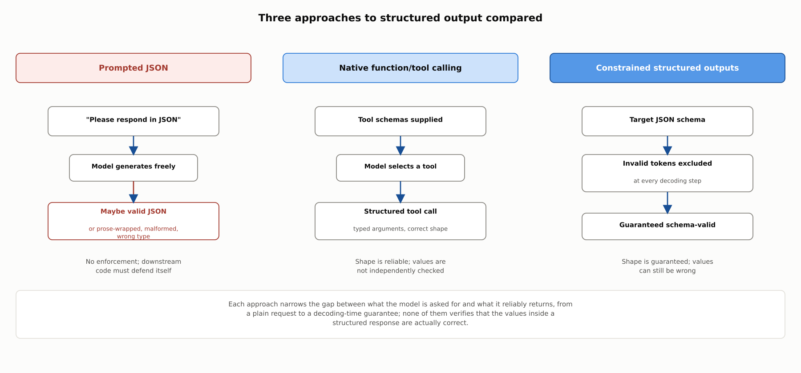
HIGH-LEVEL
Three approaches to structured output compared
Each approach narrows the gap between what the model is asked for and what it reliably returns; none of them verifies that the values inside a structured response are actually correct.

Slide 5
DEEP-DIVE
The naive approach, and native tool/function calling
Prompted JSON fails in familiar ways: prose wrapping, malformed syntax, wrong types, missing fields
OpenAI function calling (June 2023): caller supplies function schemas, model returns a structured call
Anthropic tool use: tools defined via input_schema, model returns a tool_use content block
The model decides what and how to call; executing the tool remains the calling application's job

Slide 6
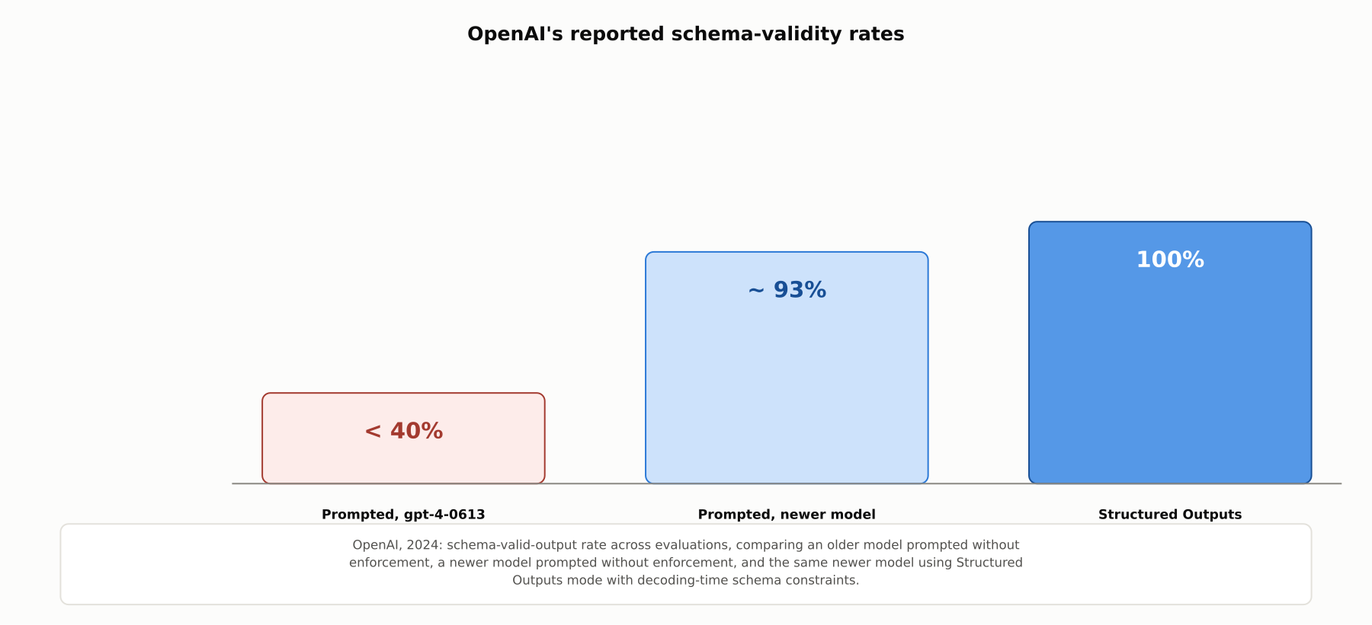
DEEP-DIVE
OpenAI's reported schema-validity rates
100% schema-valid output under Structured Outputs mode, versus under 40% for an older model prompted without enforcement and about 93% for a newer model prompted without enforcement.

Slide 7
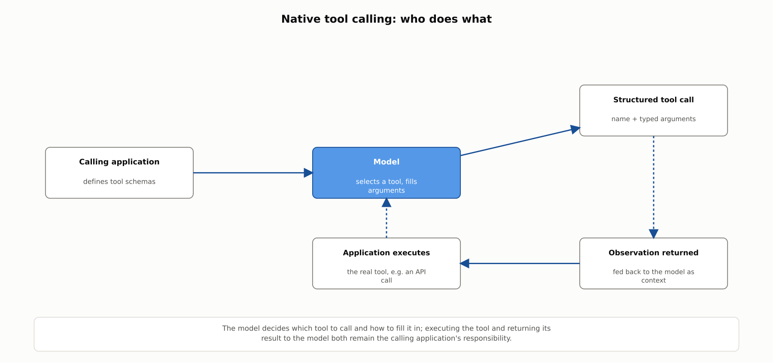
DEEP-DIVE
Native tool calling: who does what
The model selects a tool and fills its arguments; executing the tool and returning its result both remain the calling application's responsibility.

Slide 8
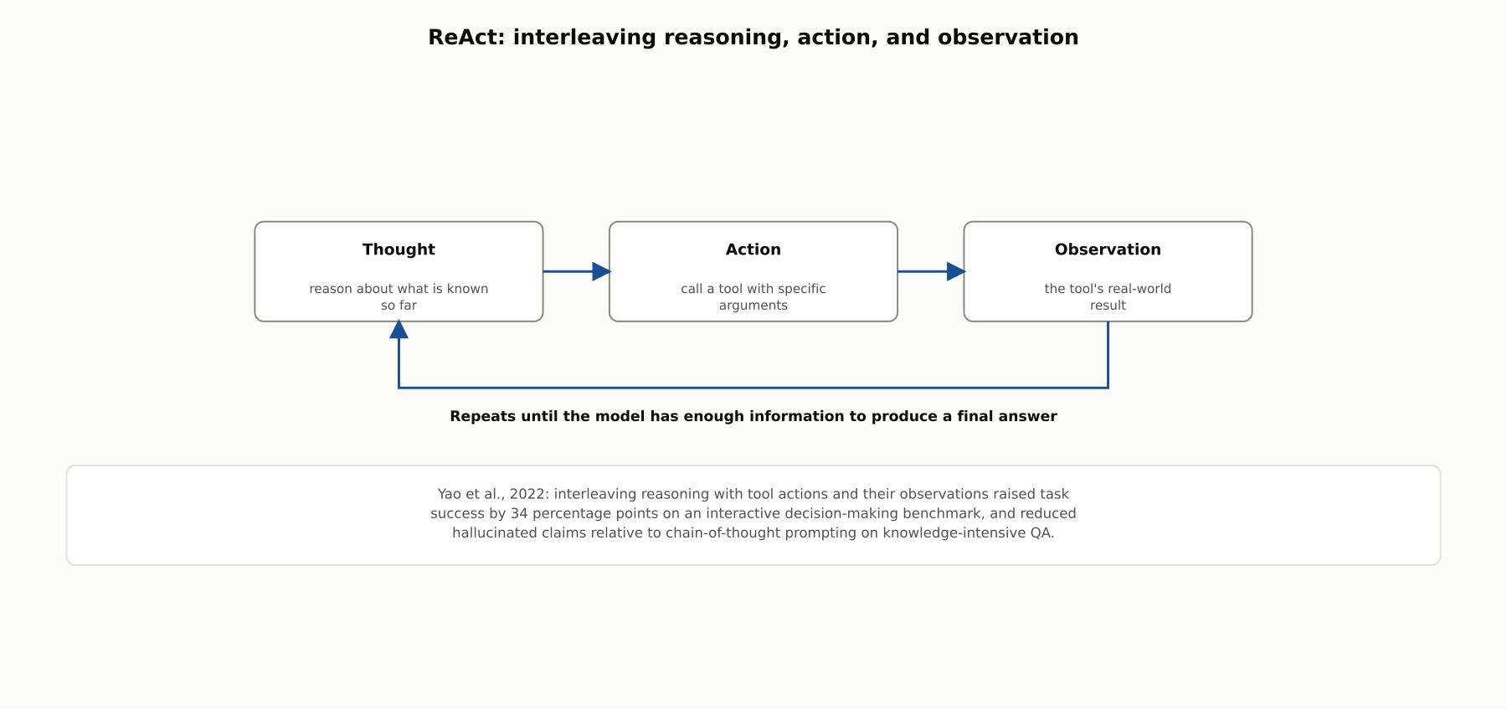
DEEP-DIVE
ReAct: interleaving reasoning, action, and observation
Yao et al., 2022: interleaving reasoning with tool actions and observations raised task success by 34 percentage points on an interactive decision-making benchmark.

Slide 9
DEEP-DIVE
A schema-valid call is not a correct call
Schema or grammar constraints guarantee shape, not content
A tool call can be well-formed JSON naming a real tool with a hallucinated argument value
Gorilla: fine-tuning specifically for API-calling accuracy, with retrieval over the API pool, reduces hallucinated calls
The Berkeley Function-Calling Leaderboard evaluates single, multiple, and parallel function-calling accuracy as its own benchmarkable capability

Slide 10
COMPARISON & RELATED CONCEPTS
Four ways to get structured output, and what each guarantees
Aspect | Prompted JSON (no enforcement) | Native function/tool calling | Constrained structured outputs | ReAct-style tool loop
Guarantees valid syntax? | No | Improves reliability, not guaranteed | Yes, by construction | Inherits guarantees of whichever call mechanism it uses
Guarantees correct values? | No | No | No | No, but observations can correct a later step
Requires special API support? | No, works with any model | Yes, a function/tool-calling API | Yes, a constrained-decoding-capable API | Built on top of a call mechanism, plus app-side orchestration
Best suited for | Low-stakes, easily re-parsed output | Single-step actions with typed arguments | Downstream systems that require a hard schema guarantee | Multi-step tasks needing information gathered along the way
Each approach solves a different part of the problem; none of them, on its own, verifies that the values inside a structured response are actually correct.

Slide 11
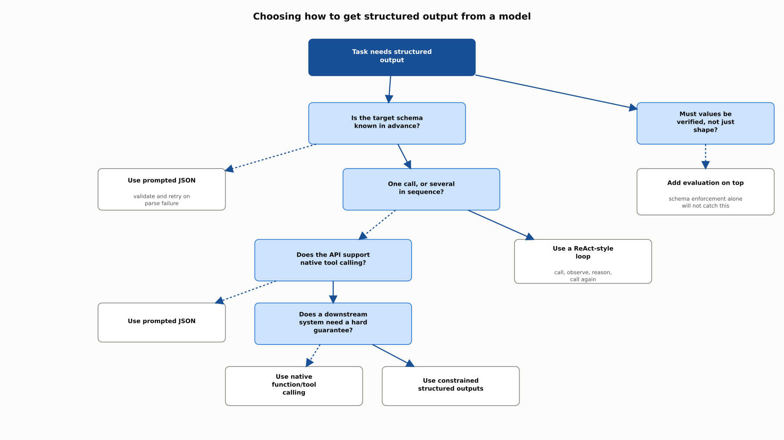
REFERENCE ARCHITECTURE
Choosing how to get structured output from a model
Schema availability and step count determine the mechanism; a separate check on whether values themselves need verification determines whether evaluation belongs on top.

Slide 12
INDUSTRY USE CASES
Finance
FINANCIAL SERVICES
Replacing prompted-JSON parsing in a transaction-categorization pipeline
Catching a schema-valid but hallucinated account number in a funds-transfer tool call
Problem: A pipeline asking for JSON "format" occasionally receives a response wrapped in commentary that breaks the downstream parser.
Problem: A funds-transfer tool call is schema-valid, but the account number itself does not match any account the customer holds.
Solution: Switch to native structured outputs so the response is schema-constrained at the decoding level.
Solution: Verify the argument's value against actual account records before the transfer executes.
Watch for: A silently dropped malformed response could leave transactions uncategorized until a reconciliation report comes up short.
Watch for: Trusting a schema-valid call as proof of correctness could route funds to a wrong destination, a mistake schema enforcement alone would never catch.

Slide 13
INDUSTRY USE CASES
Healthcare & Telecom
HEALTHCARE + TELECOM
(Healthcare) Using a ReAct-style loop for medication reconciliation
(Telecom) Adopting native tool calling for a service-restart action
Problem: Reconciling medications requires checking a prescription record, then a fill history, then an allergy list, each informed by the last.
Problem: Free-text instructions for when to restart a service are inconsistently followed, sometimes restarting a healthy service or skipping a stuck one.
Solution: Run a ReAct-style loop so each lookup's result shapes the next, rather than a fixed sequence decided in advance.
Solution: Define a typed restart tool so the decision and its target are structured and logged for review.
Watch for: A rigid pre-planned sequence could skip a follow-up check the first lookup's result would have made clearly necessary.
Watch for: An inconsistently triggered restart could interrupt a healthy service or miss the one actually stuck, extending disruption either way.

Slide 14
CHECK YOUR UNDERSTANDING
Discuss before moving on
1. What are the main ways prompted JSON can fail, and why does this motivate native tool calling?
2. How does OpenAI's Structured Outputs mode differ from simply prompting a model to follow a schema?
3. Why does a schema-valid tool call not guarantee a correct one?
4. What is the core idea behind ReAct, and what did Yao et al. report?
5. What does Gorilla contribute beyond native function-calling APIs?

Slide 15
CHAPTER 5.3 · PHASE 5
Key Takeaways
Prompted JSON has no enforcement; native tool calling and constrained decoding each add a stronger guarantee
Constrained decoding guarantees shape, never content
ReAct-style loops let multi-step tasks adapt to what earlier tool calls actually return
Fine-tuning and dedicated benchmarks now treat function-calling accuracy as its own capability
Next: 5.4 Structured Output Enforcement & Constrained Decoding, Deep Dive

