Slide 1
CHAPTER 5.4 · PHASE 5
Structured Output Enforcement & Constrained Decoding, Deep Dive
How token masking, grammars, and finite-state machines turn a schema into a hard guarantee, and what they still cannot guarantee.
Prompt Engineering & LLM Application Development

Slide 2
AGENDA
What this chapter covers
The core mechanism: masking invalid tokens at every decoding step
The tokenization-boundary problem, and how it is resolved
Outlines: compiling a schema into a finite-state machine
XGrammar: making grammar-constrained decoding fast enough for production
What constrained decoding still cannot guarantee: correct values
The real cost of the guarantee: compilation latency and grammar-writing pitfalls

Slide 3
TL;DR
The short version
A JSON Schema is compiled into a grammar; at every step, invalid tokens are masked out before sampling
Tokens are subwords, not characters, so grammars must be resolved at the token level (Geng et al.)
Outlines compiles a schema/regex into a finite-state machine with a precomputed state-to-token index
XGrammar precomputes context-independent token checks (over 99% of tokens) for large speedups
A grammar guarantees shape, never content: OpenAI's own docs confirm values can still be wrong
The first request against a new schema pays a real compilation cost, cached after that

Slide 4
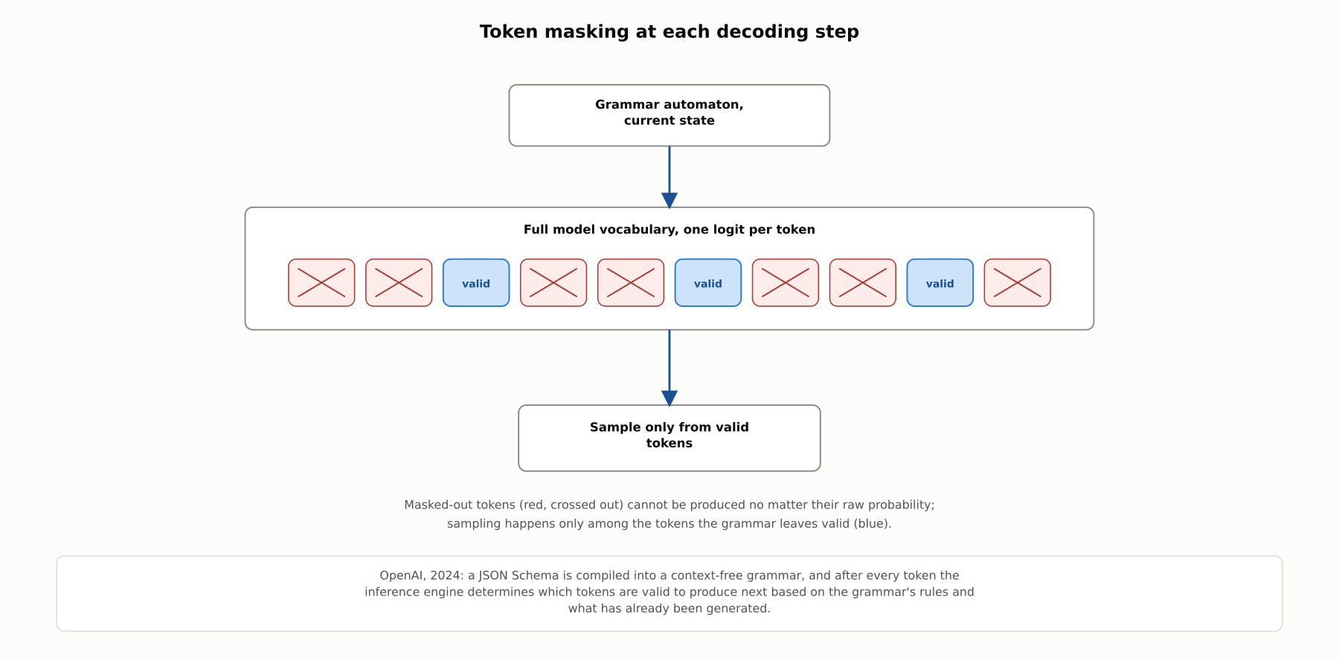
HIGH-LEVEL
Token masking at each decoding step
At every decoding step, the grammar's current state determines which tokens are even eligible to be sampled; everything else is masked out before sampling happens.

Slide 5
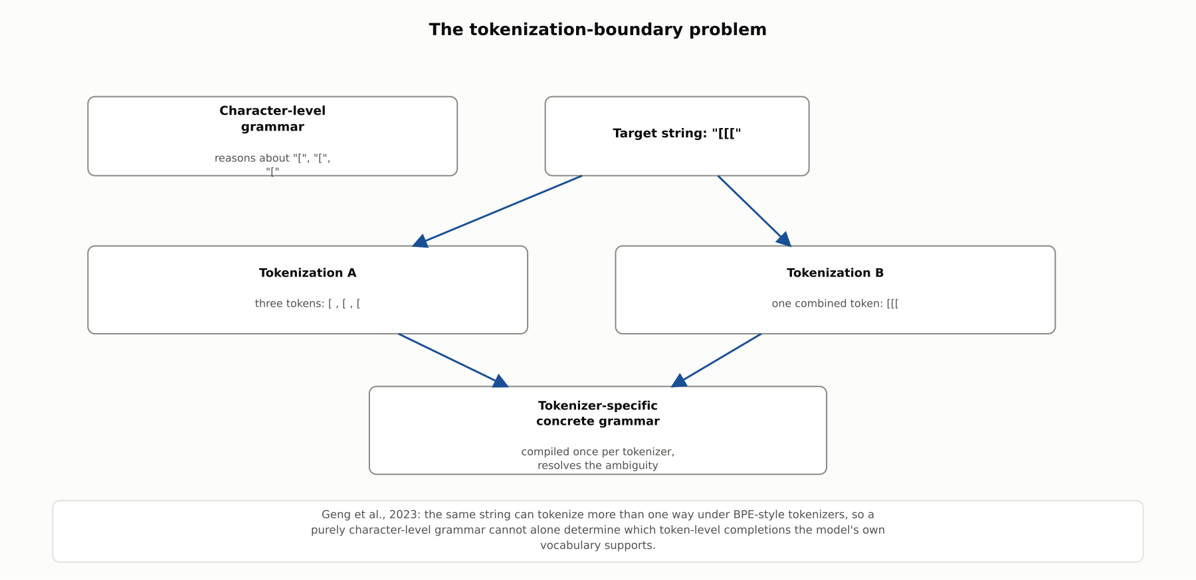
DEEP-DIVE
The tokenization-boundary problem
Geng et al., 2023: the same string can tokenize more than one way under BPE, so grammars must be resolved at the token level via a tokenizer-specific concrete grammar.

Slide 6
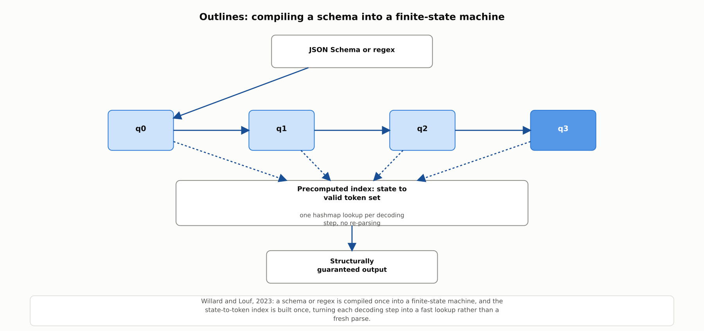
DEEP-DIVE
Outlines: compiling a schema into a finite-state machine
Willard and Louf, 2023: a schema or regex is compiled once into an FSM, with a precomputed state-to-token index turning each decoding step into a fast lookup.

Slide 7
DEEP-DIVE
Finite-state machines versus fuller context-free grammars
A regex or a JSON Schema without recursive structure is expressible as a finite-state machine (FSM)
An FSM lets the entire state-to-token index be precomputed once, making each step a fast lookup
A grammar with recursive or deeply nested structure needs a fuller context-free grammar (CFG) engine
A CFG engine can express more, at the cost of some runtime bookkeeping an FSM does not need

Slide 8
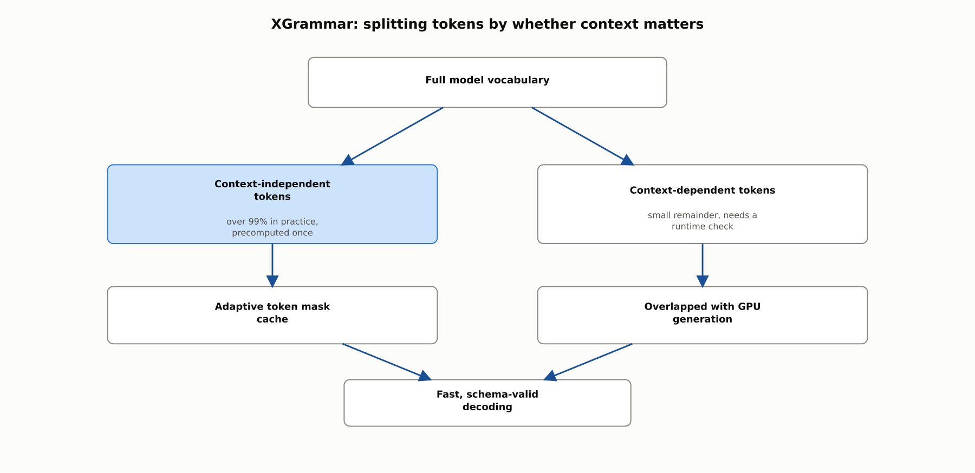
DEEP-DIVE
XGrammar: splitting tokens by whether context matters
Over 99% of tokens can be precomputed as context-independent; XGrammar reports up to roughly 3x faster JSON-schema mask computation and over 100x on general CFG workloads versus earlier engines.

Slide 9
DEEP-DIVE
What none of this guarantees, and what it costs
OpenAI: "Structured Outputs doesn't prevent all kinds of model mistakes... the model may still make mistakes within the values"
A grammar constrains shape, never content; catching wrong values requires evaluation, not a tighter schema
The first request against a new schema pays a real compilation cost, often under 10 seconds, up to a minute for complex schemas
Inefficiently written grammar patterns can force far more automaton states to track than a compact equivalent

Slide 10
COMPARISON & RELATED CONCEPTS
Four ways to enforce structure, and what each costs
Aspect | Naive per-token grammar walk | FSM-precomputed index (Outlines) | Optimized engine (XGrammar) | Fine-tuning for format adherence
Core mechanism | Re-parse the grammar from scratch at each step | Precomputed state-to-token index, hashmap lookup per step | Precomputed context-independent token checks plus a small runtime remainder | Train the model itself to prefer the target format
Guarantees structural validity? | Yes, but potentially slow | Yes | Yes, and fast | No, only a learned tendency
Per-token overhead | Can be significant for large vocabularies | Low, mostly precomputed | Very low, ~99% of tokens precomputed | None at inference time
Best suited for | Simple grammars, low request volume | JSON Schema or regex-shaped targets | High-throughput production serving | Cases with no access to constrained decoding infrastructure
These sit on a spectrum of engineering maturity for the same underlying guarantee; none of them, including fine-tuning, guarantees the values inside a structurally valid output are actually correct.

Slide 11
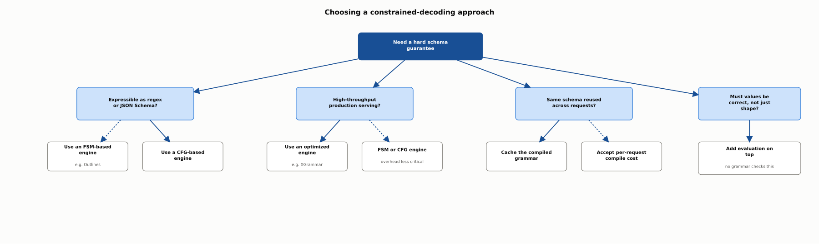
REFERENCE ARCHITECTURE
Choosing a constrained-decoding approach
Schema shape and throughput needs determine the engine; reuse frequency determines whether compilation cost is cached or accepted; value correctness always needs a separate evaluation layer.

Slide 12
INDUSTRY USE CASES
Finance
FINANCIAL SERVICES
A tokenization-boundary bug silently corrupting a constrained decimal-amount field
A first-request grammar-compilation delay disrupting a real-time trading-desk assistant
Problem: A currency-amount grammar was validated only against character-level rules, never against the tokenizer's actual boundaries.
Problem: Introducing a new response schema mid-session triggers a first-request compilation delay at a moment when a fast reply matters.
Solution: Test the compiled grammar against the tokenizer's real token boundaries across the full range of amount formats.
Solution: Pre-warm and cache newly introduced schemas during a quiet period rather than paying the cost live.
Watch for: An untested boundary case could force an unintended fallback, producing a figure that parses as valid but is not the amount actually intended.
Watch for: An unexpected multi-second delay could push a time-sensitive trading decision past the window where the number was still actionable.

Slide 13
INDUSTRY USE CASES
Healthcare & Telecom
HEALTHCARE + TELECOM
(Healthcare) Trusting a decoding-time-guaranteed lab-reference-range field as a verified one
(Telecom) Choosing an FSM-based engine over a general CFG engine for an alert-classification schema
Problem: Staff have started treating a schema-valid reference range as proof the range itself is correct for the specific test.
Problem: A simple, JSON-Schema-expressible alert-classification task defaults to a heavier general-purpose CFG engine than it needs.
Solution: Keep an independent check of the reference-range value against actual test and population norms.
Solution: Recognize the schema is FSM-expressible and use a lighter, precomputed-index engine instead.
Watch for: A well-typed but wrong reference range could make an abnormal result read as normal to a clinician scanning quickly.
Watch for: Running an unnecessarily heavy grammar engine at peak alert volume could add latency exactly when triage speed matters most.

Slide 14
CHECK YOUR UNDERSTANDING
Discuss before moving on
1. What does it mean to "mask" a model's output at each decoding step?
2. What is the tokenization-boundary problem, and how do Geng et al. and Outlines each address it?
3. What is Outlines' core approach to constrained generation, and what guarantee does it provide?
4. What optimization does XGrammar introduce, and what speedup did its authors report?
5. Why does a schema-valid output still require a separate evaluation step?

Slide 15
CHAPTER 5.4 · PHASE 5
Key Takeaways
Constrained decoding masks invalid tokens at every step; it does not ask the model to comply
Tokenization boundaries are a real engineering problem, solved by reasoning at the token level
FSM-based and optimized engines trade engineering effort for speed at the same guarantee
The guarantee is always shape, never content; evaluation remains a separate, necessary layer
Next: 5.5 System Prompts, Guardrails & Prompt-Injection Defense

