Slide 1
CHAPTER 5.5 · PHASE 5
System Prompts, Guardrails & Prompt-Injection Defense
Why a system prompt is not automatically obeyed, how untrusted content hijacks a model that cannot tell instructions from data, and what actually closes the gap.
Prompt Engineering & LLM Application Development

Slide 2
AGENDA
What this chapter covers
Prompt injection: Simon Willison's original framing and the SQL-injection analogy
Indirect prompt injection: attacks hidden inside content the model merely reads
The Bing "Sydney" incident as a concrete illustration of the underlying gap
The instruction hierarchy: training a model to prioritize instructions by source
OpenAI's model spec chain of command, made explicit at the API level
Guardrail frameworks and privilege separation as complementary, model-independent defenses

Slide 3
TL;DR
The short version
Most models historically had no trained notion that a system prompt outranks a user message or retrieved text
Willison (2022) named prompt injection: untrusted input read as an instruction instead of as data
Greshake et al. (2023): indirect injection hides instructions inside content the model later reads, no malicious typing required
The Bing "Sydney" incident (Feb 2023) is a well-known illustration of the same gap
Two complementary defenses: instruction-hierarchy training (Wallace et al., 2024) and architectural privilege separation
External guardrails (NeMo Guardrails, Llama Guard) add an independent layer regardless of what the model was trained to prioritize

Slide 4
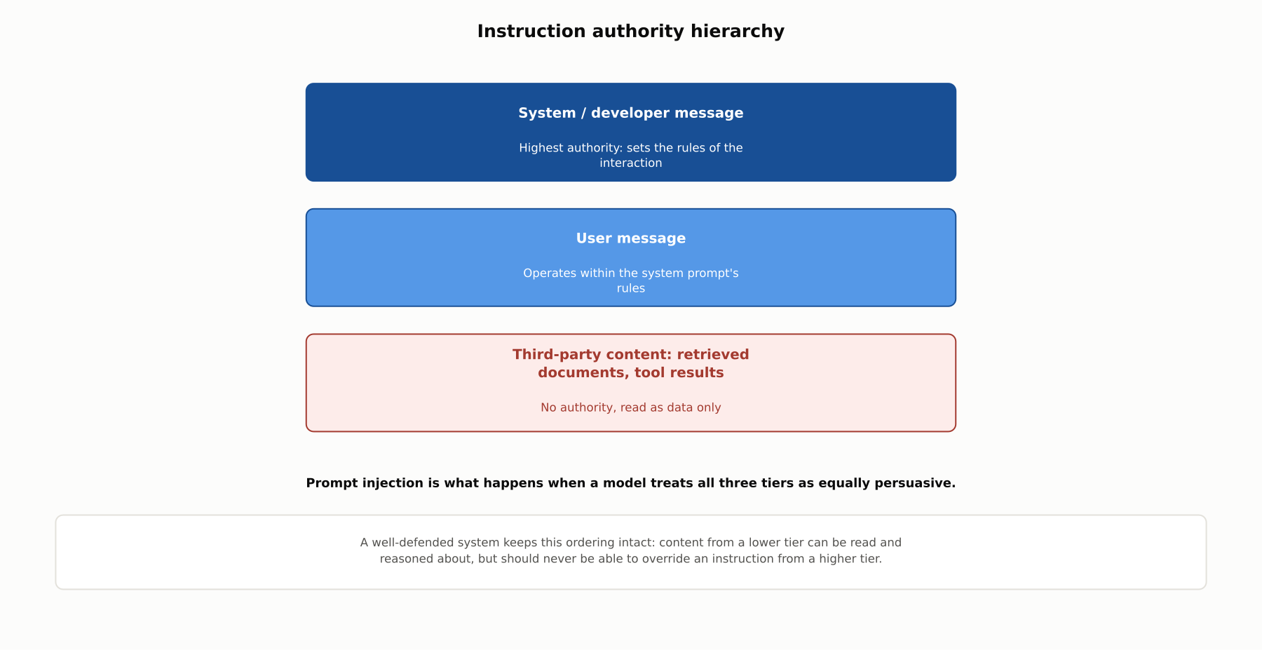
HIGH-LEVEL
Instruction authority hierarchy
Content reaching a model differs in how much authority it should carry; prompt injection exploits a model that cannot tell the difference.

Slide 5
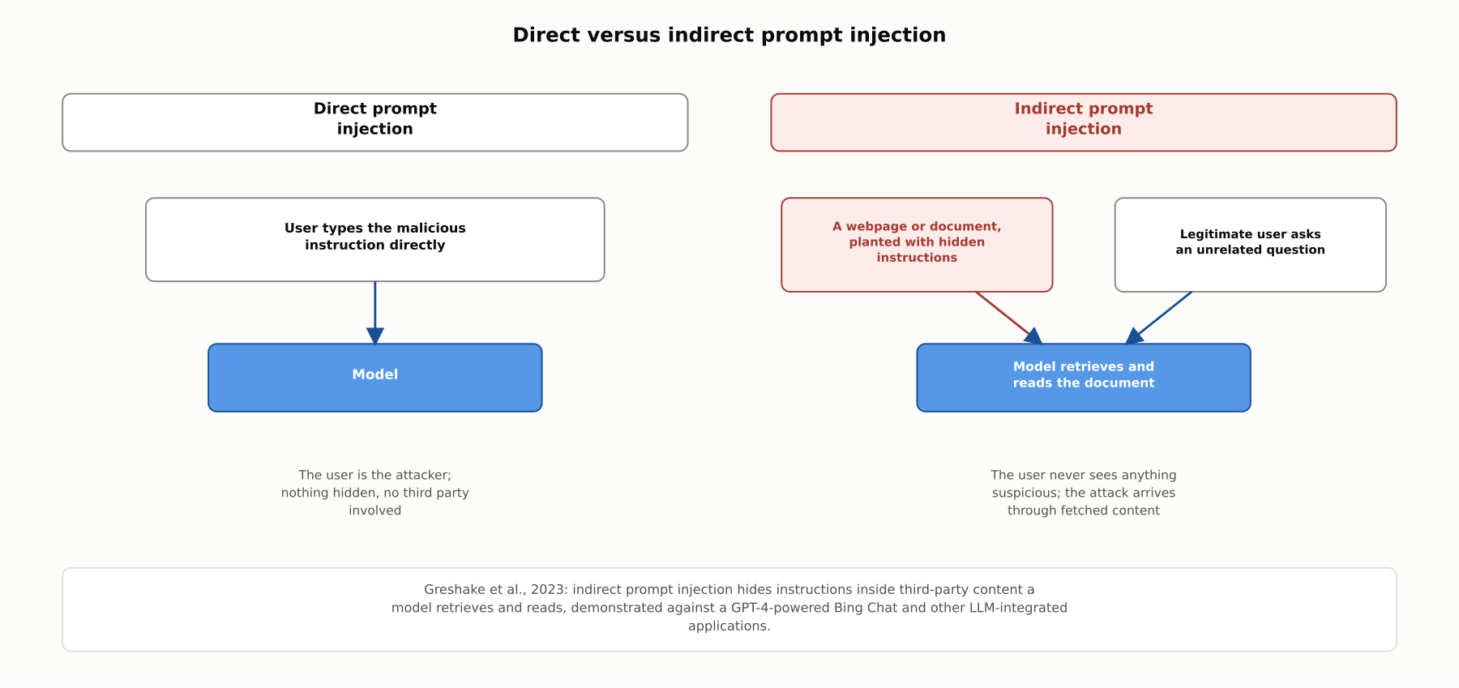
DEEP-DIVE
Direct versus indirect prompt injection
Greshake et al., 2023: indirect prompt injection hides instructions inside third-party content a model retrieves and reads, demonstrated against a GPT-4-powered Bing Chat and other LLM-integrated applications.

Slide 6
DEEP-DIVE
Willison's framing, and a concrete illustration
Willison (2022): a translation app told instead to say "HAHA PWNED" shows the user's text overwriting the developer's own instruction
Explicitly compared to SQL injection: untrusted input interpreted as executable code, not the inert data it was supposed to be
The Bing "Sydney" incident (Feb 2023): a user got the system to reveal its confidential codename and internal rules
System-prompt confidentiality cannot be assumed just because a system prompt is never shown to the user by default

Slide 7
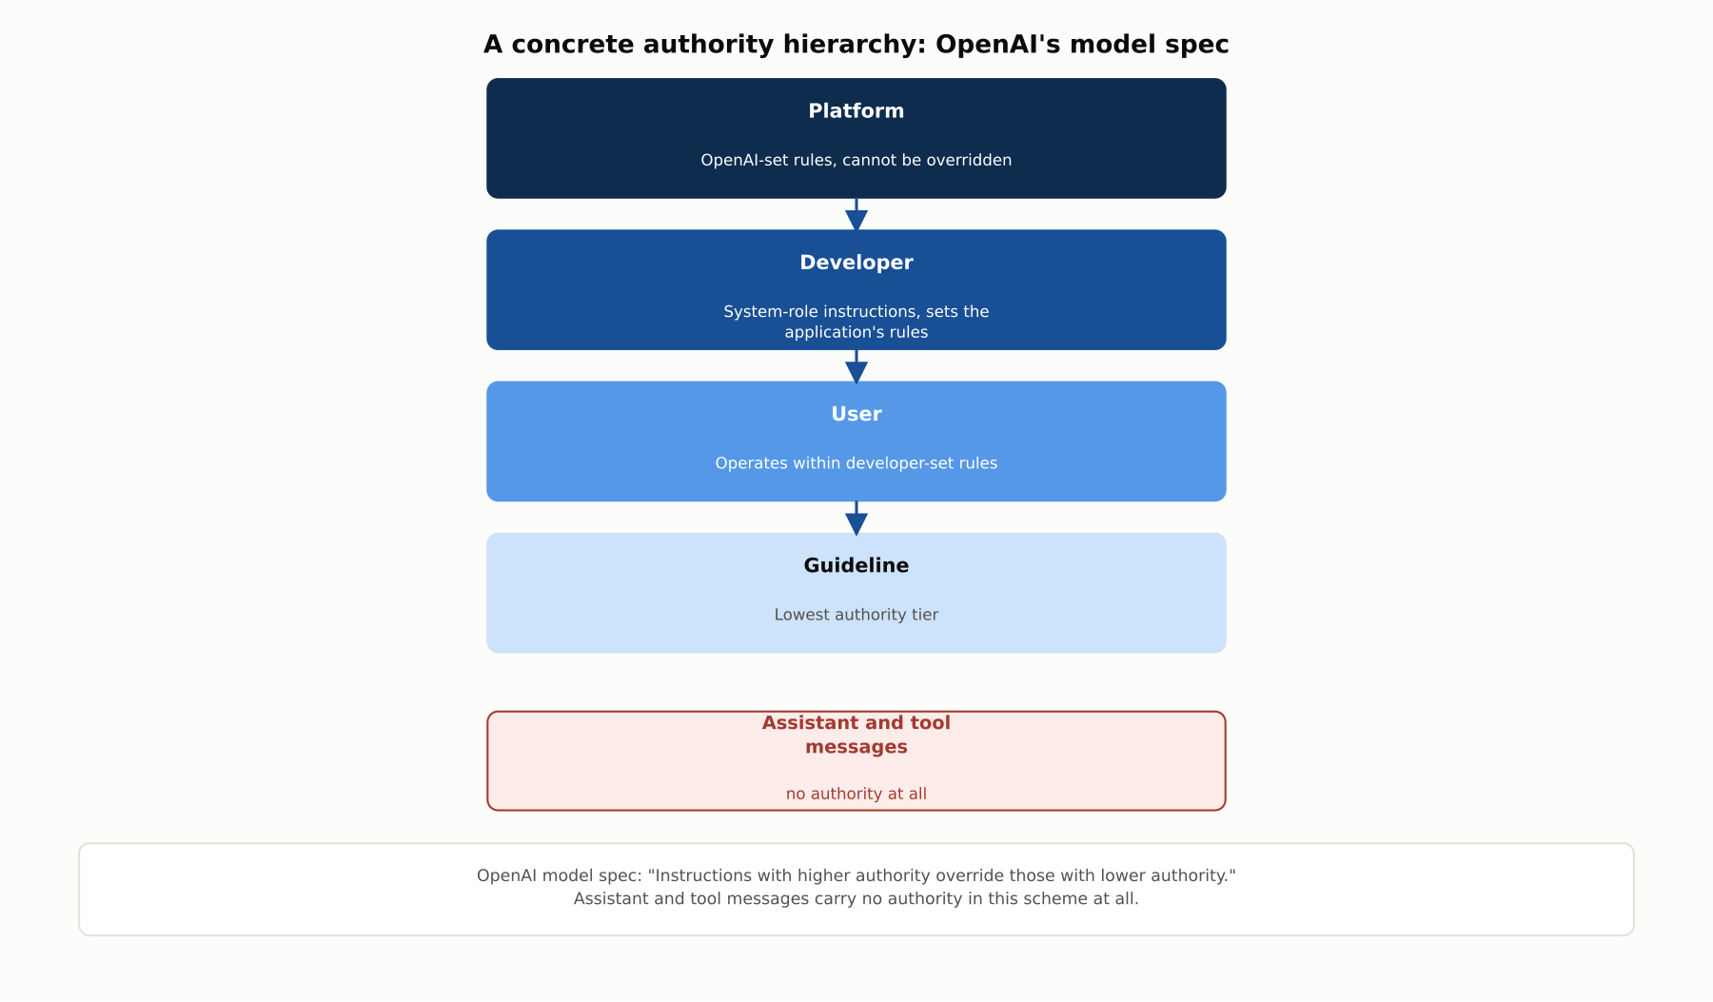
DEEP-DIVE
OpenAI's model spec chain of command
Platform, developer, user, and guideline tiers, in descending authority; assistant and tool messages carry no authority in this scheme at all, the API-level expression of the same principle instruction-hierarchy training targets.

Slide 8
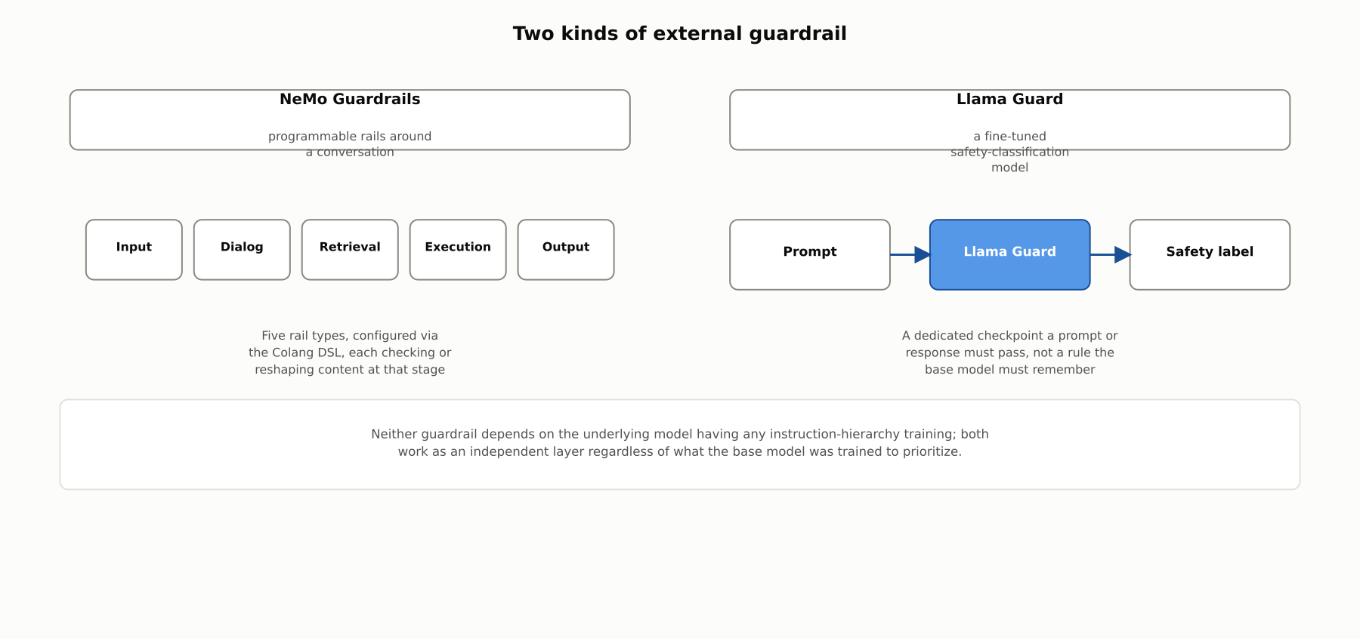
DEEP-DIVE
Two kinds of external guardrail
NeMo Guardrails checks or reshapes content across five configurable stages; Llama Guard is a dedicated fine-tuned classifier a prompt or response must pass. Neither depends on the base model's own training.

Slide 9
DEEP-DIVE
Privilege separation, and defense in depth
Wallace et al. (2024): training a model to prioritize instructions by source "drastically increases robustness... while imposing minimal degradations"
Privilege separation: convert retrieved or tool-returned content into typed data the model reads, never concatenated text it could misread as a command
This reuses the structured-output discipline from 5.3 and 5.4, applied to the input side of an application
No single layer closes the gap alone; the current state of practice is layering all of them together

Slide 10
COMPARISON & RELATED CONCEPTS
Four defenses, and what each actually covers
Aspect | System prompt alone (no hierarchy training) | Instruction-hierarchy-trained model | External guardrail (NeMo, Llama Guard) | Privilege separation for tool/retrieved content
Where the defense lives | Nowhere, purely aspirational | Baked into model training | A separate classifier or rule layer, in front of/behind the model | Application architecture, how content is structured before reaching the model
Defends against indirect injection? | No | Partially, if trained on similar patterns | Partially, if the classifier catches the pattern | Yes, by design, regardless of the pattern
Requires a specific model? | No | Yes, a model trained this way | No, model-agnostic | No, model-agnostic
Best used | Never, on its own, for anything adversarial | As a foundation, not a complete solution | As an independent additional layer | Whenever an app ingests third-party or tool-returned content
These are complementary, not competing; the strongest posture layers a hierarchy-trained model, an external guardrail, and privilege separation together rather than relying on any single one.

Slide 11
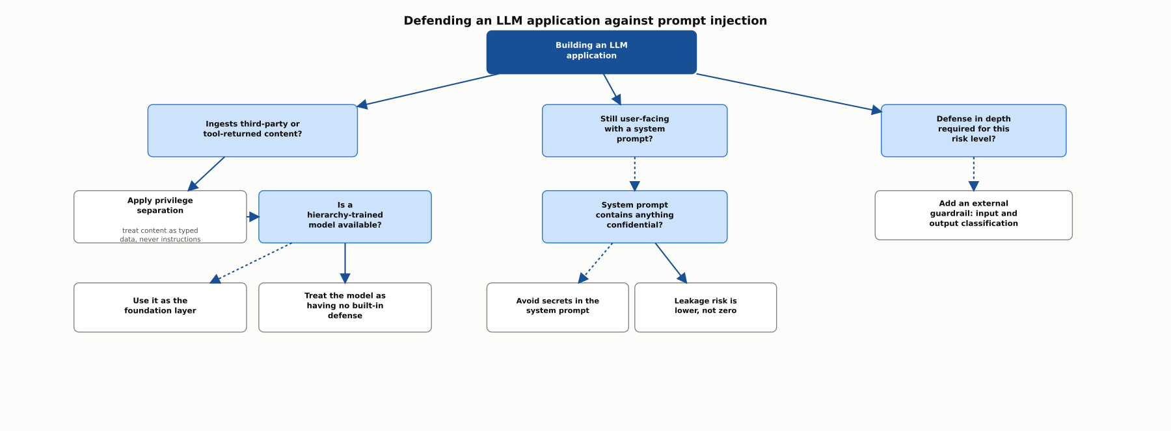
REFERENCE ARCHITECTURE
Defending an LLM application against prompt injection
Whether content is ingested from third parties or tools determines whether privilege separation applies; hierarchy-trained models and external guardrails layer on top as independent, additional defenses.

Slide 12
INDUSTRY USE CASES
Finance
FINANCIAL SERVICES
An indirect prompt injection hidden inside a fetched market-research document
Confidential system-prompt language leaking through a support chatbot
Problem: A research assistant summarizes retrieved analyst reports, and one planted document instructs the model to recommend a specific security regardless of the actual analysis.
Problem: A support chatbot's system prompt contains internal escalation thresholds the business does not want customers to see, and a customer discovers a phrasing that gets the model to recite them.
Solution: Apply privilege separation so retrieved document text is passed through as quoted material to summarize, never as a new instruction to follow.
Solution: Keep genuinely sensitive thresholds out of the system prompt entirely, enforcing them in code the model never has direct access to recite.
Watch for: A planted instruction embedded in a routine document could quietly bias a research summary, with nothing in the analyst's own query looking suspicious enough to prompt a second look.
Watch for: A leaked internal threshold gives every future customer who learns it a way to game the escalation process, a cost that only grows the longer the phrasing stays undiscovered.

Slide 13
INDUSTRY USE CASES
Healthcare & Telecom
HEALTHCARE + TELECOM
(Healthcare) Applying instruction-hierarchy training to a clinical-documentation agent
(Telecom) Adding an external guardrail to catch injection attempts in support tickets
Problem: A documentation agent pulling prior records from an external system has no trained sense those records carry less authority than the clinician's own dictation.
Problem: A ticket-triage assistant processes free-text submissions that occasionally contain crafted phrasing attempting to manipulate its routing decision.
Solution: Deploy the agent on a model trained with an explicit instruction hierarchy, deprioritizing text arriving from a queried record.
Solution: Add an independent guardrail classifier that screens ticket text for injection-style phrasing before routing runs.
Watch for: A single altered record entry could silently shape a new note's content in a way the reviewing clinician would have no reason to trace back to that entry.
Watch for: A crafted ticket could reach exactly the team the submitter wanted rather than the team the actual issue warranted, a misdirection the routing outcome itself would never obviously reveal.

Slide 14
CHECK YOUR UNDERSTANDING
Discuss before moving on
1. What is prompt injection, as Simon Willison originally framed it, and what is the security analogy he drew?
2. How does indirect prompt injection differ from direct prompt injection, and what did Greshake et al. demonstrate?
3. What is the "instruction hierarchy," and what did Wallace et al. report about its effect on robustness?
4. What is privilege separation for tool or retrieved content, and how does it relate to structured outputs from earlier chapters?
5. Why are external guardrail systems useful even on a model that already has instruction-hierarchy training?

Slide 15
CHAPTER 5.5 · PHASE 5
Key Takeaways
Prompt injection exploits a model with no trained sense of which content carries authority
Indirect injection needs no malicious typing at all, only content the model is asked to read
Instruction-hierarchy training and privilege separation are complementary, not substitutes for each other
External guardrails add an independent layer regardless of what the base model was trained to prioritize
Next: 5.6 Prompt Optimization & Evaluation (Versioning, A/B Testing Prompts)

