Slide 1
CHAPTER 5.6 · PHASE 5
Prompt Optimization & Evaluation (Versioning, A/B Testing Prompts)
Why a prompt that looked better on a glance is not the same thing as a prompt that has been evaluated, versioned, and properly tested.
Prompt Engineering & LLM Application Development

Slide 2
AGENDA
What this chapter covers
Why ad hoc prompt iteration breaks down, and what a golden dataset fixes
Grading methods: code-based, human, and LLM-as-judge
How reliable an LLM judge really is, and its documented biases (Zheng et al.)
G-Eval: improving judge quality with chain-of-thought and form-filling
Prompt versioning and diffing tools: LangSmith, PromptLayer, Weights & Biases Weave
A/B testing prompts with real statistical rigor, and automatic prompt optimization (APE, DSPy)

Slide 3
TL;DR
The short version
A prompt change needs a version history, a held-out golden dataset, and a real grading method, the same discipline as a code review
Zheng et al. (2023): GPT-4 as judge agreed with humans about 85% of the time, versus 81% human-human agreement, but with position, verbosity, and self-enhancement bias
G-Eval (Liu et al., 2023) improves judge alignment with chain-of-thought plus form-filling, reporting 0.514 Spearman correlation with humans
LangSmith, PromptLayer, and Weights & Biases Weave treat prompts as versioned, diffable, taggable artifacts
A/B testing prompts needs real statistical power and significance testing, not an eyeballed pass-rate difference
APE and DSPy treat the prompt itself as an optimizable parameter, searched or compiled rather than hand-tuned

Slide 4
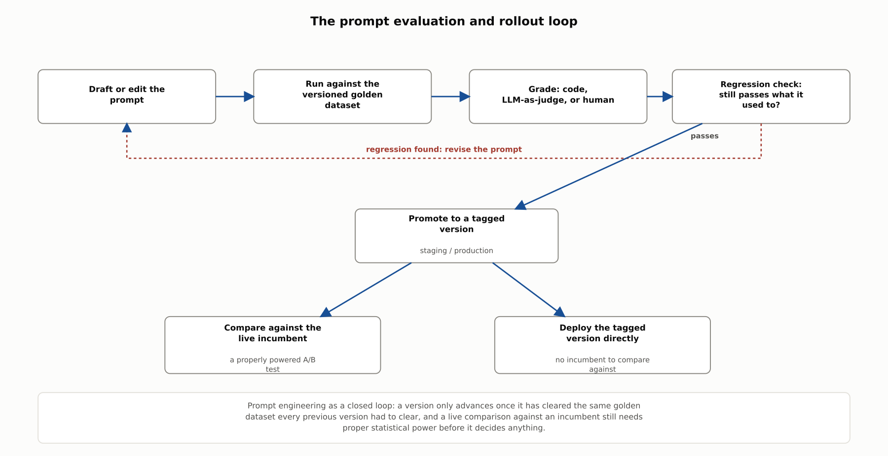
HIGH-LEVEL
The prompt evaluation and rollout loop
A version only advances once it clears the same golden dataset every previous version had to clear, and a live comparison against an incumbent still needs proper statistical power before it decides anything.

Slide 5
DEEP-DIVE
Golden datasets and regression evals
A golden dataset is a curated, versioned set of representative cases every candidate prompt is run against
Anthropic: a regression eval asks whether a prompt "still handle[s] all the tasks it used to," near 100% pass rate expected
Start small and real: "20-50 simple tasks drawn from real failures is a great start"
Hamel Husain: a team does not need to wait for production traffic to begin testing a system

Slide 6
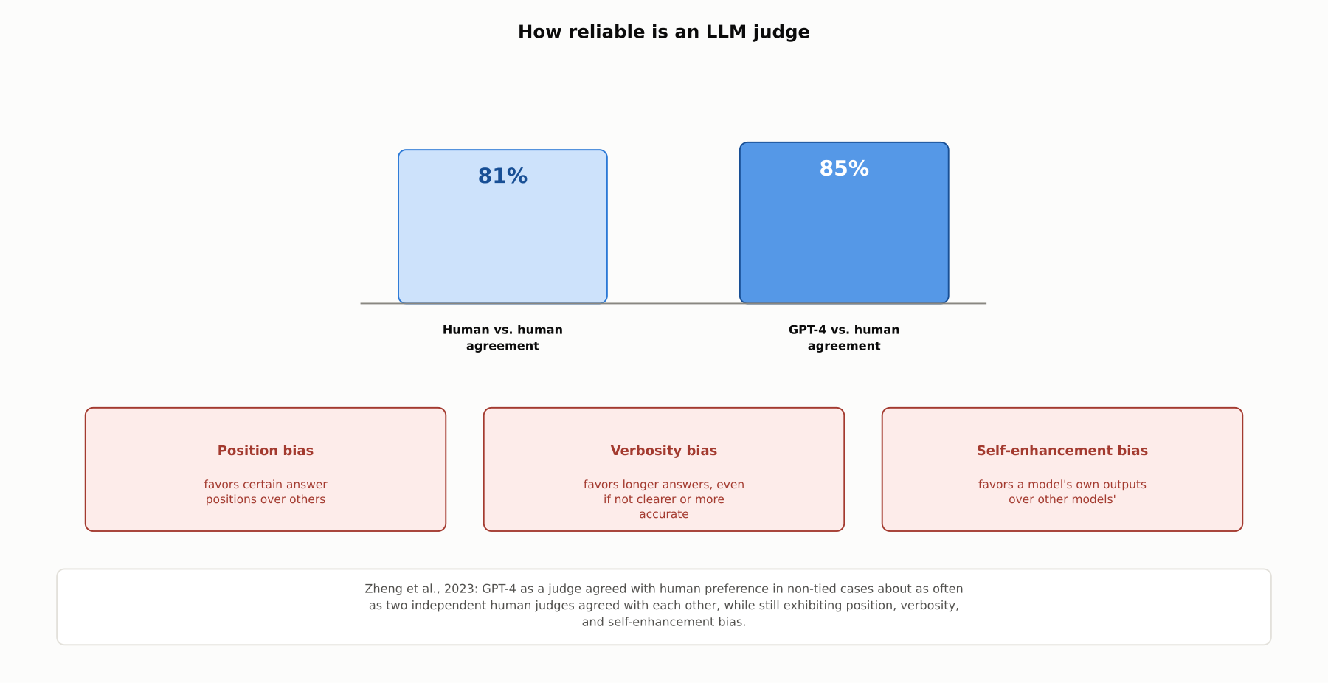
DEEP-DIVE
How reliable is an LLM judge
Zheng et al., 2023: GPT-4 as judge agreed with human preference about as often as two humans agreed with each other, while still showing position, verbosity, and self-enhancement bias.

Slide 7
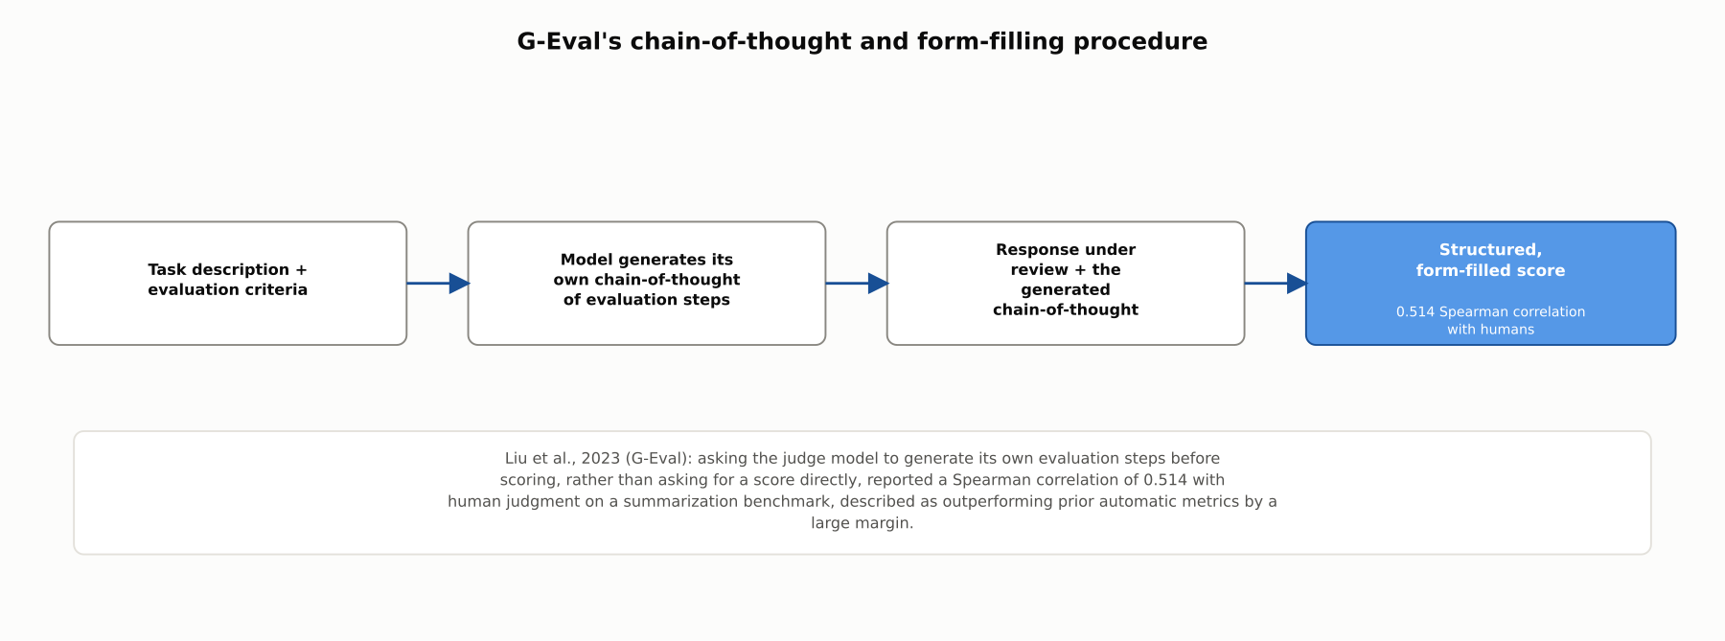
DEEP-DIVE
G-Eval's chain-of-thought and form-filling procedure
Liu et al., 2023: having the judge model generate its own evaluation steps before scoring reported a 0.514 Spearman correlation with human judgment, outperforming prior automatic metrics by a large margin.

Slide 8
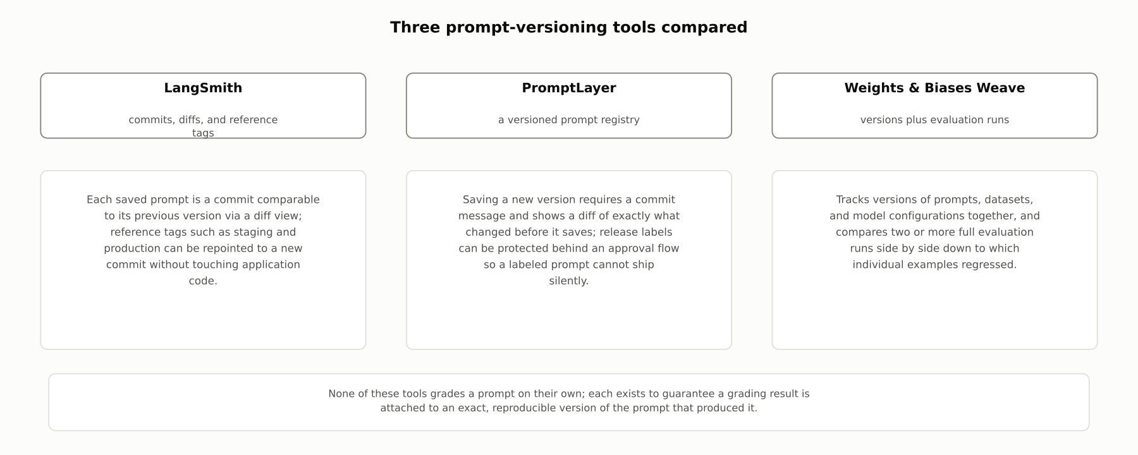
DEEP-DIVE
Three prompt-versioning tools compared
LangSmith, PromptLayer, and Weights & Biases Weave each treat a prompt as a versioned, diffable artifact; none of them grades a prompt on their own.

Slide 9
DEEP-DIVE
A/B testing prompts, and automatic optimization
A visible pass-rate lift on a small sample is not evidence without a power analysis and a significance test
Koehn (2004): paired bootstrap resampling, the standard method for testing whether one system beats another, transfers directly to comparing prompt variants
Anthropic's pass@k and pass^k summarize performance across repeated attempts rather than a single stochastic run
APE (Zhou et al.) searches candidate instructions; DSPy (Khattab et al.) compiles a pipeline's prompts via a "teleprompter" optimizer

Slide 10
COMPARISON & RELATED CONCEPTS
Four ways to decide if a prompt change is better
Aspect | Ad hoc manual iteration | Code-based grading | LLM-as-judge grading | Automatic prompt optimization (APE, DSPy)
What decides if a change is better | A person's impression of a few outputs | An exact match, regex, or schema check | Another model scoring outputs at dataset scale | A search or compiler maximizing a defined metric
Catches subjective quality issues? | Only as well as the reviewer notices | No, only objectively checkable properties | Yes, approximately, with known biases | Only as well as the metric captures them
Scales to frequent changes? | No, review time grows linearly | Yes, cheaply | Yes, at model-call cost | Yes, but each run costs many model calls
Best used | Early exploration before a dataset exists | Objectively correct answer shapes | Subjective quality at scale | Well-defined tasks where search outpaces tuning
Stages on the same maturity curve, not competitors; most production workflows combine code-based checks, LLM-as-judge grading, and reserved human review.

Slide 11
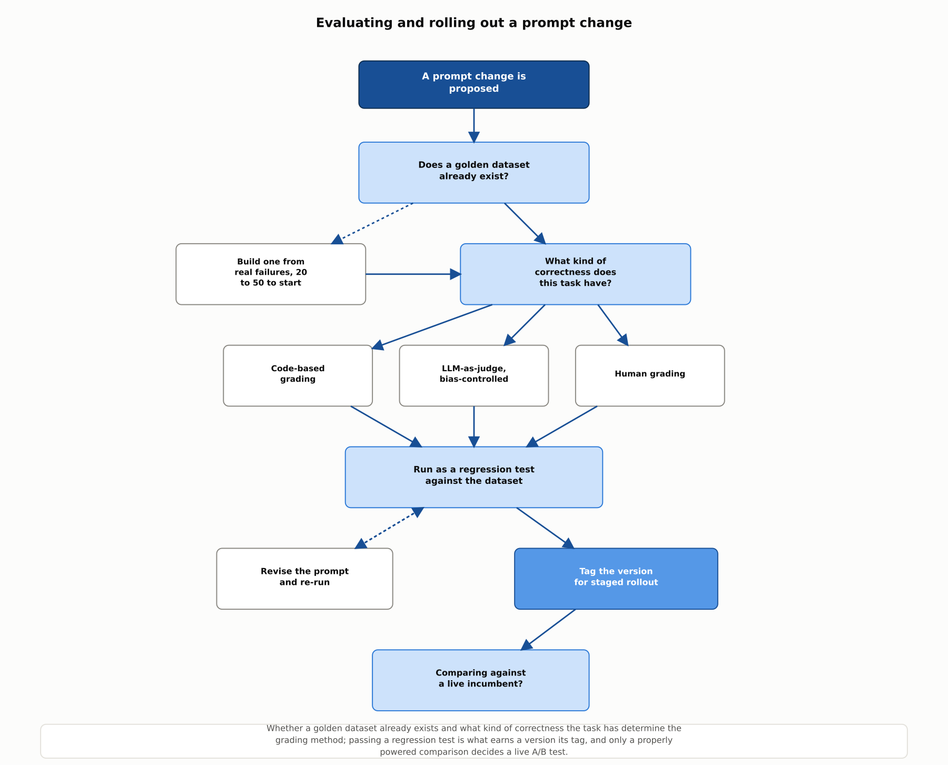
REFERENCE ARCHITECTURE
Evaluating and rolling out a prompt change
Dataset availability and the task's kind of correctness determine the grading method; a regression test earns a version its tag, and only a properly powered comparison decides a live A/B test.

Slide 12
INDUSTRY USE CASES
Finance
FINANCIAL SERVICES
Shipping a rewritten fraud-flagging prompt with no golden-dataset regression check
Declaring an A/B test winner from one day of live trading-desk-assistant traffic
Problem: An analyst tightens a fraud-detection prompt to catch a new pattern, and ships it once that one case is confirmed fixed.
Problem: A new prompt variant shows a higher pass rate after one day of traffic, and the team promotes it to full rollout on that basis alone.
Solution: Run the revised prompt against the full versioned golden dataset before deployment, not only the case that motivated the change.
Solution: Run the comparison with a proper power analysis and significance test before treating any observed difference as real.
Watch for: A prompt tuned to catch one new pattern can quietly stop catching an older one nobody re-tested, and the gap would not surface until a real fraud case slips through.
Watch for: A one-day sample is small enough that an apparent lift can be pure noise, risking a rollout that replaces a working prompt with a worse one believed, incorrectly, to be an improvement.

Slide 13
INDUSTRY USE CASES
Healthcare & Telecom
HEALTHCARE + TELECOM
(Healthcare) Self-enhancement bias in an LLM-as-judge setup comparing two summarizer models
(Telecom) Position bias in an LLM-as-judge setup comparing two ticket-routing prompts
Problem: The same model family used to generate discharge summaries is also used to judge which candidate is better, and its judgments favor its own family's outputs.
Problem: A judge model consistently prefers whichever candidate response is shown first, regardless of actual routing quality.
Solution: Use a judge model from a different family than the models being compared, or validate against an independent human-labeled sample.
Solution: Randomize which candidate appears first, or grade each candidate independently rather than only side by side.
Watch for: A biased judge could keep declaring a worse summarizer the winner simply because its wording resembles the judge's own style, not because it is more clinically accurate.
Watch for: An uncorrected position bias could make prompt iteration converge on whichever variant is listed first during evaluation, unrelated to actual routing quality.

Slide 14
CHECK YOUR UNDERSTANDING
Discuss before moving on
1. What is a golden dataset, and why should a regression eval's pass rate stay close to 100%?
2. What did Zheng et al. find about GPT-4-as-judge agreement with humans, and what three biases did they document?
3. How does G-Eval's grading procedure differ from asking a model for a quality score directly?
4. Why is a visible pass-rate improvement in a short A/B test not automatically evidence of a real difference?
5. How do APE and DSPy each treat prompt improvement differently from manual editing?

Slide 15
CHAPTER 5.6 · PHASE 5
Key Takeaways
Treat prompts like code: version them, diff them, and test every change against a held-out dataset
LLM-as-judge is a strong tool with known, correctable biases, not a free pass on rigor
A/B testing prompts needs the same statistical discipline as any other online experiment
Automatic prompt optimization still depends entirely on the quality of the metric and dataset behind it
Next: 5.7 Architecture Patterns for Your First LLM App

