Slide 1
CHAPTER 5.7 · PHASE 5
Architecture Patterns for Your First LLM App
A single call to a model API is a prototype, not a product; here is the rest of the restaurant around the chef.
Prompt Engineering & LLM Application Development

Slide 2
AGENDA
What this chapter covers
The a16z reference architecture for LLM applications (Bornstein and Radovanovic, 2023)
Orchestration: what it abstracted in 2023, and where it has moved since
Why chat completion APIs are stateless, and what that means for your app
Streaming: faster to first token, harder to moderate before delivery
Reliability: per-request exponential backoff versus a cross-provider LLM gateway
Cutting cost with a semantic cache, and seeing what happened with observability and tracing

Slide 3
TL;DR
The short version
a16z's reference architecture (2023) named the layers around a model call: orchestration, cache, gateway, observability, and validation
Chat completion APIs are stateless per request; the calling app, not the API, resends conversation history every turn
Both OpenAI and Anthropic recommend exponential backoff for rate-limit errors, not naive immediate retries
Streaming reduces time to first token, at the real cost of making partial output harder to moderate before it reaches a user
A gateway (LiteLLM, Portkey) solves a different problem than backoff: staying up when an entire provider is down
None of this is retrieval or multi-step autonomous behavior yet, those are Phase 6 and Phase 8 territory

Slide 4
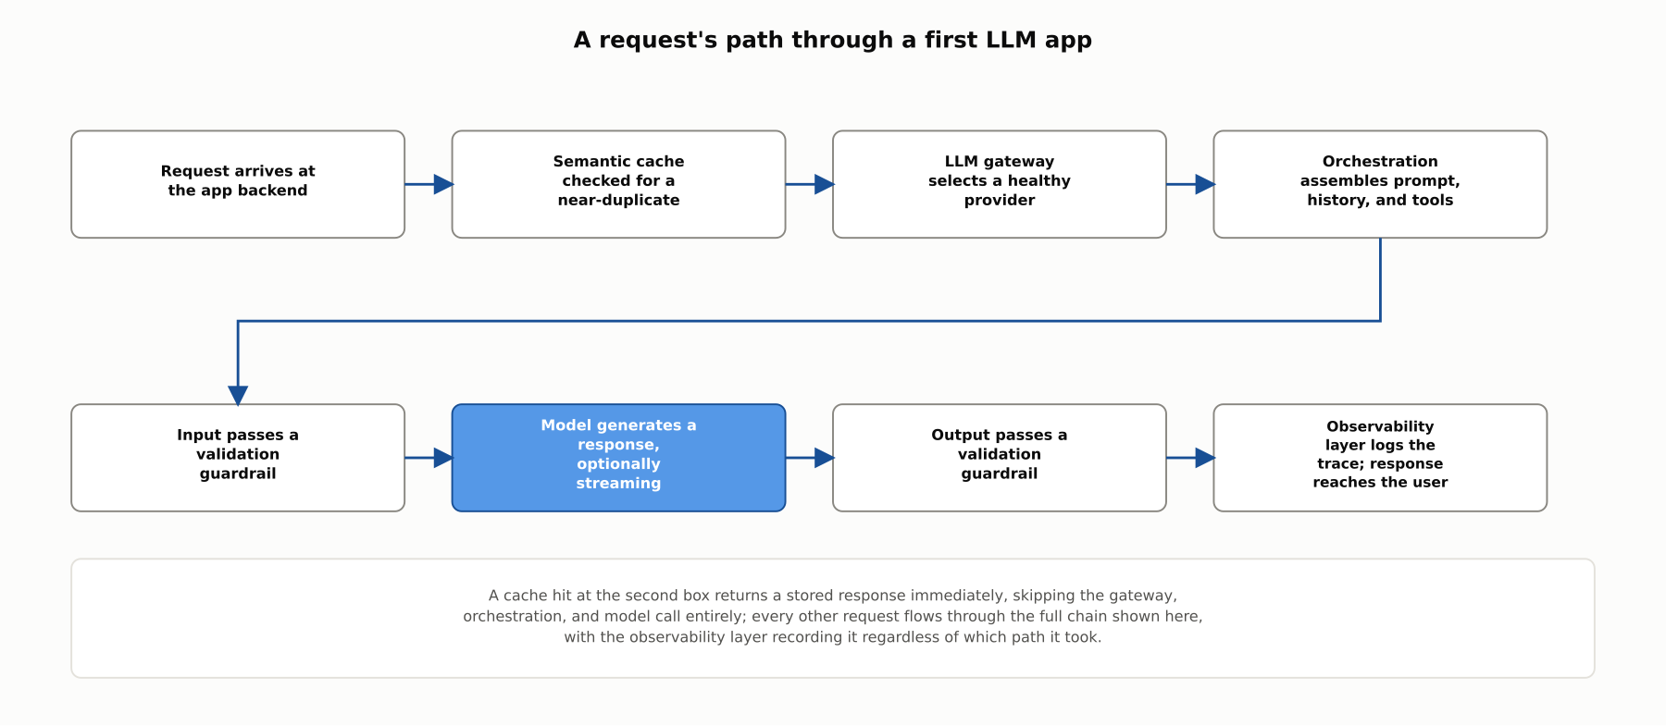
HIGH-LEVEL
A request's path through a first LLM app
A model API call is one box in a larger request lifecycle; a first production LLM app needs the rest of the boxes too.

Slide 5
DEEP-DIVE
The a16z reference architecture
Bornstein and Radovanovic (a16z, June 2023): the most widely cited map of a production LLM application stack
Three stages: data preprocessing and embedding, prompt construction and retrieval, prompt execution and inference
Orchestration "abstract[s] away...prompt chaining; interfacing with external APIs...retrieving contextual data...and maintaining memory across multiple LLM calls"
This chapter's scope: orchestration, caching, the gateway, observability, and validation, the layers before your app has a retrieval pipeline of its own

Slide 6
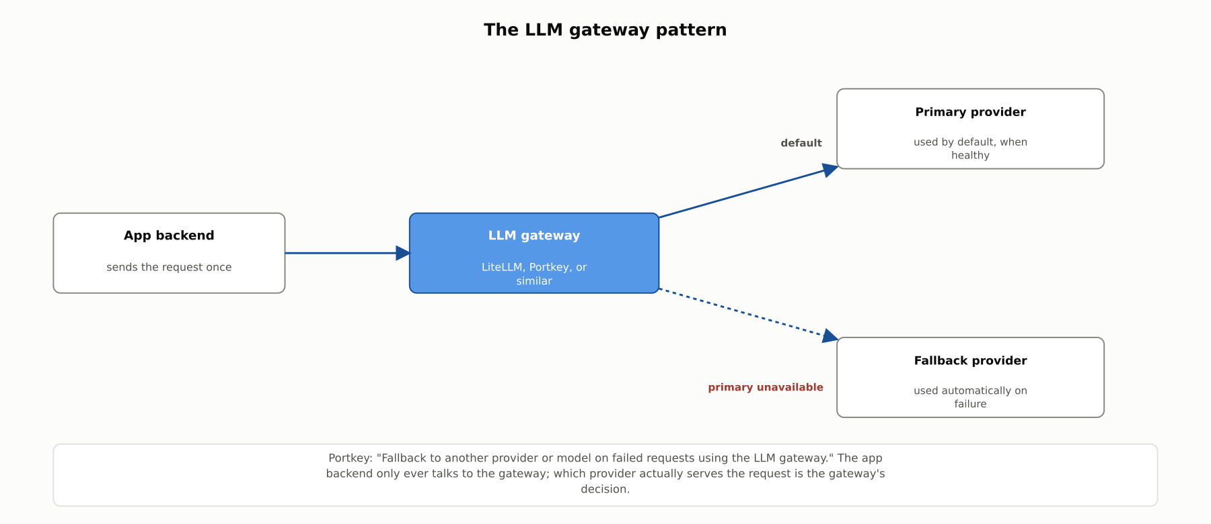
DEEP-DIVE
The LLM gateway pattern
Portkey: "Fallback to another provider or model on failed requests using the LLM gateway." The app backend only ever talks to the gateway.

Slide 7
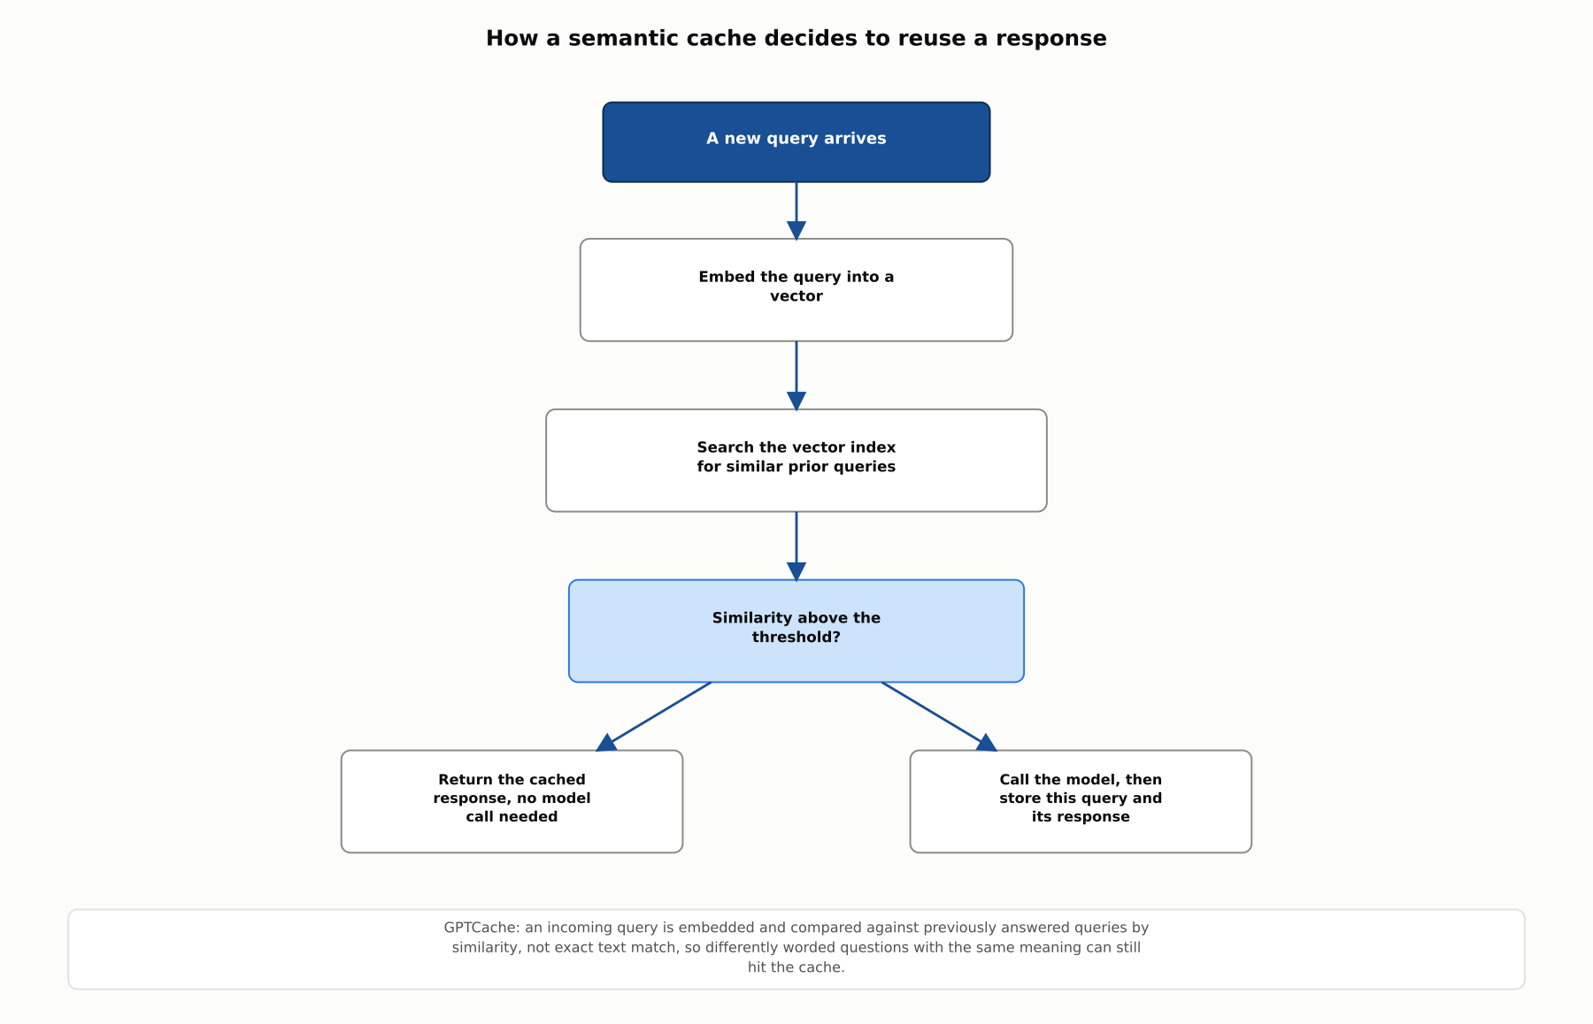
DEEP-DIVE
How a semantic cache decides to reuse a response
GPTCache: an incoming query is embedded and compared against previously answered queries by similarity, not exact text match.

Slide 8
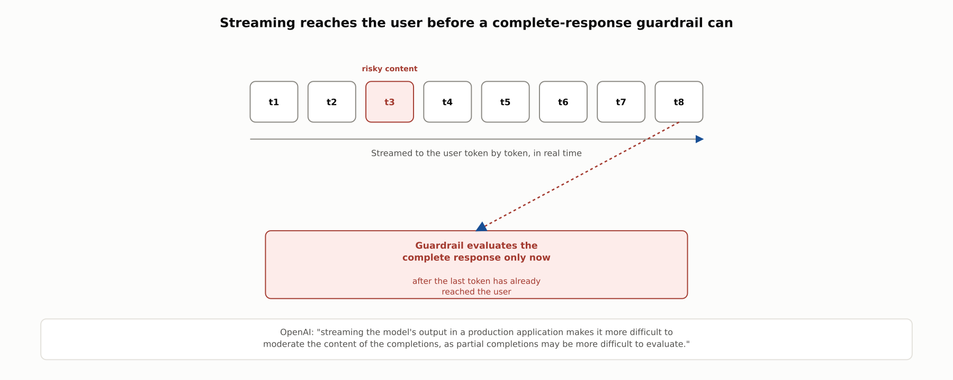
DEEP-DIVE
Streaming reaches the user before a complete-response guardrail can
OpenAI: streaming "makes it more difficult to moderate the content of the completions, as partial completions may be more difficult to evaluate."

Slide 9
DEEP-DIVE
Stateless APIs, backoff, and observability
Anthropic: "The Messages API is stateless, which means that you always send the full conversational history to the API"
OpenAI: "unsuccessful requests contribute to your per-minute limit, so continuously resending a request won't work," recommending exponential backoff
LangSmith: "instrument your LLM application, investigate traces, and monitor performance in production"
Observability traces what already happened to live traffic, a different concern from 5.6's pre-deployment prompt versioning

Slide 10
COMPARISON & RELATED CONCEPTS
Four layers of a first LLM app stack
Aspect | Orchestration framework | LLM gateway | Semantic cache | Observability / tracing platform
What problem it solves | Assembling one request: prompt, tools, conversation history | Keeping the app answering when a provider is slow, rate-limited, or down | Avoiding a fresh model call for a repeated or near-duplicate question | Seeing what a multi-step request actually did, after the fact
Sits in the request path? | Yes, builds the request itself | Yes, between the app and the model providers | Yes, checked before a model call is made | No, observes and logs, does not alter the request
Requires code changes to adopt? | Yes, the app is built around it | Usually minimal, an API-compatible drop-in | Minimal, added in front of existing calls | Minimal, usually an instrumentation call or wrapper
Best used | Any app composing more than a single bare model call | Any app that cannot tolerate a single provider's outage | High-volume apps with naturally repetitive queries | Any app complex enough that a failure is hard to explain from logs alone
Complementary layers of the same stack, not alternatives; a serious first LLM app typically adopts orchestration and observability immediately, and adds a gateway and a cache as traffic and reliability demands grow.

Slide 11
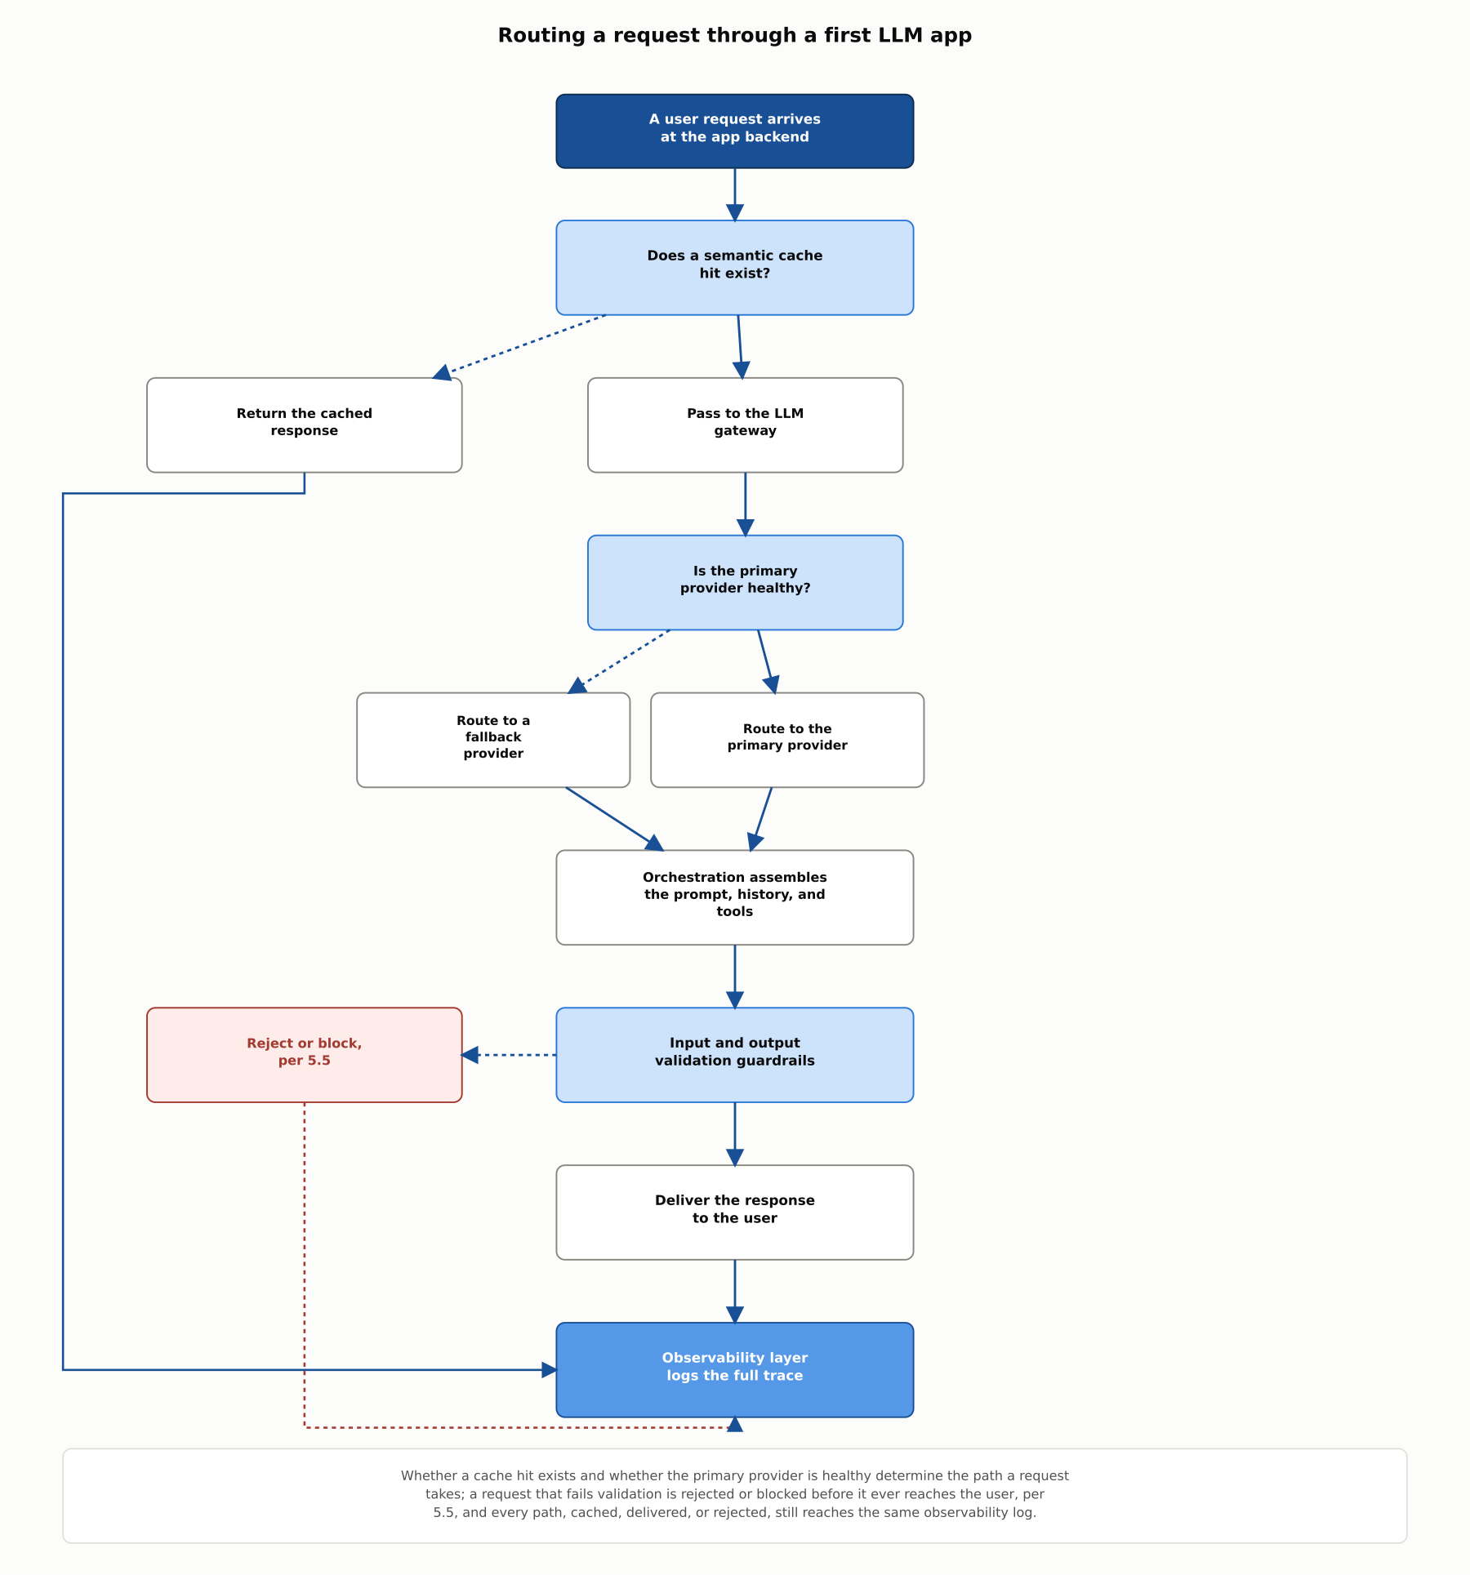
REFERENCE ARCHITECTURE
Routing a request through a first LLM app
Whether a cache hit exists and whether the primary provider is healthy determine the path; every path converges on the same observability log.

Slide 12
INDUSTRY USE CASES
Finance
FINANCIAL SERVICES
Adding a semantic cache to a high-volume compliance-question chatbot
Streaming a client-facing investment-explanation response without adapting the guardrail
Problem: A compliance chatbot answers the same handful of underlying questions phrased hundreds of different ways each day, and every rephrasing triggers a full, billed model call.
Problem: A client-facing explanation feature streams its response token by token, while its output guardrail was built to check only a complete response.
Solution: Add a semantic cache that embeds each query and serves a stored answer for anything within a similarity threshold of a question already answered.
Solution: Redesign the guardrail to evaluate streamed output incrementally, or hold delivery a fixed number of tokens behind the model's generation.
Watch for: Skipping a cache layer means every near-duplicate question triggers a full model call, and the resulting per-query cost can make an otherwise viable feature economically unsustainable at real usage volumes.
Watch for: Streaming a response token by token means a policy-violating recommendation can already be visible to a client well before a guardrail check on the complete response ever finishes evaluating it.

Slide 13
INDUSTRY USE CASES
Healthcare & Telecom
HEALTHCARE + TELECOM
(Healthcare) Adding an LLM gateway with fallback to a clinical-documentation tool
(Telecom) Adding tracing to a multi-step ticket-routing pipeline
Problem: A clinical-documentation tool integrates with a single model provider, and any outage at that vendor becomes an outage of the documentation tool itself.
Problem: A ticket-routing pipeline chains classification, prioritization, and assignment steps, and a misrouted ticket cannot easily be traced back to which step made the wrong call.
Solution: Route calls through a gateway with an automatic fallback provider configured for exactly this scenario.
Solution: Instrument the pipeline with tracing that records each step's decision, not just the final routing outcome.
Watch for: A single-provider integration turns any outage at that vendor into an outage of the clinical tool itself, and nothing about the failure mode gives a clinician warning before they start dictating into a tool that will silently fail to save.
Watch for: Debugging a multi-step routing failure without tracing turns into guesswork across several independent logs that were never designed to reconstruct a single request's actual path through the pipeline.

Slide 14
CHECK YOUR UNDERSTANDING
Discuss before moving on
1. According to the a16z reference architecture, what does an orchestration framework abstract away, and which two frameworks did they cite as examples?
2. Why must a calling application resend the full conversation history on every request to a chat completion API?
3. What benefit does streaming a response provide, and what cost did OpenAI's documentation identify as a direct consequence?
4. What is the difference between per-request exponential backoff and an LLM gateway, and what problem does each actually solve?
5. How does a semantic cache differ from an ordinary exact-match cache, and what mechanism does GPTCache use to implement this?

Slide 15
CHAPTER 5.7 · PHASE 5
Key Takeaways
A model API call is one box in a larger request lifecycle, not the whole app
Chat completion APIs are stateless: your app owns the conversation history
Backoff fixes a transient failure against one provider; a gateway fixes an outage of that provider entirely
Streaming trades faster first-token latency for harder-to-moderate partial output
Next: 5.8 Prompting vs. Fine-Tuning vs. RAG, A Decision Framework

