Slide 1
CHAPTER 5.8 · PHASE 5
Prompting vs. Fine-Tuning vs. RAG, A Decision Framework
Three different levers, not three tiers of the same lever, and reaching for the wrong one is the most common architectural mistake in a first LLM app.
Prompt Engineering & LLM Application Development

Slide 2
AGENDA
What this chapter covers
Why prompting should be tried first, and what OpenAI's own guidance says about that sequencing
Why RAG exists: the limits of parametric knowledge, per Lewis et al. (2020)
Why fine-tuning exists: baking a behavior into weights instead of re-explaining it every request
A rough decision map, built from OpenAI, Anthropic, AWS, and Google Cloud's published guidance
Why the three approaches are not mutually exclusive, and what RAFT combines
Deferring the deep mechanics: Phase 6 covers RAG in full, Phase 7 covers fine-tuning in full

Slide 3
TL;DR
The short version
OpenAI: "the prompt engineering process may be all you need in order to get great results for your use case"
Lewis et al. (2020): pretrained models' "ability to access and precisely manipulate knowledge is still limited," and "updating their world knowledge remain[s an] open research problem"
RAG grounds a response in retrieved, current, citable documents; fine-tuning bakes a narrow behavior into the model's weights
Fine-tuning needs labeled data, compute, and retraining whenever the behavior needs to change
The three approaches combine in production; RAFT fine-tunes a model specifically to use retrieved context better
This chapter is a decision framework; RAG and fine-tuning mechanics are Phase 6 and Phase 7

Slide 4
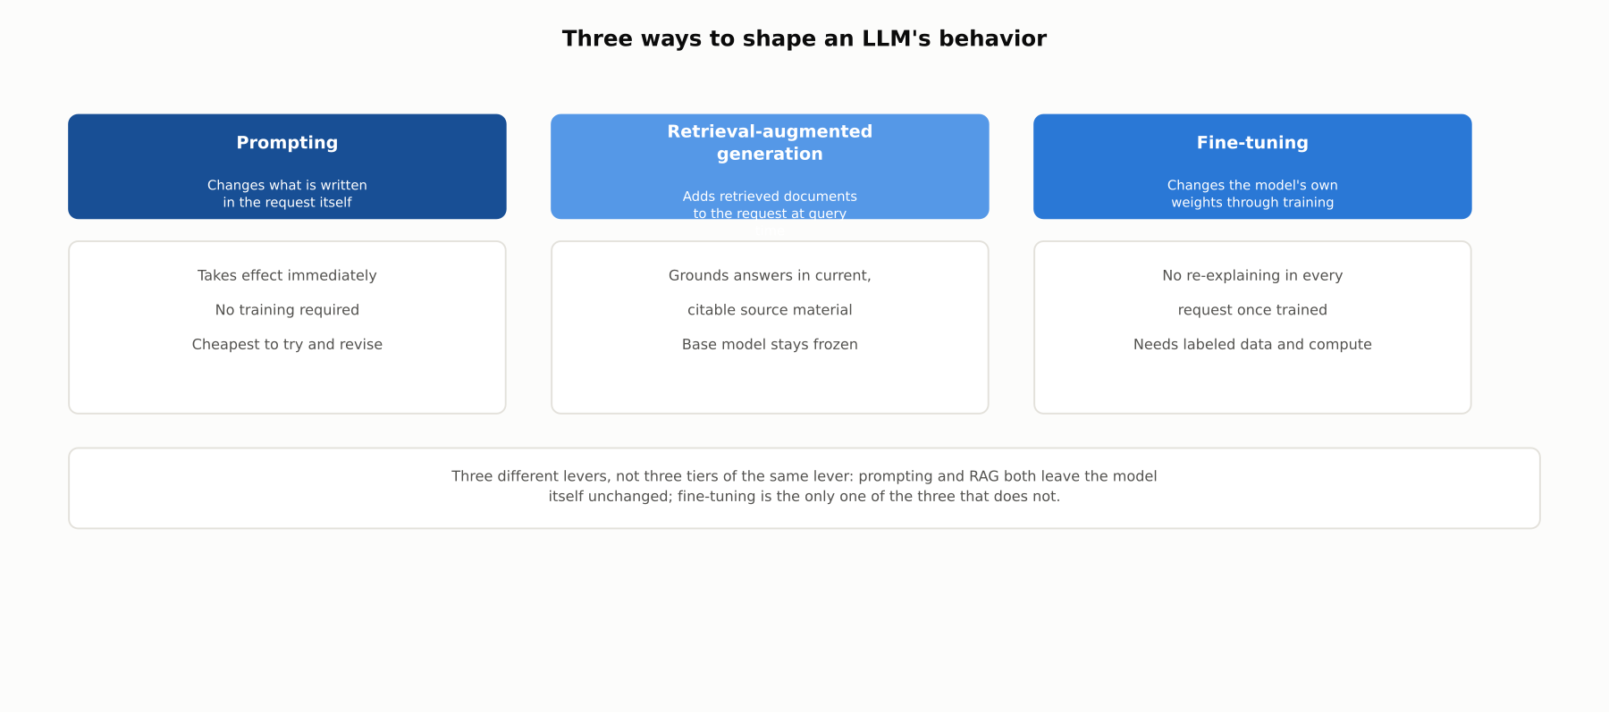
HIGH-LEVEL
Three ways to shape an LLM's behavior
Three different levers, changing the request, adding retrieved context to the request, or changing the model itself, not three tiers of the same lever.

Slide 5
DEEP-DIVE
Start with prompting, and mean it
OpenAI: "the prompt engineering process may be all you need in order to get great results for your use case"
Fine-tuning's named benefits ("shorter prompts," "lower latency," "a smaller, cheaper, faster model") are reasons to graduate beyond prompting, not reasons to start elsewhere
Build an eval set first, the golden-dataset discipline from 5.6 applies here directly
Only then decide whether the gap is a knowledge problem (RAG) or a behavior problem (fine-tuning)

Slide 6
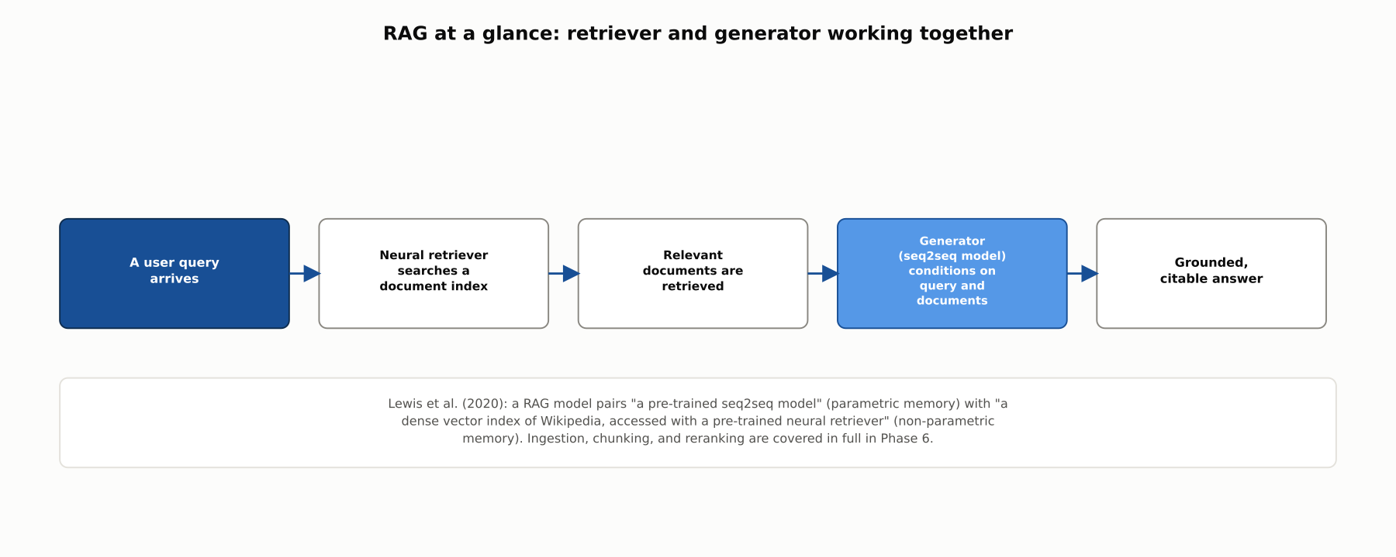
DEEP-DIVE
RAG at a glance: retriever and generator working together
Lewis et al. (2020): a RAG model pairs a pre-trained seq2seq model with a dense vector index accessed by a pre-trained neural retriever.

Slide 7
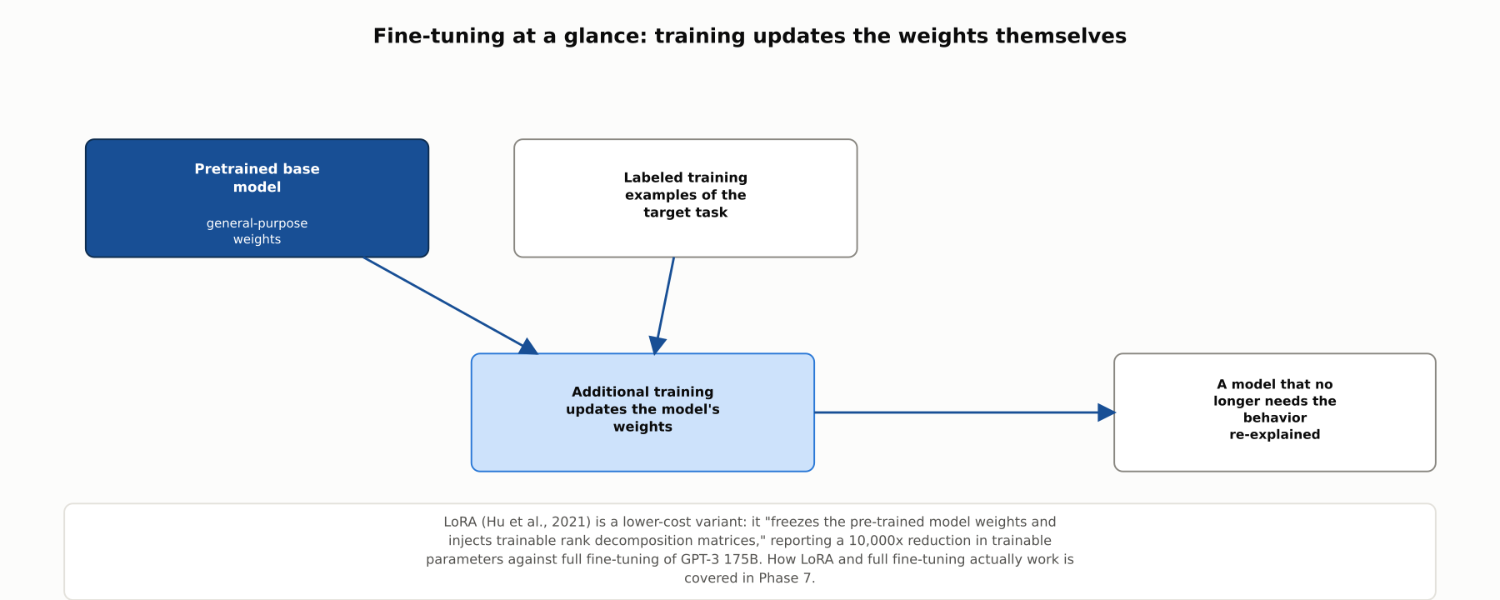
DEEP-DIVE
Fine-tuning at a glance: training updates the weights themselves
LoRA (Hu et al., 2021) can reduce trainable parameters by 10,000x and GPU memory by 3x against full fine-tuning of GPT-3 175B.

Slide 8
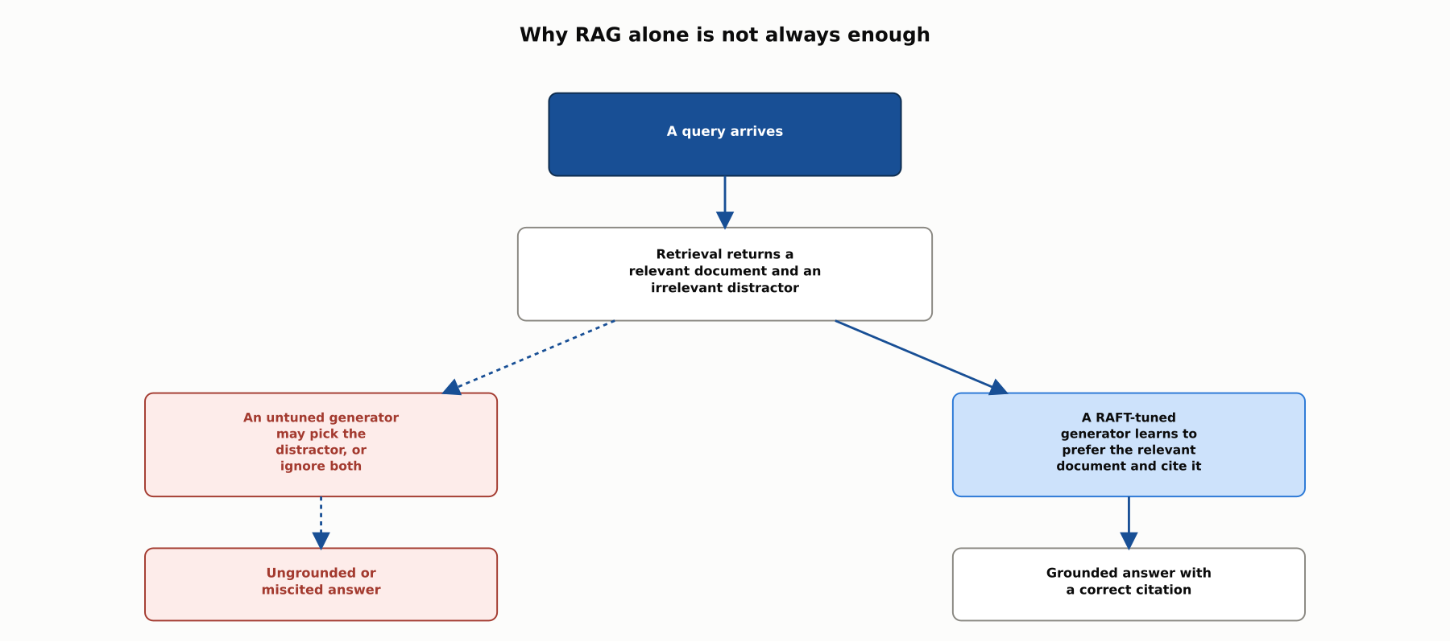
DEEP-DIVE
Why RAG alone is not always enough
RAFT (Zhang et al., 2024) fine-tunes a model to distinguish a relevant retrieved passage from a distractor, and to cite the one it actually used.

Slide 9
DEEP-DIVE
A rough map from question to approach
Google Cloud: "do you need the model to always give a citation of a source grounded in your data? If yes, you will need to use RAG"
Google Cloud: "if you have only a small amount of data, then prompt engineering may suffice"
AWS: "RAG can incorporate the latest documents in a few minutes," while "fine-tuning can take a few hours to days"
AWS: fine-tuned models "do not provide a reference to the source," while a RAG model "provides a reference to the information source"
Google Cloud, and Snorkel AI: "you can freely combine the aforementioned methods at your convenience"

Slide 10
COMPARISON & RELATED CONCEPTS
Three complementary levers
Aspect | Prompting / few-shot | Retrieval-augmented generation (RAG) | Fine-tuning (full or parameter-efficient)
What actually changes | The request sent to the model, nothing about the model itself | The request, augmented with retrieved documents at query time | The model's own weights, through additional training
Best for | Getting started, and any task a few good examples can demonstrate | Answers that must cite current, specific source documents | A narrow, high-volume behavior expensive to keep re-explaining
Upfront cost before it helps at all | Near zero, iterate in the prompt itself | A retrieval pipeline and a document index, no model training | Labeled training data, compute, and an evaluation harness
Can it cite a source for a specific claim | Only what was included in the prompt itself | Yes, this is RAG's defining advantage | No, a fact baked into weights carries no provenance
Complementary levers, not competing tiers; a mature system commonly combines all three rather than picking exactly one.

Slide 11
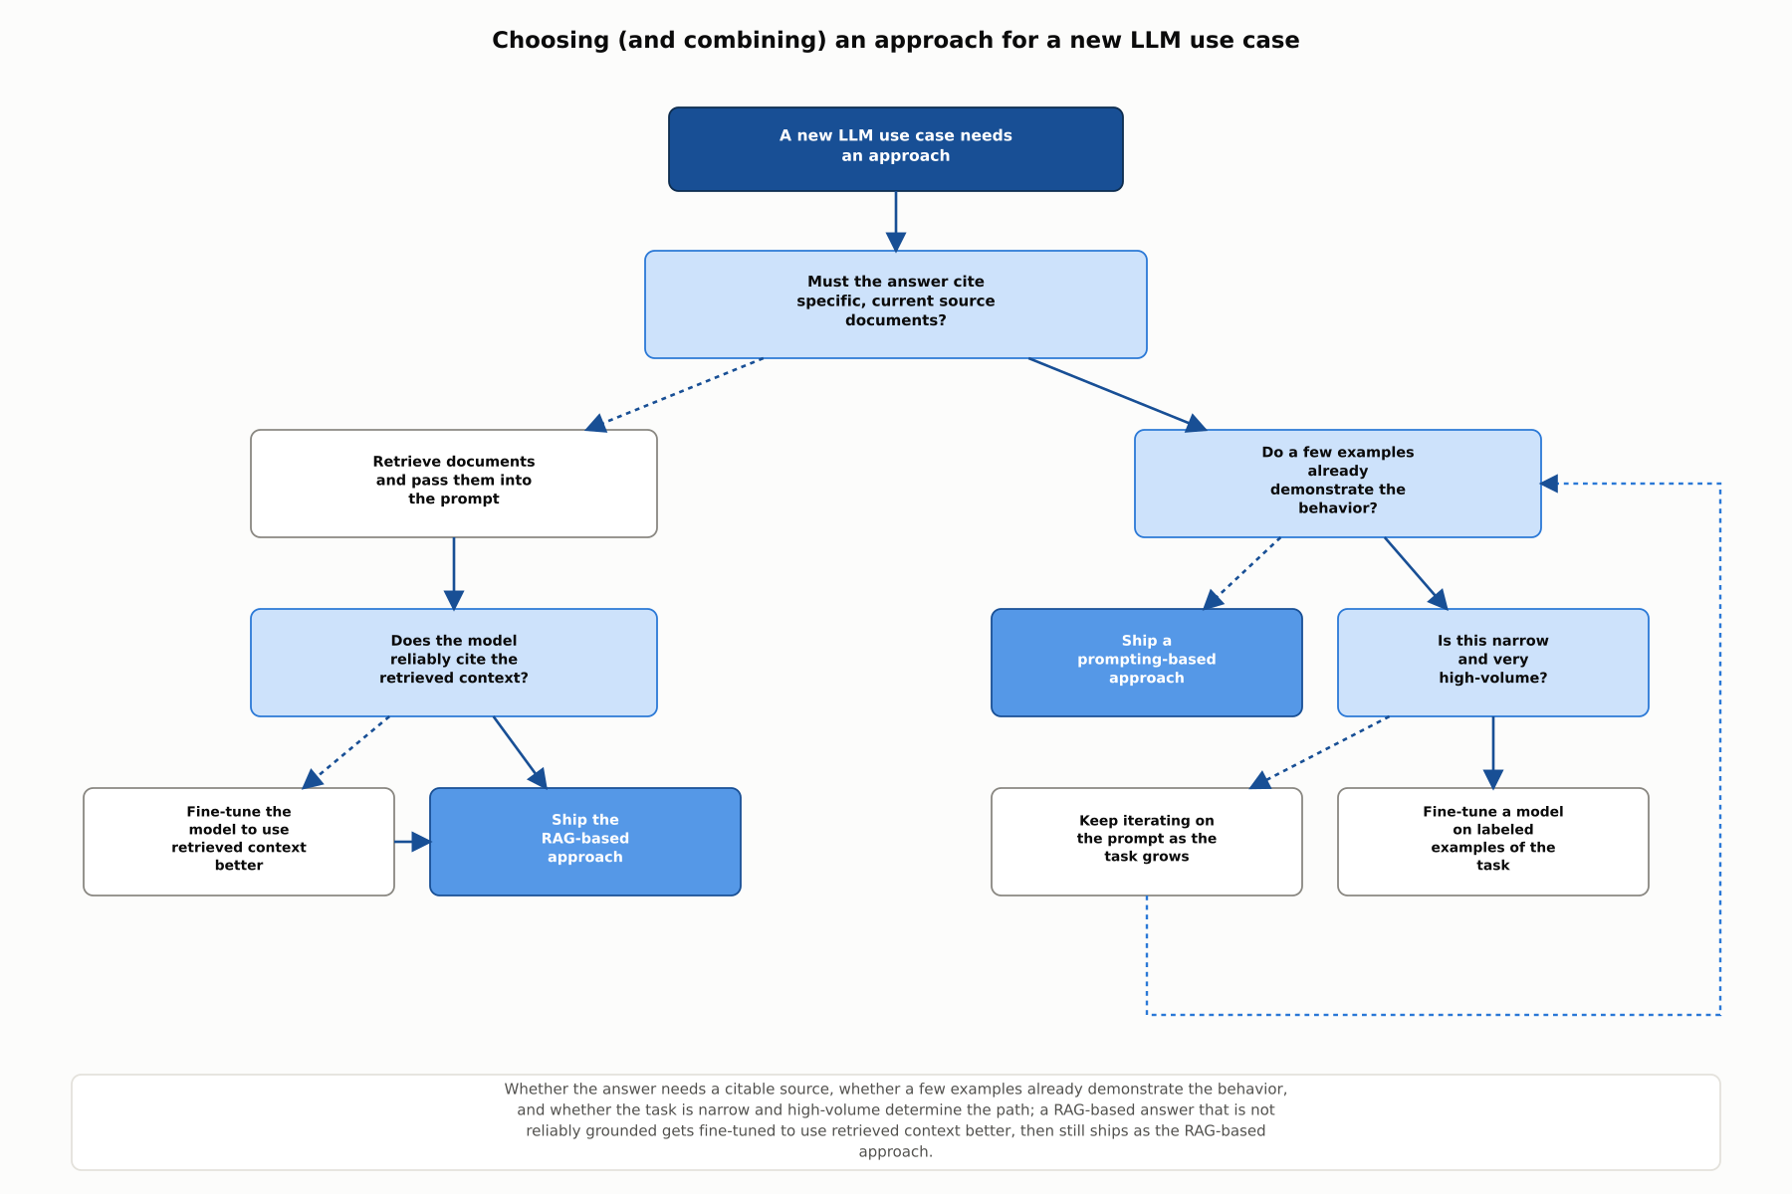
REFERENCE ARCHITECTURE
Choosing (and combining) an approach for a new LLM use case
A RAG-based answer that is not reliably grounded gets fine-tuned to use retrieved context better, then still ships as the RAG-based approach.

Slide 12
INDUSTRY USE CASES
Finance
FINANCIAL SERVICES
Fine-tuning a compliance-answer model on rules that change quarterly
Shipping a RAG-based advisory assistant that ignores its own retrieved documents
Problem: A compliance assistant is fine-tuned on the current regulatory thresholds, and those thresholds are revised again before the next quarter ends.
Problem: An investment-advisory assistant retrieves the right internal research note for a query, and the generated answer still contradicts what that note says.
Solution: Use RAG to ground compliance answers in the current version of the regulation document, updated the moment the source changes.
Solution: Evaluate whether the base model reliably grounds its answer in retrieved content, and apply RAFT-style fine-tuning if it does not.
Watch for: A fine-tuned model has no way to know its regulatory knowledge went stale the day the rule changed, and it will keep citing the old threshold with exactly the same confidence as it once cited the correct one.
Watch for: Even when the retriever surfaces exactly the right document, a model that was never trained to prefer that document's content over its own frozen assumptions will not reliably use it.

Slide 13
INDUSTRY USE CASES
Healthcare & Telecom
HEALTHCARE + TELECOM
(Healthcare) Fine-tuning a clinical-guidance assistant on protocols that get revised
(Telecom) Fine-tuning a plan-and-pricing assistant on promotions that rotate monthly
Problem: A clinical-guidance assistant is fine-tuned on the current treatment protocol, and a revised version is published a few months later.
Problem: A customer-facing plan-and-pricing assistant is fine-tuned on this month's promotional offers, and next month's promotions replace them entirely.
Solution: Ground clinical guidance in RAG over the current protocol documents instead, so an update to the source document is reflected immediately.
Solution: Ground pricing and promotion answers in RAG over the current plan catalog, so a promotion change is reflected the moment the catalog updates.
Watch for: Whatever protocol version was baked into the fine-tuned model keeps being recommended after a revision ships, with no signal to a clinician that the guidance is now out of date.
Watch for: Once fine-tuned into the model, an expired promotion keeps getting quoted to customers with full confidence long after it stopped being valid.

Slide 14
CHECK YOUR UNDERSTANDING
Discuss before moving on
1. What does OpenAI's guidance say you should try before committing to fine-tuning?
2. What core limitation of pretrained language models motivated Lewis et al.'s original RAG paper?
3. What three properties does Anthropic name as reasons to reach for RAG specifically?
4. What does LoRA change about how fine-tuning works, and what cost reduction does it report?
5. Why are prompting, RAG, and fine-tuning not mutually exclusive, and what does RAFT fine-tune a model to do?

Slide 15
CHAPTER 5.8 · PHASE 5
Key Takeaways
Try prompting first; it is the cheapest lever and the fastest to revise
Reach for RAG when an answer must be current, domain-specific, or citable
Reach for fine-tuning when a narrow, high-volume behavior is expensive to keep re-explaining
The three approaches combine in production; RAG and fine-tuning mechanics come in Phase 6 and Phase 7
Next: Phase 6, Retrieval-Augmented Generation & Knowledge Systems

