Slide 1
Phase 2 — Deep Learning Foundations
Backpropagation & Optimization: How Networks Actually Learn
The chain rule backward through the network, gradient descent, momentum, Adam, and learning rate schedules
Chapter 2.2

Slide 2
Agenda
01 | TL;DR
02 | High-Level: forward pass, loss, backward pass
03 | Deep-Dive: chain rule, vanishing/exploding gradients, optimizers
04 | Comparison & Related Concepts
05 | Reference Architecture: one training step
06 | Industry Use Cases (Finance, Healthcare, Telecom)
07 | Check Your Understanding
RegAITraining · Chapter 2.2
2 / 15

Slide 3
TL;DR
Backpropagation is how a network learns from being wrong: it runs the chain rule backward through the network, from the loss to the input layer, to compute exactly how much each weight contributed to the error.
Gradient descent then nudges every weight in the direction that reduces that error.
Plain gradient descent is slow and easily gets stuck, so momentum smooths the update direction and Adam, the most widely used optimizer today, adapts the step size separately for every parameter.
Learning rate schedules change the step size over the course of training rather than fixing it.
RegAITraining · Chapter 2.2
3 / 15

Slide 4
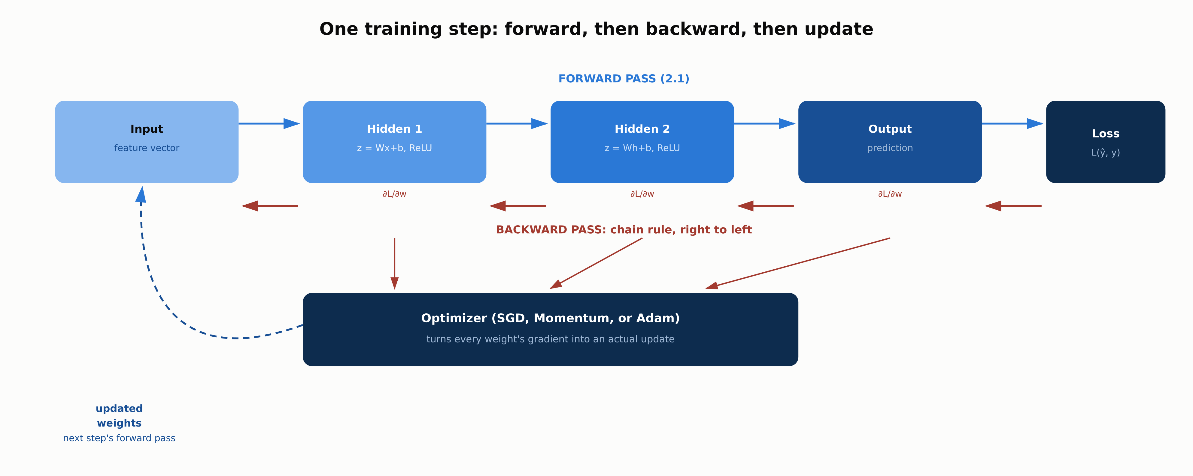
One training step: forward, backward, update
The backward pass reuses the forward pass's computation graph in reverse to compute a gradient for every weight.
RegAITraining · Chapter 2.2
4 / 15

Slide 5
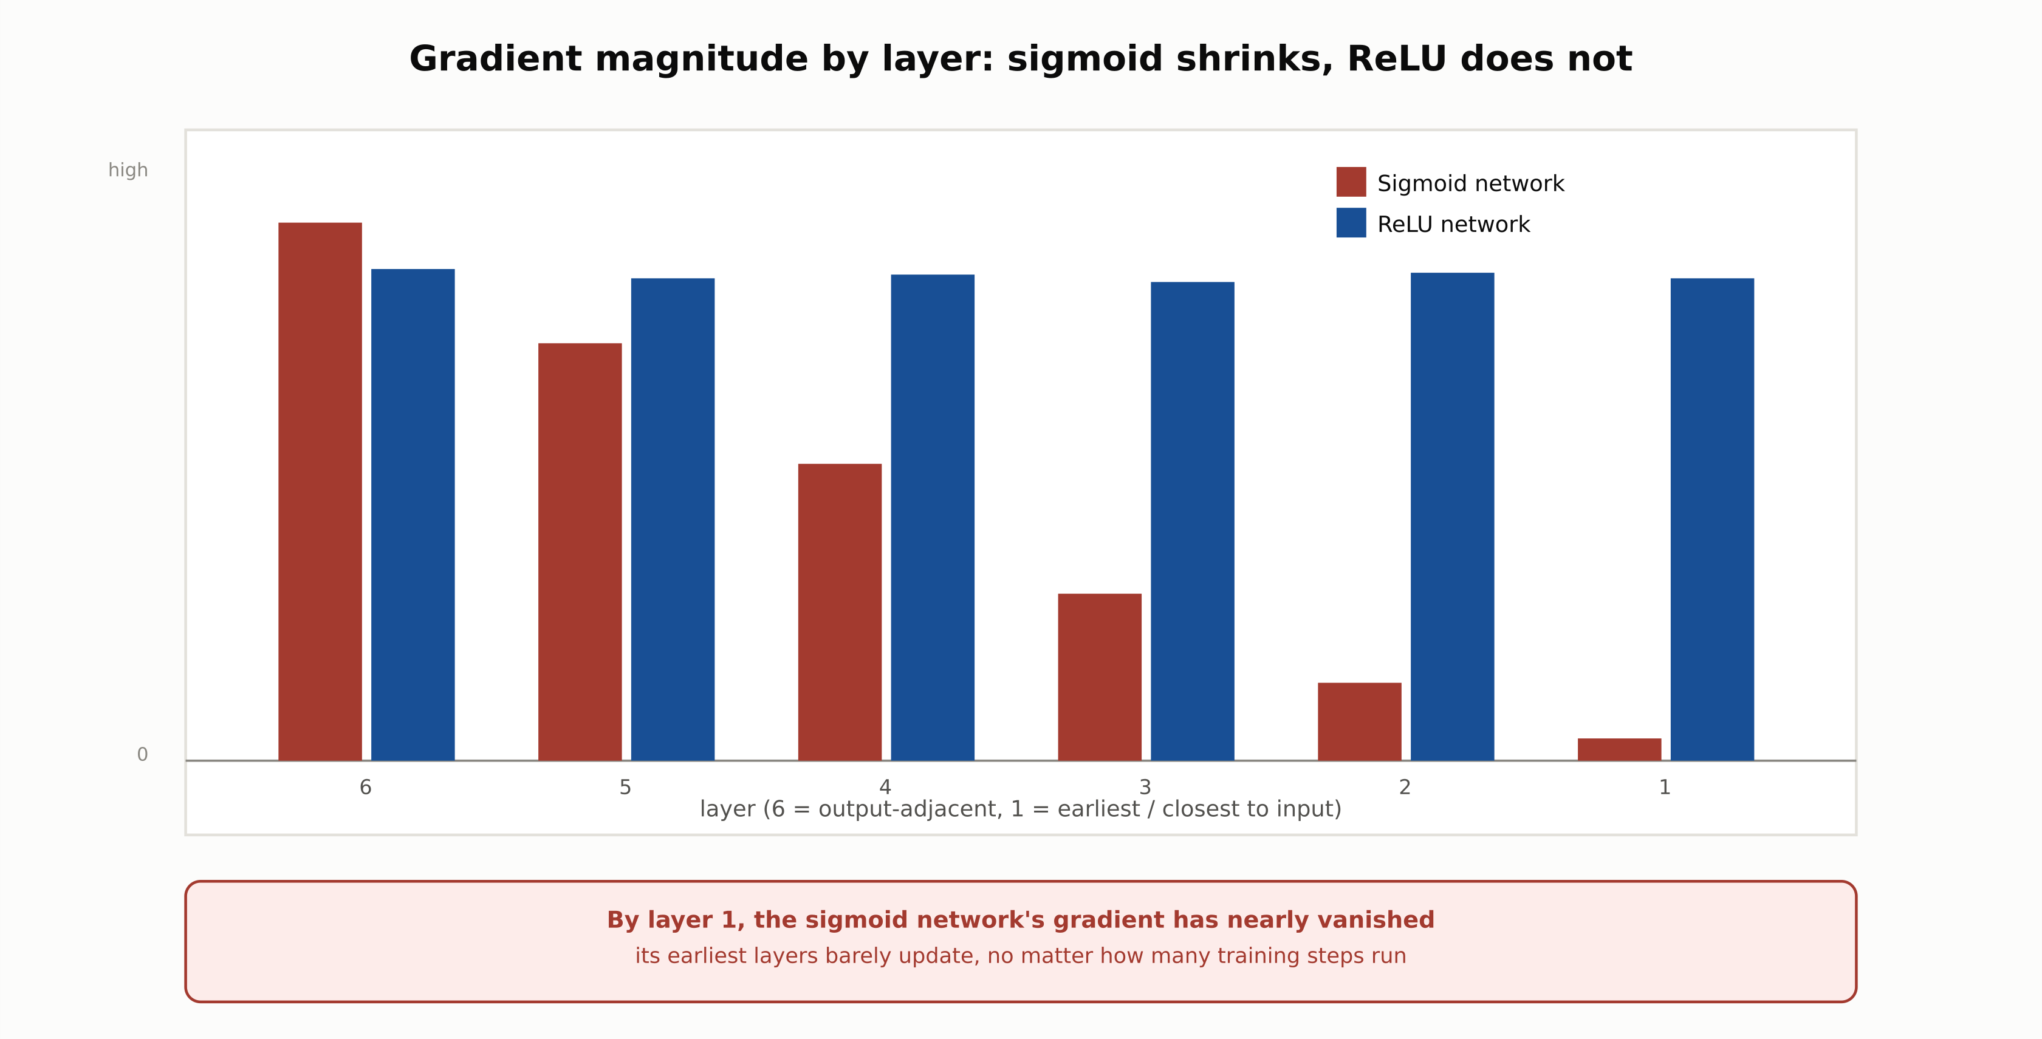
Vanishing gradients by layer depth
A sigmoid network's earliest layers barely update; a ReLU network's gradient stays roughly constant across depth.
RegAITraining · Chapter 2.2
5 / 15

Slide 6
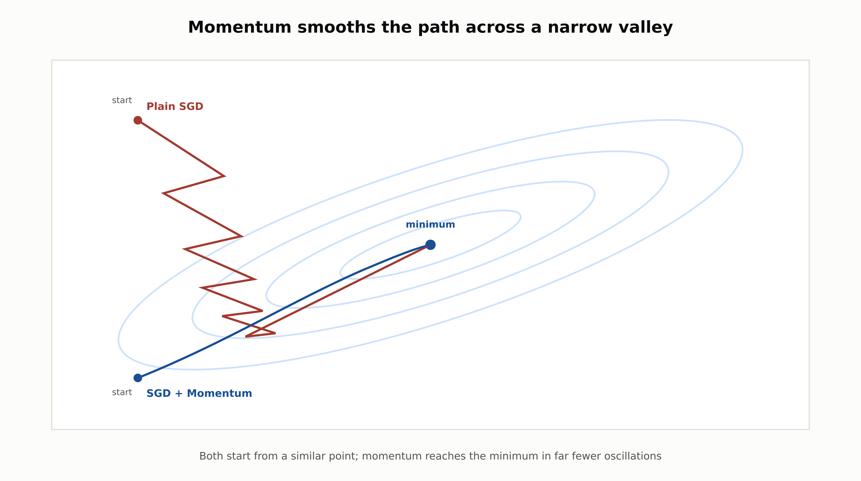
Momentum smooths the descent path
Plain SGD zigzags across a narrow loss valley; momentum builds velocity along the valley and reaches the minimum faster.
RegAITraining · Chapter 2.2
6 / 15

Slide 7
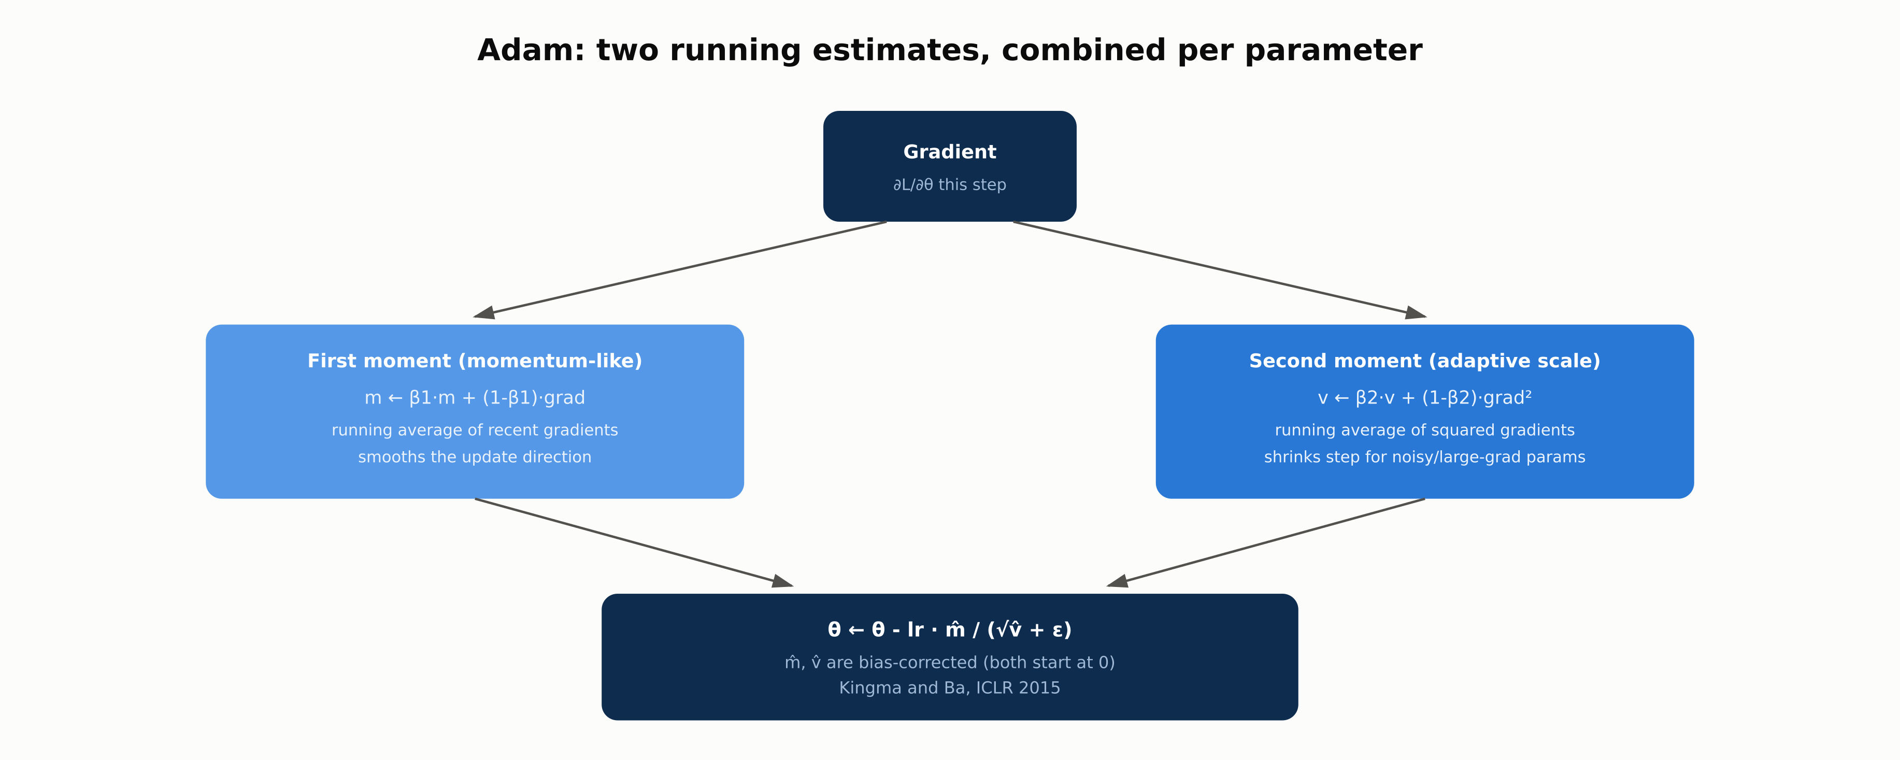
Adam: two running estimates, combined
A first moment (momentum-like) and a second moment (adaptive per-parameter scale), both bias-corrected.
RegAITraining · Chapter 2.2
7 / 15

Slide 8
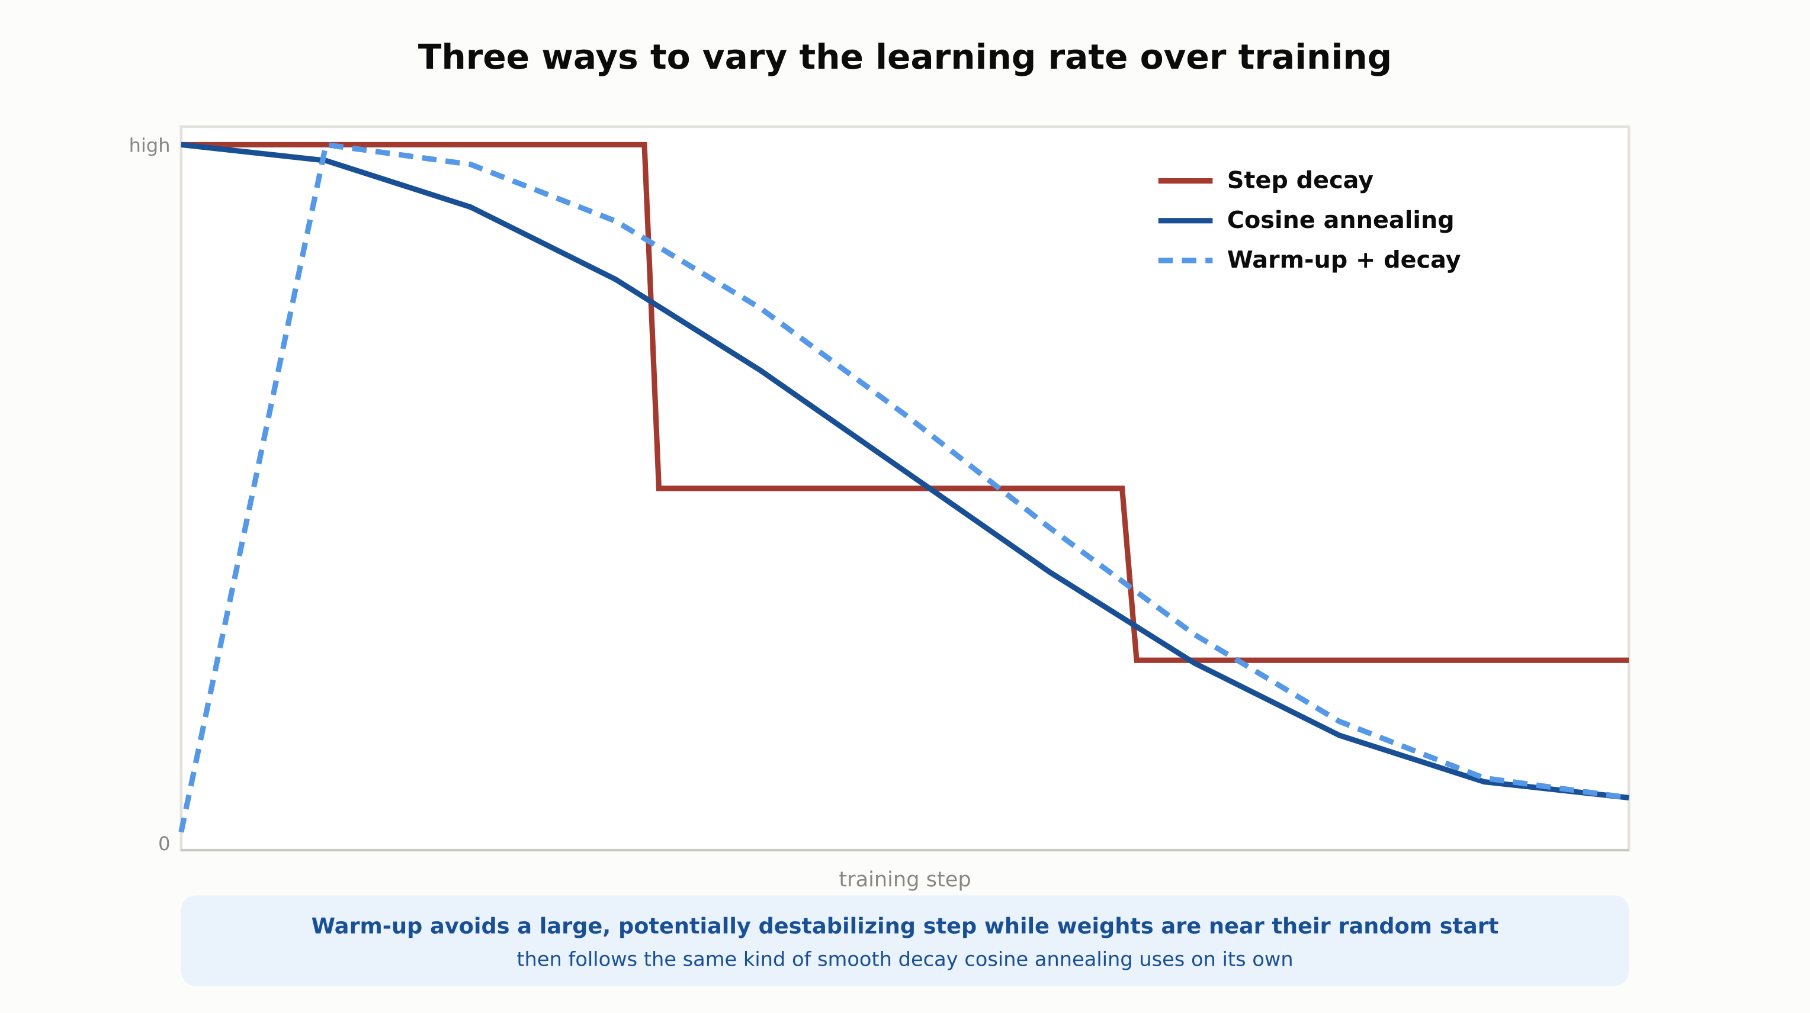
Three learning rate schedules
Step decay, cosine annealing, and warm-up plus decay all change the step size over training rather than fixing it.
RegAITraining · Chapter 2.2
8 / 15

Slide 9
Comparison & Related Concepts
Aspect | Batch Gradient Descent | SGD (mini-batch) | SGD + Momentum | Adam
Gradient computed over | Entire training set | Small random batch | Small random batch | Small random batch
Per-parameter learning rate | No, one global rate | No, one global rate | No, one global rate | Yes, adapted per parameter
Convergence behavior | Accurate but slow, memory-heavy | Fast per step, noisy | Smoother than plain SGD | Fast, reliable with default settings
Typical use | Small datasets, convex problems | Rare alone in deep learning | Large-scale vision, careful tuning | Default first choice for most deep learning
Adam's main practical advantage is the per-parameter adaptive learning rate; well-tuned SGD with momentum can still edge out Adam on generalization for some large-scale vision tasks.
RegAITraining · Chapter 2.2
9 / 15

Slide 10
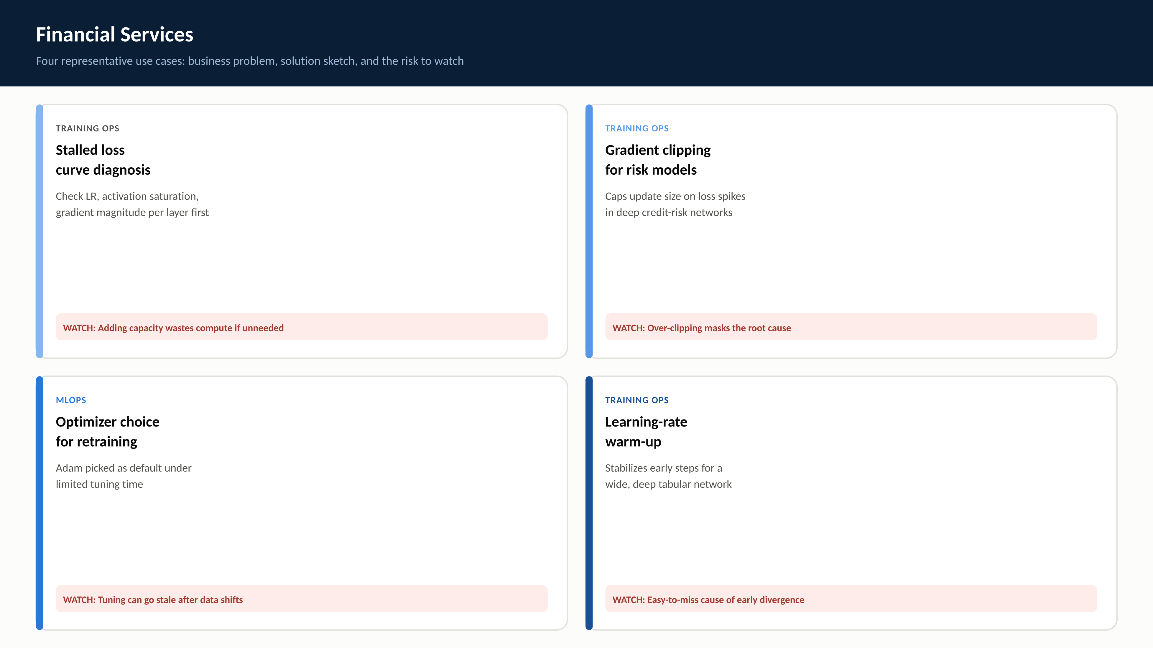
RegAITraining · Chapter 2.2
10 / 15

Slide 11
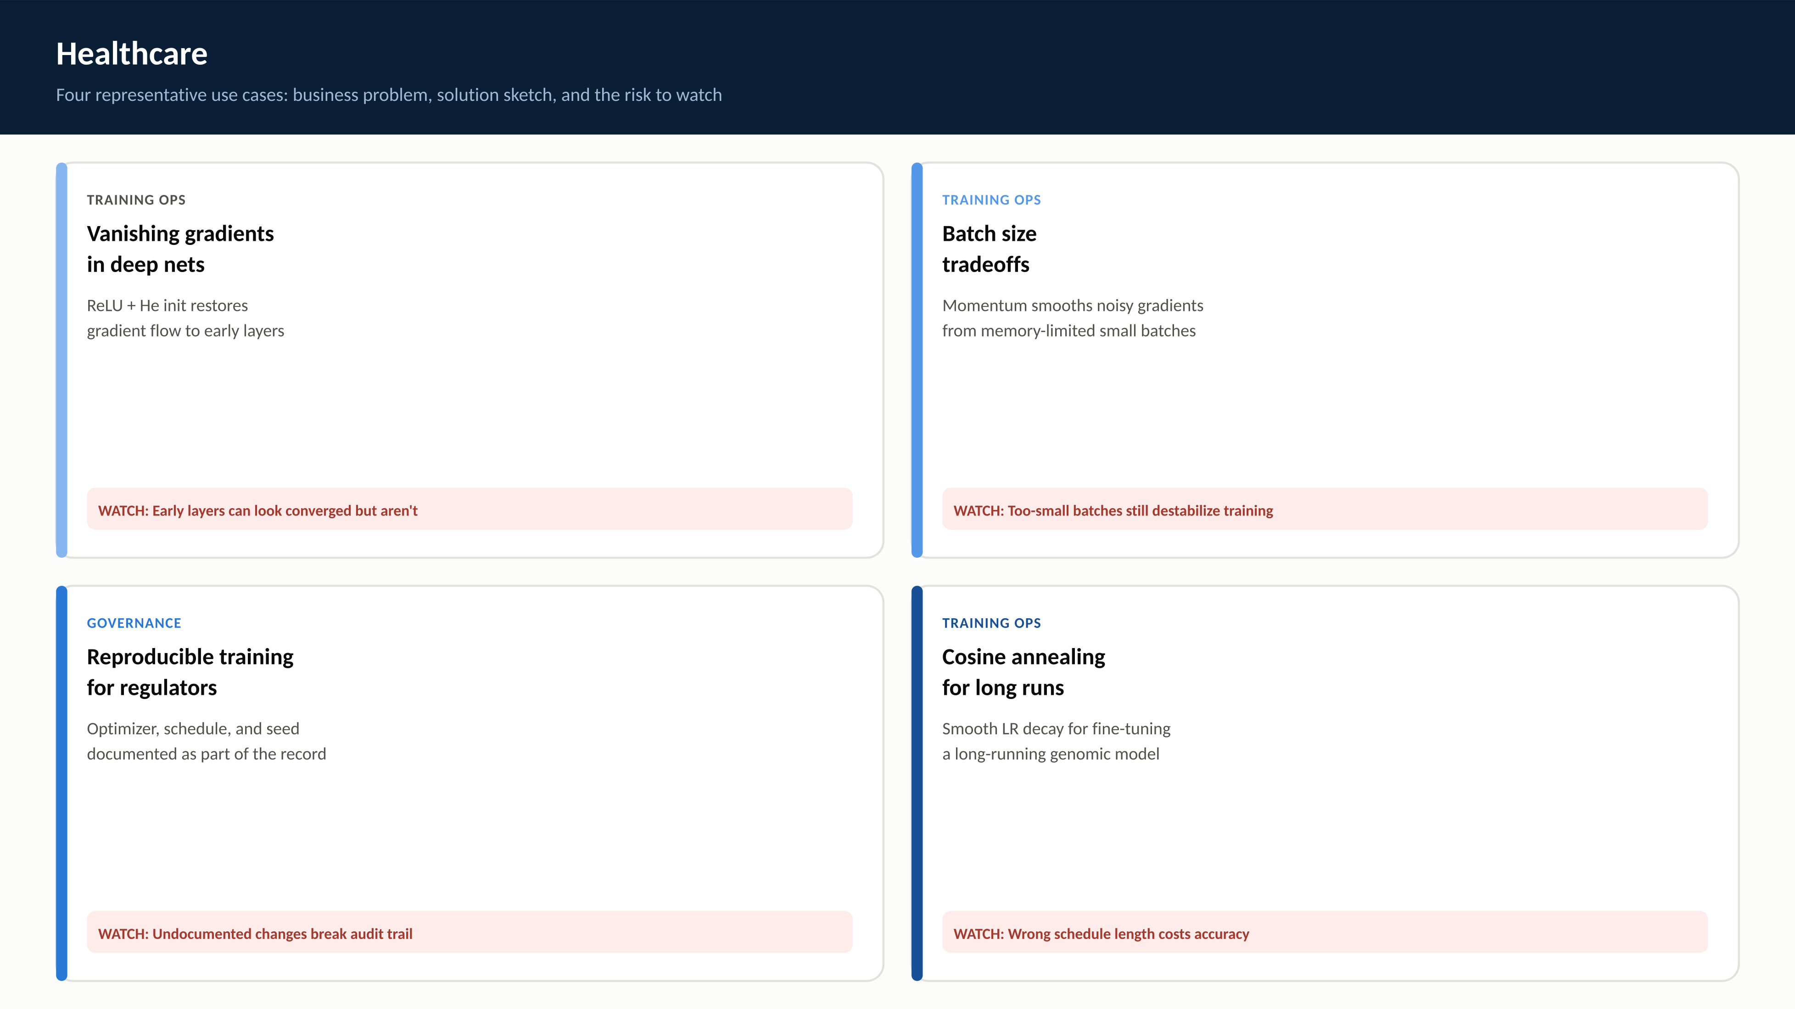
RegAITraining · Chapter 2.2
11 / 15

Slide 12
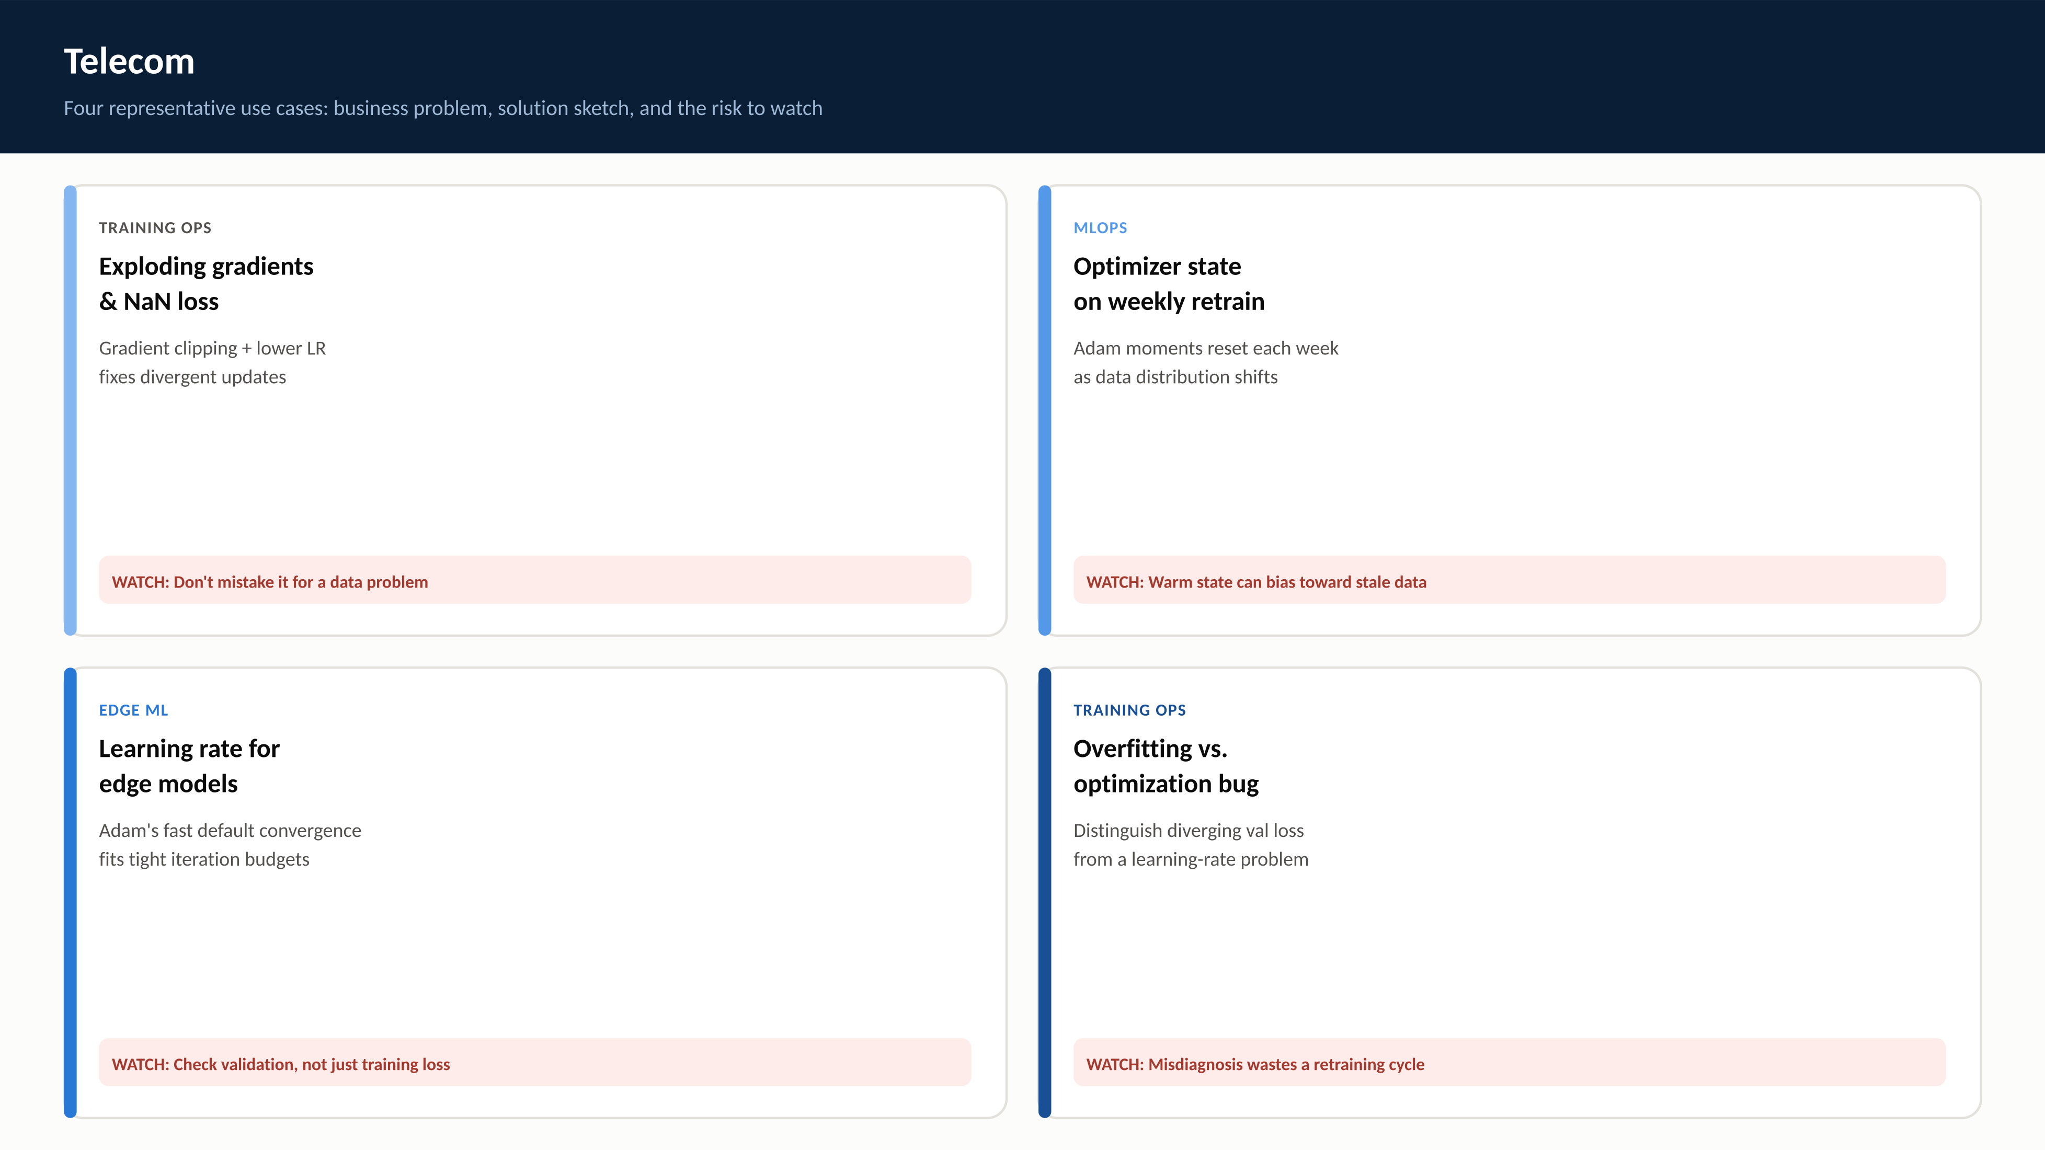
RegAITraining · Chapter 2.2
12 / 15

Slide 13
Check Your Understanding
1. Why is backpropagation more efficient than computing each weight's gradient independently from scratch?
2. What causes the vanishing gradient problem, and why does ReLU help with it?
3. What two things does Adam track, and what does each one do?
4. Why does a learning-rate warm-up period help stabilize early training?
5. What is the practical difference between batch, stochastic, and mini-batch gradient descent?
RegAITraining · Chapter 2.2
13 / 15
Notes:
Q1: Why is backpropagation more efficient than computing each weight's gradient independently from scratch? A1: It computes each layer's gradients once, moving backward from the loss, and reuses those results for every weight feeding into that layer via the chain rule, rather than repeating the full chain rule derivation for every weight independently. Q2: What causes the vanishing gradient problem, and why does ReLU help with it? A2: The chain rule multiplies a factor per layer; if those factors are consistently below 1 (sigmoid/tanh away from zero), the product shrinks toward zero with depth. ReLU's gradient is exactly 1 for positive inputs, so it does not contribute a shrinking factor. Q3: What two things does Adam track, and what does each one do? A3: A first moment (exponentially-weighted average of past gradients, like momentum, smoothing the update direction) and a second moment (exponentially-weighted average of squared gradients, scaling the step down for parameters with historically large gradients). Q4: Why does a learning-rate warm-up period help stabilize early training? A4: Weights start close to their random initialization, where a large step is more likely to push training into an unstable region. Gradually raising the learning rate lets the network settle before the main, larger-step schedule takes over. Q5: What is the practical difference between batch, stochastic, and mini-batch gradient descent? A5: Batch computes the gradient over the whole training set per step (accurate, slow, memory-heavy); stochastic updates after every example (fast, noisy); mini-batch, the practical default, computes the gradient over a small batch as a middle ground.

Slide 14
Key Takeaways
Backpropagation applies the chain rule backward through the network, reusing forward-pass computation to get a gradient for every weight efficiently.
Vanishing and exploding gradients come directly from multiplying one factor per layer; activation choice (2.1) and initialization scale are the first levers to check.
Momentum smooths noisy per-batch gradients using a running average; Adam goes further, adapting the effective learning rate separately for every parameter.
A learning rate schedule (step decay, cosine annealing, warm-up) changes the step size over training rather than fixing one value for the whole run.
Adam is the default first choice for most deep learning workloads; well-tuned SGD with momentum can still edge it out on generalization for some tasks at the cost of more manual tuning.
RegAITraining · Chapter 2.2
14 / 15

Slide 15
Sources
Rumelhart, D., Hinton, G., and Williams, R. (1986). Learning Representations by Back-Propagating Errors. Nature. — https://www.nature.com/articles/323533a0
Bengio, Y., Simard, P., and Frasconi, P. (1994). Learning Long-Term Dependencies with Gradient Descent Is Difficult. IEEE Trans. Neural Networks. — https://dl.acm.org/doi/10.1109/72.279181
Glorot, X. and Bengio, Y. (2010). Understanding the Difficulty of Training Deep Feedforward Neural Networks. AISTATS. — https://proceedings.mlr.press/v9/glorot10a.html
He, K., Zhang, X., Ren, S., and Sun, J. (2015). Delving Deep into Rectifiers. ICCV. — https://openaccess.thecvf.com/content_iccv_2015/papers/He_Delving_Deep_into_ICCV_2015_paper.pdf
Kingma, D. and Ba, J. (2015). Adam: A Method for Stochastic Optimization. ICLR. — https://arxiv.org/pdf/1412.6980
RegAITraining · Chapter 2.2
15 / 15

