Slide 1
Phase 2 — Deep Learning Foundations
Sequence Models Before Transformers: RNN, LSTM, GRU
Hidden states, backpropagation through time, and the gating mechanisms that fixed the vanishing gradient
Chapter 2.4

Slide 2
Agenda
01 | TL;DR
02 | High-Level: the hidden state as working memory
03 | Deep-Dive: RNN recurrence, LSTM gates, GRU gates, bidirectional RNNs
04 | Comparison & Related Concepts
05 | Reference Architecture: an unrolled sequence
06 | Industry Use Cases (Finance, Healthcare, Telecom)
07 | Check Your Understanding
RegAITraining · Chapter 2.4
2 / 15

Slide 3
TL;DR
A CNN (2.3) reuses a filter across positions in an image; a recurrent neural network (RNN) reuses the same weights across steps of a sequence, carrying a hidden state forward from one step to the next.
This makes RNNs a natural fit for text, time series, and sensor data, anything where order matters.
Plain RNNs struggle to remember information from many steps earlier, because backpropagating through a long sequence multiplies the same shrinking or growing gradient factor from chapter 2.2 many times over.
LSTM and GRU cells add gating mechanisms specifically designed to keep the gradient flowing over long sequences, which is why they were the practical default for sequence modeling for two decades before the Transformer (2.5).
RegAITraining · Chapter 2.4
3 / 15

Slide 4
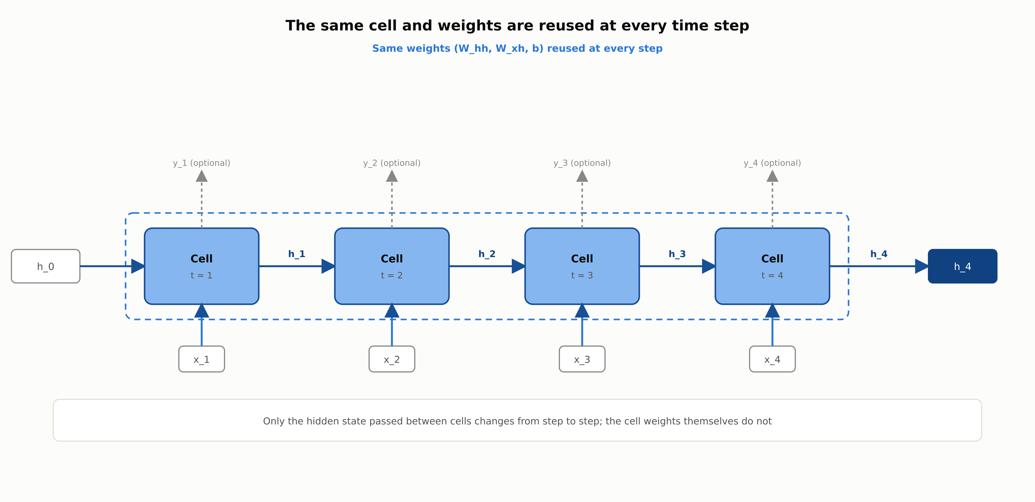
An RNN unrolled across time
The same cell and the same weights are reused at every time step; only the hidden state carried between steps changes.
RegAITraining · Chapter 2.4
4 / 15

Slide 5
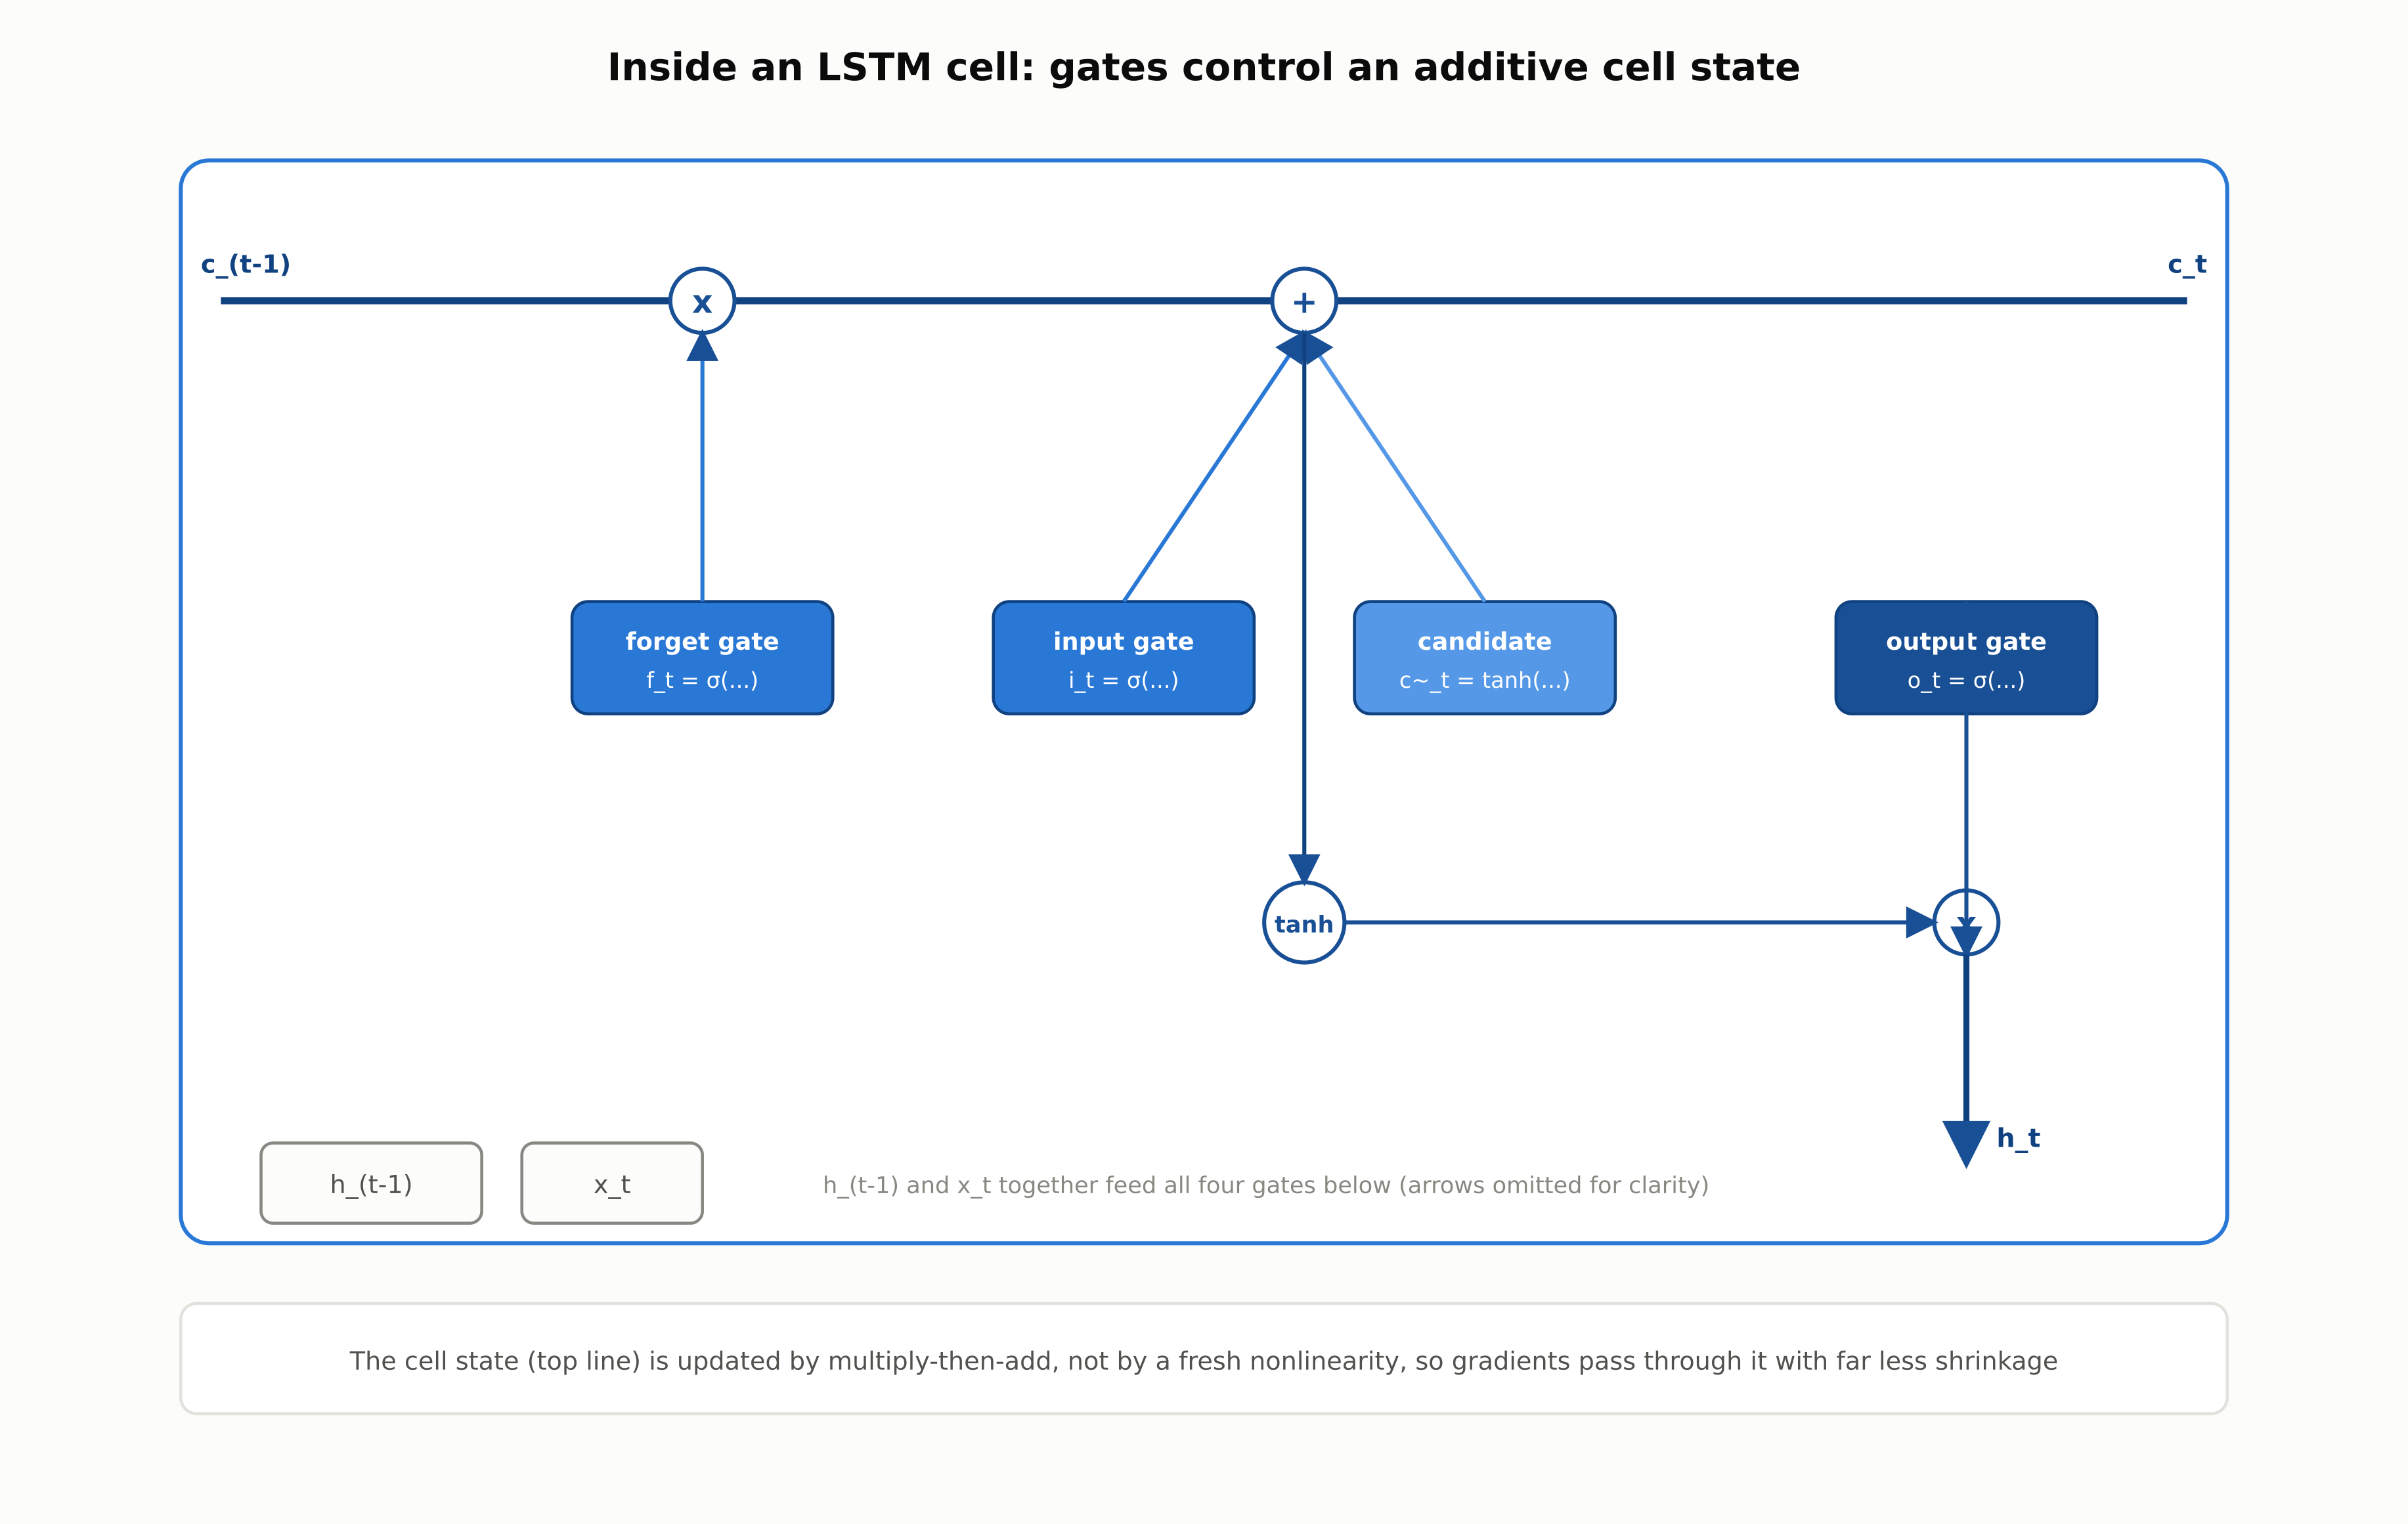
Inside an LSTM cell
The cell state (top line) is updated by multiply-then-add, not by a fresh nonlinearity, so gradients pass through it with far less shrinkage.
RegAITraining · Chapter 2.4
5 / 15

Slide 6
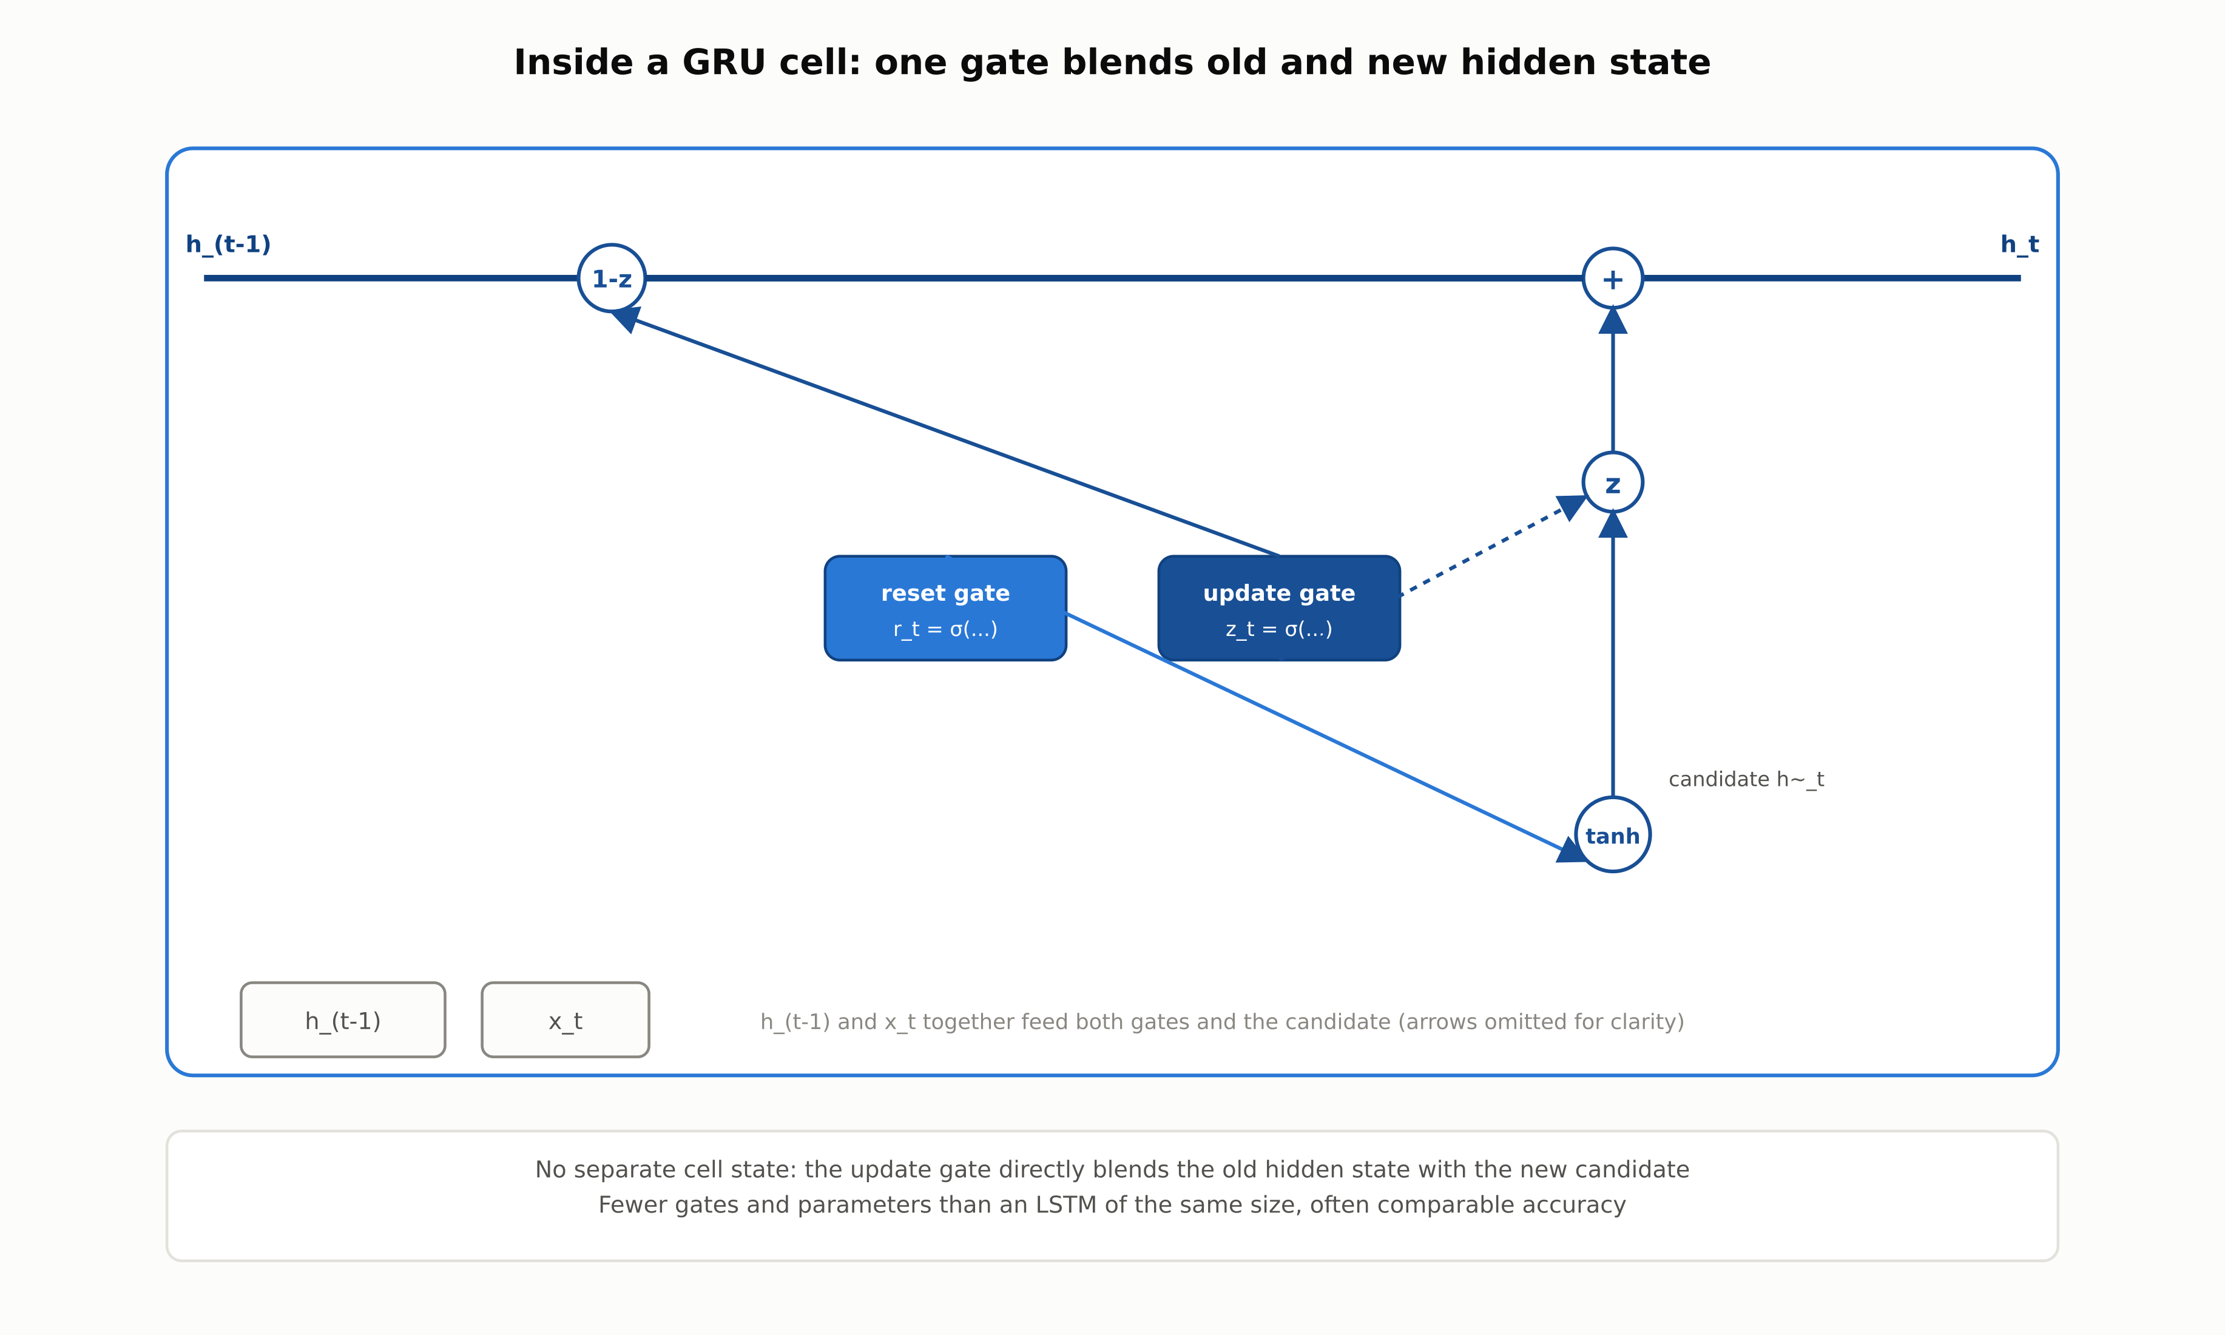
Inside a GRU cell
No separate cell state: a single update gate directly blends the old hidden state with a new candidate, using fewer gates and parameters than an LSTM.
RegAITraining · Chapter 2.4
6 / 15

Slide 7
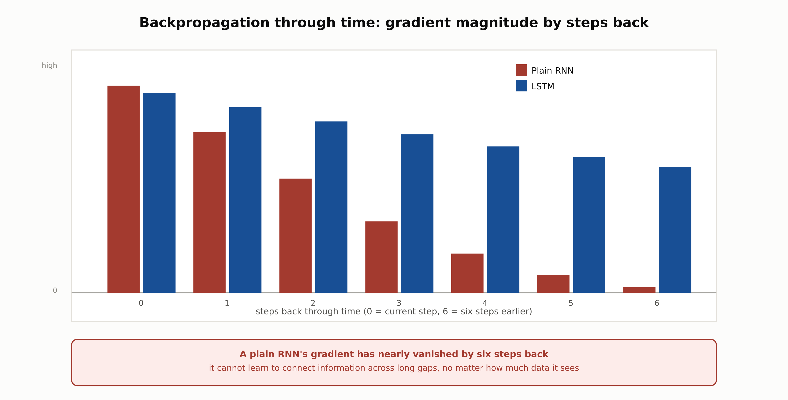
Backpropagation through time
A plain RNN's gradient nearly vanishes by six steps back; an LSTM's additive cell state decays far more slowly over the same span.
RegAITraining · Chapter 2.4
7 / 15

Slide 8
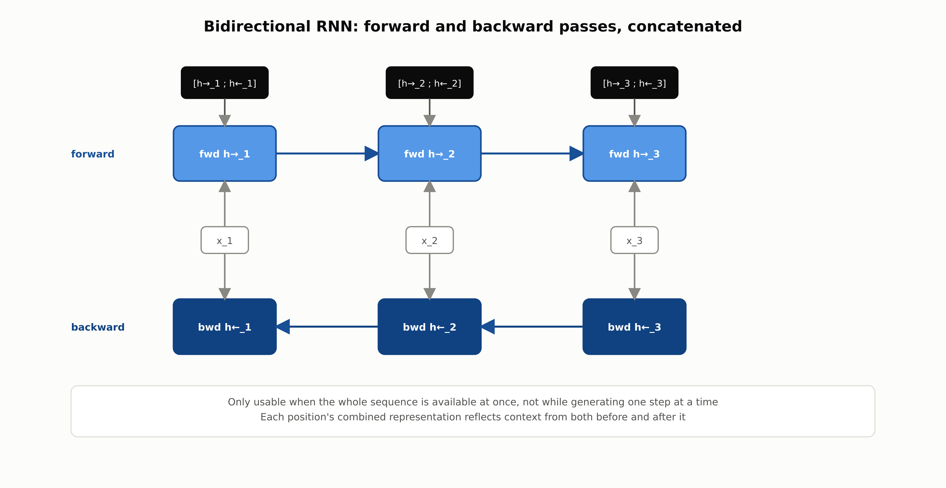
Bidirectional RNN
Forward and backward passes are concatenated at each position, so every position's representation reflects context from both directions.
RegAITraining · Chapter 2.4
8 / 15

Slide 9
Comparison & Related Concepts
Aspect | Plain RNN | LSTM | GRU
Long-range dependency handling | Poor: gradient vanishes over many steps | Strong: additive cell state preserves gradient | Strong: additive update, simpler than LSTM
Gates | None | 3: forget, input, output | 2: update, reset
Parameters per hidden unit | Fewest | Most | Fewer than LSTM, more than plain RNN
Typical choice today | Rarely used alone in production | Common where long dependencies matter most | Common where training speed matters and LSTM is not clearly better
LSTM and GRU differ mainly in how many gates control the update; both address the plain RNN's core weakness, and choosing between them is usually an empirical question.
RegAITraining · Chapter 2.4
9 / 15

Slide 10
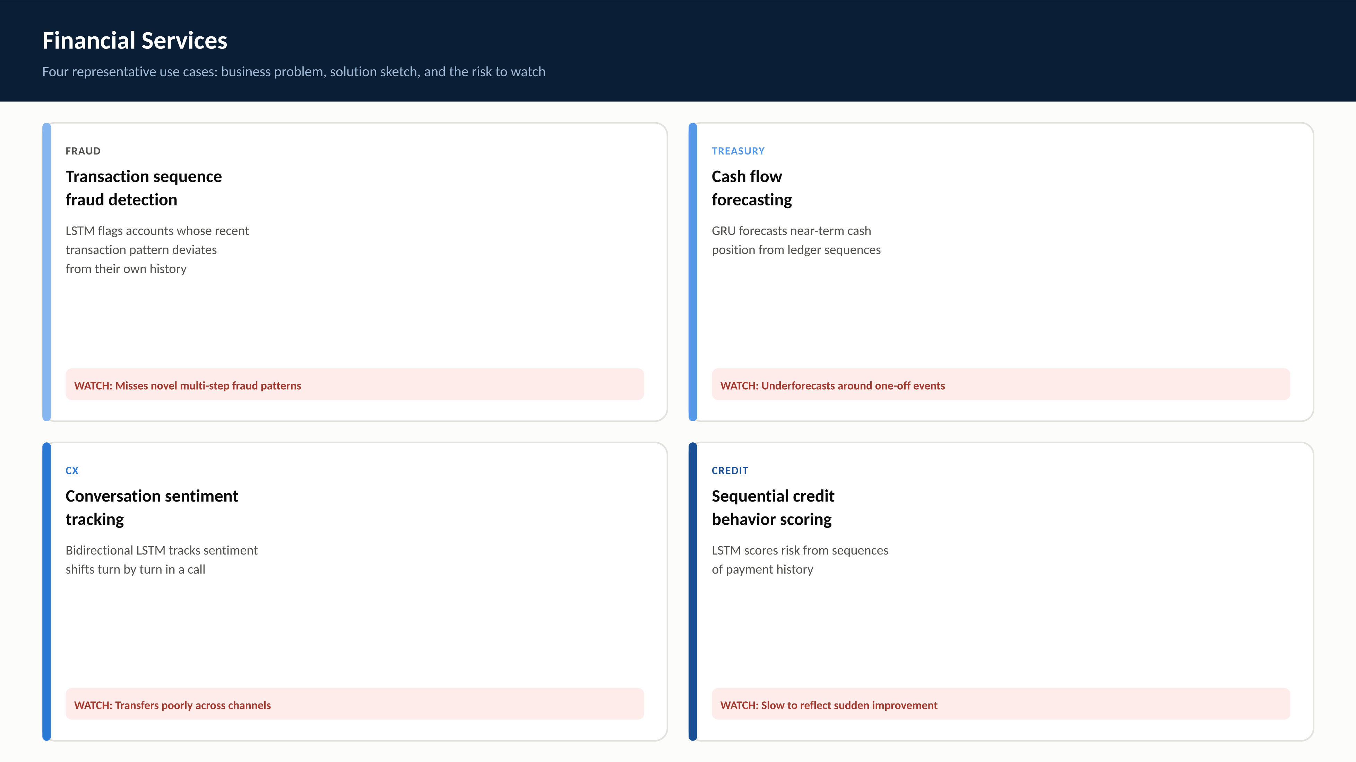
RegAITraining · Chapter 2.4
10 / 15

Slide 11

RegAITraining · Chapter 2.4
11 / 15

Slide 12
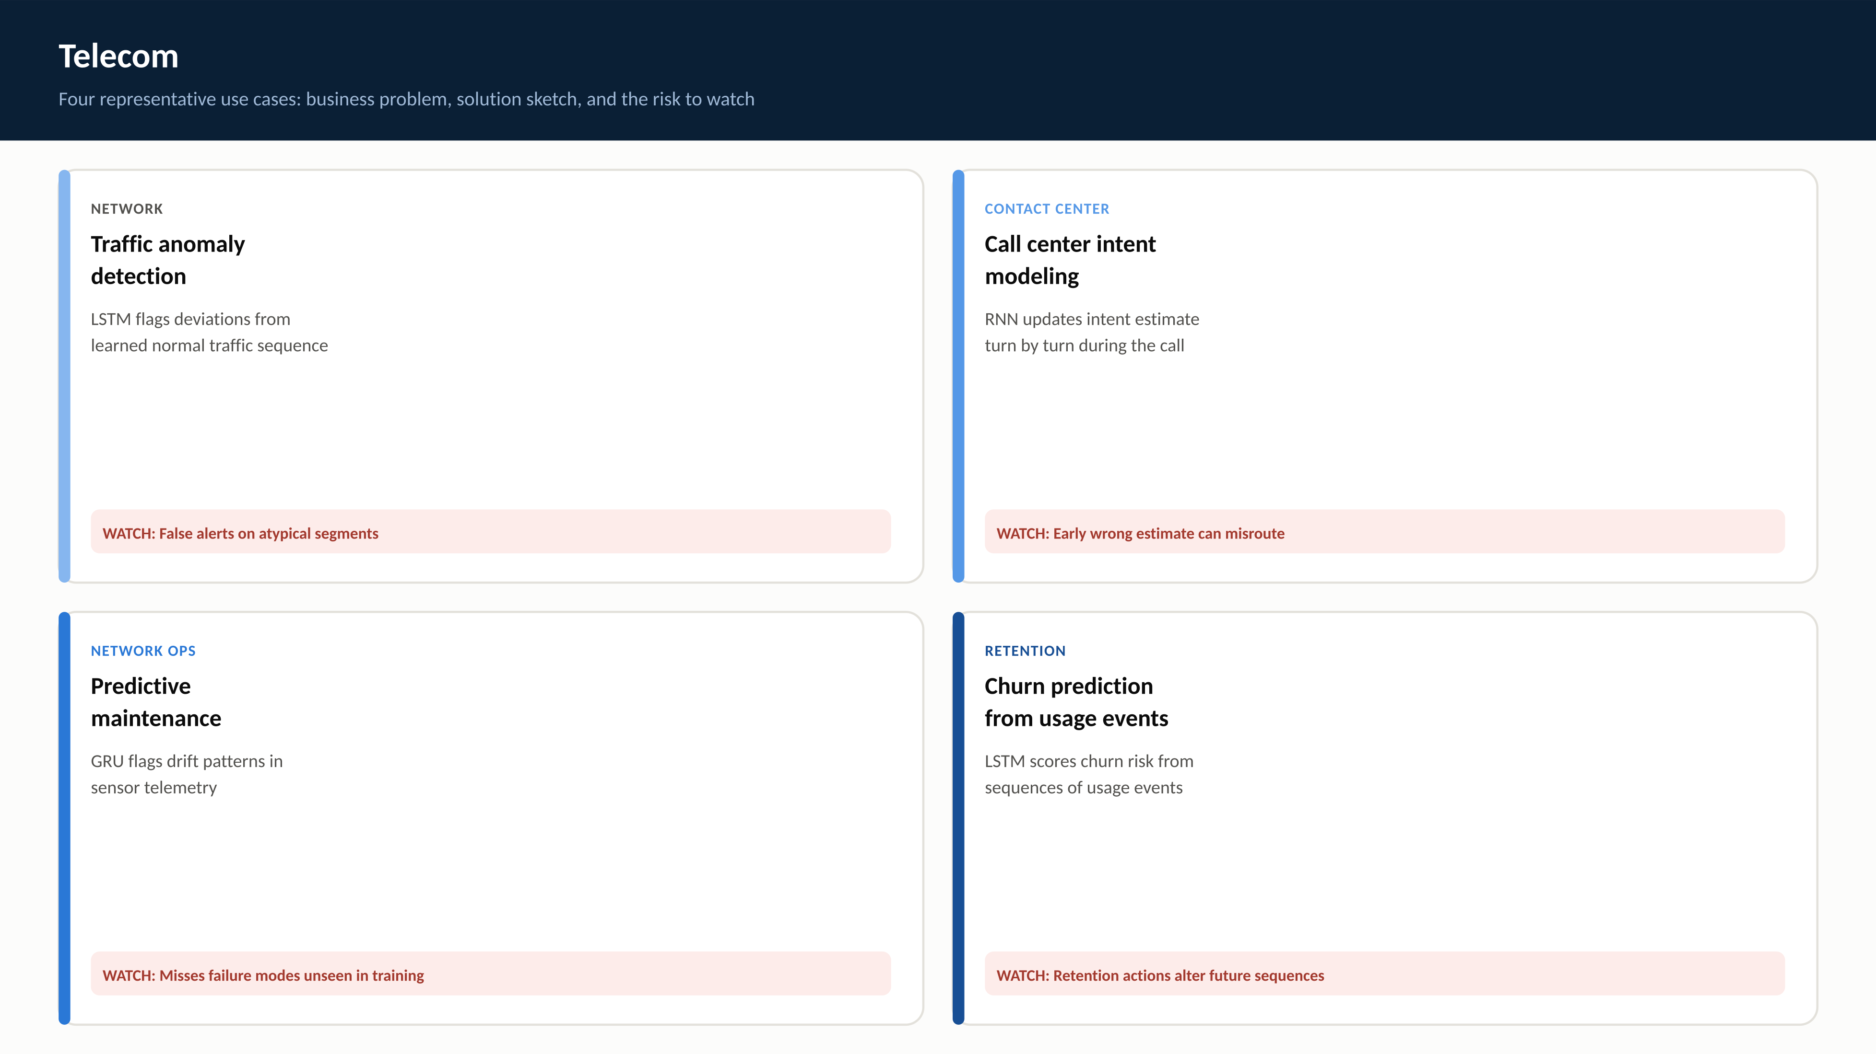
RegAITraining · Chapter 2.4
12 / 15

Slide 13
Check Your Understanding
1. What does an RNN reuse across time steps, and what is the hidden state's role?
2. Why do plain RNNs struggle with long-range dependencies, and what specifically causes this?
3. What is the key structural difference that lets an LSTM's cell state carry a gradient over long sequences better than a plain RNN's hidden state?
4. What are the three LSTM gates, and what does each one control?
5. How does a GRU differ structurally from an LSTM, and what is the practical tradeoff?
RegAITraining · Chapter 2.4
13 / 15
Notes:
Q1: What does an RNN reuse across time steps, and what is the hidden state's role? A1: An RNN reuses the same weights (W_hh and W_xh) at every time step, exactly as a CNN reuses the same filter at every spatial position. The hidden state is the network's running summary of the sequence so far, updated at each step and carried forward to the next. Q2: Why do plain RNNs struggle with long-range dependencies, and what specifically causes this? A2: Training unrolls the recurrence across all T steps of a sequence, so backpropagation through time runs through what is effectively a T-layer-deep network. The vanishing/exploding gradient problem from chapter 2.2 compounds over however many steps separate relevant information from where it is needed. Q3: What is the key structural difference that lets an LSTM's cell state carry a gradient over long sequences better than a plain RNN's hidden state? A3: The LSTM cell state update is largely additive (c_t = f_t times c_(t-1) plus i_t times a candidate value), controlled by gates, rather than being repeatedly passed through a nonlinearity via matrix multiplication at every step. This additive path gives the gradient a much more direct route backward through time. Q4: What are the three LSTM gates, and what does each one control? A4: The forget gate controls what fraction of the existing cell state to keep; the input gate controls how much of a new candidate value to add to the cell state; the output gate controls how much of the cell state to expose as the hidden state at that step. Q5: How does a GRU differ structurally from an LSTM, and what is the practical tradeoff? A5: A GRU has two gates (update and reset) instead of an LSTM's three, and no separate cell state, only a hidden state. This gives it fewer parameters and typically faster training, often with comparable accuracy, though which one performs better is task-dependent rather than settled in GRU's favor generally.

Slide 14
Key Takeaways
An RNN reuses the same weights at every time step, carrying a hidden state forward as its running summary of the sequence.
Training an RNN unrolls it across time and backpropagates through the resulting T-step graph (backpropagation through time), inheriting chapter 2.2's vanishing/exploding gradient problem, now stretched across time steps instead of layers.
LSTM adds a largely additive cell state controlled by forget, input, and output gates, giving gradients a much more direct path across long sequences.
GRU simplifies this to two gates (update, reset) and no separate cell state, trading some capacity for fewer parameters and typically faster training.
A bidirectional RNN runs forward and backward passes and concatenates their hidden states, but only works when the whole sequence is available at once.
RegAITraining · Chapter 2.4
14 / 15

Slide 15
Sources
Elman, J. L. (1990). Finding Structure in Time. Cognitive Science, 14(2), 179-211. — https://onlinelibrary.wiley.com/doi/abs/10.1207/s15516709cog1402_1
Hochreiter, S., and Schmidhuber, J. (1997). Long Short-Term Memory. Neural Computation, 9(8), 1735-1780. — https://dl.acm.org/doi/10.1162/neco.1997.9.8.1735
Cho, K., et al. (2014). Learning Phrase Representations Using RNN Encoder-Decoder for Statistical Machine Translation. EMNLP. — https://aclanthology.org/D14-1179/
RegAITraining · Chapter 2.4
15 / 15

