Slide 1
CHAPTER 3.3 · PHASE 3
Language Modeling Objectives: Causal LM vs. Masked LM vs. Seq2Seq
Three ways to train on text, and why each produces models with genuinely different strengths.
NLP & Language Model Foundations

Slide 2
AGENDA
What this chapter covers
Causal (autoregressive) language modeling: predict the next token from prior tokens
Masked language modeling: predict hidden tokens from full bidirectional context
Seq2seq: a bidirectional encoder and causal decoder joined by cross-attention
Teacher forcing, exposure bias, and perplexity
Why each objective leads to different natural strengths
Industry use cases across Finance, Healthcare, and Telecom

Slide 3
TL;DR
The short version
Causal LM: predicts next token from only prior tokens (GPT-style, natural generation)
Masked LM: predicts hidden tokens from full bidirectional context (BERT-style, understanding)
Seq2seq: encoder reads input, decoder generates output (T5/BART-style, transformation)
The objective determines what a model is naturally good at
Chapter 3.4 covers the model families built around each objective

Slide 4
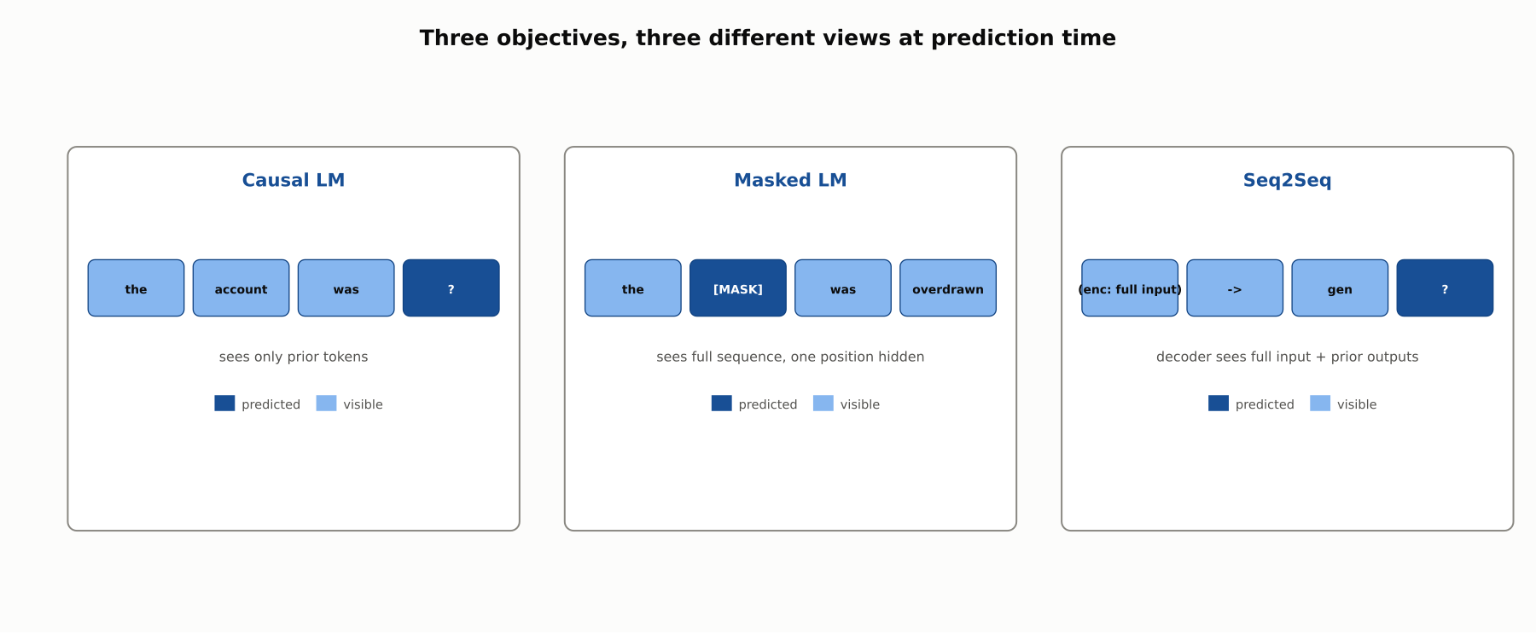
HIGH-LEVEL
Three objectives, three different views
What each objective can see when it makes a prediction is the whole story.

Slide 5
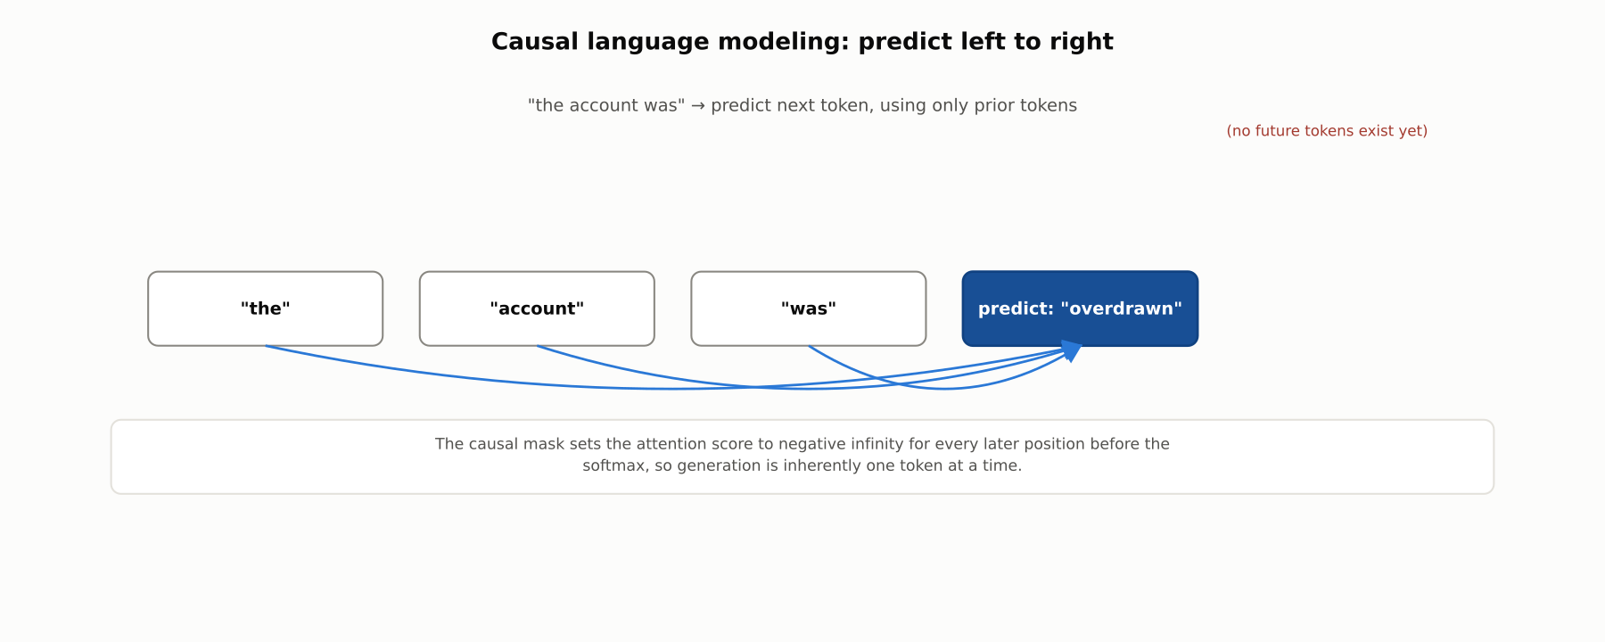
DEEP-DIVE
Causal LM: the causal mask
Attention scores for future positions are set to negative infinity before the softmax. Generation is inherently sequential.

Slide 6
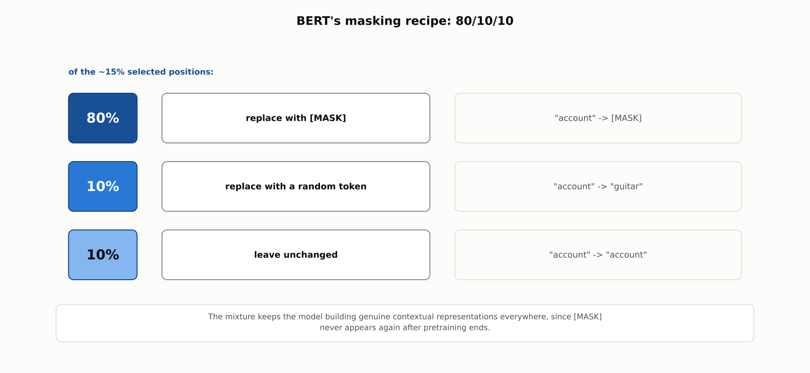
DEEP-DIVE
BERT's masking recipe: 80/10/10
The mixture prevents the model from over-relying on a [MASK] token that never appears again after pretraining.

Slide 7
DEEP-DIVE
Masked LM: the auxiliary objective that didn't pan out
BERT also trained Next Sentence Prediction (NSP) alongside masked LM
RoBERTa (Liu et al., 2019) found NSP contributed little and dropped it
Masked LM predicts a fixed set of positions: no natural generation mechanism
This is why BERT-style models are not used for open-ended text generation

Slide 8
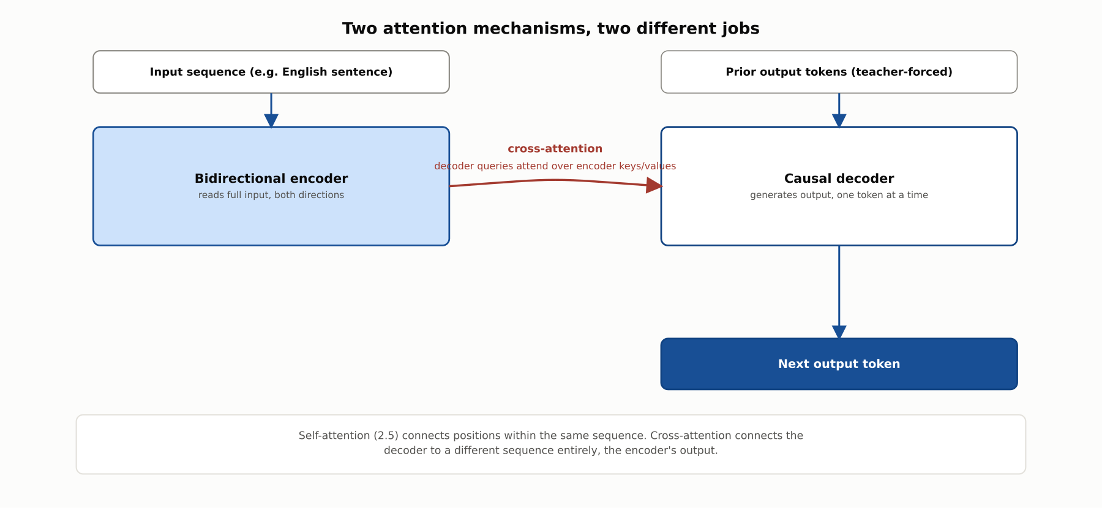
DEEP-DIVE
Seq2seq: two attention mechanisms, two jobs
Self-attention connects a sequence to itself. Cross-attention connects the decoder to the encoder's output.

Slide 9
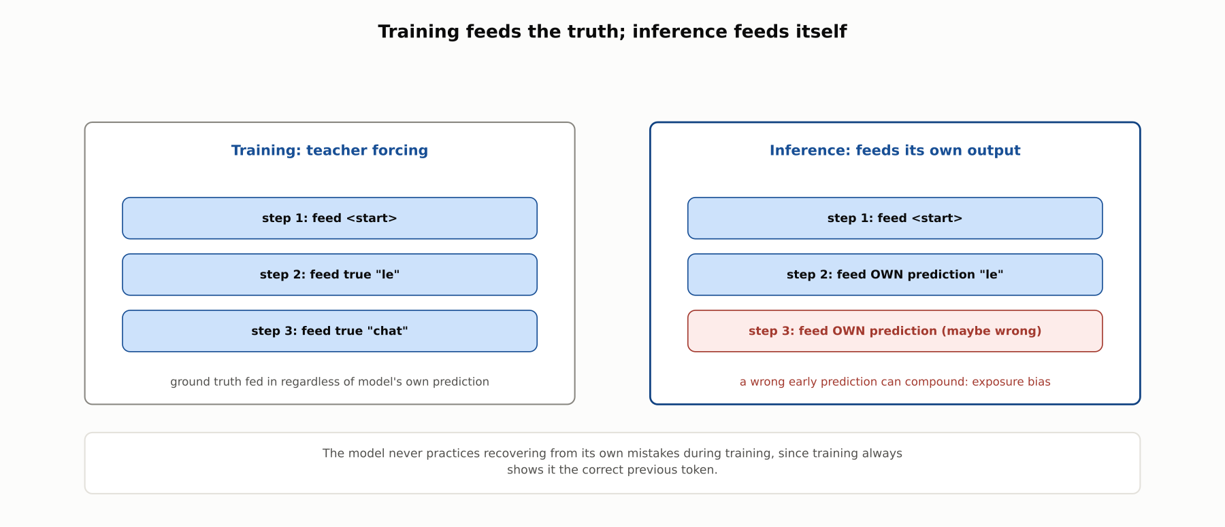
DEEP-DIVE
Teacher forcing creates exposure bias
Training always shows the ground truth; inference must feed back the model's own, possibly wrong, predictions.

Slide 10
REFERENCE ARCHITECTURE
A seq2seq model, end to end
Bidirectional encoder reads the entire input sequence at once
Cross-attention lets each decoder position attend over the encoder's output
Causal decoder generates the output sequence one token at a time
T5 casts every task, classification included, as text-to-text generation

Slide 11
COMPARISON & RELATED CONCEPTS
Causal LM vs. Masked LM vs. Seq2Seq
Aspect | Causal LM | Masked LM | Seq2Seq
Context when predicting | Only prior tokens | Full sequence, bidirectional | Encoder: full input. Decoder: cross-attention + prior outputs
Natural task fit | Open-ended generation | Classification, extraction | Transformation (translation, summarization)
Can generate open-ended text | Yes, natively | No | Yes, conditioned on input
Canonical example | GPT family | BERT family | T5, BART
Chapter 3.4 compares the model families (GPT, BERT, T5) built around these three objectives.

Slide 12
INDUSTRY USE CASES
Finance
FINANCIAL SERVICES
Summarizing lengthy credit agreements
Drafting Suspicious Activity Report narratives
Problem: Credit officers need faithful, shortened summaries of long agreements without missing buried obligations.
Problem: Analysts need to draft SAR narratives quickly from transaction detail.
Solution: A seq2seq model generates a condensed summary conditioned on the full agreement via its encoder.
Solution: A causal language model drafts a narrative from structured detail for analyst review.
Watch for: An omitted obligation clause needs model-risk-management validation on summarization fidelity, since a dropped clause changes the deal's actual risk profile.
Watch for: An uncaught hallucinated detail becomes a factual inaccuracy in a regulatory filing, a distinct audit and regulatory-accuracy exposure.

Slide 13
INDUSTRY USE CASES
Healthcare & Telecom
HEALTHCARE + TELECOM
(Healthcare) Narrative radiology report generation
(Telecom) Summarizing QA call transcripts
Problem: Structured imaging findings need to become fluent, accurate report prose.
Problem: QA review of long call transcripts needs an accurate summary of commitments made.
Solution: A seq2seq model generates report text conditioned on the structured findings via its encoder.
Solution: A seq2seq model summarizes the full transcript via its encoder.
Watch for: Report text that doesn't faithfully reflect a finding is a clinical-safety issue and may need its own regulatory-clearance review.
Watch for: A dropped restoration-time commitment from an outage call can surface later as an SLA dispute with no record it was ever made.

Slide 14
CHECK YOUR UNDERSTANDING
Discuss before moving on
1. What does a causal LM see when predicting a token, and what enforces it?
2. Why does BERT use an 80/10/10 masking mixture instead of always using [MASK]?
3. What is cross-attention, and how does it differ from self-attention?
4. What is exposure bias, and why does teacher forcing create it?

Slide 15
CHAPTER 3.3 · PHASE 3
Key Takeaways
Causal LM: next-token prediction from prior context only, natural for generation
Masked LM: fill-in-the-blank from bidirectional context, natural for understanding
Seq2seq: encoder-decoder with cross-attention, natural for transformation tasks
Teacher forcing trains efficiently but creates exposure bias at inference
Next: 3.4 Evolution of LLMs: GPT / BERT / T5 Families, Compared

