Slide 1
CHAPTER 6.10 · PHASE 6
Open Knowledge Format (OKF): A Portable, Agent-Readable Knowledge Standard
Most organizational knowledge sits in incompatible silos. OKF gives every source a common, minimal export shape, so an ingestion pipeline never needs a custom connector per source again.
Retrieval-Augmented Generation & Knowledge Systems

Slide 2
AGENDA
What this chapter covers
The fragmented-context problem OKF is trying to solve
OKF's structure: one markdown file per concept, YAML frontmatter, a directory hierarchy
The type field, the only one OKF actually requires
How markdown links turn a directory into a lightweight graph
Where OKF fits relative to a wiki, a catalog API, and a full knowledge graph (Ch. 6.6)
How OKF feeds into the ingestion pipeline from Chapter 6.9, or bypasses it entirely

Slide 3
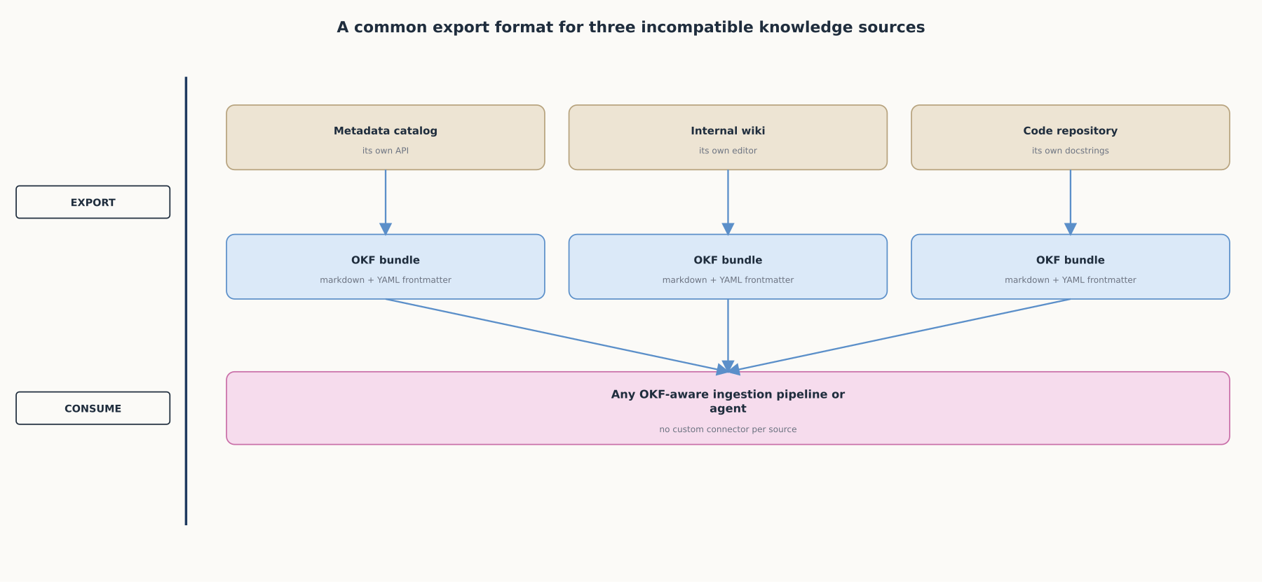
HIGH-LEVEL
A common export format for three incompatible sources
OKF does not replace a wiki, a catalog, or a code repository. It gives each a common, minimal export shape.

Slide 4
DEEP-DIVE
The problem is a missing shared format, not a missing tool
Internal knowledge lives fragmented: catalogs, wikis, shared drives, code comments, docstrings
Metadata catalogs, wikis, shared drives, code comments, docstrings, all mutually unreadable
"Every agent builder is solving the same context-assembly problem from scratch"
OKF does not replace the underlying systems; it defines a minimal export shape they can all target
Integration cost gets paid once per source, not once per source-consumer pair

Slide 5
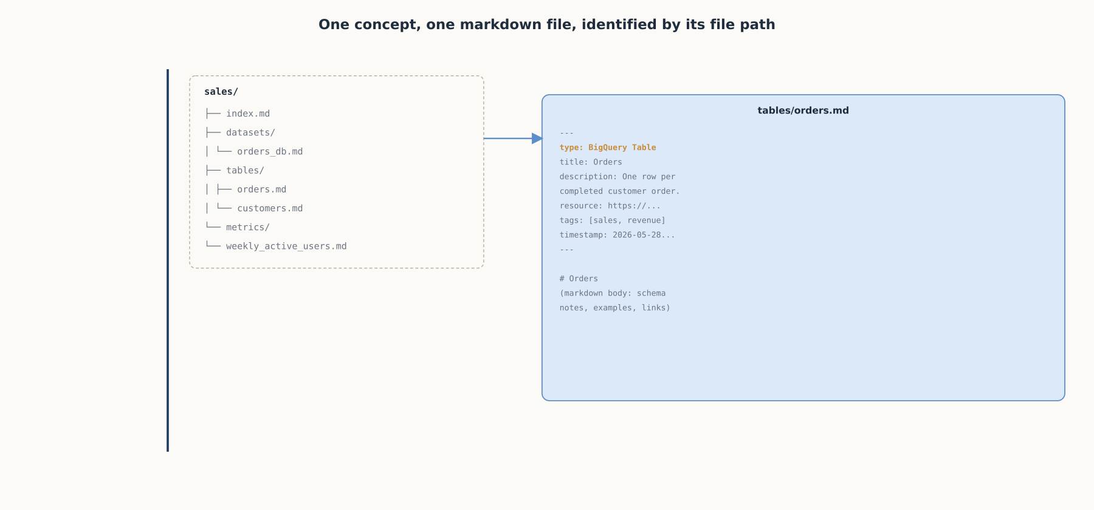
DEEP-DIVE
One concept, one markdown file
A bundle is a directory of markdown files; each concept file opens with YAML frontmatter and closes with a free-text body.

Slide 6
DEEP-DIVE
Only one field is actually required: type
"OKF requires exactly one thing of every concept: a type field"
Reserved fields: type, title, description, resource, tags, timestamp
A directory walk plus a YAML parser is enough to filter a large bundle
Deliberately less expressive than a real schema; the point is minimal structure
The rest of a concept's meaning lives in the markdown body, readable directly

Slide 7
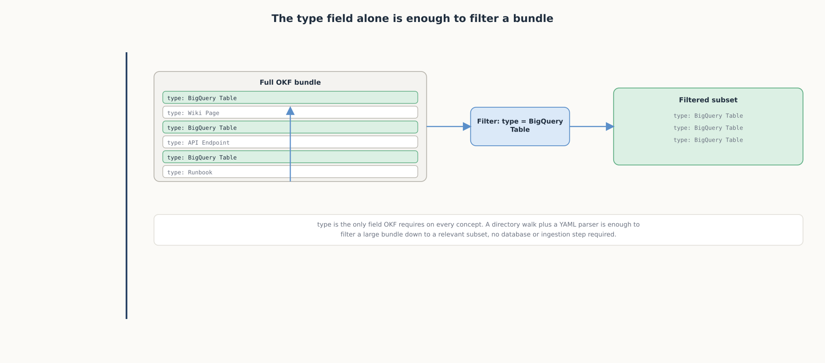
DEEP-DIVE
The type field alone is enough to filter a bundle
A directory walk and a YAML parser filter a bundle to a relevant subset, no database or ingestion step required.

Slide 8
DEEP-DIVE
Ordinary markdown links turn a flat directory into a graph
Concepts link to each other with ordinary markdown links
Those links turn a flat directory into a graph richer than file-system parent/child structure
Example: FK to [customers](/tables/customers.md)
Far less expressive than the property graphs or RDF from Chapter 6.6
No query language, no schema validation, no dedicated storage engine, but costs nothing to adopt

Slide 9
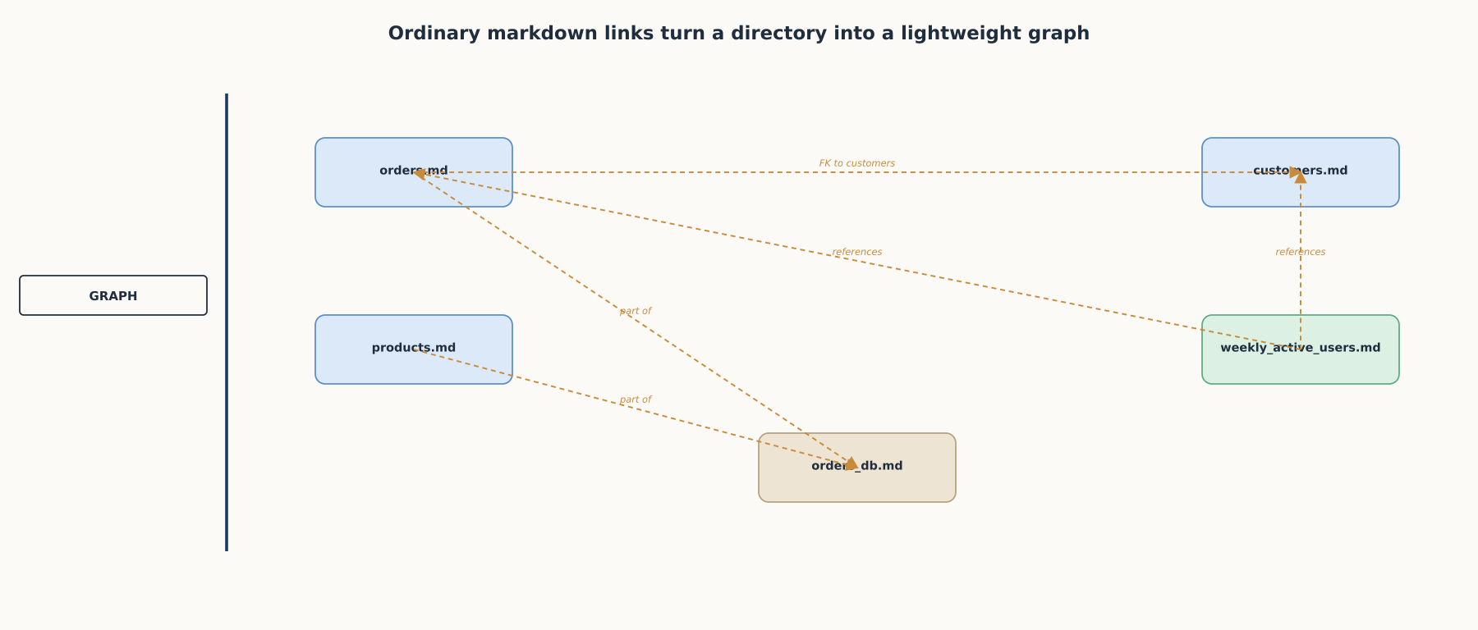
DEEP-DIVE
Ordinary markdown links turn a directory into a lightweight graph
Far less expressive than Chapter 6.6's knowledge graphs, but far cheaper to adopt.

Slide 10
COMPARISON & RELATED CONCEPTS
Where OKF sits relative to the alternatives
Aspect | OKF (markdown + YAML frontmatter) | Proprietary wiki or catalog API | Knowledge graph (Ch. 6.6) | Unstructured documents
What a consumer needs | A directory walk and a YAML parser | A client for that specific system's API | A graph query language and schema-aware client | A document parser, no structure guaranteed
Portability | Renders on GitHub, ships as a tarball, mounts anywhere | Tied to whichever platform hosts it | Tied to whichever graph database holds it | Portable as files, no shared metadata convention
Best suited for | A common export target across many sources | Teams fully invested in one platform | Deep multi-hop relationship queries at scale | A single source with no need to interoperate
OKF trades expressiveness for near-zero integration cost across sources that would otherwise each need their own connector.

Slide 11
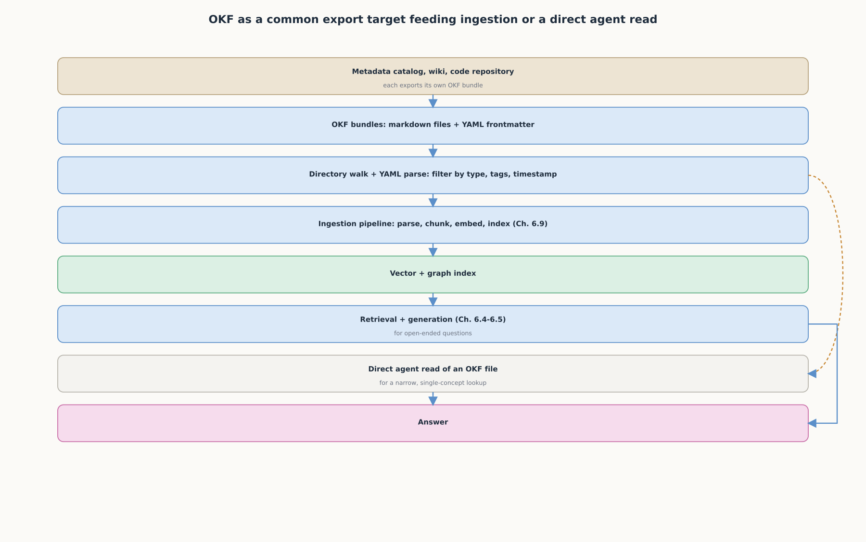
REFERENCE ARCHITECTURE
OKF feeding ingestion, or a direct agent read
A narrow lookup can read an OKF file directly; an open-ended question still goes through the full Chapter 6.9 pipeline.

Slide 12
HANDS-ON
Build your first OKF bundle in about fifteen minutes
Step 1: mkdir a directory, one concept type is enough to start
Step 2: write one markdown file with type/title/description/resource/tags/timestamp frontmatter
Step 3: add a second concept file, link it with an ordinary markdown link
Step 4: a 15-line Python script (pathlib + pyyaml) walks the bundle and parses each concept back out
Step 5: filter on type, the exact input shape Chapter 6.9's ingestion pipeline expects

Slide 13
CHECK YOUR UNDERSTANDING
Discuss before moving on
1. What problem does OKF solve that a better ingestion pipeline alone cannot fix?
2. What is the only field OKF actually requires on every concept, and what does it make possible?
3. How do OKF concepts reference each other, and how does that compare to a knowledge graph?
4. Why does OKF ship as a specification rather than a hosted service, and why does that matter for portability?
5. When might an agent read an OKF file directly instead of using the full retrieval pipeline?

