Slide 1
CHAPTER 6.5 · PHASE 6
Advanced RAG Patterns
Hybrid search and reranking made the base pipeline accurate. These patterns decide what to search, what to index, and how many times to try.
Retrieval-Augmented Generation & Knowledge Systems

Slide 2
AGENDA
What this chapter covers
HyDE: rewriting a query into a hypothetical answer before embedding it
GraphRAG: a second, structural index built from entities and relationships
Query decomposition: splitting a multi-hop question into sub-questions
ReAct: interleaving reasoning and retrieval instead of running each once
Self-RAG: training a model to retrieve on-demand and critique its own output
Where each pattern attaches to the pipeline Chapter 6.4 already built

Slide 3
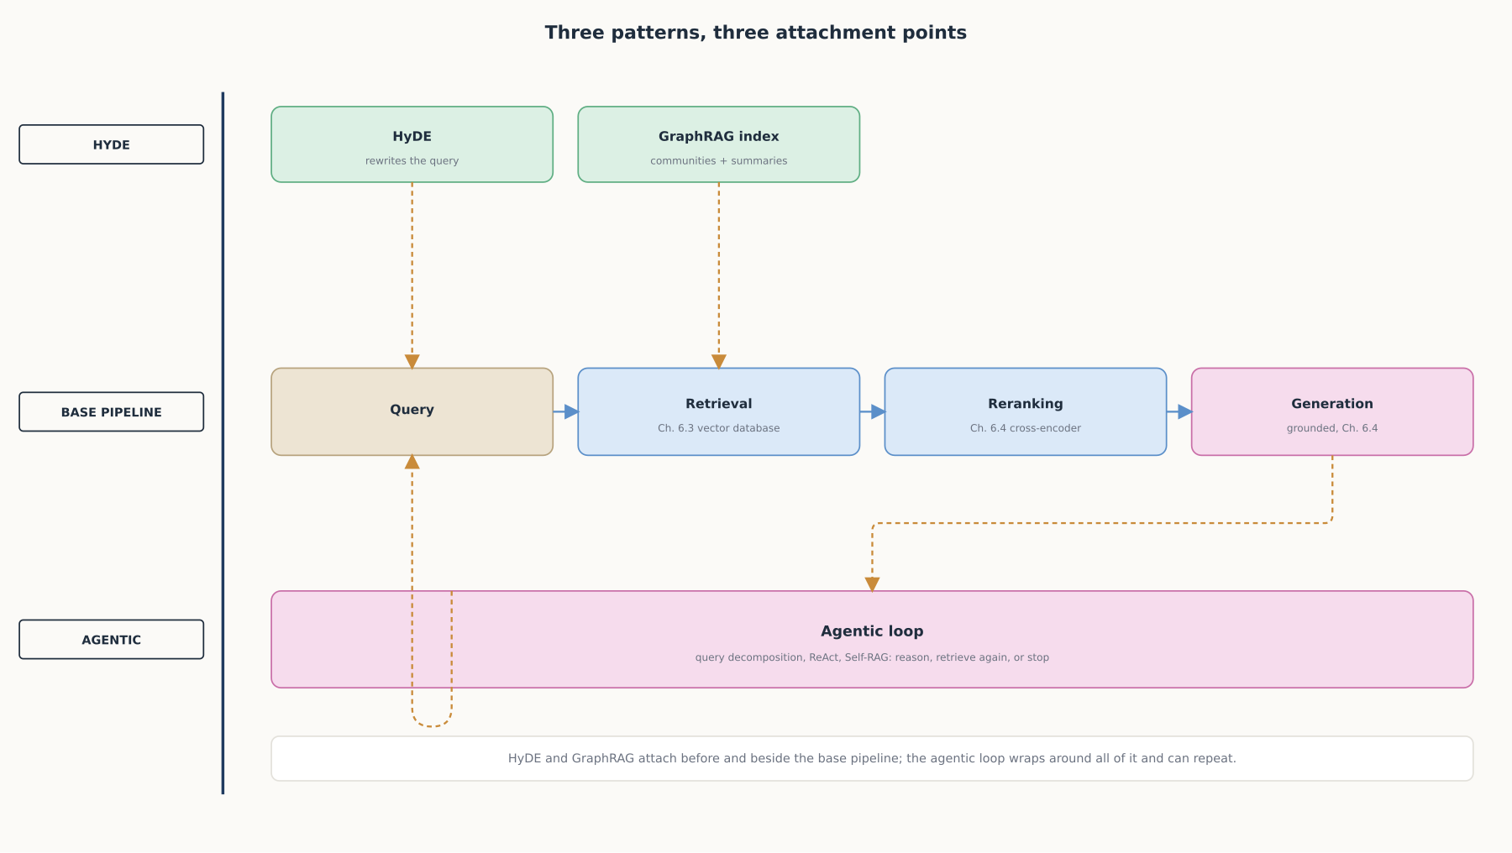
HIGH-LEVEL
Three patterns, three attachment points
HyDE and GraphRAG attach before and beside the base pipeline; the agentic loop wraps around all of it and can repeat.

Slide 4
DEEP-DIVE
HyDE rewrites the query before it ever gets embedded
A short or vague query embeds far from the detailed passages that would answer it
"HyDE first zero-shot instructs an instruction-following language model...to generate a hypothetical document"
That document "captures relevance patterns but is unreal and may contain false details"
An unsupervised contrastive encoder embeds the hypothetical document, not the raw query
"This second step ground[s] the generated document to the actual corpus, with the encoder's dense bottleneck filtering out the incorrect details"

Slide 5
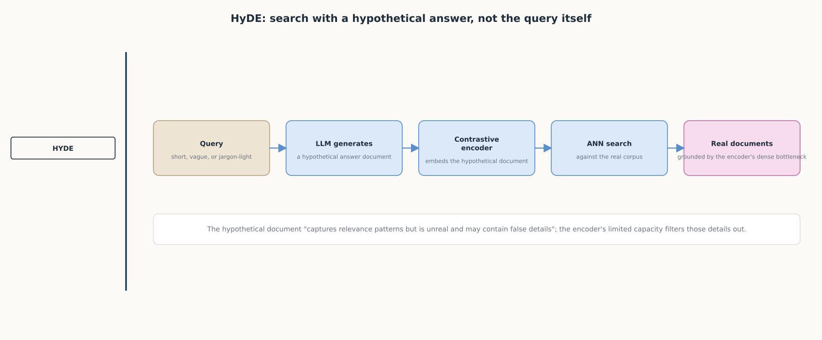
DEEP-DIVE
HyDE: search with a hypothetical answer, not the query itself
The encoder's limited capacity filters out hallucinated details while preserving the broad relevance pattern.

Slide 6
DEEP-DIVE
GraphRAG builds a second index for questions no chunk can answer alone
Chunk retrieval answers what a passage says, not how the collection relates as a whole
"The LLM processes the entire private dataset, creating references to all entities and relationships"
That builds "an LLM-generated knowledge graph"
The graph is clustered: "perform a hierarchical clustering of the graph using the Leiden technique"
Each cluster gets a summary: "generate summaries of each community and its constituents from the bottom-up"

Slide 7
DEEP-DIVE
GraphRAG query time: global search vs. local search
Global search is for "reasoning about holistic questions about the corpus by leveraging the community summaries"
Local search is for "reasoning about specific entities by fanning-out to their neighbors and associated concepts"
A flat chunk index has no equivalent of either mode
It can return passages that mention an entity, but has no summarized notion of that entity's community
And no way to answer a question about the shape of the whole dataset

Slide 8
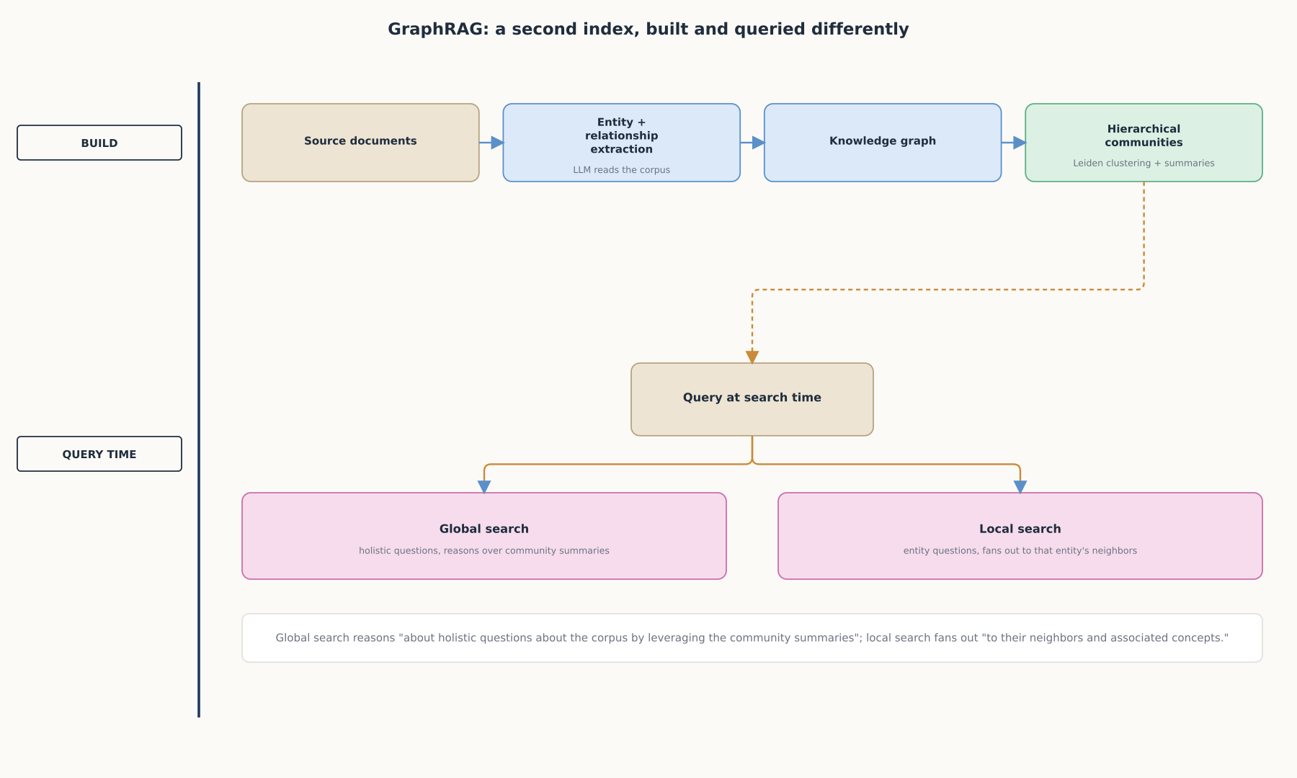
DEEP-DIVE
GraphRAG: a second index, built and queried differently
Construction happens once and is expensive; global and local search then reason over that structure at query time.

Slide 9
DEEP-DIVE
Query decomposition splits a multi-hop question before retrieval runs
A question that depends on connecting two or more facts embeds as one blended vector
A single retrieval pass over that blend tends to surface only the most dominant part of the question
"An LLM decomposes the original query into sub-questions"
"Passages are retrieved for each sub-question" independently
"The merged candidate pool is reranked to improve the coverage and precision of the retrieved evidence"
"Question decomposition effectively assembles complementary documents, while reranking reduces noise"

Slide 10
DEEP-DIVE
ReAct interleaves reasoning and retrieval instead of running each once
Standard RAG reasons once, retrieves once, generates once, in a fixed order
"Enables language models to generate both verbal reasoning traces and text actions in an interleaved manner"
Reasoning helps decide what to search for next ("reason to act")
What comes back from a search feeds further reasoning ("act to reason")
A fixed single pass cannot notice a bad first search and try again; a ReAct loop can

Slide 11
DEEP-DIVE
Self-RAG trains the model to decide when to retrieve, and to critique itself
Standard RAG retrieves a fixed number of passages on every query, needed or not
Self-RAG uses "special tokens, called reflection tokens" to decide when to retrieve
The model "adaptively retrieves passages on-demand"
The same tokens let it critique retrieved passages and its own generations for relevance and support
"Generating reflection tokens makes the LM controllable during the inference phase"

Slide 12
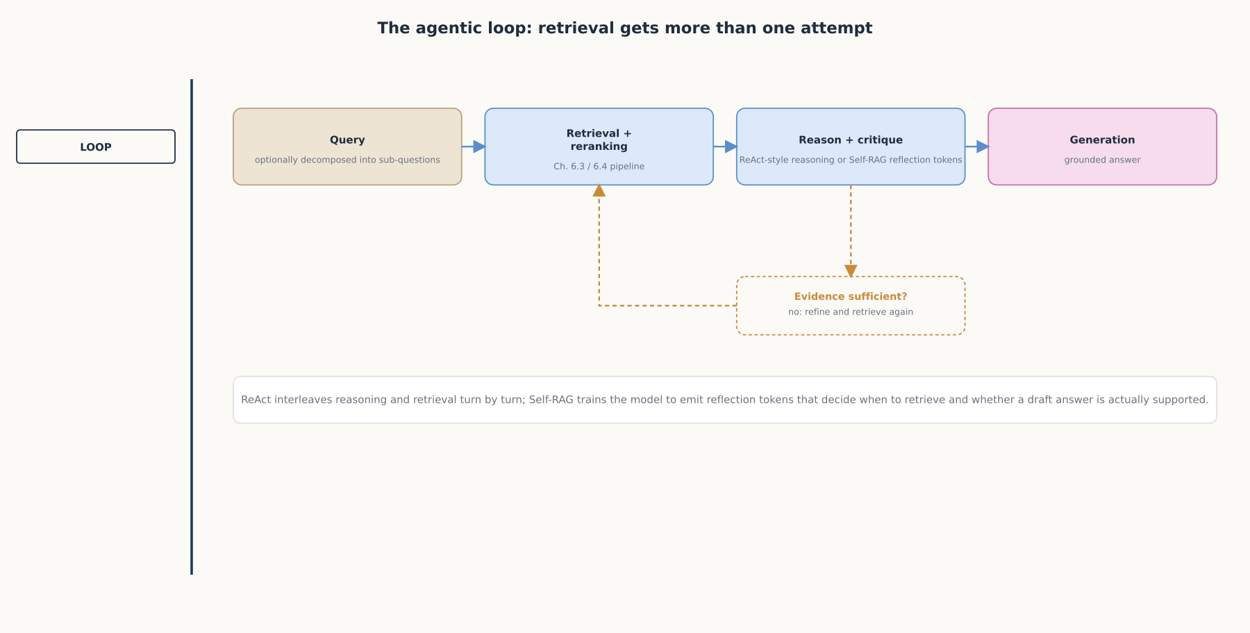
DEEP-DIVE
The agentic loop: retrieval gets more than one attempt
Decomposition, ReAct, and Self-RAG are three different ways of giving retrieval more than one shot at getting it right.

Slide 13
COMPARISON & RELATED CONCEPTS
Four patterns, four points of leverage
Aspect | HyDE | GraphRAG | Query decomposition | Agentic loop (ReAct / Self-RAG)
What it changes | Rewrites the query before embedding | Adds a structural graph index | Splits one query into several | Wraps the cycle in a repeatable loop
Cost | One extra LLM call per query | Expensive to build up front | One retrieval pass per sub-question | Multiple LLM calls, or a specially trained model
Best suited for | Short, vague, jargon-light queries | Holistic questions about the whole corpus | Multi-hop questions with several facts | Open-ended or high-stakes questions
Four different points of leverage: rewriting the query, restructuring the index, splitting the question, or looping the whole cycle.

Slide 14
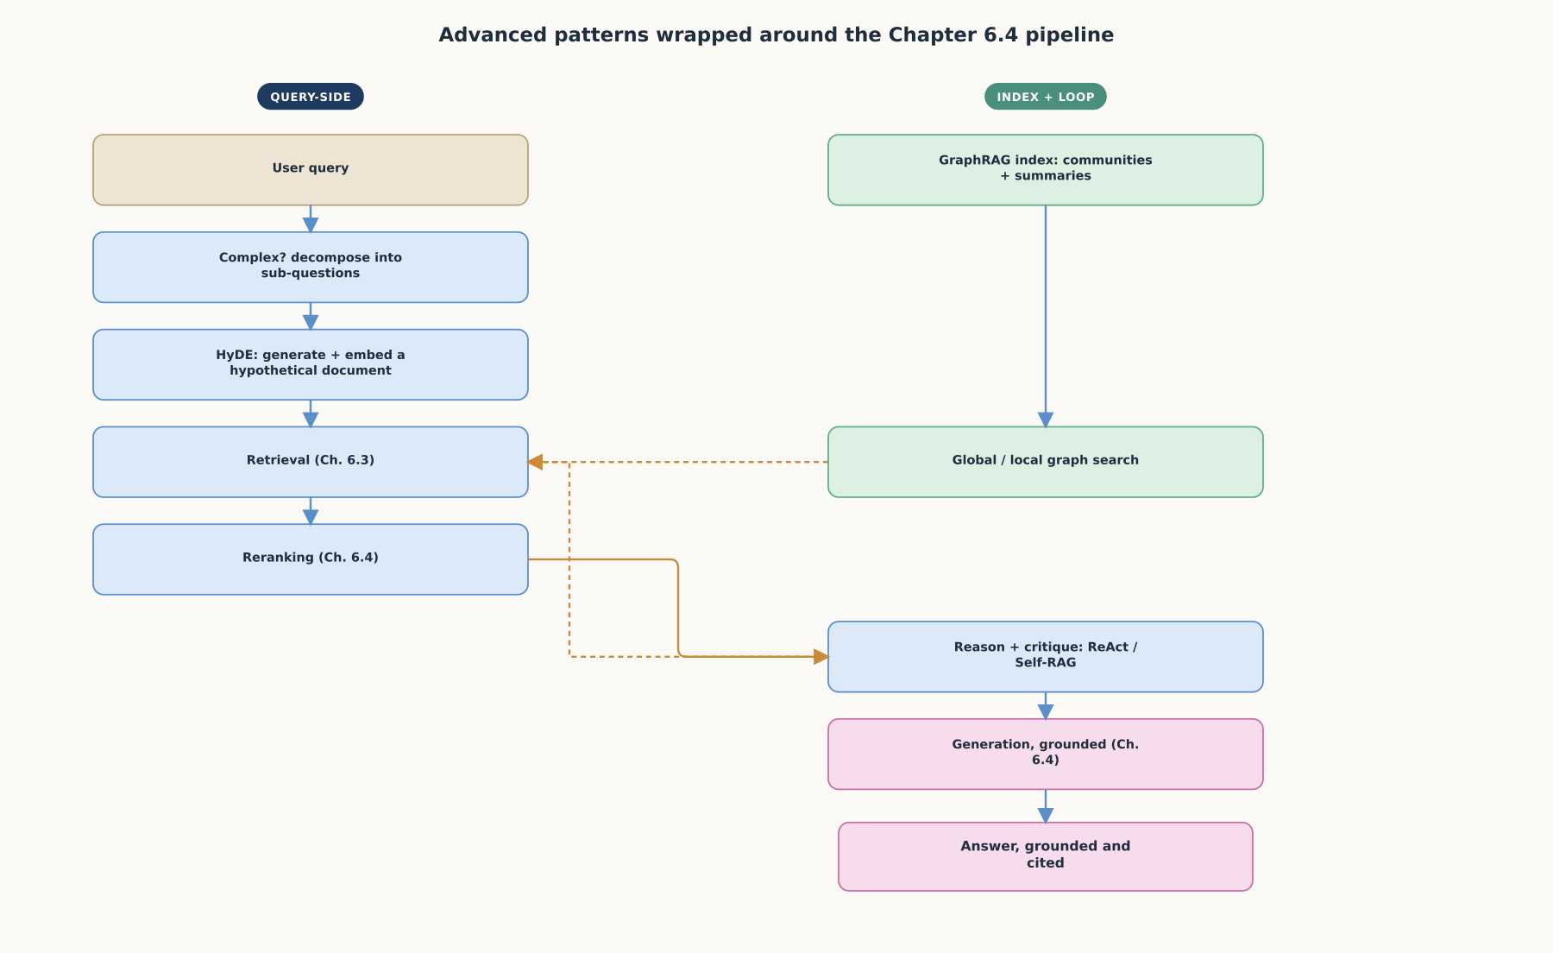
REFERENCE ARCHITECTURE
Advanced patterns wrapped around the Chapter 6.4 pipeline
Every pattern in this chapter is additive: none of them requires abandoning the mechanics Chapter 6.4 established.

Slide 15
CHECK YOUR UNDERSTANDING
Discuss before moving on
1. What problem does HyDE solve, and why does embedding a generated hypothetical document work better than embedding the original query directly?
2. What kind of question can GraphRAG answer that a flat, chunk-based vector index cannot, and what two search modes does it offer?
3. How does query decomposition handle a multi-hop question, and why is reranking still needed after decomposition?
4. What does it mean for ReAct to interleave reasoning and acting, and what failure mode does that fix?
5. How does Self-RAG decide when to retrieve, and how does it differ from a pipeline that always retrieves a fixed number of passages?

