Slide 1
CHAPTER 6.6 · PHASE 6
Knowledge Graphs + LLMs
Chapter 6.5 used a knowledge graph to power GraphRAG. This chapter is about the graph itself: its structure, construction, resolution problem, and how a model queries and predicts against it directly.
Retrieval-Augmented Generation & Knowledge Systems

Slide 2
AGENDA
What this chapter covers
What a knowledge graph actually is, and how it differs from a relational database and a vector index
RDF triple stores vs. labeled property graphs: SPARQL vs. Cypher
Building a knowledge graph from unstructured text with a schema-guided LLM
Entity resolution: why the same real-world entity needs to become a single node
Knowledge graph embeddings: predicting a link nobody entered
Text2Cypher: letting an agent query the graph directly instead of only reading summaries of it

Slide 3
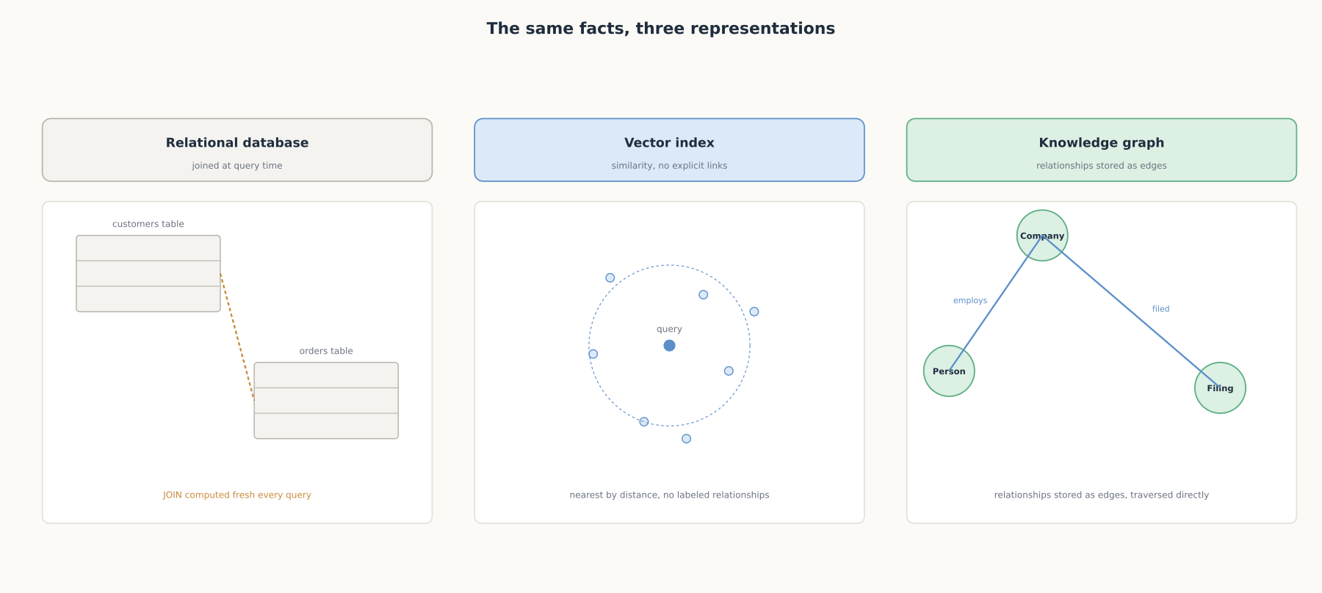
HIGH-LEVEL
The same facts, three representations
Joined at query time, embedded with no explicit relationships, or stored as first-class connections.

Slide 4
DEEP-DIVE
A knowledge graph stores relationships as data, not as something computed later
"A knowledge graph is an organized representation of real-world entities and their relationships"
"Nodes denote and store details about entities"; "relationships link two nodes together"
A relational database's relationships "reside in the code" and "must be synthesized at runtime with joins"
A graph database keeps relationships "stored directly in the database rather than re-generating them using joins"
A schema gives that structure consistent meaning across the whole graph

Slide 5
DEEP-DIVE
RDF triple stores vs. labeled property graphs
RDF: "the subject will be a resource...the predicate will represent an edge...the object will be another node or a literal value"
A "complete atomic decomposition of our data," queried with SPARQL
Property graphs: "both the nodes and relationships have an internal structure," queried with Cypher
"Because of the atomic decomposition of the data and RDF, you typically have longer patterns when you perform queries"
RDF suits cross-system interoperability; property graphs suit fast, deeply-chained traversal in one system

Slide 6
DEEP-DIVE
Building a graph from text now means instructing an LLM with a schema
LLMs "instructed with detailed prompts...to extract, and de-duplicate entities and relationships"
Output returned as "structured JSON" that "can be stored in a graph database"
"You can specify a schema with allowed nodes and relationships...and additional extraction instructions"
A full pipeline: "data loader, text splitter, chunk embedder, schema builder, lexical graph builder, entity and relation extractor, knowledge graph writer, entity resolver"

Slide 7
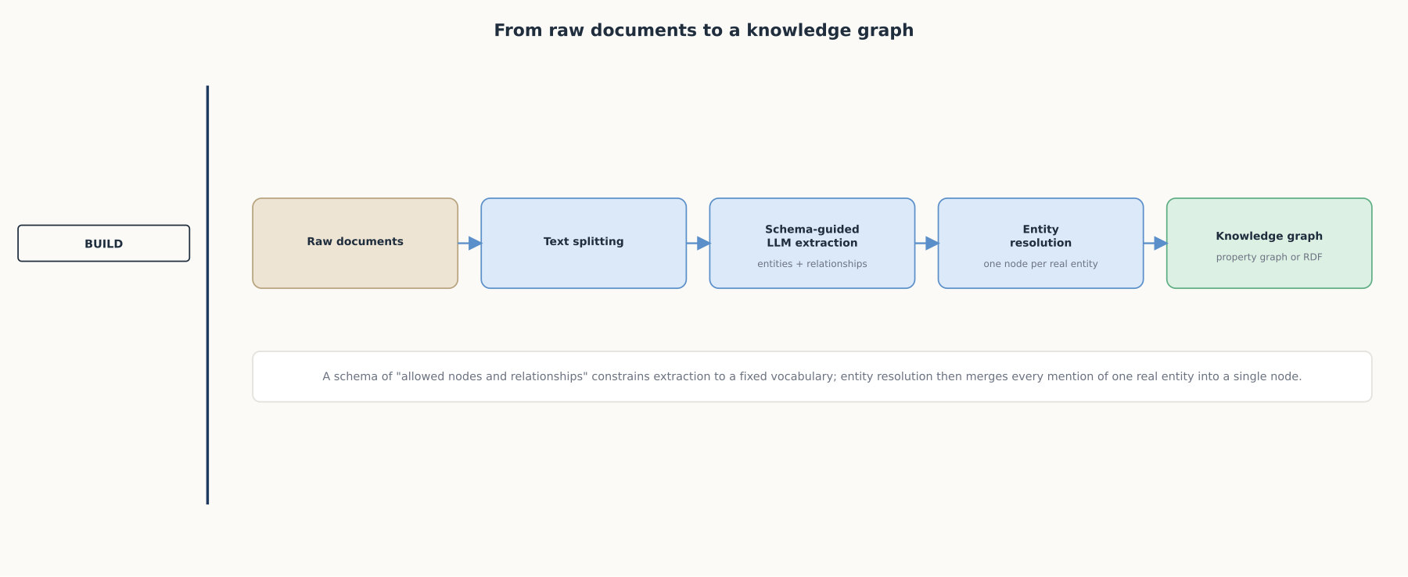
DEEP-DIVE
From raw documents to a knowledge graph
A fixed schema constrains extraction to a known vocabulary; entity resolution then merges every mention into one node.

Slide 8
DEEP-DIVE
Entity resolution: the same real-world thing rarely appears under the same name twice
One person can appear as a full name, a title and surname, and a first name across three paragraphs
"We ideally want a single real-world entity to be represented with a single node"
Named-entity recognition alone treats each mention as separate
Named-entity linking "maps those entities to a target knowledge base," often an external reference like Wikipedia
Skip this step and a graph fragments into duplicate, disconnected nodes for one entity

Slide 9
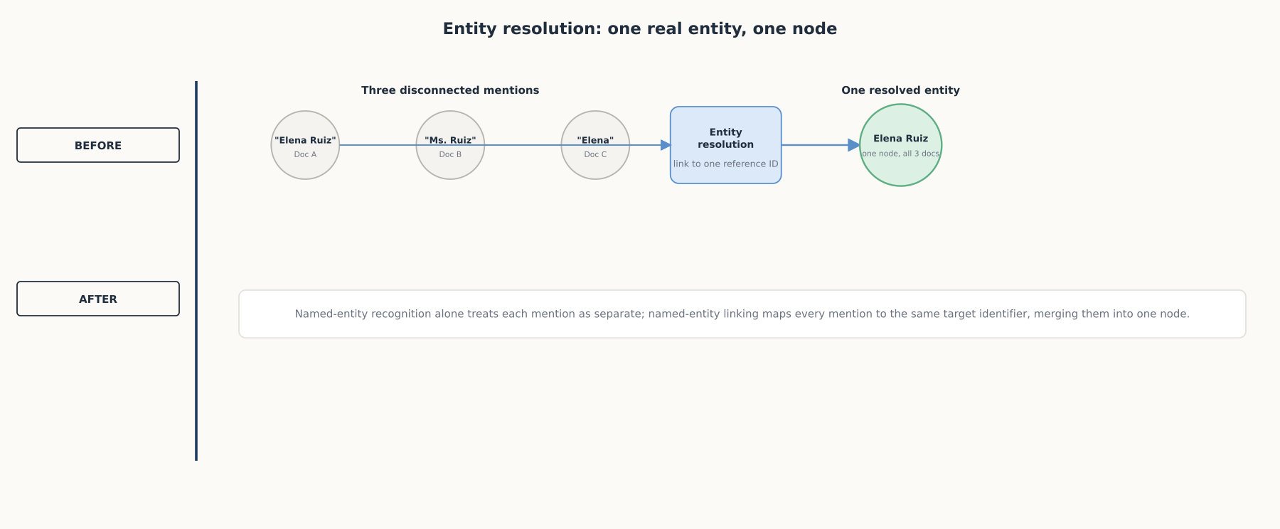
DEEP-DIVE
Entity resolution: one real entity, one node
Named-entity linking maps every mention to the same target identifier, merging separate nodes into one.

Slide 10
DEEP-DIVE
Knowledge graph embeddings predict connections nobody entered
"Vector representations of entities and relationships...used to predict missing links"
Different job from Chapter 6.2's embeddings: those represent text meaning, these represent position within the graph's structure
"Machine learning algorithms work better with numerical data...to perform tasks like link prediction"
A prediction, not a retrieval, and one that needs verification before being treated as fact

Slide 11
DEEP-DIVE
Text2Cypher lets an agent query the graph directly
"Generating Cypher queries from natural language using LLMs"
"Allowing an AI agent to generate and execute database queries...grounds its insights in actual domain knowledge"
That "reduces the risk of hallucination" compared to reading a possibly outdated summary
But: "query generation...requires agents to also have a clear understanding of the database schema"
"Large schema sizes may...overload the context and confuse the LLM"
Trades an outdated-summary risk for a malformed-query risk, not a free upgrade

Slide 12
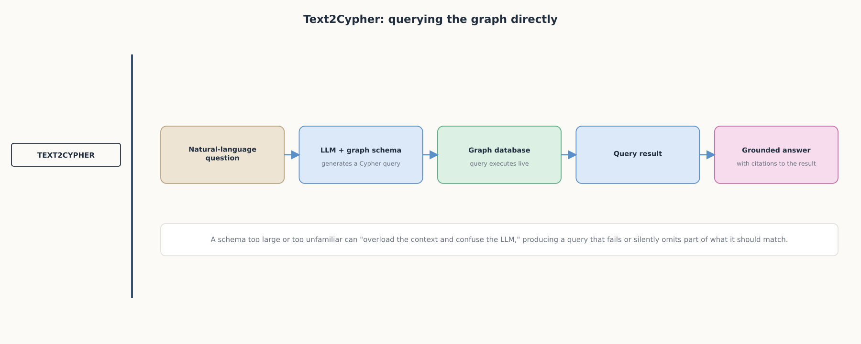
DEEP-DIVE
Text2Cypher: querying the graph directly
Grounds an answer in a live query result rather than a retrieved summary, at the cost of depending on schema clarity.

Slide 13
COMPARISON & RELATED CONCEPTS
Four ways to store the same facts
Aspect | Relational database | Vector index (Ch. 6.2/6.3) | Property graph (Cypher) | RDF triple store (SPARQL)
Relationships | Computed at query time via joins | Not explicit, only similarity | Stored directly as edges | Decomposed into atomic triples
Best at | Structured, tabular data | Finding semantically similar content | Fast, deeply-chained traversal | Interoperating across independent graphs
Cost | Mature, well-understood tooling | One embedding call per item | A construction + resolution pipeline | Longer query patterns, same construction cost
Each optimized for a different question: filtering structured records, finding similar meaning, traversing known relationships fast, or interoperating across systems.

Slide 14
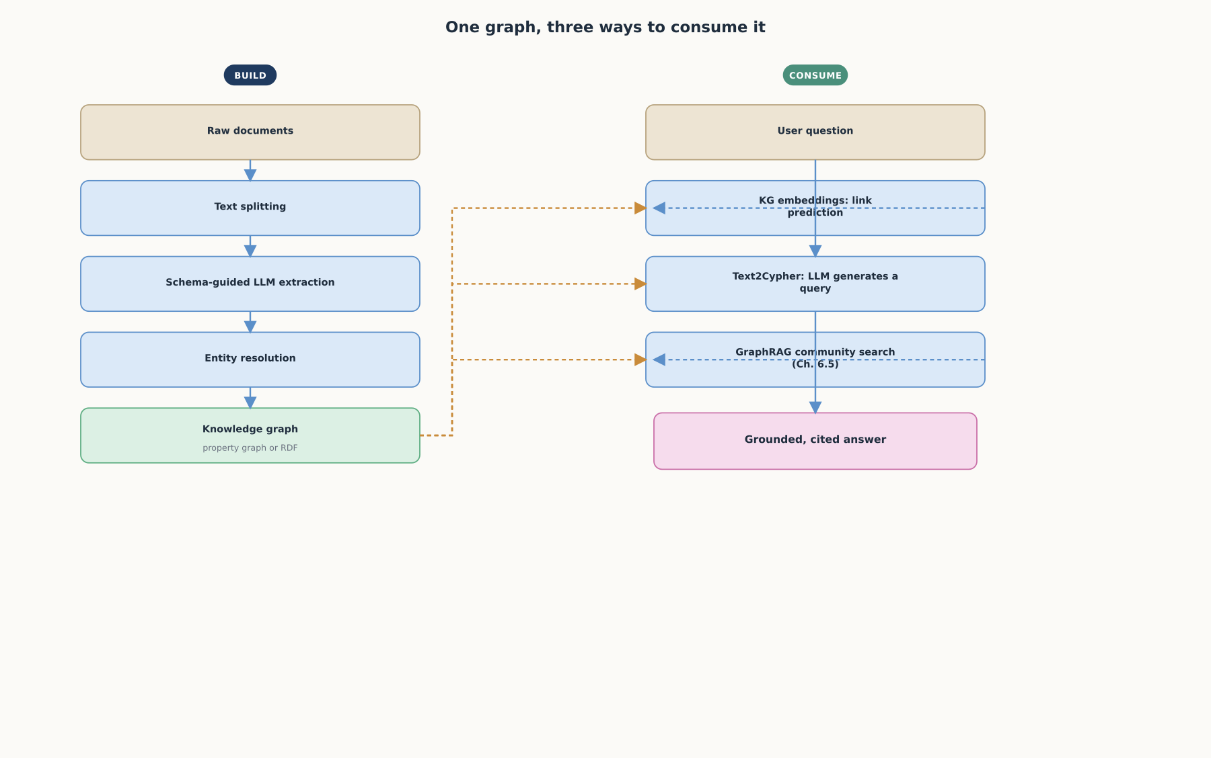
REFERENCE ARCHITECTURE
One graph, three ways to consume it
Embeddings predict a relationship nobody entered; Text2Cypher retrieves one that is already there; GraphRAG reasons over pre-built summaries.

Slide 15
CHECK YOUR UNDERSTANDING
Discuss before moving on
1. How does a knowledge graph represent relationships differently from a relational database, and why does that matter for a multi-hop query?
2. What is the structural difference between an RDF triple store and a labeled property graph, and what query language goes with each?
3. What problem does entity resolution solve, and what happens to a knowledge graph if it is skipped?
4. What is a knowledge graph embedding used for, and how is it different from the embeddings covered in Chapter 6.2?
5. What does Text2Cypher let an agent do that GraphRAG-style community search does not, and what new failure mode does it introduce?

