Slide 1
CHAPTER 6.7 · PHASE 6
Caching Infrastructure for GenAI & Agents
A surprising fraction of what a RAG or agent pipeline does is repeated work. Three caching layers avoid paying for it twice, each with a different match requirement and a different risk.
Retrieval-Augmented Generation & Knowledge Systems

Slide 2
AGENDA
What this chapter covers
Prompt caching: exact-match prefix reuse at the token level
Semantic caching: embedding-similarity matching for a much higher hit rate
The correctness risk semantic caching introduces, and how to manage it
Tool-call caching: protecting systems and correctness, not just saving tokens
Why idempotency is necessary but not sufficient for safe tool-call caching
How the three layers compose inside a single request

Slide 3
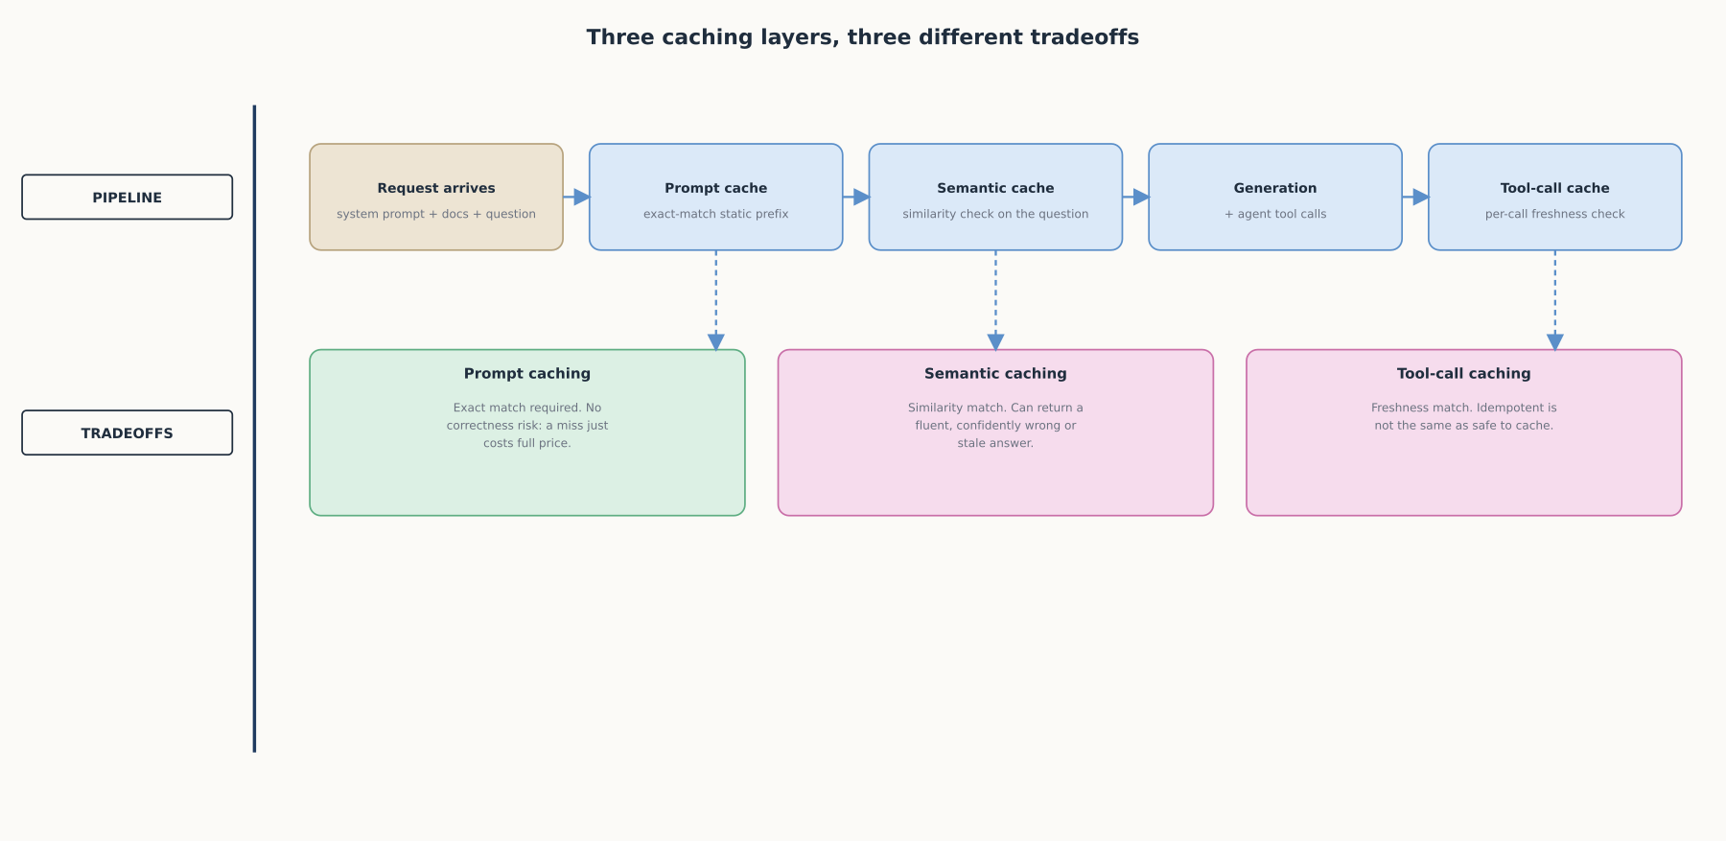
HIGH-LEVEL
Three caching layers, three different tradeoffs
Three caching layers, three different points in the pipeline, three different match requirements and risk profiles.

Slide 4
DEEP-DIVE
Prompt caching reuses the exact tokens a model already processed
"The system checks if a prompt prefix...is already cached from a recent query"
"Marking a block with cache_control writes exactly one cache entry: a hash of the prefix"
"Cache hits require 100% identical prompt segments" up to the breakpoint
A single changed character anywhere in the prefix is a full miss, not a partial credit
"Cache read tokens are 0.1 times the base input tokens price," a 90% discount on reused tokens
Default 5-minute lifetime, refreshed free on every use, with a longer option available

Slide 5
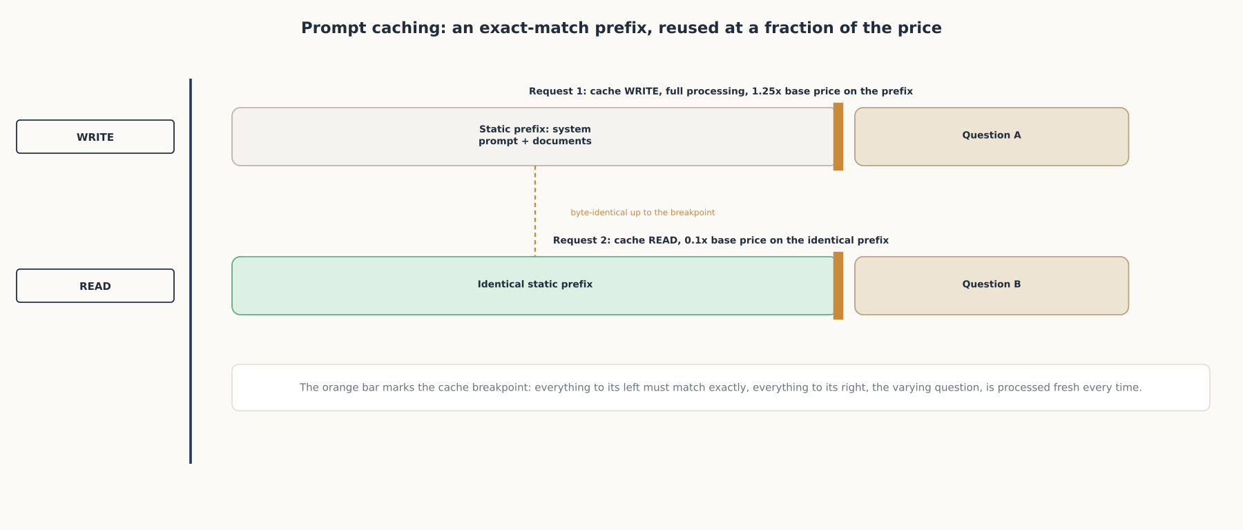
DEEP-DIVE
Prompt caching: an exact-match prefix, reused at a fraction of the price
A single changed token anywhere before the breakpoint turns a cheap cache read back into a full-price write.

Slide 6
DEEP-DIVE
Semantic caching trades exact match for a much higher hit rate
"Employs embedding algorithms to convert queries into embeddings and uses a vector store for similarity search"
"Using an exact match approach for LLM caches is less effective...resulting in a low cache hit rate"
"Semantic caching identifies and stores similar or related queries, thereby increasing cache hit probability"
Projects built around the idea claim order-of-magnitude cost and latency gains on a true hit

Slide 7
DEEP-DIVE
The risk lives in exactly what makes semantic caching powerful
"My left arm hurts" and "my right arm hurts" can score 0.91 similarity, opposite conditions
"What is the current interest rate?" is semantically identical yesterday and today, and factually different
Threshold tuning is a real risk-benefit tradeoff, not a knob with one correct setting
The right threshold matches what a false hit actually costs in a given domain
Validate a new threshold in shadow mode against real traffic before it serves a live response

Slide 8
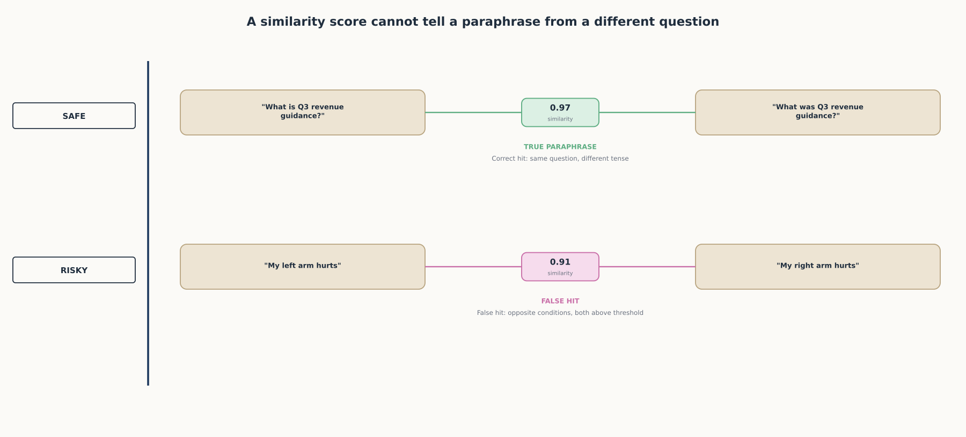
DEEP-DIVE
A similarity score cannot tell a paraphrase from a different question
A score close to the threshold cannot distinguish a true paraphrase from two questions that merely use similar words.

Slide 9
DEEP-DIVE
Tool-call caching is about protecting systems, not primarily saving tokens
"Tool calls often dominate token usage indirectly by expanding context windows with raw data"
"Idempotent tool calls are necessary but not sufficient" for caching
"A read-only database query might be idempotent, but if the underlying data changes, your cached answer becomes a lie"
A cache key needs to capture intent, not just literal arguments
Caching too aggressively serves stale data; caching too conservatively wastes real savings

Slide 10
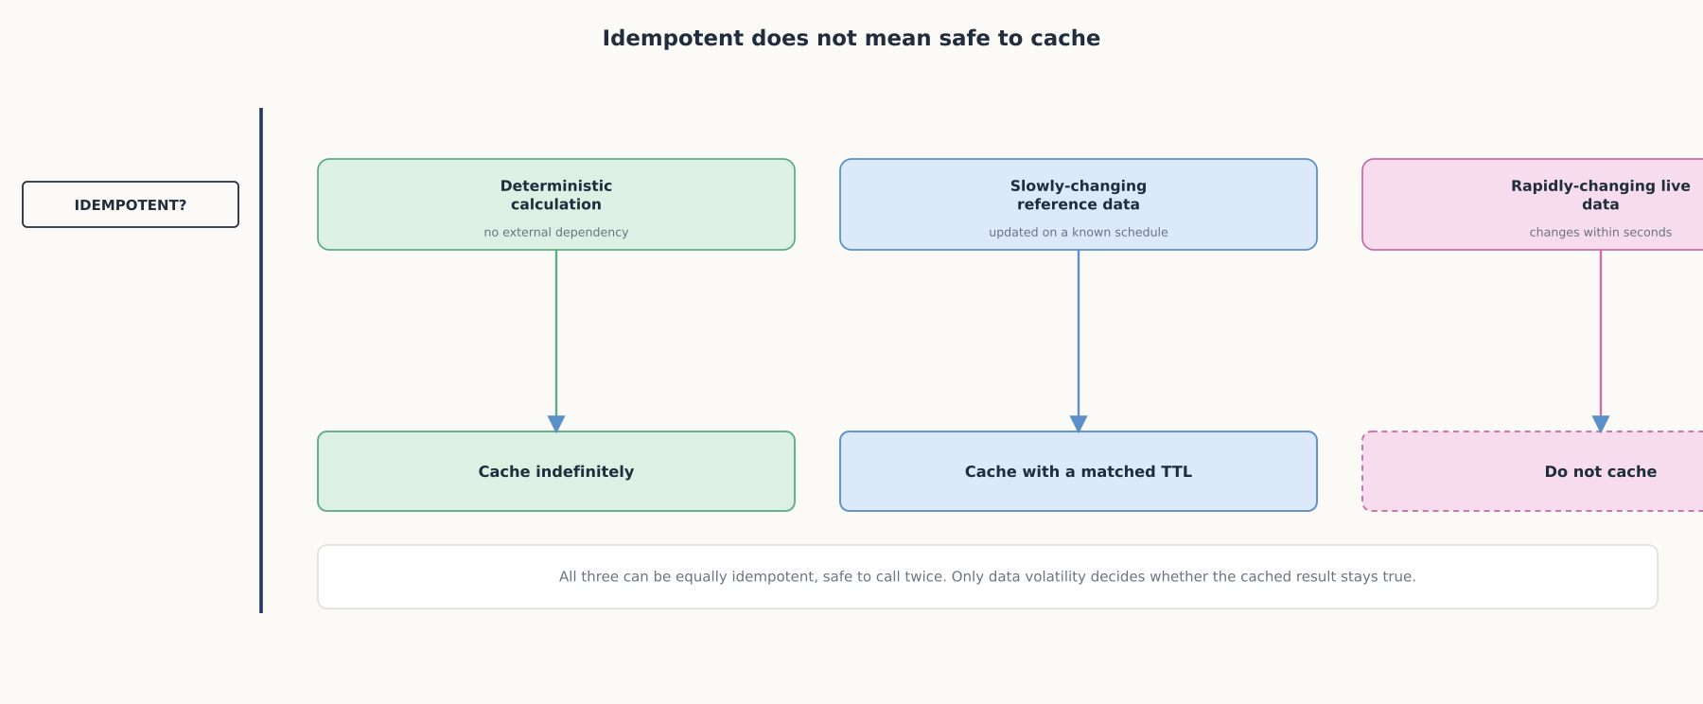
DEEP-DIVE
Idempotent does not mean safe to cache
Idempotency answers whether a call is safe to repeat; it says nothing about whether its cached answer is still true.

Slide 11
DEEP-DIVE
The three layers compose, because each caches a different kind of repetition
A static system prompt and stable documents: prompt caching's exact-match reuse
The user-facing question in front of that context: semantic caching, if the domain tolerates its risk
Each tool call an agent makes: its own, separate freshness decision
A single request can pass through all three at once
Designing a caching strategy means matching each piece of a request to the right kind of cache

Slide 12
COMPARISON & RELATED CONCEPTS
Three ways to avoid repeating work
Aspect | Prompt caching | Semantic caching | Tool-call caching | No caching
What counts as a hit | Byte-identical prefix up to breakpoint | Embedding similarity above threshold | Arguments + context match, freshness OK | Never
Primary risk | None: a miss just costs full price | A false hit returns a wrong or stale answer | A cached answer silently goes stale | No wrong answers, but no savings
Typical savings | ~90% off every reused token | Order-of-magnitude cost + latency on a hit | Avoids a repeated call and its context cost | None
Each trades a different kind of risk for a different kind of saving.

Slide 13
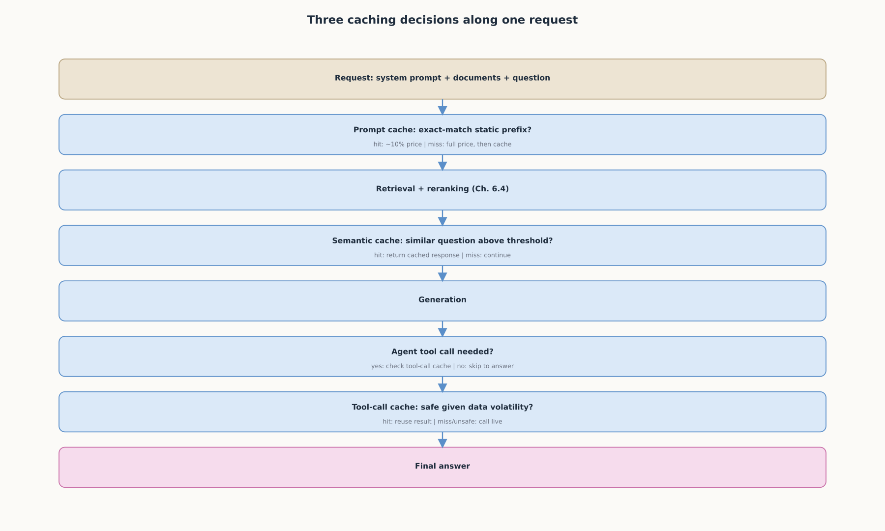
REFERENCE ARCHITECTURE
Three caching decisions along one request
Caching decides how often the pipeline from Chapter 6.4 actually has to run, not how it works once it does.

Slide 14
CHECK YOUR UNDERSTANDING
Discuss before moving on
1. How does prompt caching decide whether a request gets a cache hit, and what happens if even one character changes before the cache breakpoint?
2. Why does semantic caching achieve a higher hit rate than prompt caching, and what specific risk does that introduce?
3. Why is idempotency "necessary but not sufficient" for safely caching a tool call?
4. What determines whether a given tool call is safe to cache indefinitely, cache with a short time-to-live, or not cache at all?
5. Why do prompt caching, semantic caching, and tool-call caching compose rather than compete inside a single request?

