Slide 1
CHAPTER 6.8 · PHASE 6
Evaluating RAG Systems: Retrieval Metrics, Faithfulness, RAGAS
Building a RAG pipeline does not tell you whether it works. This chapter covers the metrics and framework that answer that question, for both the retrieval half and the generation half.
Retrieval-Augmented Generation & Knowledge Systems

Slide 2
AGENDA
What this chapter covers
Retrieval metrics: Precision@k, Recall@k, Mean Reciprocal Rank, NDCG
Ragas: a reference-free framework for scoring RAG generation quality
Faithfulness: does the response stick to what the context actually says
Context Precision and Context Recall: scoring the retrieval side without labels
Answer Relevancy: does the response address the question at all
Why an LLM judge has its own biases, and how to keep it honest

Slide 3
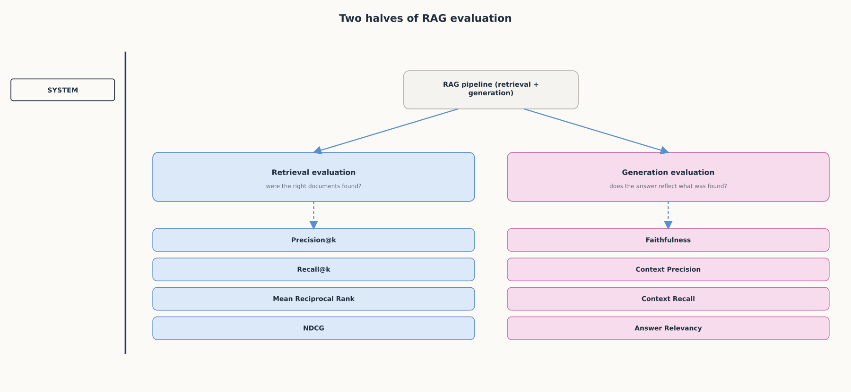
HIGH-LEVEL
Two halves of RAG evaluation
Retrieval evaluation checks whether the right documents were found; generation evaluation checks whether the answer reflects them.

Slide 4
DEEP-DIVE
Retrieval metrics score the search half against a known-relevant set
Precision@k: of the k documents retrieved, how many were relevant
Recall@k: of all relevant documents that exist, how many made the top k
A retriever can score well on one and poorly on the other
Mean Reciprocal Rank: "the multiplicative inverse of the rank of the first correct answer"
NDCG compares actual ranking quality against an ideal ranking, DCG / IDCG
Neither MRR nor NDCG is captured by precision or recall alone

Slide 5
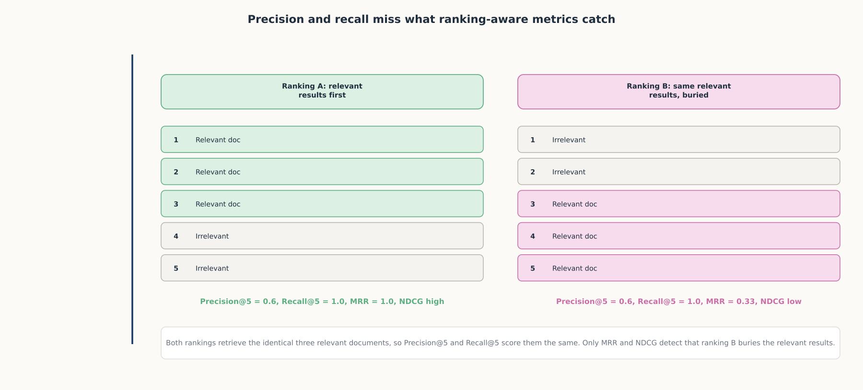
DEEP-DIVE
Precision and recall miss what ranking-aware metrics catch
Two rankings with identical Precision@5 and Recall@5 can have very different Mean Reciprocal Rank and NDCG scores.

Slide 6
DEEP-DIVE
Ragas scores generation quality without requiring a labeled correct answer
"A framework for reference-free evaluation of Retrieval Augmented Generation (RAG) pipelines"
Built because evaluating RAG spans several dimensions: retrieval quality, faithful use of context, and generation quality
Faithfulness: "how factually consistent a response is with the retrieved context"
Scoring: claims supported by context / total claims in the response
A response can be entirely faithful and still wrong, if the context itself was bad

Slide 7
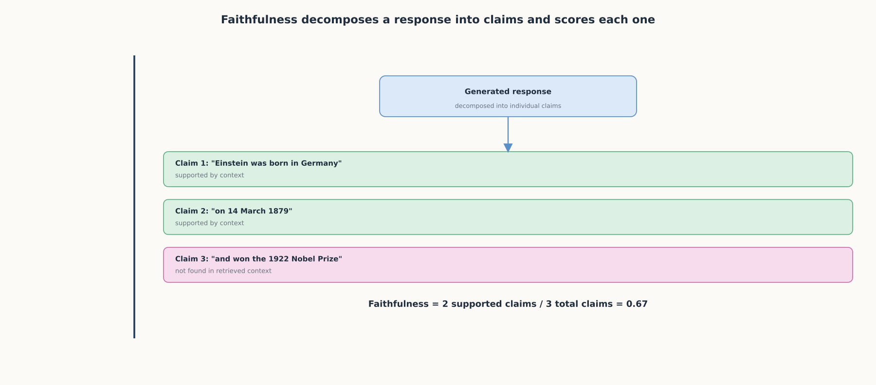
DEEP-DIVE
Faithfulness decomposes a response into claims and scores each one
Each claim in a response is checked against the retrieved context; the score is the fraction that is actually supported.

Slide 8
DEEP-DIVE
Context Precision and Context Recall extend retrieval metrics into a reference-free setting
Context Precision: "the retriever's ability to rank relevant chunks higher than irrelevant ones"
Calculated as the mean of the precision@k for each chunk in the context
Context Recall: "measures how many of the relevant documents...were successfully retrieved"
Answer Relevancy: generates artificial questions from the response, scores similarity to the actual input
A verbose or off-topic response scores low on Answer Relevancy even if every sentence is true

Slide 9
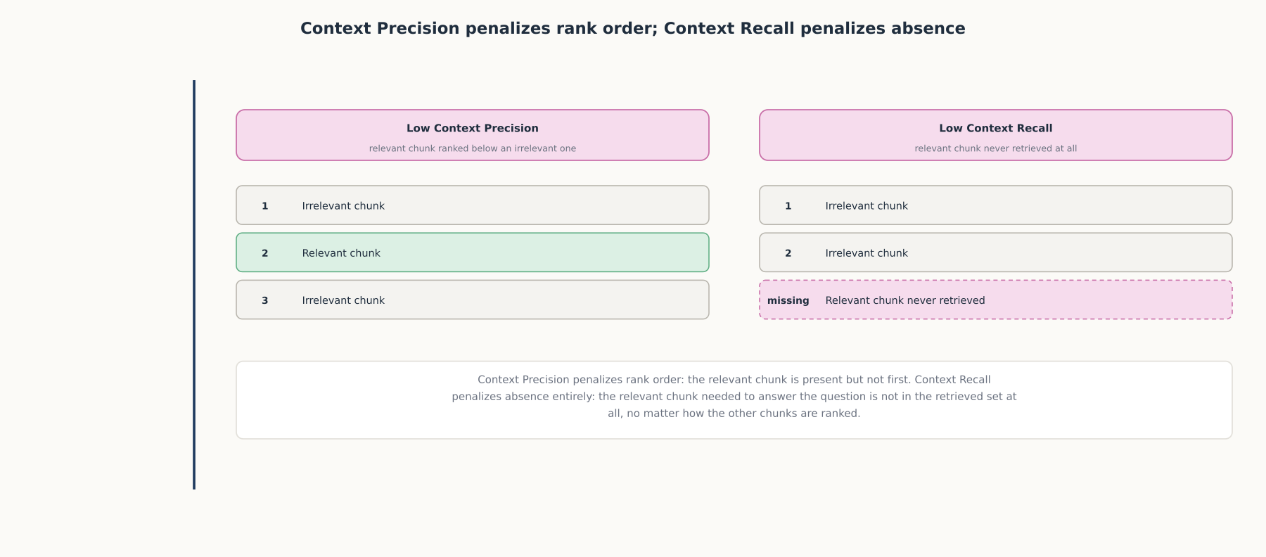
DEEP-DIVE
Context Precision penalizes rank order; Context Recall penalizes absence
A relevant chunk ranked too low costs Context Precision; a relevant chunk never retrieved at all costs Context Recall.

Slide 10
DEEP-DIVE
An LLM judge has its own, well-documented biases
"Verbosity bias rewards longer answers even when shorter ones deliver better accuracy"
"Position bias causes judges to favor responses appearing first or last...independent of quality"
"Self-preference bias appears when a judge scores outputs from its own model family"
Even a strong judge "aligns with human preferences over 80% of the time," leaving a real error rate
Pair automated scores with periodic human spot-checks and track agreement over time

Slide 11
COMPARISON & RELATED CONCEPTS
Two metric families, scoring two different halves
Aspect | Retrieval metrics (P@k, Recall@k, MRR, NDCG) | Faithfulness | Context Precision / Recall | Answer Relevancy
What it scores | Whether the right documents were found, and where they ranked | Whether claims are supported by retrieved context | Whether relevant chunks rank highly and were found at all | Whether the response addresses the question
Needs labeled ground truth? | Yes, a known-relevant document set | No | Recall needs a reference; Precision does not | No
Primary risk | A regression can go unnoticed if only final answers are reviewed | A fluent hallucination can still fool the judge | A high score does not guarantee generation used it well | Relevant-sounding but unfaithful answers can score high
None of these metrics alone certifies a RAG system is production-ready.

Slide 12
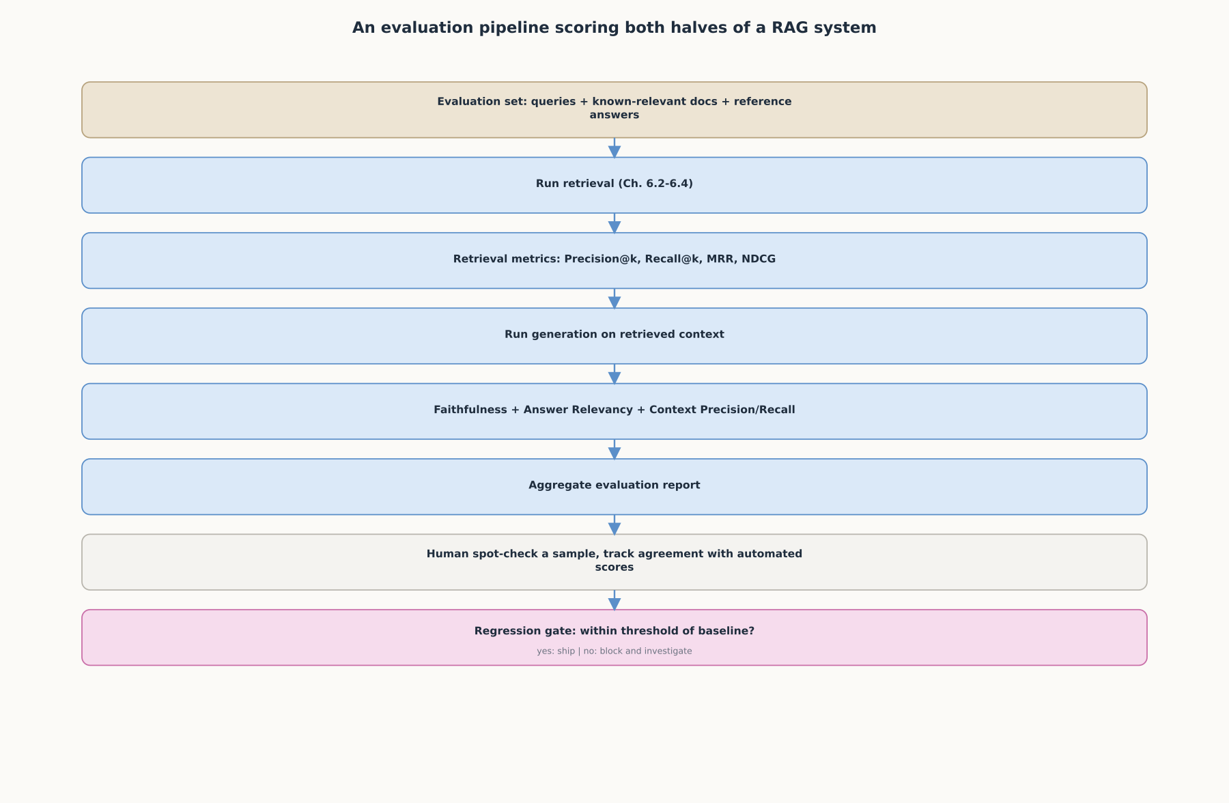
REFERENCE ARCHITECTURE
An evaluation pipeline scoring both halves of a RAG system
Retrieval metrics and Ragas generation metrics feed one aggregate report, checked by a human sample before a regression gate decides whether to ship.

Slide 13
CHECK YOUR UNDERSTANDING
Discuss before moving on
1. Why can a retriever score well on Precision@k and poorly on Recall@k for the same query?
2. What does Mean Reciprocal Rank measure that Precision@k and Recall@k do not?
3. How does the Faithfulness metric compute its score, and what kind of error does a low score reveal?
4. Why can a RAG system score perfectly on Faithfulness and still give a wrong answer?
5. What is verbosity bias in LLM-as-judge evaluation, and what does it mean for how scores should be used?

