Slide 1
CHAPTER 6.9 · PHASE 6
RAG Reference Architecture Blueprint
Every chapter in this phase built one piece. This chapter assembles them into the blueprint a production system actually needs: an ingestion pipeline, a query pipeline, an observability layer, and a governance loop.
Retrieval-Augmented Generation & Knowledge Systems

Slide 2
AGENDA
What this chapter covers
Why the ingestion pipeline and the query pipeline are two separate systems
The failure modes a demo never surfaces, and why they only appear in production
Observability as a continuous layer, distinct from periodic evaluation
Context drift: a risk that evaluation metrics cannot detect at all
Governance and the feedback loop that closes the blueprint
The full reference architecture, bringing together every chapter in this phase

Slide 3
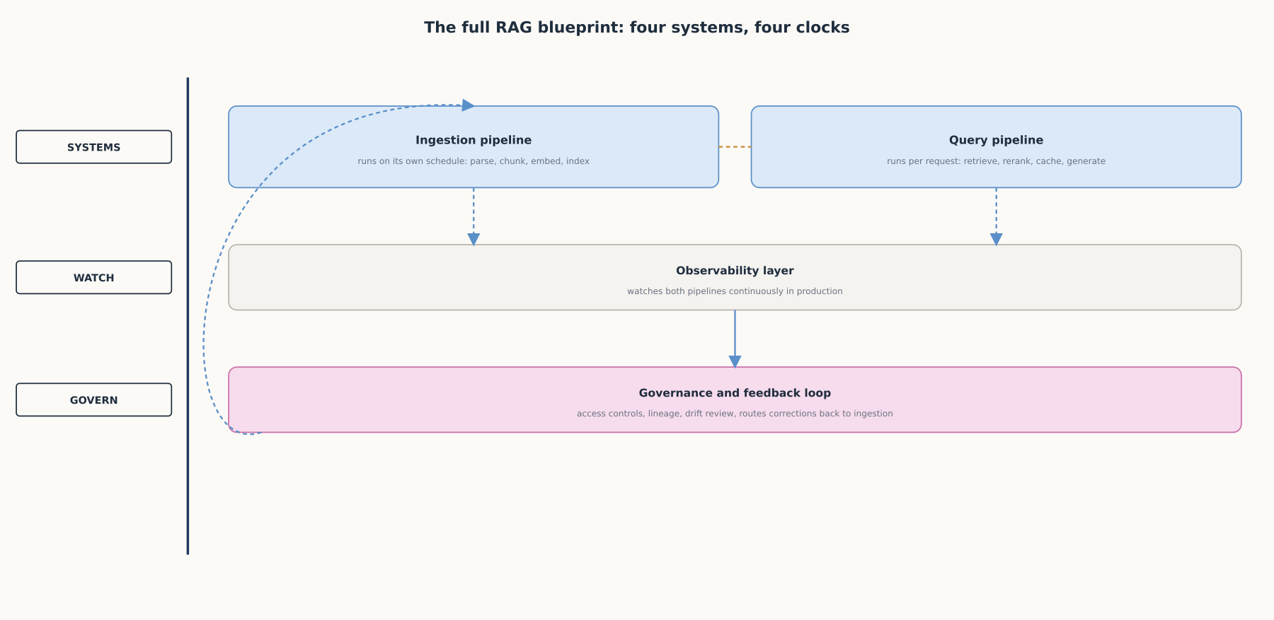
HIGH-LEVEL
The full RAG blueprint: four systems, four clocks
A demo wires one path from question to answer. A production blueprint separates ingestion, query, observability, and governance.

Slide 4
DEEP-DIVE
Ingestion and query are two systems with two different failure modes
Ingestion: "source documents are parsed, chunked, embedded, and stored...with associated metadata"
Query: "the system runs semantic and keyword search to surface the most relevant chunks from the index"
A bug in ingestion does not show up as an ingestion error
It surfaces days later as a query-time symptom that looks like a different problem
The two need separate monitoring even though they feed one another

Slide 5
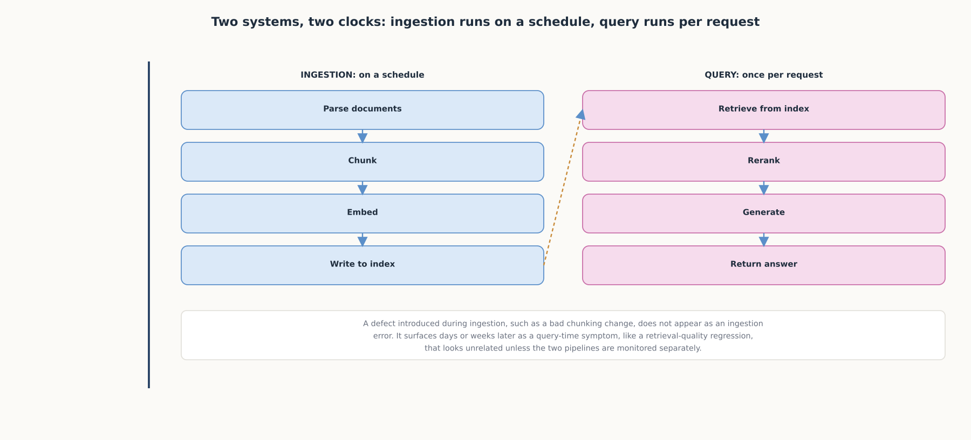
DEEP-DIVE
Two systems, two clocks
Ingestion runs on a schedule; query runs once per request. A defect in one surfaces as a symptom in the other.

Slide 6
DEEP-DIVE
A demo never runs long enough to hit the failure modes that sink production
"Retrieval recall...does not tell you whether the LLM used it faithfully"
"Chunking occupies an outsized amount of engineering time relative to the ROI it delivers"
Multi-hop questions break single-shot retrieval; query decomposition (Ch. 6.5) is the fix
A fixed eval set that scored well once can silently stop representing production traffic
Teams can spend months improving faithfulness while ignoring 6-second P95 latency

Slide 7
DEEP-DIVE
Observability watches continuously; evaluation samples periodically
"GenAI observability offers insights into the inputs and outputs of a workflow, along with every intervening step"
Retrieval signals: Chunk Attribution, Chunk Utilization
Generation signals: Context Adherence
System signals: latency, resource utilization
Observability catches drift in the gap between evaluation runs

Slide 8
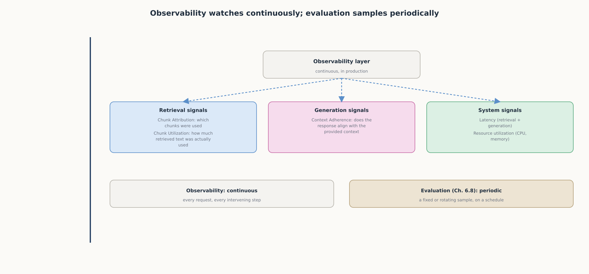
DEEP-DIVE
Observability watches continuously; evaluation samples periodically
Production needs both: observability for continuous coverage, periodic evaluation for the deeper Chapter 6.8 metrics.

Slide 9
DEEP-DIVE
Context drift: a risk invisible to standard evaluation metrics
"Context drift is invisible to standard RAG evaluation metrics"
A system "can maintain high faithfulness scores while producing answers that are organizationally wrong"
Schema drift, semantic drift, and staleness drift are three separate ways the index goes quietly wrong
Governance applies "access controls, data quality standards, lineage tracking" to catch it
"Production RAG systems aren't static"; feedback has to route back into ingestion

Slide 10
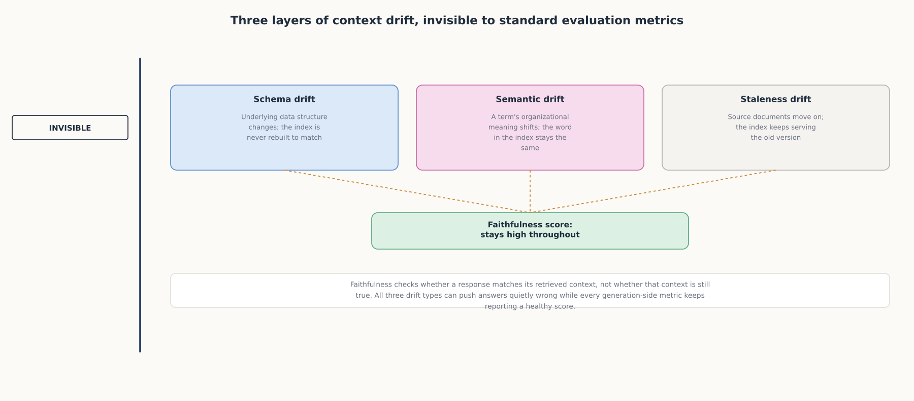
DEEP-DIVE
Three layers of context drift
Faithfulness measures consistency with retrieved context, not whether that context is still true.

Slide 11
COMPARISON & RELATED CONCEPTS
Four systems, four different clocks
Aspect | Ingestion pipeline | Query pipeline | Evaluation & observability | Governance & feedback loop
When it runs | On a schedule, independent of traffic | Once per request, in real time | Periodic evaluation; continuous observability | Continuously, as signals accumulate
What it owns | Parsing, chunking, embedding, indexing | Retrieval, reranking, caching, generation | Faithfulness, chunk attribution, latency, cost | Access controls, lineage, routing corrections back
A failure here looks like | A stale or badly-chunked index with no obvious symptom | A wrong answer despite a healthy index | A metric that looked fine while traffic quietly diverged | Great scores on a system answering from context that stopped being true
A production RAG blueprint is four systems on four different clocks, not one pipeline.

Slide 12
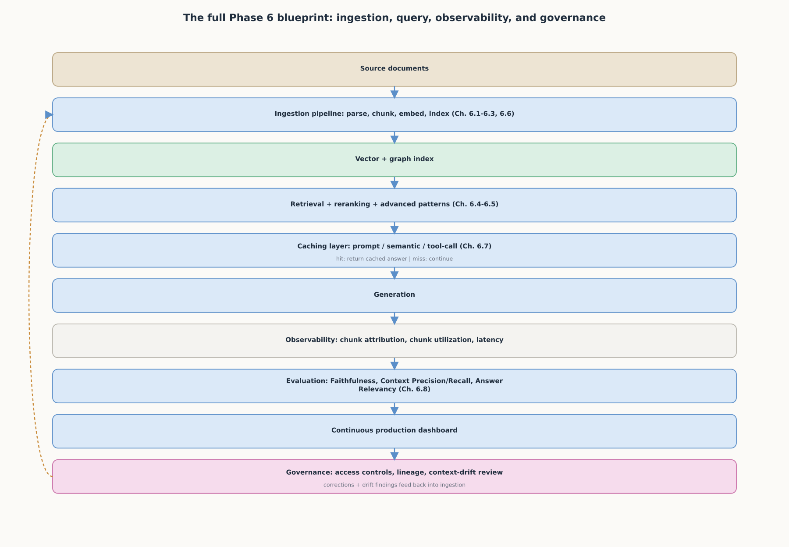
REFERENCE ARCHITECTURE
The full Phase 6 blueprint
Ingestion, query, observability, evaluation, and governance, closing the loop back into the next ingestion cycle.

Slide 13
CHECK YOUR UNDERSTANDING
Discuss before moving on
1. Why are the ingestion pipeline and the query pipeline two separate systems rather than one?
2. Why can a RAG system's retrieval step look correct while the overall answer is still wrong?
3. Why does a fixed evaluation set that scored well at launch stop being reliable over time?
4. What is context drift, and why can Faithfulness stay high while it happens?
5. What role does the governance and feedback loop play that neither query nor evaluation can play alone?

