Slide 1
CHAPTER 7.1 · PHASE 7
When to Fine-Tune vs. Prompt vs. RAG: A Decision Framework
Chapter 5.8 gave the first version of this decision. This chapter revisits it with the full mechanics of RAG behind it and fine-tuning ahead of it, plus a 2026 shift in which fine-tuning path is actually reachable.
Fine-Tuning, Alignment & Model Customization

Slide 2
AGENDA
What this chapter covers
The diagnostic question that comes before any tool choice: knowledge gap, or behavior gap
"Form, not facts": what fine-tuning reliably teaches a model, and what it cannot
Why prompting comes first, and what fine-tuning actually buys once it is warranted
Concrete thresholds: how much data, how narrow a task, before a fine-tune is justified
The 2026 shift in vendor fine-tuning access, and why it matters for this decision
The full decision path, from a failing eval to the right fix

Slide 3
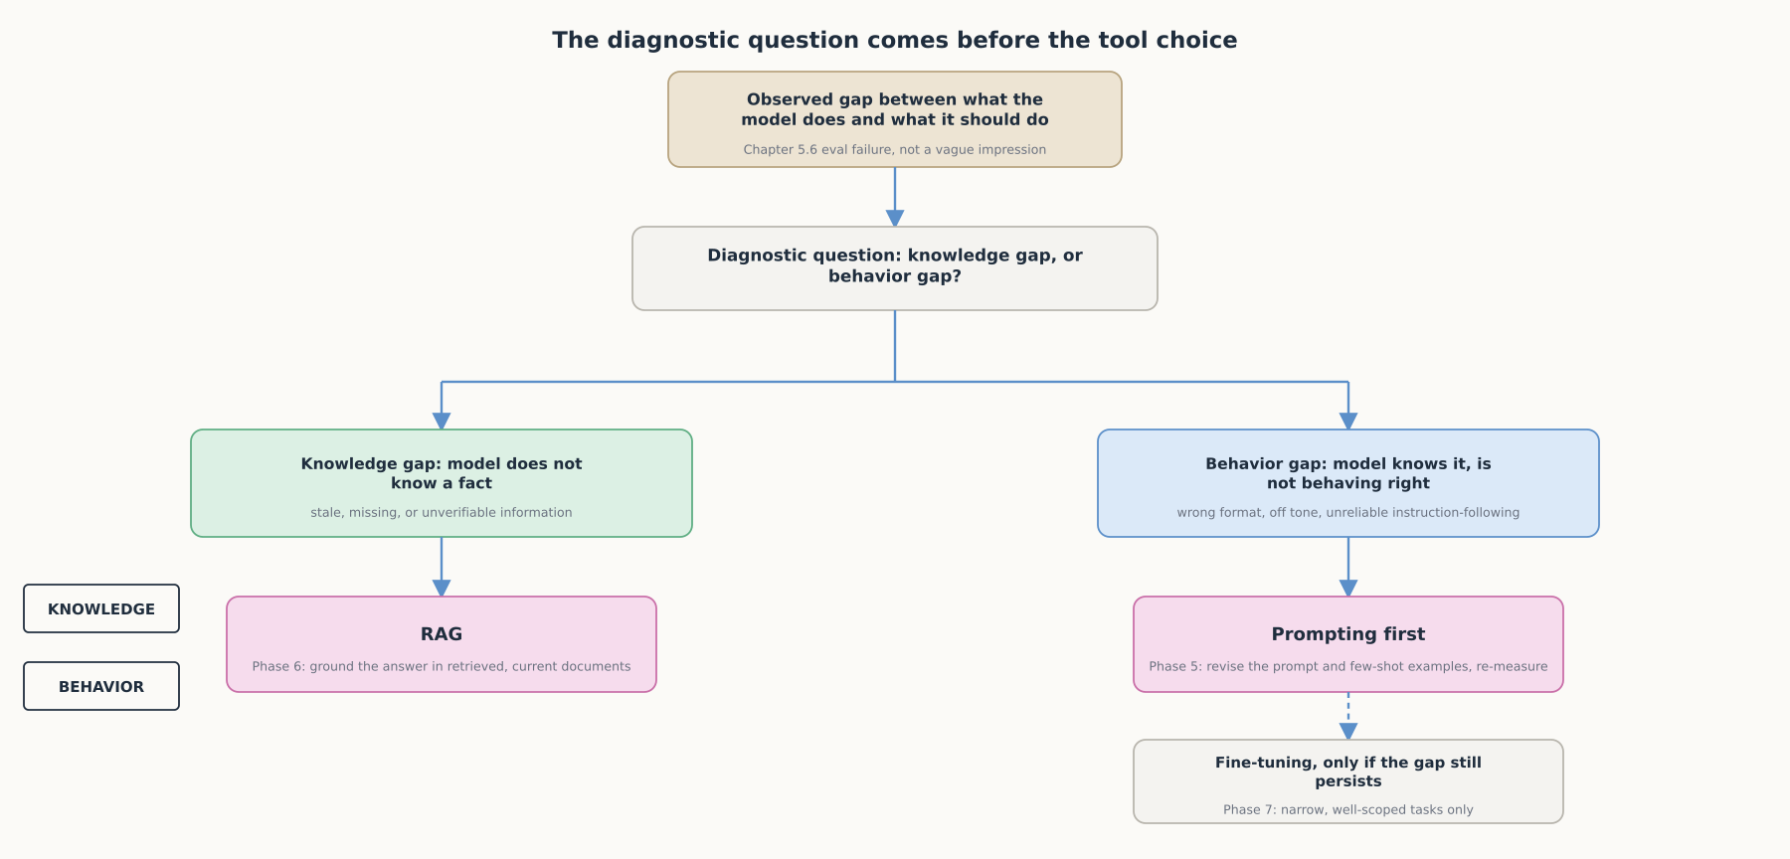
HIGH-LEVEL
The diagnostic question comes before the tool choice
A knowledge gap routes to RAG. A behavior gap routes first to prompting, and only escalates to fine-tuning if prompting cannot close it.

Slide 4
DEEP-DIVE
Fine-tuning changes form, not facts
"Fine-tuning typically results in creating a niche model for a niche use-case"
Effective for style and form of language, not for learning new concepts
The Romeo-to-Bob experiment: every "Romeo" replaced with "Bob," fine-tuned, never learned
"Next token prediction loss on a tiny text...cannot change the internals of the neural networks knowledge base"
Fix for a knowledge problem: keep the facts in a separate store, retrieve them into the prompt

Slide 5
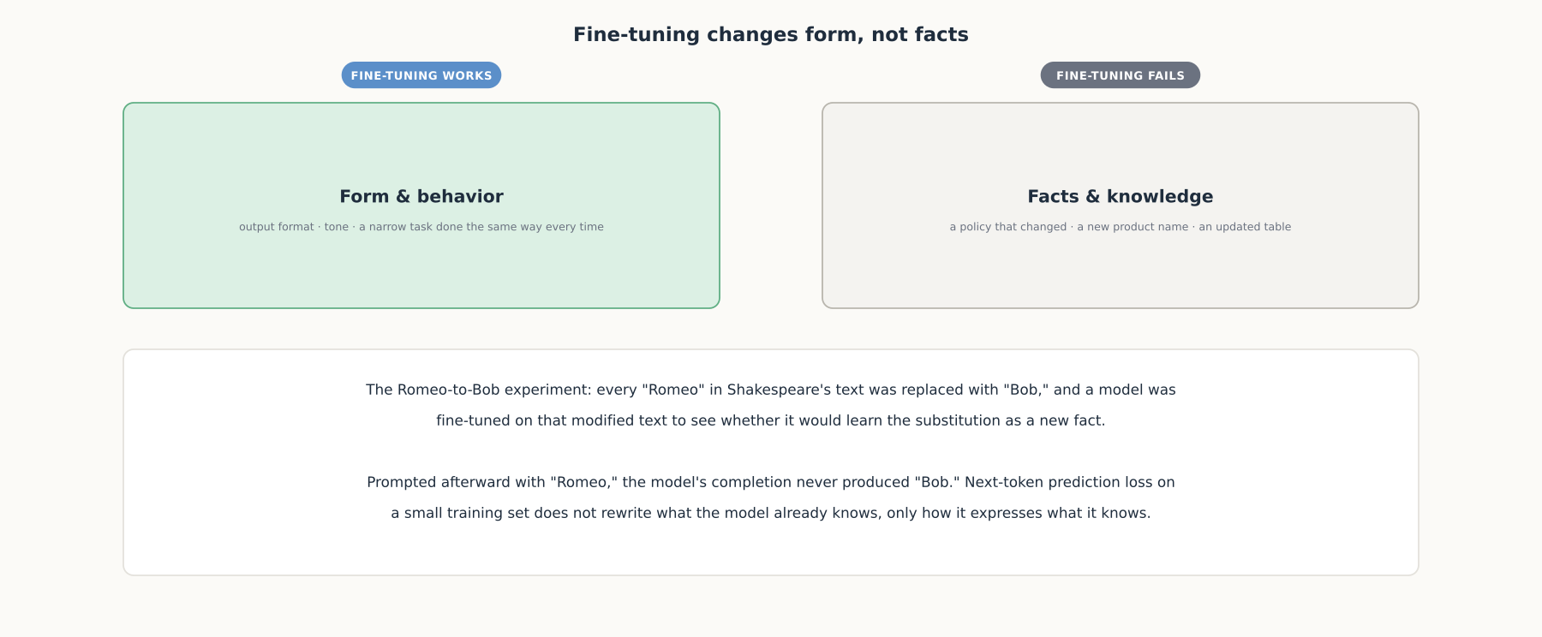
DEEP-DIVE
Form and behavior vs. facts and knowledge
The same training run that reliably teaches format or tone will not reliably teach a model that a fact changed.

Slide 6
DEEP-DIVE
Prompting comes first because it might just be enough
"The prompt engineering process may be all you need...for your use case"
Fine-tuning's real benefits: shorter prompts at scale, more examples than fit a context window
Training on proprietary data without including it in every request
A smaller, cheaper, faster model for one particular task
Every benefit is a scaling/cost argument, not a reason to skip prompting on day one

Slide 7
DEEP-DIVE
The practical thresholds are lower, and stricter, than most teams assume
"There should be at least 10 examples," with 50-100 recommended once a task is scoped
"Ensure that each fine-tuned model is for one task only"
"Keep system and user prompts similar between training and production"
Fine-tuning adoption among API users: "less than one percent"
Described as "one of the last tools you should reach for," not the first

Slide 8
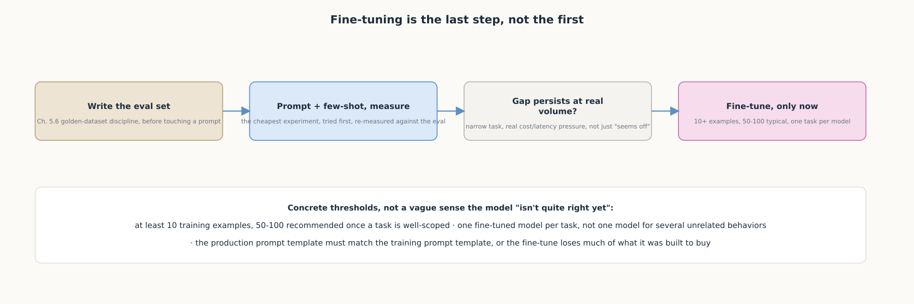
DEEP-DIVE
Fine-tuning is the last step, not the first
Write the eval set, prompt and measure, confirm the gap persists at real volume, only then fine-tune.

Slide 9
DEEP-DIVE
The vendor landscape for fine-tuning is shifting in 2026
OpenAI: "the platform is no longer accessible to new users"
Phased wind-down: May 2026 new-org limits, July 2026 inactive-org limits, Jan 2027 all-org limits
"Inference on fine-tuned models will continue to be available until the base models are deprecated"
Replacement: assisted fine-tuning and custom-trained-models programs, both vendor relationships
The open-weight, self-hosted PEFT path (Ch. 7.2) stays fully self-serve regardless

Slide 10
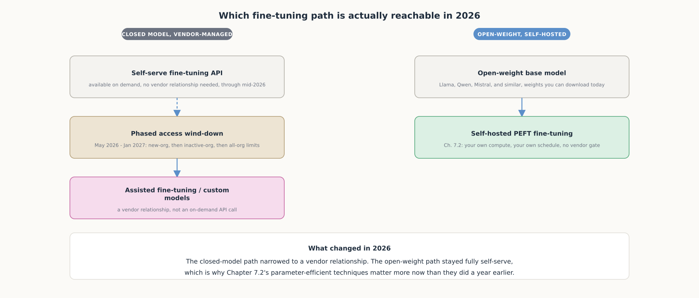
DEEP-DIVE
Which fine-tuning path is actually reachable in 2026
The closed-model path narrowed to a vendor relationship. The open-weight path stayed fully self-serve.

Slide 11
COMPARISON & RELATED CONCEPTS
Four paths, and what each one actually costs
Aspect | Prompting (Ch. 5) | RAG (Ch. 6) | Vendor-assisted fine-tuning | Self-hosted PEFT (Ch. 7.2)
What it fixes | A behavior/format gap the model can already express | A knowledge gap: stale or missing facts | A recurring behavior gap at vendor-relationship scale | The same behavior gap, on infrastructure the team controls
Data/setup needed | None beyond in-prompt examples | A retrieval pipeline and indexed corpus | Dozens to low hundreds of examples + vendor onboarding | Same training set + the team's own compute
Access in 2026 | Available to every API user | Available to every API user | Narrowing: self-serve winding down | Fully open: any open-weight model + a GPU
What changed in 2026 is which fine-tuning path is reachable without a vendor relationship, not whether fine-tuning itself is worth learning.

Slide 12
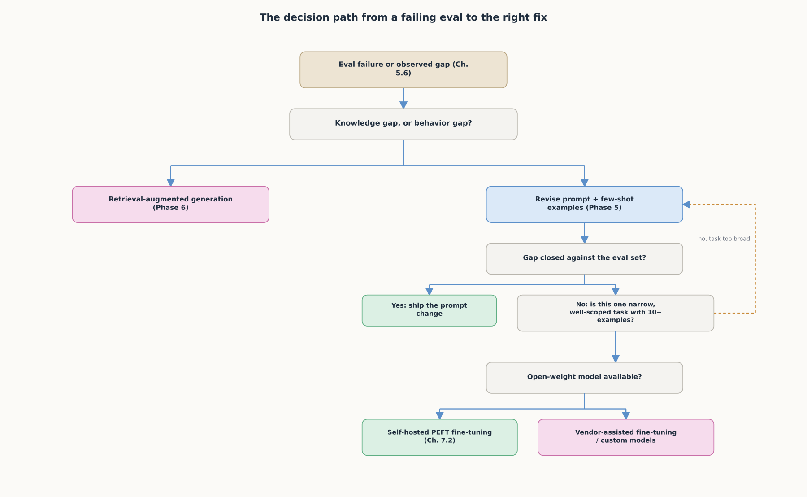
REFERENCE ARCHITECTURE
The decision path from a failing eval to the right fix
Each step is cheaper than the one after it: knowledge-or-behavior, then prompting, then scope and access.

Slide 13
CHECK YOUR UNDERSTANDING
Discuss before moving on
1. What is the "form, not facts" thesis, and what experiment demonstrated it?
2. Why does OpenAI recommend prompting before fine-tuning, and what does fine-tuning actually offer over prompting?
3. What concrete data and scope thresholds justify a fine-tuning project?
4. What changed about self-serve fine-tuning access in 2026, and why does it matter here?
5. Why does the knowledge-or-behavior question come before any check on data volume or model access?

