Slide 1
CHAPTER 7.2 · PHASE 7
Full Fine-Tuning vs. Parameter-Efficient Fine-Tuning, Compared
Chapter 7.1 established when to fine-tune. This chapter covers how, and why almost nobody in 2026 updates every one of a model's weights to do it.
Fine-Tuning, Alignment & Model Customization

Slide 2
AGENDA
What this chapter covers
Why full fine-tuning stopped scaling before PEFT existed to replace it
LoRA: freezing the base model, training a low-rank matrix pair instead
QLoRA: stacking 4-bit quantization underneath a full-precision LoRA adapter
Where adapters fit, and what Hugging Face's PEFT library generalizes from them
A hands-on LoRA fine-tune, with the trainable-parameter count printed and verified
Why matching benchmark scores are not proof of matching solutions

Slide 3
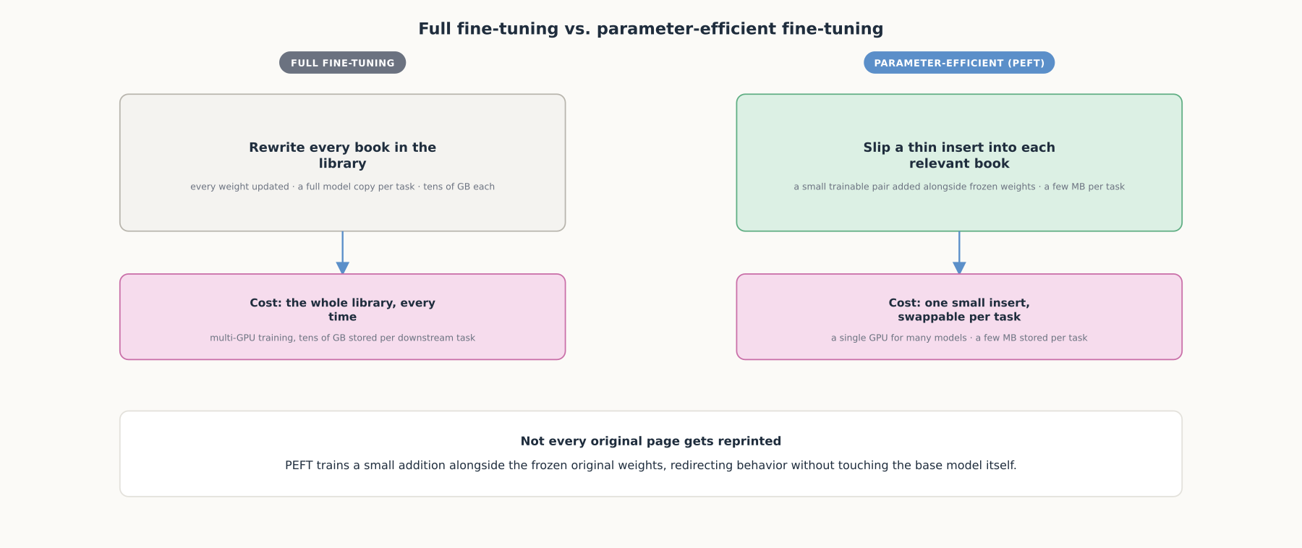
HIGH-LEVEL
Full fine-tuning vs. parameter-efficient fine-tuning
PEFT trains a small, swappable addition alongside the frozen original weights, not a rewrite of the whole model.

Slide 4
DEEP-DIVE
Full fine-tuning stopped scaling before PEFT existed to replace it
"Full fine-tuning, which retrains all model parameters, becomes less feasible" at scale
Every downstream task needs its own full-sized model copy
LoRA freezes the base weights, trains a low-rank matrix pair injected into each layer
"Reduce the number of trainable parameters by 10,000 times and the GPU memory requirement by 3 times"
"On-par or better than fine-tuning in model quality," with no added inference latency

Slide 5
DEEP-DIVE
QLoRA stacks quantization underneath LoRA without losing quality
"Reduces memory usage enough to finetune a 65B parameter model on a single 48GB GPU"
4-bit NormalFloat (NF4): optimal for normally distributed weights
Double quantization: compresses the quantization constants themselves
Paged optimizers: absorb memory spikes during training
Guanaco reached "99.3% of the performance level of ChatGPT" in 24 hours on one GPU

Slide 6
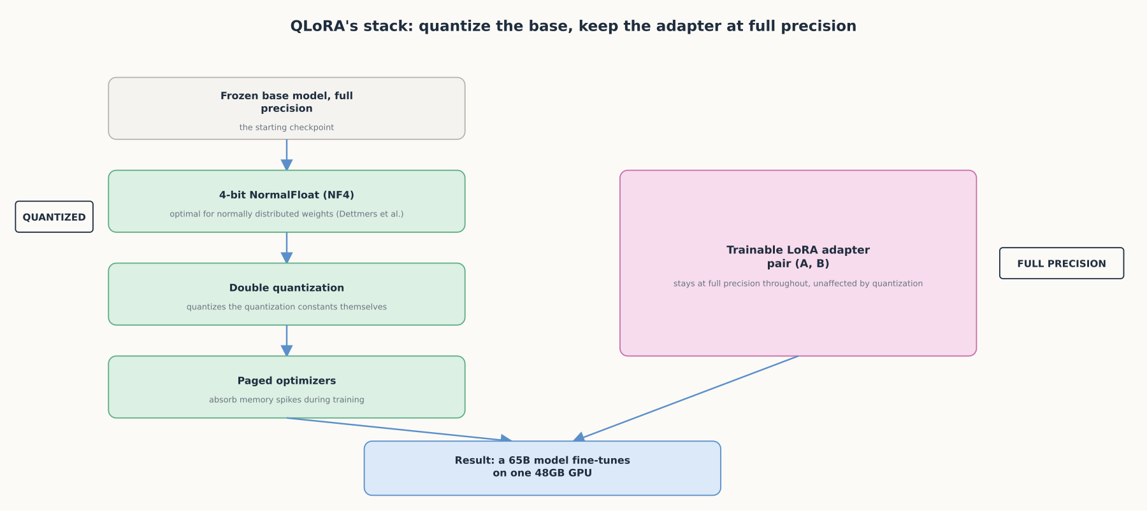
DEEP-DIVE
QLoRA's stack: quantize the base, keep the adapter at full precision
Quantization only ever touches the frozen base. The trainable low-rank pair still learns at full precision.

Slide 7
DEEP-DIVE
Adapters came first; PEFT is the general principle behind all of them
Houlsby et al. (2019): adapters reach "within 0.4% of the performance of full fine-tuning, adding only 3.6% parameters per task"
"By contrast, fine-tuning trains 100% of the parameters per task"
PEFT "overcomes the issues of catastrophic forgetting" seen in full fine-tuning
A 40GB full-fine-tune checkpoint becomes "just a few MBs" with PEFT
One concrete adapter checkpoint: "just 19MB"

Slide 8
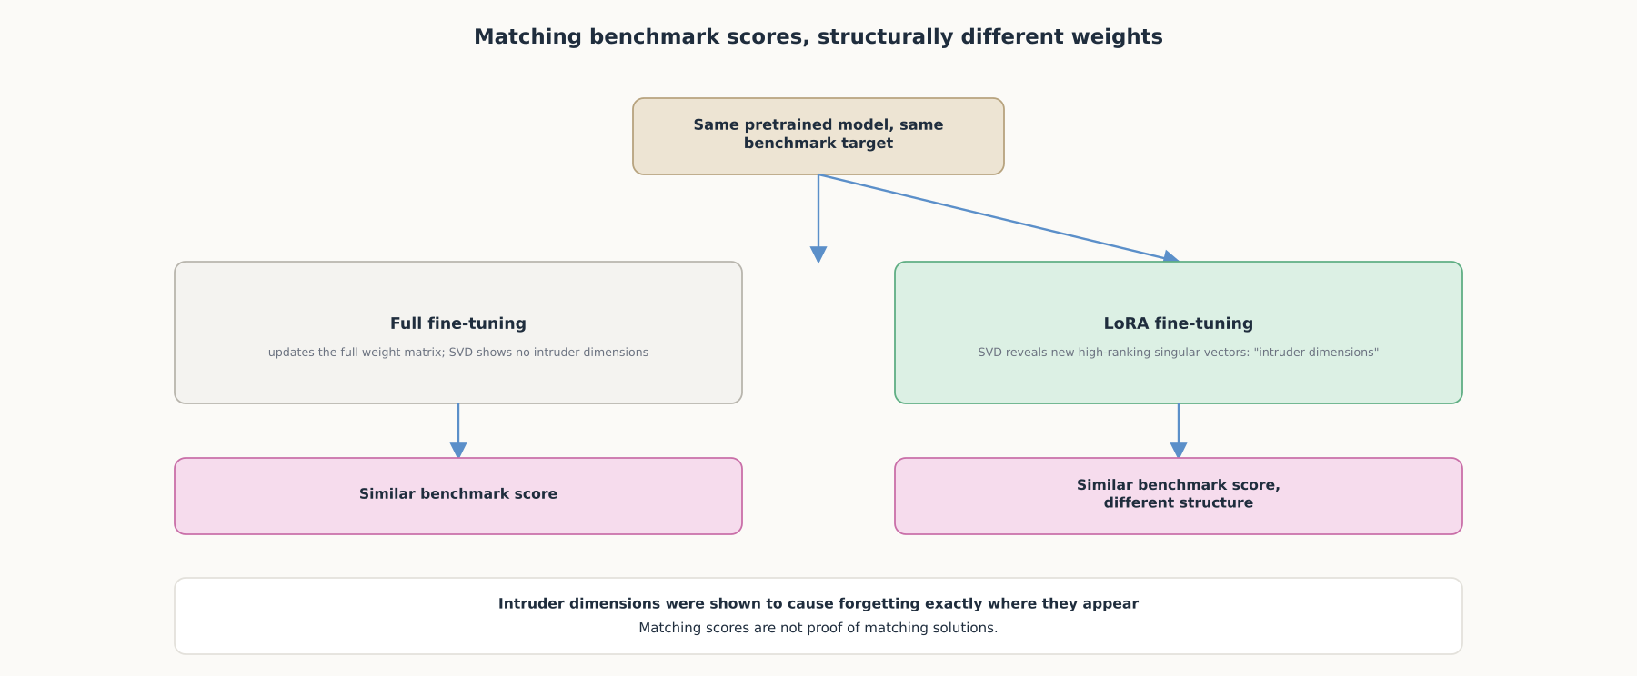
DEEP-DIVE
Matching benchmark scores, structurally different weights
LoRA introduces "intruder dimensions" full fine-tuning does not produce, shown to cause localized forgetting.

Slide 9
HANDS-ON
Fine-tune a small model with LoRA and print the difference
Step 1: load a small base model (distilgpt2) with transformers
Step 2: wrap it in a LoraConfig, rank r controls the trainable-parameter count
Step 3: print_trainable_parameters(): under 0.2% of the model is ever updated
Step 4: train with the standard Trainer API, unchanged from a full fine-tune
Step 5: save only the adapter, a few MB, then merge_and_unload() before serving

Slide 10
COMPARISON & RELATED CONCEPTS
Four ways to update a model, and what each one costs
Aspect | Full fine-tuning | Adapters (Houlsby et al.) | LoRA | QLoRA
Trainable parameters | 100% of the model | ~3.6% added per task | 10,000x fewer than full fine-tuning | Same order of magnitude as LoRA
Checkpoint size | Tens of GB per task | A few MB per task | A few MB, mergeable into the base | A few MB, mergeable into a dequantized base
Where it still wins | A domain shift too large for a low-rank update | Rarely chosen over LoRA today | The default for most narrow fine-tunes | The default when the base doesn't fit at full precision
LoRA and full fine-tuning learn structurally different solutions, which is why a large enough domain shift can still favor full fine-tuning's cost.

Slide 11
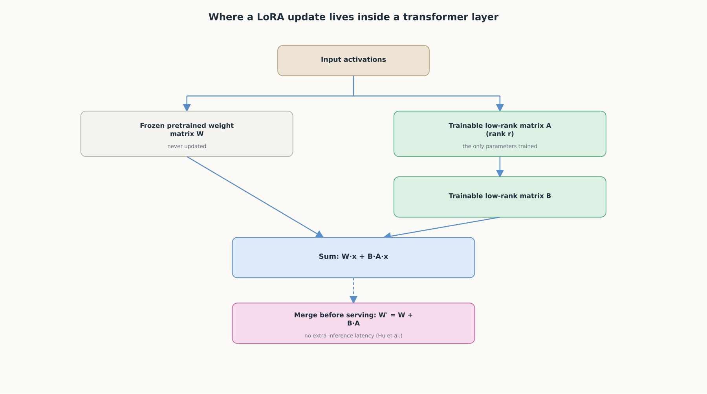
REFERENCE ARCHITECTURE
Where a LoRA update lives inside a transformer layer
Merging B·A into W before serving is what removes the extra inference latency an unmerged adapter would add.

Slide 12
CHECK YOUR UNDERSTANDING
Discuss before moving on
1. What problem did LoRA set out to solve, and what are its concrete numbers versus full fine-tuning?
2. How does QLoRA extend LoRA, and what does that combination make possible?
3. Why is PEFT "not simply a cheaper way to reach the same destination" as full fine-tuning?
4. What does the trainable-parameter count demonstrate, and why does merging matter before serving?
5. When does full fine-tuning's higher cost still buy something PEFT cannot?

