Slide 1
CHAPTER 8.10 · PHASE 8: AI AGENTS — FOUNDATIONS
Single-Agent Reference
Architecture Blueprint

Slide 2
TL;DR / INTUITION
Almost no new mechanism, just one coherent assembly
• Every layer already exists: perception, memory, tool use, planning, UX and confirmation were each built in Chapters 8.2 through 8.9.
• Two vendors converge on the same shape: Anthropic frames it as "an LLM enhanced with augmentations," OpenAI decomposes it into model, tools, and guardrails.
• Deliberately scoped to one agent: OpenAI's own recommendation is to "maximize a single agent's capabilities first" before reaching for multiple agents.
• This chapter's job: wire all six layers together and trace one complete request through every one of them.

Slide 3
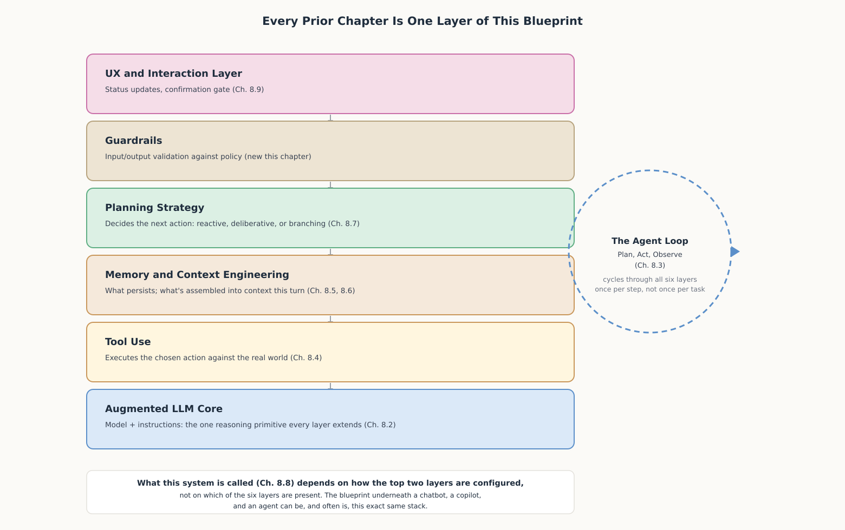
HIGH-LEVEL EXPLANATION
Six layers, stacked bottom-up, cycled once per step

Slide 4
DEEP-DIVE · 1 OF 5
The Augmented LLM: The One Primitive Everything Extends
• Anthropic: "The basic building block of agentic systems is an LLM enhanced with augmentations such as retrieval, tools, and memory."
• OpenAI, same ground, different framing: model plus "external functions or APIs the agent can use to take action" plus "explicit guidelines and guardrails."
• Start simple, both sources agree: "start with simple prompts, optimize them with comprehensive evaluation, and add multi-step agentic systems only when simpler solutions fall short."
• Each layer earns its place by a checkable trigger: tools when the model's own text cannot supply an answer; memory once a task spans more than one turn; never by default.

Slide 5
DEEP-DIVE · 2 OF 5
Perception, Context, and Memory: What Enters the Loop
• Two concerns, not one layer: a context constructor decides what to assemble this turn (Ch. 8.2, 8.6); memory decides what to retain across turns (Ch. 8.5).
• Just-in-time vs. upfront retrieval: a real architectural choice inside this one layer, trading a larger initial context against an extra retrieval round-trip.
• Concretely, for the order-status task: system message, short working-memory record, an order ID if supplied, and exactly two tool descriptions - nothing else.
• Same discipline as Ch. 8.9's guideline 4: show only what is relevant, applied one layer lower, to what the model sees rather than what the user sees.

Slide 6
DEEP-DIVE · 3 OF 5
Planning and Guardrails: What Happens Next, and Is It Allowed
• Planning strategy is a real choice (Ch. 8.7): a narrow, cheap-to-verify task warrants reactive planning; costly intermediate steps warrant deliberative or branching strategies.
• Guardrails answer a different question: OpenAI: "a critical component of any LLM-based deployment," "a layered defense mechanism" of several specialized checks.
• Guardrail vs. confirmation gate: a guardrail asks whether an action is permitted at all; the gate assumes permission and asks whether a human should approve this instance.
• Ties back to Ch. 8.8's autonomy spectrum: a copilot's explicit human-paired-in commitment generally warrants a stricter guardrail policy than a fully autonomous agent.

Slide 7
DEEP-DIVE · 4 OF 5
Assembling the Blueprint: One Request, Every Layer
• The clean trace: context assembled, planner picks lookup, input guardrail clears it, reversibility check auto-proceeds, tool runs, output guardrail clears the result, loop returns for escalation, gate fires, done.
• The failure-path trace: a scope violation is caught by the input guardrail before the tool ever runs - refused outright, never offered to a human as something to approve.
• Why two layers, not one: conflating them either annoys reviewers with invalid actions dressed as approval requests, or lets a violation slip through if approval is ever bypassed.
• The real test of layering: can one layer be swapped, a stricter guardrail, a harder task's planner, without changing the layers around it?

Slide 8
DEEP-DIVE · 5 OF 5
What This Blueprint Is Not: Scope, Limits, What's Next
• Deliberately single-agent: OpenAI: "our general recommendation is to maximize a single agent's capabilities first" before adding coordination overhead.
• The overhead is concrete: every additional agent carries its own full six-layer stack - its own context budget, its own memory to keep consistent, its own guardrails to align.
• A genuine candidate for splitting: a task that decomposes into independent sub-results a later step combines (Ch. 8.7's graph-of-thought), not a linear task cut apart for its own sake.
• What multi-agent actually adds: each agent inside it is still this exact same blueprint, plus a coordination layer routing work between instances.

Slide 9
COMPARISON & RELATED CONCEPTS
Each column adds structure only where the last one fell short
Aspect | Minimal augmented LLM | Production single agent | Multi-agent system (future)
What runs the reasoning | One LLM call, retrieval and in-context examples only | All six layers of this chapter's stack, cycled by the agent loop | Multiple instances of this same stack, plus a coordination layer
Planning strategy (Ch. 8.7) | None: the single call is the whole answer | Selected per task: reactive for cheap steps, deliberative for costly ones | Selected per agent, plus routing among agents
Guardrails and confirmation | Whatever the base model provides by default | Dedicated input/output guardrails, plus a reversibility-based gate | The same layer per agent, plus policy on what one agent may ask another
When it is the right choice | A task a single well-optimized call already handles reliably | A task needing memory, planning, or actions, but one agent can own end to end | A task that genuinely decomposes into separable sub-tasks
A multi-agent system is this same blueprint replicated and coordinated, not a different architecture.

Slide 10
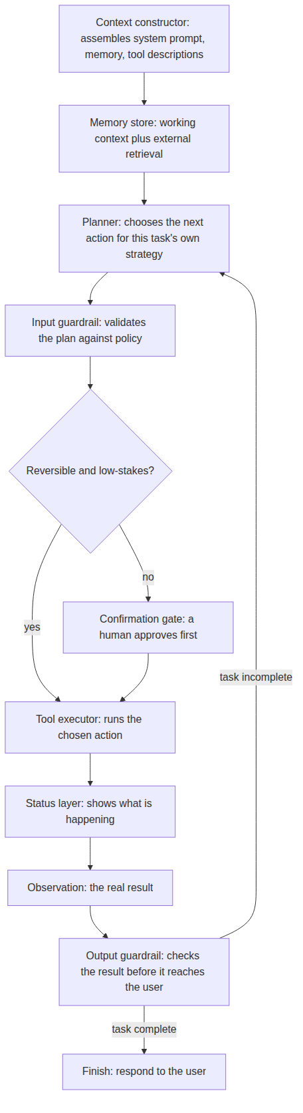
REFERENCE ARCHITECTURE
One request, traced through every layer of a single agent
Context constructor: assembles this turn's system prompt, working memory, and tool descriptions (Ch. 8.2, 8.6).
Memory store: supplies working context and scored external retrieval (Ch. 8.5).
Planner: chooses the next action using this task's own planning strategy (Ch. 8.7).
Input guardrail: checks the planner's chosen action against policy before anything executes.
Reversibility check: Ch. 8.9's gate: decides whether the action can auto-proceed or needs approval first.
Confirmation gate: pauses an irreversible or high-stakes action for explicit human approval.
Tool executor: runs the approved action against the real world (Ch. 8.4).
Status layer: shows the user what is happening, sized to the action's duration (Ch. 8.9).
Observation: captures the tool executor's real-world result before any guardrail or planner sees it.
Output guardrail: checks the real result against policy before it reaches the user or the planner.
Finish: reached only once the output guardrail finds the task complete; otherwise control returns to the planner.

Slide 11
HANDS-ON
A complete single-agent loop, assembled and run
• Every layer, reduced to its essential behavior: a context constructor, a reactive planner, a tool executor, and a guardrail table keyed by Ch. 8.9's reversibility check.
• One loop wires them together: run_agent() checks the reversibility gate before any tool actually runs, exactly like the reference architecture diagram.
• Three scenarios, same six functions: delivered order (3 steps, no gate), delayed order (5 steps, gate fires before escalation), missing order ID (2 steps, asks rather than guesses).
• The honest limitation: plan_next_action is a fixed decision tree because this task's action space is small - a harder task plugs a Ch. 8.7 planning strategy into this same slot without touching any other layer.

