Slide 1
CHAPTER 3.1 · PHASE 3
NLP Fundamentals: Tokenization, Embeddings, Vector Semantics
How raw text becomes the numbers a neural network actually consumes, and why the resulting vector space encodes meaning.
NLP & Language Model Foundations

Slide 2
AGENDA
What this chapter covers
Tokenization: splitting text into a fixed vocabulary of units
Embeddings: mapping token IDs to learned dense vectors
Vector semantics: similarity and analogy as geometry
One-hot vs. dense representations, compared
Where this breaks: static embeddings and context (a preview of 3.2)
Industry use cases across Finance, Healthcare, and Telecom

Slide 3
TL;DR
The short version
Every model from Phase 2 onward computes on numbers, not text
Tokenization breaks text into units and assigns each a fixed integer ID
Embeddings replace each ID with a learned dense vector
Tokens used in similar contexts end up with similar vectors
This is the bridge from a sentence to the tensor a model consumes

Slide 4
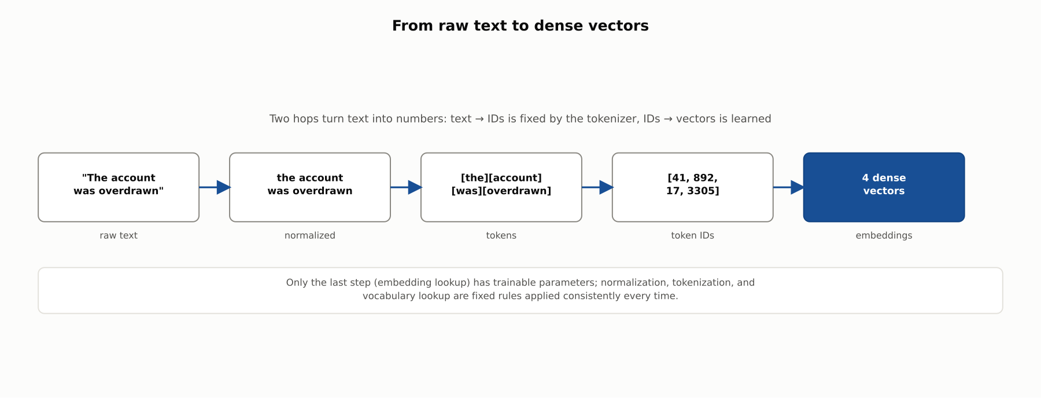
HIGH-LEVEL
Two hops: text to IDs, IDs to vectors
Normalization, tokenization, and vocabulary lookup are fixed rules; only the embedding lookup is learned.

Slide 5
HIGH-LEVEL
Why bother with a learned vector space?
Without embeddings
With embeddings
A token ID is just an arbitrary label
ID 41 is not "more" or "less" than ID 12
No notion of which tokens are related
Every token equally similar (or dissimilar) to every other
Similar-context tokens end up with similar vectors
Similarity becomes a geometric operation (an angle)
Relationships between tokens can be structured (analogy)
Learned automatically from a training objective, no manual labeling

Slide 6
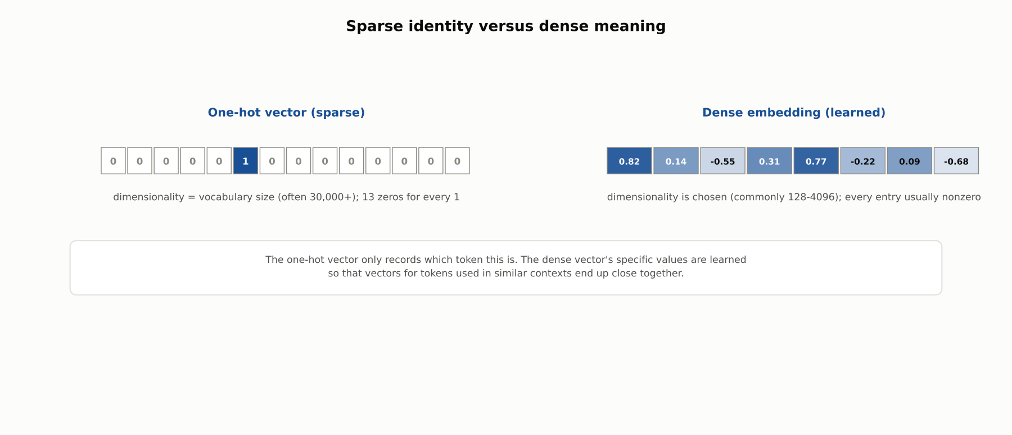
DEEP-DIVE
The one-hot dead end
Cosine similarity between any two distinct one-hot vectors is always exactly 0: they are orthogonal by construction.

Slide 7
DEEP-DIVE
The distributional hypothesis
J.R. Firth, 1957: "a word is characterized by the company it keeps"
Tokens in similar surrounding contexts across a large corpus tend to be related in meaning
No explicit definition of any word is ever given to the model
This is the theoretical basis chapter 3.2's Word2Vec objectives (skip-gram, CBOW) turn into a concrete training procedure

Slide 8
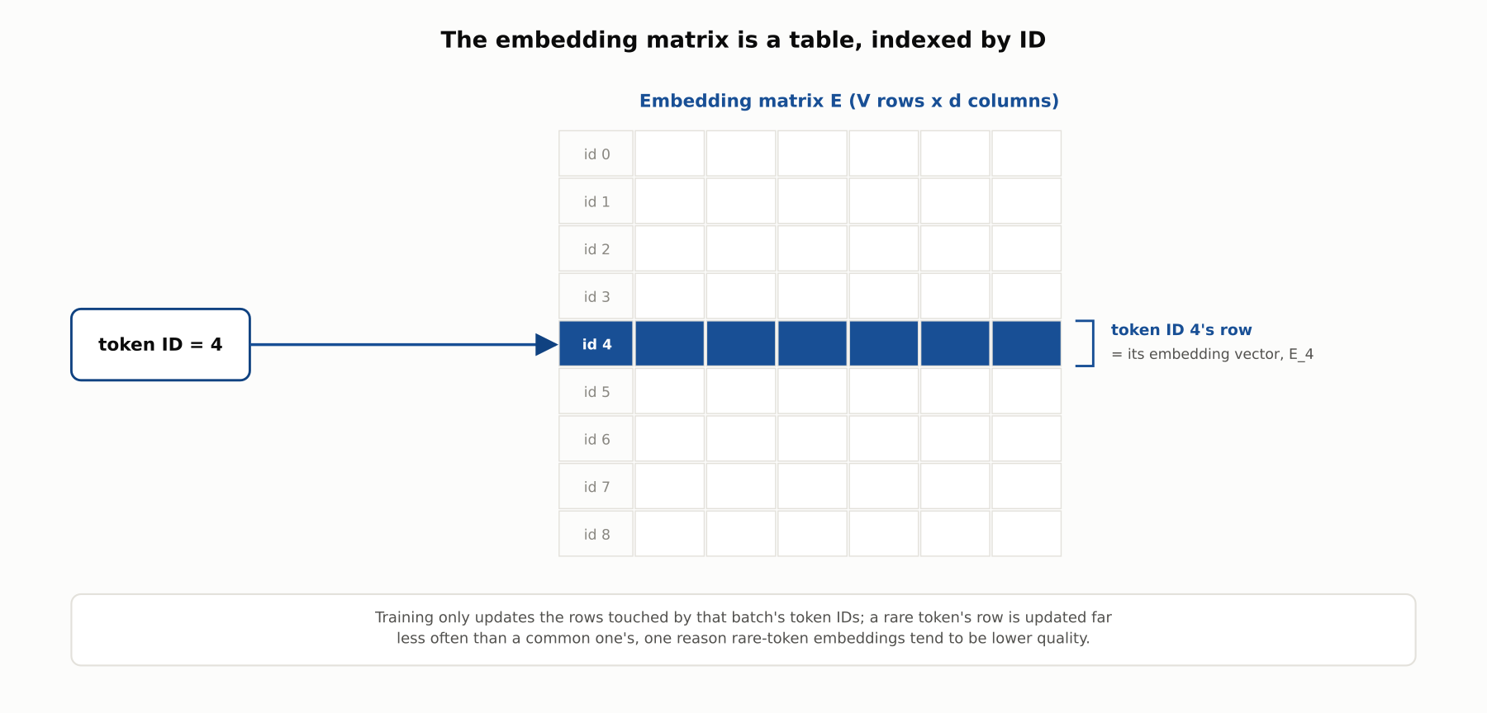
DEEP-DIVE
The embedding matrix is a lookup table
E is V x d. Token ID i maps to row E_i, implemented as a direct array index, not a matrix multiply.

Slide 9
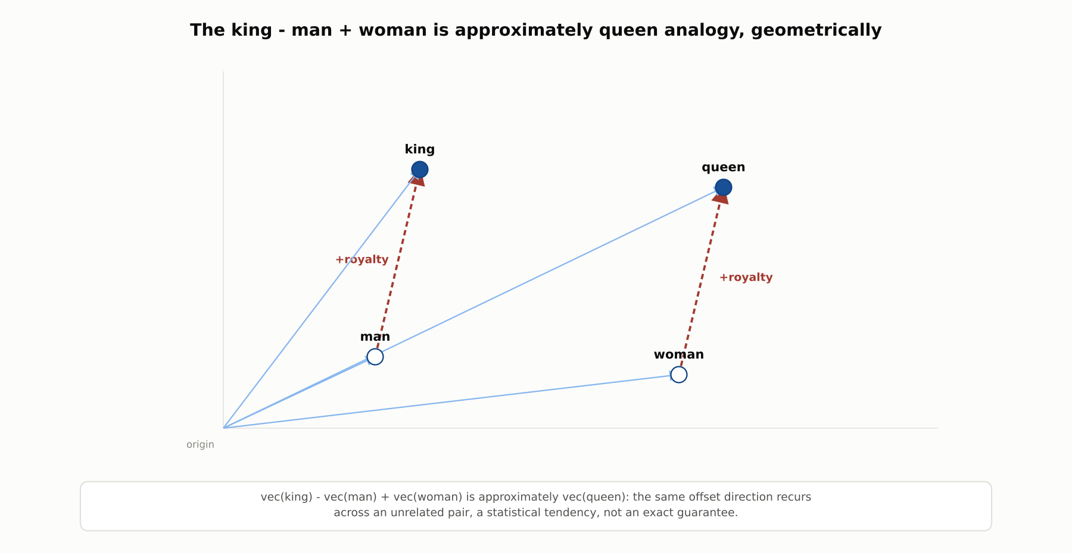
DEEP-DIVE
Analogical structure in vector space
vec(king) - vec(man) + vec(woman) is approximately vec(queen): an emergent, statistical tendency, not a designed rule.

Slide 10
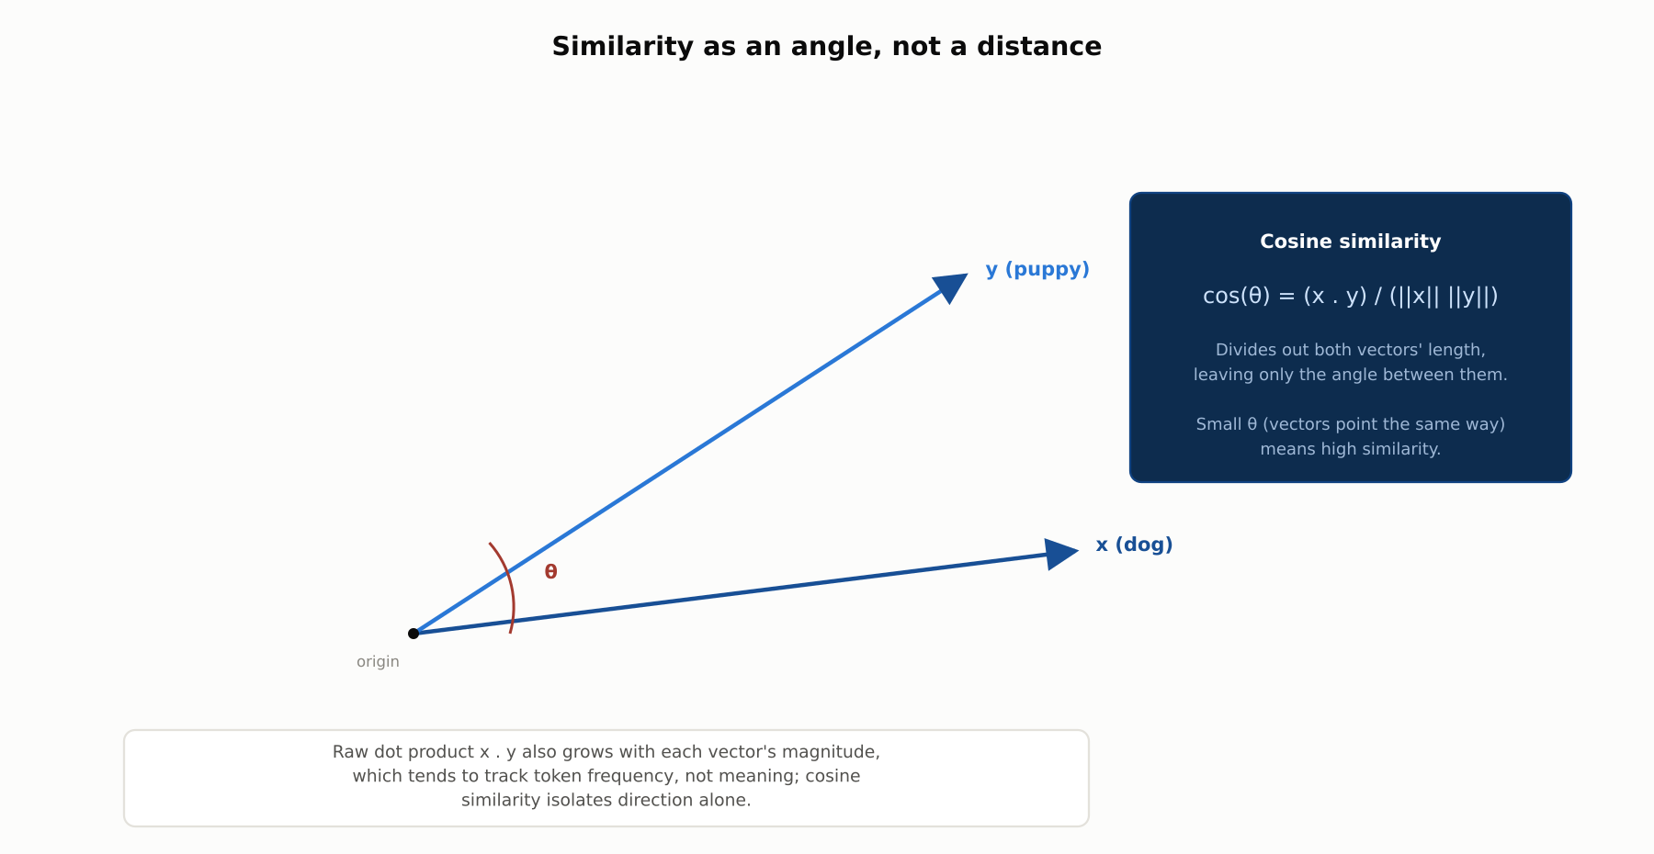
DEEP-DIVE
Cosine similarity: angle, not magnitude
A token's vector norm tracks frequency, not meaning. Dividing by both norms isolates direction.

Slide 11
DEEP-DIVE
What static embeddings cannot do
One fixed vector per token, regardless of context
"bank" gets the same vector in "river bank" and "bank account"
Meaning shifts with context; a static lookup table cannot
Chapter 3.2 introduces contextual embeddings to fix exactly this

Slide 12
COMPARISON & RELATED CONCEPTS
One-hot vs. count vectors vs. dense embeddings
Aspect | One-Hot / Sparse Counts | Bag-of-Words / TF-IDF | Dense Learned Embeddings
Dimensionality | = vocabulary size (30K+) | = vocabulary size | Chosen (128-4096)
Captures semantic similarity | No: mutually orthogonal | No: still just counts | Yes: learned from context
Sparse or dense | Sparse | Sparse | Dense
Typical use today | Teaching baseline | Lightweight keyword search | Default for modern NLP/LLMs
One-hot and count-based schemes record which tokens appeared; dense embeddings are trained to also encode how tokens relate.

Slide 13
INDUSTRY USE CASES
Finance
FINANCIAL SERVICES
Semantic search across research notes and filings
Near-duplicate detection in trade communications
Problem: Analysts need documents discussing a concept, not just exact keyword matches.
Problem: Surveillance must flag substantively identical, reworded messages that exact-text matching misses.
Solution: Embedding documents and queries into one vector space ranks results by cosine similarity.
Solution: Embedding communications and flagging high cosine-similarity pairs catches paraphrased duplicates.
Watch for: A search feeding compliance or research decisions needs model-risk-management sign-off, since a silent embedding update can shift results with no code change.
Watch for: An embedding blind spot between two substantively identical messages is a real compliance gap regulators expect documented and remediated.

Slide 14
CHECK YOUR UNDERSTANDING
Discuss before moving on
1. Why is a one-hot vector a poor representation of a token's meaning?
2. What is the distributional hypothesis, and what role does it play here?
3. Why is cosine similarity preferred over the raw dot product for comparing embeddings?
4. What limitation of static embeddings does chapter 3.2 exist to solve?

Slide 15
CHAPTER 3.1 · PHASE 3
Key Takeaways
Tokenization + embeddings bridge text to the numbers models consume
The embedding matrix is a learned lookup table, updated by gradient descent
Similarity and analogy become geometric operations in vector space
Static embeddings assign one vector per token regardless of context
Next: 3.2 From Word2Vec to Contextual Embeddings (BERT-Era Shift)

