Slide 1
CHAPTER 3.4 · PHASE 3
Evolution of LLMs: GPT / BERT / T5 Families, Compared
The model families each pretraining objective from 3.3 actually produced, and how each one evolved.
NLP & Language Model Foundations

Slide 2
AGENDA
What this chapter covers
GPT family: decoder-only, causal LM, from GPT-1 through GPT-4
BERT family: encoder-only, masked LM, from BERT through RoBERTa, ALBERT, DeBERTa
T5 / BART family: encoder-decoder, seq2seq, converging on text-to-text
Why architecture is largely inherited from pretraining objective, not a free choice
In-context learning versus fine-tuning as two different adaptation mechanisms
Industry use cases across Finance, Healthcare, and Telecom

Slide 3
TL;DR
The short version
GPT: decoder-only, causal LM, evolves through scale (GPT-1 to GPT-4)
BERT: encoder-only, masked LM, evolves through training recipe and architecture refinements
T5 / BART: encoder-decoder, seq2seq, converge on text-to-text for every task
Picking a family means picking which of 3.3's three objectives fits the task
Chapter 3.6 covers why scale specifically unlocks new capabilities like in-context learning

Slide 4
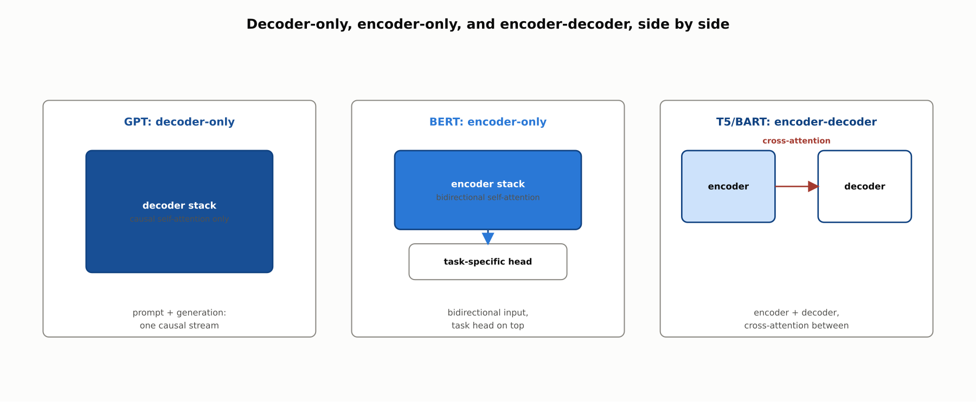
HIGH-LEVEL
Three family trees, three structural choices
GPT keeps only a decoder. BERT keeps only an encoder. T5 and BART keep both, joined by cross-attention.

Slide 5
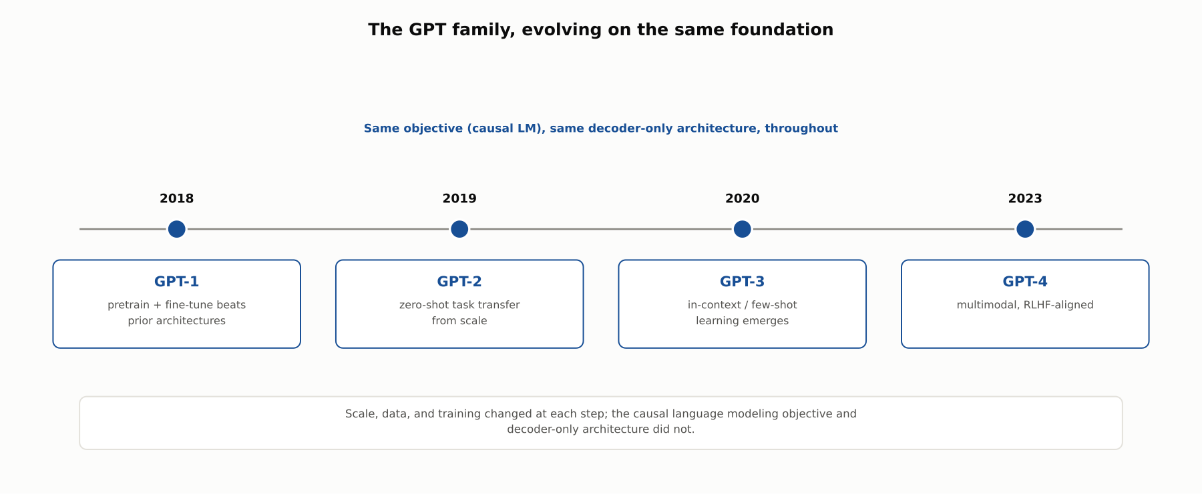
DEEP-DIVE
The GPT family: what scale unlocked at each step
Same causal LM objective and decoder-only architecture throughout; scale, data, and training changed at each step.

Slide 6
DEEP-DIVE
Why decoder-only models can be prompted directly
The prompt and the generated continuation live in the same token sequence
The same causal self-attention stack processes both
Few-shot examples in the prompt are just more prior tokens to condition on
No architectural seam between reading the prompt and writing the answer
This mechanical fact is what makes in-context learning possible at all

Slide 7
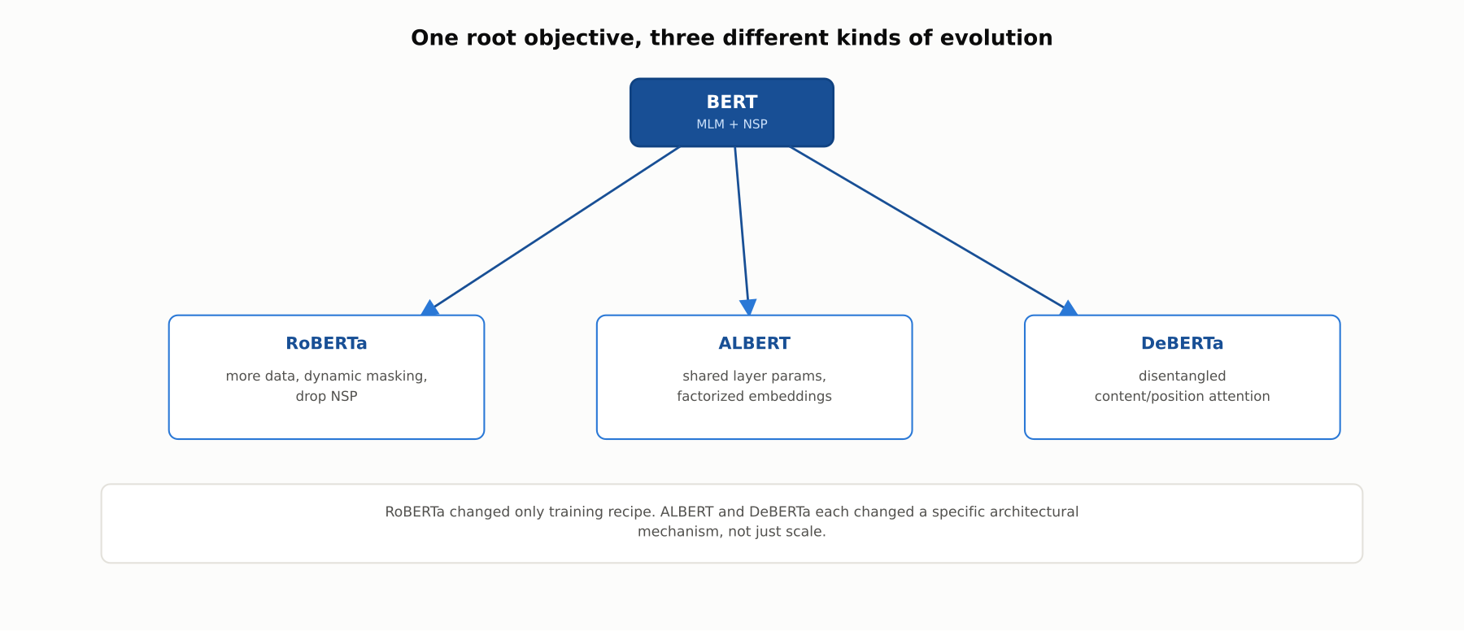
DEEP-DIVE
The BERT family: three different kinds of change
RoBERTa changed only training recipe. ALBERT and DeBERTa each changed a specific architectural mechanism.

Slide 8
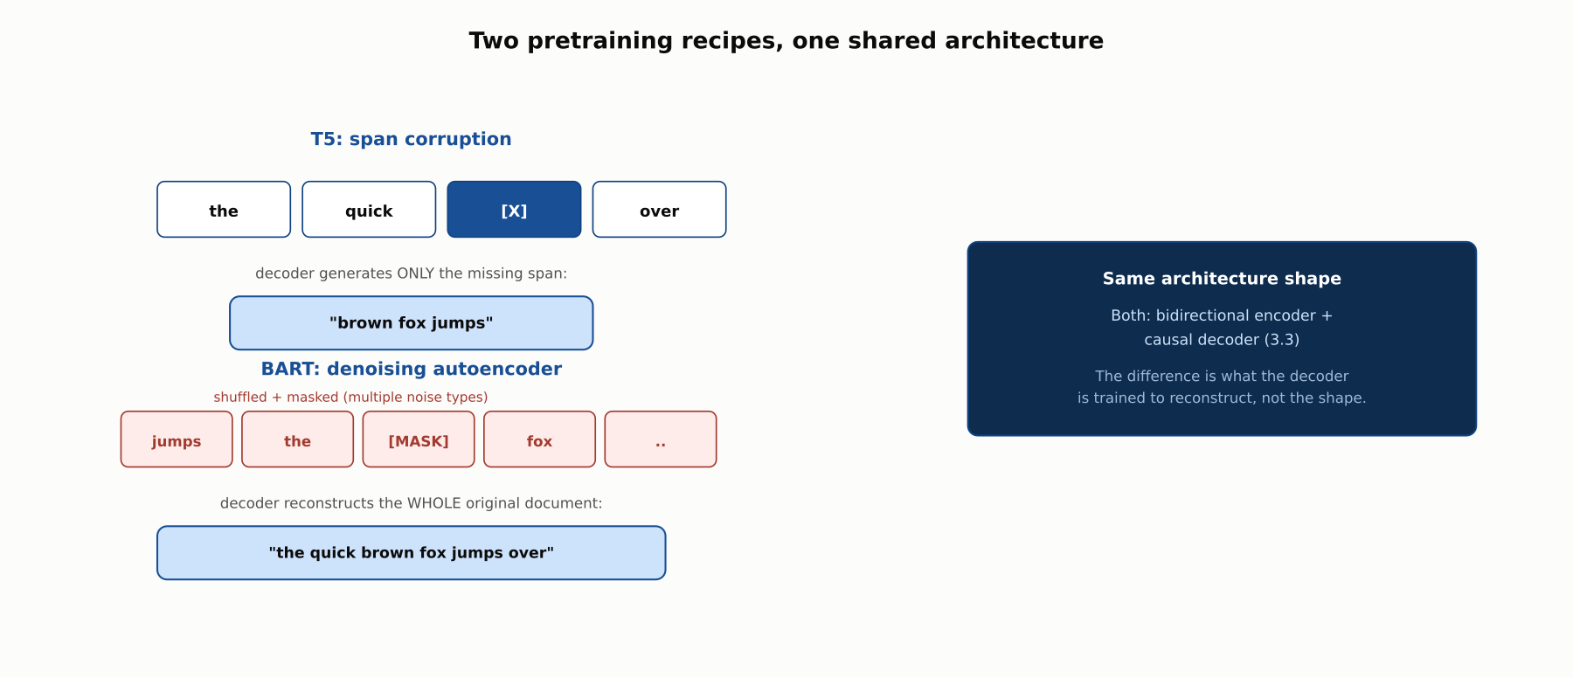
DEEP-DIVE
T5 versus BART: two pretraining recipes, one architecture
T5 generates only the missing spans. BART reconstructs the entire corrupted document.

Slide 9
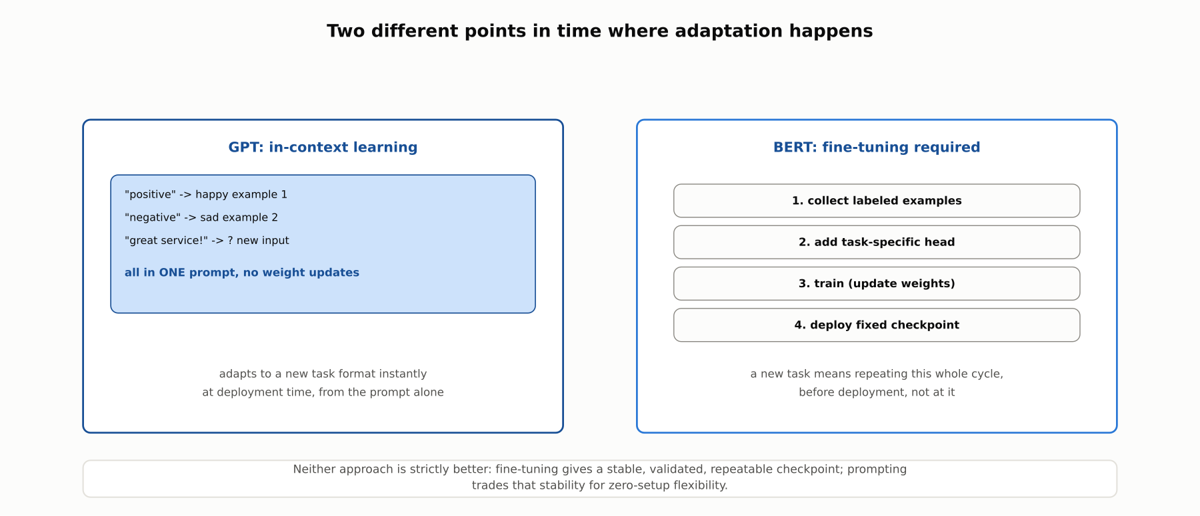
DEEP-DIVE
In-context learning versus fine-tuning
A GPT-family model adapts at deployment time from a few prompt examples. A BERT-family model requires collecting labels, training, and deploying a fixed checkpoint.

Slide 10
REFERENCE ARCHITECTURE
Matching a task to the right family
Open-ended generation from a prompt: GPT family, decoder-only, causal LM
Fixed-input classification or extraction: BERT family, encoder-only, masked LM
Input-to-output transformation (translate, summarize): T5 / BART, encoder-decoder, seq2seq
The architecture is largely inherited from which objective in 3.3 fits the task

Slide 11
COMPARISON & RELATED CONCEPTS
GPT vs. BERT vs. T5 / BART
Aspect | GPT family | BERT family | T5 / BART family
Architecture | Decoder-only | Encoder-only | Encoder-decoder
Pretraining objective (3.3) | Causal LM | Masked LM | Seq2seq (span corruption / denoising)
Can generate open-ended text | Yes, natively | No: needs a task head, no decoder | Yes, conditioned on input
Zero/few-shot without fine-tuning | Yes, at scale (GPT-3+) | Not naturally; typically fine-tuned | Limited without fine-tuning
Representative evolution | GPT-1 → GPT-2 → GPT-3 → GPT-4 | BERT → RoBERTa, ALBERT, DeBERTa | T5, BART, mT5
Picking a family means picking which of chapter 3.3's three objectives fits the task.

Slide 12
INDUSTRY USE CASES
Finance
FINANCIAL SERVICES
Few-shot classification of ad-hoc regulatory queries
Generating disclosure narrative from structured filing data
Problem: A new, narrow query category does not justify a dedicated fine-tuning pipeline.
Problem: Structured financial data needs to become readable narrative disclosure text.
Solution: A GPT-family model classifies via a handful of in-context examples, no fine-tuning infrastructure required.
Solution: A T5-family model generates narrative text conditioned on the structured input.
Watch for: Classification behavior can shift when the underlying model version changes, an ongoing validation surface rather than a one-time sign-off, since there is no fixed checkpoint to re-certify.
Watch for: A generated narrative that misstates or rounds a figure inconsistently with the underlying data creates a disclosure-accuracy exposure caught before filing, not after.

Slide 13
INDUSTRY USE CASES
Healthcare & Telecom
HEALTHCARE + TELECOM
(Healthcare) Correcting OCR errors in scanned medical records
(Telecom) Zero-shot drafting of new technical documentation
Problem: Scanned historical records often contain OCR errors needing correction before indexing.
Problem: A newly launched feature needs support documentation before a fine-tuning pipeline for its vocabulary could exist.
Solution: A BART-style denoising model reconstructs the likely original text from corrupted OCR output.
Solution: A GPT-family model drafts documentation zero-shot or few-shot from a short description and examples.
Watch for: A "corrected" reconstruction that silently changes a clinical value, such as a dosage digit, is a clinical-safety issue distinct from an ordinary OCR-accuracy problem.
Watch for: An unreviewed drafting error reaching a support queue can lead a technician to a wrong resolution step mid-incident, extending the very outage it was meant to help resolve.

Slide 14
CHECK YOUR UNDERSTANDING
Discuss before moving on
1. Why can a decoder-only GPT-family model be prompted directly with in-context examples, while a BERT-family model cannot?
2. What specifically changed between BERT and RoBERTa, and what changed between BERT and ALBERT?
3. What is the key difference between T5's and BART's pretraining objectives, even though both use an encoder-decoder architecture?
4. What did GPT-3 demonstrate that GPT-2 did not, and what stayed the same across both?

Slide 15
CHAPTER 3.4 · PHASE 3
Key Takeaways
GPT: decoder-only, causal LM, evolves through scale, unlocking zero/few-shot transfer
BERT: encoder-only, masked LM, evolves through training recipe and architecture refinements
T5 / BART: encoder-decoder, seq2seq, converge on text-to-text for every task
Architecture is largely inherited from which pretraining objective fits the task
Next: 3.5 Tokenizers Deep Dive: BPE, WordPiece, SentencePiece

