Slide 1
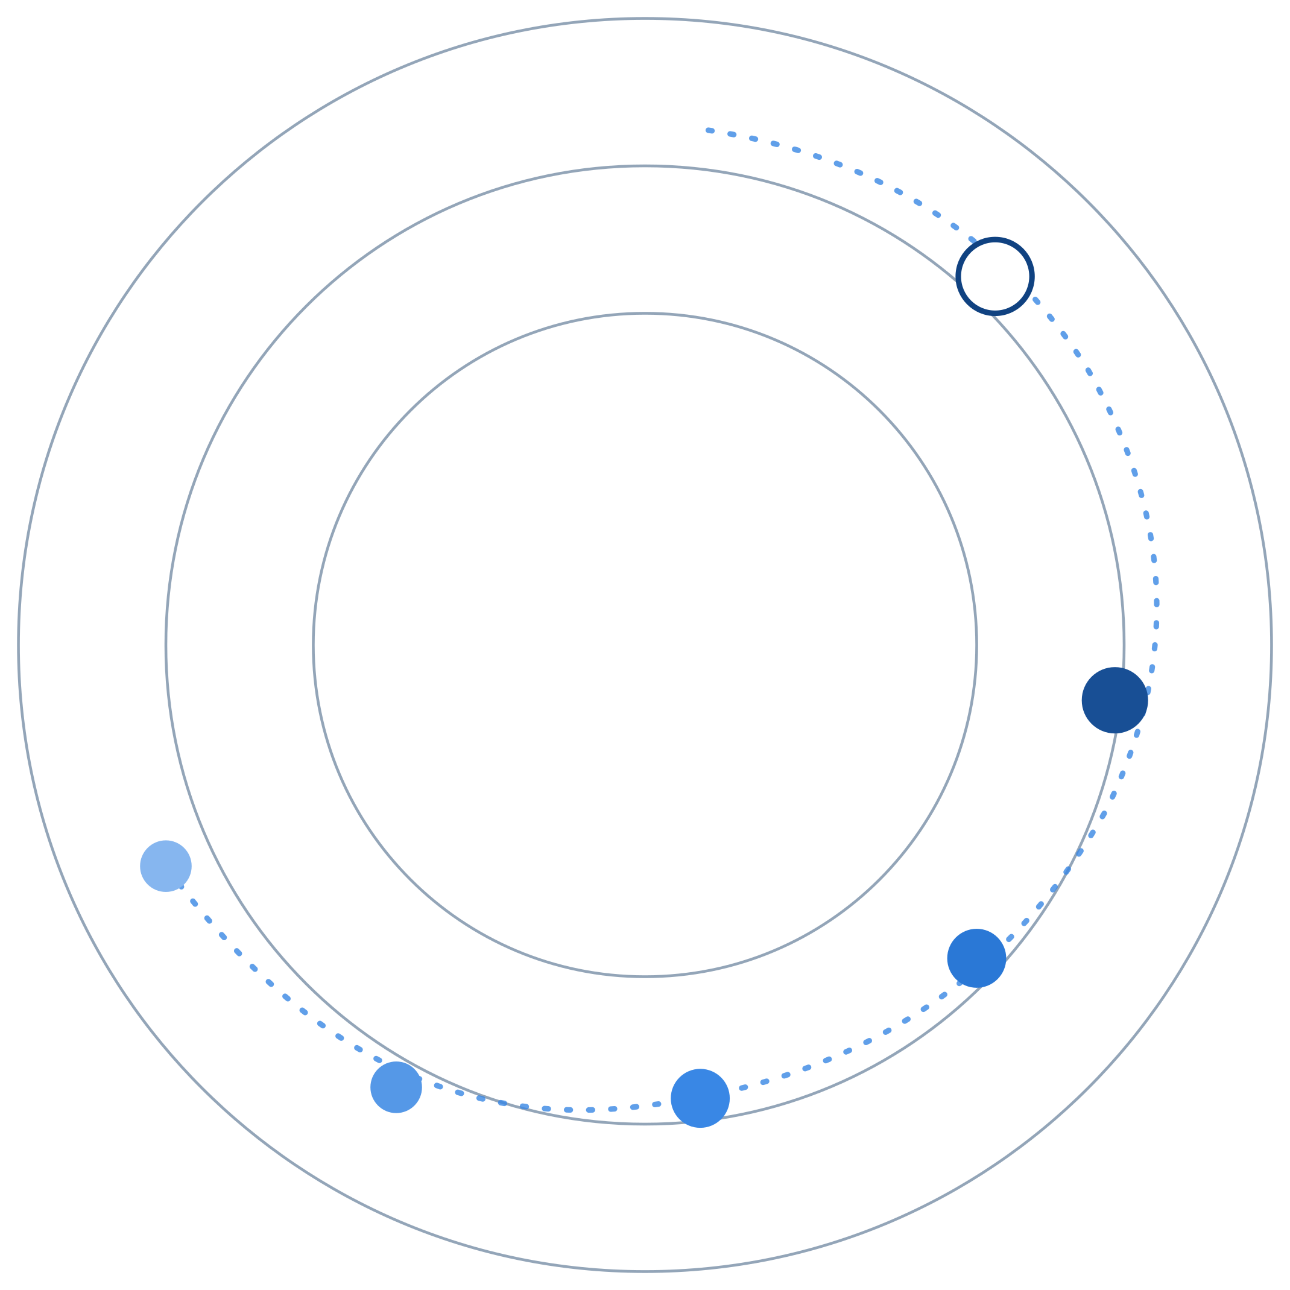
REGAITRAINING · PHASE 1 -- AI & MACHINE LEARNING FOUNDATIONS
CHAPTER 1.9
Ethics & Responsible AI
Bias, Fairness, and Explainability
A teaching-slide walkthrough of the chapter: where bias enters a model, why fairness has several incompatible definitions, and how explainability closes the loop.
Instructor deck · 15 slides · based on docs/01-ai-ml-foundations/1-9-ethics-responsible-ai.mdx

Slide 2
ROADMAP
What We'll Cover
1
How bias enters
5
A reference architecture
Historical, representation, measurement, and label bias
Where a bias and fairness audit sits in the lifecycle
2
Fairness definitions
6
Comparison table
Demographic parity, equalized odds, and predictive parity
Four fairness definitions, side by side
3
The impossibility result
7
Industry use cases
Why some fairness definitions cannot both hold
Finance, Healthcare, and Telecom - 4 each
4
Explainability
LIME and SHAP, and the difference they make
1.9 | Phase 1 - AI & Machine Learning Foundations
2

Slide 3
TL;DR
Bias In, Bias Out, Unless Audited
A model trained on data that reflects historical or societal bias reproduces that bias, and can amplify it through feedback loops. Fairness is not one property a model has or lacks: several reasonable definitions of "fair" exist, and some are provably impossible to satisfy at once.
THE PRACTICAL TAKEAWAY
Explainability gives stakeholders, developers, auditors, and the people a decision affects a way to see why a model produced a specific output.
1.9 | Phase 1 - AI & Machine Learning Foundations
3

Slide 4
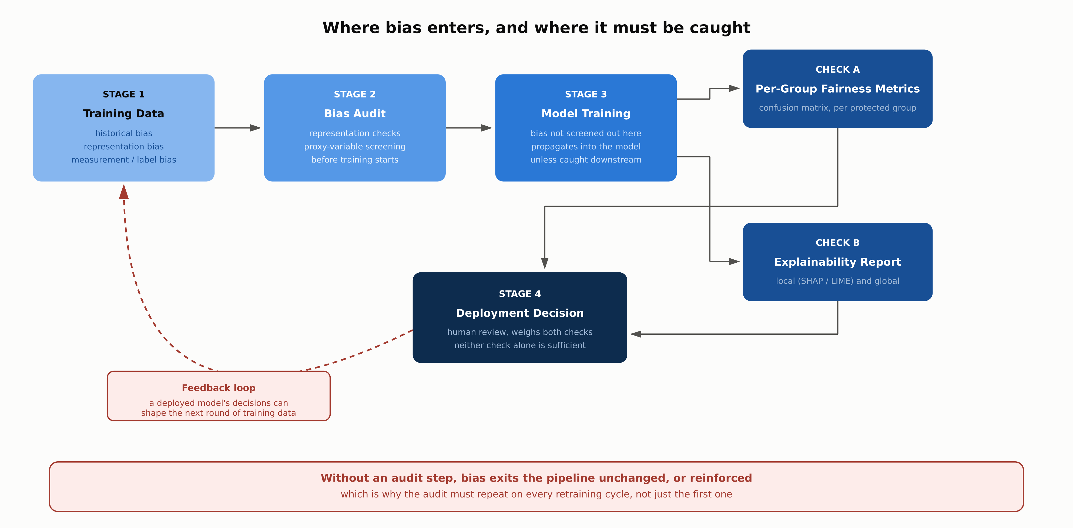
HIGH-LEVEL
Where Bias Enters, and Where It Must Be Caught
1.9 | Phase 1 - AI & Machine Learning Foundations
4

Slide 5
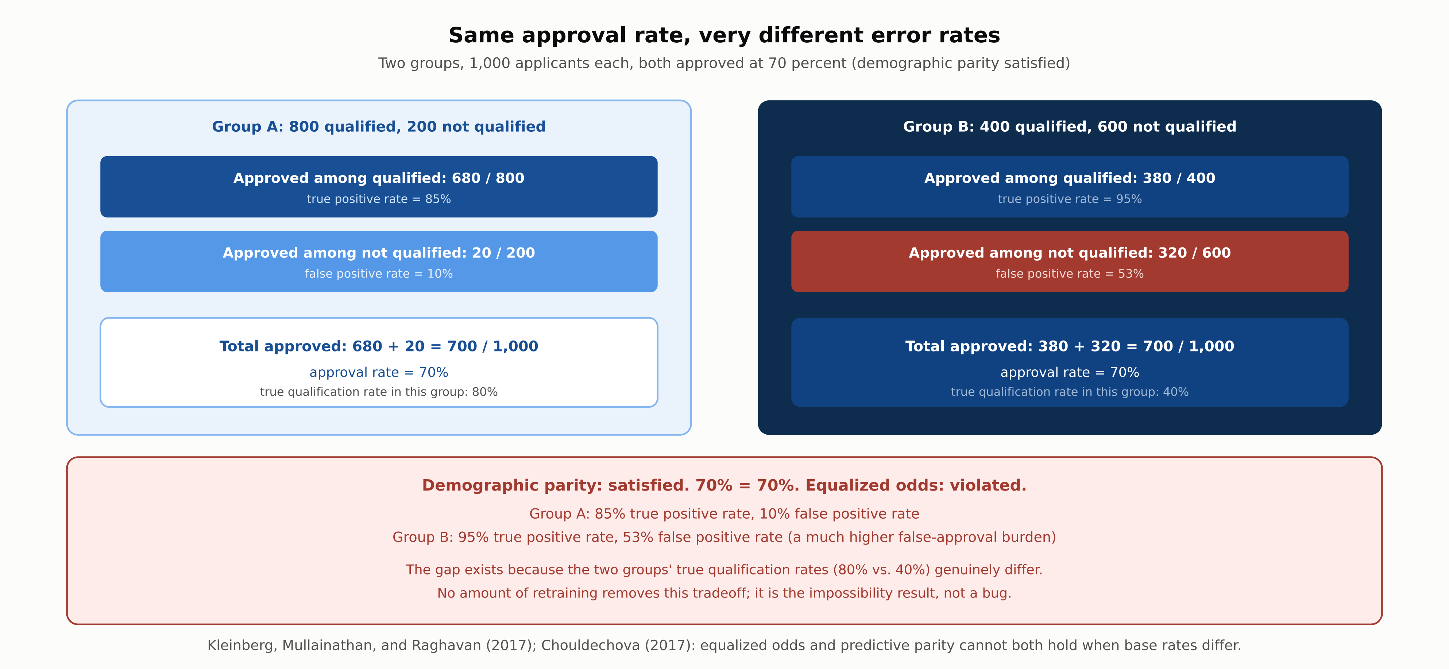
DEEP-DIVE
Same Approval Rate, Very Different Error Rates
1.9 | Phase 1 - AI & Machine Learning Foundations
5

Slide 6
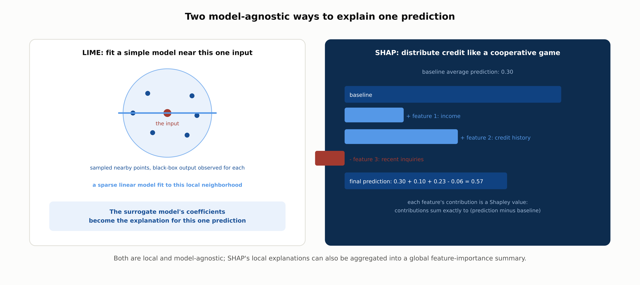
DEEP-DIVE
Two Ways to Explain One Prediction
1.9 | Phase 1 - AI & Machine Learning Foundations
6

Slide 7
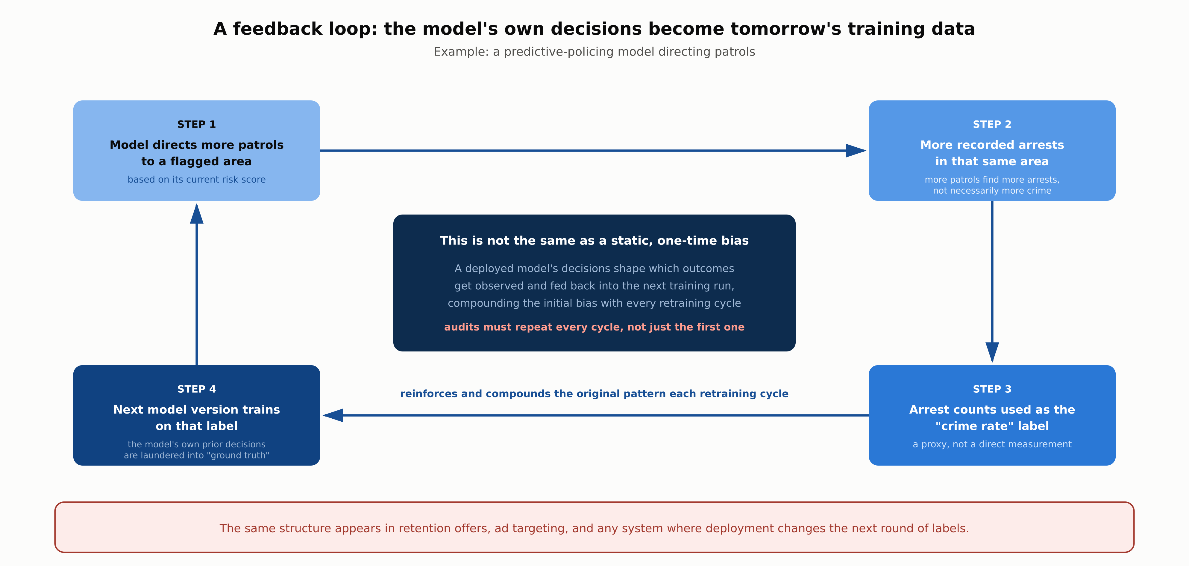
DEEP-DIVE
A Feedback Loop Compounds Bias Each Cycle
1.9 | Phase 1 - AI & Machine Learning Foundations
7

Slide 8
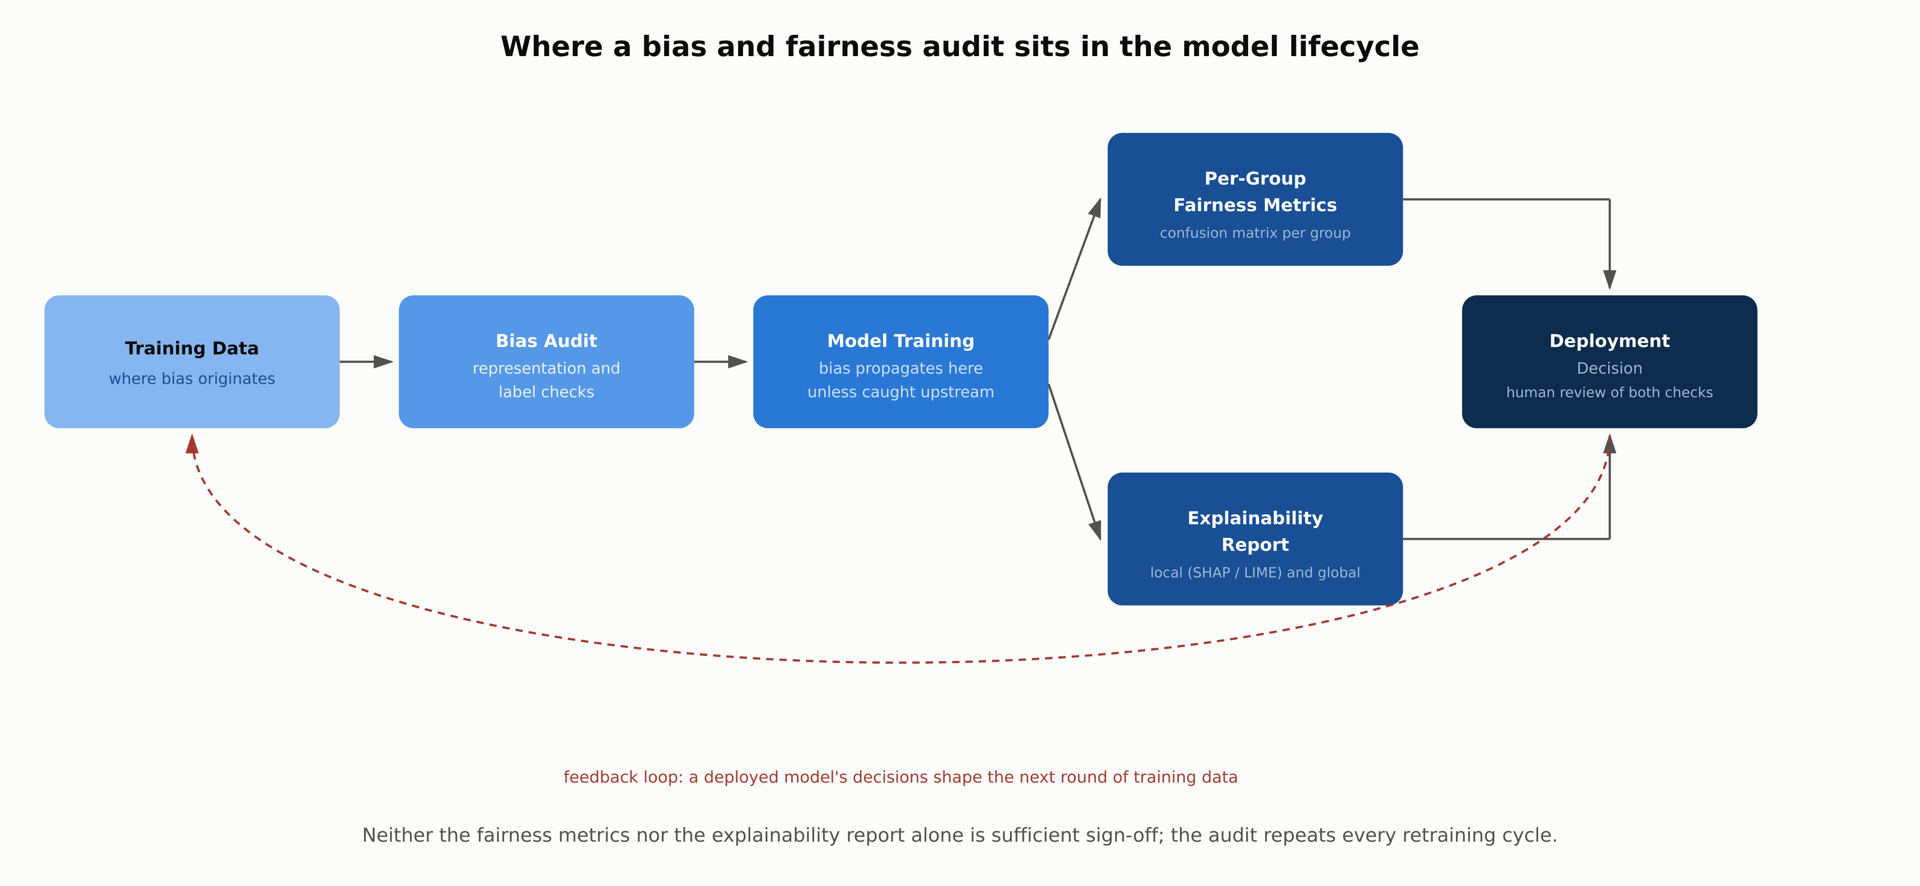
REFERENCE ARCHITECTURE
Where the Audit Sits in the Model Lifecycle
1.9 | Phase 1 - AI & Machine Learning Foundations
8

Slide 9
COMPARISON & RELATED CONCEPTS
Four Fairness Definitions, Side by Side
 | Demographic Parity | Equalized Odds | Predictive Parity | Individual Fairness
What it equalizes | Positive rate across groups | TPR and FPR across groups | Outcome rate given a score | Similar inputs, similar outputs
Formal condition | P(Y-hat=1 | A=a) equal | P(Y-hat=1 | Y=y, A=a) equal | P(Y=1 | Y-hat=1, A=a) equal | No group attribute in the definition
Fails when | Base rates genuinely differ | Base rates + predictive parity | Base rates + equalized odds | No agreed similarity metric exists
Best suited to | Equal access regardless of rate | Guarding unequal error burden | A score means the same thing | A defensible similarity measure
These four definitions are not competing implementations of one idea; several are mutually exclusive whenever group base rates differ, so picking one is a policy decision.
1.9 | Phase 1 - AI & Machine Learning Foundations
9

Slide 10
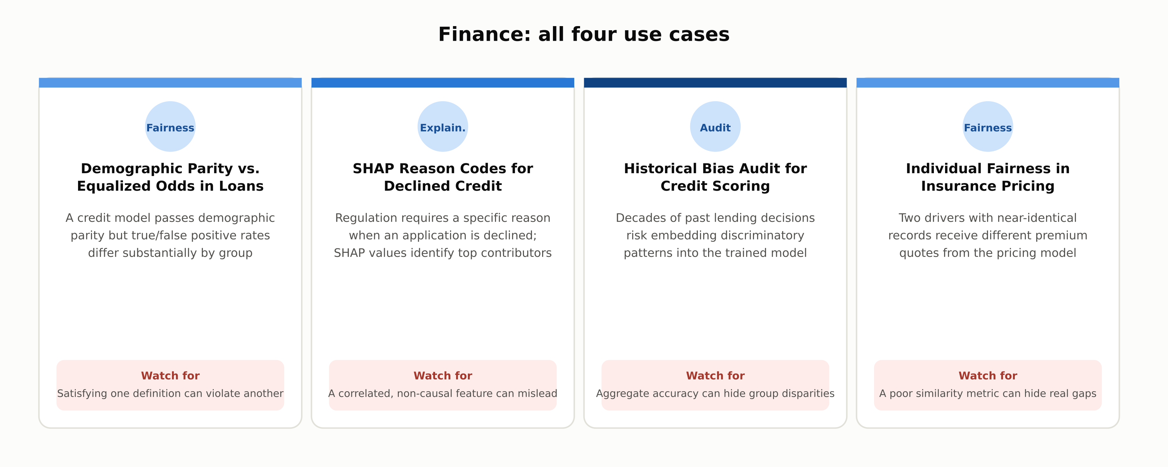
INDUSTRY USE CASES · 1 OF 3
Finance
1.9 | Phase 1 - AI & Machine Learning Foundations
10

Slide 11
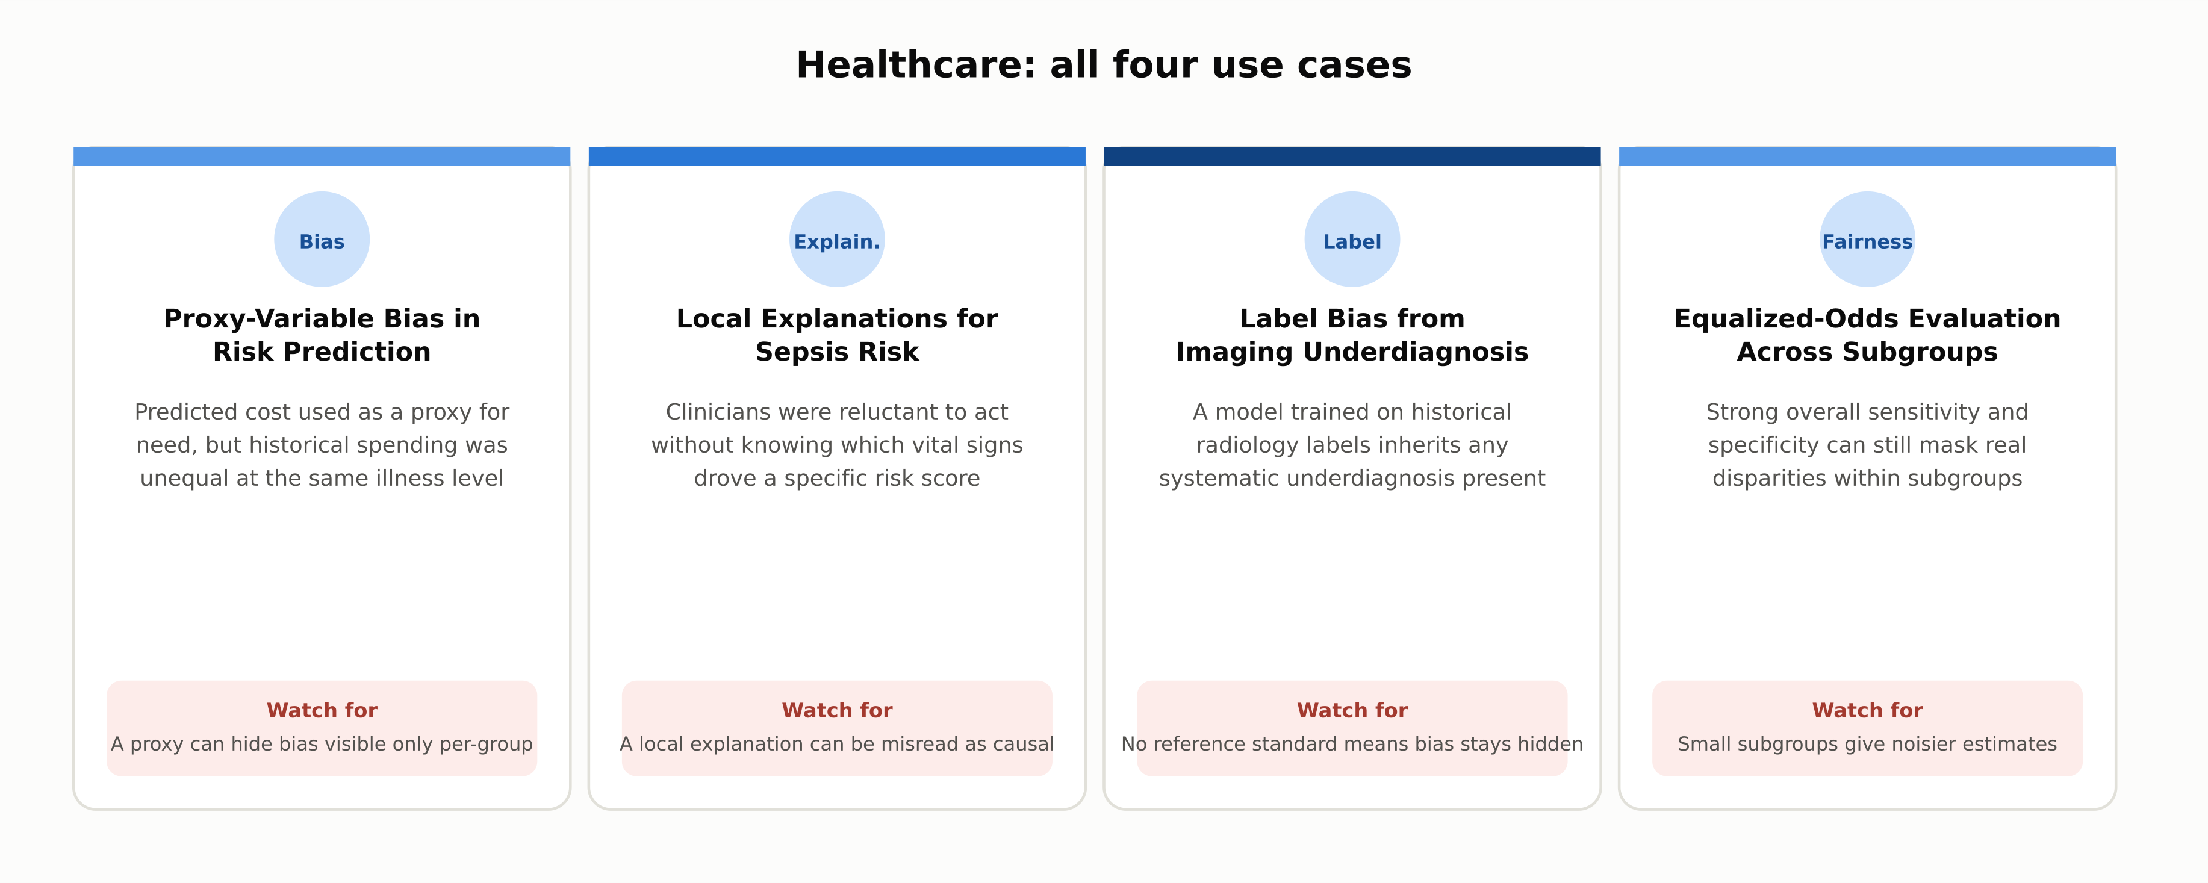
INDUSTRY USE CASES · 2 OF 3
Healthcare
1.9 | Phase 1 - AI & Machine Learning Foundations
11

Slide 12
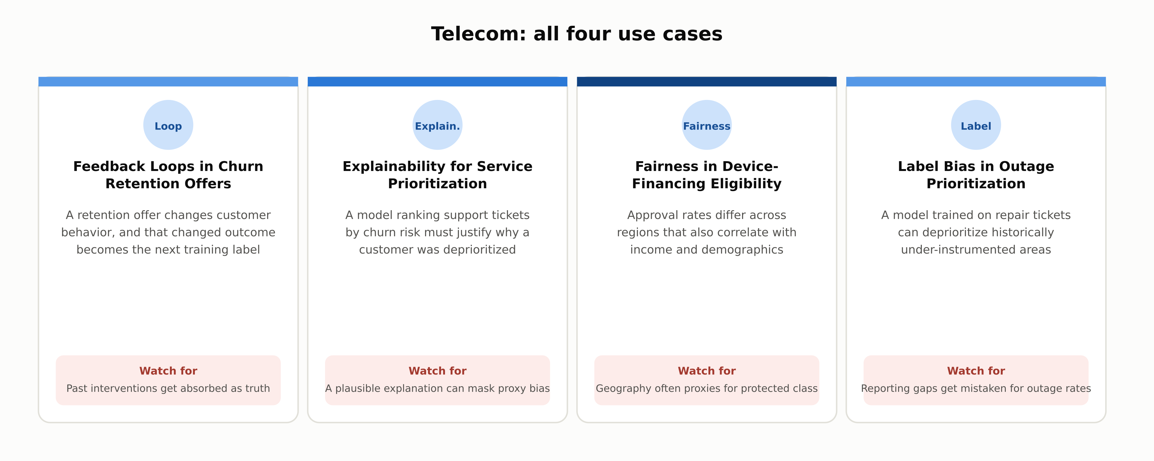
INDUSTRY USE CASES · 3 OF 3
Telecom
1.9 | Phase 1 - AI & Machine Learning Foundations
12

Slide 13
DISCUSS AS A CLASS
Check Your Understanding
Q1
Why can equalized odds and predictive parity be mathematically impossible to satisfy at the same time?
Q2
What is a feedback loop in the predictive-policing or retention-offer sense, and why does it compound bias?
Q3
What is the difference between demographic parity and equalized odds, and when would you prefer one?
Q4
What do LIME and SHAP actually explain, and what is the difference between local and global?
Q5
Why did using historical healthcare cost as a proxy for need introduce racial bias into the algorithm?
Answers are in the speaker notes for this slide.
1.9 | Phase 1 - AI & Machine Learning Foundations
13
Notes:
Q1: Why can equalized odds and predictive parity be mathematically impossible to satisfy at the same time? A1: When the true base rate of the outcome genuinely differs between two groups, no classifier other than a perfect one can simultaneously equalize both the true/false positive rates across groups (equalized odds) and the actual outcome rate given a score (predictive parity). This is a mathematical consequence of the differing base rates, not a fixable modeling error. Q2: What is a feedback loop in the predictive-policing or retention-offer sense, and why does it compound bias? A2: A feedback loop happens when a deployed model's own decisions influence which outcomes get observed, and those observed outcomes then become training data for the next version of the model. If a policing model directs more patrols to an area and that generates more recorded arrests there, using arrest counts as a "crime rate" label launders the model's own prior decisions into ground truth, reinforcing the original pattern each cycle. Q3: What is the difference between demographic parity and equalized odds, and when would you prefer one? A3: Demographic parity requires the same positive prediction rate across groups regardless of the true outcome; equalized odds requires the same true and false positive rate across groups, conditioned on the actual outcome. Demographic parity fits equal-access goals; equalized odds fits contexts where an unequal error burden is the harm of concern. Q4: What do LIME and SHAP actually explain, and what is the difference between local and global? A4: Both are model-agnostic post-hoc methods: LIME fits a simple interpretable model to the local neighborhood around one prediction, while SHAP distributes a prediction's difference from a baseline across features using Shapley values. A local explanation covers one prediction; a global explanation summarizes the model's behavior overall. Q5: Why did using historical healthcare cost as a proxy for need introduce racial bias into the algorithm? A5: Historical healthcare spending was itself unequal across racial groups even among patients with the same underlying illness level, because less money had historically been spent on Black patients' care. Because the algorithm used predicted cost as a stand-in for need, it systematically assigned Black patients lower risk scores than white patients with the same actual level of illness.

Slide 14
SUMMARY
Key Takeaways
✓
Bias enters through historical, representation, measurement, and label sources, often before training starts.
✓
Demographic parity, equalized odds, and predictive parity can be mutually exclusive when base rates differ.
✓
Choosing a fairness definition is a policy decision about which error to tolerate, not a bug to fix.
✓
LIME and SHAP explain individual predictions; SHAP values can also aggregate into a global summary.
✓
A feedback loop lets a deployed model's own decisions compound bias with every retraining cycle.
1.9 | Phase 1 - AI & Machine Learning Foundations
14

Slide 15
FURTHER READING
Sources Cited in This Chapter
Kleinberg, Mullainathan, and Raghavan (ITCS, 2017)
Inherent Trade-Offs in the Fair Determination of Risk Scores - arxiv.org/abs/1609.05807
Chouldechova (Big Data, 2017)
Fair Prediction with Disparate Impact - doi.org/10.1089/big.2016.0047
Ribeiro, Singh, and Guestrin (KDD, 2016)
"Why Should I Trust You?": Explaining the Predictions of Any Classifier - dl.acm.org/doi/10.1145/2939672.2939778
Lundberg and Lee (NeurIPS, 2017)
A Unified Approach to Interpreting Model Predictions
Obermeyer, Powers, Vogeli, and Mullainathan (Science, 2019)
Dissecting Racial Bias in an Algorithm Used to Manage the Health of Populations - doi.org/10.1126/science.aax2342
Full chapter with inline links: docs/01-ai-ml-foundations/1-9-ethics-responsible-ai.mdx
1.9 | Phase 1 - AI & Machine Learning Foundations
15

