Slide 1
Phase 2 — Deep Learning Foundations
Neural Networks 101: From Perceptron to MLP
The perceptron, the XOR problem, and why a hidden layer with nonlinear activations changes everything
Chapter 2.1

Slide 2
Agenda
01 | TL;DR
02 | High-Level: perceptron and MLP
03 | Deep-Dive: forward pass, XOR, universal approximation
04 | Comparison & Related Concepts
05 | Reference Architecture: the forward pass
06 | Industry Use Cases (Finance, Healthcare, Telecom)
07 | Check Your Understanding
RegAITraining · Chapter 2.1
2 / 15

Slide 3
TL;DR
A neural network is built from a simple unit, the perceptron, that takes a weighted sum of its inputs, adds a bias, and passes the result through an activation function.
One perceptron alone can only separate data with a straight line, so it cannot even learn the XOR function.
Stacking perceptrons into layers (a multilayer perceptron, or MLP) and giving each unit a nonlinear activation lets the network bend that line into an arbitrarily complex decision boundary.
Per the universal approximation theorem, an MLP with a hidden layer and enough units can approximate essentially any continuous function.
RegAITraining · Chapter 2.1
3 / 15

Slide 4
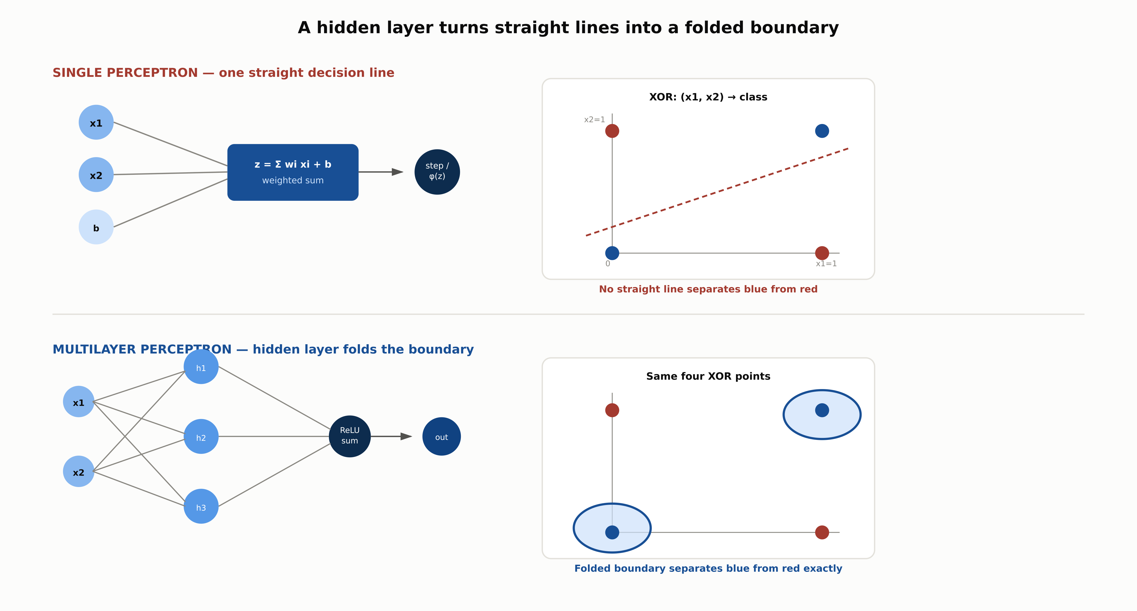
Single perceptron vs. multilayer perceptron on XOR
A hidden layer of perceptrons combines several straight lines into a folded boundary a single unit cannot produce.
RegAITraining · Chapter 2.1
4 / 15

Slide 5
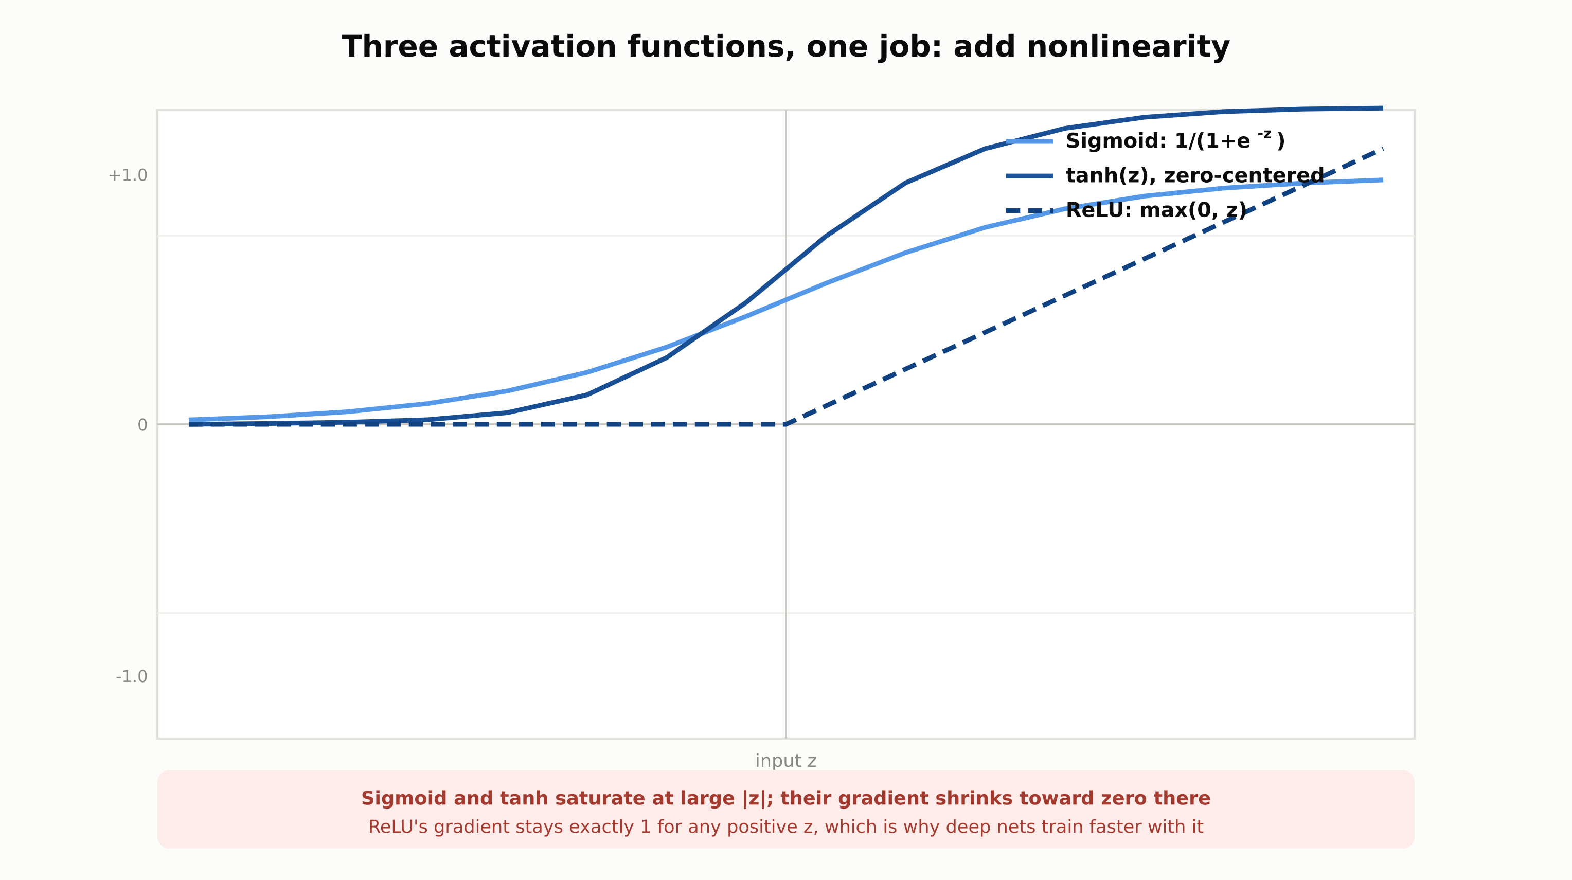
Activation functions: sigmoid, tanh, ReLU
ReLU's gradient does not shrink for positive inputs the way sigmoid's and tanh's do, which is why it trains faster in deep networks.
RegAITraining · Chapter 2.1
5 / 15

Slide 6
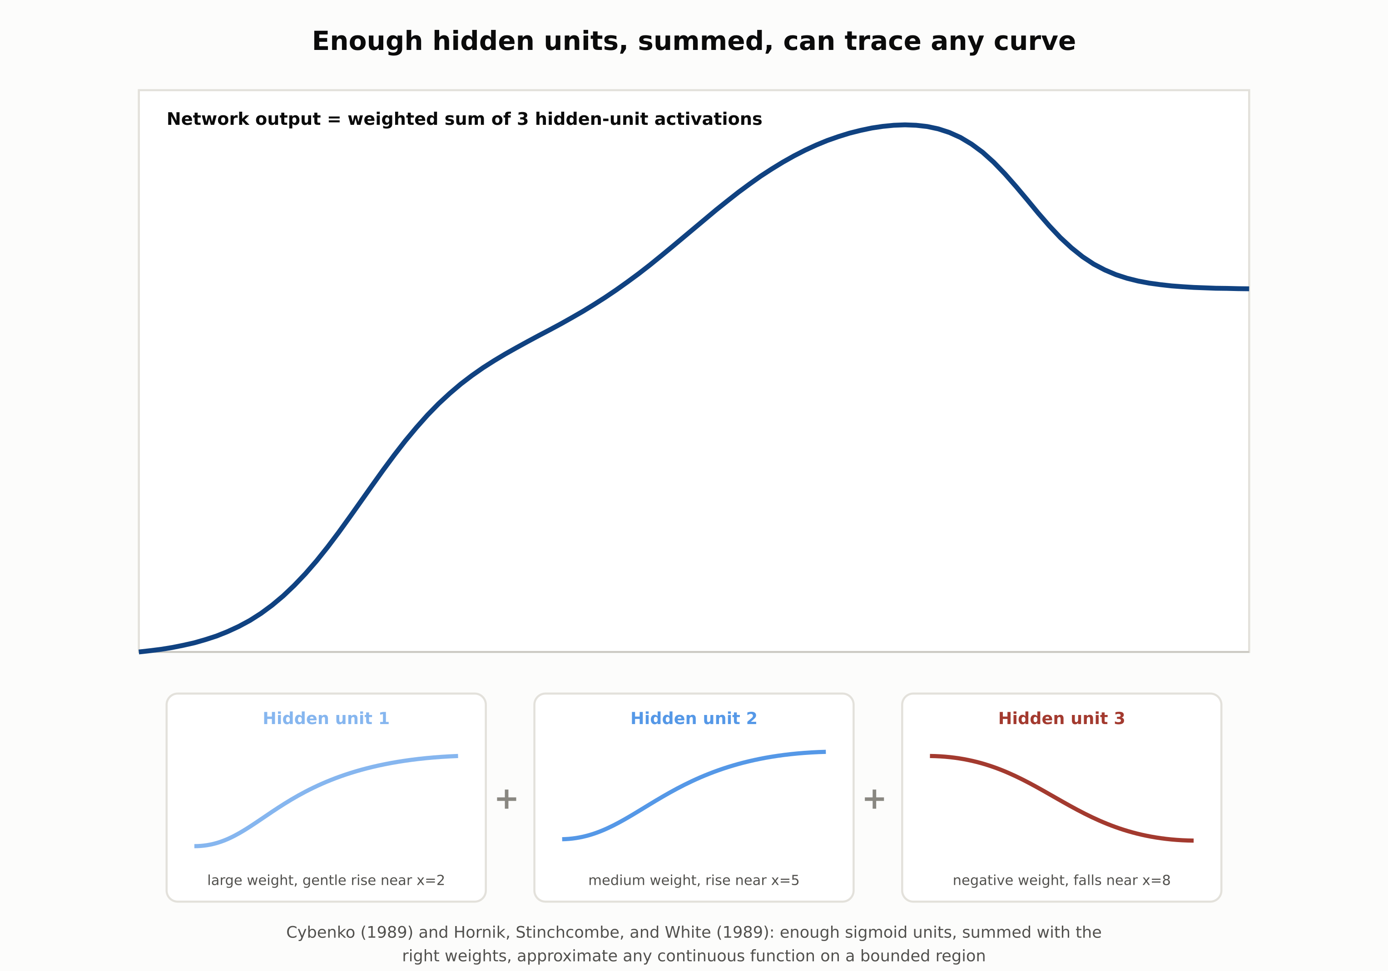
The universal approximation theorem, mechanically
Cybenko (1989) and Hornik, Stinchcombe, and White (1989): enough weighted sigmoid units, summed, approximate any continuous function.
RegAITraining · Chapter 2.1
6 / 15

Slide 7
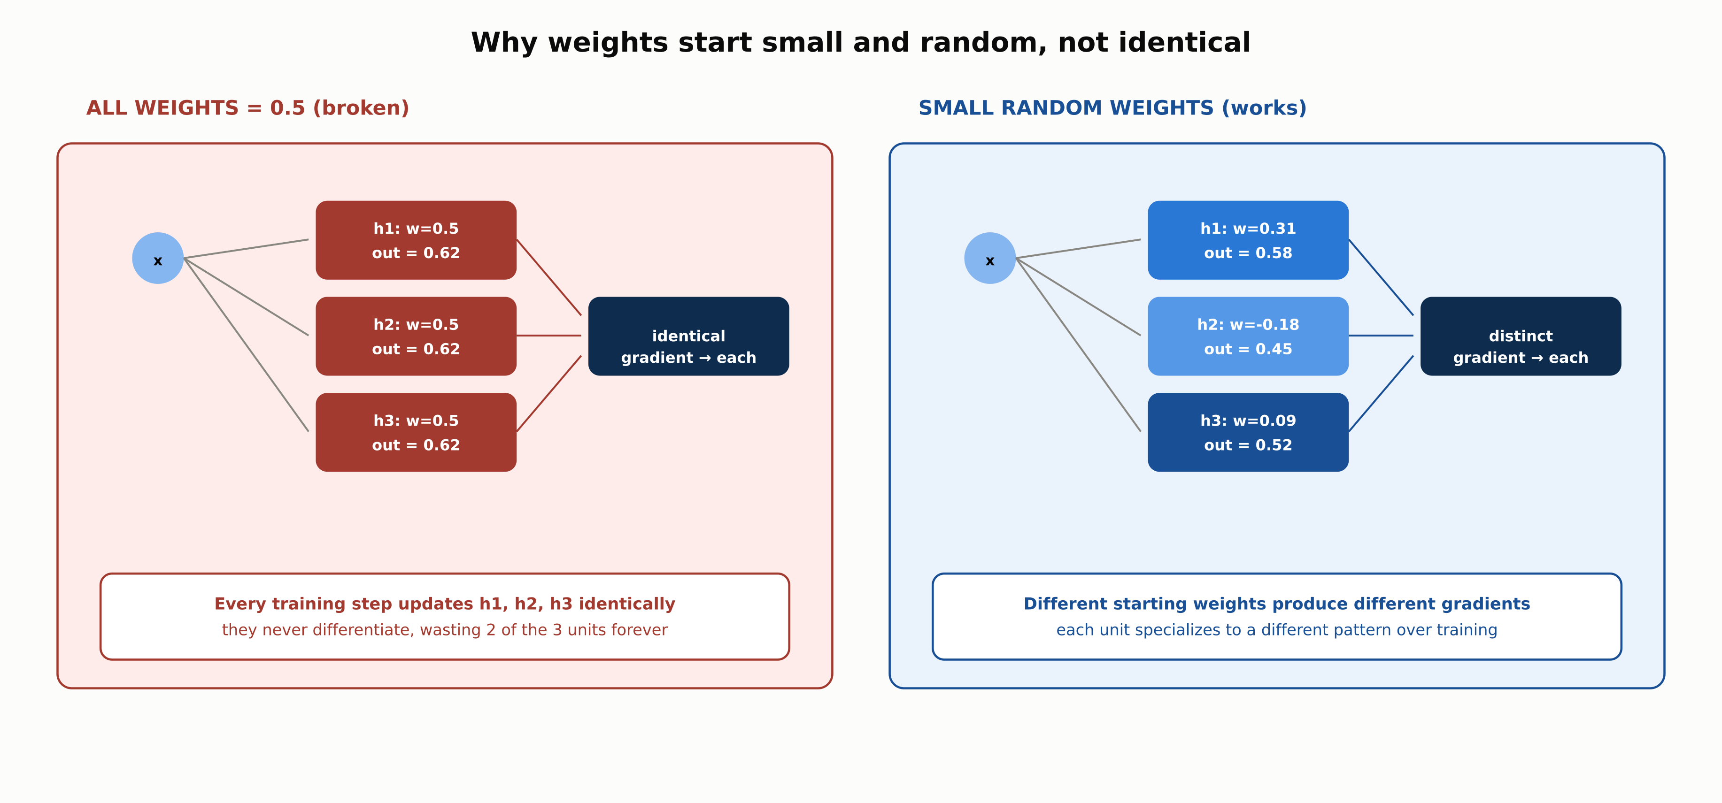
Why weight initialization must be small and random
Identical initial weights produce identical gradients forever; random initialization lets hidden units specialize.
RegAITraining · Chapter 2.1
7 / 15

Slide 8
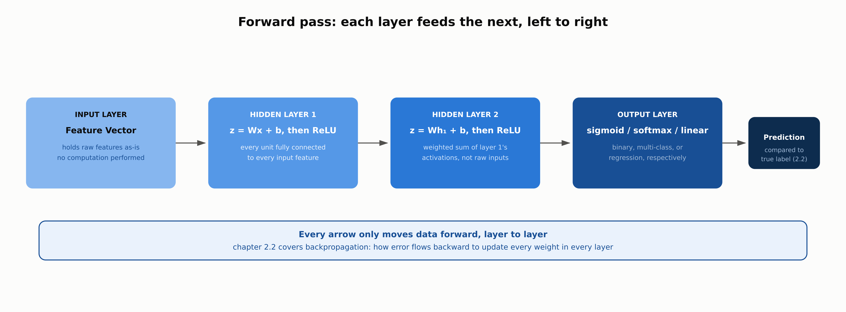
Reference architecture: the forward pass
Every arrow moves data forward only; chapter 2.2 covers how error flows backward to update every weight.
RegAITraining · Chapter 2.1
8 / 15

Slide 9
Comparison & Related Concepts
Aspect | Single Perceptron | Multilayer Perceptron (MLP) | Logistic Regression | Decision Tree
Decision boundary shape | One straight line/hyperplane | Arbitrarily complex, folded regions | One straight line/hyperplane | Axis-aligned rectangular regions
Can it solve XOR | No | Yes, with one hidden layer | No | Yes, with enough splits
How it learns | Perceptron rule or gradient descent | Backpropagation + gradient descent | Gradient descent on log loss | Greedy recursive splitting
Interpretability | High: weights are directly readable | Low without SHAP/LIME tooling | High: coefficients are directly readable | High: split path is directly readable
Logistic regression is mathematically a single perceptron with a sigmoid activation; the hidden layer is what makes an MLP qualitatively different.
RegAITraining · Chapter 2.1
9 / 15

Slide 10

RegAITraining · Chapter 2.1
10 / 15

Slide 11

RegAITraining · Chapter 2.1
11 / 15

Slide 12

RegAITraining · Chapter 2.1
12 / 15

Slide 13
Check Your Understanding
1. Why can a single perceptron not learn the XOR function, and what specifically about an MLP fixes it?
2. Why does stacking layers with no nonlinear activation function fail to add any expressive power?
3. What does the universal approximation theorem actually guarantee, and what does it not guarantee?
4. Why does initializing every weight in a network to the same value break training?
5. Why did ReLU replace sigmoid as the default hidden-layer activation in deep networks?
RegAITraining · Chapter 2.1
13 / 15
Notes:
Q1: Why can a single perceptron not learn the XOR function, and what specifically about an MLP fixes it? A1: A single perceptron can only separate its input space with one straight line, and XOR's positive and negative examples are diagonally interleaved so no single line separates them. An MLP fixes this with a hidden layer: each hidden unit draws its own line, and the output unit combines them into a folded boundary. Q2: Why does stacking layers with no nonlinear activation function fail to add any expressive power? A2: A linear transformation followed by another linear transformation is algebraically still one linear transformation. Without nonlinearity, any depth of stacked layers collapses to the same expressive power as one layer. Q3: What does the universal approximation theorem actually guarantee, and what does it not guarantee? A3: It guarantees a feedforward network with one hidden layer and enough units can approximate any continuous function on a bounded region to arbitrary precision. It does not say how many units are needed, nor whether gradient descent will find the right weights. Q4: Why does initializing every weight in a network to the same value break training? A4: Every unit in the layer computes the same output and receives the same gradient update at every step, so they stay identical forever, a failure called the symmetry problem. Random initialization breaks the tie. Q5: Why did ReLU replace sigmoid as the default hidden-layer activation in deep networks? A5: Nair and Hinton (2010) showed ReLU units train faster than sigmoid or tanh in deep architectures, largely because ReLU's gradient does not shrink toward zero for positive inputs the way sigmoid's does across many stacked layers.

Slide 14
Key Takeaways
A perceptron computes one weighted sum plus a bias, then an activation; alone it can only draw a straight decision line.
A hidden layer with a nonlinear activation is what lets a network fold that line into an arbitrarily complex boundary, solving problems like XOR that a single perceptron cannot.
The universal approximation theorem is an existence proof, not a training or efficiency guarantee: it says a wide enough network can represent a function, not that gradient descent will find the right weights.
Weights are initialized small and random, not identical, to break the symmetry that would otherwise make every hidden unit learn the same thing forever.
ReLU is the default hidden-layer activation in modern deep networks because its gradient does not vanish for positive inputs the way sigmoid's and tanh's do.
RegAITraining · Chapter 2.1
14 / 15

Slide 15
Sources
Rosenblatt, F. (1958). The Perceptron: A Probabilistic Model for Information Storage and Organization in the Brain. Psychological Review. — https://pubmed.ncbi.nlm.nih.gov/13602029/
Minsky, M. and Papert, S. (1969). Perceptrons: An Introduction to Computational Geometry. MIT Press. — https://en.wikipedia.org/wiki/Perceptrons_(book)
Cybenko, G. (1989). Approximation by Superpositions of a Sigmoidal Function. Mathematics of Control, Signals and Systems. — https://www.sciencedirect.com/science/article/abs/pii/0893608089900208
Hornik, K., Stinchcombe, M., and White, H. (1989). Multilayer Feedforward Networks Are Universal Approximators. Neural Networks. — https://www.sciencedirect.com/science/article/abs/pii/0893608089900256
Nair, V. and Hinton, G. (2010). Rectified Linear Units Improve Restricted Boltzmann Machines. ICML. — http://www.cs.toronto.edu/~fritz/absps/reluICML.pdf
RegAITraining · Chapter 2.1
15 / 15

