Slide 1
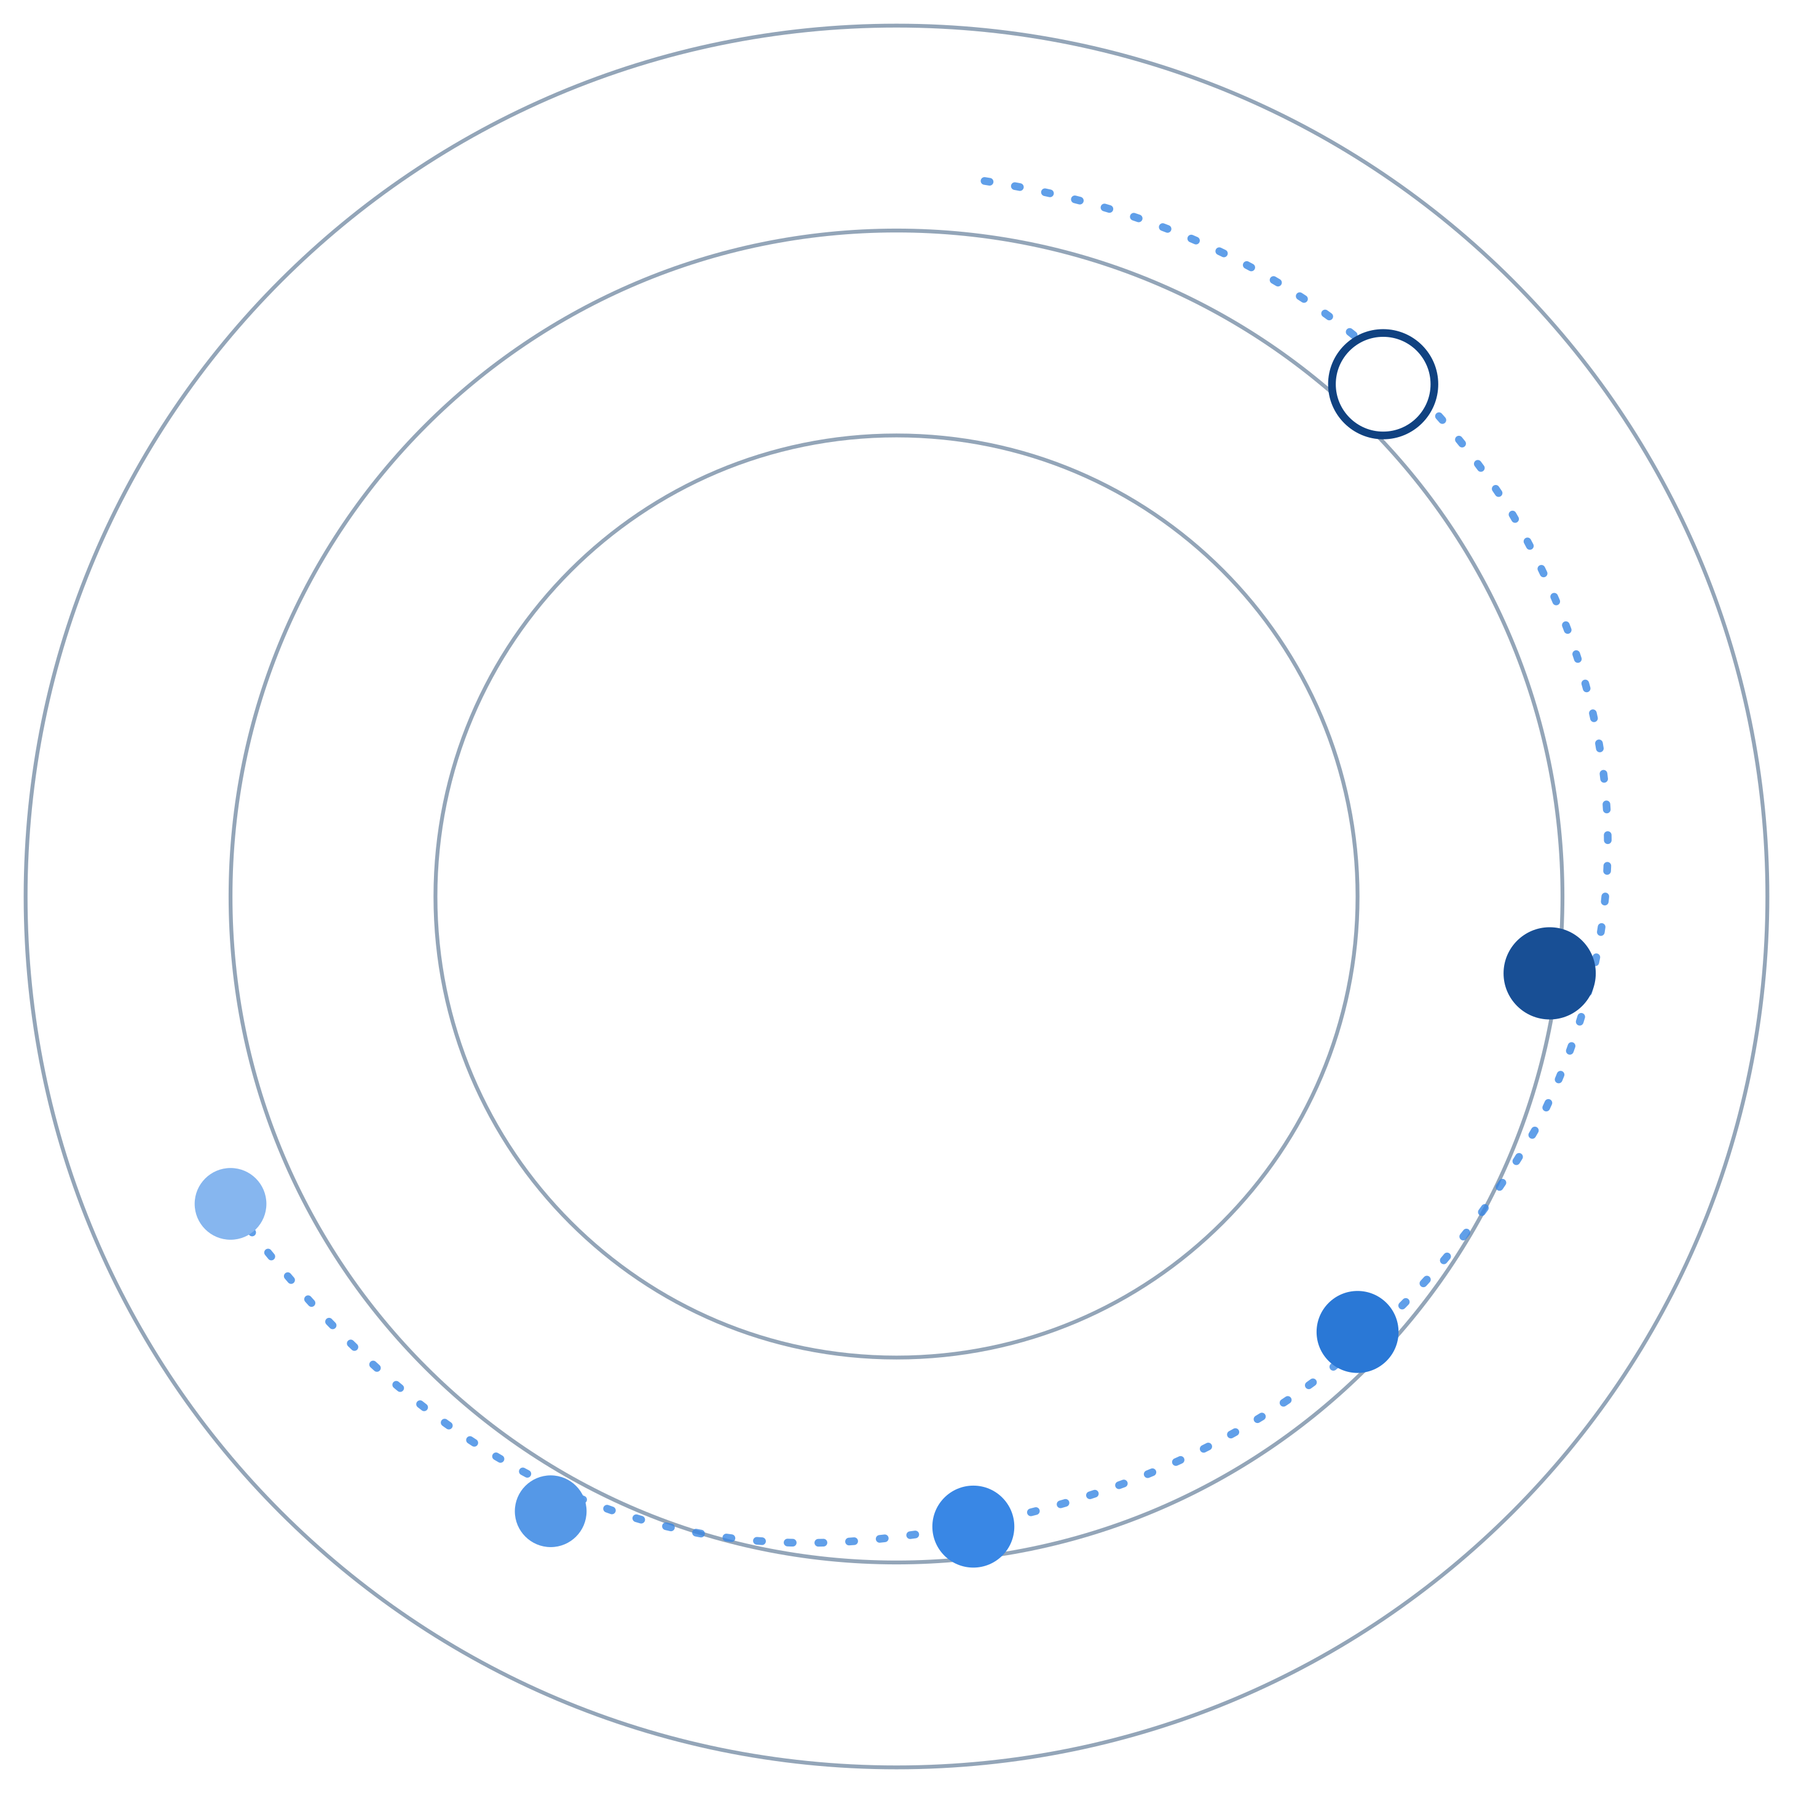
REGAITRAINING · PHASE 1 — AI & MACHINE LEARNING FOUNDATIONS
CHAPTER 1.2
A Taxonomy of AI
Rule-Based, Machine Learning, Deep Learning, Generative, and Agentic
A teaching-slide walkthrough of the chapter: five layers as specializations, not competing technologies, and where the boundaries actually blur.
Instructor deck · 17 slides · based on docs/01-ai-ml-foundations/1-2-taxonomy-of-ai.mdx

Slide 2
ROADMAP
What We'll Cover
1
The pyramid: five nested layers
5
A reference architecture
Widest at the base, narrowest at the tip
All five layers in one loan-intake pipeline
2
What formally distinguishes each
6
Industry use cases
Where the logic came from, not how it looks
Finance, Healthcare, and Telecom — 4 each
3
Discriminative vs. generative
7
Check your understanding
An older distinction, a narrower modern usage
Five questions to discuss as a class
4
Where the boundary blurs
Decision trees, and the agentic control loop
1.2 · Phase 1 — AI & Machine Learning Foundations
2

Slide 3
TL;DR
Five Layers, One Idea
Rule-based, machine learning, deep learning, generative AI, and agentic AI aren't five competing technologies. They're five layers, each a narrower specialization of the one below it.
Like medical specialization: a GP treats a wide range of conditions; a subspecialist treats a narrower set, but goes deeper on each one.
THE PRACTICAL TAKEAWAY
A real production system usually stacks several of these layers together — it doesn't pick just one. A rule-based input check still runs in front of a machine-learned model in most systems today.
1.2 · Phase 1 — AI & Machine Learning Foundations
3

Slide 4
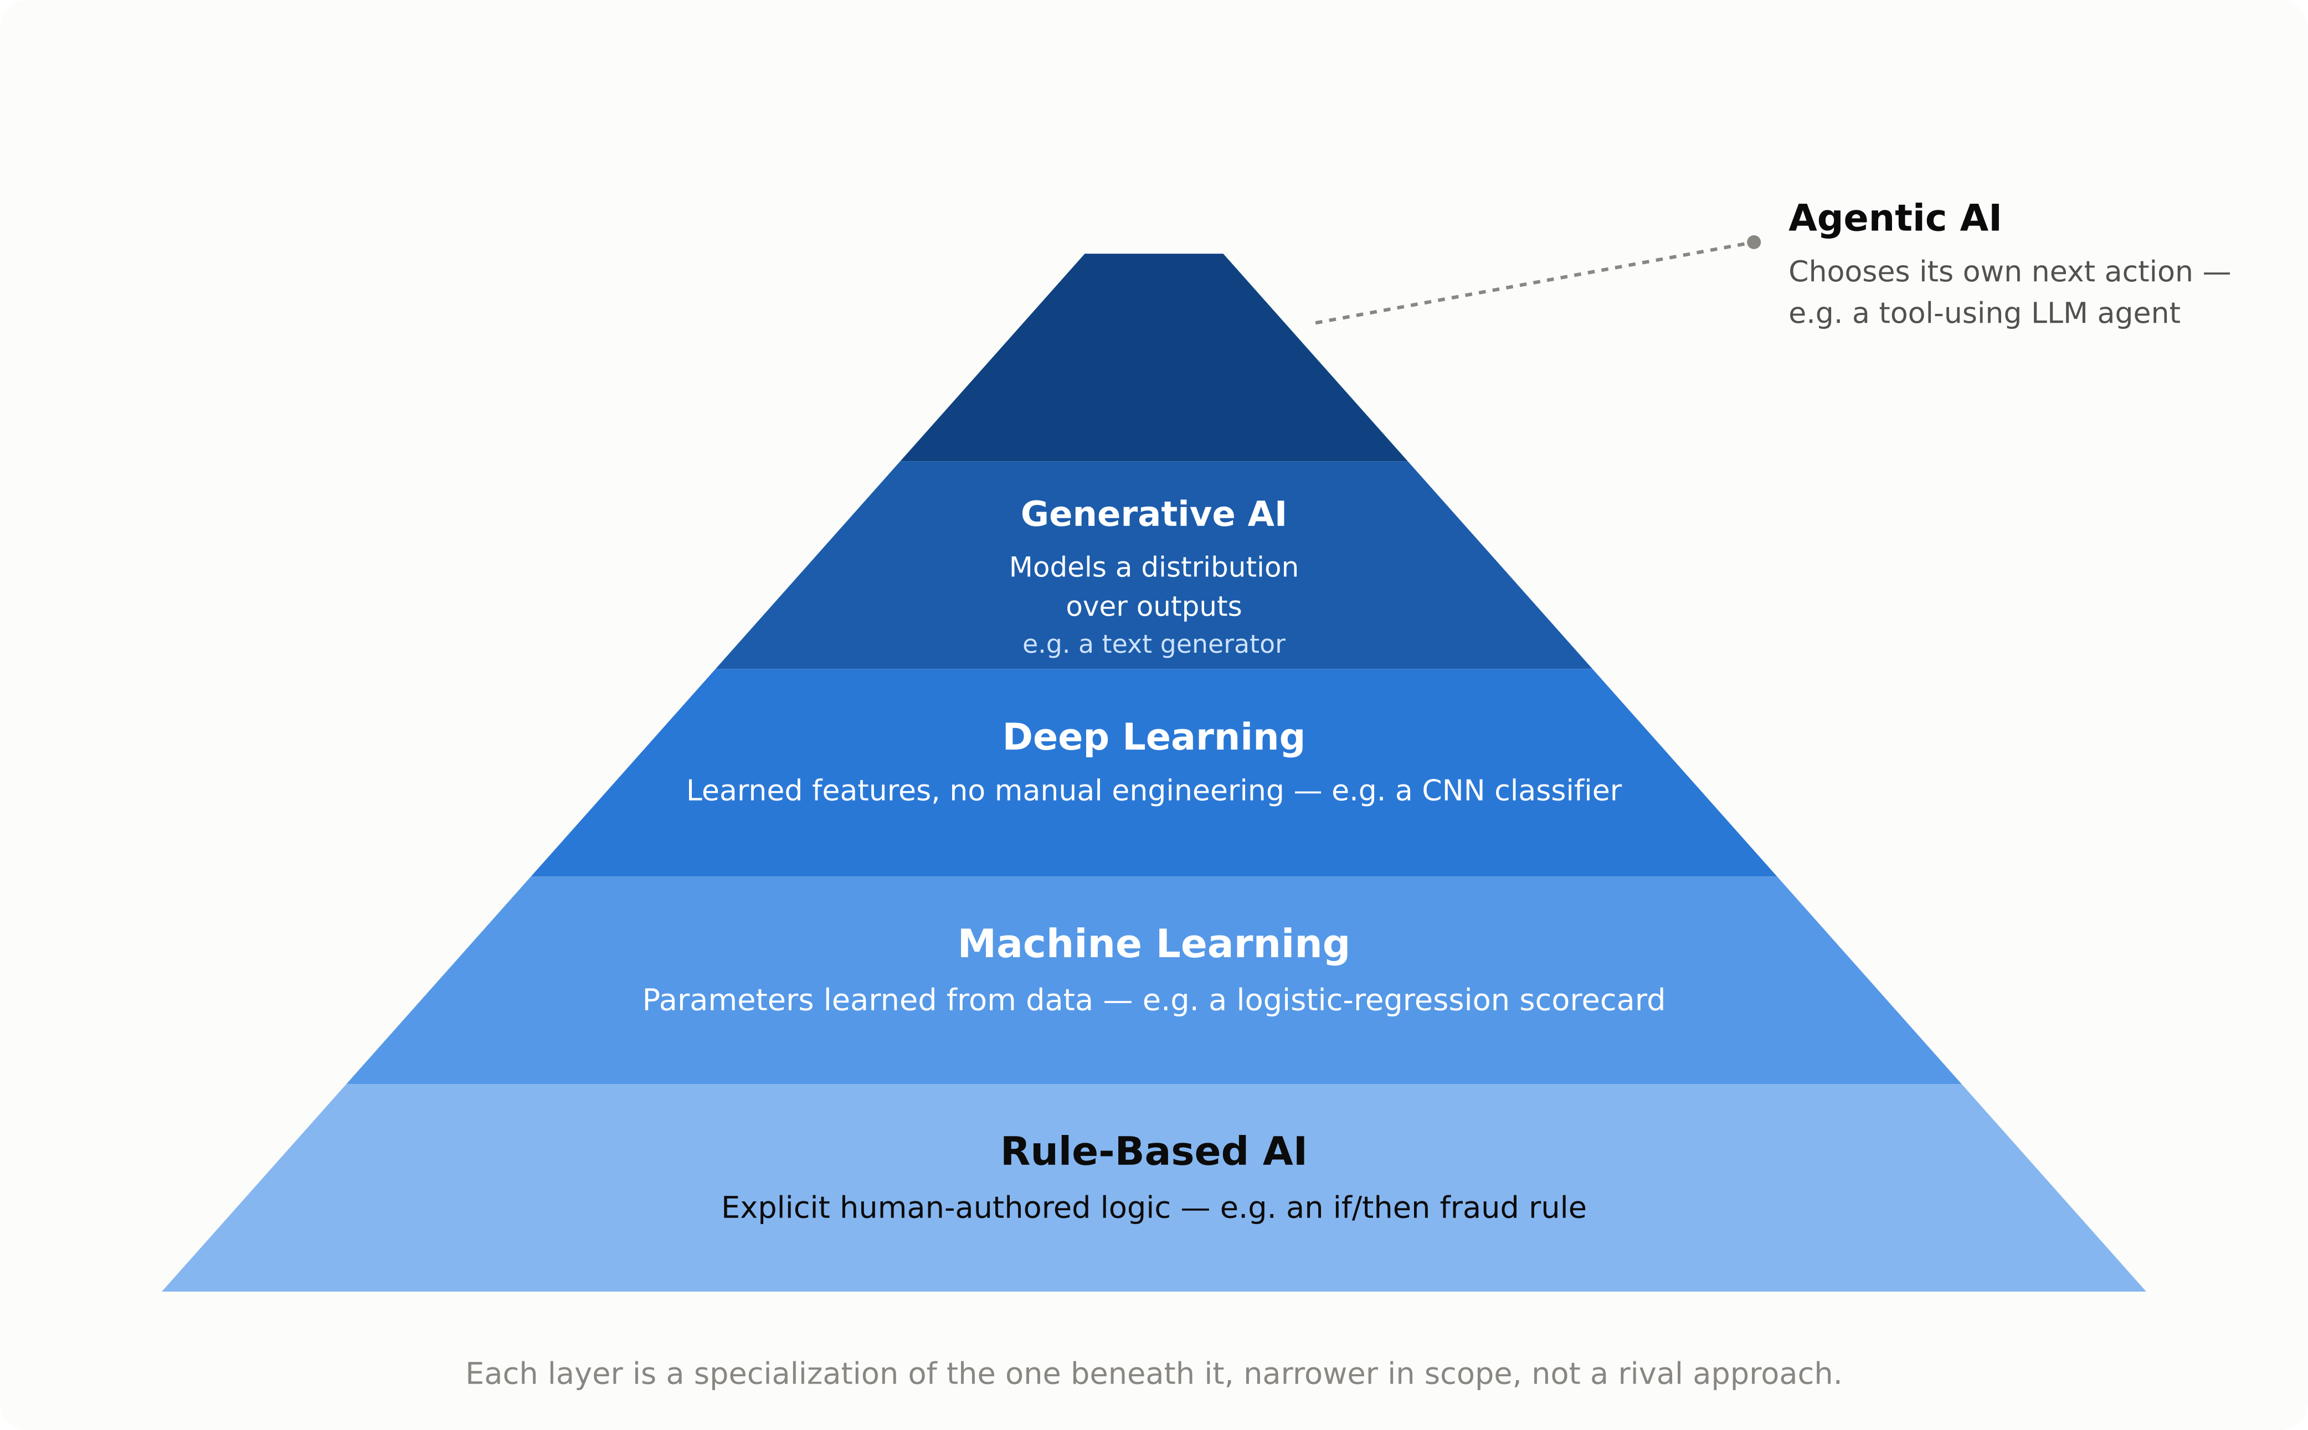
HIGH-LEVEL
The Five-Layer Pyramid
1.2 · Phase 1 — AI & Machine Learning Foundations
4

Slide 5
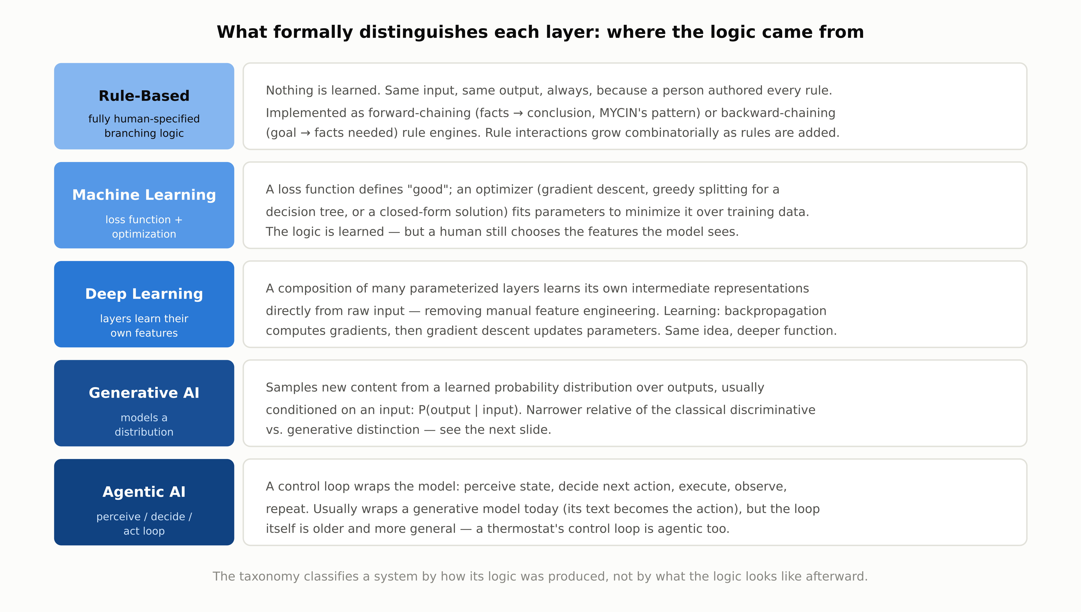
DEEP-DIVE
What Formally Distinguishes Each Layer
1.2 · Phase 1 — AI & Machine Learning Foundations
5

Slide 6
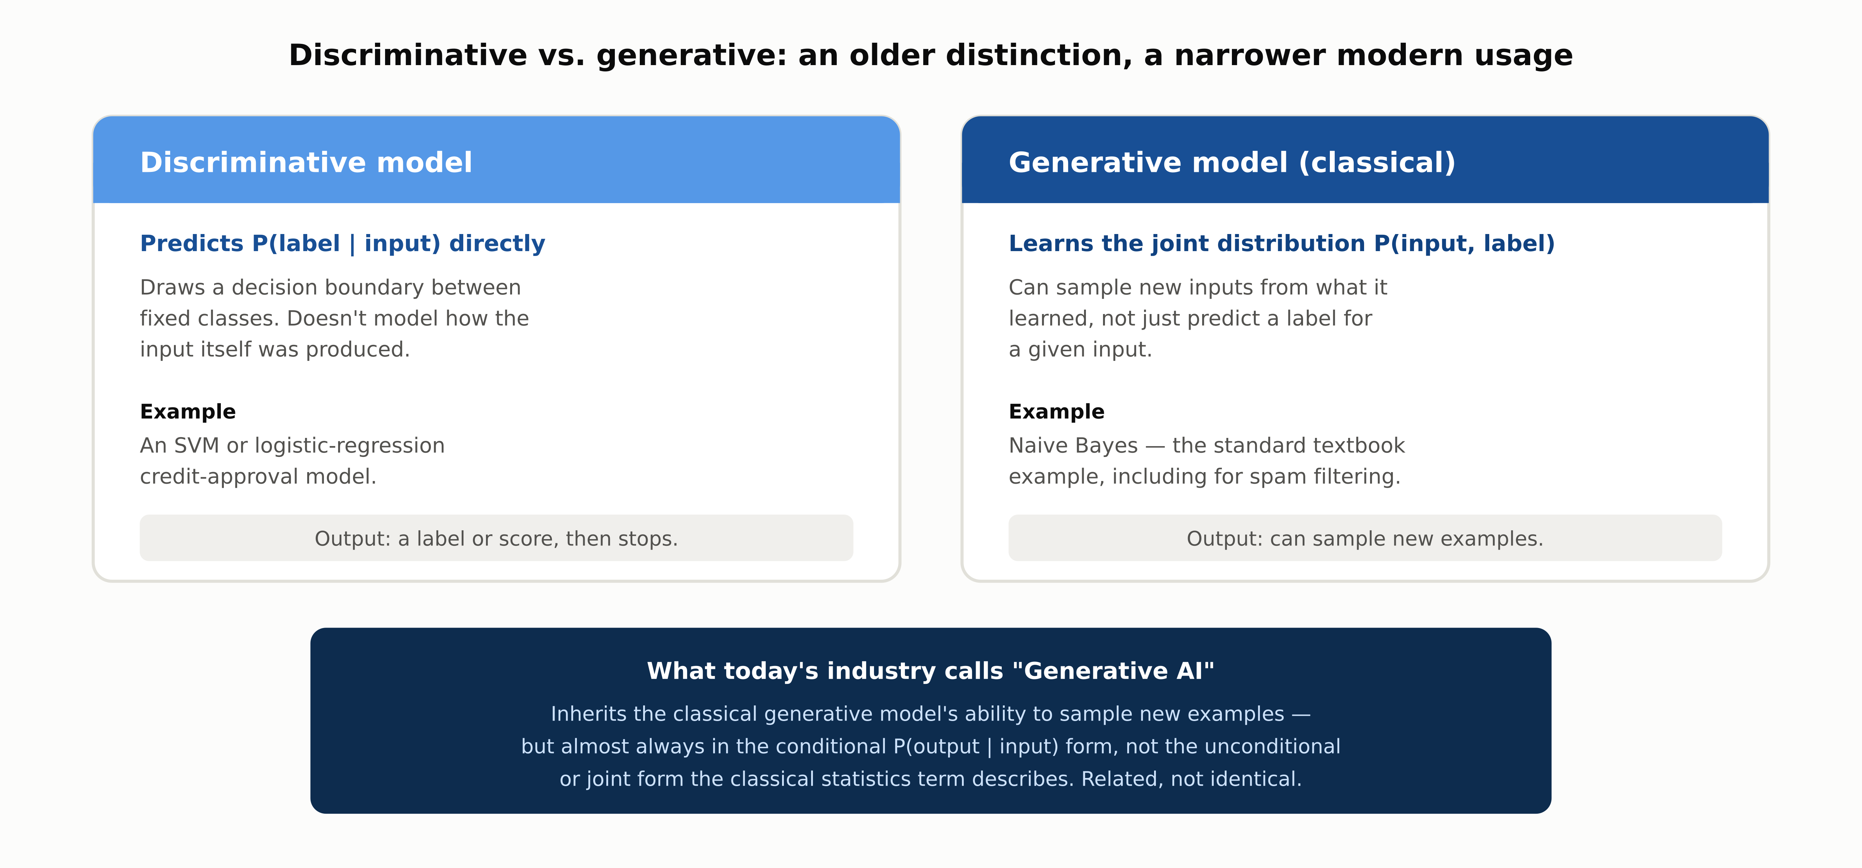
DEEP-DIVE
Discriminative vs. Generative
1.2 · Phase 1 — AI & Machine Learning Foundations
6

Slide 7
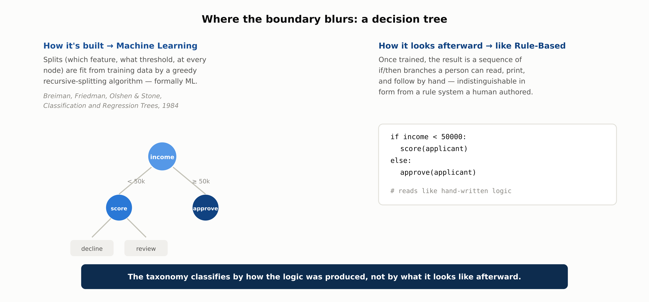
WHERE THE BOUNDARY BLURS
A Decision Tree: ML to Build, Rules to Read
1.2 · Phase 1 — AI & Machine Learning Foundations
7

Slide 8
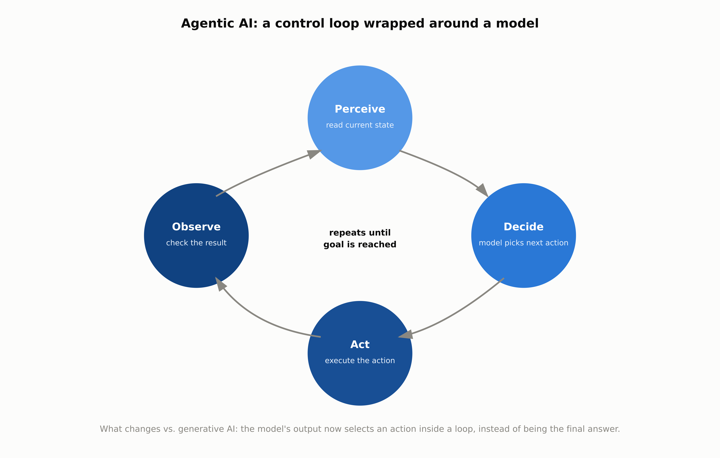
WHERE THE BOUNDARY BLURS
Agentic AI Is a Control Loop, Not a New Model
1.2 · Phase 1 — AI & Machine Learning Foundations
8

Slide 9
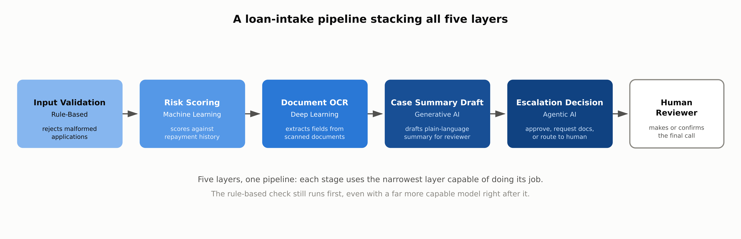
REFERENCE ARCHITECTURE
A Loan-Intake Pipeline, All Five Layers
1.2 · Phase 1 — AI & Machine Learning Foundations
9

Slide 10
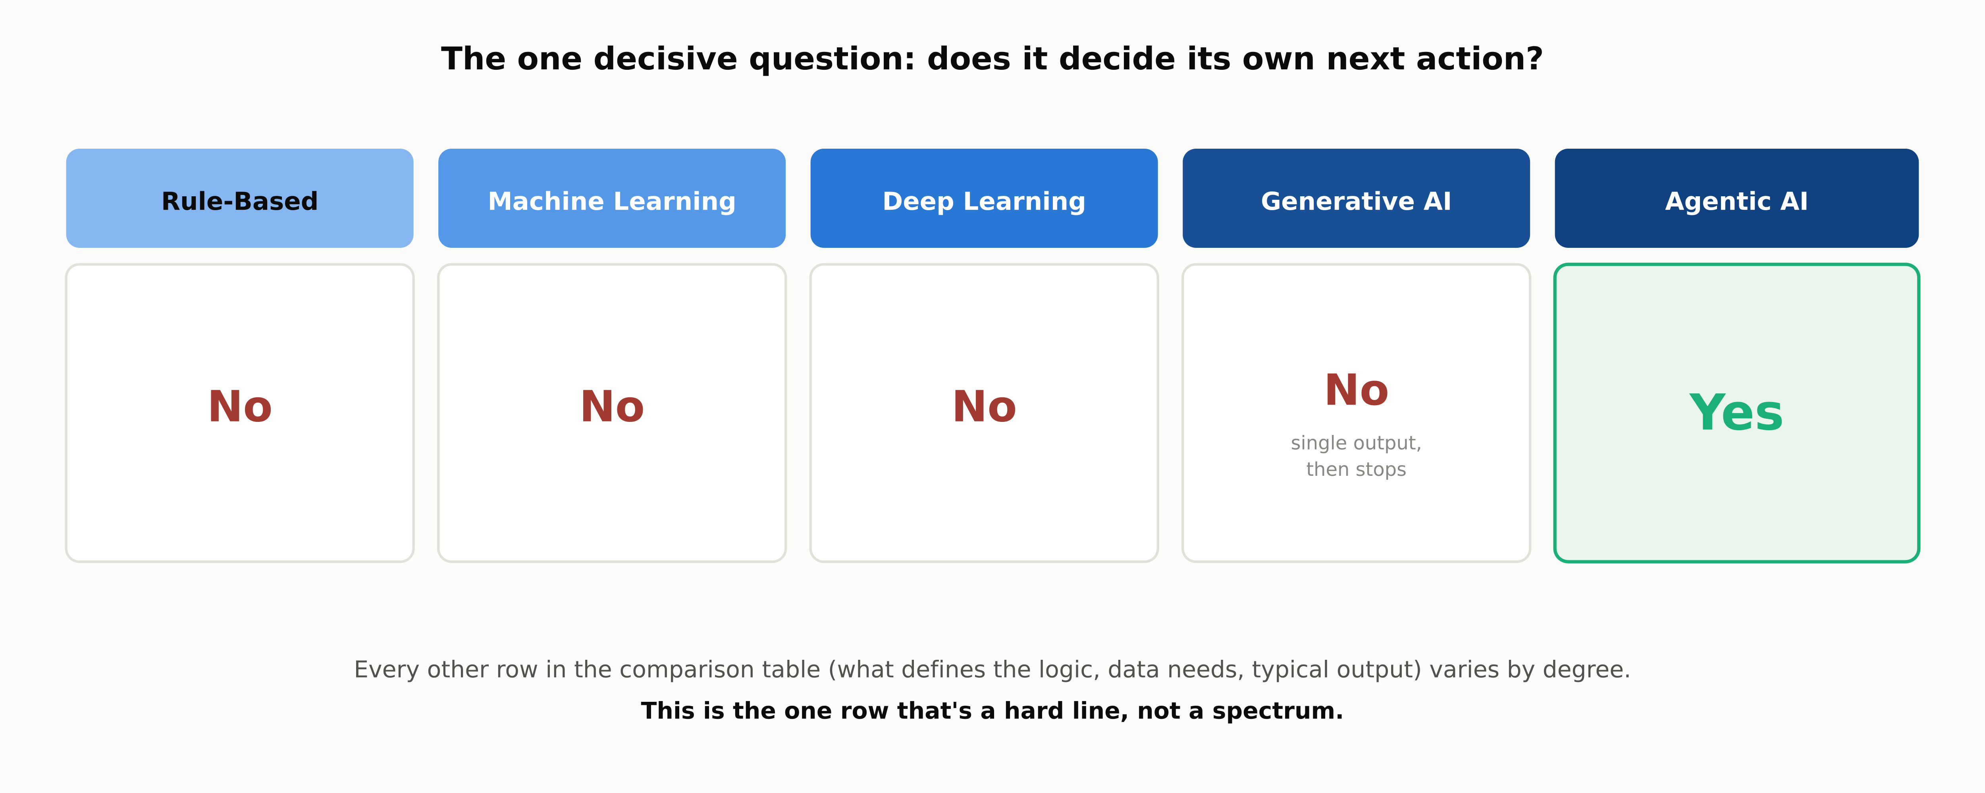
COMPARISON
The One Decisive Question
1.2 · Phase 1 — AI & Machine Learning Foundations
10

Slide 11
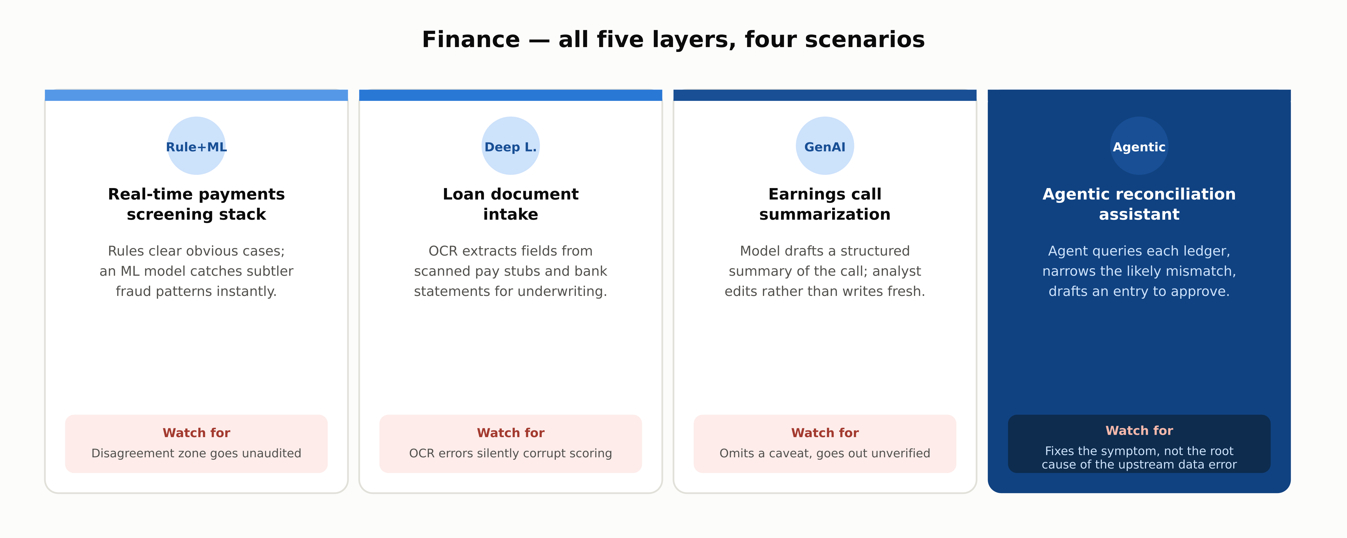
INDUSTRY USE CASES · 1 OF 3
Finance
1.2 · Phase 1 — AI & Machine Learning Foundations
11

Slide 12
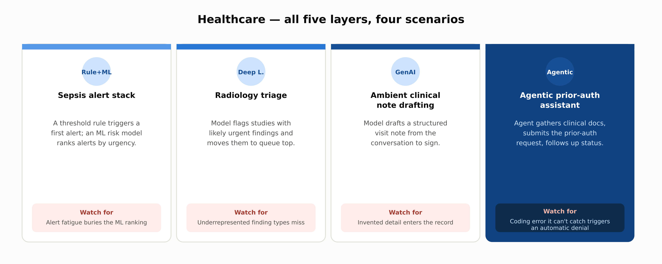
INDUSTRY USE CASES · 2 OF 3
Healthcare
1.2 · Phase 1 — AI & Machine Learning Foundations
12

Slide 13

INDUSTRY USE CASES · 3 OF 3
Telecom
1.2 · Phase 1 — AI & Machine Learning Foundations
13

Slide 14
DISCUSS AS A CLASS
Check Your Understanding
Q1
A decision tree learns its splits from data, but its output looks like a hand-written if/then rule set. Which layer does it belong to, and why?
Q2
Why is deep learning described as a subset of machine learning rather than a separate category?
Q3
A company fine-tunes a deep learning model to sort tickets into ten fixed categories. Is this generative AI?
Q4
What is the one property that separates agentic AI from generative AI?
Q5
Why does the rule-based input-validation step still exist next to a far more capable ML model?
Answers are in the speaker notes for this slide.
1.2 · Phase 1 — AI & Machine Learning Foundations
14
Notes:
Q1: A decision tree learns its splits from data, but its output looks like a hand-written if/then rule set. Which layer does it belong to, and why? A1: Machine learning. The taxonomy classifies a system by how its logic was produced, not by what it looks like afterward — the splits are fit from data by an algorithm. Q2: Why is deep learning described as a subset of machine learning rather than a separate category? A2: Because deep learning uses the same underlying idea (parameters fit to minimize a loss via gradient-based optimization) and only narrows it further, to models that also learn their own feature representations. Q3: A company fine-tunes a deep learning model to sort tickets into ten fixed categories. Is this generative AI? A3: No. It's a deep-learning discriminative model: it draws a boundary between ten known classes rather than modeling a distribution it can sample new content from. Q4: What is the one property that separates agentic AI from generative AI? A4: Whether the system decides its own next action. A generative model produces one output and stops; an agentic system wraps a model in a perceive/decide/act loop. Q5: Why does the rule-based input-validation step still exist next to a far more capable ML model? A5: A narrower, more general-purpose layer is often cheaper and more reliable for what it's good at: catching a malformed input with one line of logic doesn't need a trained model.

Slide 15
COMPARISON & RELATED CONCEPTS
Five Layers Side by Side
 | Rule-Based | Machine Learning | Deep Learning | Generative AI | Agentic AI
Decides own next action? | No | No | No | No (stops) | Yes
Data requirement | None | Moderate | Large | Large, varies | Inherits base model
Typical output | Fixed decision | Label or score | Label / embedding | New content | Sequence of actions
Each column is a narrower specialization of the one to its left, not a competing option. Most production systems use several columns together.
1.2 · Phase 1 — AI & Machine Learning Foundations
15

Slide 16
SUMMARY
Key Takeaways
✓
Five layers, each a narrower specialization of the one below it, not five rival technologies.
✓
The taxonomy classifies by how the logic was produced, not by what it looks like afterward.
✓
"Generative AI" narrows the classical generative-model idea to the conditional P(output | input) case.
✓
Agentic AI wraps a control loop around a model; today that model is usually generative, but the loop itself is older and more general.
✓
The decisive question across all five layers: does the system decide its own next action?
1.2 · Phase 1 — AI & Machine Learning Foundations
16

Slide 17
FURTHER READING
Sources Cited in This Chapter
Breiman, Friedman, Olshen & Stone (1984)
Classification and Regression Trees — routledge.com
Ng & Jordan, discriminative vs. generative classifiers
classical statistics background, NeurIPS
Chapter 1.1
docs/01-ai-ml-foundations/1-1-what-is-ai.mdx
Glossary: Agent, Discriminative / Generative model
docs/00-orientation/0-5-glossary-notation-conventions.md
Phase 8 (8.1–8.3)
the full agent control-loop treatment
Full chapter with inline links: docs/01-ai-ml-foundations/1-2-taxonomy-of-ai.mdx
1.2 · Phase 1 — AI & Machine Learning Foundations
17

