Slide 1
Phase 2 — Deep Learning Foundations
Deep Learning Frameworks Compared: PyTorch, TensorFlow, and JAX
Automatic differentiation, execution models, and how PyTorch, TensorFlow, and JAX each mechanize the chain rule
Chapter 2.7

Slide 2
Agenda
01 | TL;DR
02 | High-Level: the shared training loop every framework implements
03 | Deep-Dive: reverse-mode autodiff, PyTorch, TensorFlow, and JAX
04 | Comparison & Related Concepts
05 | Reference Architecture: forward, loss, backward, optimizer step
06 | Industry Use Cases (Finance, Healthcare, Telecom)
07 | Check Your Understanding
RegAITraining · Chapter 2.7
2 / 15

Slide 3
TL;DR
Every network in this phase, from a two-layer MLP to a full Transformer, needs to be implemented, trained on real hardware, and have its gradients computed correctly.
A deep learning framework provides automatic differentiation, GPU-accelerated tensor operations, and pre-built layers and optimizers.
PyTorch runs eagerly and made itself the default in research; TensorFlow runs eagerly by default but keeps strong graph-compilation and deployment tooling; JAX takes a functional approach with composable transformations.
All three exist to do the same underlying job: mechanize the chain rule so nobody has to re-derive backpropagation by hand for every new architecture.
RegAITraining · Chapter 2.7
3 / 15

Slide 4
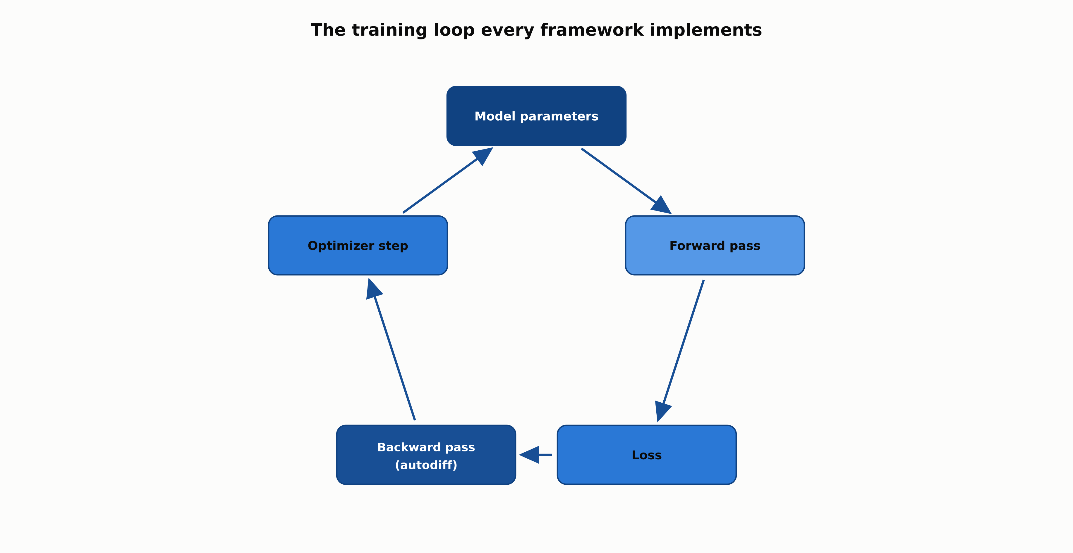
The training loop every framework implements
All three frameworks implement the same loop; they differ in execution model, not in the underlying math.
RegAITraining · Chapter 2.7
4 / 15

Slide 5
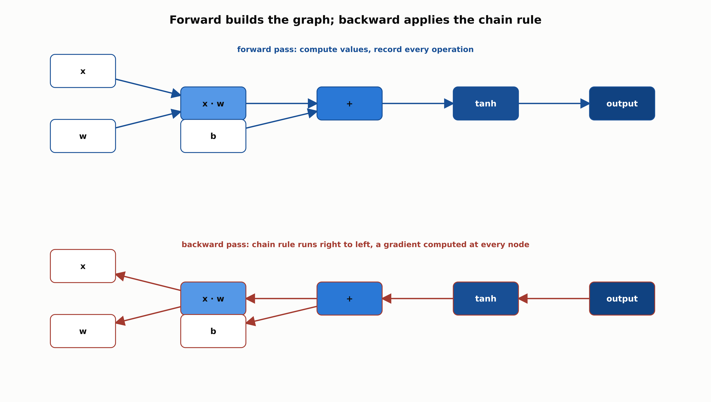
Forward builds the graph; backward applies the chain rule
Reverse-mode automatic differentiation walks the recorded computation graph backward, computing a gradient at every node.
RegAITraining · Chapter 2.7
5 / 15

Slide 6
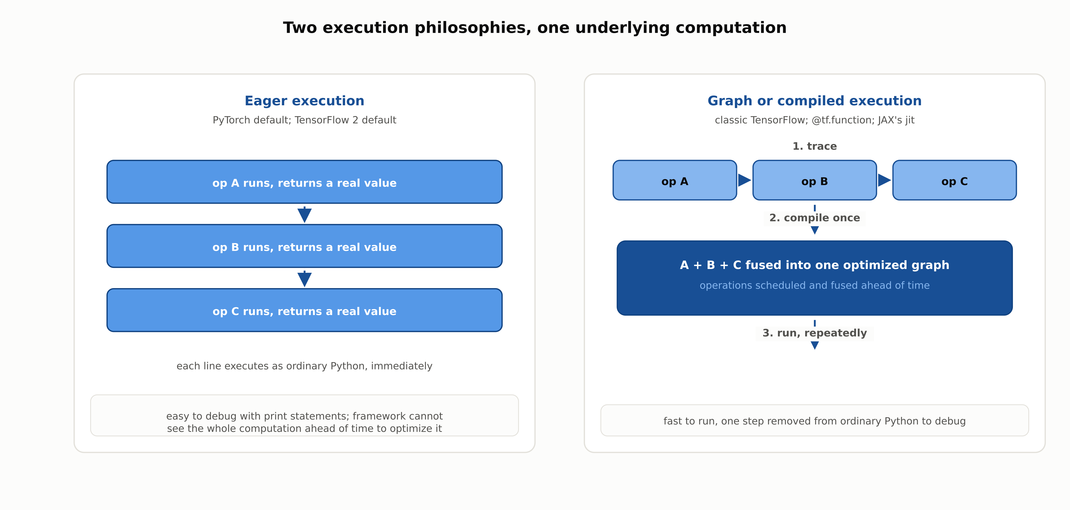
Two execution philosophies, one underlying computation
Eager execution runs each step immediately; graph or compiled execution traces first, then runs the fused result repeatedly.
RegAITraining · Chapter 2.7
6 / 15

Slide 7
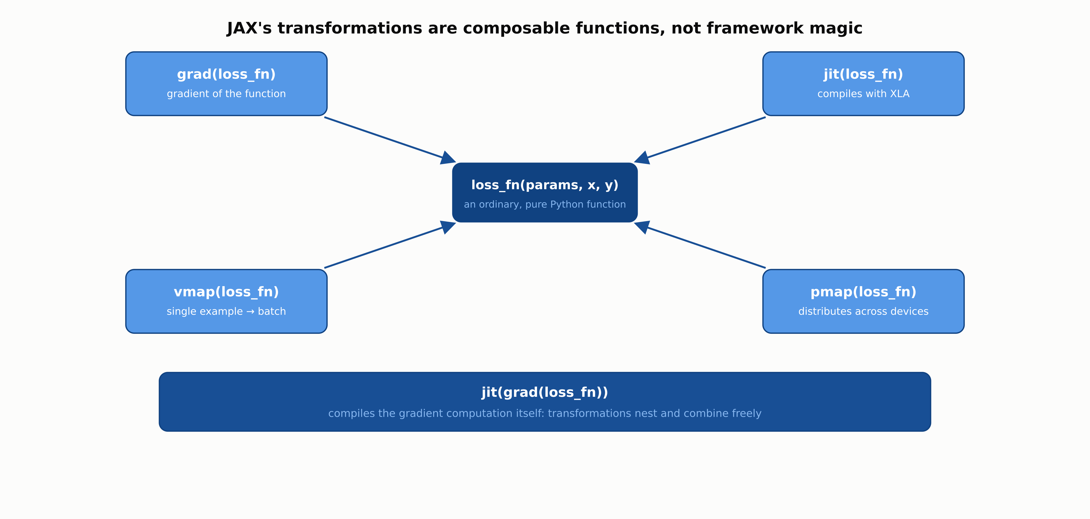
JAX's transformations are composable functions
grad, jit, vmap, and pmap can be layered on the same function, and nest freely.
RegAITraining · Chapter 2.7
7 / 15

Slide 8
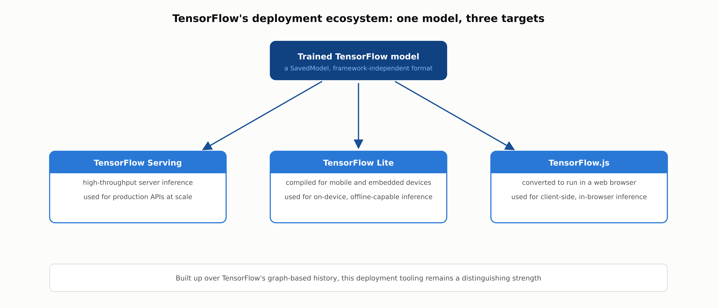
TensorFlow's deployment ecosystem: one model, three targets
Built up over TensorFlow's graph-based history, this deployment tooling remains a distinguishing strength.
RegAITraining · Chapter 2.7
8 / 15

Slide 9
Comparison & Related Concepts
Aspect | PyTorch | TensorFlow | JAX
Default execution model | Eager (dynamic graph each forward pass) | Eager by default; @tf.function compiles a graph | Functional; jit compiles ahead of time
Debugging experience | Ordinary Python, easy to step through | Easy in eager mode; harder inside a compiled graph | Easy outside jit; harder once jit-compiled
Built-in layers/model objects | Yes: nn.Module | Yes: Keras | No: provided by libraries built on JAX (e.g. Flax)
Primary strength | Research iteration speed and debuggability | Production deployment tooling (Serving, Lite, .js) | Composable transformations for custom, large-scale training
All three mechanize the same chain rule from chapter 2.2; the differences are in execution model, ecosystem, and how much structure the framework itself provides versus leaves to add-on libraries.
RegAITraining · Chapter 2.7
9 / 15

Slide 10
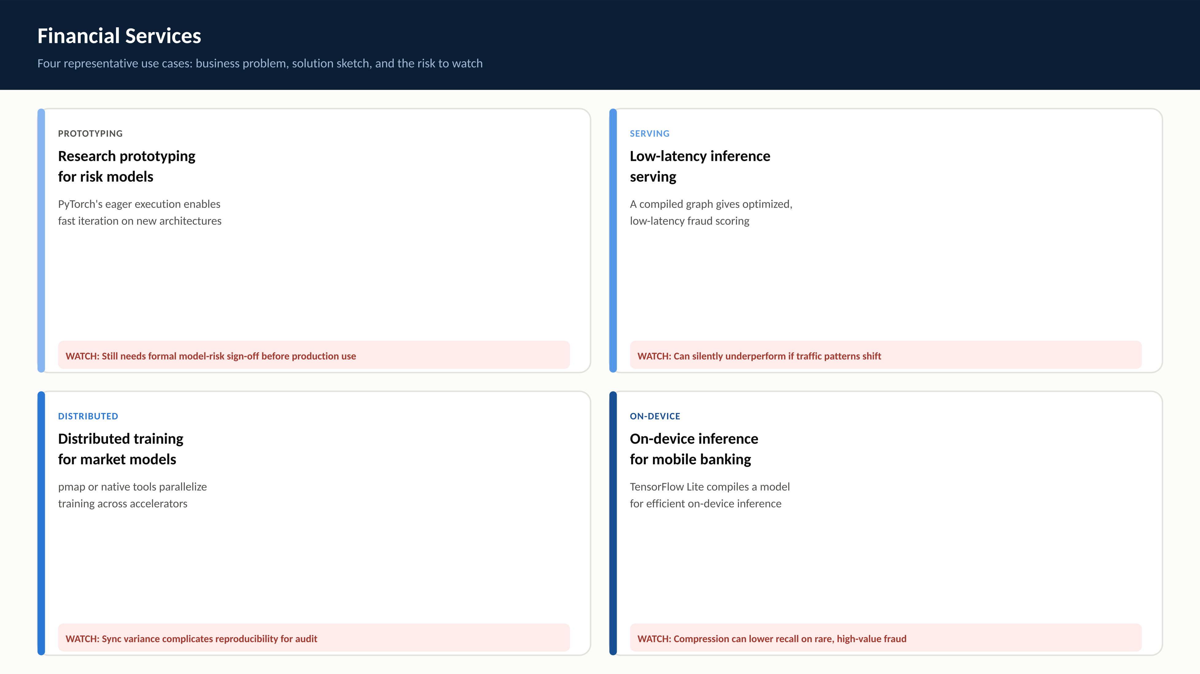
RegAITraining · Chapter 2.7
10 / 15

Slide 11
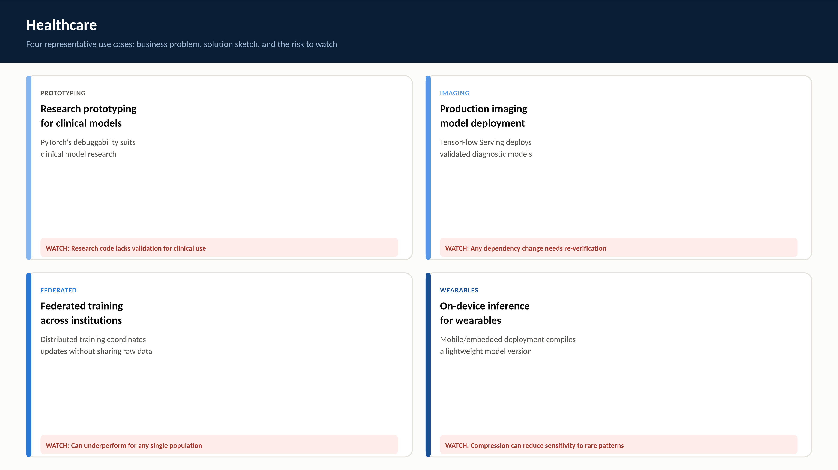
RegAITraining · Chapter 2.7
11 / 15

Slide 12
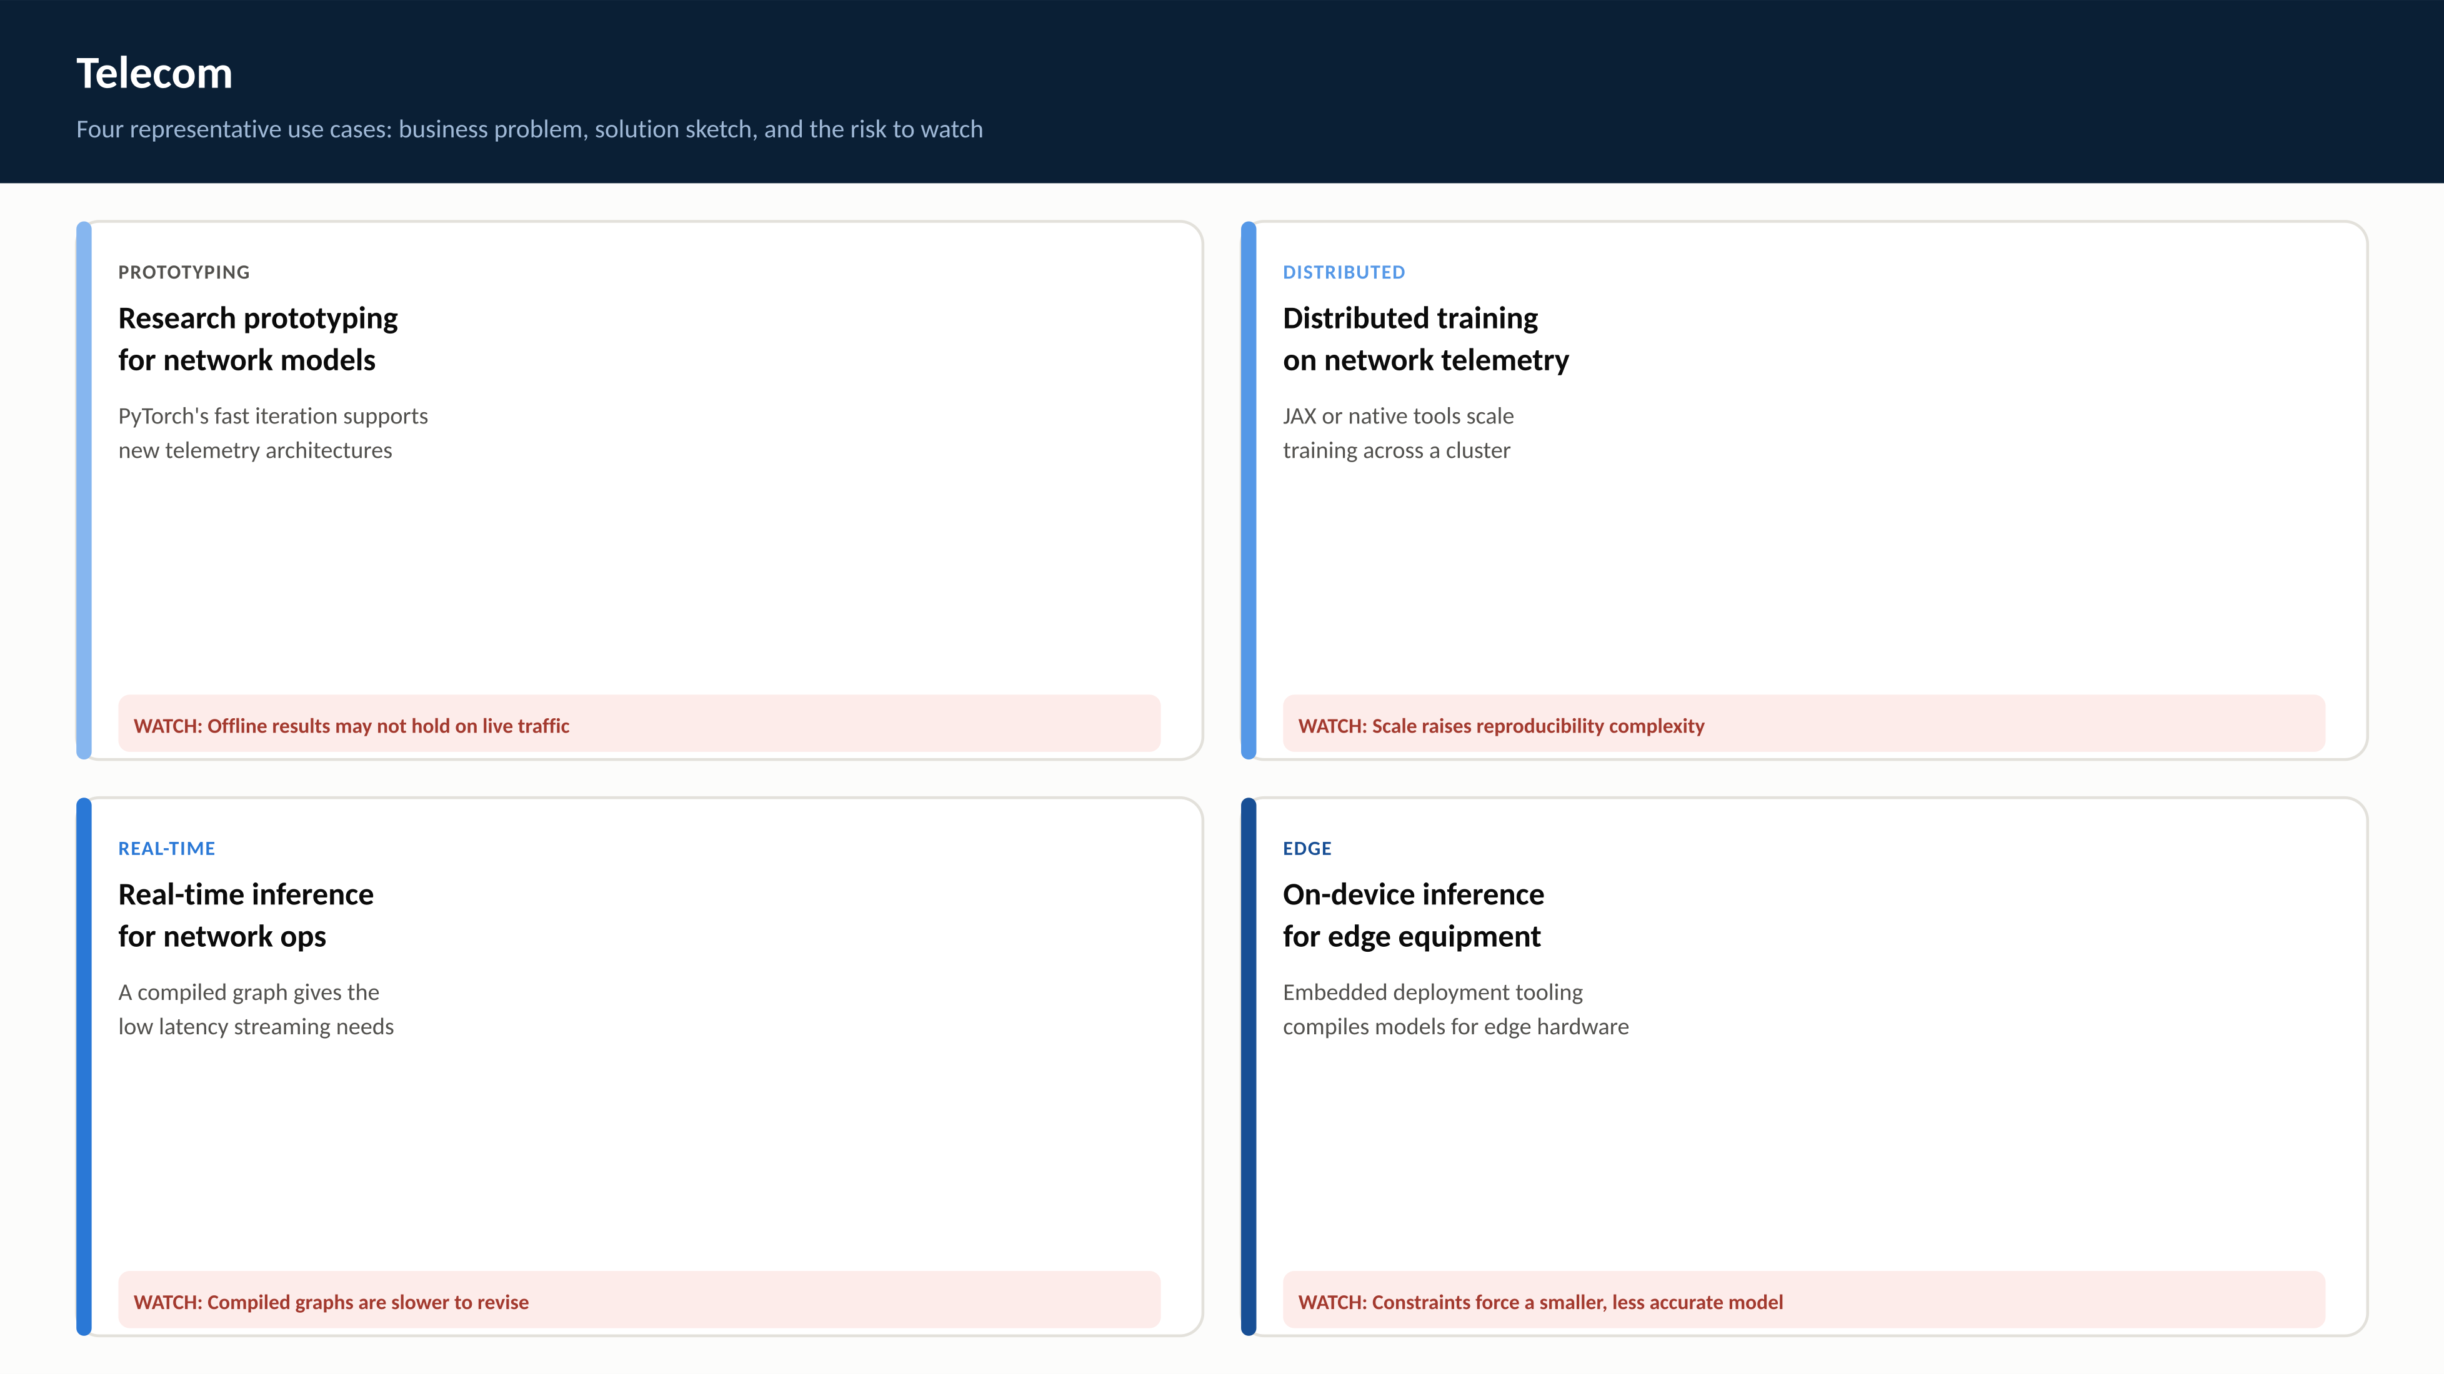
RegAITraining · Chapter 2.7
12 / 15

Slide 13
Check Your Understanding
1. What problem does automatic differentiation solve, and how does it relate to the backpropagation chapter 2.2 introduced?
2. What is the key difference between PyTorch's and classic TensorFlow's approach to building a computation graph?
3. What does it mean that JAX's function transformations compose, and why does this matter?
4. What is the practical tradeoff between eager execution and graph/compiled execution?
5. Why might a team choose TensorFlow over PyTorch or JAX for a specific project, given all three implement the same underlying training loop?
RegAITraining · Chapter 2.7
13 / 15
Notes:
Q1: What problem does automatic differentiation solve, and how does it relate to the backpropagation chapter 2.2 introduced? A1: Automatic differentiation mechanizes the chain rule so gradients for arbitrary differentiable code can be computed without hand-deriving them for every new architecture. It is a direct, generalized implementation of the same backpropagation chapter 2.2 walked through by hand for a small MLP, extended to work over any computation graph shape rather than a fixed sequence of layers. Q2: What is the key difference between PyTorch's and classic TensorFlow's approach to building a computation graph? A2: PyTorch builds its computation graph dynamically: each forward pass records the actual sequence of operations Python executes, including data-dependent control flow. Classic TensorFlow required defining a static computation graph up front and running it in a separate session, which enabled aggressive optimization and deployment but made step-by-step debugging harder. Q3: What does it mean that JAX's function transformations compose, and why does this matter? A3: JAX transformations like grad, jit, vmap, and pmap can be layered on top of each other, for example compiling the gradient computation itself with jit(grad(loss_fn)). This matters because it lets researchers build custom training procedures beyond a standard forward-loss-backward-step loop without needing framework-specific escape hatches. Q4: What is the practical tradeoff between eager execution and graph/compiled execution? A4: Eager execution runs each operation immediately as ordinary Python, making debugging straightforward at some cost to raw speed, since the framework cannot see the whole computation ahead of time to optimize it. Graph or compiled execution traces or compiles the computation before running it, allowing operations to be fused and scheduled efficiently, at the cost of a compilation step and a debugging experience one step removed from ordinary Python. Q5: Why might a team choose TensorFlow over PyTorch or JAX for a specific project, given all three implement the same underlying training loop? A5: TensorFlow's deployment ecosystem, including TensorFlow Serving for servers, TensorFlow Lite for mobile and embedded devices, and TensorFlow.js for browsers, is a distinguishing strength built up over its graph-based history. A team prioritizing a well-supported path to production deployment across many target environments might choose TensorFlow even though PyTorch or JAX could implement the same model.

Slide 14
Key Takeaways
A deep learning framework provides automatic differentiation, GPU-accelerated tensors, and pre-built layers and optimizers, mechanizing the chain rule from chapter 2.2.
Reverse-mode autodiff walks a recorded computation graph backward, computing a vector-Jacobian product at every node.
PyTorch builds its graph dynamically each forward pass, favoring debuggability; classic TensorFlow compiled a static graph up front, favoring optimization and deployment; TensorFlow 2 now runs eagerly by default with @tf.function available for compilation.
JAX takes a functional approach with composable transformations, grad, jit, vmap, and pmap, that nest freely, at the cost of having no built-in notion of a layer or model object.
Eager execution favors debuggability; graph or compiled execution favors raw speed once debugging is done, a tradeoff every framework offers in some form.
RegAITraining · Chapter 2.7
14 / 15

Slide 15
Sources
Paszke, A., et al. (2019). PyTorch: An Imperative Style, High-Performance Deep Learning Library. NeurIPS. — https://arxiv.org/abs/1912.01703
Abadi, M., et al. (2016). TensorFlow: A System for Large-Scale Machine Learning. OSDI. — https://www.usenix.org/conference/osdi16/technical-sessions/presentation/abadi
Frostig, R., Johnson, M., and Leary, C. (2018). Compiling Machine Learning Programs via High-Level Tracing. SysML. — https://cs.stanford.edu/~rfrostig/pubs/jax-mlsys2018.pdf
RegAITraining · Chapter 2.7
15 / 15

