Slide 1
Phase 2 — Deep Learning Foundations
Hardware for AI: GPUs, TPUs, and Training vs. Inference Compute Economics
CPU vs. GPU vs. TPU architecture, mixed-precision training, the roofline model, and why inference cost usually dominates a model's lifetime compute cost
Chapter 2.8

Slide 2
Agenda
01 | TL;DR
02 | High-Level: why deep learning needs specialized hardware
03 | Deep-Dive: GPU and TPU architecture, the roofline model, training vs. inference economics
04 | Comparison & Related Concepts
05 | Reference Architecture: a training step across host and accelerator
06 | Industry Use Cases (Finance, Healthcare, Telecom)
07 | Check Your Understanding
RegAITraining · Chapter 2.8
2 / 15

Slide 3
TL;DR
Every framework in chapter 2.7 ultimately runs its forward pass, backward pass, and optimizer step as matrix multiplications on physical hardware.
GPUs became the default deep learning accelerator because thousands of simple parallel cores suit the same matrix operation repeated across many data points; modern GPUs add dedicated Tensor Cores for mixed-precision matrix multiply-accumulate.
TPUs are Google's custom ASICs, built around a systolic array purpose-designed for matrix multiplication, trading flexibility for efficiency.
Large-batch training tends to be compute-bound while small-batch inference tends to be memory-bandwidth-bound, and because inference runs continuously against live traffic, it typically dominates a widely-deployed model's total lifetime compute cost.
RegAITraining · Chapter 2.8
3 / 15

Slide 4
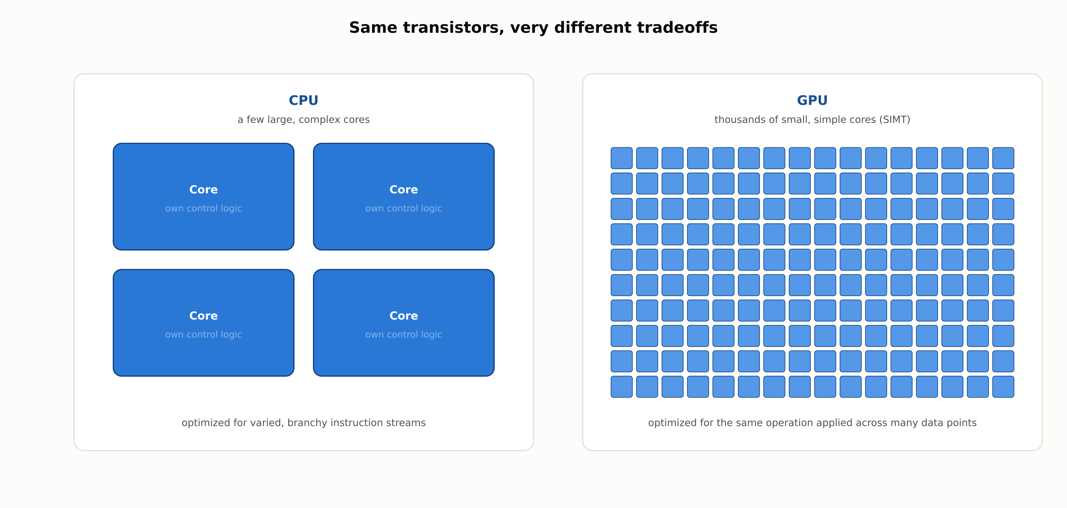
Same transistors, very different tradeoffs
A CPU optimizes for one complex instruction stream; a GPU optimizes for the same simple instruction applied to thousands of data points at once.
RegAITraining · Chapter 2.8
4 / 15

Slide 5
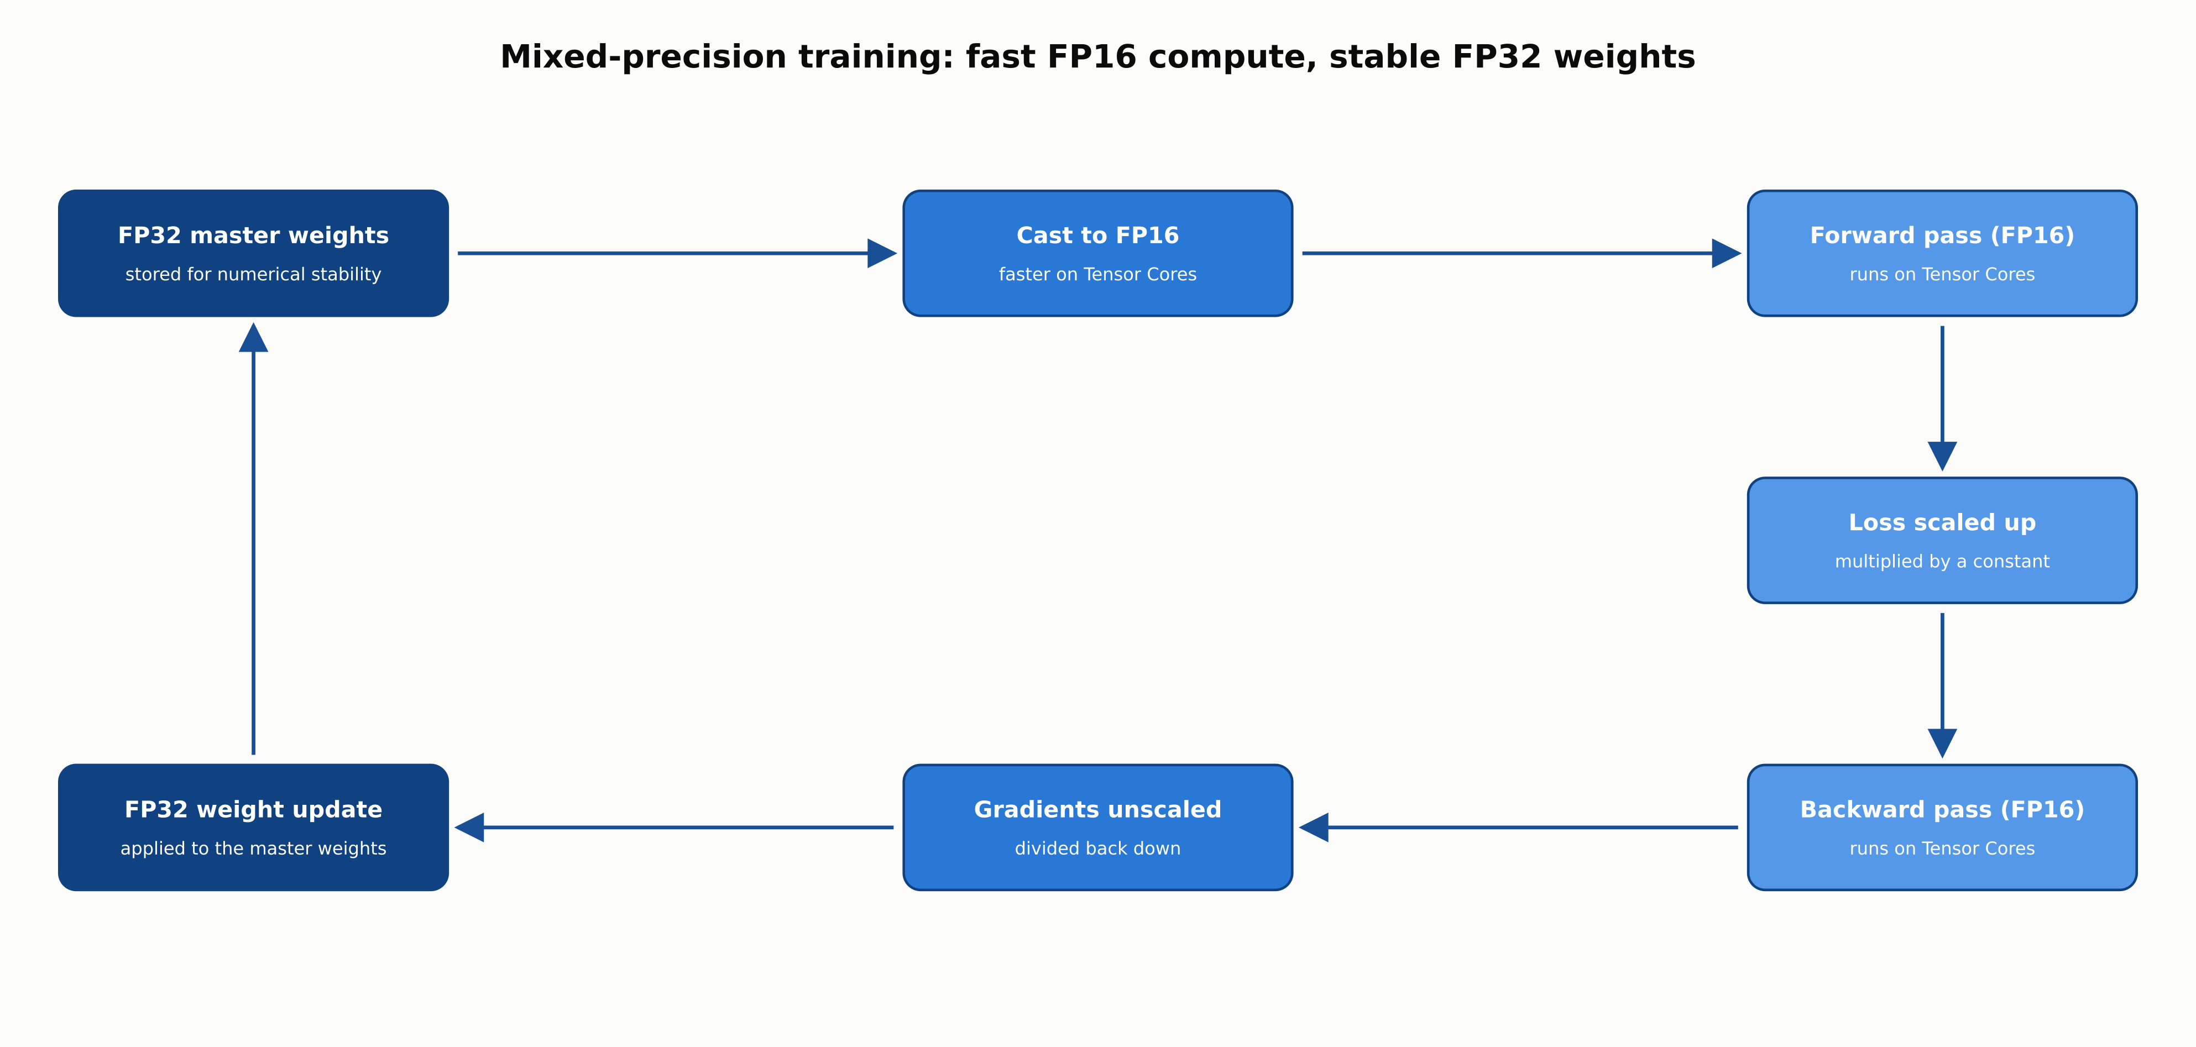
Mixed-precision training: fast FP16 compute, stable FP32 weights
FP32 master weights, FP16 forward and backward pass on Tensor Cores, and loss scaling to protect small gradients from underflowing.
RegAITraining · Chapter 2.8
5 / 15

Slide 6
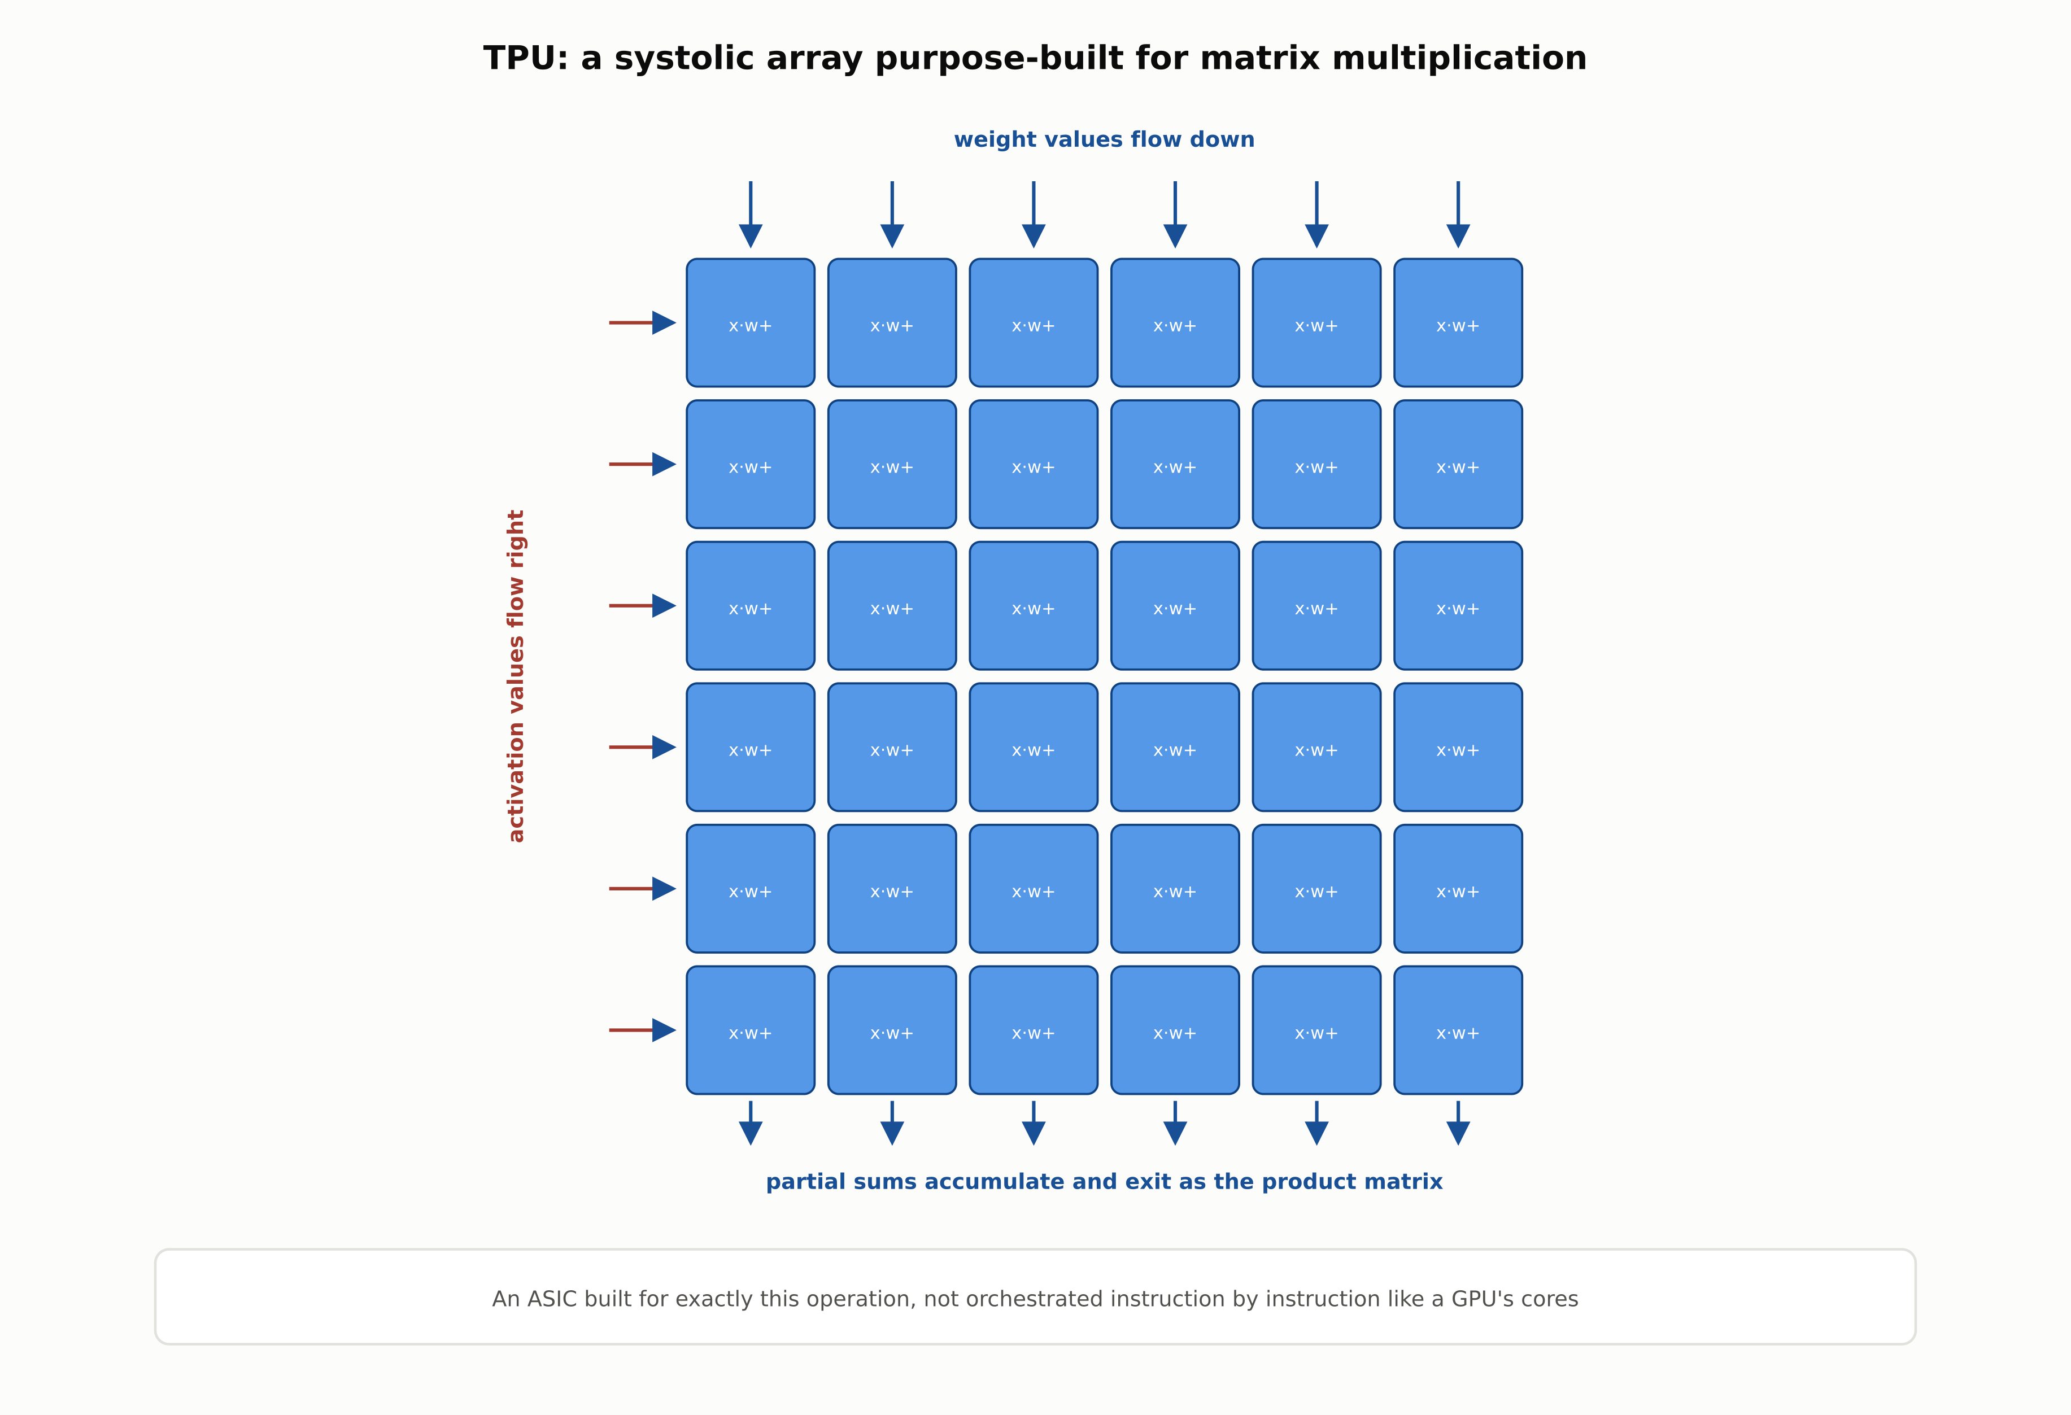
TPU: a systolic array purpose-built for matrix multiplication
An ASIC built for exactly this operation, not orchestrated instruction by instruction like a GPU's cores.
RegAITraining · Chapter 2.8
6 / 15

Slide 7
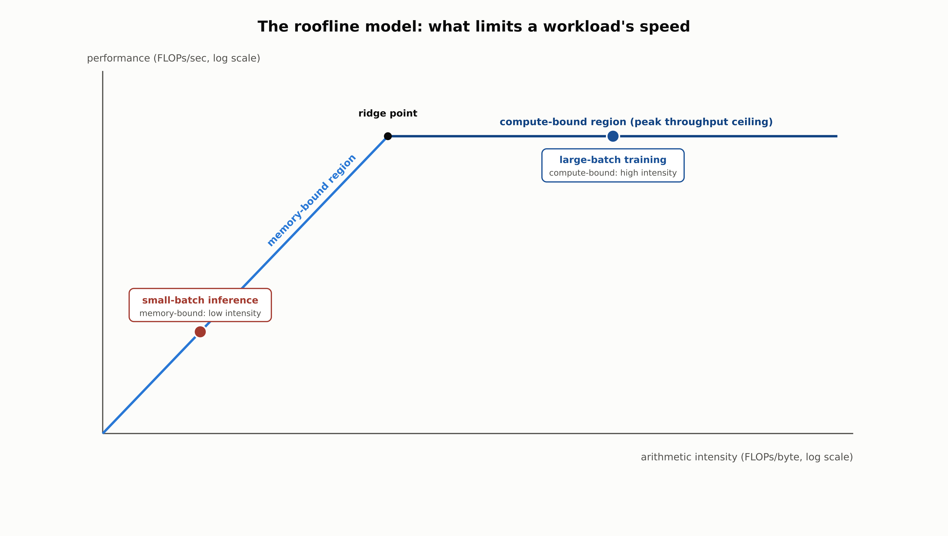
The roofline model: what limits a workload's speed
Small-batch inference sits in the memory-bound region; large-batch training sits near the compute-bound ceiling.
RegAITraining · Chapter 2.8
7 / 15

Slide 8
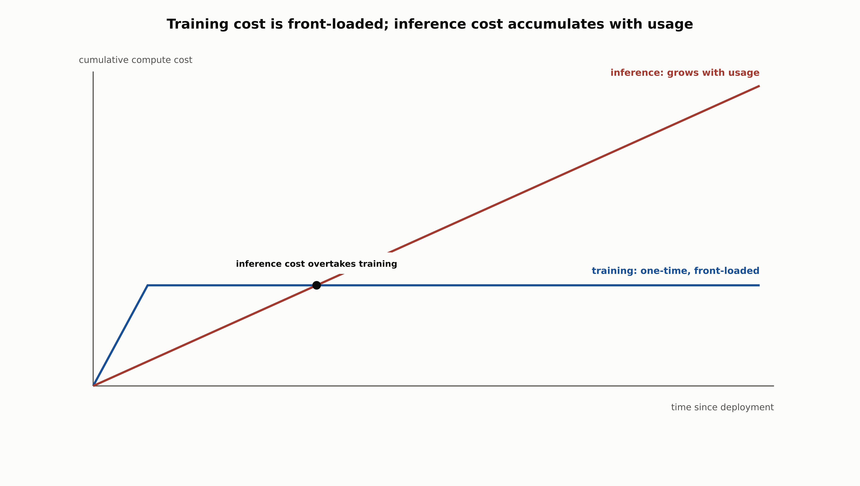
Training cost is front-loaded; inference cost accumulates with usage
Cumulative inference cost typically overtakes the one-time training cost once a model serves meaningful production traffic.
RegAITraining · Chapter 2.8
8 / 15

Slide 9
Comparison & Related Concepts
Aspect | CPU | GPU | TPU
Core design | Few complex cores, optimized for varied, branchy instruction streams | Thousands of simple cores executing one instruction across many data points (SIMT), plus dedicated Tensor Cores | A systolic array of processing elements purpose-built for matrix multiplication
Flexibility | General-purpose: runs any code well | General-purpose parallel: runs most deep learning workloads well | Purpose-built: highly efficient on matrix-multiply-heavy workloads, a poor fit otherwise
Typical role in a deep learning pipeline | Data loading, preprocessing, and orchestrating the accelerator | Default accelerator for both training and inference across most organizations | Large-scale training, especially on Google Cloud, tightly coupled to XLA
Best suited for | Control-flow-heavy, non-parallelizable code | The broadest range of training and inference workloads | Very large-scale, matrix-multiply-dominated training runs
Every deep learning workload eventually runs on one of these three; the right choice depends on how matrix-multiply-heavy the workload is and how much general-purpose flexibility it needs.
RegAITraining · Chapter 2.8
9 / 15

Slide 10
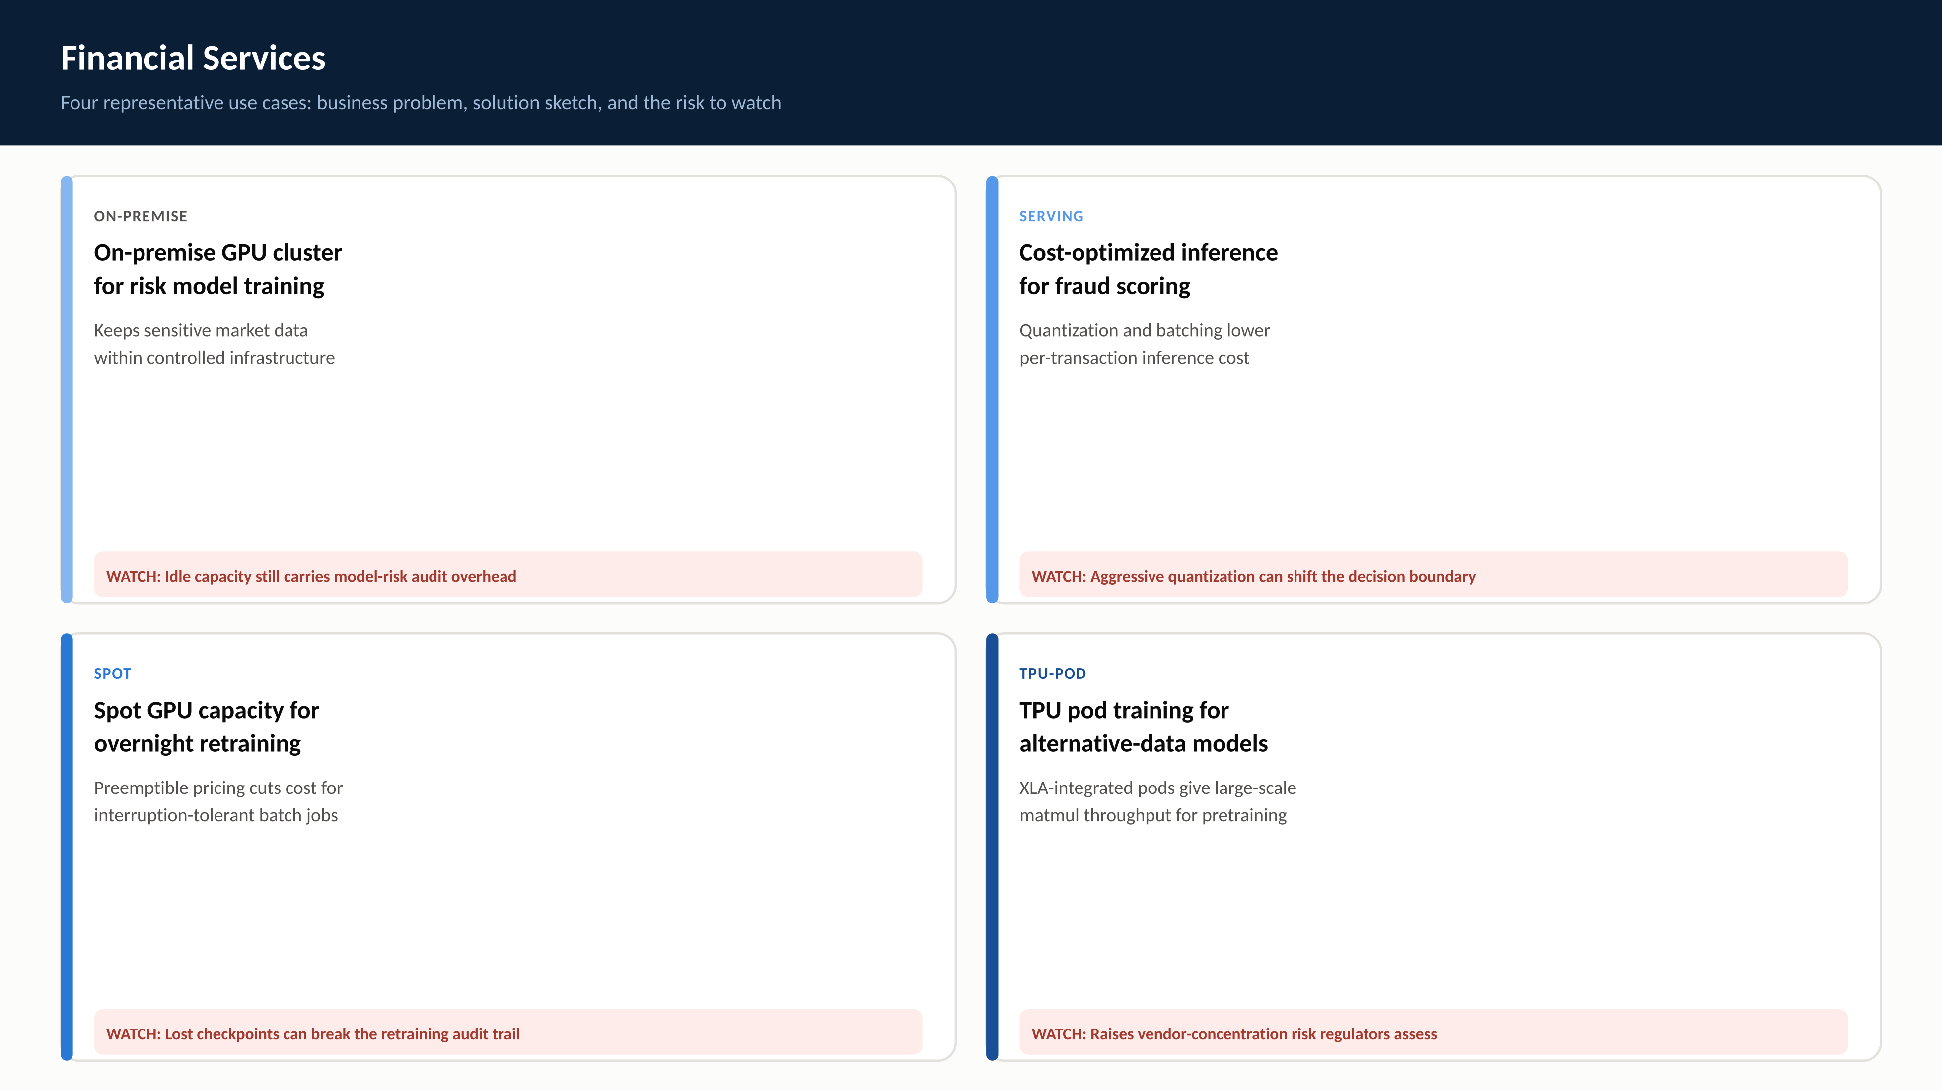
RegAITraining · Chapter 2.8
10 / 15

Slide 11

RegAITraining · Chapter 2.8
11 / 15

Slide 12
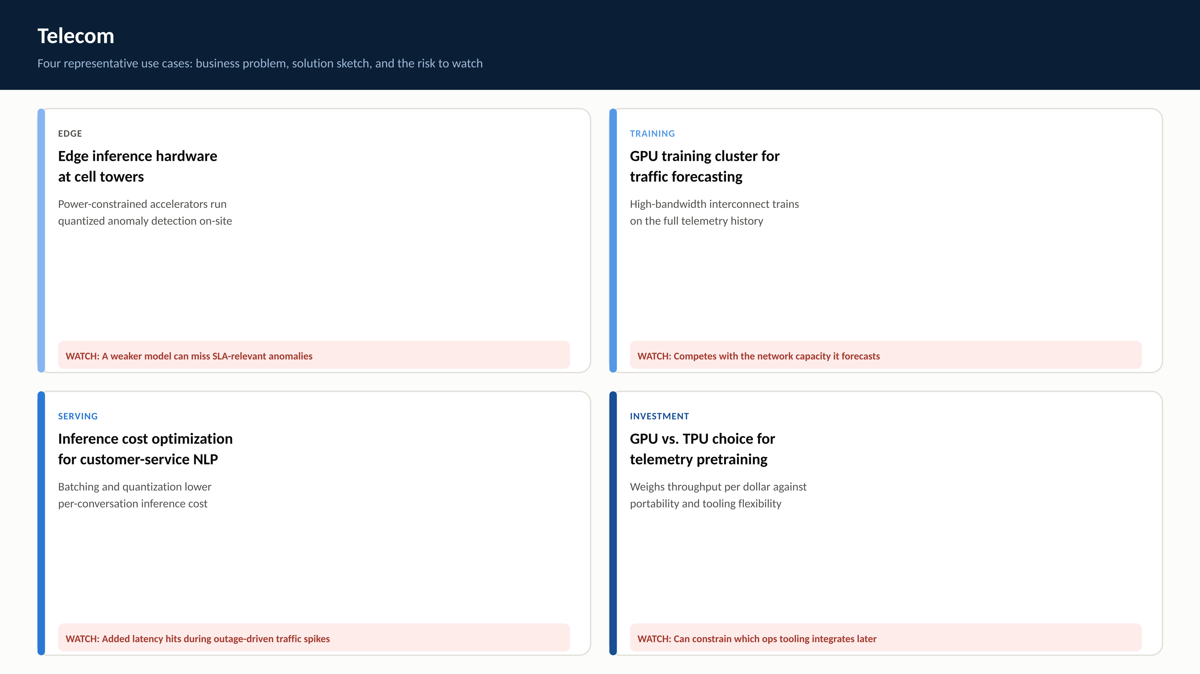
RegAITraining · Chapter 2.8
12 / 15

Slide 13
Check Your Understanding
1. Why does a GPU train a neural network faster than a CPU running the same arithmetic, given both can do floating-point math?
2. What is a TPU, and how does its systolic array differ from how a GPU executes a matrix multiplication?
3. What is arithmetic intensity, and how does the roofline model use it to distinguish compute-bound from memory-bound workloads?
4. Why does large-batch training tend to be compute-bound while small-batch inference tends to be memory-bound?
5. Why does inference cost typically dominate a widely-deployed model's total lifetime compute cost, and what are the standard levers for controlling it?
RegAITraining · Chapter 2.8
13 / 15
Notes:
Q1: Why does a GPU train a neural network faster than a CPU running the same arithmetic, given both can do floating-point math? A1: A CPU has a small number of complex cores optimized for varied, branchy instruction streams, while a GPU has thousands of simple cores that all execute the same instruction across many data elements at once (SIMT). Since the forward and backward pass are dominated by the same matrix-multiply operation repeated across many data points, the GPU's massive parallelism, not a faster clock, is what makes it faster for this specific kind of workload. Q2: What is a TPU, and how does its systolic array differ from how a GPU executes a matrix multiplication? A2: A TPU is an application-specific integrated circuit (ASIC) purpose-built for matrix multiplication, implemented as a systolic array: a grid of simple processing elements where values and partial sums flow through the grid in a tightly pipelined wave. A GPU instead orchestrates many independent cores executing the same instruction, which is more flexible for general parallel code but not as specialized for matrix multiplication specifically as a systolic array. Q3: What is arithmetic intensity, and how does the roofline model use it to distinguish compute-bound from memory-bound workloads? A3: Arithmetic intensity is the number of floating-point operations performed per byte moved from memory (FLOPs / bytes moved). The roofline model plots achievable performance against arithmetic intensity: at low arithmetic intensity, performance is capped by memory bandwidth (memory-bound), and at high arithmetic intensity, performance is capped by the hardware's peak compute throughput (compute-bound), with the ridge point marking where the two limits meet. Q4: Why does large-batch training tend to be compute-bound while small-batch inference tends to be memory-bound? A4: Training processes many examples through the same loaded weights at once, amortizing the cost of moving those weights from memory across a large batch and pushing arithmetic intensity up toward the compute-bound region. A single inference request, especially at batch size 1, reuses those same weights for comparatively little computation, keeping arithmetic intensity low and leaving the workload limited by how fast weights can be read from memory. Q5: Why does inference cost typically dominate a widely-deployed model's total lifetime compute cost, and what are the standard levers for controlling it? A5: Training is a comparatively bounded, front-loaded cost that happens a finite number of times, while inference runs continuously for as long as the model is deployed, so its total cost scales with usage and commonly exceeds the one-time training cost at meaningful production traffic. The standard levers for controlling inference cost are batching requests to raise arithmetic intensity and quantization to shrink the bytes moved per request, both of which push a memory-bound workload back toward the compute-bound region.

Slide 14
Key Takeaways
Deep learning's forward and backward passes are dominated by matrix multiplication, favoring massively parallel (GPU) or purpose-built (TPU) hardware over a CPU running the same arithmetic.
GPUs pair CUDA cores with dedicated Tensor Cores for fast mixed-precision matmul; mixed-precision training uses FP32 master weights, FP16 compute, and loss scaling.
TPUs are ASICs built around a systolic array, trading general-purpose flexibility for efficiency on matrix-multiply-heavy workloads, and are tightly integrated with XLA.
The roofline model explains why large-batch training tends to be compute-bound while small-batch inference tends to be memory-bound, via arithmetic intensity.
Training cost is a bounded, front-loaded expense; inference cost scales with usage and typically dominates a model's lifetime compute cost.
RegAITraining · Chapter 2.8
14 / 15

Slide 15
Sources
Jouppi, N., et al. (2017). In-Datacenter Performance Analysis of a Tensor Processing Unit. ISCA. — https://arxiv.org/abs/1704.04760
Williams, S., Waterman, A., and Patterson, D. (2009). Roofline: An Insightful Visual Performance Model for Multicore Architectures. Communications of the ACM, 52(4). — https://dl.acm.org/doi/10.1145/1498765.1498785
Micikevicius, P., et al. (2018). Mixed Precision Training. ICLR. — https://arxiv.org/abs/1710.03740
RegAITraining · Chapter 2.8
15 / 15

