Slide 1
CHAPTER 3.2 · PHASE 3
From Word2Vec to Contextual Embeddings (BERT-Era Shift)
How embeddings first learned to train, then learned to depend on context.
NLP & Language Model Foundations

Slide 2
AGENDA
What this chapter covers
Word2Vec: skip-gram and CBOW, and how they turn co-occurrence into training signal
Negative sampling: making training tractable at vocabulary scale
Why static embeddings can never resolve "bank" by context
The architectural shift: ELMo and BERT compute vectors from the whole sequence
How information specializes across a contextual encoder's layers
Industry use cases where polysemy resolution actually matters

Slide 3
TL;DR
The short version
Word2Vec (2013) operationalized the distributional hypothesis into a trainable task
It produces static embeddings: one fixed vector per word
ELMo (2018), then BERT (2018-19), computed vectors from the whole sentence instead
A contextual embedding is computed fresh per occurrence, not looked up
"bank" now gets different vectors in different sentences

Slide 4
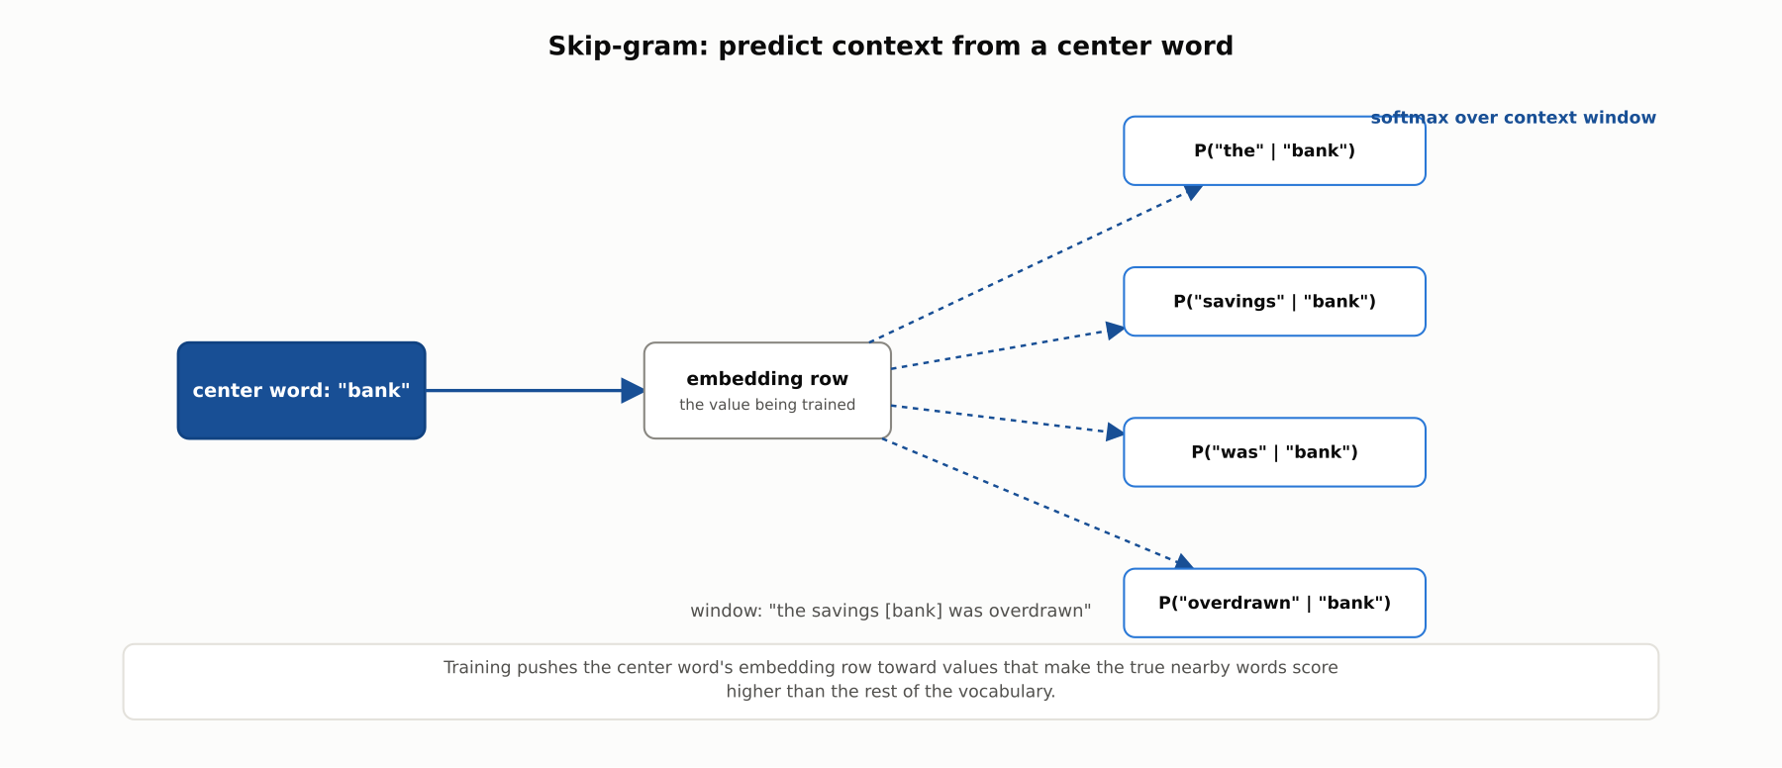
HIGH-LEVEL
Skip-gram: predict context from a center word
Getting good at this narrow prediction task forces similar-context words toward similar vectors.

Slide 5
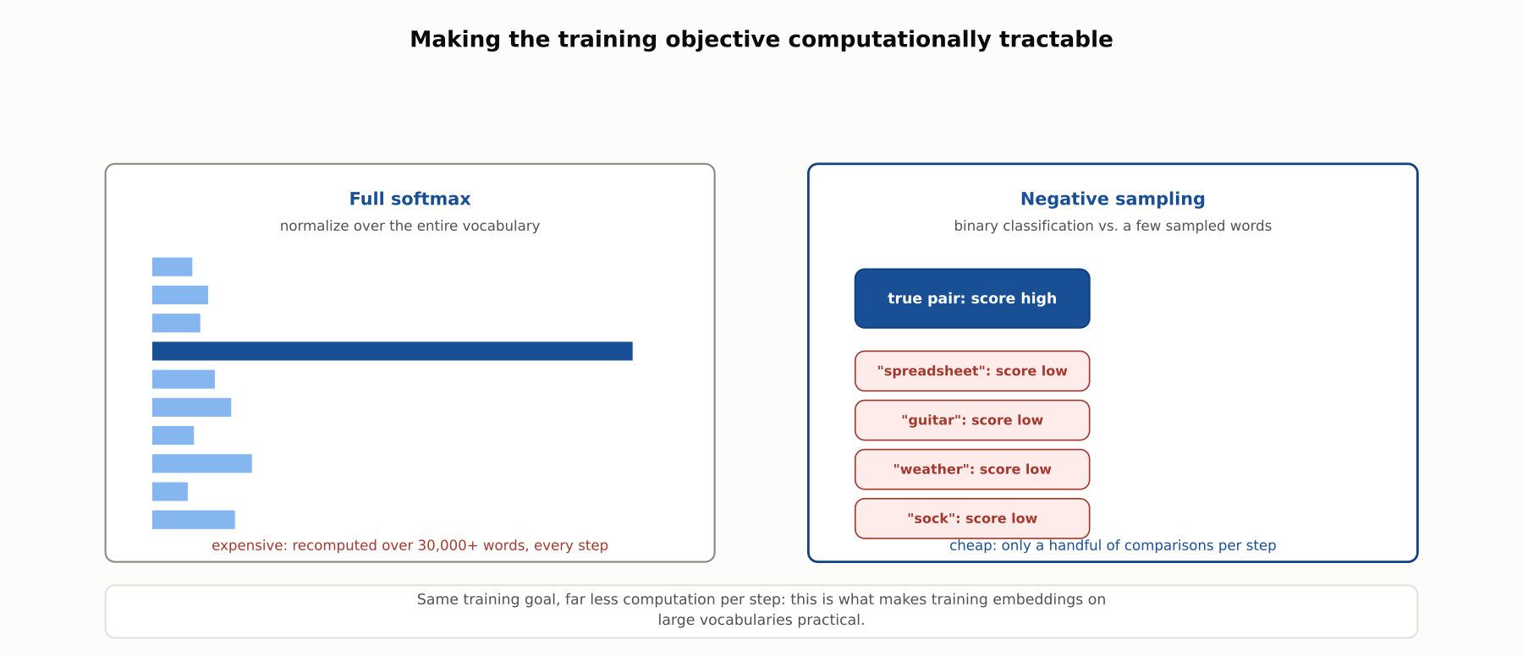
DEEP-DIVE
Negative sampling makes training tractable
Binary classification against a handful of sampled negatives, instead of a full-vocabulary softmax every step.

Slide 6
DEEP-DIVE
Word2Vec, formally
Skip-gram: maximize P(context word | center word), summed across the corpus
CBOW: predict the center word from the average of its context words
Skip-gram: better on rare words. CBOW: faster, slightly better on frequent words
Levy & Goldberg (2014): skip-gram with negative sampling implicitly factorizes a co-occurrence matrix

Slide 7
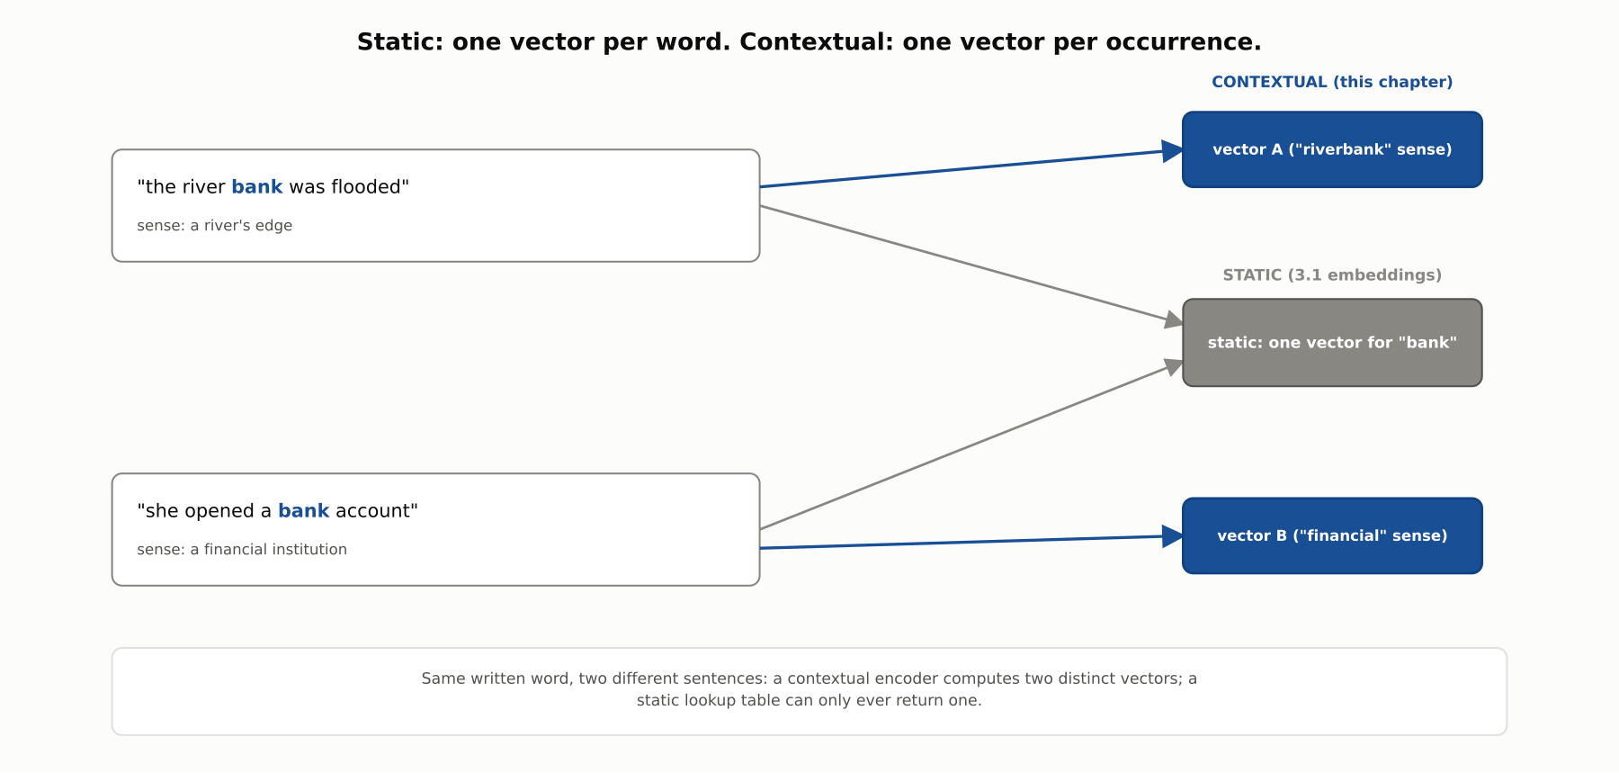
DEEP-DIVE
Why a static vector can't resolve context
Every occurrence of a word updates the same embedding row; there is no mechanism for two different vectors to emerge.

Slide 8
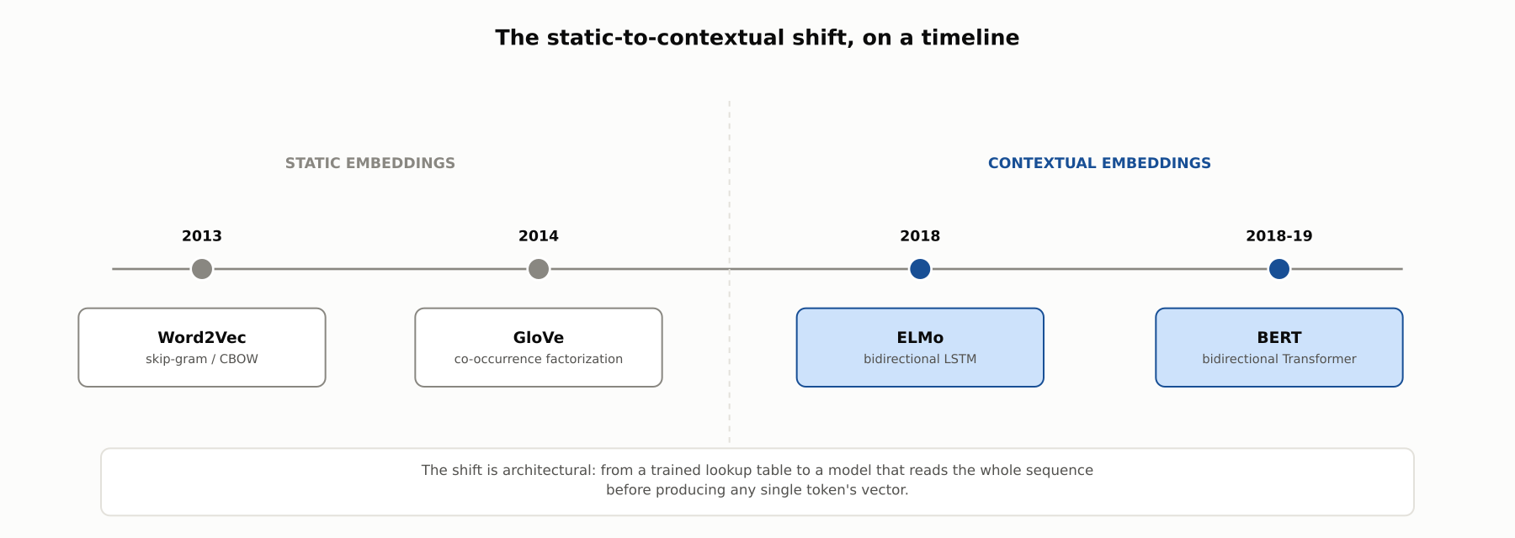
DEEP-DIVE
The architectural shift
ELMo's bidirectional LSTM, then BERT's bidirectional Transformer, compute a vector per occurrence from the whole sequence.

Slide 9
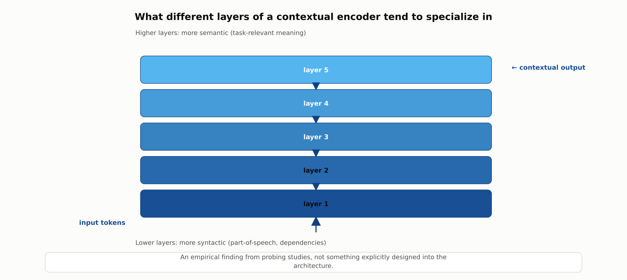
DEEP-DIVE
Layers specialize, empirically
Tenney et al. (2019): earlier layers skew syntactic, later layers skew semantic. Not designed in; observed.

Slide 10
REFERENCE ARCHITECTURE
Computing a contextual embedding for one token
Full token sequence: the whole sentence is available to the encoder at once
Bidirectional encoder: LSTM (ELMo) or Transformer (BERT) reads both directions
Layer stack: lower layers skew syntactic, higher layers skew semantic
Output: one contextual vector per token, per occurrence, not a lookup

Slide 11
COMPARISON & RELATED CONCEPTS
Static vs. contextual embeddings
Aspect | Word2Vec | GloVe | ELMo | BERT-style
Static or contextual | Static | Static | Contextual | Contextual
Handles polysemy | No | No | Yes | Yes
Architecture | Shallow + negative sampling | Co-occurrence factorization | Bidirectional LSTM | Bidirectional Transformer
Role today | Lightweight baseline | Lightweight baseline | Largely superseded | Default for modern NLP
Word2Vec and GloVe solved how to train from raw text; ELMo and BERT solved how to make the result depend on context.

Slide 12
INDUSTRY USE CASES
Healthcare
HEALTHCARE
Negation detection in radiology reports
Disambiguating overloaded abbreviations ("MS")
Problem: "No evidence of fracture" must never be treated like "fracture present" by downstream systems.
Problem: The same abbreviation can mean multiple sclerosis, mitral stenosis, or something else entirely.
Solution: Contextual embeddings represent a finding conditioned on its negation phrase, not scored in isolation.
Solution: Contextual embeddings of the surrounding clinical narrative disambiguate the intended expansion.
Watch for: A negation failure that lets a negated finding trigger a false alert (or suppresses a real one) is a direct clinical-safety issue affecting a patient's care pathway.
Watch for: A misresolved abbreviation in a decision support tool can point clinicians toward the wrong condition, a patient-safety failure a regulatory-clearance review must specifically test for.

Slide 13
INDUSTRY USE CASES
Telecom
TELECOM
Scoping "outage" in incident tickets
Sentiment scoring during outage-driven contact spikes
Problem: The word "outage" can describe a single device fault or a network-wide event in ticket text.
Problem: Customers use sarcasm ("great, another outage") that bag-of-words sentiment models read as positive.
Solution: Contextual embeddings of the surrounding ticket description distinguish device-scoped from network-wide language.
Solution: Contextual embeddings score sentiment from the full surrounding conversation, capturing sarcasm.
Watch for: A network-wide event misclassified as device-level directly delays the escalation that starts the outage-resolution SLA clock.
Watch for: A misread sentiment signal during an active outage can suppress escalation of a high-churn-risk customer exactly when churn exposure is highest.

Slide 14
CHECK YOUR UNDERSTANDING
Discuss before moving on
1. What does skip-gram actually train the model to predict?
2. Why does negative sampling make training tractable?
3. Why can a static embedding never produce two different vectors for the same word?
4. What architectural change lets BERT-style models compute contextual embeddings?

Slide 15
CHAPTER 3.2 · PHASE 3
Key Takeaways
Word2Vec turned the distributional hypothesis into a trainable objective
Negative sampling makes that objective cheap at vocabulary scale
Static embeddings store one vector per word; they cannot resolve context
ELMo, then BERT, compute a vector per occurrence from the whole sequence
Next: 3.3 Language Modeling Objectives: Causal LM vs. Masked LM vs. Seq2Seq

