Slide 1
CHAPTER 6.2 · PHASE 6
Embeddings & Vector Search Foundations
How text becomes a vector positioned by meaning, and how the right vector gets found quickly once there are millions, or billions, of them to search.
Retrieval-Augmented Generation & Knowledge Systems

Slide 2
AGENDA
What this chapter covers
How embeddings turn text into coordinates, from word2vec to sentence-level vectors
Why no single embedding model dominates every task, and how the field benchmarks them
How two vectors get compared: cosine similarity, dot product, and Euclidean distance
Why exact nearest-neighbor search collapses at scale: the curse of dimensionality
Three families of approximate nearest-neighbor algorithms: HNSW, IVF, and product quantization
Where this leaves off: Chapter 6.3 compares the vector databases that implement these techniques

Slide 3
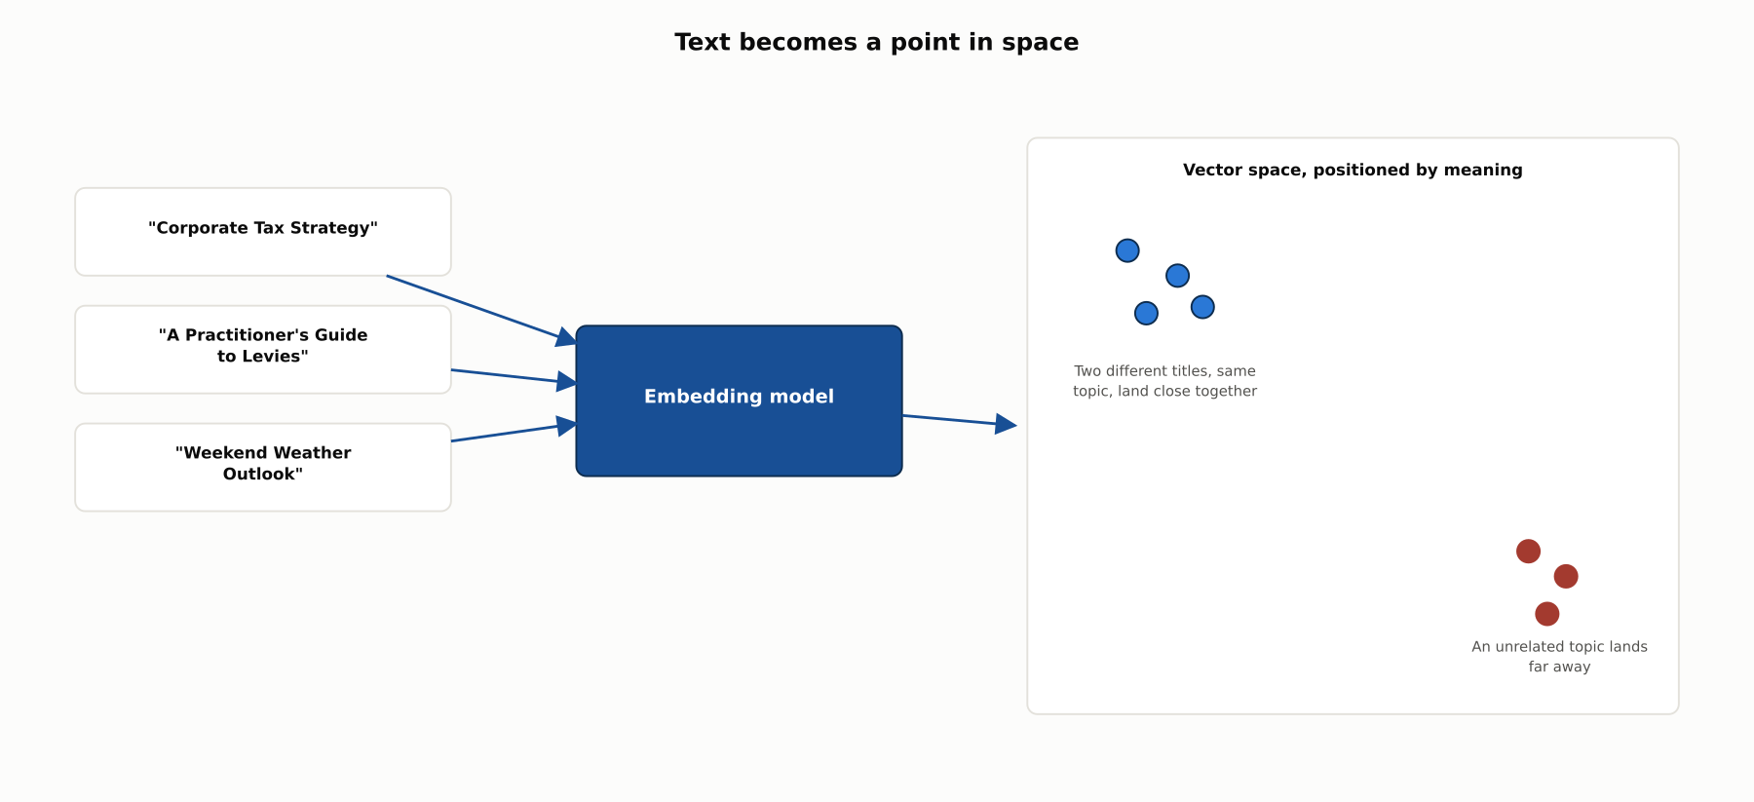
HIGH-LEVEL
Text becomes a point in space
An embedding model positions text by meaning, so similar ideas land near each other in vector space regardless of the specific words used.

Slide 4
DEEP-DIVE
A word's meaning becomes a set of coordinates
Mikolov et al. (2013), word2vec: two neural architectures for computing word vectors from raw text, no manual labeling required
"It takes less than a day to learn high quality word vectors from a 1.6 billion words data set"
Reaches "state-of-the-art performance...for measuring syntactic and semantic word similarities"
Words used in similar contexts end up with similar vectors, the foundational insight everything downstream builds on
Meaning becomes coordinates, and coordinates can be compared mathematically

Slide 5
DEEP-DIVE
Sentences need their own vectors, not averaged words
A document to retrieve is rarely one word, it is a sentence, paragraph, or passage
Averaging word vectors together to represent a sentence loses too much of what it actually means
Reimers and Gurevych (2019), Sentence-BERT: fine-tunes BERT with pooling inside a siamese or triplet network
Produces one fixed-size vector per sentence, where cosine similarity reflects actual sentence similarity
This is the model family that made embedding an entire knowledge store a practical idea

Slide 6
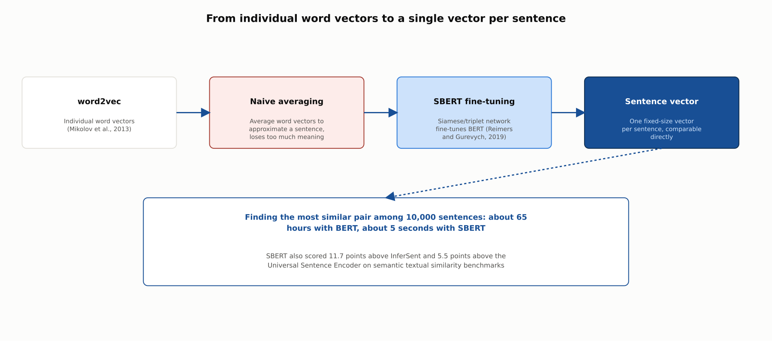
DEEP-DIVE
From individual word vectors to a single vector per sentence
Finding the most similar pair among 10,000 sentences: about 65 hours with BERT, about 5 seconds with SBERT, the change that made retrieval at scale practical.

Slide 7
DEEP-DIVE
No embedding model wins everywhere
Muennighoff et al. (2022), MTEB: built because embeddings were typically evaluated on one narrow task at a time
Covers "8 embedding tasks," "58 datasets," and "112 languages"
Central finding: "no particular text embedding method dominates across all tasks"
A model that excels at semantic similarity is not guaranteed to excel at clustering, classification, or retrieval
Choosing an embedding model is a benchmarking decision, not a one-time pick of the current leaderboard leader

Slide 8
DEEP-DIVE
The current embedding model landscape
OpenAI text-embedding-3-large: MIRACL 31.4% to 54.9%, MTEB 61.0% to 64.6%, versus the older ada-002 model
Both new OpenAI models support Matryoshka Representation Learning via a dimensions API parameter
A shortened text-embedding-3-large at 256 dimensions still beats unshortened ada-002 at 1,536 dimensions on MTEB
Google Gemini Embedding: "consistently held a top spot on the...MTEB Multilingual leaderboard"
Defaults to 3,072 dimensions, scalable to 1,536 or 768 with the same Matryoshka technique, over 100 languages
Neither leaderboard position is permanent, this is a fast-moving landscape

Slide 9
DEEP-DIVE
Comparing vectors: cosine, dot product, and Euclidean distance
Cosine similarity measures the angle between two vectors, ignoring their length entirely
Dot product multiplies vectors directly, growing with length as well as angle
Euclidean distance measures the straight-line distance between vectors' endpoints
Google: frequently-occurring examples, like popular YouTube videos, "tend to have embedding vectors with large lengths," so dot product can favor popularity over relevance
When vectors are normalized to unit length, "all three similarity measures are equivalent because they are proportional to" cosine similarity
Most modern text embedding models are used with normalized vectors and cosine similarity for this reason

Slide 10
DEEP-DIVE
Exact nearest-neighbor search breaks down at scale
Bellman coined "curse of dimensionality" in 1957, decades before anyone was embedding text
Indyk and Motwani (1998): classic indexing structures "provide little improvement over the brute-force algorithm" in high dimensions
Exact structures face a genuine dilemma: "low preprocessing cost but query time linear in n and d"
Or "query time sublinear in n" bought at the cost of "severely exponential preprocessing" to build
Their fix: accept an approximate nearest neighbor, within a small, controllable factor of the true one
"Determining an epsilon-approximate nearest neighbor...should suffice for most practical purposes"
This shift, exact to approximate, is what every algorithm in the rest of this chapter depends on

Slide 11
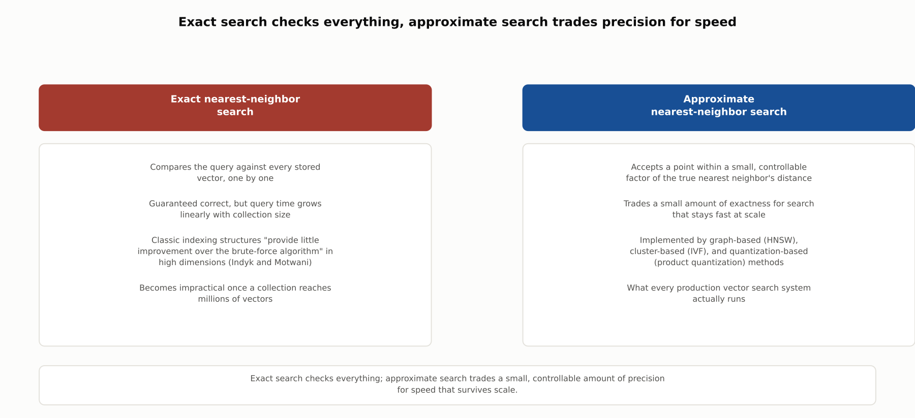
DEEP-DIVE
Exact search checks everything, approximate search trades precision for speed
Approximate nearest-neighbor search accepts a small, controllable amount of imprecision in exchange for search that stays fast and memory-efficient at scale.

Slide 12
DEEP-DIVE
HNSW: graph-based approximate search
Malkov and Yashunin: builds a multi-layer graph connecting each vector to a handful of neighbors
Sparse layers on top for long jumps across the space, dense layers below for fine-grained refinement
"Allows a logarithmic complexity scaling" for search
Structural "similarity...to the skip list structure allows straightforward balanced distributed implementation"
Tends to win on recall at a given latency, especially on clustered data

Slide 13
DEEP-DIVE
IVF: cluster-based approximate search
Partitions the vector space into cells around centroids using a Voronoi-style assignment
A query searches only the cell it falls into, plus a configurable number of neighboring cells
That count is the nprobe parameter, "the number of cells to search"
Raising nprobe trades speed for recall directly
On a 1-million-vector benchmark: roughly 1-9ms queries at 0.7-0.95 recall, versus ~18ms for a flat exhaustive scan
Simple to reason about and tune, a common default starting point

Slide 14
DEEP-DIVE
Product quantization: compression-based approximate search
Jegou, Douze, and Schmid (2011): compresses each vector into a short code
Splits a vector into m subvectors, quantizes each independently against a small set of centroids
A companion paper (Jegou, Tavenard, Douze, and Amsaleg) demonstrated it at billion-vector scale
"Refines estimated distances based on short quantization codes, to avoid reading the full vectors from disk"
Tested on "a new public dataset of one billion 128-dimensional vectors," "outperforming FLANN"
What makes holding billions of vectors in memory affordable in the first place

Slide 15
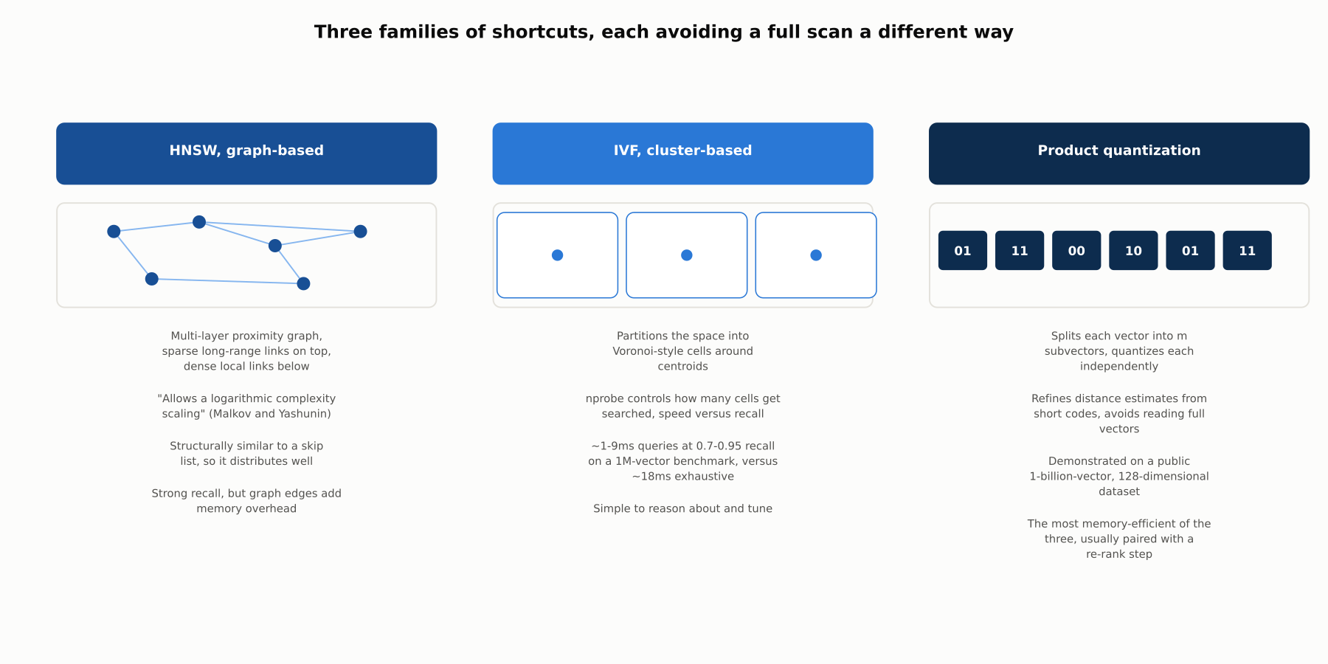
DEEP-DIVE
Three families of shortcuts, each avoiding a full scan a different way
A graph to navigate, cells to partition, or codes to compress: none of the three families is strictly better than the others.

Slide 16
DEEP-DIVE
In production, these techniques are combined, not chosen in isolation
IVF partitioning plus product quantization within each cell, to save memory
HNSW graphs built over quantized codes, for graph-based recall at a fraction of full-vector memory cost
ANN-Benchmarks and similar projects exist because the right combination is empirical, not a matter of taste
The right choice depends on the specific recall target, latency budget, and memory ceiling of a given system
Which database or library actually implements which combination is exactly what Chapter 6.3 covers next

Slide 17
COMPARISON & RELATED CONCEPTS
Four ways to find the closest vector
Aspect | Exact (brute-force) kNN | HNSW (graph-based) | IVF (cluster-based) | Product quantization
Core mechanism | Compare against every stored vector directly | Navigate a multi-layer proximity graph | Search only the nearest cell(s) of a partitioned space | Compress vectors into short quantized codes
Query time behavior | Linear in the number of vectors | Roughly logarithmic | Tunable via nprobe, speed against recall | Very fast estimates via lookup tables
Memory footprint | Full vectors, no compression | Full vectors plus graph edges | Full or compressed vectors, moderate overhead | Short codes only, the most efficient of the four
Best suited for | Small collections, or ground-truth evaluation | Recall-sensitive workloads with memory to spare | Simple, tunable setups | Billion-scale collections where memory binds
Four different ways to find the closest vector, from checking everything to navigating a graph, searching selected clusters, or comparing compressed codes.

Slide 18
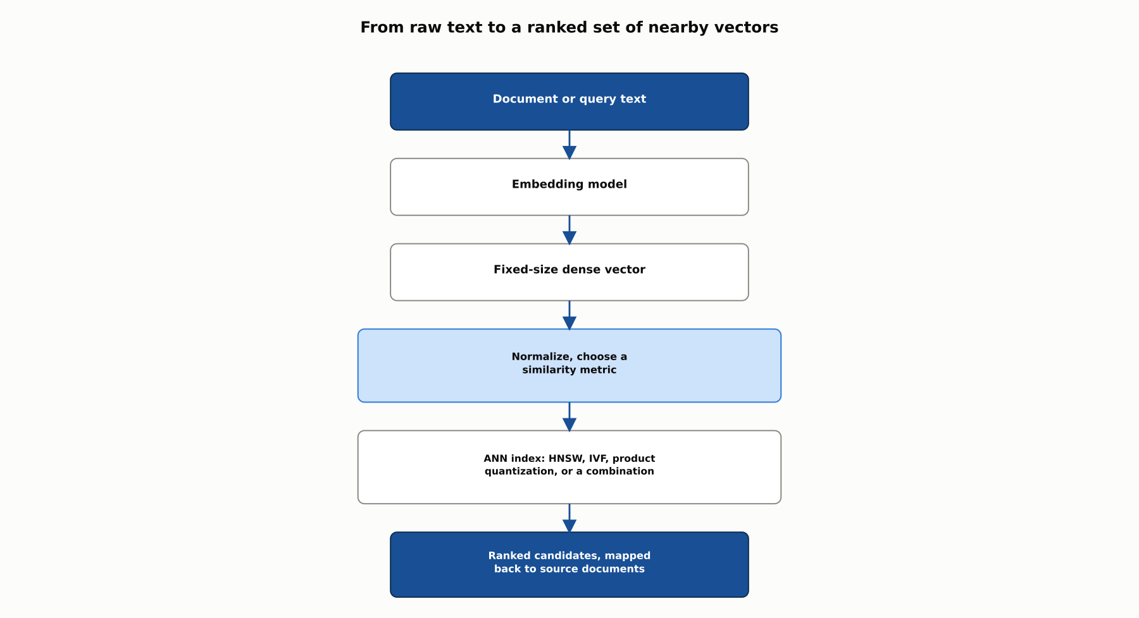
REFERENCE ARCHITECTURE
From raw text to a ranked set of nearby vectors
This chapter stops at a ranked candidate set; Chapter 6.3 compares the vector databases that implement this indexing layer, and 6.4 covers chunking, reranking, and generation.

Slide 19
CHECK YOUR UNDERSTANDING
Discuss before moving on
1. What did Mikolov et al. (2013) demonstrate about word2vec's training efficiency and accuracy, and why did that combination matter?
2. What speedup did Sentence-BERT achieve over plain BERT for finding the most similar sentence pair, and what architectural change produced it?
3. What did Muennighoff et al.'s MTEB paper find about embedding models across tasks, and what practical conclusion follows?
4. What is the curse of dimensionality per Indyk and Motwani, and what dilemma does it create for exact nearest-neighbor search?
5. Name the three families of approximate nearest-neighbor algorithms, and the mechanism each uses to avoid a full scan.

