Slide 1
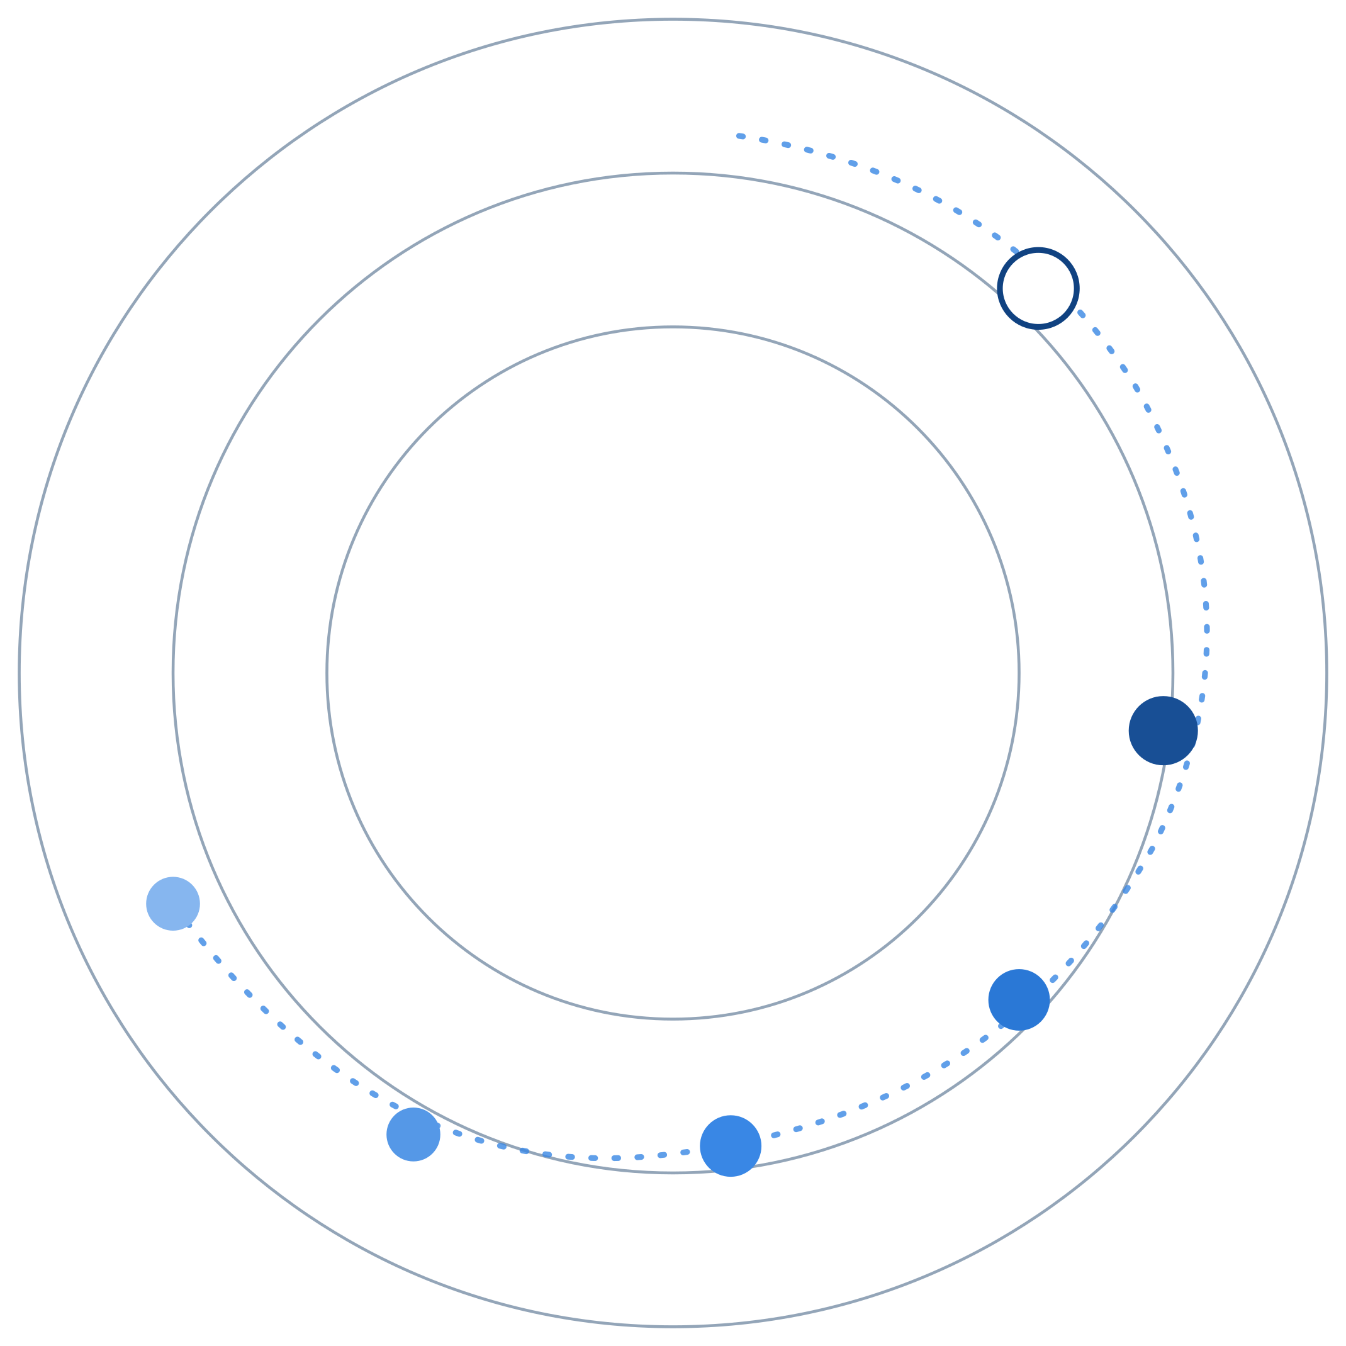
REGAITRAINING · PHASE 1 -- AI & MACHINE LEARNING FOUNDATIONS
CHAPTER 1.6
Evaluation Metrics
Accuracy, Precision/Recall, F1, ROC-AUC, and RMSE
A teaching-slide walkthrough of the chapter: what a confusion matrix hides, why precision and recall trade off, and what ROC-AUC and RMSE actually measure.
Instructor deck · 15 slides · based on docs/01-ai-ml-foundations/1-6-evaluation-metrics.mdx

Slide 2
ROADMAP
What We'll Cover
1
The confusion matrix
5
A deployment pipeline
Where every metric in this chapter comes from
From raw scores to a chosen operating threshold
2
ROC-AUC
6
Comparison table
Ranking quality summarized across every threshold
What each metric is blind to
3
Precision vs. recall
7
Industry use cases
Why they trade off, and what F1 does about it
Finance, Healthcare, and Telecom - 4 each
4
RMSE vs. MAE
Two different verdicts on the same regression errors
1.6 | Phase 1 - AI & Machine Learning Foundations
2

Slide 3
TL;DR
Performance Is Not One Number
Accuracy is the most intuitive metric and the easiest to get badly wrong, because it falls apart on the imbalanced data that shows up constantly in fraud, disease screening, and churn.
Precision and recall separate two kinds of mistakes; F1 balances them. ROC-AUC summarizes ranking quality across every threshold. RMSE plays a similar role for regression.
THE PRACTICAL TAKEAWAY
Choosing a metric is choosing what kind of error the business actually cares about most, not picking the number that looks best.
1.6 | Phase 1 - AI & Machine Learning Foundations
3

Slide 4
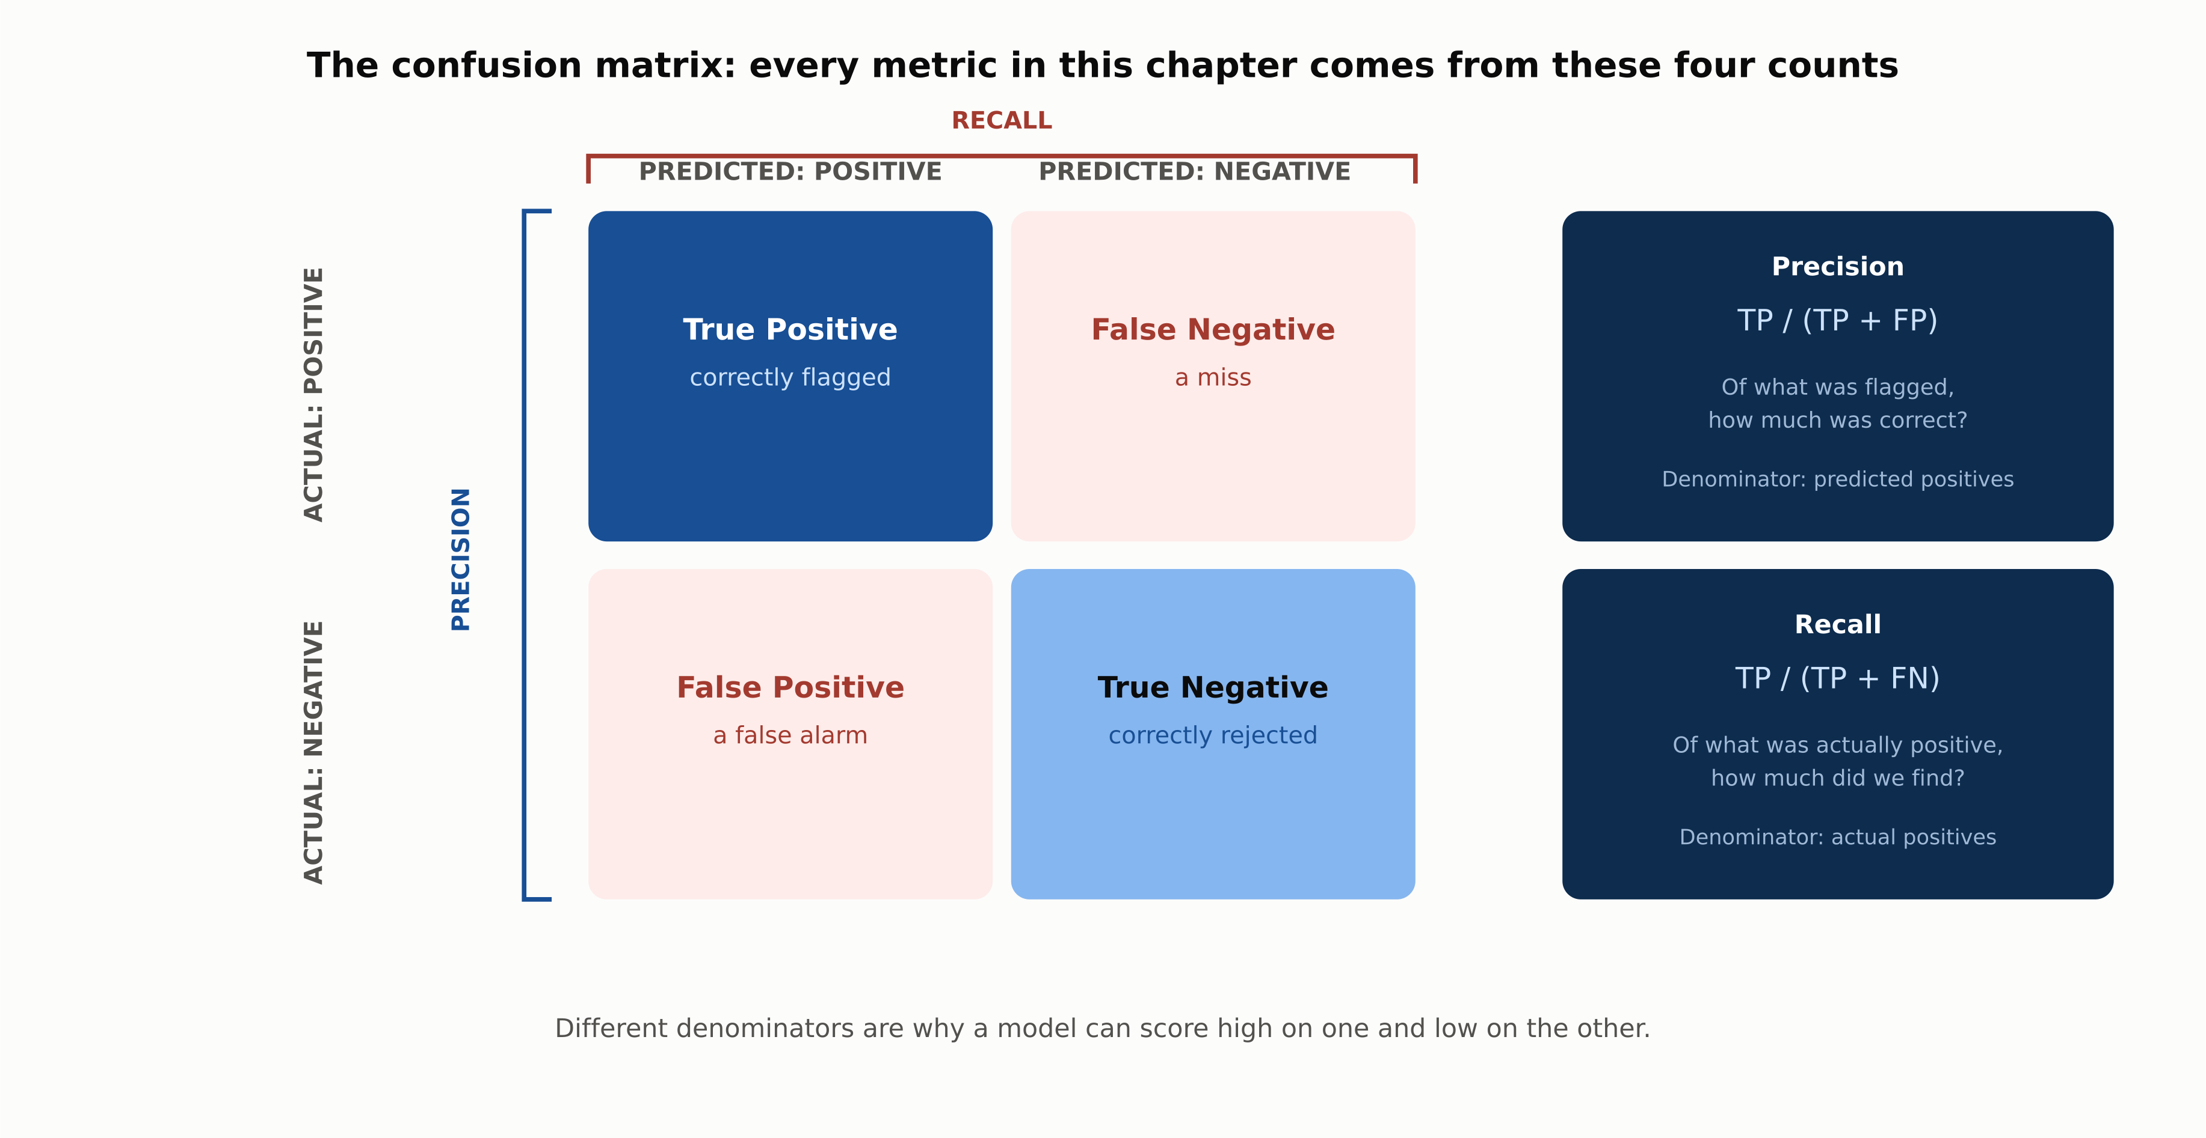
HIGH-LEVEL
The Confusion Matrix
1.6 | Phase 1 - AI & Machine Learning Foundations
4

Slide 5
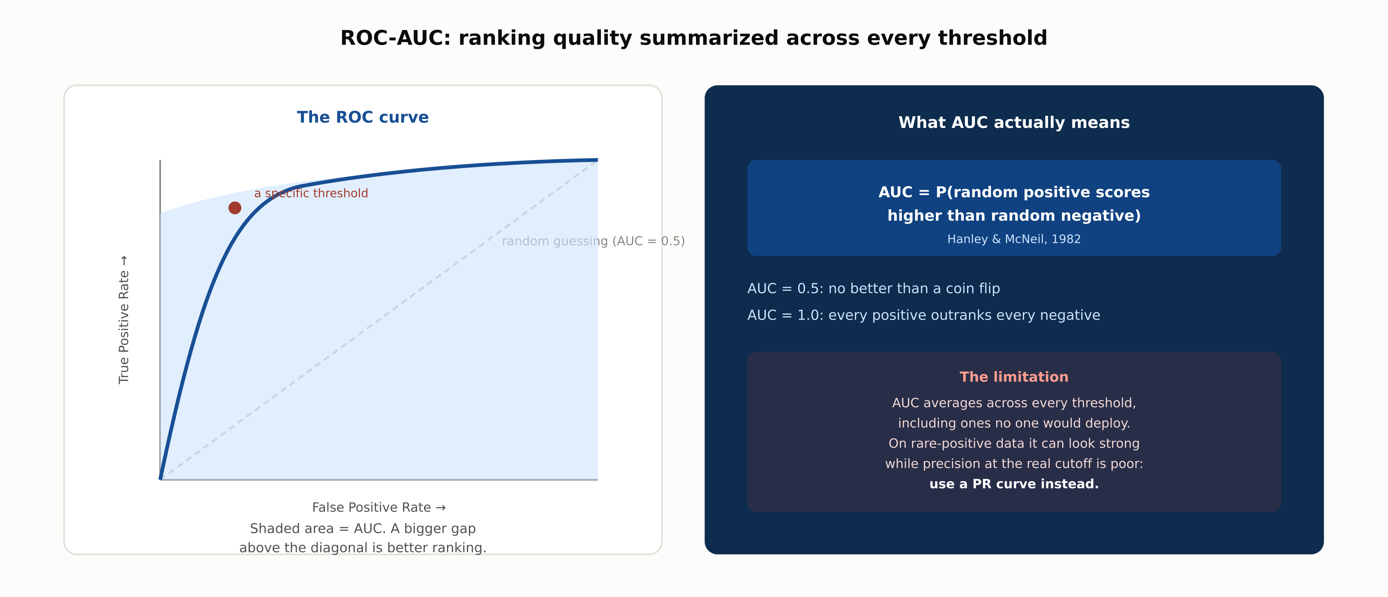
DEEP-DIVE
ROC-AUC: Ranking Across Every Threshold
1.6 | Phase 1 - AI & Machine Learning Foundations
5

Slide 6
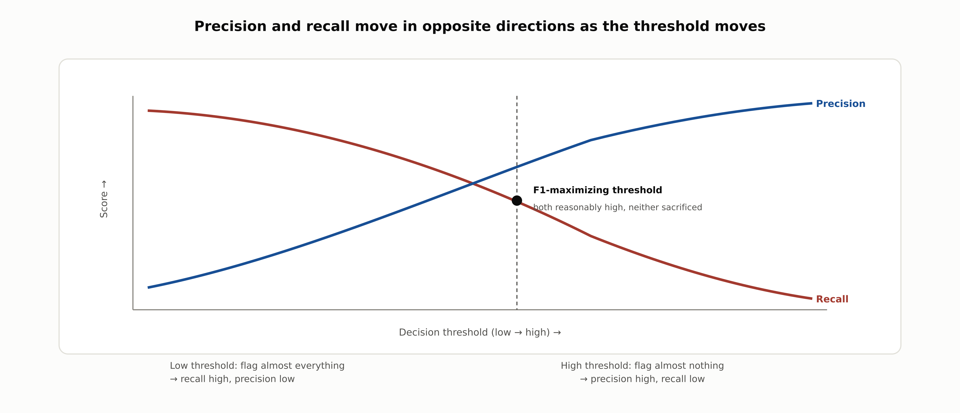
DEEP-DIVE
Precision and Recall Trade Off
1.6 | Phase 1 - AI & Machine Learning Foundations
6

Slide 7
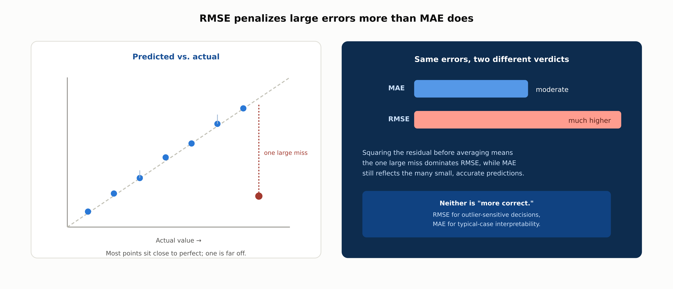
DEEP-DIVE
RMSE Penalizes Large Errors More Than MAE
1.6 | Phase 1 - AI & Machine Learning Foundations
7

Slide 8
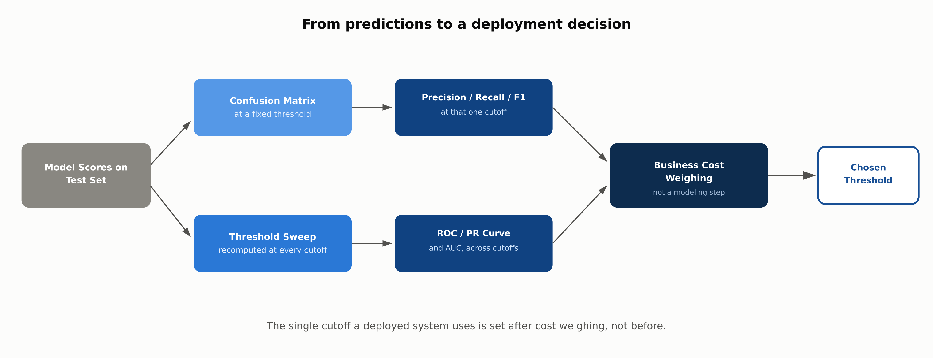
REFERENCE ARCHITECTURE
From Predictions to a Deployment Decision
1.6 | Phase 1 - AI & Machine Learning Foundations
8

Slide 9
COMPARISON & RELATED CONCEPTS
What Each Metric Hides
 | Accuracy | Precision / Recall | F1 | ROC-AUC
What it's blind to | Class imbalance | Precision ignores misses; recall ignores false alarms | The specific error-cost tradeoff | Performance at the deployed threshold
Threshold-dependent | Yes | Yes | Yes | No: summarizes across all thresholds
Best suited to | Balanced classes, equal costs | One error type clearly costlier | A single balanced number | Comparing ranking before a threshold
Reads as | Fraction correct overall | Two separate ratios | One balanced ratio | Probability of correct ranking
No single metric is sufficient on its own; the decisive question is which failure mode a metric hides, not which one is "best."
1.6 | Phase 1 - AI & Machine Learning Foundations
9

Slide 10
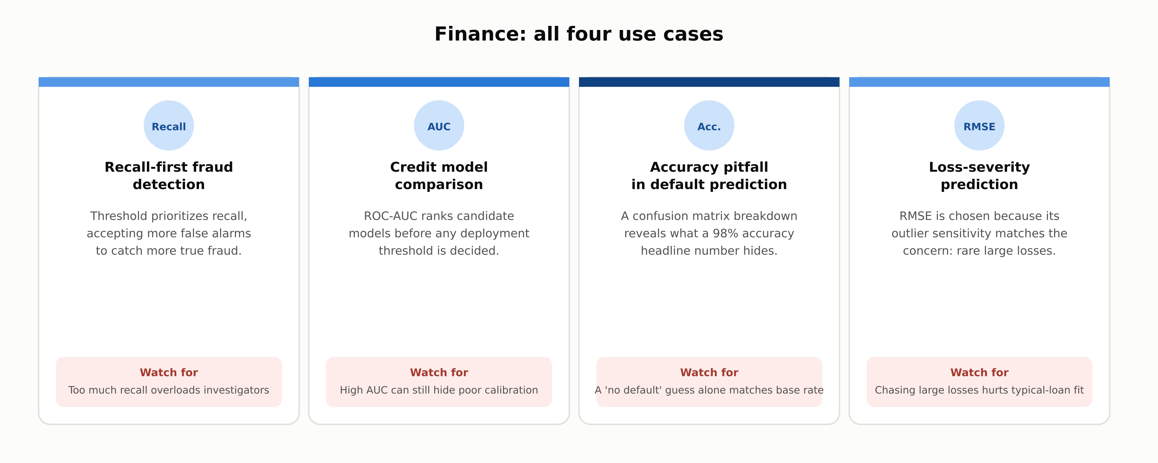
INDUSTRY USE CASES · 1 OF 3
Finance
1.6 | Phase 1 - AI & Machine Learning Foundations
10

Slide 11
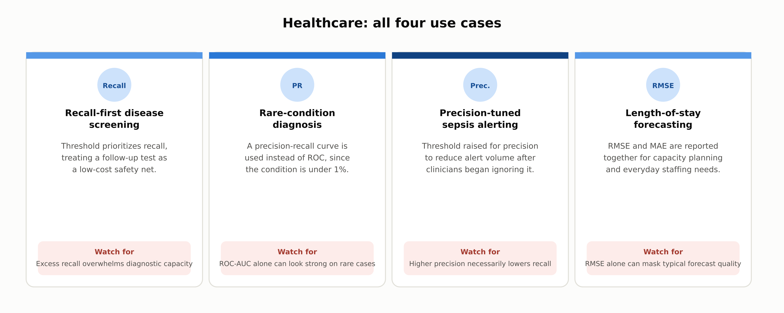
INDUSTRY USE CASES · 2 OF 3
Healthcare
1.6 | Phase 1 - AI & Machine Learning Foundations
11

Slide 12
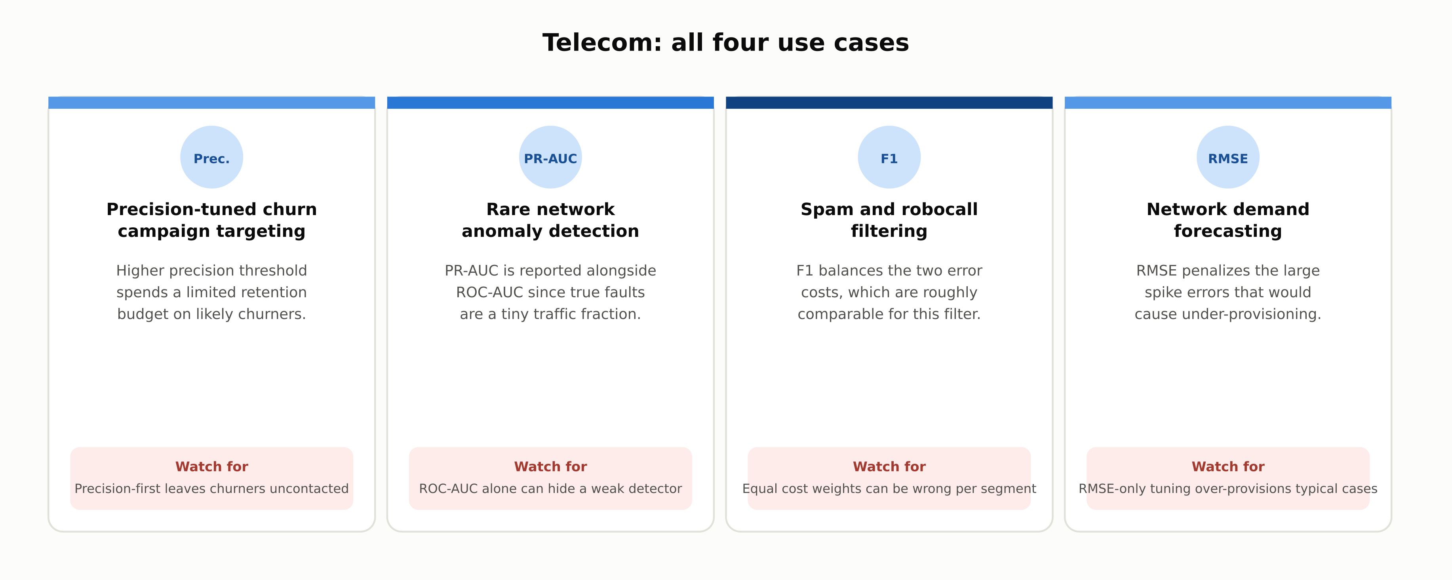
INDUSTRY USE CASES · 3 OF 3
Telecom
1.6 | Phase 1 - AI & Machine Learning Foundations
12

Slide 13
DISCUSS AS A CLASS
Check Your Understanding
Q1
A dataset is 99% negative and 1% positive. Why can a model with 99% accuracy still be useless, and what would you check instead?
Q2
What is the fundamental tradeoff between precision and recall, and what does F1 do about it?
Q3
What does an AUC of 0.5 versus 0.9 actually mean, in terms of the model's predictions?
Q4
Two regression models are compared, and one has lower MAE while the other has lower RMSE. What does that disagreement tell you?
Q5
A hospital is choosing an evaluation metric for a rare-disease screening test. Walk through the reasoning for which metric to prioritize.
Answers are in the speaker notes for this slide.
1.6 | Phase 1 - AI & Machine Learning Foundations
13
Notes:
Q1: A dataset is 99% negative and 1% positive. Why can a model with 99% accuracy still be useless, and what would you check instead? A1: A model that predicts the negative class for every example matches the 99% base rate without ever identifying a true positive. Checking the confusion matrix, specifically recall on the positive class, would show it catches zero actual positives. Q2: What is the fundamental tradeoff between precision and recall, and what does F1 do about it? A2: Precision and recall are computed over different denominators, predicted positives versus actual positives, so a model can trivially maximize one at the expense of the other. F1, the harmonic mean, stays low unless both are reasonably high, so it cannot be gamed by pushing just one up. Q3: What does an AUC of 0.5 versus 0.9 actually mean, in terms of the model's predictions? A3: AUC is the probability that a randomly chosen actual positive receives a higher score than a randomly chosen actual negative. 0.5 means no better than chance; 0.9 means a random positive outranks a random negative 90% of the time. Q4: Two regression models are compared, and one has lower MAE while the other has lower RMSE. What does that disagreement tell you? A4: RMSE squares each residual before averaging, so it penalizes large errors far more heavily than MAE. A model with mostly small errors and one large outlier can have lower MAE but higher RMSE than one with consistently moderate errors, pointing to a difference in error distribution. Q5: A hospital is choosing an evaluation metric for a rare-disease screening test. Walk through the reasoning for which metric to prioritize. A5: Accuracy is uninformative given the rarity of the disease. Missing a true case is typically costlier than a false alarm that triggers a routine follow-up, arguing for recall. Because the positive class is rare, a precision-recall curve, not ROC, should compare candidate models.

Slide 14
SUMMARY
Key Takeaways
✓
Every classification metric in this chapter is a ratio built from the confusion matrix's four counts.
✓
Accuracy is dangerous on imbalanced data; a majority-class guess can score deceptively high.
✓
Precision and recall trade off; F1 is the balanced default when neither error is clearly costlier.
✓
ROC-AUC summarizes ranking across thresholds, but a PR curve is safer when positives are rare.
✓
RMSE and MAE can disagree; the disagreement itself reveals how errors are distributed.
1.6 | Phase 1 - AI & Machine Learning Foundations
14

Slide 15
FURTHER READING
Sources Cited in This Chapter
van Rijsbergen, Information Retrieval, 2nd ed.
Butterworths, 1979
Hanley & McNeil, The Meaning and Use of the Area Under a ROC Curve
Radiology, 1982
Davis & Goadrich, The Relationship Between Precision-Recall and ROC Curves
ICML, 2006
Chapter 1.3
docs/01-ai-ml-foundations/1-3-ml-foundations.mdx
Chapter 1.4
docs/01-ai-ml-foundations/1-4-core-ml-concepts.mdx
Full chapter with inline links: docs/01-ai-ml-foundations/1-6-evaluation-metrics.mdx
1.6 | Phase 1 - AI & Machine Learning Foundations
15

