Slide 1

REGAITRAINING · PHASE 1 -- AI & MACHINE LEARNING FOUNDATIONS
CHAPTER 1.7
Data Foundations
Pipelines, Feature Engineering, and Data Quality
A teaching-slide walkthrough of the chapter: how raw data becomes model-ready features, why the same feature can be computed two different ways, and what that costs in production.
Instructor deck · 15 slides · based on docs/01-ai-ml-foundations/1-7-data-foundations.mdx

Slide 2
ROADMAP
What We'll Cover
1
The data pipeline
5
A reference architecture
Ingestion, cleaning, feature engineering, and where it can silently break
A feature store that keeps training and serving in sync
2
Missing data taxonomy
6
Comparison table
MCAR, MAR, and MNAR, and why the fix depends on which applies
The decisive question is leakage risk, not compactness
3
Categorical encoding
7
Industry use cases
One-hot, ordinal, target encoding, and learned embeddings
Finance, Healthcare, and Telecom - 4 each
4
Feature scaling
Standardization and min-max, and who actually needs them
1.7 | Phase 1 - AI & Machine Learning Foundations
2

Slide 3
TL;DR
Most ML Problems Are Data Problems
Before any model in chapter 1.5 can be trained, raw data has to survive a pipeline: cleaning, encoding, scaling, and validation, each stage capable of silently corrupting what the model eventually learns.
Missing values, duplicates, and mismatches between how a feature is computed for training versus serving degrade a model without ever throwing an error, which is exactly what makes them dangerous.
THE PRACTICAL TAKEAWAY
A pipeline that runs without crashing gives no signal that its output is wrong; data quality has to be checked, not assumed.
1.7 | Phase 1 - AI & Machine Learning Foundations
3

Slide 4
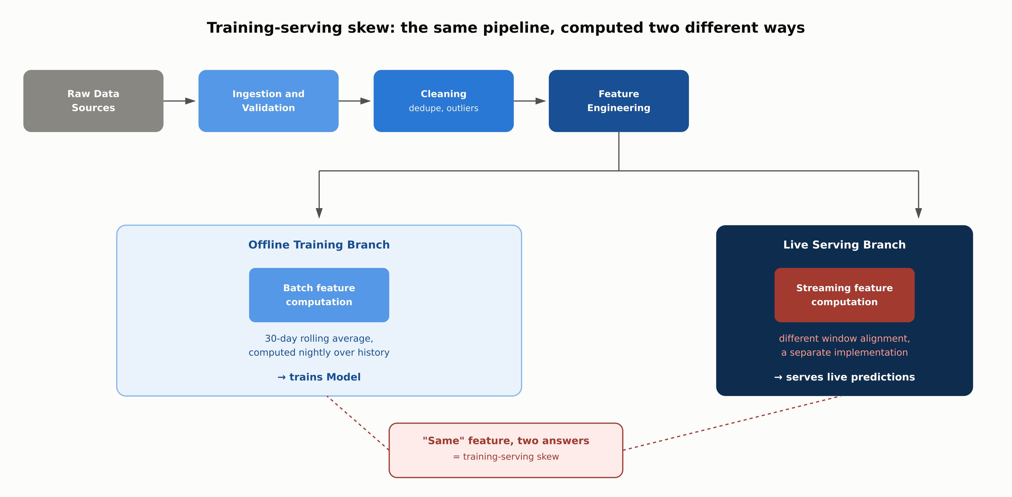
HIGH-LEVEL
Training-Serving Skew: One Pipeline, Two Answers
1.7 | Phase 1 - AI & Machine Learning Foundations
4

Slide 5
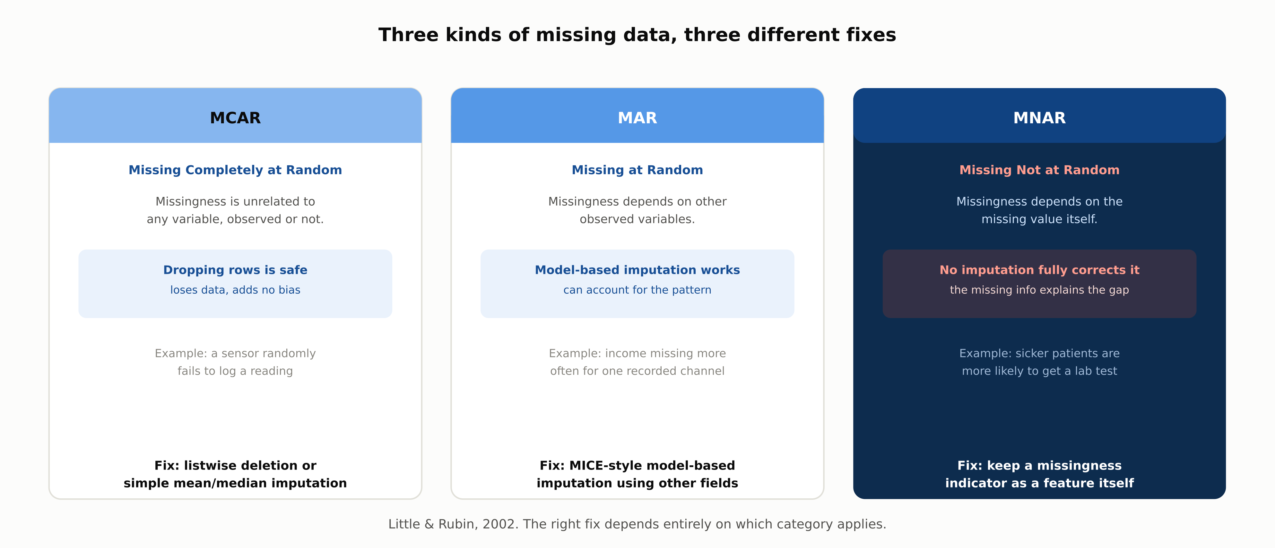
DEEP-DIVE
Three Kinds of Missing Data, Three Different Fixes
1.7 | Phase 1 - AI & Machine Learning Foundations
5

Slide 6
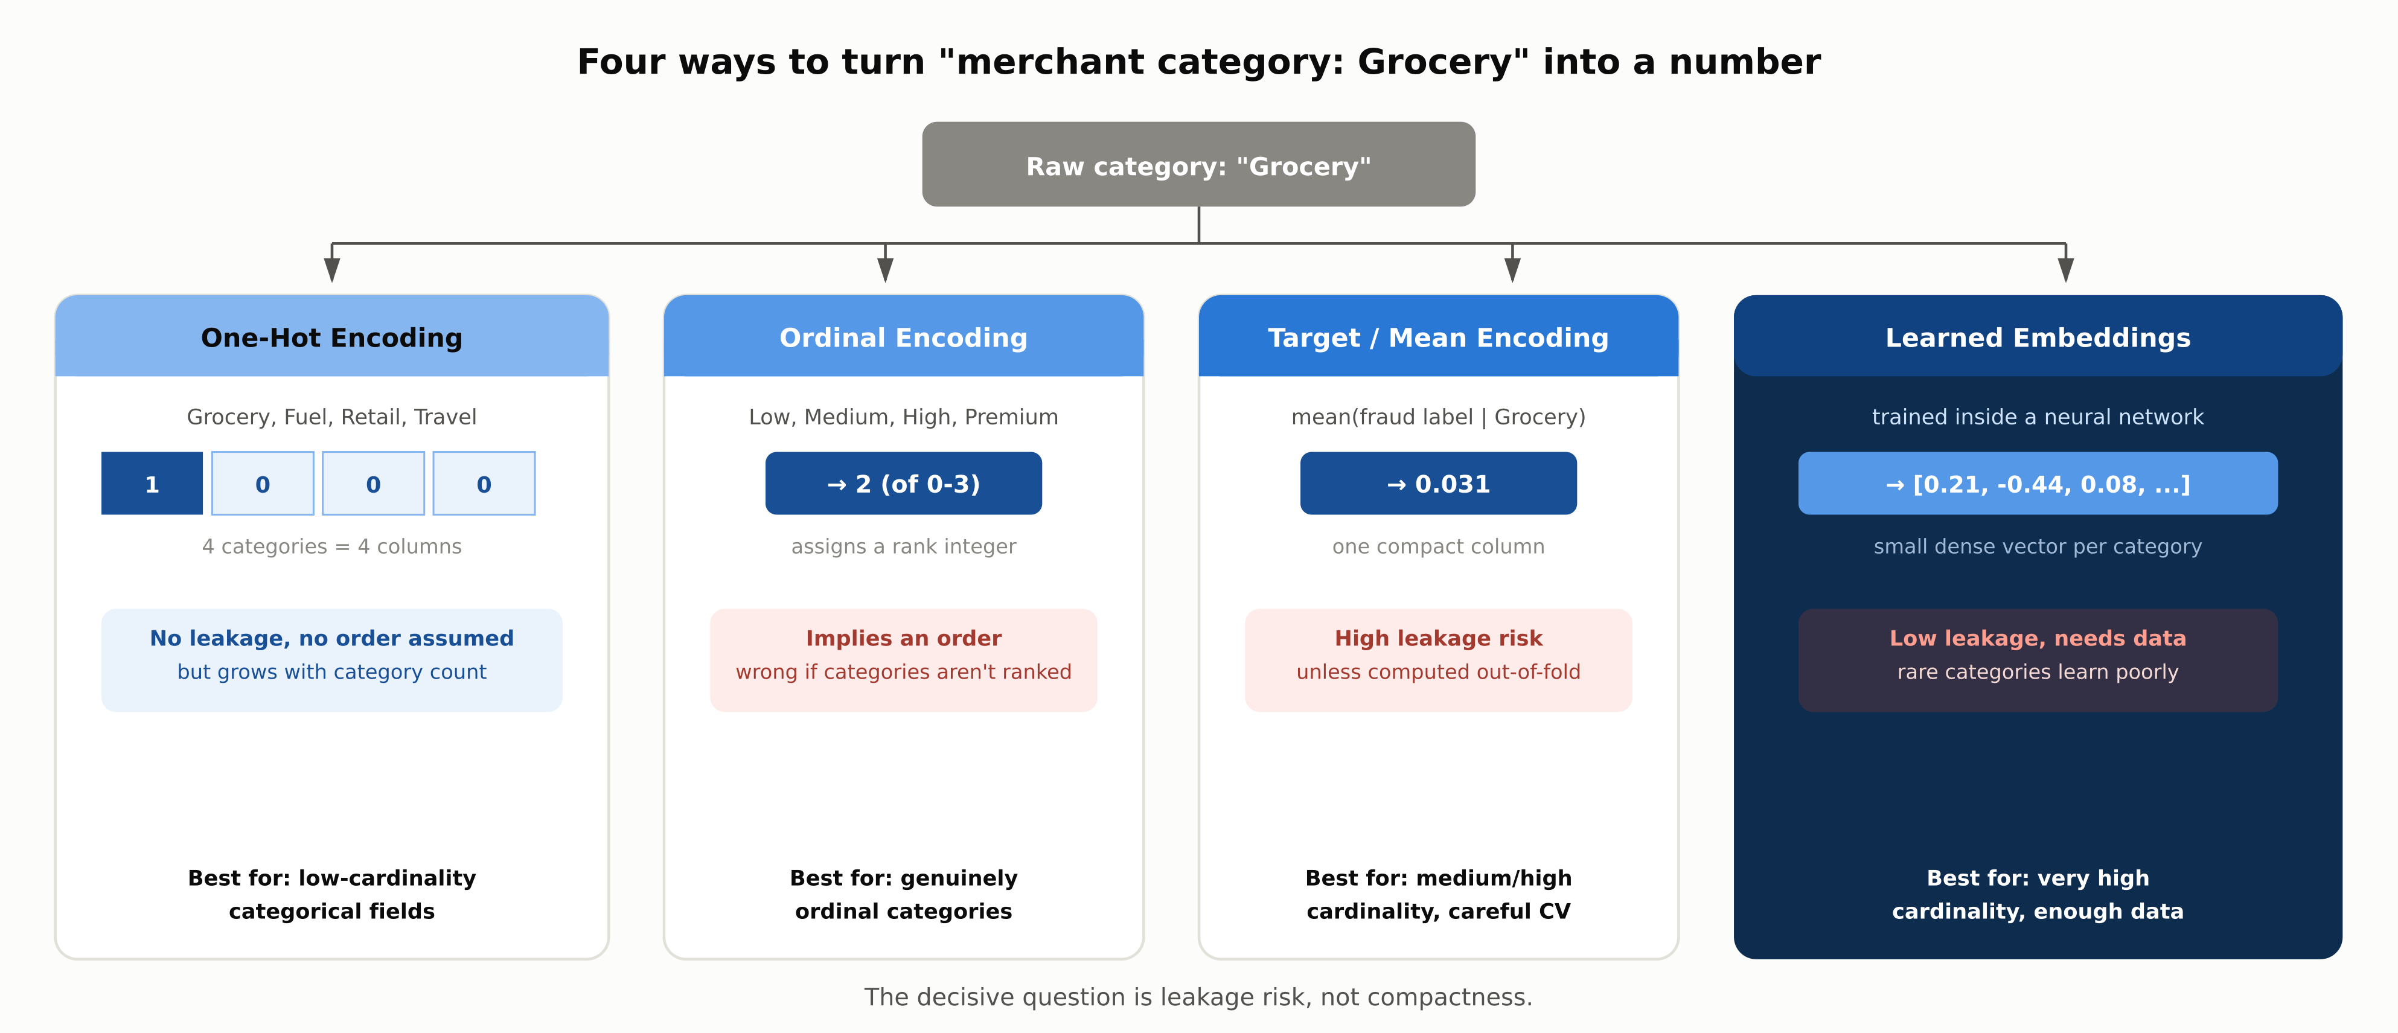
DEEP-DIVE
Four Ways to Encode a Category
1.7 | Phase 1 - AI & Machine Learning Foundations
6

Slide 7
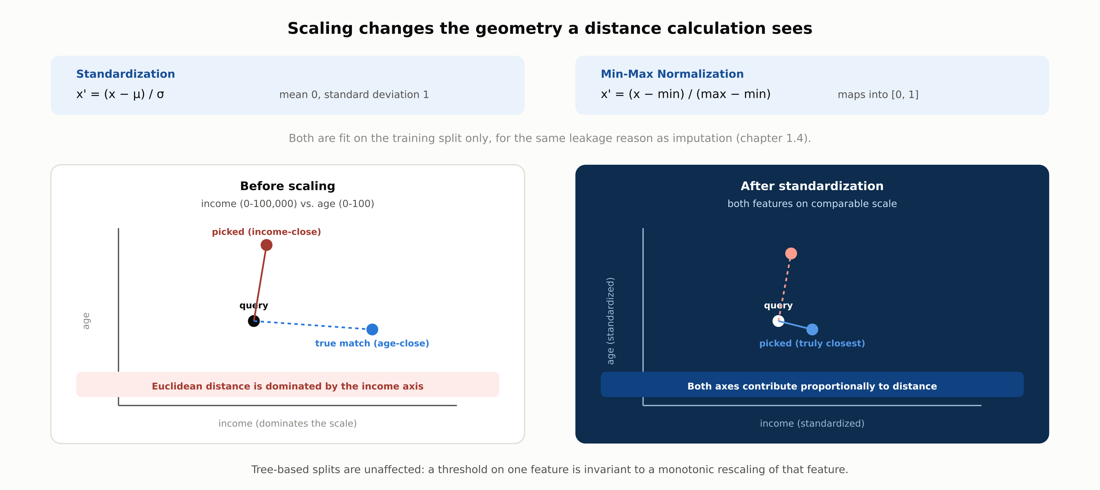
DEEP-DIVE
Scaling Changes the Geometry a Distance Sees
1.7 | Phase 1 - AI & Machine Learning Foundations
7

Slide 8
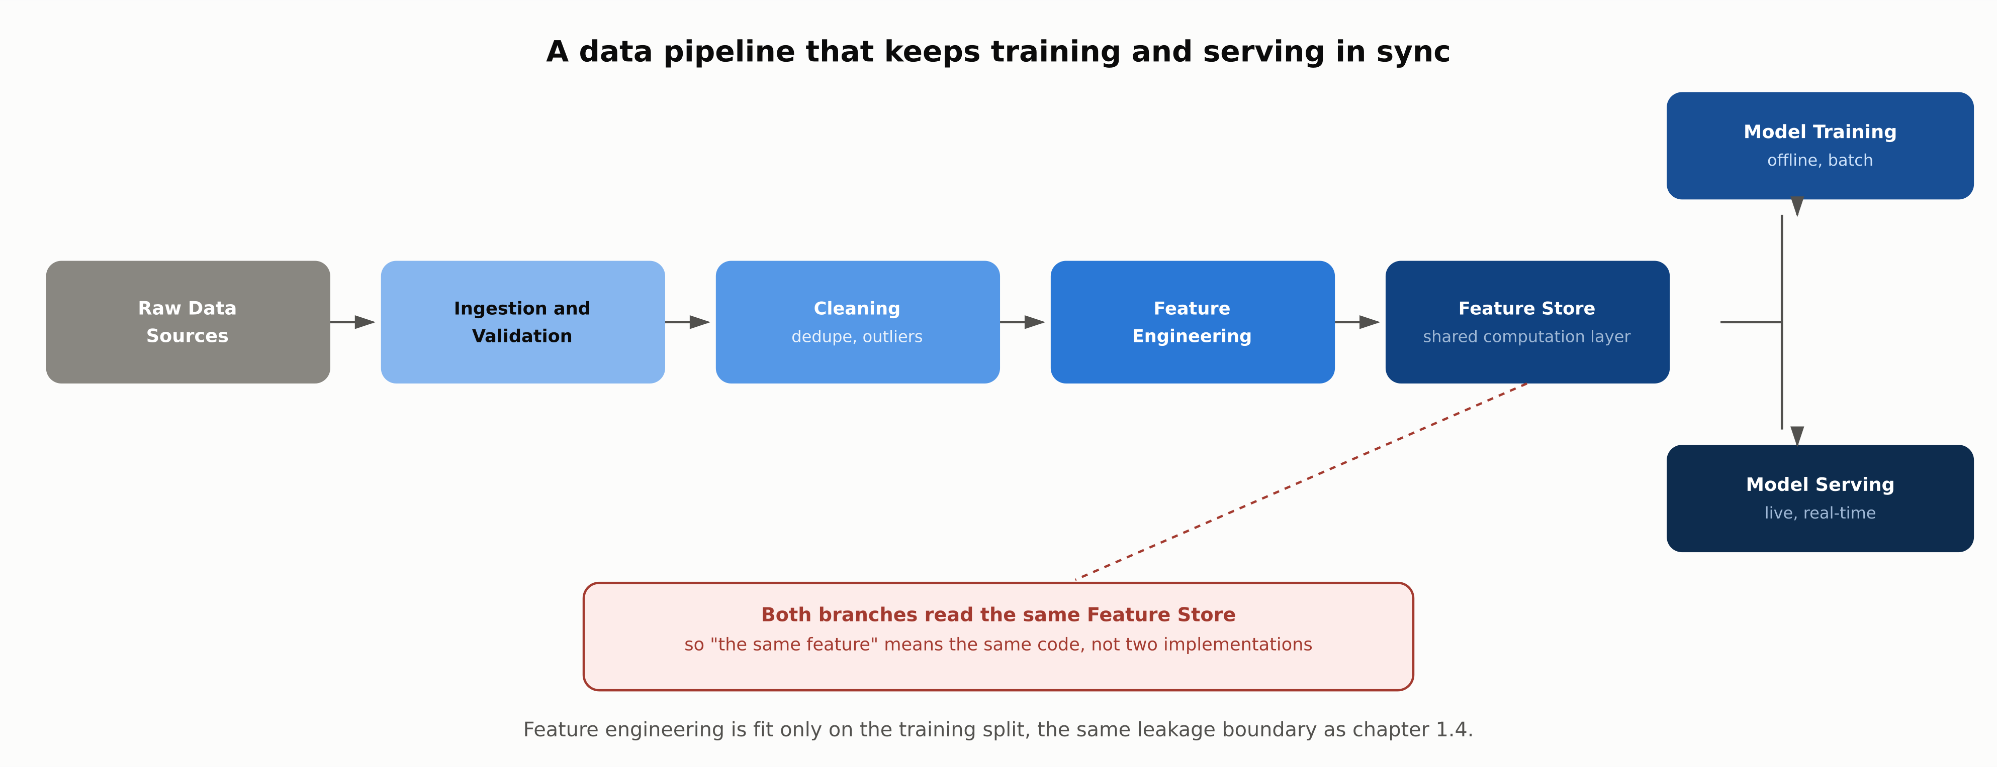
REFERENCE ARCHITECTURE
A Pipeline That Keeps Training and Serving in Sync
1.7 | Phase 1 - AI & Machine Learning Foundations
8

Slide 9
COMPARISON & RELATED CONCEPTS
Four Ways to Encode a Category
 | One-Hot | Ordinal | Target / Mean | Learned Embeddings
Leakage risk | None | None | High if not out-of-fold | Low, but needs enough data per category
Dimensionality impact | Grows with category count | None: one column | None: one column | Small fixed-size vector per category
Assumes an order | No | Yes, often incorrectly | No | No
Best suited to | Low-cardinality categories | Genuinely ordinal categories | Medium/high cardinality, careful CV | Very high cardinality, enough data
The decisive question is leakage risk, not compactness: an encoding that looks efficient but leaks the label fails exactly when it reaches production.
1.7 | Phase 1 - AI & Machine Learning Foundations
9

Slide 10
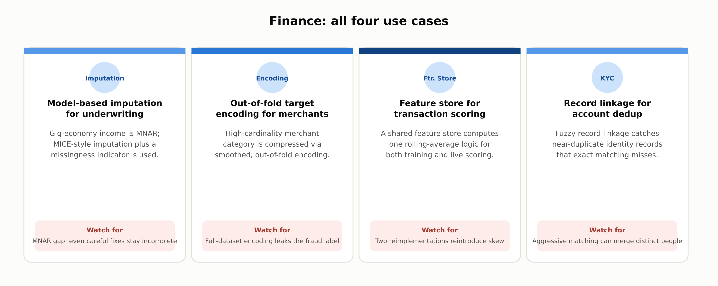
INDUSTRY USE CASES · 1 OF 3
Finance
1.7 | Phase 1 - AI & Machine Learning Foundations
10

Slide 11
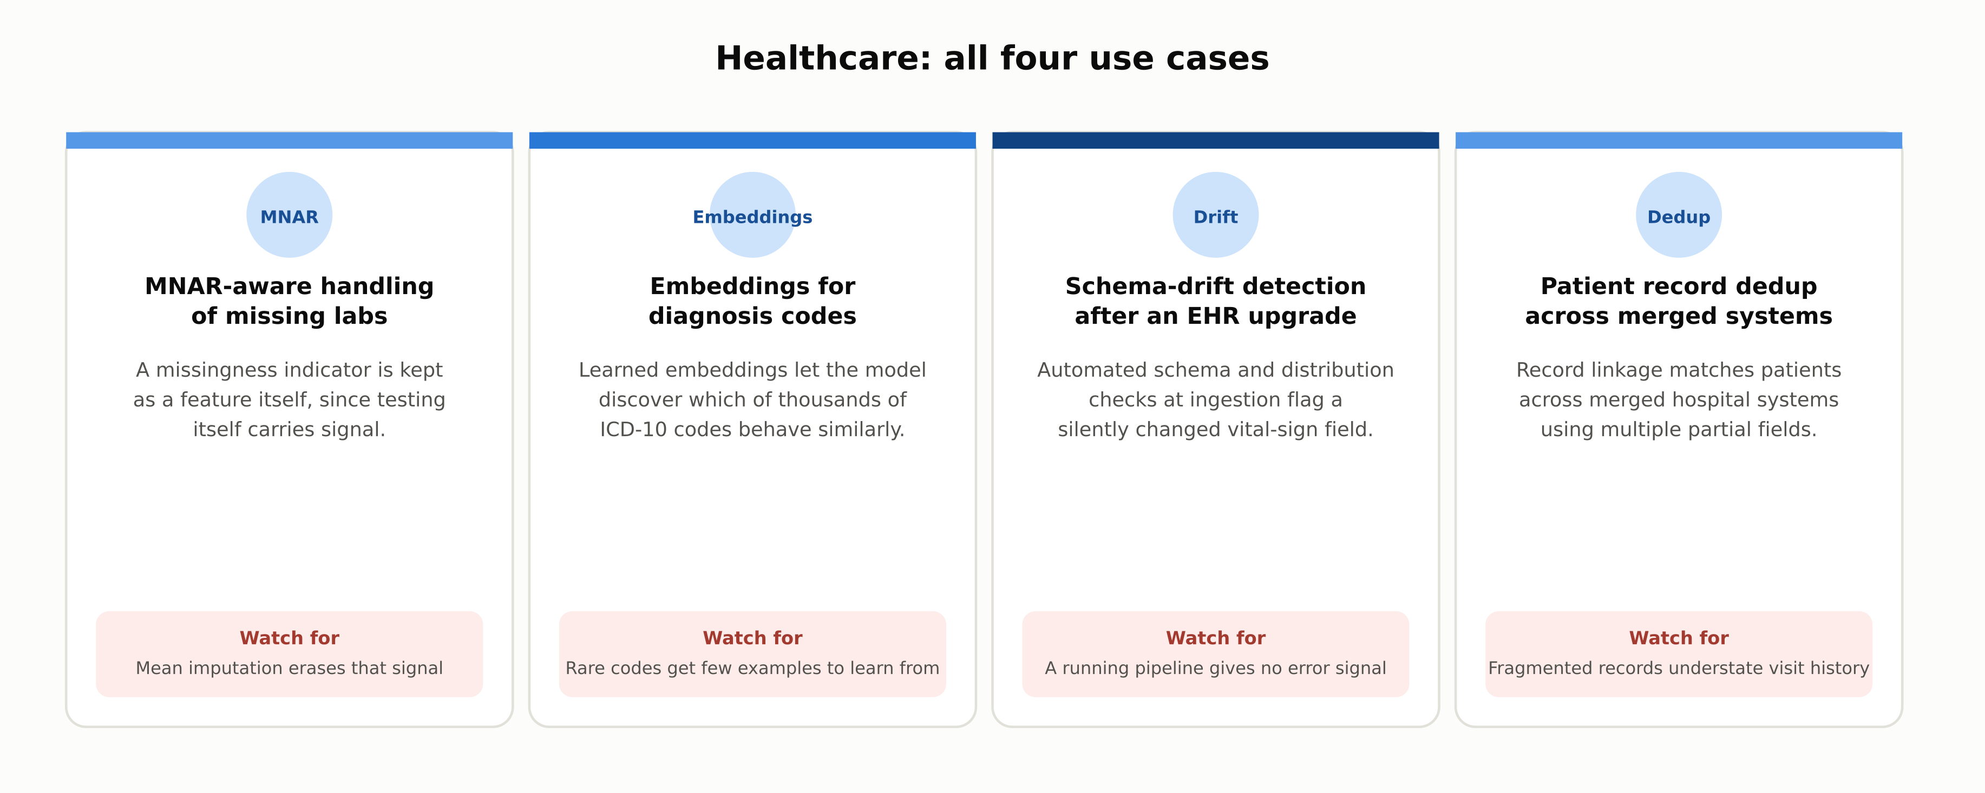
INDUSTRY USE CASES · 2 OF 3
Healthcare
1.7 | Phase 1 - AI & Machine Learning Foundations
11

Slide 12
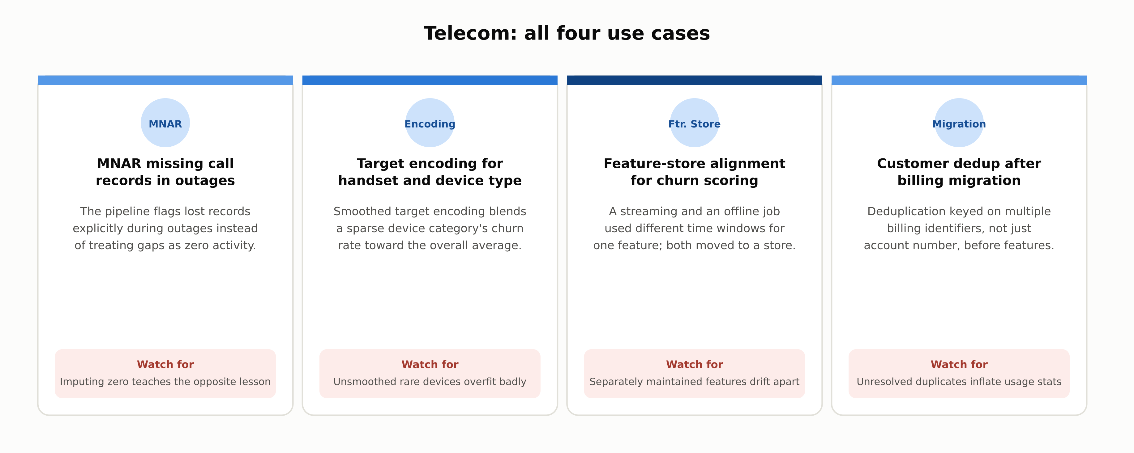
INDUSTRY USE CASES · 3 OF 3
Telecom
1.7 | Phase 1 - AI & Machine Learning Foundations
12

Slide 13
DISCUSS AS A CLASS
Check Your Understanding
Q1
Why is fitting an imputer's statistics on the full dataset before splitting into train and test a form of data leakage?
Q2
What is the difference between MCAR, MAR, and MNAR missingness, and why does it matter for choosing a strategy?
Q3
Why can target encoding a categorical variable leak label information, and how is that risk mitigated?
Q4
What is training-serving skew, and why might a model that performed well offline still fail in production because of it?
Q5
Why does real-world deduplication usually require more than exact-match comparison?
Answers are in the speaker notes for this slide.
1.7 | Phase 1 - AI & Machine Learning Foundations
13
Notes:
Q1: Why is fitting an imputer's statistics on the full dataset before splitting into train and test a form of data leakage? A1: Fitting on the full dataset lets information from the validation and test rows influence the imputation values used during training, the same boundary violation covered in chapter 1.4. The imputer must be fit on the training split only and then applied unchanged to validation and test. Q2: What is the difference between MCAR, MAR, and MNAR missingness, and why does it matter for choosing a strategy? A2: MCAR means missingness is unrelated to any variable, so dropping rows loses data but adds no bias. MAR means missingness depends on other observed variables, which model-based imputation can account for. MNAR means missingness depends on the missing value itself, which no imputation method can fully correct, because the information needed to correct it is exactly what was not recorded. Q3: Why can target encoding a categorical variable leak label information, and how is that risk mitigated? A3: Target encoding replaces a category with a statistic of the target variable for that category; if a row's own label contributes to its own encoded value, the encoding has effectively seen the answer. The standard mitigation is to compute the encoding out-of-fold, so no row contributes to its own encoded value, and to smooth rare categories toward the global mean. Q4: What is training-serving skew, and why might a model that performed well offline still fail in production because of it? A4: Training-serving skew happens when a feature is computed differently by the training pipeline than by the live serving system, so the model receives inputs at serving time that do not match what it learned from. Offline evaluation metrics cannot detect this, because they run entirely inside the training-side code path and never exercise the serving path. Q5: Why does real-world deduplication usually require more than exact-match comparison? A5: The same real-world entity, a customer or a patient, is frequently recorded with small variations, typos, formatting differences, or partial fields, across different source systems. Exact-match comparison misses these near-duplicates, so record linkage techniques that compare multiple partially-identifying fields are needed instead.

Slide 14
SUMMARY
Key Takeaways
✓
A pipeline that runs without crashing gives no signal that its output is wrong; failures propagate silently.
✓
The right fix for missing data depends on whether it's MCAR, MAR, or MNAR; no single strategy fits all three.
✓
Target encoding is powerful but leaks the label unless computed strictly out-of-fold, with rare categories smoothed.
✓
Scaling matters for distance- and gradient-based methods, but tree-based splits are invariant to it.
✓
A shared feature store is the standard fix for training-serving skew: the same code, not two implementations.
1.7 | Phase 1 - AI & Machine Learning Foundations
14

Slide 15
FURTHER READING
Sources Cited in This Chapter
Little & Rubin, Statistical Analysis with Missing Data, 2nd ed.
Wiley, 2002
van Buuren & Groothuis-Oudshoorn, mice: Multivariate Imputation by Chained Equations in R
Journal of Statistical Software, 2011
Micci-Barreca, A Preprocessing Scheme for High-Cardinality Categorical Attributes
SIGKDD Explorations, 2001
Guo & Berkhahn, Entity Embeddings of Categorical Variables
arXiv, 2016
Sculley et al., Hidden Technical Debt in Machine Learning Systems
NeurIPS, 2015
Full chapter with inline links: docs/01-ai-ml-foundations/1-7-data-foundations.mdx
1.7 | Phase 1 - AI & Machine Learning Foundations
15

