Slide 1
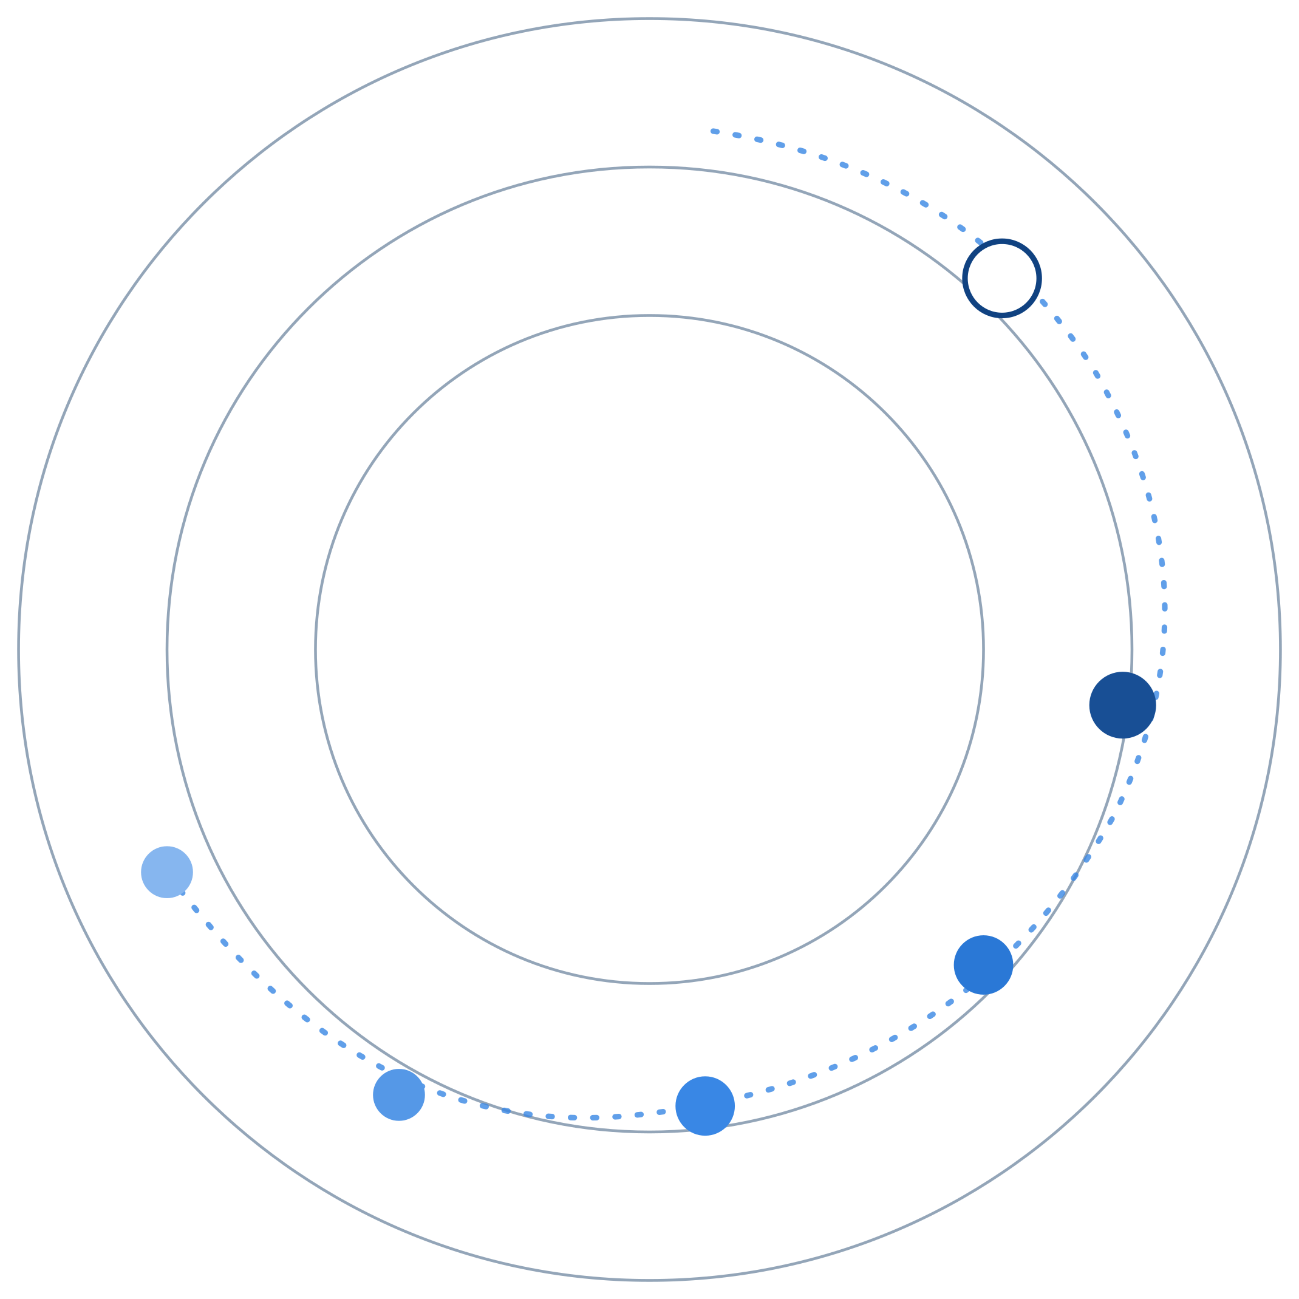
REGAITRAINING · PHASE 1 -- AI & MACHINE LEARNING FOUNDATIONS
CHAPTER 1.8
Math Refresher
Linear Algebra, Probability, Statistics, and Optimization
A teaching-slide walkthrough of the chapter: the four math areas doing the work behind every model in this curriculum, and just enough of each to recognize a suspicious result.
Instructor deck · 15 slides · based on docs/01-ai-ml-foundations/1-8-math-refresher.mdx

Slide 2
ROADMAP
What We'll Cover
1
Linear algebra
5
A reference architecture
Vectors, matrices, and the dot product behind every prediction
Where each math area does its work in a training loop
2
Probability
6
Comparison table
Bayes' theorem and why the prior matters more than it seems
Four different jobs in the same pipeline
3
Statistics
7
Industry use cases
p-values, confidence intervals, and deciding if a result is real
Finance, Healthcare, and Telecom - 4 each
4
Optimization
Gradient descent, the learning rate, and convexity
1.8 | Phase 1 - AI & Machine Learning Foundations
2

Slide 3
TL;DR
Four Tools, One Pipeline
Linear algebra is the language a model's inputs and parameters are written in. Probability is how a model expresses uncertainty. Statistics is how a practitioner decides whether a result is real. Optimization is how a model actually learns.
THE PRACTICAL TAKEAWAY
None of this requires proving theorems; it requires knowing what each tool is for well enough to recognize when a result is suspicious.
1.8 | Phase 1 - AI & Machine Learning Foundations
3

Slide 4
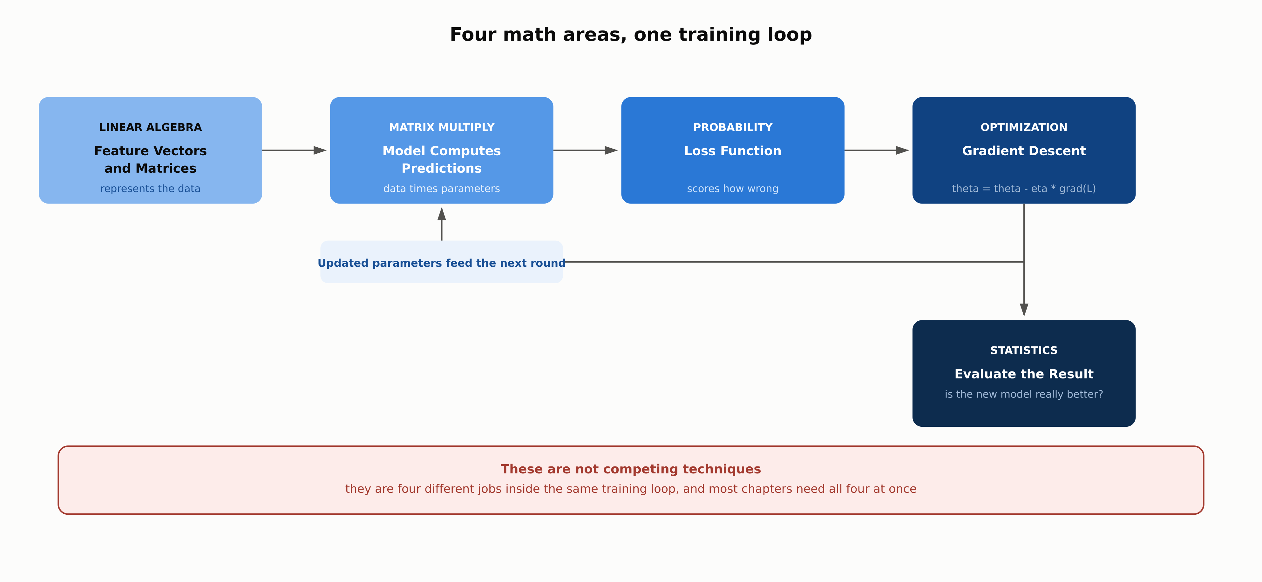
HIGH-LEVEL
Four Math Areas, One Training Loop
1.8 | Phase 1 - AI & Machine Learning Foundations
4

Slide 5
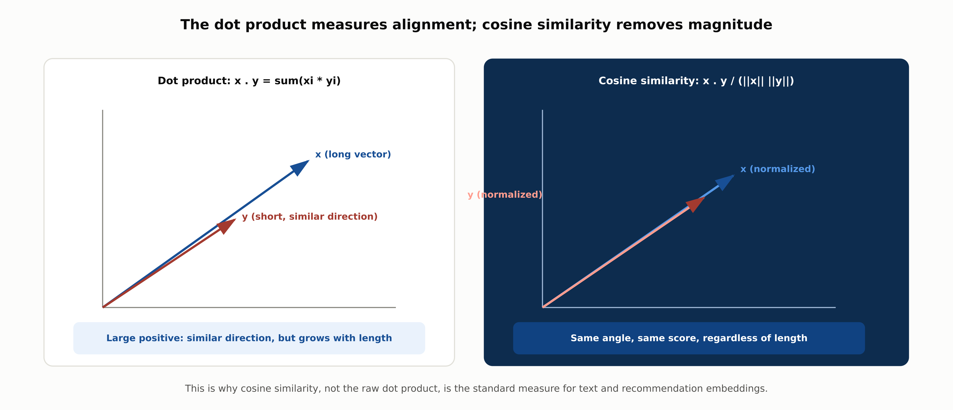
DEEP-DIVE
The Dot Product and Cosine Similarity
1.8 | Phase 1 - AI & Machine Learning Foundations
5

Slide 6
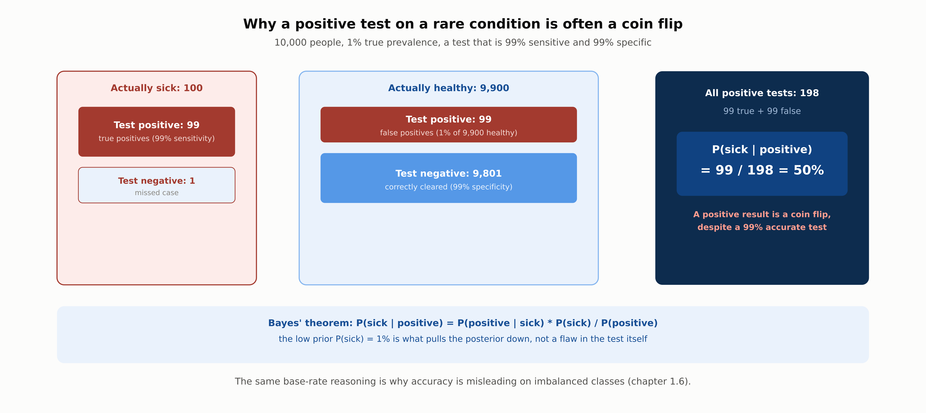
DEEP-DIVE
Bayes' Theorem: Why the Prior Matters
1.8 | Phase 1 - AI & Machine Learning Foundations
6

Slide 7
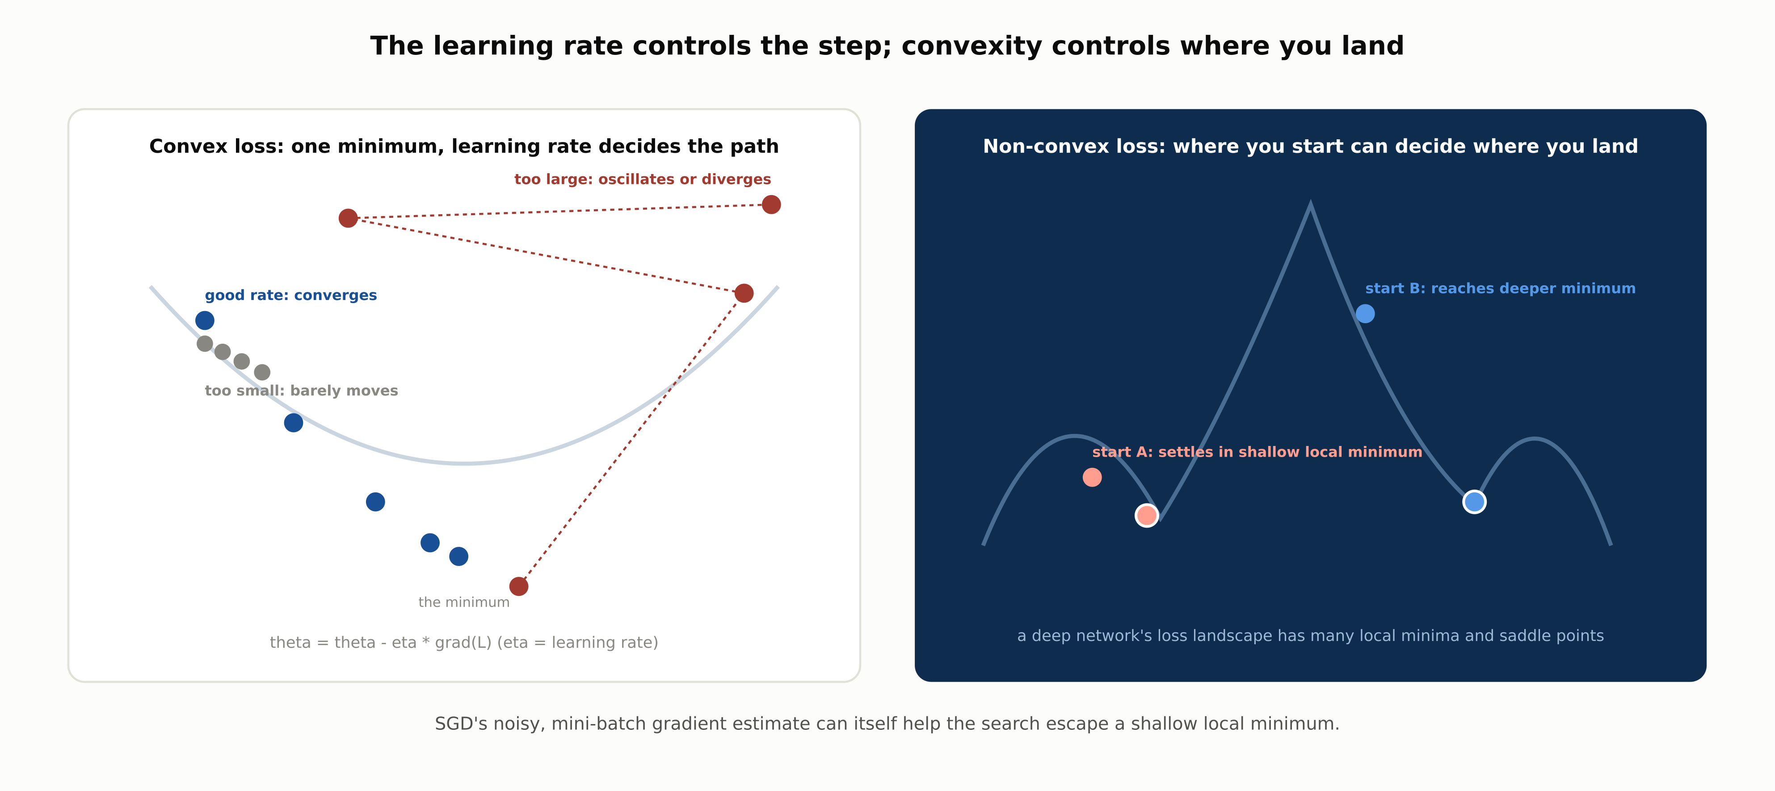
DEEP-DIVE
The Learning Rate and Convexity
1.8 | Phase 1 - AI & Machine Learning Foundations
7

Slide 8
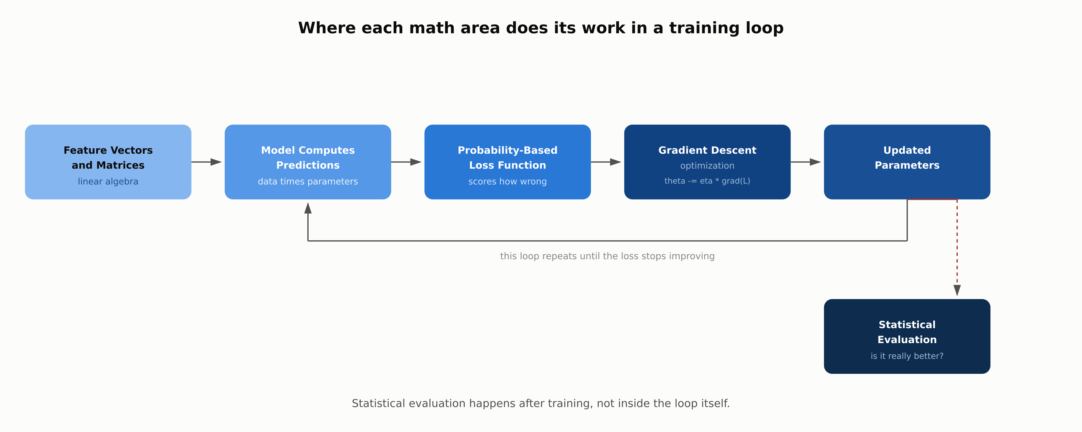
REFERENCE ARCHITECTURE
Where Each Math Area Does Its Work
1.8 | Phase 1 - AI & Machine Learning Foundations
8

Slide 9
COMPARISON & RELATED CONCEPTS
Four Different Jobs, One Pipeline
 | Linear Algebra | Probability | Statistics | Optimization
Core question | How is data represented? | How certain is the model? | Is this result real or noise? | How does the model learn?
Key object | Vectors and matrices | Distributions, Bayes' theorem | p-values, confidence intervals | The gradient, the learning rate
Shows up in this curriculum | Feature vectors (1.4), PCA | Naive Bayes (1.2), A/B testing | Comparing model A vs. B (1.6) | Training loop for every model (1.5)
Failure mode if ignored | Unscaled features compared directly | Ignoring the prior on a rare event | Calling noise "significant" | A learning rate that diverges
These four areas are not competing techniques to choose between, they are different jobs in the same pipeline, and a chapter's real math content usually needs all four at once.
1.8 | Phase 1 - AI & Machine Learning Foundations
9

Slide 10
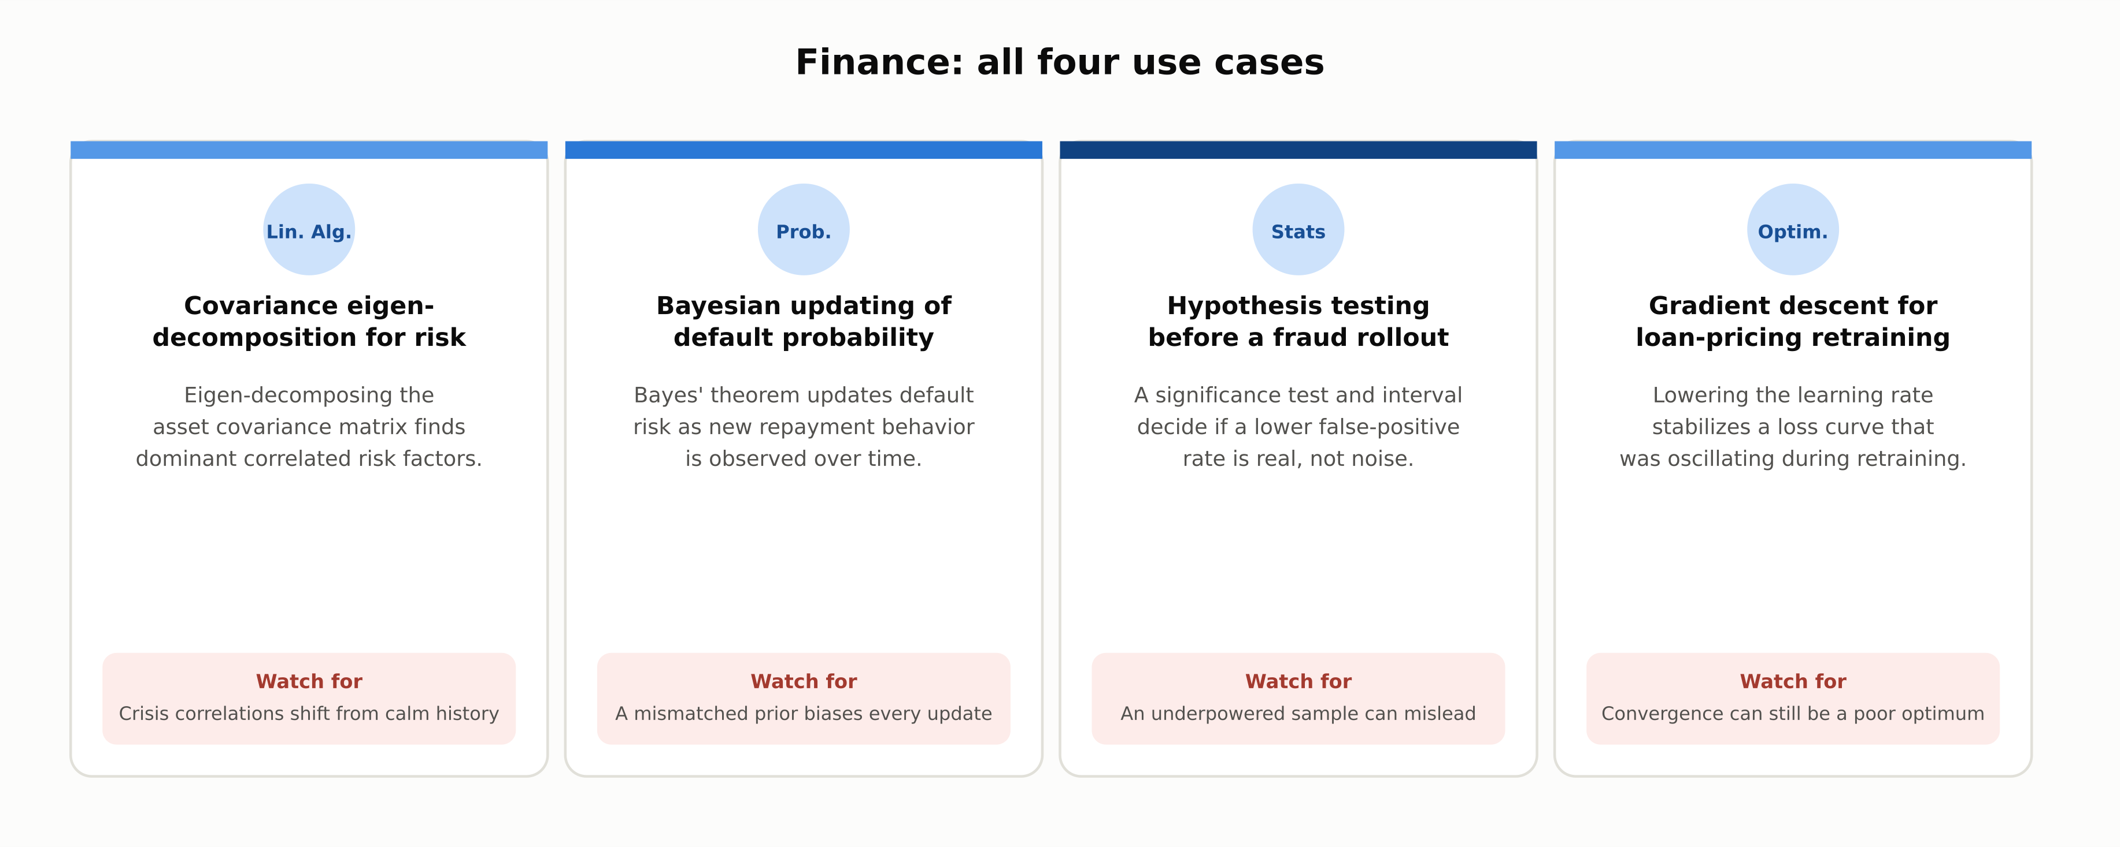
INDUSTRY USE CASES · 1 OF 3
Finance
1.8 | Phase 1 - AI & Machine Learning Foundations
10

Slide 11
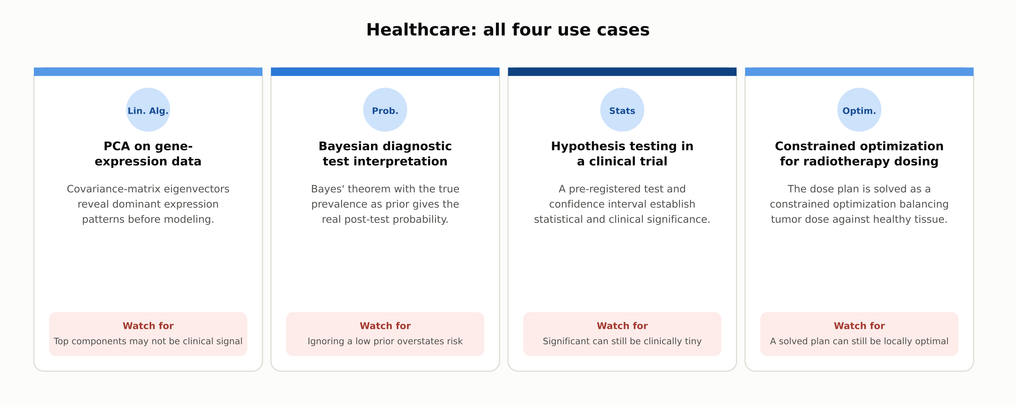
INDUSTRY USE CASES · 2 OF 3
Healthcare
1.8 | Phase 1 - AI & Machine Learning Foundations
11

Slide 12
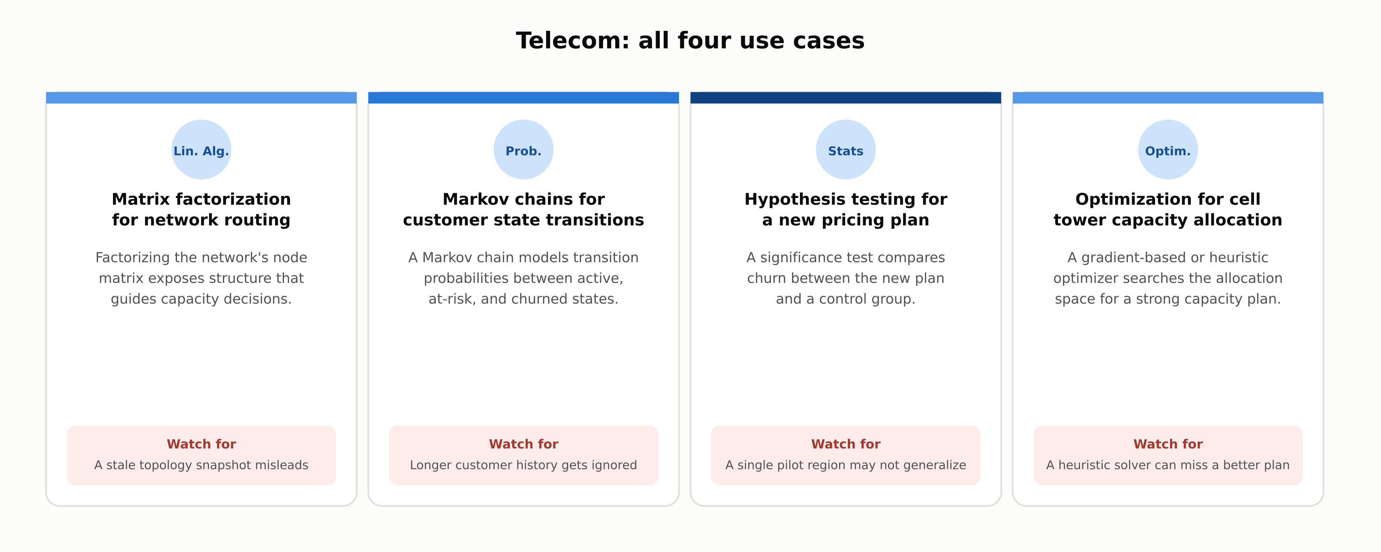
INDUSTRY USE CASES · 3 OF 3
Telecom
1.8 | Phase 1 - AI & Machine Learning Foundations
12

Slide 13
DISCUSS AS A CLASS
Check Your Understanding
Q1
What does the dot product of two vectors measure, and why does cosine similarity divide it by the vectors' lengths?
Q2
In the rare-disease diagnostic test example, why can a 99% sensitive, 99% specific test still produce mostly false positives?
Q3
What is the difference between a p-value and a confidence interval, and what does a small p-value fail to guarantee?
Q4
In one step of gradient descent, what does the gradient tell you, and what happens if the learning rate is too high?
Q5
Why does it matter whether a loss surface is convex or non-convex?
Answers are in the speaker notes for this slide.
1.8 | Phase 1 - AI & Machine Learning Foundations
13
Notes:
Q1: What does the dot product of two vectors measure, and why does cosine similarity divide it by the vectors' lengths? A1: The dot product is large when two vectors point in similar directions but its value also grows with each vector's magnitude. Cosine similarity divides by both vectors' lengths so it measures direction alone, which is why it is used to compare embeddings regardless of length. Q2: In the rare-disease diagnostic test example, why can a 99% sensitive, 99% specific test still produce mostly false positives? A2: When the condition is rare, the low prior means even a small false-positive rate applied to the much larger healthy population produces more false positives than true positives from the small sick population. Bayes' theorem, which weights the test's accuracy by the prior, gives the correct post-test probability. Q3: What is the difference between a p-value and a confidence interval, and what does a small p-value fail to guarantee? A3: A p-value is the probability of seeing a difference at least this extreme if there were truly no effect; a confidence interval gives a range of plausible values for the actual effect size. A small p-value shows evidence against "no difference," but does not guarantee the effect is large or practically meaningful. Q4: In one step of gradient descent, what does the gradient tell you, and what happens if the learning rate is too high? A4: The gradient points in the direction of steepest increase in the loss, so gradient descent steps in the opposite direction. If the learning rate is too high, each step overshoots and the loss can oscillate or diverge instead of decreasing. Q5: Why does it matter whether a loss surface is convex or non-convex? A5: A convex loss surface has exactly one minimum, so gradient descent is guaranteed to reach it regardless of starting point. A non-convex surface can have many local minima and saddle points, so the starting point, regularization, and optimizer choice all affect where training ends up.

Slide 14
SUMMARY
Key Takeaways
✓
Cosine similarity, not the raw dot product, is the standard measure because it removes magnitude.
✓
A rare event's prior can dominate a test's apparent accuracy; Bayes' theorem makes that explicit.
✓
A small p-value shows evidence against "no difference," not proof of a large or important effect.
✓
The learning rate trades off convergence speed against the risk of overshooting or diverging.
✓
Non-convex loss surfaces make the starting point and optimizer choice matter, unlike convex ones.
1.8 | Phase 1 - AI & Machine Learning Foundations
14

Slide 15
FURTHER READING
Sources Cited in This Chapter
Chapter 1.2
docs/01-ai-ml-foundations/1-2-taxonomy-of-ai.mdx
Chapter 1.4
docs/01-ai-ml-foundations/1-4-core-ml-concepts.mdx
Chapter 1.5
docs/01-ai-ml-foundations/1-5-classical-ml-algorithms.mdx
Chapter 1.6
docs/01-ai-ml-foundations/1-6-evaluation-metrics.mdx
Chapter 1.7
docs/01-ai-ml-foundations/1-7-data-foundations.mdx
Full chapter with inline links: docs/01-ai-ml-foundations/1-8-math-refresher.mdx
1.8 | Phase 1 - AI & Machine Learning Foundations
15

