Slide 1
Phase 2 — Deep Learning Foundations
Convolutional Neural Networks: Architecture & Use Cases
Convolution, pooling, receptive fields, and the LeNet-5, AlexNet, and ResNet milestones
Chapter 2.3

Slide 2
Agenda
01 | TL;DR
02 | High-Level: convolution and pooling
03 | Deep-Dive: parameter sharing, receptive fields, LeNet/AlexNet/ResNet
04 | Comparison & Related Concepts
05 | Reference Architecture: a LeNet-style pipeline
06 | Industry Use Cases (Finance, Healthcare, Telecom)
07 | Check Your Understanding
RegAITraining · Chapter 2.3
2 / 15

Slide 3
TL;DR
A fully connected MLP treats every input feature as independent, which wastes the spatial structure images have: an edge looks the same wherever it appears in the frame.
A CNN exploits that structure with a small filter that slides across the entire image, reusing the same weights at every position instead of learning a separate weight per pixel.
This parameter sharing makes CNNs dramatically more efficient than a fully connected network on image data.
Stacking convolution and pooling layers builds a hierarchy of features automatically: edges, then textures, then object parts, then whole objects.
RegAITraining · Chapter 2.3
3 / 15

Slide 4
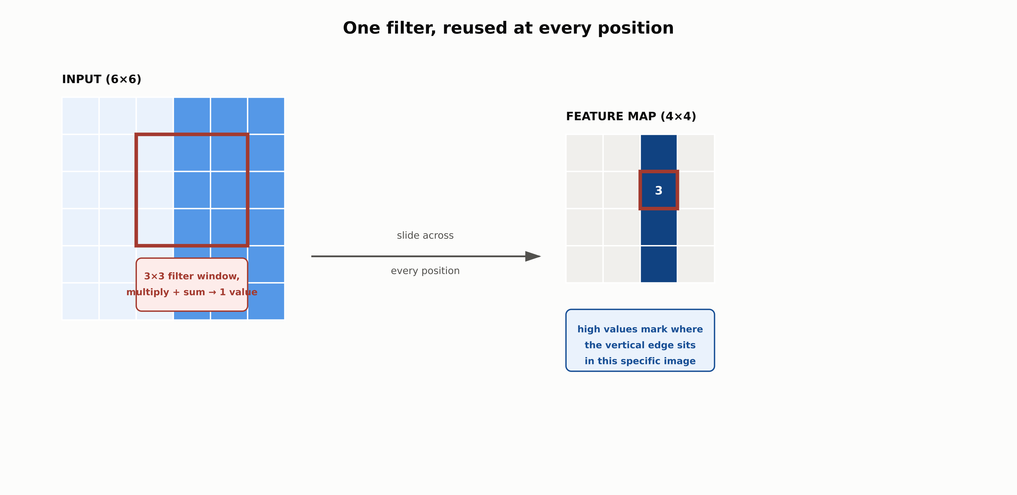
The convolution operation
The same small filter is reused at every position, which is why a CNN needs far fewer parameters than a fully connected layer.
RegAITraining · Chapter 2.3
4 / 15

Slide 5
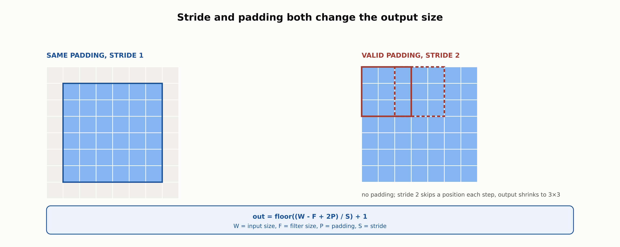
Stride and padding change output size
out = floor((W - F + 2P) / S) + 1, where W is input size, F filter size, P padding, S stride.
RegAITraining · Chapter 2.3
5 / 15

Slide 6
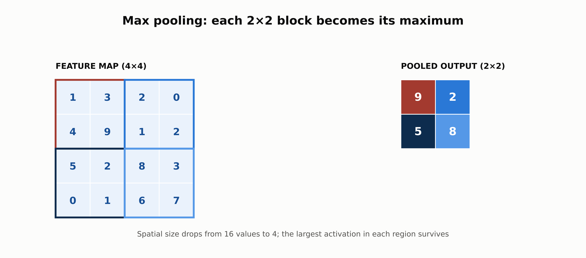
Max pooling downsamples feature maps
Spatial size drops sharply; the largest activation in each region survives, adding some tolerance to small shifts.
RegAITraining · Chapter 2.3
6 / 15

Slide 7
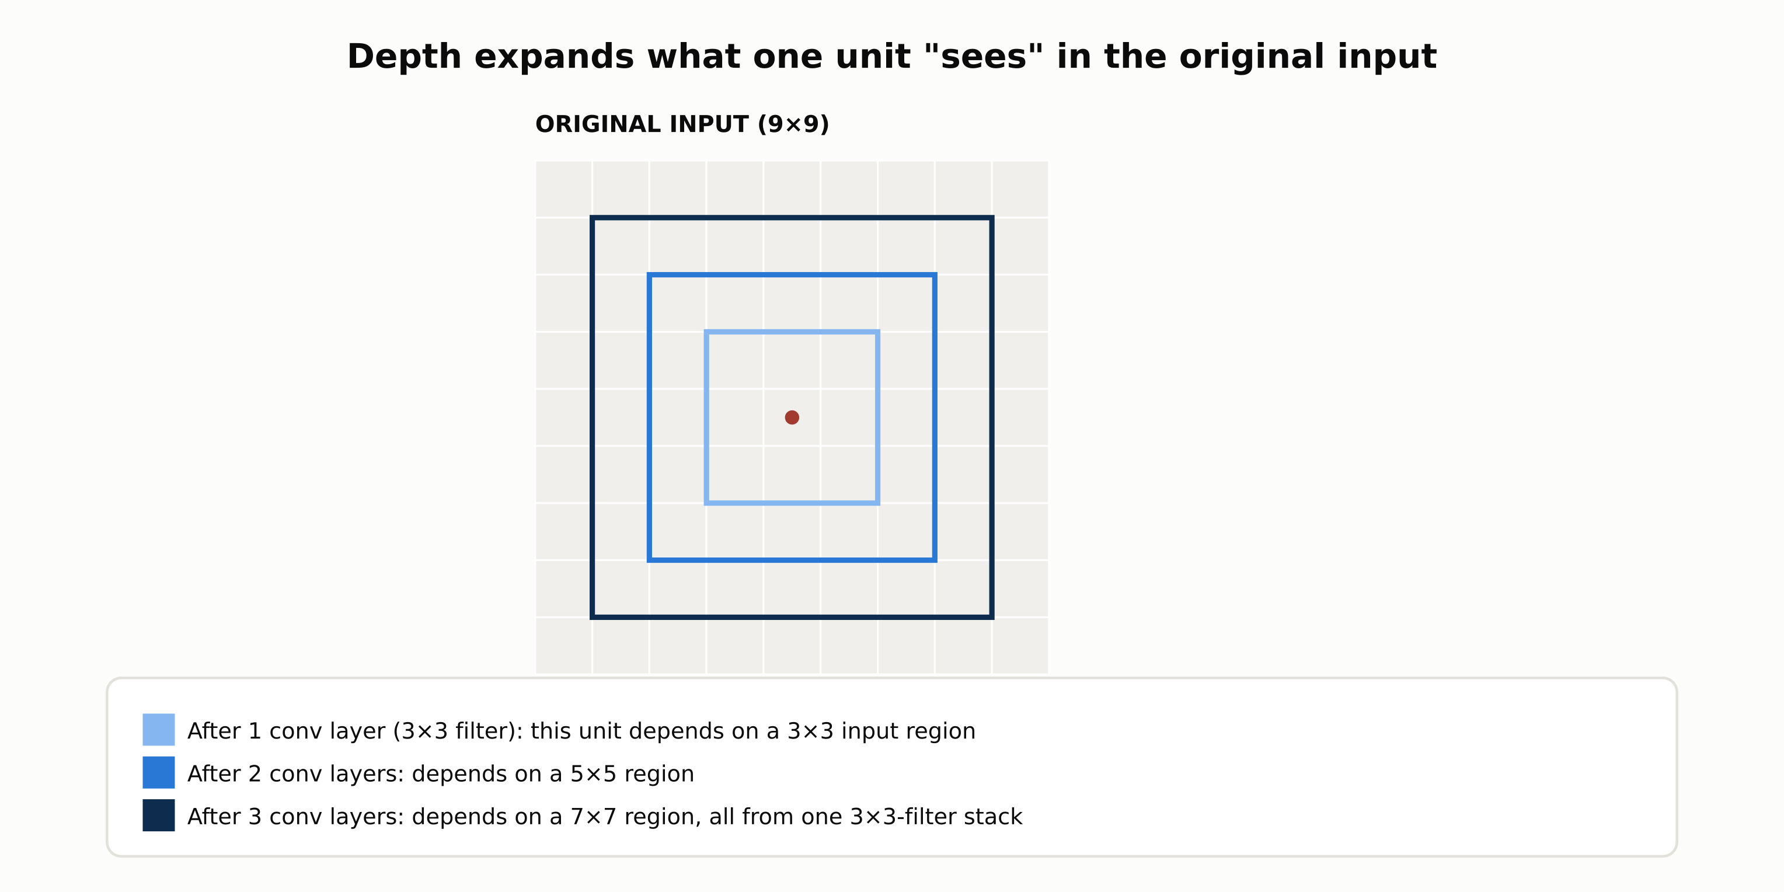
Receptive field grows with depth
Each additional convolutional layer expands the region of the original input that a later unit's value depends on.
RegAITraining · Chapter 2.3
7 / 15

Slide 8
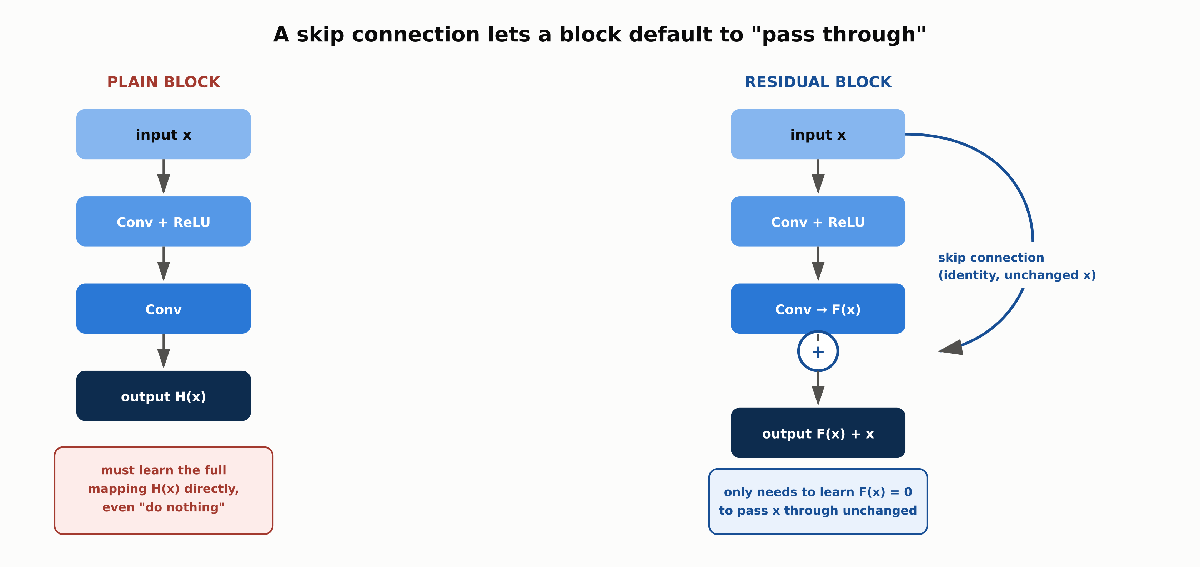
ResNet's residual (skip) connection
A block only needs to learn F(x) = 0 to pass its input through unchanged, which is why very deep ResNets still train well.
RegAITraining · Chapter 2.3
8 / 15

Slide 9
Comparison & Related Concepts
Aspect | CNN | Fully Connected MLP (2.1) | Classical ML + Hand Features (1.5)
Parameter count on image data | Low: filters are reused across positions | Very high: one weight per pixel per unit | Low, but features are hand-designed
Exploits spatial locality | Yes, by construction | No, treats every pixel independently | Only if the hand-designed features do
Feature engineering required | No, learned end-to-end | No, but impractical on raw images | Yes, a human designs the features
Translation tolerance | Some, from pooling and shared filters | None, a shifted pattern looks entirely new | Depends on the specific features chosen
A CNN's inductive bias (locality and shared weights) is what makes it practical on raw images at all.
RegAITraining · Chapter 2.3
9 / 15

Slide 10
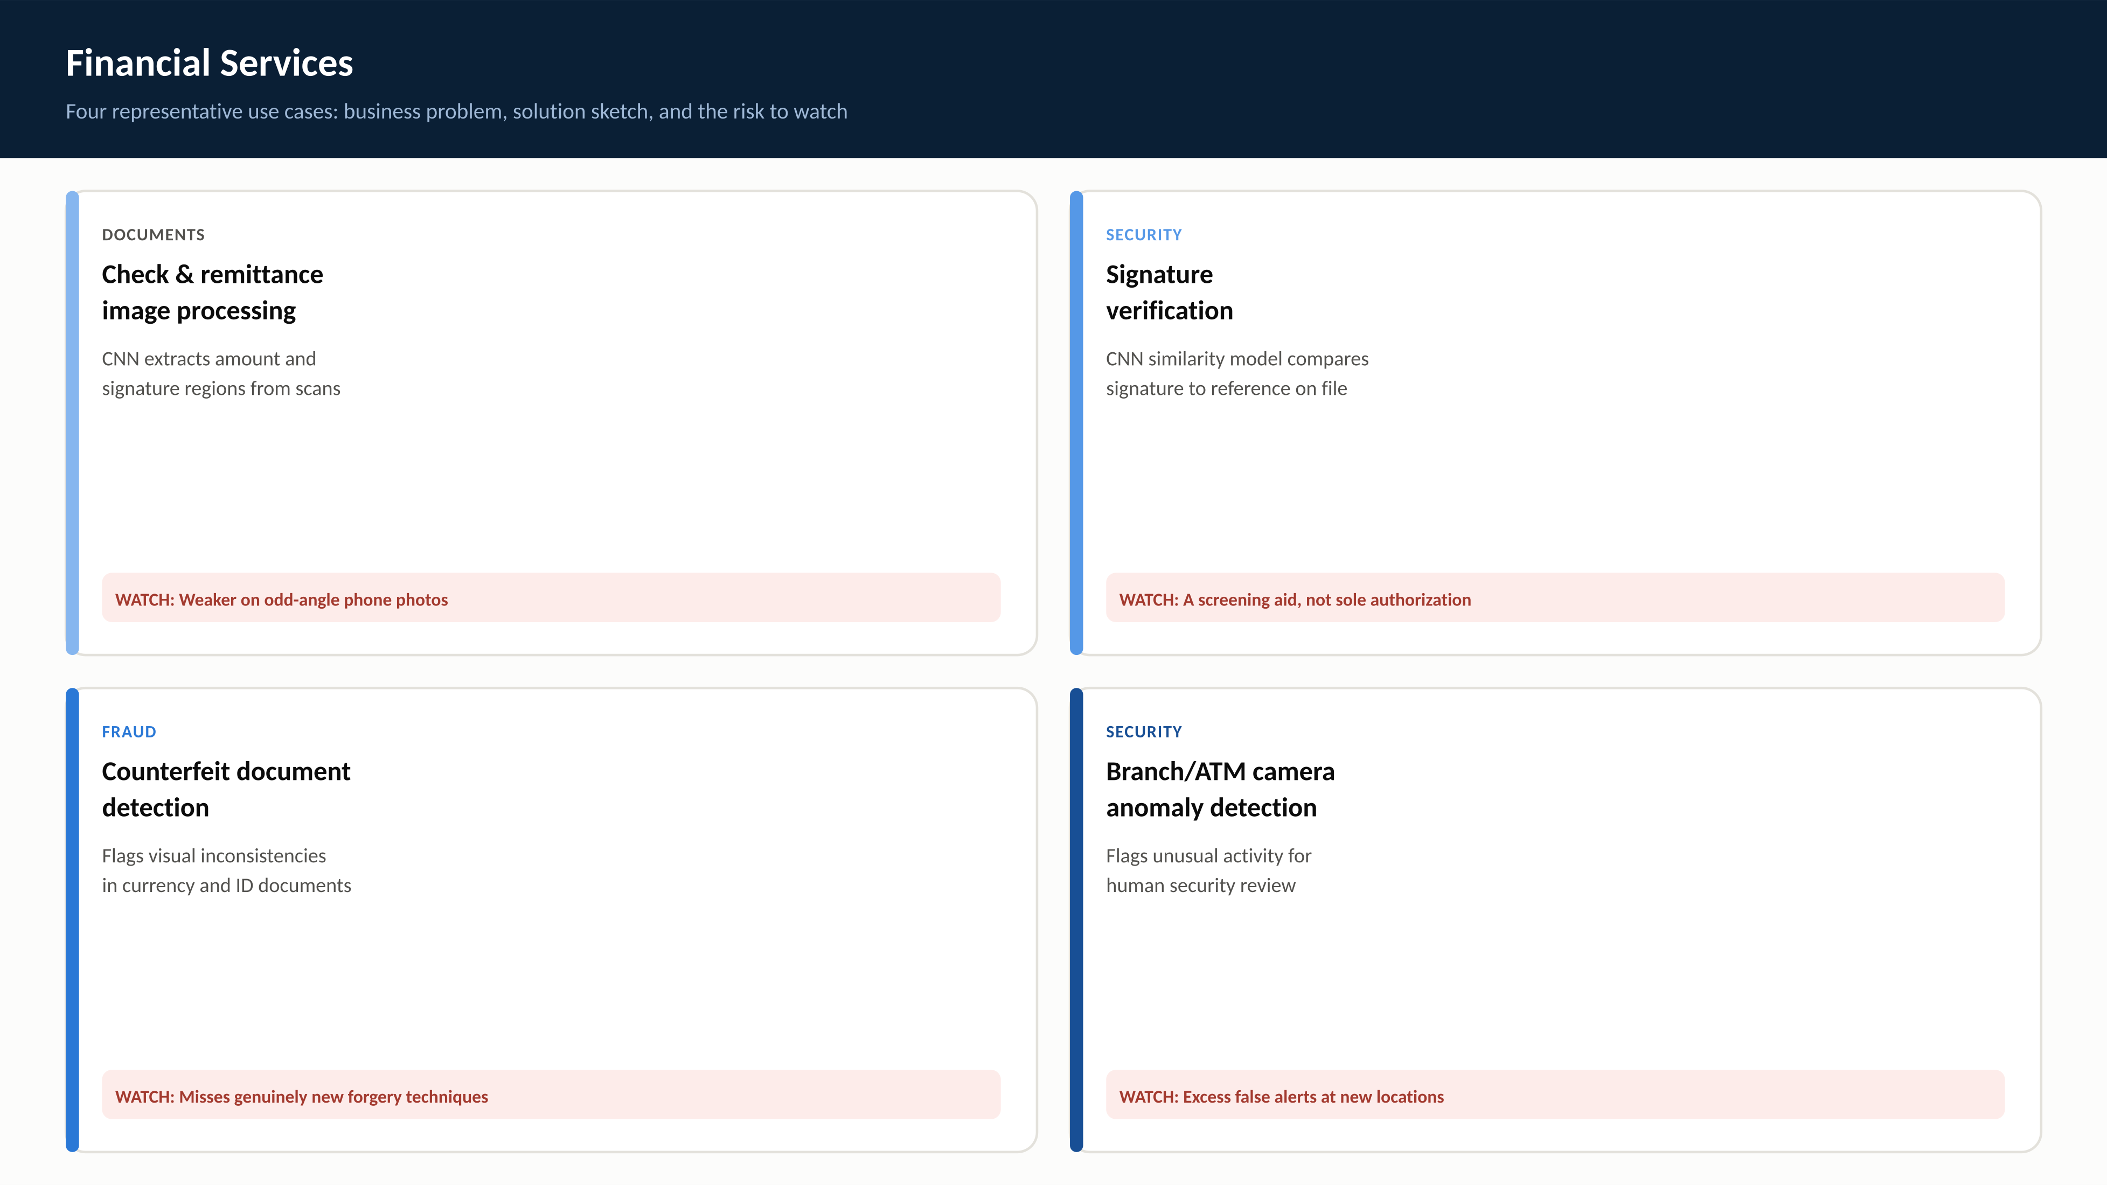
RegAITraining · Chapter 2.3
10 / 15

Slide 11
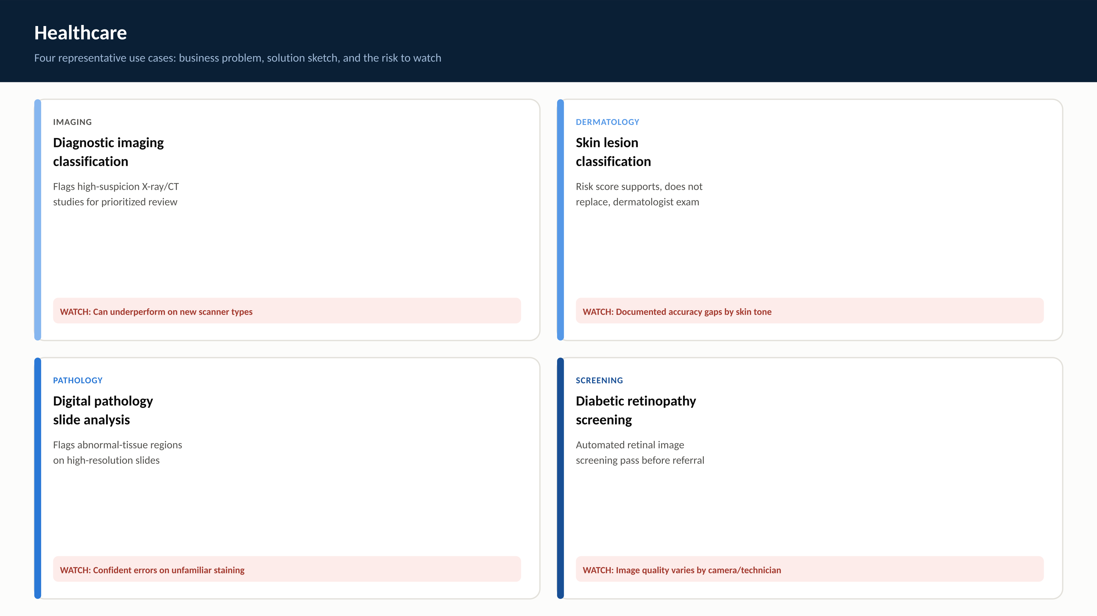
RegAITraining · Chapter 2.3
11 / 15

Slide 12
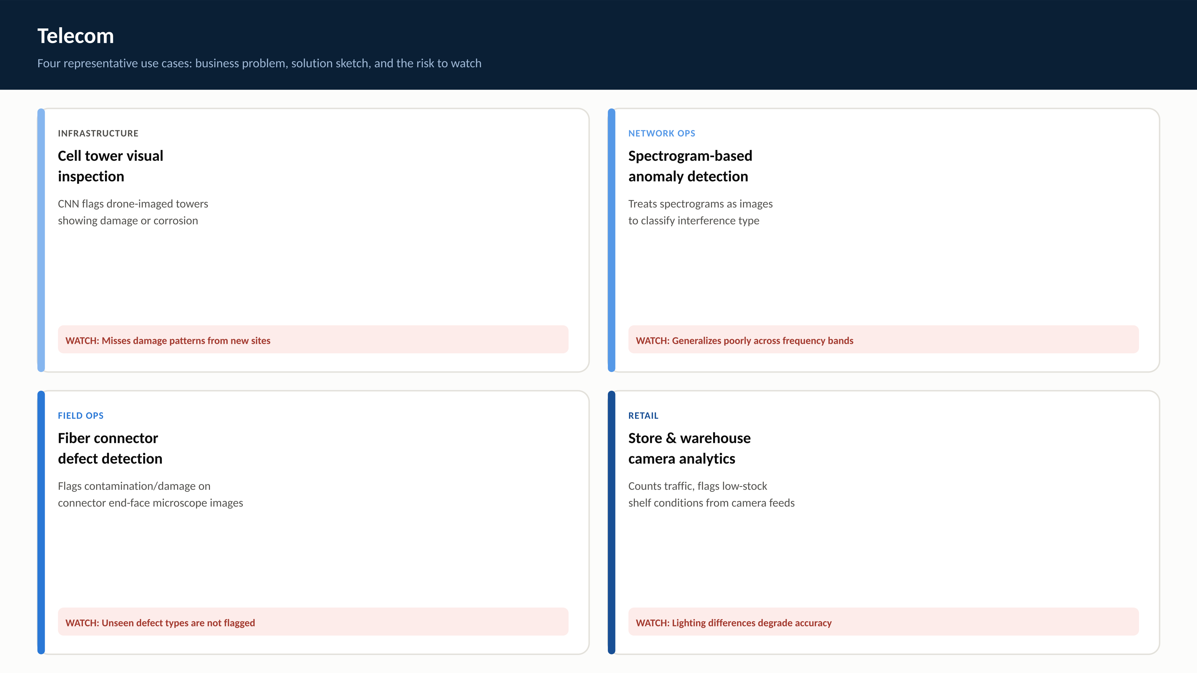
RegAITraining · Chapter 2.3
12 / 15

Slide 13
Check Your Understanding
1. What is parameter sharing in a convolutional layer, and why does it make CNNs so much more efficient than a fully connected layer on image data?
2. What does max pooling do, and what two benefits does it provide?
3. What is a receptive field, and why do later CNN layers detect more complex patterns?
4. What problem did ResNet's residual connections solve?
5. How do stride and padding each affect a convolutional layer's output size?
RegAITraining · Chapter 2.3
13 / 15
Notes:
Q1: What is parameter sharing in a convolutional layer, and why does it make CNNs so much more efficient than a fully connected layer on image data? A1: The same filter weights are reused at every spatial position, rather than each position having its own weights. A fully connected layer needs a separate weight per pixel per unit, which grows enormous for realistic images, while a convolutional layer's parameter count depends only on filter size and channel counts. Q2: What does max pooling do, and what two benefits does it provide? A2: It takes the maximum value in each small non-overlapping region of a feature map, reducing spatial size. This reduces later computation and adds tolerance to a pattern shifting by a small number of pixels, since the same maximum often survives a small translation. Q3: What is a receptive field, and why do later CNN layers detect more complex patterns? A3: A unit's receptive field is the region of the original input its value depends on. Each layer expands the receptive field of later units, so deeper units depend on a larger input region and can combine simpler earlier patterns into more complex, composite ones. Q4: What problem did ResNet's residual connections solve? A4: Beyond a certain depth, stacking more plain convolutional layers caused accuracy to degrade, even on the training set, distinct from overfitting. Residual connections let a block learn a residual added back to its own input, so a block with nothing to add can more easily pass its input through unchanged, letting networks scale past a hundred layers. Q5: How do stride and padding each affect a convolutional layer's output size? A5: Stride controls how many pixels the filter shifts between positions; a larger stride produces a smaller output. Padding adds pixels around the input's border; same padding keeps output size equal to input size, while valid padding (no padding) shrinks the output.

Slide 14
Key Takeaways
A CNN reuses the same small filter at every position in an image (parameter sharing), which is why it needs far fewer weights than a fully connected layer on the same data.
Pooling downsamples feature maps, reducing computation and adding some tolerance to small shifts.
Stacking convolution and pooling layers builds a hierarchy of features automatically, from edges to textures to object parts to whole objects, because each layer expands the receptive field of the units that follow it.
LeNet-5 proved CNNs could learn their own features end-to-end; AlexNet scaled the idea with ReLU and GPUs to win ImageNet 2012 and trigger the deep learning boom in vision.
ResNet's residual connections let very deep networks (100+ layers) keep improving by letting a block default to passing its input through unchanged.
RegAITraining · Chapter 2.3
14 / 15

Slide 15
Sources
LeCun, Y., Bottou, L., Bengio, Y., and Haffner, P. (1998). Gradient-Based Learning Applied to Document Recognition. Proceedings of the IEEE. — https://ieeexplore.ieee.org/document/726791
Krizhevsky, A., Sutskever, I., and Hinton, G. (2012). ImageNet Classification with Deep Convolutional Neural Networks. NeurIPS. — https://papers.nips.cc/paper/4824-imagenet-classification-with-deep-convolutional-neural-networks
He, K., Zhang, X., Ren, S., and Sun, J. (2016). Deep Residual Learning for Image Recognition. CVPR. — https://arxiv.org/abs/1512.03385
RegAITraining · Chapter 2.3
15 / 15

