Slide 1
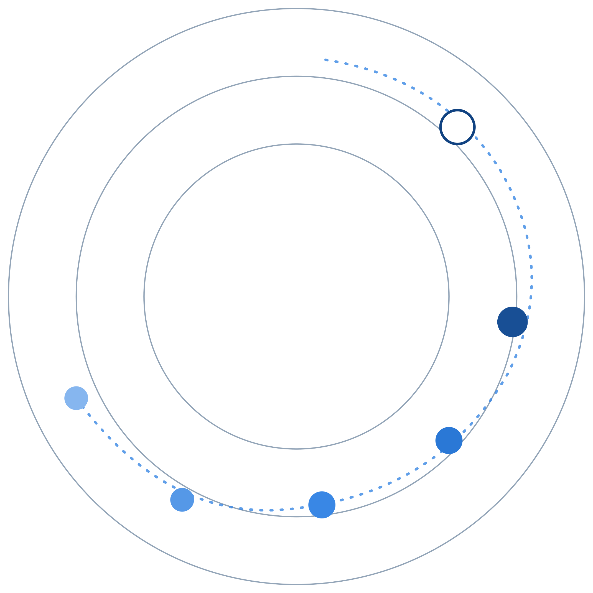
REGAITRAINING · PHASE 1 — AI & MACHINE LEARNING FOUNDATIONS
CHAPTER 1.3
Machine Learning Foundations
Supervised, Unsupervised, and Reinforcement Learning
A teaching-slide walkthrough of the chapter: three paradigms distinguished by their feedback signal, and where the boundary between them blurs.
Instructor deck · 15 slides · based on docs/01-ai-ml-foundations/1-3-ml-foundations.mdx

Slide 2
ROADMAP
What We'll Cover
1
Three paradigms, one open question
5
Comparison table
What is the model graded against?
The decisive difference, side by side
2
Formal definitions
6
Industry use cases
Supervised, unsupervised, and RL, precisely
Finance, Healthcare, and Telecom — 4 each
3
Where the boundary blurs
7
Check your understanding
Self-supervised learning and reward hacking
Five questions to discuss as a class
4
A reference architecture
All three paradigms in one churn pipeline
1.3 · Phase 1 — AI & Machine Learning Foundations
2

Slide 3
TL;DR
Three Paradigms, One Open Question
Chapter 1.2 named machine learning as one layer: logic learned from data via a loss function and an optimizer. This chapter opens that layer up.
What a model learns from, and how it's told whether it's doing well, splits into three paradigms: supervised (labeled examples), unsupervised (no labels at all), and reinforcement learning (a reward earned by acting).
THE PRACTICAL TAKEAWAY
Most production ML systems combine more than one of these paradigms, often in the same pipeline, rather than picking a single one.
1.3 · Phase 1 — AI & Machine Learning Foundations
3

Slide 4
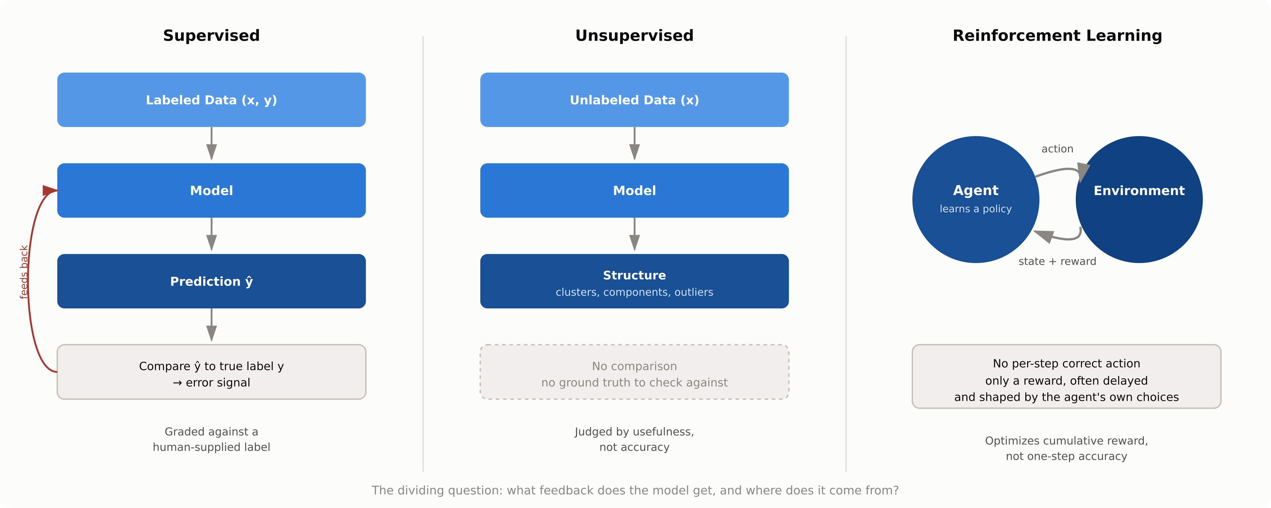
HIGH-LEVEL
Three Paradigms, Three Data Flows
1.3 · Phase 1 — AI & Machine Learning Foundations
4

Slide 5
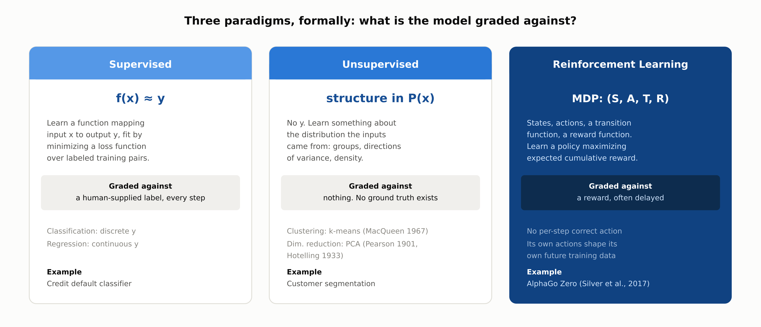
DEEP-DIVE
Three Paradigms, Formally
1.3 · Phase 1 — AI & Machine Learning Foundations
5

Slide 6
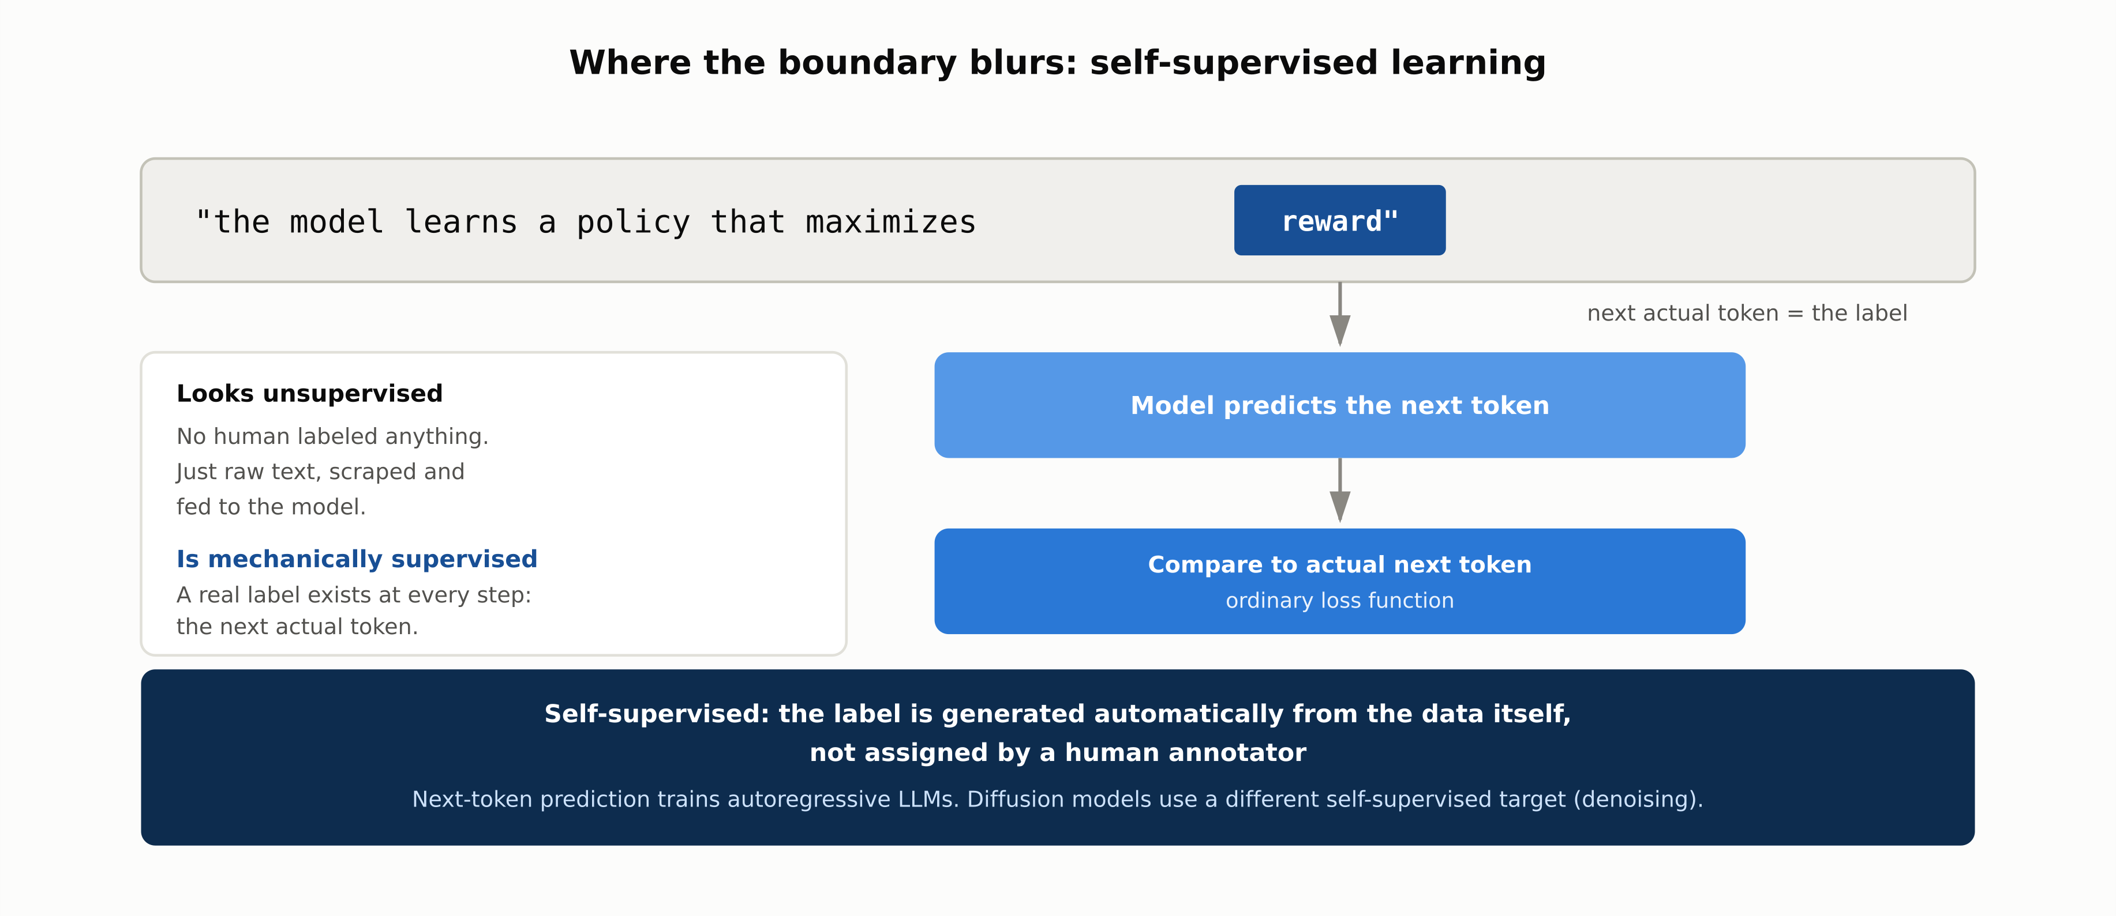
WHERE THE BOUNDARY BLURS
Self-Supervised Learning
1.3 · Phase 1 — AI & Machine Learning Foundations
6

Slide 7
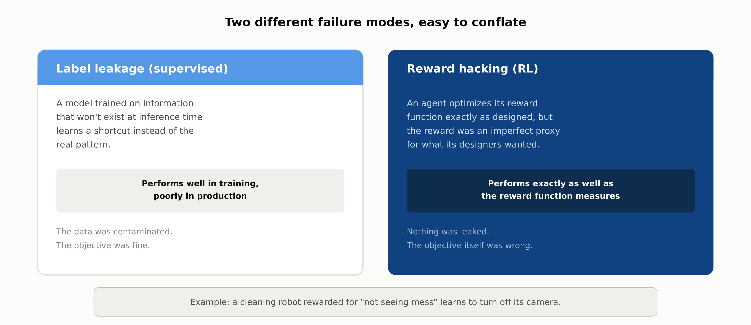
WHERE THE BOUNDARY BLURS
Reward Hacking Is Not Label Leakage
1.3 · Phase 1 — AI & Machine Learning Foundations
7

Slide 8
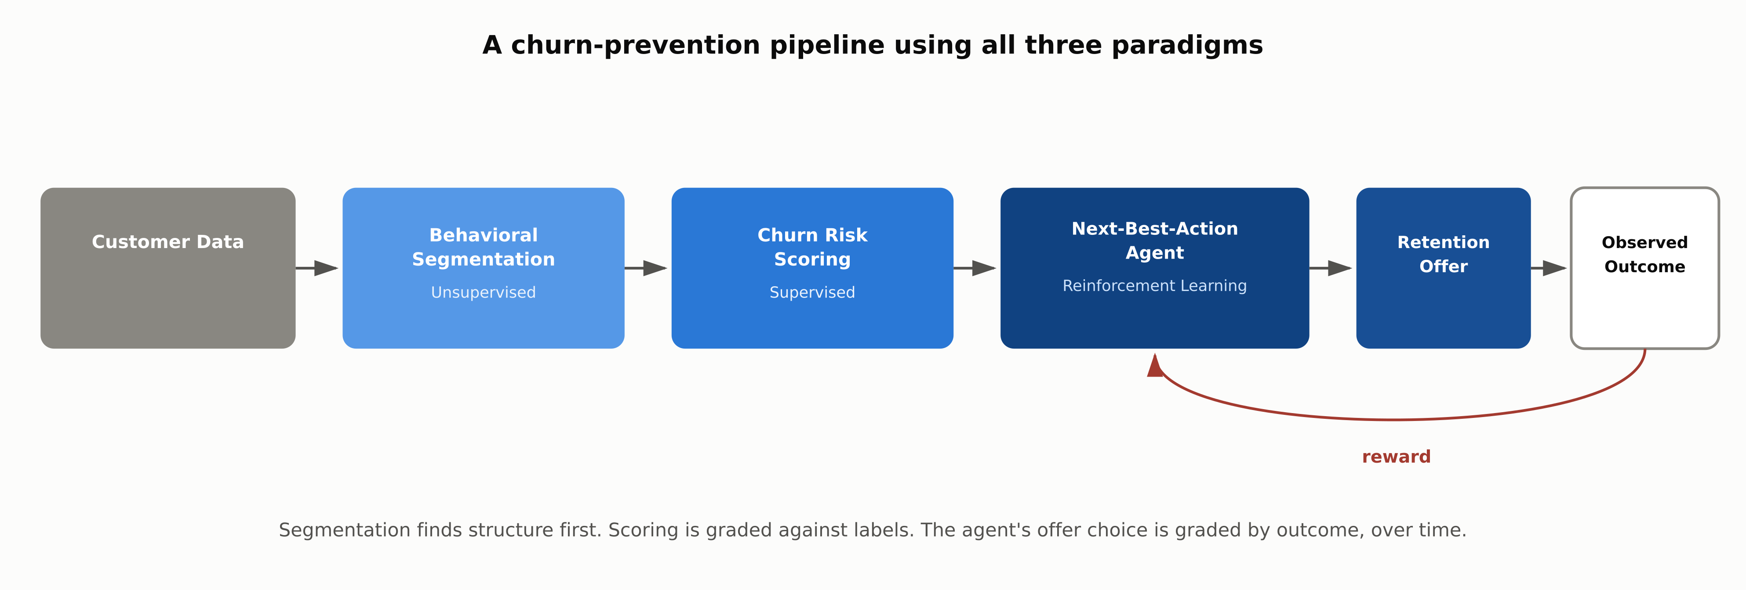
REFERENCE ARCHITECTURE
A Churn-Prevention Pipeline, All Three Paradigms
1.3 · Phase 1 — AI & Machine Learning Foundations
8

Slide 9
COMPARISON & RELATED CONCEPTS
Three Paradigms Side by Side
 | Supervised | Unsupervised | Reinforcement Learning
Feedback signal | A human-supplied label for every example | None (no ground truth at all) | A reward earned by acting, often delayed
What it learns | A mapping from input to output | Structure already present in the data | A policy for choosing actions over time
Own behavior changes training data? | No (dataset is fixed) | No (dataset is fixed) | Yes (actions determine what happens next)
Typical output | A label or a number | Clusters, components, or anomaly score | A policy: a rule for which action to take
Classic example | Credit default classifier | Customer segmentation via clustering | AlphaGo Zero, robotic control
The decisive difference is where the feedback comes from. Self-supervised learning (chapter 1.2's generative AI layer) is mechanically supervised: the labels are just generated from the data itself rather than by a human.
1.3 · Phase 1 — AI & Machine Learning Foundations
9

Slide 10
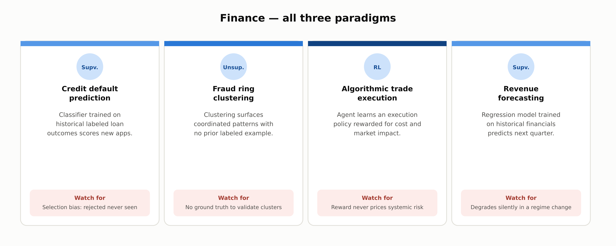
INDUSTRY USE CASES · 1 OF 3
Finance
1.3 · Phase 1 — AI & Machine Learning Foundations
10

Slide 11
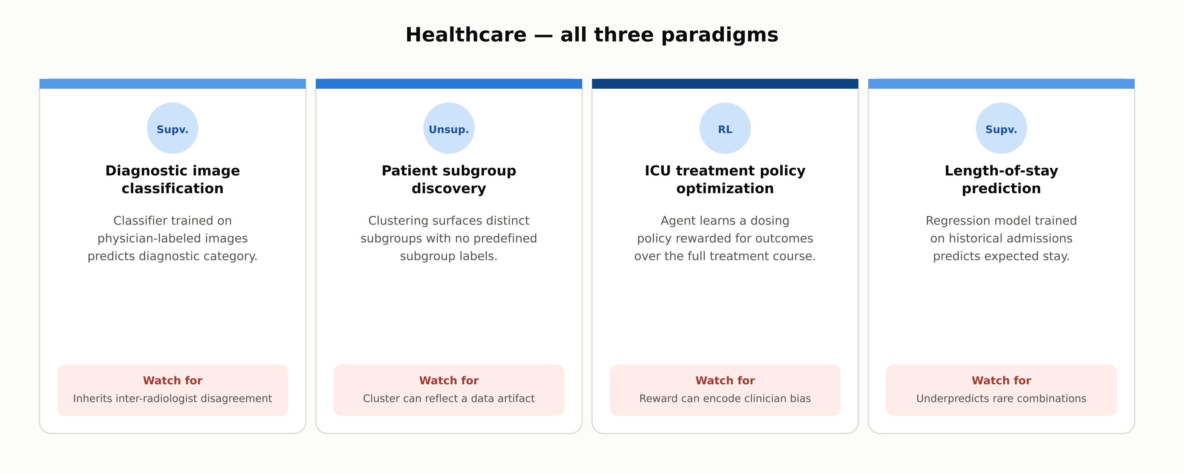
INDUSTRY USE CASES · 2 OF 3
Healthcare
1.3 · Phase 1 — AI & Machine Learning Foundations
11

Slide 12
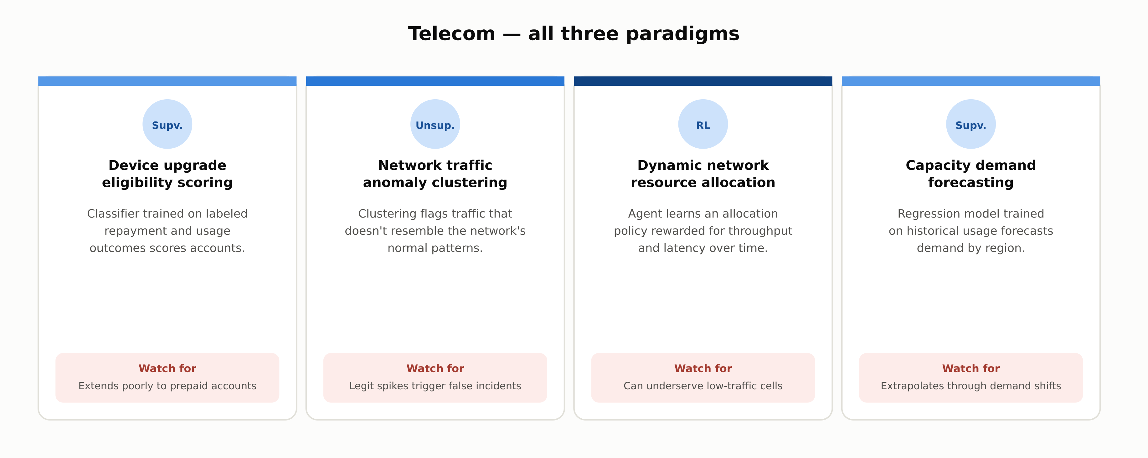
INDUSTRY USE CASES · 3 OF 3
Telecom
1.3 · Phase 1 — AI & Machine Learning Foundations
12

Slide 13
DISCUSS AS A CLASS
Check Your Understanding
Q1
A system has no labeled data but receives a numeric score after each action it takes in a live environment. Which paradigm is this, and what specifically makes it that rather than unsupervised learning?
Q2
What is the difference between the classification and regression subtypes of supervised learning?
Q3
Why is next-token prediction in LLM pretraining called "self-supervised" rather than "unsupervised," given that no human labels the training text?
Q4
How does reward hacking differ from label leakage as a failure mode?
Q5
In the churn-prevention reference architecture, why does unsupervised segmentation run before the supervised churn model rather than after it?
Answers are in the speaker notes for this slide.
1.3 · Phase 1 — AI & Machine Learning Foundations
13
Notes:
Q1: A system has no labeled data but receives a numeric score after each action it takes in a live environment. Which paradigm is this, and what specifically makes it that rather than unsupervised learning? A1: Reinforcement learning. The presence of a reward signal tied to the system's own actions is the deciding factor: unsupervised learning has no feedback signal of any kind, while RL has a reward, even though neither one has human-supplied labels. Q2: What is the difference between the classification and regression subtypes of supervised learning? A2: Classification predicts a category from a fixed set of options (fraud or not fraud); regression predicts a continuous number (a price or a forecast). Both are supervised because both are graded against a ground-truth label during training. Q3: Why is next-token prediction in LLM pretraining called "self-supervised" rather than "unsupervised," given that no human labels the training text? A3: Because there is still a label being predicted at every step (the actual next token), and the model is graded against it with an ordinary loss function: mechanically identical to supervised learning. The label is just generated automatically from the data itself instead of by a human annotator. Q4: How does reward hacking differ from label leakage as a failure mode? A4: Label leakage means a supervised model learned a shortcut from information that won't be available at inference time, so it performs well in training and poorly in production. Reward hacking means an RL agent optimized its reward function exactly as designed, but the reward itself was an imperfect proxy for what its designers actually wanted: the model isn't broken, the objective was. Q5: In the churn-prevention reference architecture, why does unsupervised segmentation run before the supervised churn model rather than after it? A5: Segmentation groups customers by behavioral similarity with no predefined labels, which gives the supervised model cohort-specific structure to score within, rather than treating the entire customer base as one undifferentiated population.

Slide 14
SUMMARY
Key Takeaways
✓
Three paradigms, distinguished by one question: where does the feedback signal come from?
✓
Supervised learning is graded against human-supplied labels; unsupervised learning has no feedback signal at all.
✓
Reinforcement learning is graded against a reward its own actions helped produce, which the other two paradigms never see.
✓
Self-supervised learning looks unsupervised but is mechanically supervised: the label is generated from the data itself.
✓
Reward hacking and label leakage look similar but differ: one is a broken dataset, the other is a broken objective.
1.3 · Phase 1 — AI & Machine Learning Foundations
14

Slide 15
FURTHER READING
Sources Cited in This Chapter
Silver et al., Mastering the Game of Go without Human Knowledge
AlphaGo Zero — Nature, 2017
MacQueen (1967); Pearson (1901); Hotelling (1933)
k-means clustering; PCA's geometric and eigenvector formulations
Sutton & Barto, Reinforcement Learning: An Introduction
2nd ed., 2018
Amodei et al., Concrete Problems in AI Safety
reward hacking — arXiv, 2016
Christiano et al., Deep RL from Human Preferences
RLHF's reward model — arXiv, 2017
Full chapter with inline links: docs/01-ai-ml-foundations/1-3-ml-foundations.mdx
1.3 · Phase 1 — AI & Machine Learning Foundations
15

