Slide 1
Phase 2 — Deep Learning Foundations
Transfer Learning & the Pretrain-Then-Adapt Paradigm
Feature extraction, fine-tuning, catastrophic forgetting, and the paradigm behind modern vision and language models
Chapter 2.6

Slide 2
Agenda
01 | TL;DR
02 | High-Level: reusing general-purpose representations
03 | Deep-Dive: layer transferability, catastrophic forgetting, domain vs. task adaptation
04 | Comparison & Related Concepts
05 | Reference Architecture: pretrain once, adapt per target task
06 | Industry Use Cases (Finance, Healthcare, Telecom)
07 | Check Your Understanding
RegAITraining · Chapter 2.6
2 / 15

Slide 3
TL;DR
Training a large network from scratch needs huge labeled datasets and enormous compute; transfer learning avoids repeating that cost by adapting a model already trained on a large source task.
Feature extraction freezes the pretrained weights and trains only a new final layer; fine-tuning continues training some or all of the pretrained weights, usually at a smaller learning rate.
Naively continuing to train risks catastrophic forgetting, where performance on the original task degrades as the new task overwrites earlier learning.
This pretrain-then-adapt pattern is the paradigm behind both ImageNet-pretrained vision backbones and BERT/GPT-style language models pretrained on massive unlabeled text.
RegAITraining · Chapter 2.6
3 / 15

Slide 4
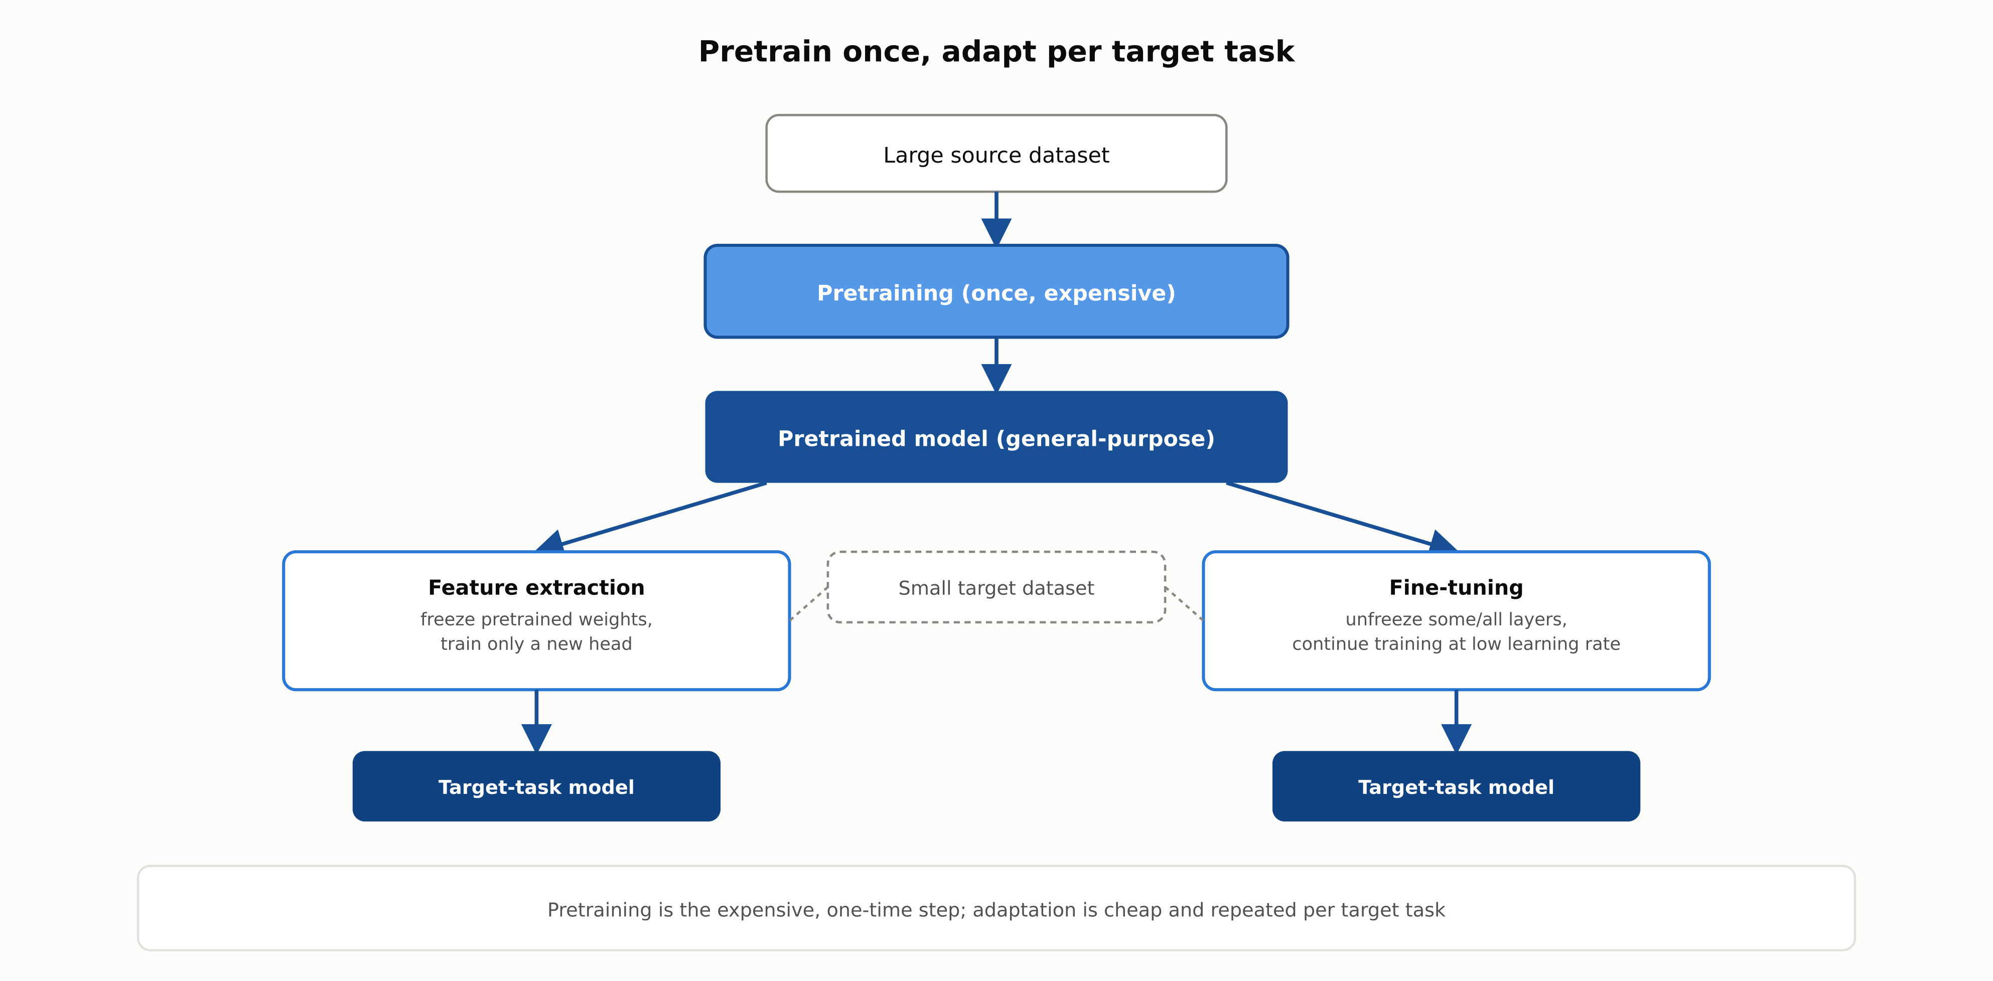
Pretrain once, adapt per target task
Pretraining is the expensive, one-time step; adaptation is cheap and repeated per target task.
RegAITraining · Chapter 2.6
4 / 15

Slide 5
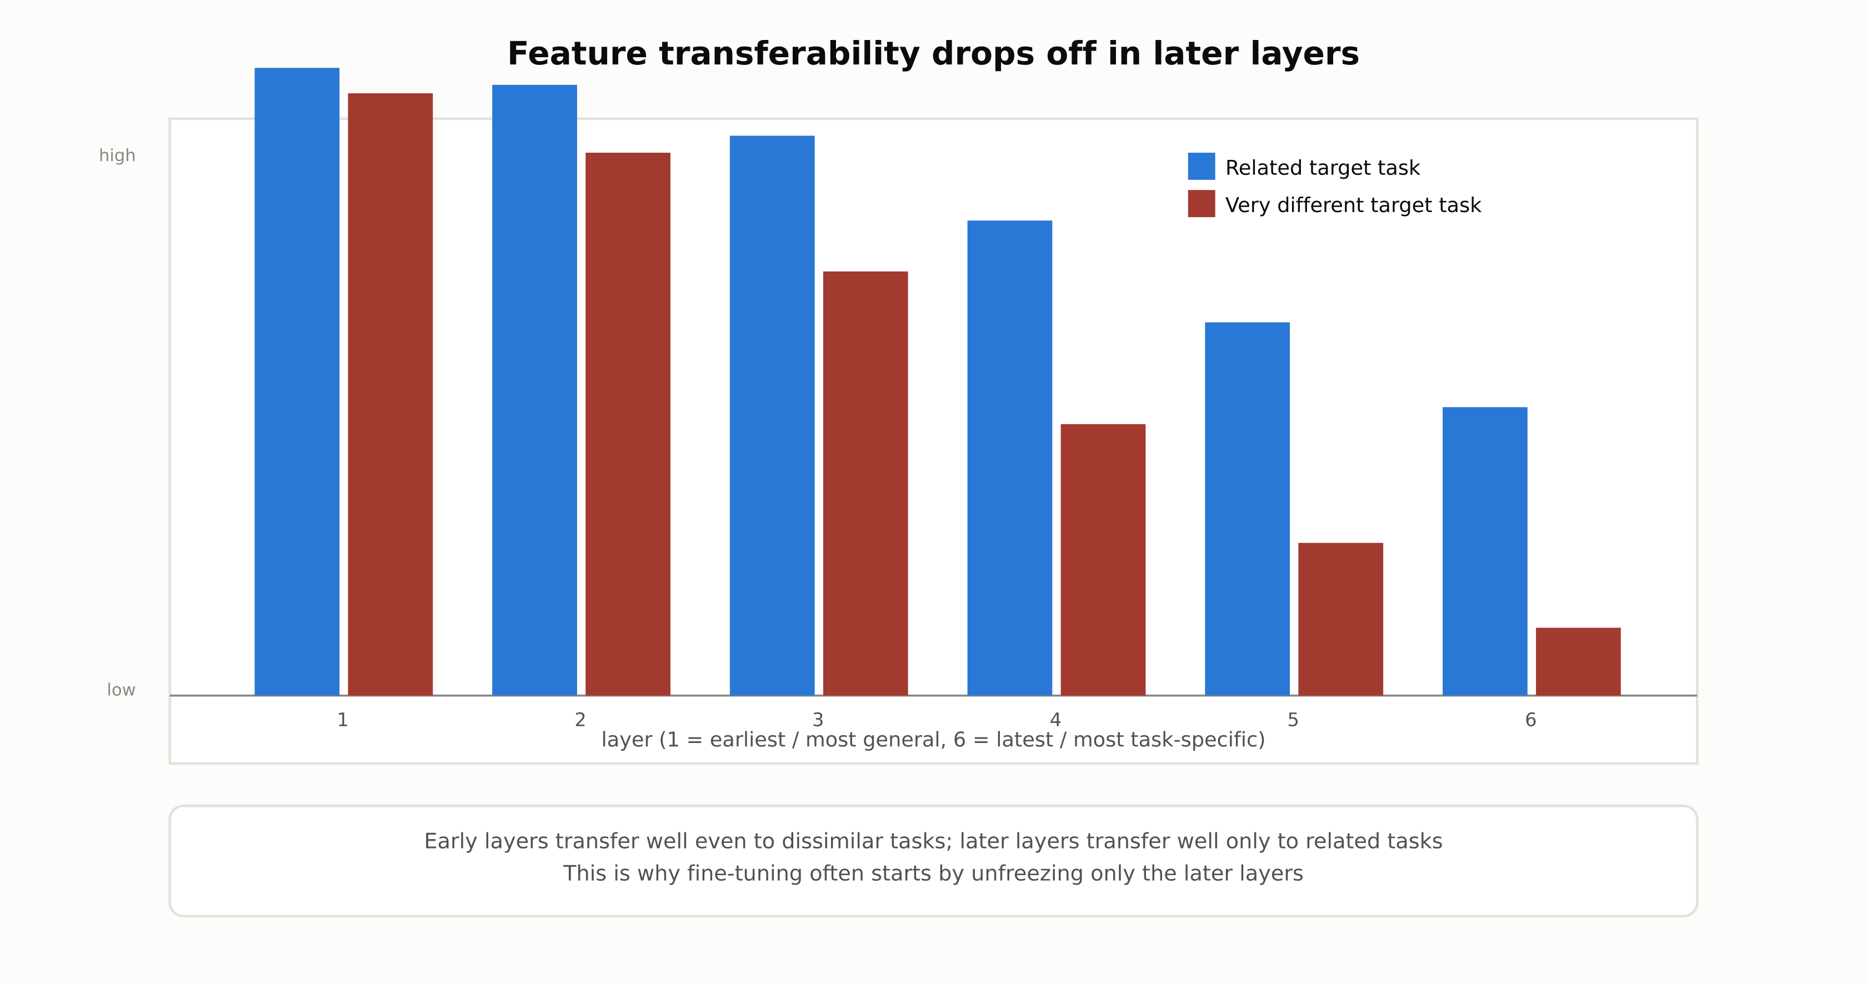
Feature transferability drops off in later layers
Early layers transfer well even to dissimilar tasks; later layers transfer well only to related tasks.
RegAITraining · Chapter 2.6
5 / 15

Slide 6
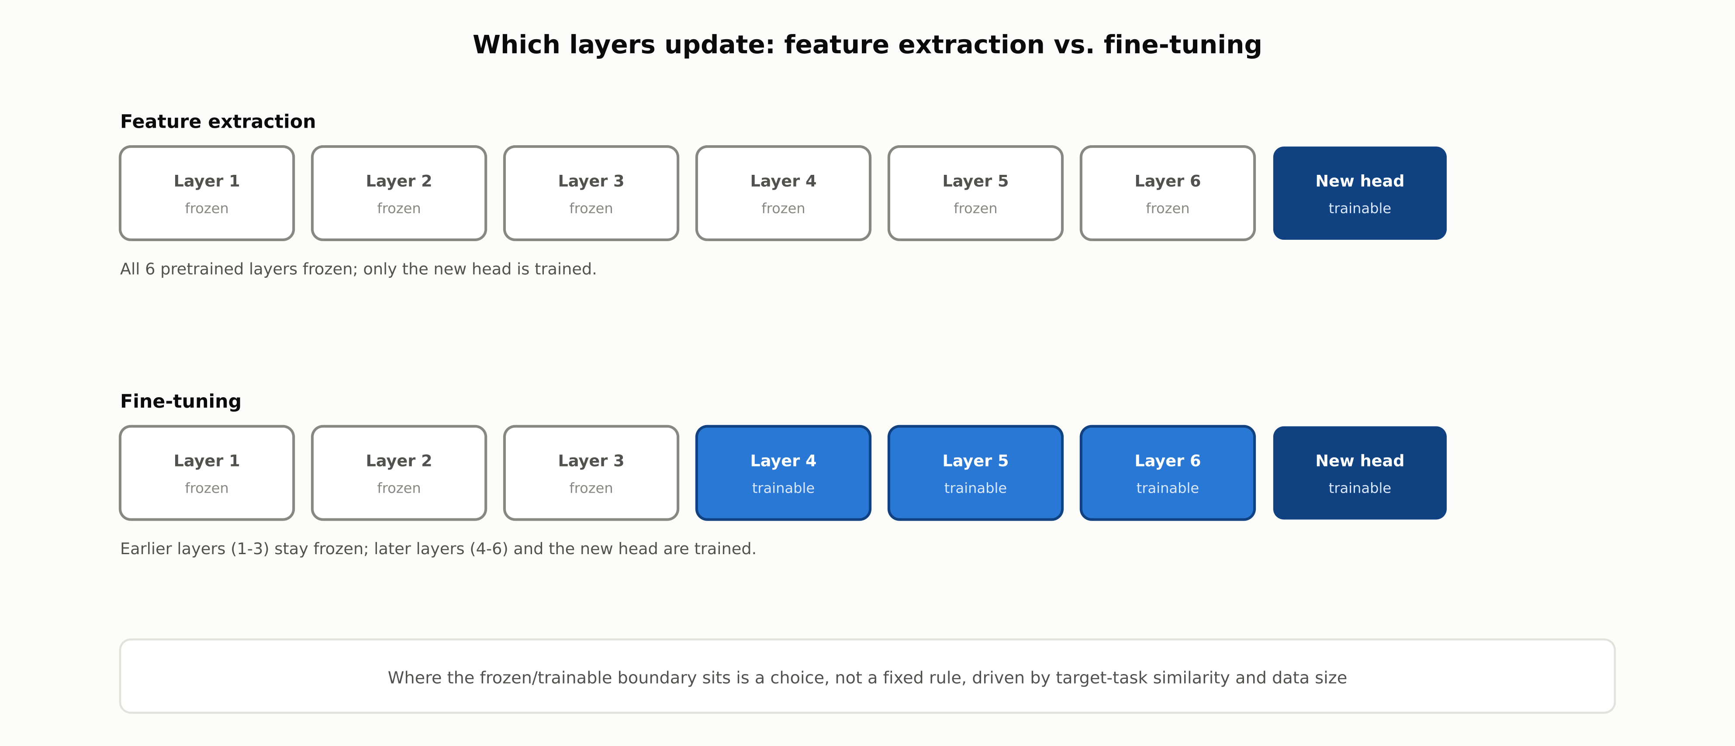
Which layers update: feature extraction vs. fine-tuning
Where the frozen/trainable boundary sits is a choice, driven by target-task similarity and data size.
RegAITraining · Chapter 2.6
6 / 15

Slide 7
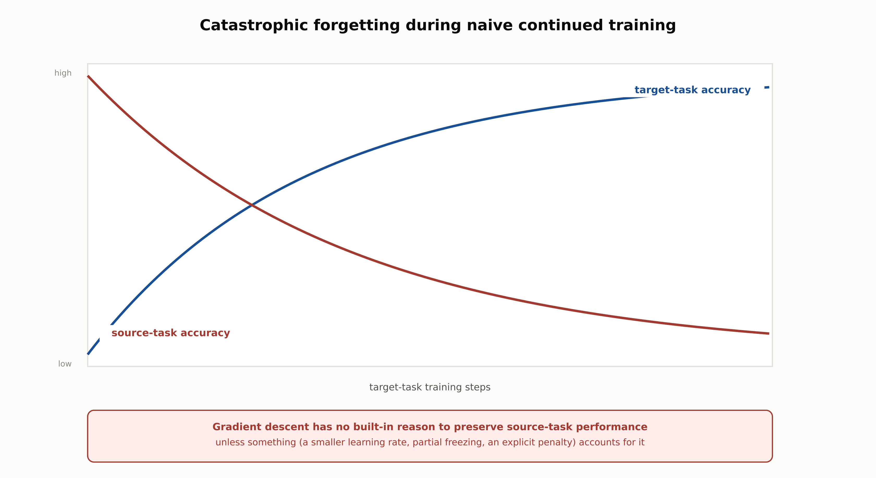
Catastrophic forgetting during naive continued training
Gradient descent has no built-in reason to preserve source-task performance unless something accounts for it.
RegAITraining · Chapter 2.6
7 / 15

Slide 8
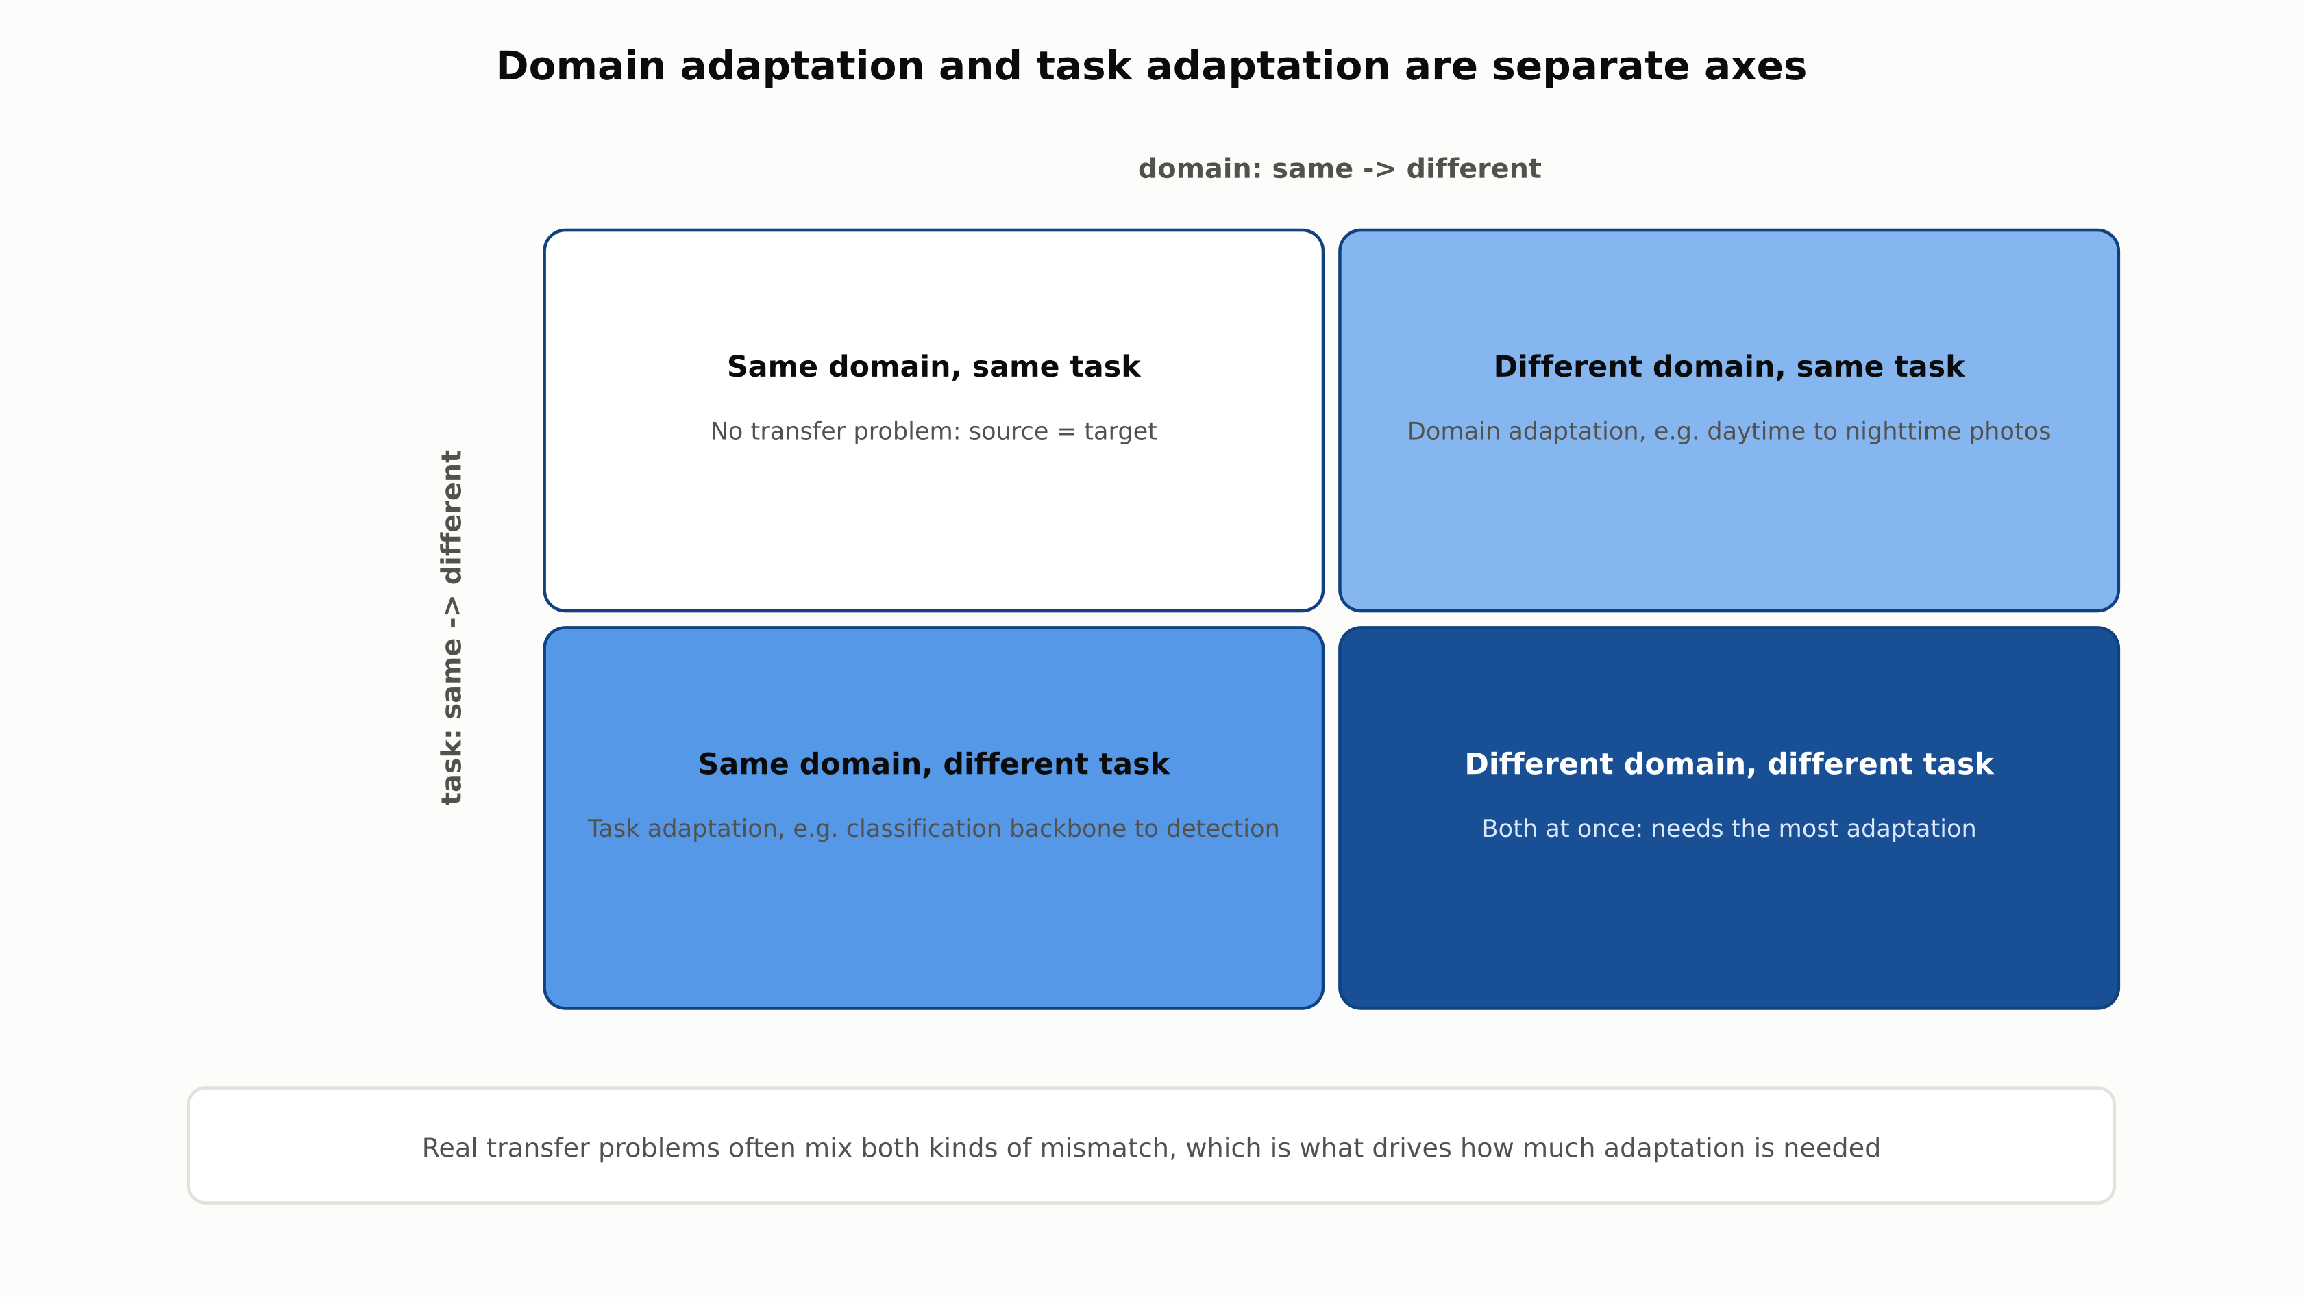
Domain adaptation and task adaptation are separate axes
Real transfer problems often mix both kinds of mismatch, which drives how much adaptation is needed.
RegAITraining · Chapter 2.6
8 / 15

Slide 9
Comparison & Related Concepts
Aspect | Train from scratch | Feature extraction | Fine-tuning
Target data needed | Large | Small to moderate | Moderate (small risks overfitting on unfrozen weights)
Compute cost to adapt | Highest: trains every weight from a random start | Lowest: only a new final layer is trained | Moderate: some or all pretrained weights keep updating
Risk of catastrophic forgetting | Not applicable, no prior task to forget | None: pretrained weights never change | Present, mitigated by a small learning rate and/or partial unfreezing
Typical use case | Source task itself, or target data is genuinely large | Target task is very similar to the source task | Target task differs somewhat from the source task
Feature extraction and fine-tuning sit on a spectrum, not a binary choice: partial unfreezing is a common middle ground.
RegAITraining · Chapter 2.6
9 / 15

Slide 10
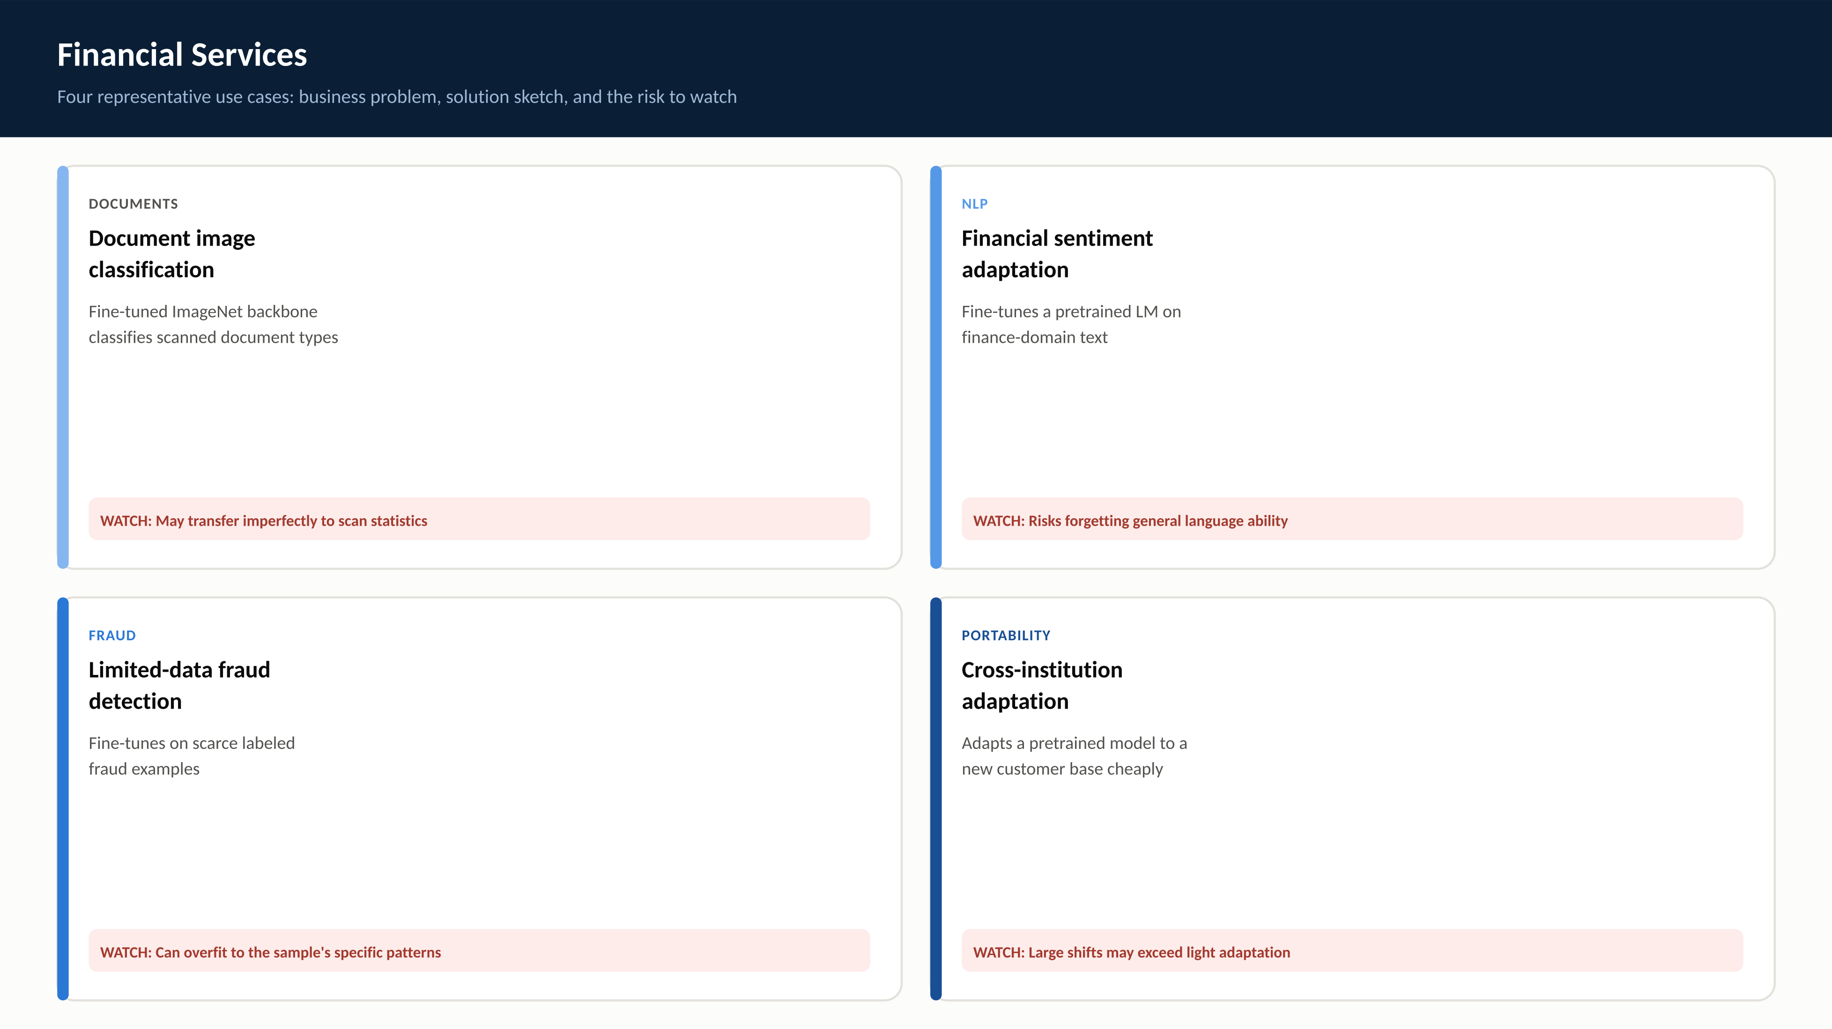
RegAITraining · Chapter 2.6
10 / 15

Slide 11
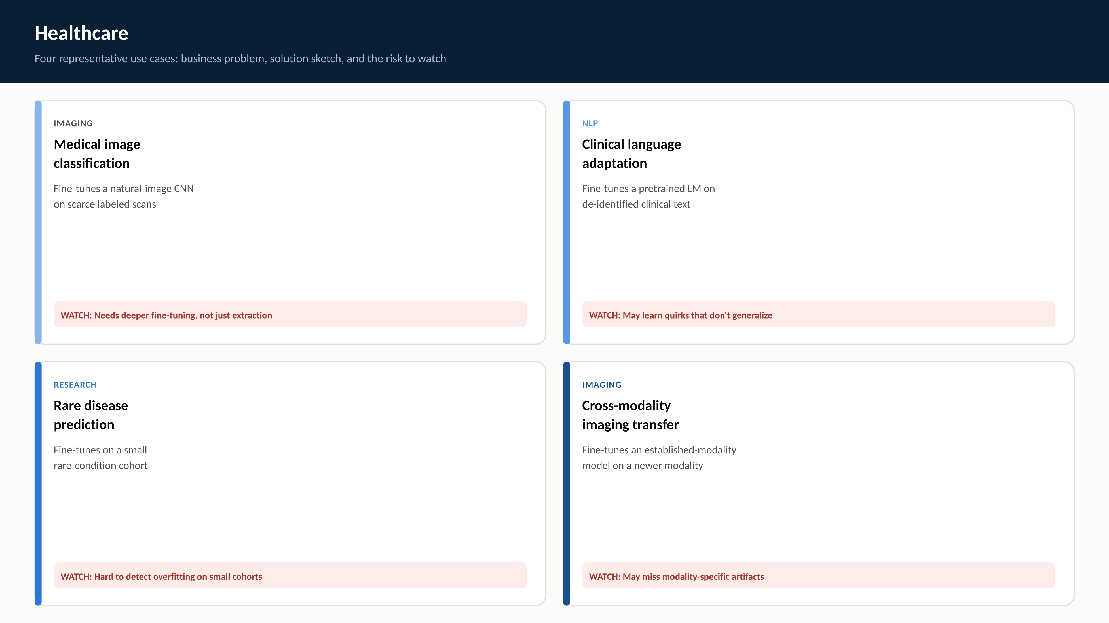
RegAITraining · Chapter 2.6
11 / 15

Slide 12
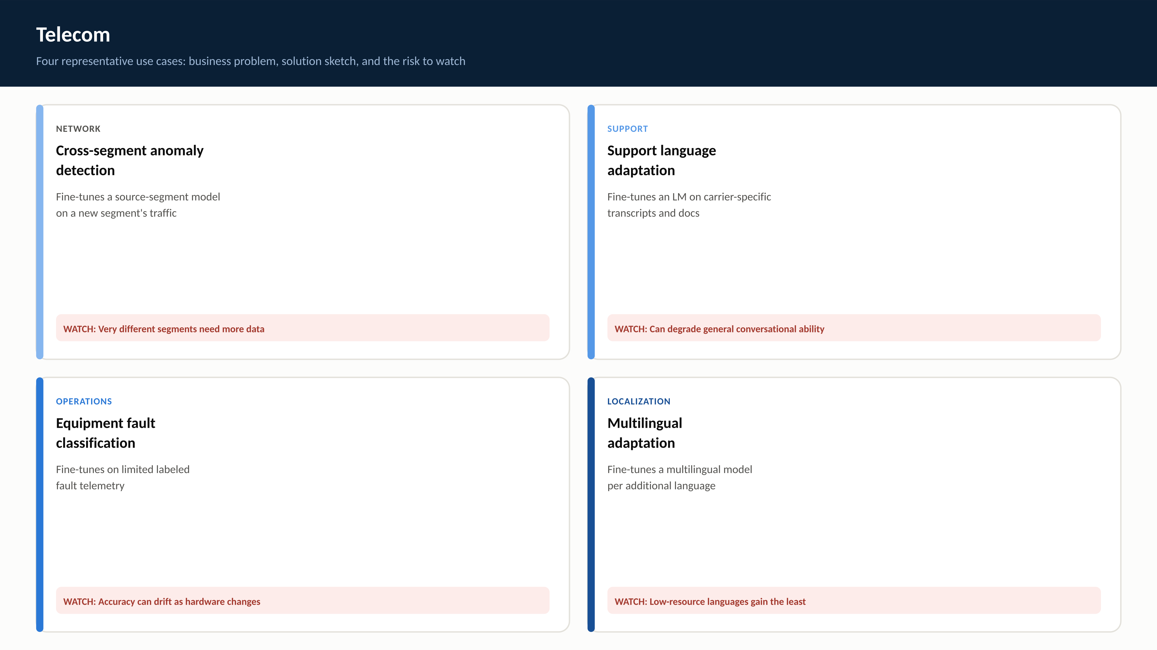
RegAITraining · Chapter 2.6
12 / 15

Slide 13
Check Your Understanding
1. What is the core idea of transfer learning, and why is it especially valuable when target data is limited?
2. What is the difference between feature extraction and fine-tuning as adaptation strategies?
3. How does feature transferability change with layer depth, and why does fine-tuning from pretrained weights outperform training from scratch even with enough target data?
4. What is catastrophic forgetting, and why does it happen mechanically?
5. How does the pretrain-then-adapt paradigm in modern language models relate to feature extraction and fine-tuning?
RegAITraining · Chapter 2.6
13 / 15
Notes:
Q1: What is the core idea of transfer learning, and why is it especially valuable when target data is limited? A1: Transfer learning reuses a model already trained on a large source task as the starting point for a target task, instead of training from randomly initialized weights on the target data alone. It is especially valuable with limited target data because training a large network from scratch on a small dataset tends to overfit, while starting from pretrained, already-useful representations needs far less target data. Q2: What is the difference between feature extraction and fine-tuning as adaptation strategies? A2: Feature extraction freezes every pretrained weight and trains only a newly added task-specific output layer. Fine-tuning unfreezes some or all of the pretrained weights and continues updating them on the target data, typically with a smaller learning rate so the useful pretrained weights shift gradually rather than being overwritten. Q3: How does feature transferability change with layer depth, and why does fine-tuning from pretrained weights outperform training from scratch even with enough target data? A3: Transferability decreases as layer depth increases, since later layers are more specific to the source task, and decreases further as source and target tasks become less related. Fine-tuning from pretrained weights outperforms training from scratch even with sufficient data because the pretrained weights are also a better optimization starting point, not merely a substitute for missing data. Q4: What is catastrophic forgetting, and why does it happen mechanically? A4: Catastrophic forgetting is the collapse of a model's performance on a previously learned task after it continues training on a new task. It happens because gradient descent updates weights purely to reduce the current loss, with no built-in mechanism to preserve weights that mattered for a task it is no longer being trained on. Q5: How does the pretrain-then-adapt paradigm in modern language models relate to feature extraction and fine-tuning? A5: BERT and GPT are pretrained once on a large, general text corpus, producing general-purpose language representations, and are then adapted to specific downstream tasks with far less task-specific data. This is the same pretrain-once, adapt-per-task pattern as feature extraction and fine-tuning, applied at a much larger scale.

Slide 14
Key Takeaways
Transfer learning starts from a model already trained on a large source task instead of random initialization, dramatically reducing the data and compute needed for a new target task.
Feature extraction freezes pretrained weights and trains only a new head; fine-tuning unfreezes some or all layers and continues training at a reduced learning rate.
Feature transferability is highest in early, general-purpose layers and drops off in later, more task-specific layers.
Naive continued training risks catastrophic forgetting; a small learning rate, partial unfreezing, or an explicit penalty (Elastic Weight Consolidation) can mitigate it.
The pretrain-then-adapt paradigm, scaled up, is the same pattern behind ImageNet-pretrained vision backbones and BERT/GPT-style language model pretraining.
RegAITraining · Chapter 2.6
14 / 15

Slide 15
Sources
Yosinski, J., Clune, J., Bengio, Y., and Lipson, H. (2014). How Transferable Are Features in Deep Neural Networks? NIPS. — https://arxiv.org/abs/1411.1792
Kirkpatrick, J., et al. (2017). Overcoming Catastrophic Forgetting in Neural Networks. PNAS, 114(13), 3521-3526. — https://www.pnas.org/doi/10.1073/pnas.1611835114
Devlin, J., Chang, M., Lee, K., and Toutanova, K. (2019). BERT: Pre-training of Deep Bidirectional Transformers for Language Understanding. NAACL. — https://aclanthology.org/N19-1423/
Radford, A., Narasimhan, K., Salimans, T., and Sutskever, I. (2018). Improving Language Understanding by Generative Pre-Training. OpenAI. — https://cdn.openai.com/research-covers/language-unsupervised/language_understanding_paper.pdf
RegAITraining · Chapter 2.6
15 / 15

