Slide 1

BUILD ON ARC · CHECKPOINT 2 · AGENTIC ECONOMY
Programmable authority
for autonomous money.
INTENT
Give agents economic autonomy without giving them unrestricted authority.
ECONOMIC ACTION
AUTHORITY
AgenticOperations/AOPS-PMOA
Latest working branch · feat/mcp-paid-http
Notes:
Checkpoint cover. Product definition and repository branch are based on the user-provided PMOA submission context and the tested feat/mcp-paid-http branch.

Slide 2
THE MISSING ORGANIZATIONAL LAYER
Circle gives agents programmable money. Organizations still need control.
CIRCLE PRIMITIVES
ORGANIZATIONAL AUTHORITY
Wallets
hold and sign
AOPS
Roles
Policy
who may act
what may happen
USDC
move stable value
AUTHORITY
SEAM
Approvals
Budgets
where humans intervene
how much is at risk
Gateway
reach supported networks
Emergency control
Evidence
x402
purchase machine services
before signing
how autonomy stops
what can be proven
The wedge is not another wallet. It is the layer that decides whether money may move—and preserves why.
Category thesis · programmable money needs programmable authority
Notes:
Circle primitives are presented as infrastructure inputs. AOPS is positioned as the organizational policy, approval, budget, emergency-control, and evidence layer before signing.

Slide 3
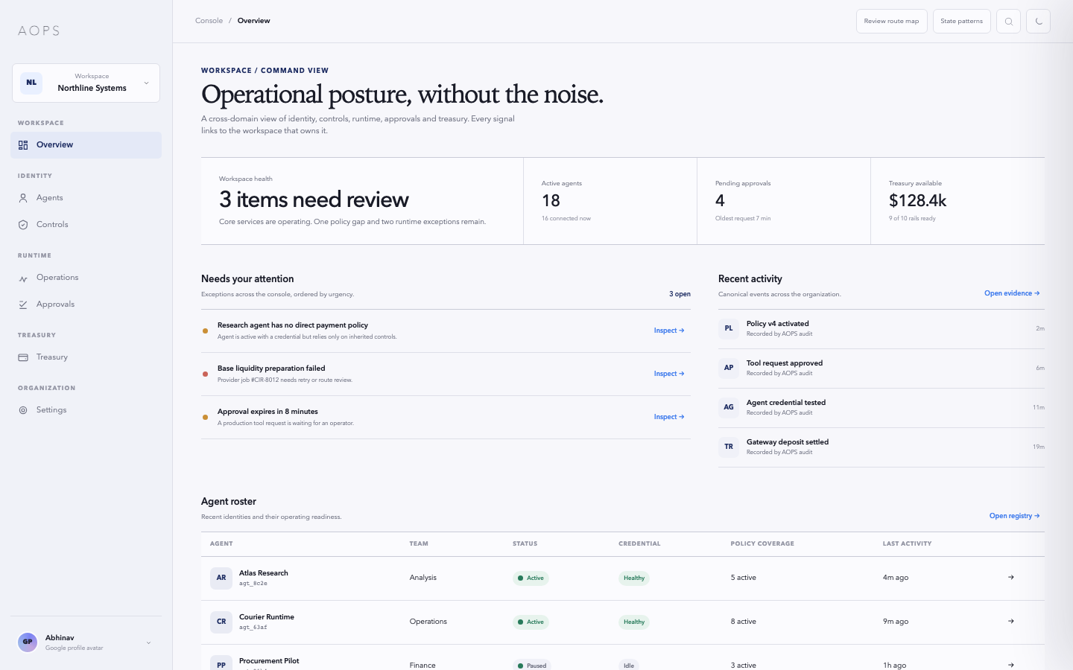
VERIFIED PROGRESS
The control foundation already works.
878 / 878
WORKING PRODUCT SURFACE
verification tests passed
Role-level policy inheritance
Credentialed hosted MCP
Approval and spend controls
Real Circle USDC execution
Replay-safe paid HTTP
Hash-chained evidence
MCP-only → 0.001 USDC → HTTP 200
Verified on feat/mcp-paid-http · code checkpoint add41aa · Arc-native settlement is next
Notes:
Evidence: docs/qa/2026-07-13-x402-paid-http-evidence.md and docs/qa/2026-07-12-testnet-release-evidence.md. Fresh npm run verify on 2026-07-26 passed lint, typecheck, production builds, and 878/878 tests. UI image is an approved AOPS product-design capture, not live production data.

Slide 4
EXECUTION MODEL
One policy follows the agent from intent to evidence.
Mandate
MCP intent
Decision
Service result
purpose + role
tool request
allow or deny
resource returns
01
02
03
04
05
06
07
08
Credential
Policy + hold
Circle execution
Evidence
scoped identity
reserve budget
wallet / rail
reconcile + prove
Authorization is not enough.
Budget is reserved before execution and reconciled after the result.
Intent → policy → execution → outcome · one continuous authority record
Notes:
The workflow reflects the current AOPS authorization, reservation, execution, reconciliation, and evidence architecture. It does not claim Arc settlement is complete.

Slide 5
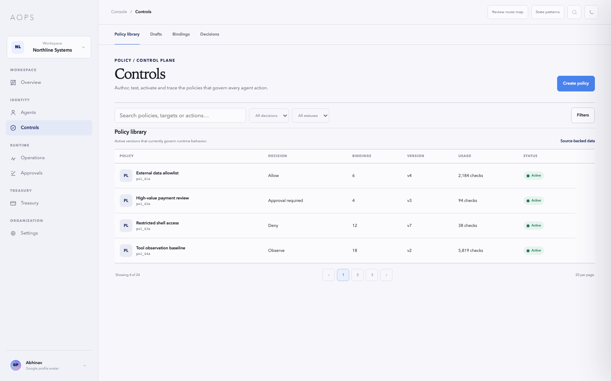
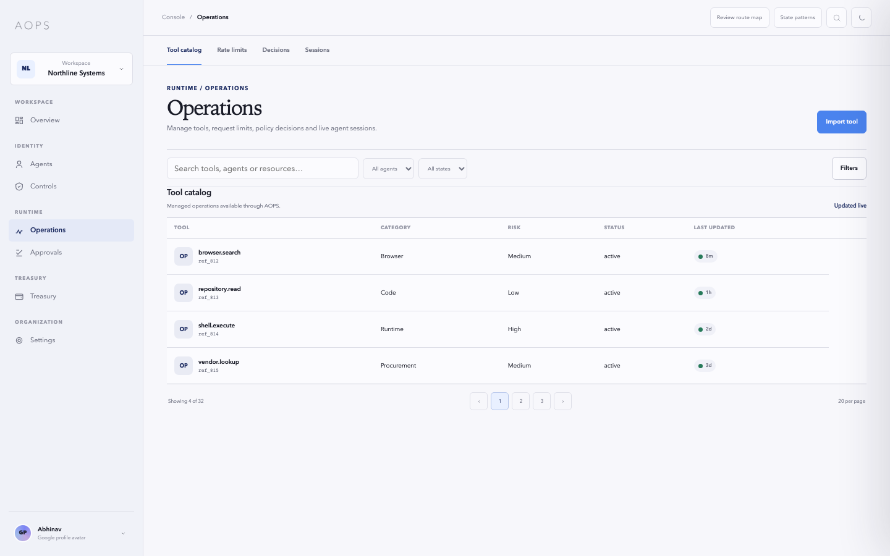
PRODUCT SURFACE
Built as an operating system, not a wallet wrapper.
01
Define authority
Roles, policy, budgets, approvals
OVERVIEW
02
Operate agents
Credentials, status, emergency control
03
Govern money
CONTROLS
Treasury boundaries and execution state
04
Prove outcomes
OPERATIONS
Decisions, events, reconciliation, evidence
Approved AOPS console-system captures · visual design aid, not production data
Notes:
All three UI images are first-party captures from the approved AOPS console design aid. They are used to demonstrate information architecture and product surface, not to claim live production values.

Slide 6
TECHNICAL DIRECTION
Circle-native infrastructure, designed toward Arc.
AGENT
HOSTED MCP
AOPS CONTROL
CIRCLE
SERVICE
PROOF
mission + intent
credentialed tools
policy · approval · hold
wallet · Gateway · x402
paid result
evidence
CURRENTLY PROVEN
POLICY
MCP
USDC
PAID HTTP
EVIDENCE
NEXT NATIVE ENVIRONMENT
Circle-supported compatibility proof
Arc
Base · Arbitrum · Polygon
Optimism · Avalanche
USDC-native settlement · agent transactions · economic proof
Current rails prove portability. Arc becomes the product’s native economic environment next.
Notes:
Current proof is Circle-native and uses Circle-supported test rails. The slide explicitly labels Arc as the next native environment, not current settlement proof.

Slide 7
CHECKPOINT 3 FOCUS
Next: make Arc the native execution environment.
01
02
03
04
05
Arc Testnet settlement
Arc-aware wallet + Gateway
Governed paid-service flow
Production resilience
Company-grade UX
Move the proven execution path onto Arc.
Connect policy, wallet state, and rail behavior.
Demonstrate intent, payment, result, and proof on Arc.
Close deployment, observability, backup, and recovery gaps.
Center missions, providers, and measurable outcomes.
Milestone test
A real agent purchases a service on Arc, stays inside an organizational mandate, and leaves a verifiable outcome trail.
The next checkpoint is integration + product hardening, not a second feature inventory
Notes:
These are forward-looking Checkpoint 3 milestones. None are presented as already complete.

Slide 8
COMPANY DIRECTION
From agent control to
economic operations.
AOPS becomes the organizational authority layer between autonomous agents and the economic services they use.
NOW
NEXT
COMPANY
Governed execution
Arc-native operations
Economic authority
Policy · approvals · budgets · MCP · evidence
USDC settlement · paid services · resilient control
Provider commerce · treasury orchestration · outcome proof
Programmable money needs programmable authority.
REPOSITORY
AgenticOperations/AOPS-PMOA
feat/mcp-paid-http · tested checkpoint add41aa
Build on Arc · Checkpoint 2 · Agentic Economy
Notes:
Closing company direction. The NOW column is current product proof; NEXT and COMPANY are explicitly forward-looking.

