Slide 1
Self-similar hydrodynamics of first-order phase transitions in the early universe
Mika Mäki
2023-04-13

Slide 2
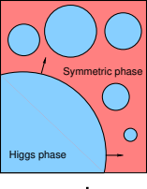
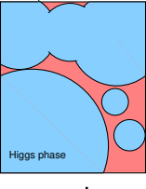
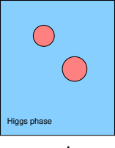
Bubbles are hydrodynamics
How to compute the properties of a first-order phase transition bubble?
  Hydrodynamics
From the energy-momentum tensor to
  Wave equation
  Bubble wall junction conditions
  Continuity equations, aka. hydrodynamic equations

Slide 3
Dimensionality of the problem
Self-similarity
  Friction results in a constant wall speed
  → As the bubble expands, its relative shape stays the same
  → Time-independent solution
Spherical symmetry
3+1 dimensional problem reduces to time-independent 1D

Slide 4
Energy-momentum tensor
In Minkowski space and Cartesian coordinates
Ideal fluid

Slide 5
Wave equation
Constant background space-time
→ energy-momentum conservation
Energy-momentum tensor of an ideal fluid
For a one-dimensional flow in Cartesian coordinates
Frst-order perturbation → wave equation with speed of sound:

Slide 6
Phase boundary
Energy-momentum conservation
Inserting ideal fluid:
By defining new variables

Slide 7
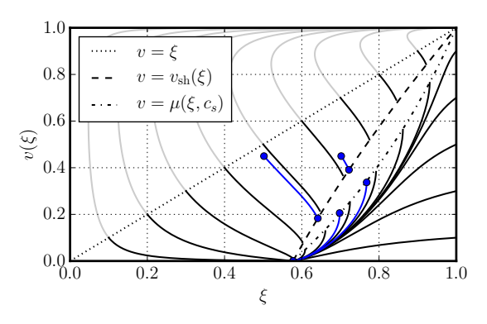
Hydrodynamic equations
Energy-momentum conservation
Projection
→ hydrodynamic equations
Using self-similarity
Unphysical: no sound
can propagate here
Symmetric phase
(outside the bubble)
Broken phase
(inside the bubble)

Slide 8
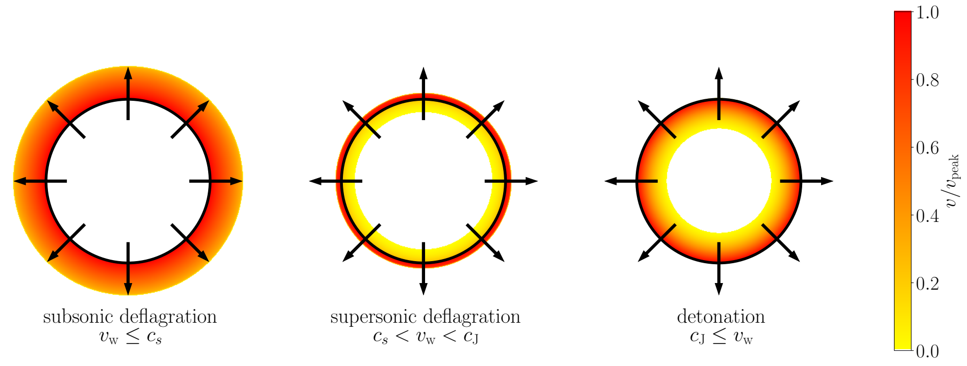
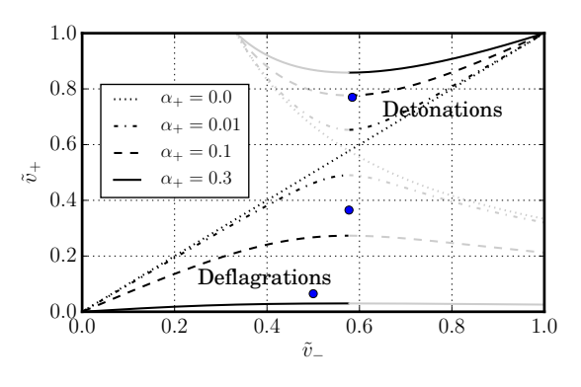
Fluid shells
Three types of solutions, determined by
  Wall velocity
  Transition strength
Black: bubble wall / phase boundary
Colour: velocity of moving plasma

Slide 9
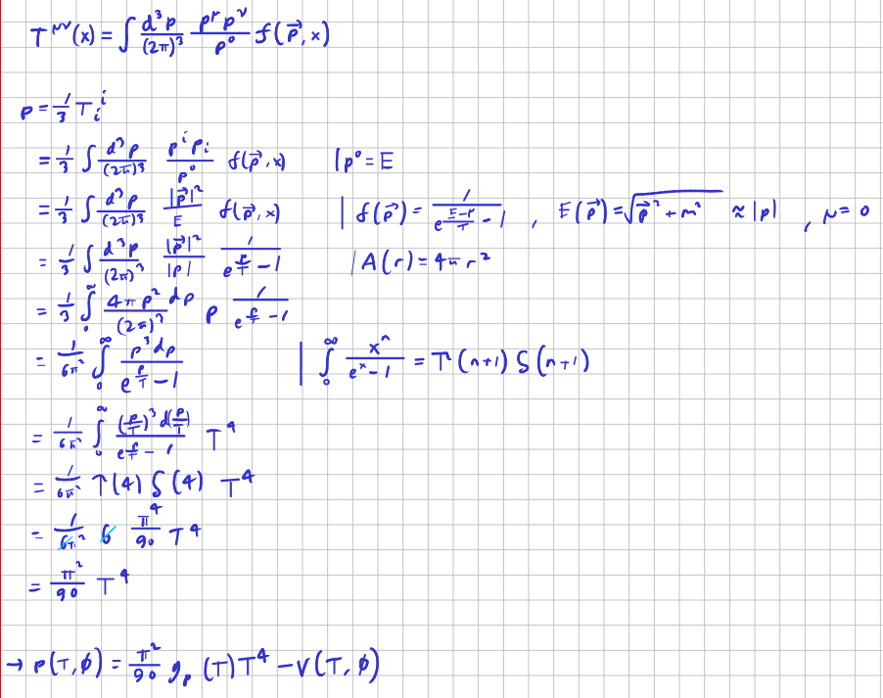
Deriving the generic equation of state
Pressure from momentum integral
Bose-Einstein ultrarelativistic
3D integral to 1D
Mathematics
Accounting for multiple fields and an external potential

Slide 10



Bag model: the simplest model
Equation of state:
The rest can be deduced with thermodynamics
  Enthalpy density
  Energy density
  Entropy density
  Sound speed

Slide 11


Beyond the bag model
Non-constant degrees of freedom → Bag model assumptions broken
  Different equations of state for each phase
  Different sound speeds, possibly temperature-dependent:
Computing the velocity profile becomes more difficult
  Sound speed may change at each point
  → No analytical shortcuts in finding the solution
Next approximation: Constant sound speed model
  Different but constant speed of sound in each phase

Slide 12
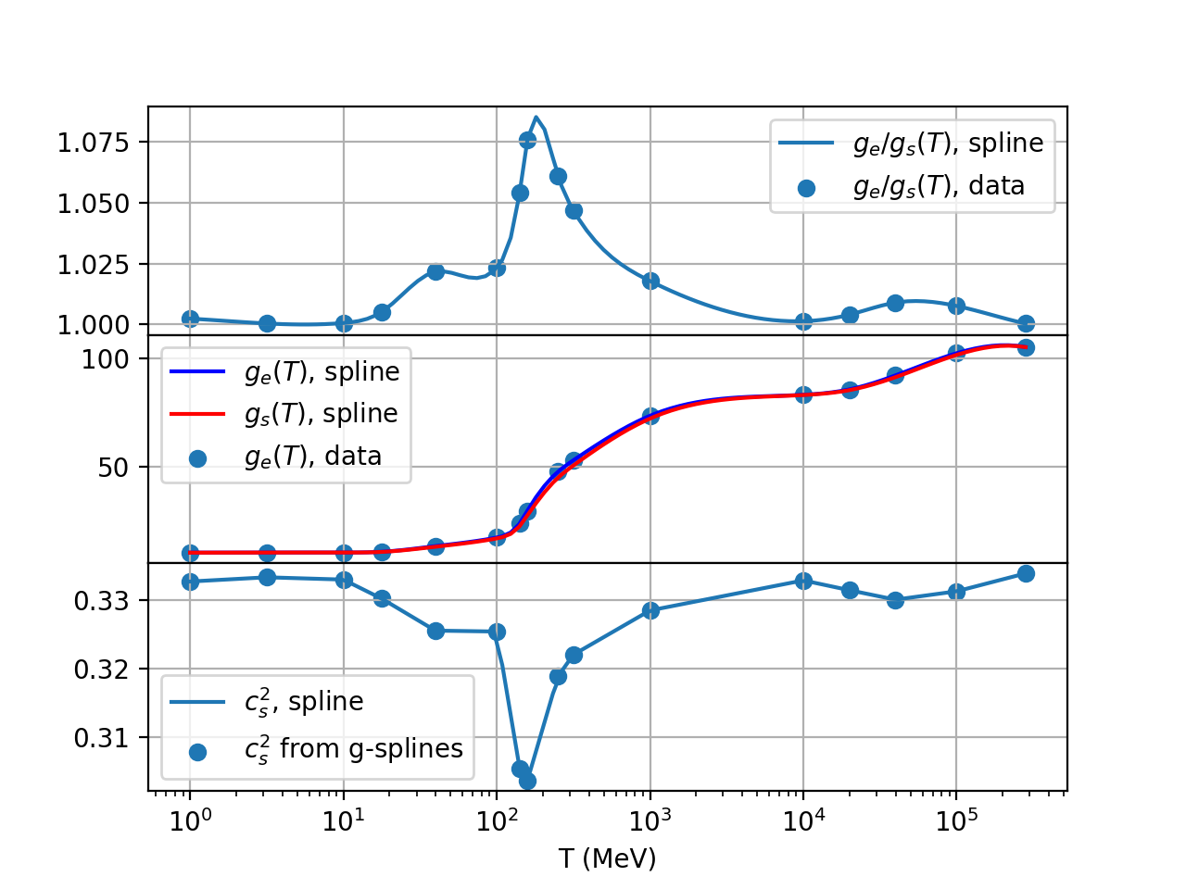

Goal: Equation of state from an arbitrary model
Example: Standard Model
Fluid properties depend on
  Temperature
  Phase
Arbitrary models can be tested, when is given
Data from Borsanyi et al., 2016

Slide 13
Old algorithm
Find the for which is correct
Compute fluid speeds at the wall from
Deflagrations and hybrids: integrate forward to shock
Detonations and hybrids: integrate backward to sound speed (where v=0)

Slide 14
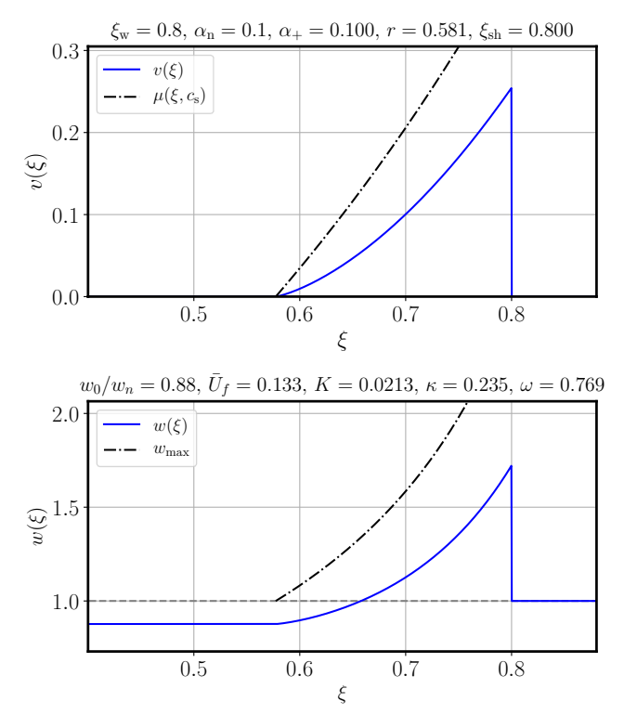
Fluid shell solver algorithm
Detonations
Start from the known conditions outside the wall
Solve boundary conditions at the wall
  SciPy fsolve (MINPACK hybrd, hybrj)
Integrate to v=0
  SciPy odeint, SciPy solve_ivp, NumbaLSODA
Extend to the center of the bubble

Slide 15
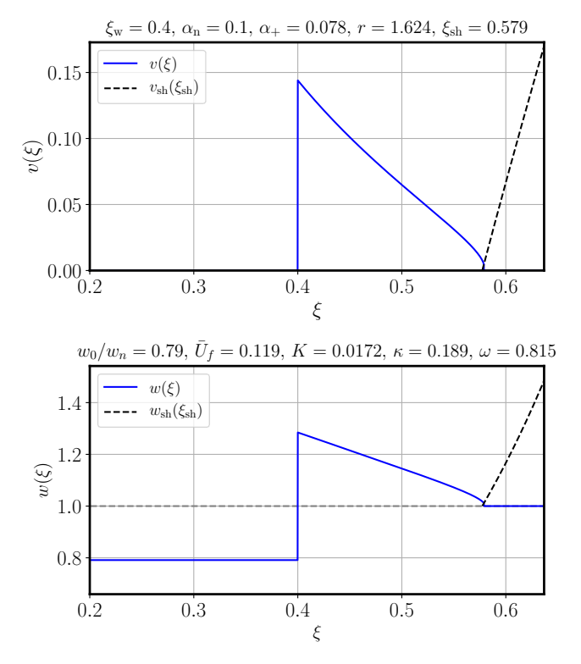
Fluid shell solver algorithm
Subsonic deflagrations
Guess an enthalpy within the bubble
Solve boundary conditions at the wall
  A solver within a solver
Integrate to the shock
  The curve turns backwards at v > 0
  → outside can only be reached with a shock
Solve boundary conditions at the shock
Check if w=wn
If not, change the enthalpy guess

Slide 16
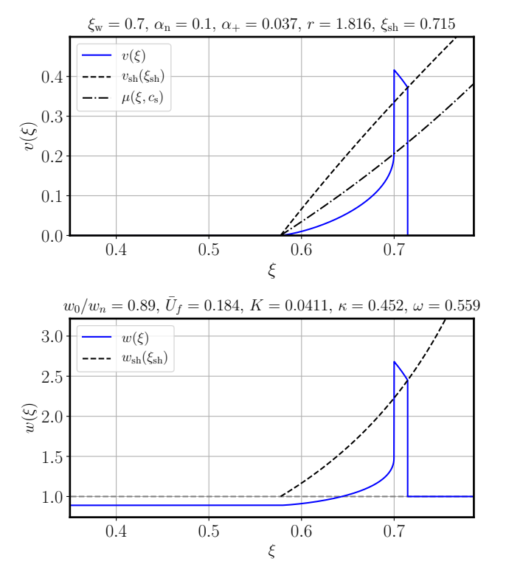
Fluid shell solver algorithm
Hybrids (supersonic deflagrations)
As for subsonic deflagrations
  Guess an enthalpy behind the wall,
  Solve boundary conditions at the wall
  Integrate to the shock
  Solve boundary conditions at the shock
  Check if w=wn
  If not, change the enthalpy guess
Integrate from the wall to v=0

Slide 17
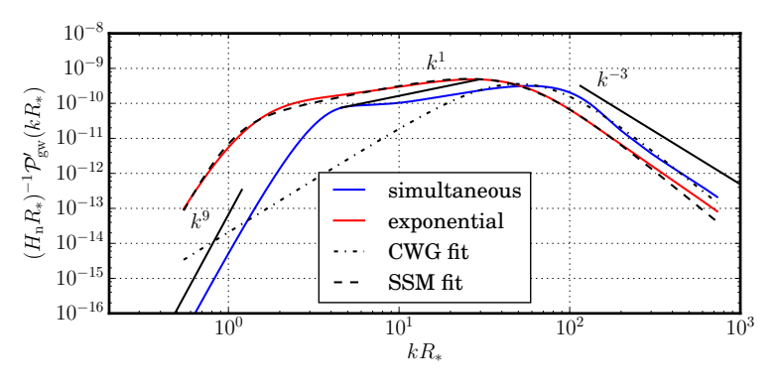
GW production
Sine transform
→ velocity power spectrum
Convolution with the nucleation rate function
→ overall velocity power spectrum
Convolution with a Green’s function
→ GW power spectrum

Slide 18
GW power spectrum is characterized by five key parameters
GW power spectrum is characterized by
  Nucleation temperature
  Phase transition strength at the nucleation temperature
  Bubble wall speed
  Transition rate parameter
  Sound speed
Initial analysis: simple toy models
Goal of the thesis: arbitrary model from particle physics parameters

Slide 19
Numerical tricks & bugs
The solver converges to the correct solution only when the starting guess is close to the correct solution
  Solution: use the old bag model solver as a starting guess
Insufficient accuracy of the ODE integrator at the shock
  Solution: use analytical knowledge about the shape of the curve to accept the nearest point
Numerical equation group solver gets stuck
  Solution: vary the initial guesses

Slide 20
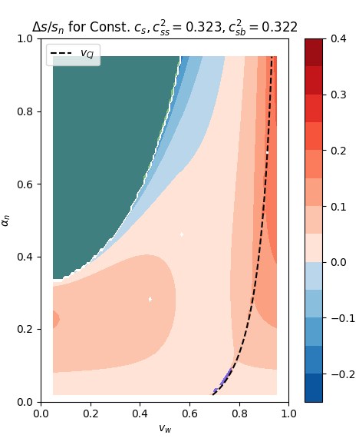
Numerical solving takes time
Testing with e.g. 100 values for
and
  → 10 000 bubbles! And multiple full
  iterations for each until the solution is found
Python is single-threaded
  Solution: parallelism with concurrent.futures
Laptops are slow, but development requires
quick feedback
  Solution: CFT remote workstation,
  SSH connection, IDE integration

Slide 21

Speedup: Numba
Python is an interpreted language
  Orders of magnitude slower than compiled languages such as C, C++ and FORTRAN
  Most of the heavy mathematics is done inside Numpy, which is written in C
Numba can compile [a subset of] Python code to native binary
  Using the LLVM compiler framework
  Speed comparable to C and FORTRAN
  Support for GPUs: CUDA & ROCm
Python is single-threaded (GIL), albeit with concurrency, but Numba can unlock true parallelism within a single process

Slide 22
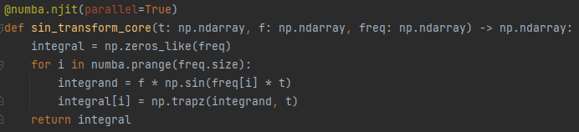
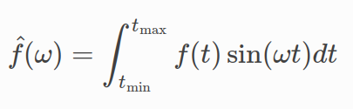
Speedup example with Numba
Add JIT decorator
Replace unsupported features with simpler code or split the unsupported parts to another function
(Restructure the function to make possible parallelism explicit)

Slide 23
Summary
Hydrodynamics is based on energy-momentum conservation
Solving a bubble starts with the equation of state
+ equation solving & ODE integration → fluid velocity profile
+ sine transform & convolutions → GW power spectrum
PTtools now supports arbitary equations of state
  Will be published soon

Slide 24
Thank you!

Slide 25
Sources
M. Hindmarsh, M. Lüben, J. Lumma, and M. Pauly, “Phase transitions in the early universe,” SciPost Phys. Lect. Notes, Feb. 2021, doi: 10.21468/SciPostPhysLectNotes.24.
Hindmarsh, Mark, and Mulham Hijazi. “Gravitational Waves from First Order Cosmological Phase Transitions in the Sound Shell Model.” Journal of Cosmology and Astroparticle Physics 2019, Dec. 2019, doi: 10.1088/1475-7516/2019/12/062.
Caprini et al. “Detecting Gravitational Waves from Cosmological Phase Transitions with LISA: An Update.” Journal of Cosmology and Astroparticle Physics 2020, Mar. 2020, doi: 10.1088/1475-7516/2020/03/024.
Espinosa et al. “Energy Budget of Cosmological First-Order Phase Transitions.” Journal of Cosmology and Astroparticle Physics 2010, Jun. 2010, doi: 10.1088/1475-7516/2010/06/028.
Giese et al., “Model-Independent Energy Budget for LISA.” Journal of Cosmology and Astroparticle Physics, Jan. 2021, doi: 10.1088/1475-7516/2021/01/072.
Borsanyi, Sz, Z. Fodor, K. H. Kampert, S. D. Katz, T. Kawanai, T. G. Kovacs, S. W. Mages, et al. “Lattice QCD for Cosmology.”, Jun. 2016, ArXiv: 1606.07494

