Slide 1
Self-similar hydrodynamics of first-order phase transitions in the early universe
Mika Mäki
2024-09-25

Slide 2
Infant universe blows bubbles
https://www.youtube.com/watch?v=mfGL8CpORPA

Slide 3
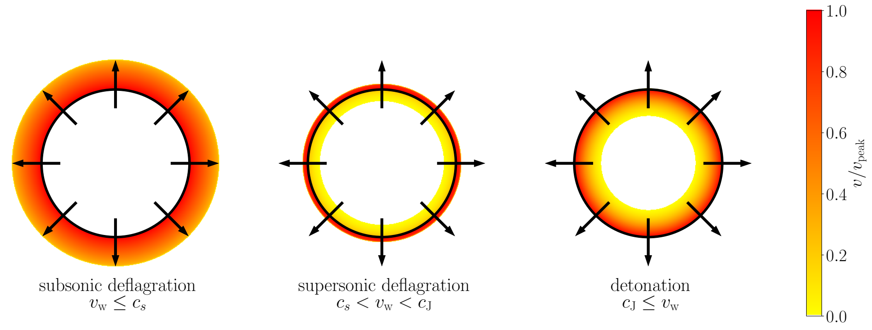
Types of relativistic combustion
Black: bubble wall / phase boundary
Colour: velocity of moving plasma
Hindmarsh et al., 2021

Slide 4
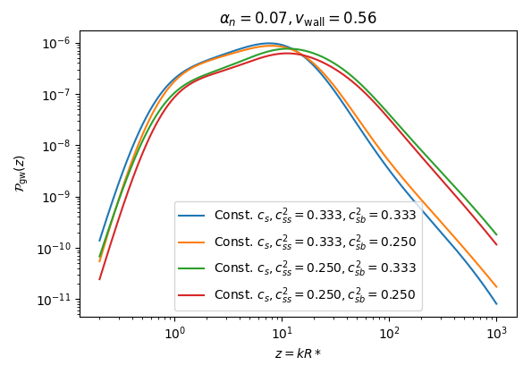
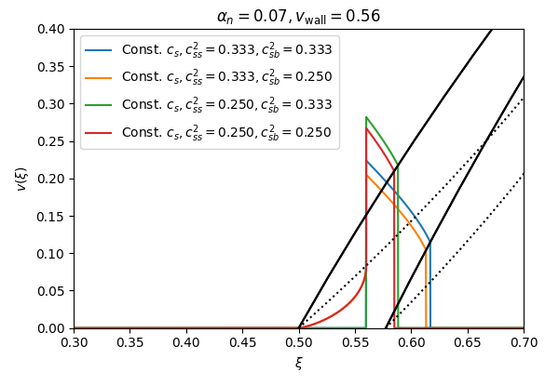
Self-similar hydrodynamics of first-order phase transitions in the early universe
Simulation of a single expanding self-similar spherically symmetric bubble → GW power spectrum
Accounting for a general equation of state
  Resulting in speeds of sound

Slide 5
Some old slides

Slide 6

Hi everyone!
Who am I?
  MSc student of particle physics and cosmology
  Previous studies: MSc (diplomi-insinööri) in applied physics from Tampere University
  (lasers, computational physics, software engineering, machine learning)
  Personal interests: free software, automating everything with Python (github.com/AgenttiX), RPGs (D&D etc.), video games (Factorio etc.)
What am I doing in the CFT group?
  Summer employee 2021: PTtools refactoring and optimization
    Parallelisation, code quality, documentation etc.
  MSc thesis: Equations of state for phase transitions in the early universe
    How to model the fluid velocity profile of an arbitrary equation of state?
  Doctoral studies (starting in January): Stochastic backgrounds and the LISA global fit

Slide 7
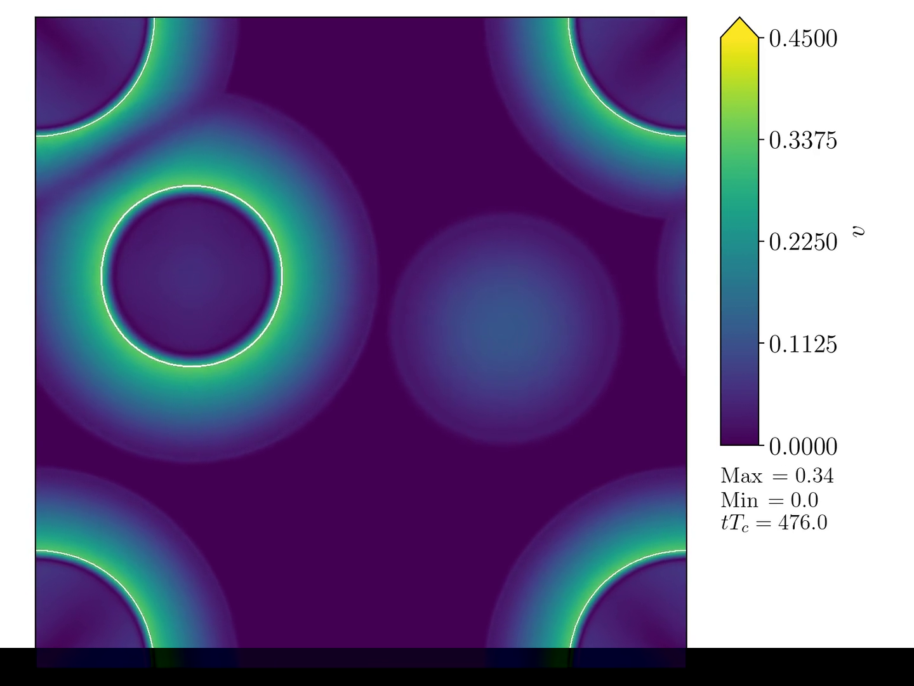
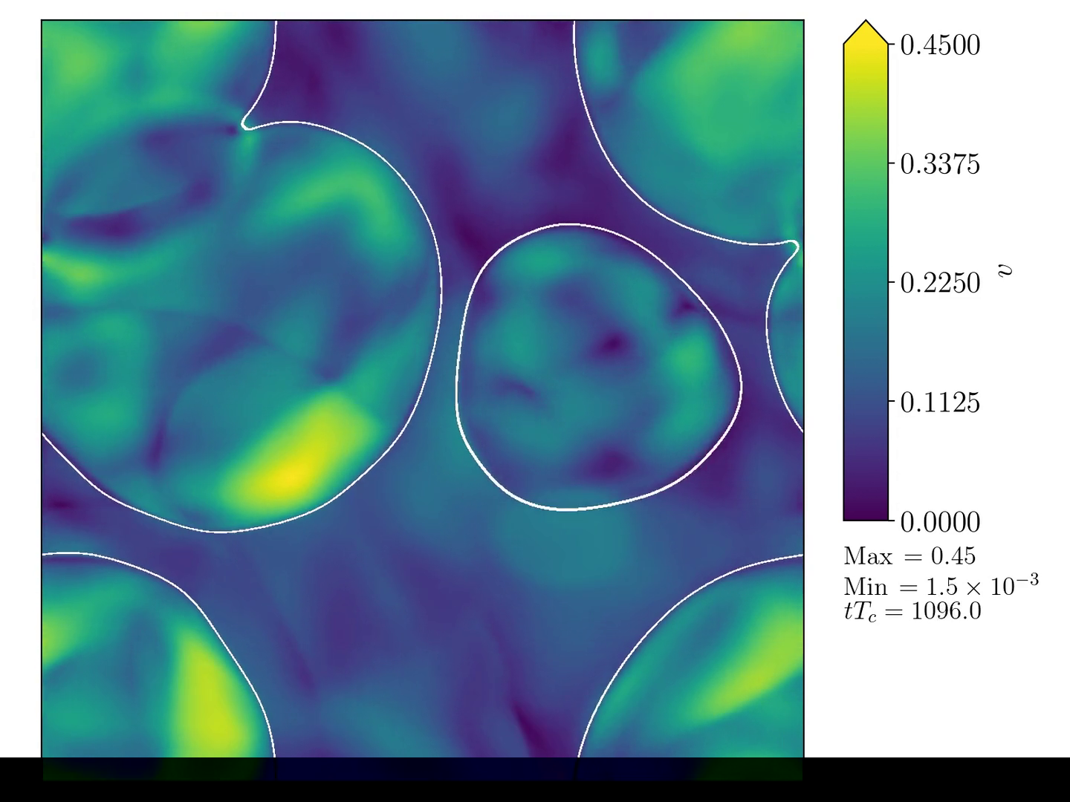
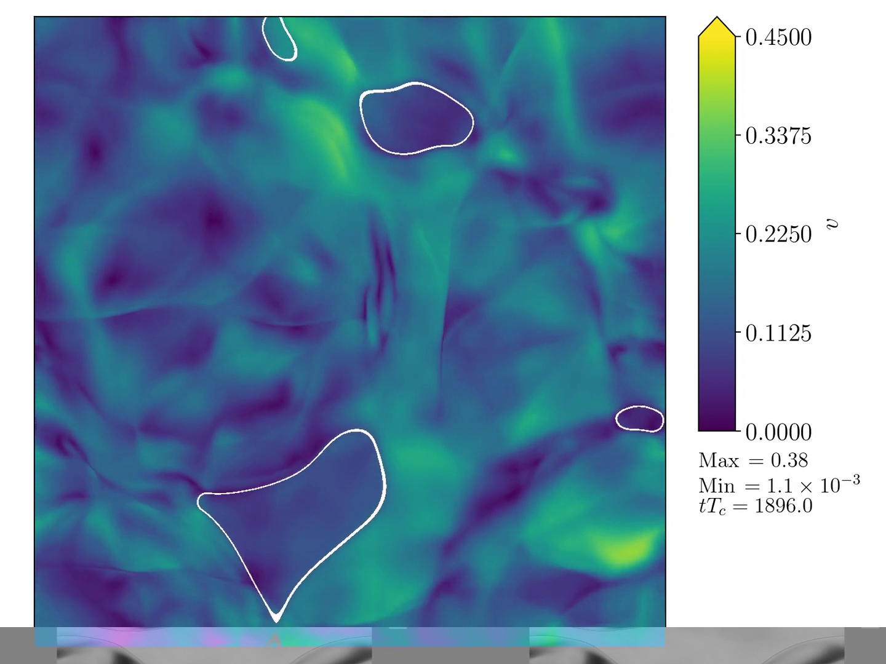
Simulation with multiple bubbles
Cutting et al., 2021

Slide 8



From fluid properties to GWs
Starting point: bag model equation of state
Equation of state → fluid velocity profile → GW power spectrum
  Spherically symmetric → 1D simulation
  Numerical integration, sine transform
How to account for different models of the underlying particle physics?

Slide 9
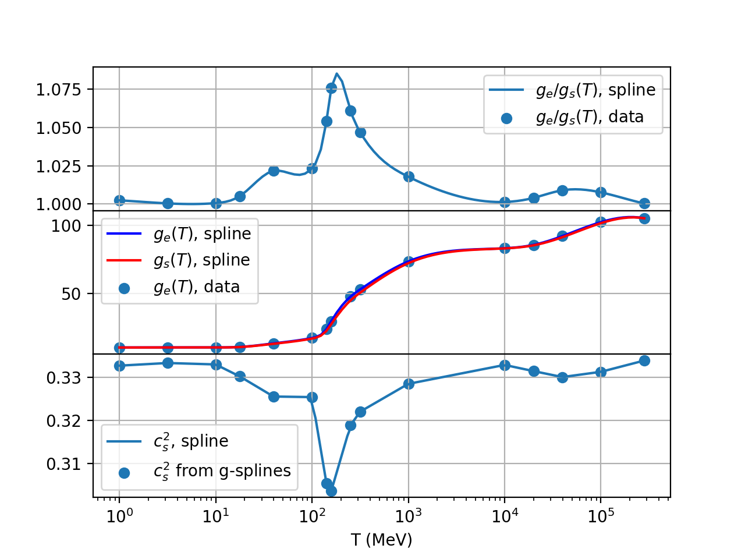

Goal: Equation of state from an arbitrary model
Example: Standard Model
Fluid properties depend on
  Temperature
  Phase
Arbitrary models can be tested, when is given
Data from Borsanyi et al., 2016

Slide 10
Thesis seminar slides:
Equations of state for phase transitions in the early universe
Mika Mäki
2022-04-27

Slide 11
Outline
Background and context
  The early universe and Higgs mechanism
  Phase transitions and gravitational waves
Relativistic hydrodynamics and combustion
  Bubble walls and fluid velocity
  Equations of state

Slide 12
Timeline of the Big Bang
Epoch | Time (s) | T (K) | T (GeV) | Description
Planck epoch | < 10⁻⁴³ | > 10³² | > 10¹⁹ | ???, quantum gravity?
Grand unification epoch | < 10⁻³⁶ | > 10²⁹ | > 10¹⁶ | Grand unified theories?
Inflationary epoch? | < 10⁻³² | 10²⁸~10²² | 10¹⁵~10⁹ | Inflation, exact temperature range unknown
Electroweak transition | 10⁻¹² | 10¹⁵ | ~150 | Higgs mechanism
QCD transition | 10⁻¹²~1 | 10¹⁵~10¹⁰ | 150 GeV ~ 1 MeV | Quarks form hadrons
Big bang nucleosynthesis | 10~10³ | 10⁹~10⁷ | 100 keV ~ 1 keV | Hydrogen & helium production
Recombination | 18 kyr ~ 370 kyr | 4000 | 0.4 keV | Cosmic microwave background

Slide 13

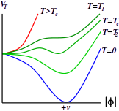
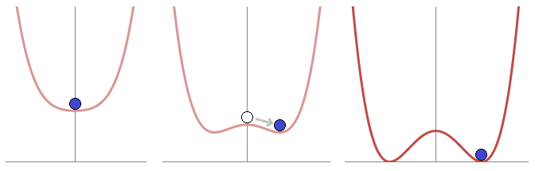
Higgs mechanism: from massless to massive
Temperature decreases
Energetically optimal to break symmetry
Higgs field obtains a vacuum expectation value
Particles obtain their rest masses by the Yukawa couplings
rest mass for A
Wikimedia Commons, CC BY-SA 3.0
Hindmarsh et al., 2021
TODO: Bump between the minima means a first-order phase transition. Put another plot without the bump and a question mark in between

Slide 14
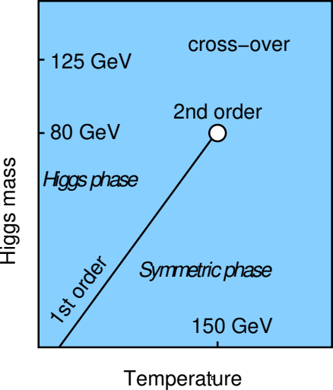
Many extensions of the Standard Model result in first-order phase transitions
Can help in solving
  Dark matter
  Electroweak hierarchy problem:
  Why is the Higgs mass only 125 GeV?
  Baryogenesis: matter-antimatter asymmetry
Examples
  Additional singlet scalar fields
  Electroweakly charged scalar fields: two Higgs doublets etc.
  Supersymmetry (non-minimal, e.g. minimal + singlet)
  Extra dimensions
  (Dark sectors)
Change of the critical point in the phase diagram
Higgs mass
Temperature
Hindmarsh et al., 2021

Slide 15
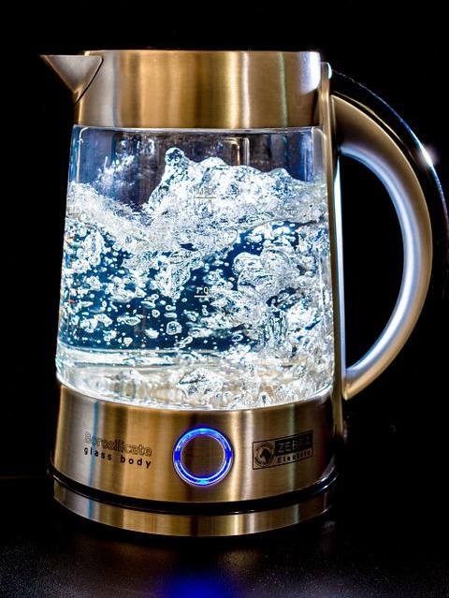
First-order phase transition proceeds by bubbles
Sharp boundary
In our case the transition is from a high-temperature phase to a low-temperature phase
If strong enough, the sound waves generate gravitational waves
”Listening to the noise of a cosmic kettle”
https://www.youtube.com/watch?v=mfGL8CpORPA
Speeding up the video:
ffmpeg -i "Infant universe blows bubbles [mfGL8CpORPA].webm" -filter:v "setpts=PTS*24/60,fps=60" -an "out.mp4"
Figure source:
https://pixabay.com/photos/water-heater-glass-water-blow-357186/

Slide 16
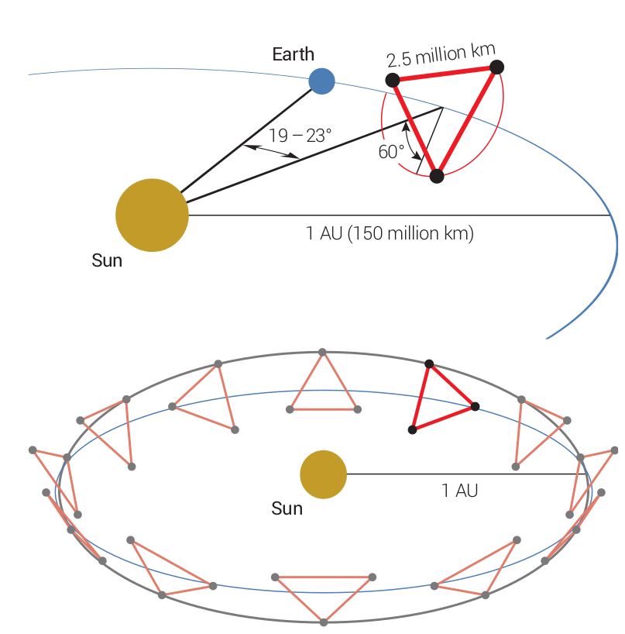
Gravitational waves
Weak coupling with matter
→ Early universe is transparent
Production steps in phase transitions
  Bubble collision and merger
  Expansion of fluid kinetic energy shells: sound waves
  Turbulence: non-linearities, sound waves → shocks
GW mathematics omitted from this presentation
Isotropic background signal
  The galactic white dwarf foreground etc. is expected to vary → distinguishable
Detection: LISA in mid-2030s
Hindmarsh et al., 2021

Slide 17
Relativistic hydrodynamics
[Ultra]relativistic plasma
Unlike classical fluids: non-conserved particle number
Characterised by an equation of state
State given by the energy-momentum tensor

Slide 18
GW power spectrum is characterized by five key parameters
GW power spectrum is characterized by
  Nucleation temperature
  Phase transition strength at the nucleation temperature
  Bubble wall speed
  Transition rate parameter
  Sound speed
Initial analysis: simple toy models
Goal of the thesis: arbitrary model from particle physics parameters

Slide 19

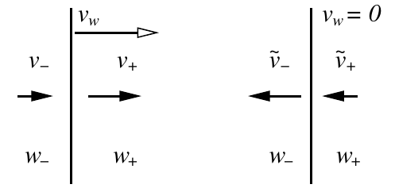
Relativistic combustion: self-similar bubbles
Conservation of energy-momentum at the wall
  Junction conditions
  Change in the potential gives kinetic energy to the plasma
Constant wall speed due to friction
Relative shape is constant
= self-similarity
Universe/plasma rest frame
Wall frame
Hindmarsh et al., 2021

Slide 20
Types of relativistic combustion
Black: bubble wall / phase boundary
Colour: velocity of moving plasma
Hindmarsh et al., 2021

Slide 21
Bag model: the simplest model
Equation of state:
The rest can be deduced with thermodynamics
  Enthalpy density
  Energy density
  Entropy density
  Sound speed

Slide 22
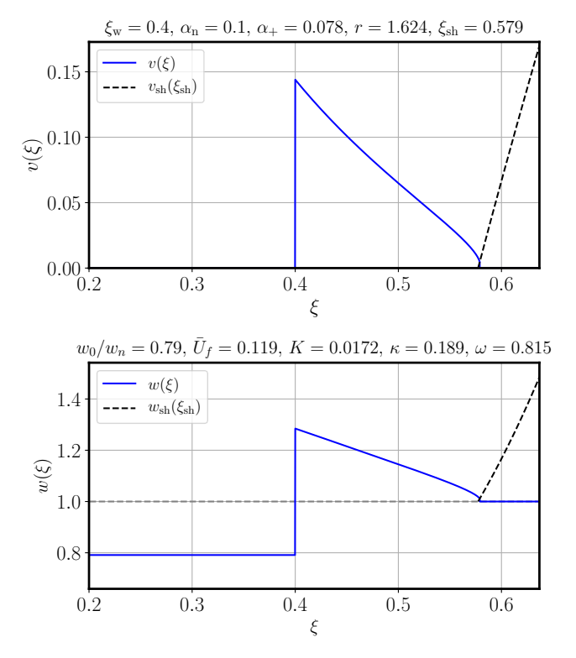
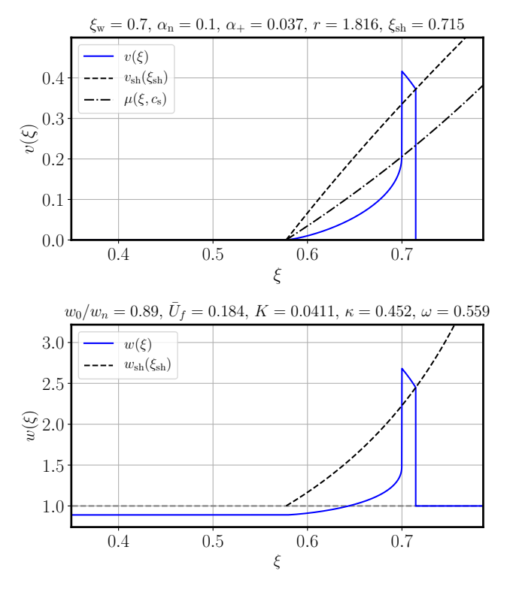
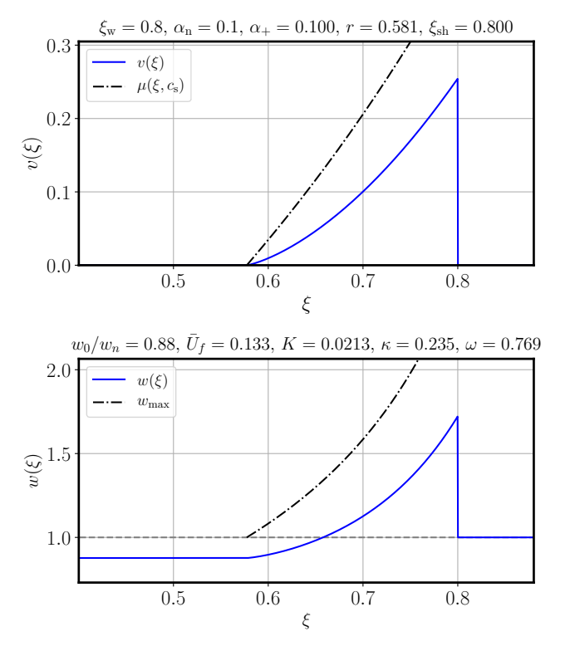
Velocity and enthalpy profiles are different for each type of combustion
Subsonic deflagration:
movement only outside
Supersonic deflagration (hybrid):
movement on both sides
Detonation: movement only inside
Hindmarsh et al., 2021

Slide 23
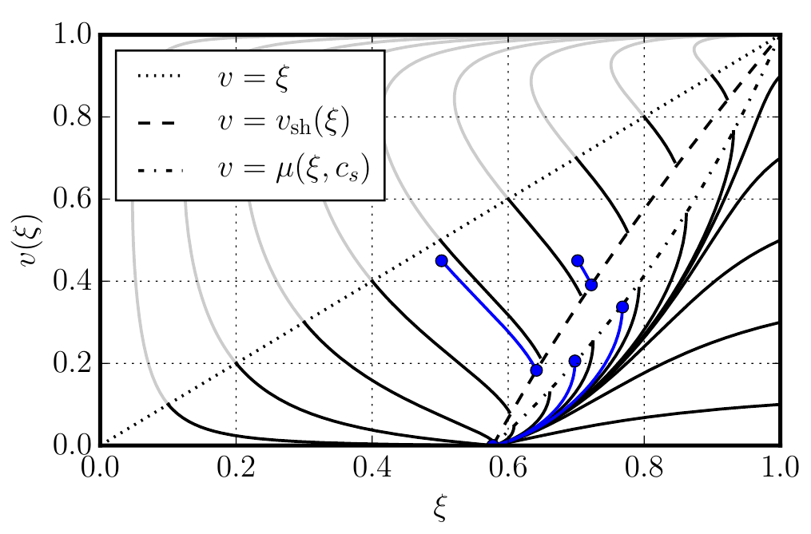
Mathematics: numerical integration
Compute the velocity profile
  Start from known boundary conditions
    and far away
    at the center of the bubble
  Integrate numerically
Use the Sound Shell Model to convert the velocity profile to GW power spectrum
  Sine transform (a bit like Fourier, numerical integration)
Unphysical: no sound
can propagate here
Symmetric phase
(outside the bubble)
Broken phase
(inside the bubble)
Hindmarsh and Hijazi, 2019

Slide 24


Beyond the bag model
Assumptions broken
  Different equations for the phases
  Different sound speeds, possibly temperature-dependent:
Computing the velocity profile becomes more difficult
  Sound speed may change at each point
  May require nested numerical integration
Next approximation: Constant sound speed model
  Different but constant speed of sound in each phase

Slide 25
Goal: Equation of state from an arbitrary model
Example: Standard Model
Fluid properties depend on
  Temperature
  Phase
Arbitrary models can be tested, when is given
Data from Borsanyi et al., 2016

Slide 26
Summary
Many extensions of the Standard model result in first-order phase transitions
→ Gravitational waves
GW power spectrum
→ Velocity profile of bubbles
→ Underlying physics
Were there first-order phase transitions in the early universe?We will know in the 2030s when LISA is launched.
If yes, it’s a sign of new physics!

Slide 27
Sources
M. Hindmarsh, M. Lüben, J. Lumma, and M. Pauly, “Phase transitions in the early universe,” SciPost Phys. Lect. Notes, Feb. 2021, doi: 10.21468/SciPostPhysLectNotes.24.
Hindmarsh, Mark, and Mulham Hijazi. “Gravitational Waves from First Order Cosmological Phase Transitions in the Sound Shell Model.” Journal of Cosmology and Astroparticle Physics 2019, Dec. 2019, doi: 10.1088/1475-7516/2019/12/062.
Caprini et al. “Detecting Gravitational Waves from Cosmological Phase Transitions with LISA: An Update.” Journal of Cosmology and Astroparticle Physics 2020, Mar. 2020, doi: 10.1088/1475-7516/2020/03/024.
Espinosa et al. “Energy Budget of Cosmological First-Order Phase Transitions.” Journal of Cosmology and Astroparticle Physics 2010, Jun. 2010, doi: 10.1088/1475-7516/2010/06/028.
Giese et al., “Model-Independent Energy Budget for LISA.” Journal of Cosmology and Astroparticle Physics, Jan. 2021, doi: 10.1088/1475-7516/2021/01/072.
Borsanyi, Sz, Z. Fodor, K. H. Kampert, S. D. Katz, T. Kawanai, T. G. Kovacs, S. W. Mages, et al. “Lattice QCD for Cosmology.”, Jun. 2016, ArXiv: 1606.07494

