Slide 1

Key-value stores
Advanced Databases
Arthur Font
Eduard vives

Slide 2
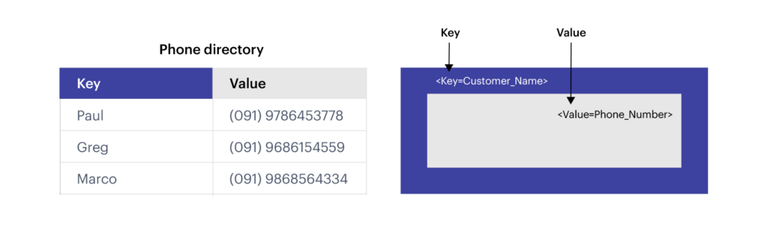
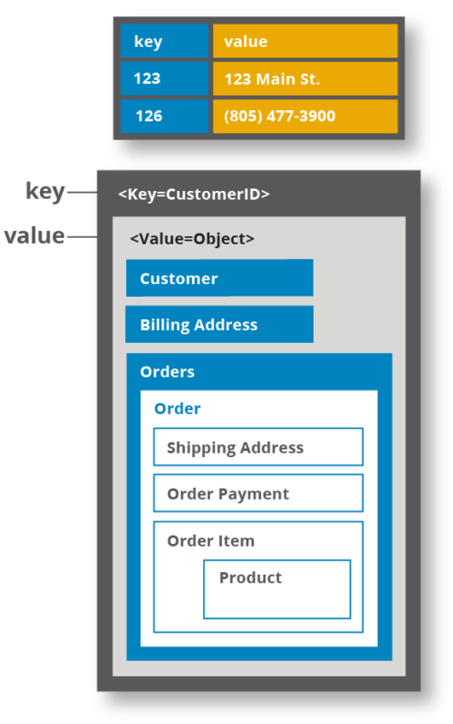
What is a key-value store?
Data storage that uses a simple key-value method to store data

Slide 3
Data pairing key-value
Hash table stores unique keys along with the pointers to the corresponding data values
Key: unique identifier that points to a value
Only the key can be queried
Value: arbitrary data field
Simplest form: string
Complex structures (we’ll talk about later…)

Slide 4
When should we use a key-value store?
When:
Need to handle lots of small continuous reads/writes
Storing basic information
Data caching

Slide 5

Key points
Easy to design and implement
Very fast for read/write operations
Unique key
In-memory key-value store*
Flexible data modeling
Scalability
Memory limit
Eviction policy (default: LRU)
*Note: There are also disk-based key-value stores, such as RocksDB

Slide 6

Use cases
Session management
User details and preferences
Shopping cart (our implementation)
Using cache to accelerate responses
Storing webpages
Real-time recommendation/advertising

Slide 7

Redis
Open source in-memory key-value store
Provides data structures and operations on those structures
Different levels of on-disk persistence
Snapshots
Log file
Snapshots + Log file

Slide 8
How the data can be stored at Redis?
Data Types
Strings: (max 512 Mb in length)
Lists
Sets
Hashes
Sorted Sets
Bitmap and HyperLogLogs
Integrated Modules
RedisJSON
RedisGraph
…

Slide 9
Thank you!

